Slide 1

Product presentation
GSW-M
Magnetic gripper

Slide 2
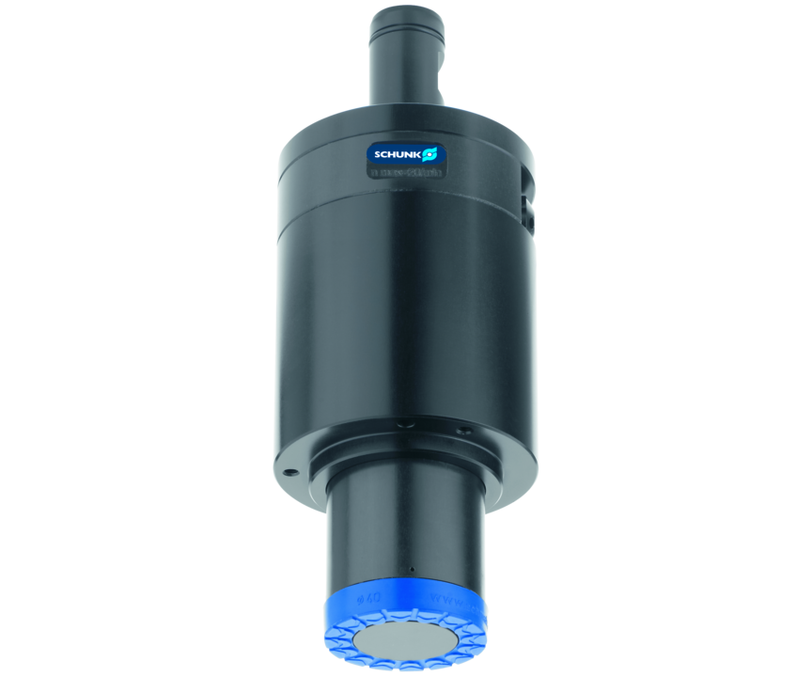
Magnetic gripper
Magnetic gripper for spindle interfaces for handling flat components
The simplest solution for the integration of magnetic grippers in the machine tools.
0 W electricity requirement, actuation via cooling lubricant

Slide 3

Cost-effective. Productive. Compliant.

Slide 4
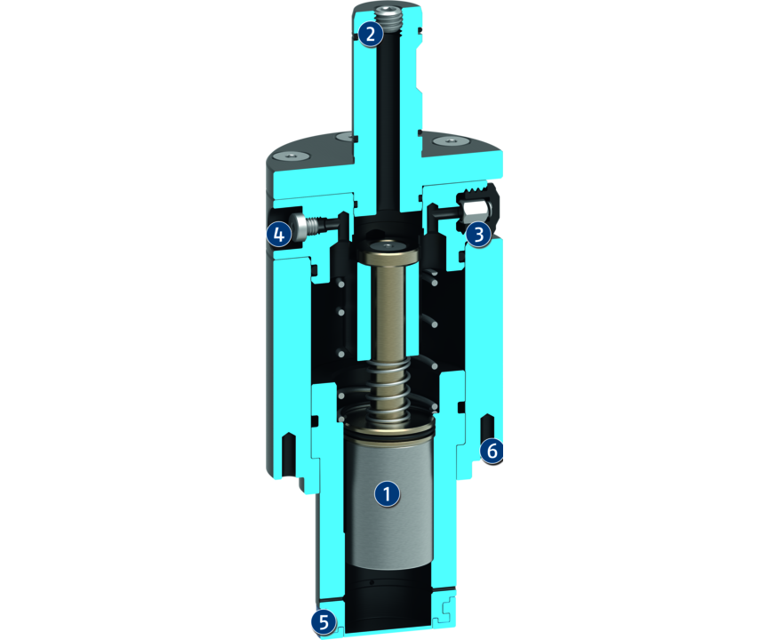
Principle of function
Functional description
The gripper can be used in any machine which provides compressed air or lubricating coolants supply via the toolholder mounting.
The magnetic gripper GSW-M is placed on the workpiece and pressed 20 mm deep. The spring force (Fc) of the ejector must be overcome. (In addition, there is a reserve or compensation stroke of 9 mm.)
The stroke causes the permanent magnet to approach the workpiece and the workpiece is firmly held by the magnet. To place the workpiece, the gripper is actuated with compressed air or coolant. During the placement, the gripper continuously supplies coolant or compressed air via the outlet port.
1
Permanent magnet
2
Media supply
3
Overpressure valve
4
Drain valve
5
Rubber friction ring
6
Thread

Slide 5
Advantages – Your benefits
Low-cost module for flexible automation in your machine
Fast, automated gripper changeover from the gripper to the storage rack
Fully automated workpiece changeover without robot or gantry system
Universally suitable for many different workpieces

Slide 6
Technical data
Technical data overview
Size | Weight | Holding force | Recommended workpiece weight | Max. permissible speed | Nominal operating pressure compressed air | Nominal operating pressure coolant
 | [kg] | [N] | [kg] | [1/min] | [bar] | [bar]
20 | 1 | 70 | 3.5 | 0 | 6 | 40

