Slide 1

Product presentation
GSW-B-AGE
Gripper with shaft interface

Slide 2
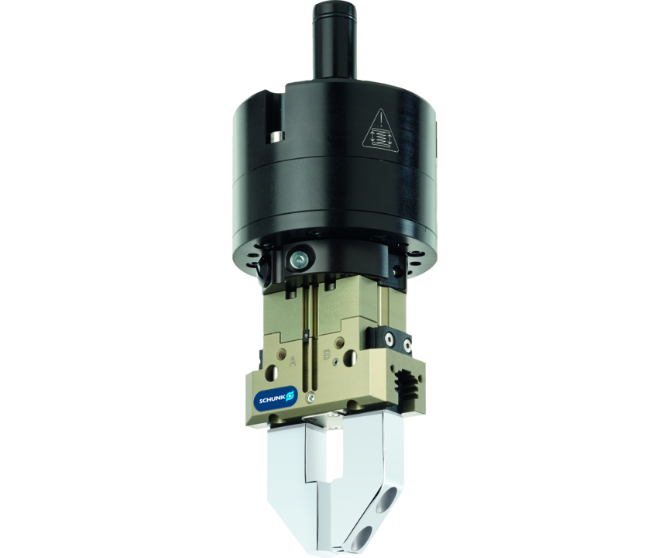
Gripper with shaft interface
Universal gripper PGN-plus/PZN-plus with GSW-B shank interface and compensation unit AGE
The simplest solution for the integration of SCHUNK grippers with compensation unit in the machine tools.
Up to 2.7 mm compensation path

Slide 3

High flow rate. Cost-effective. Compliant.

Slide 4
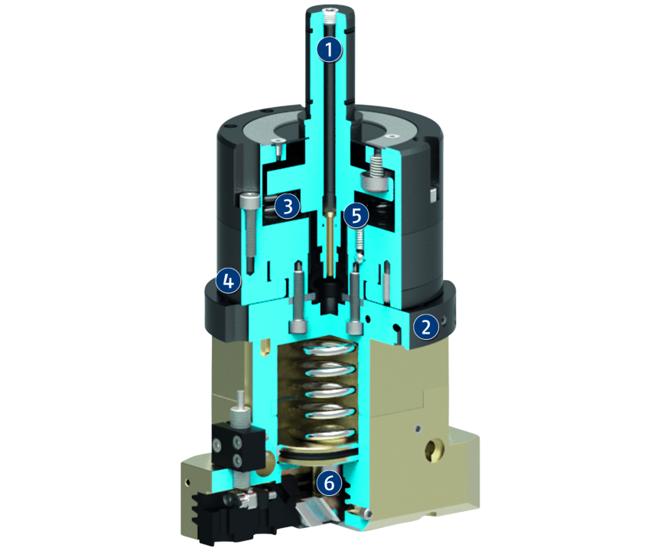
Principle of function
Functional description
The pressure generated by the central machine coolant supply is reduced by the pressure distributor, which is integrated in the adapter plates. The gripper can then be actuated and can actuate the base jaws correspondingly via the piston and wedge hook.
During the gripping operation the gripper continuously supplies coolant or compressed air via the lateral pressure control valve.
1
Taper shank
2
Adapter plate with integrated pressure distributor
3
Axial compensation
4
Planar compensation
5
Angular compensation
6
Gripper kinematics

Slide 5
Advantages – Your benefits
Low-cost module from a universal gripper PGN-plus/PZN-plus and a shank interface
Fast, automated gripper changeover from the gripper to the storage rack
Fully automated workpiece changeover without robot or gantry system
Three compensation directions in one unit compact design for minimum installation height
Robust sliding guide for high moment load at minimum space
Compensation of workpiece-related tolerances and position inaccuracies reduced risk of jamming, necessary assembly forces are reduced and wear of the workpiece and handling device is minimized

Slide 6
Technical data
Technical data overview
Size | Angular deflection | Deflection rotatory | Rotary compensation torque | Weight | Max. permissible speed | Nominal operating pressure compressed air | Nominal operating pressure coolant
 | [°] | [°] | [Nm] | [kg] | [1/min] | [bar] | [bar]
120 | 5.5 | 3.5 | 0.2 | 1.1 | 20 | 6 | 40
150 | 5.5 | 3.5 | 0.2 | 1.1 | 20 | 6 | 40
220 | 5.5 | 3.5 | 0.2 | 1.1 | 20 | 6 | 40
600 | 5.5 | 3.5 | 0.2 | 1.1 | 20 | 6 | 40

