Slide 1

Product presentation
LGP
Universal gripper

Slide 2
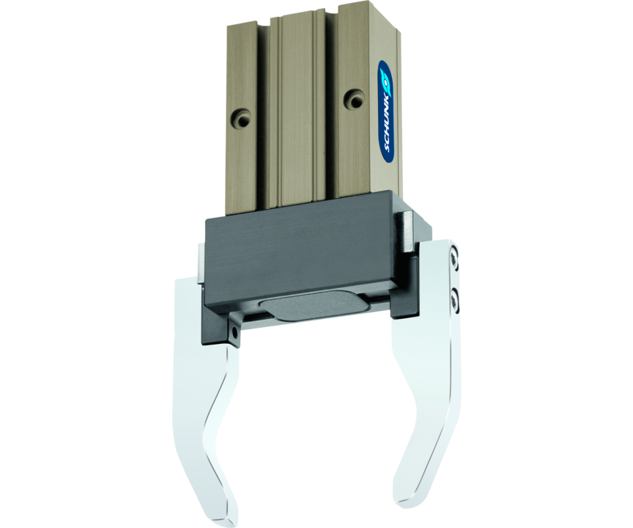
Universal gripper
Universal 2-finger parallel gripper with T-slot guidance and excellent cost-performance ratio

Slide 3

Easy. Economical. Reliable.

Slide 4
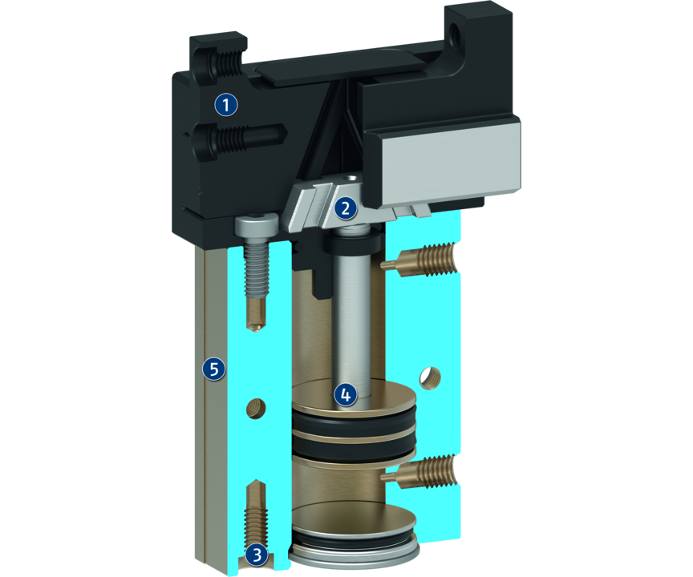
Principle of function
Functional description
The round piston is pushed upwards or downwards with compressed air.
The angled active surfaces of the wedge-hook produce a synchronized, parallel jaw motion.
1
Base Jaw
2
Wedge-hook design
3
Centering and mounting possibilities
4
Drive
5
Housing

Slide 5
Advantages – Your benefits
Function optimized gripper type for maximum cost effectiveness
Stable, ground T-groove slideway for highest precision in handling
Matching SCHUNK C-slot switch for process reliable position monitoring
Hard-anodized or hardened functional components For long service life
Wedge-hook design for high power transmission and synchronized gripping
Compact dimensions for minimized interfering contours

Slide 6
Technical data
Technical data overview
Size | Stroke per jaw | Closing force | Opening force | Recommended workpiece weight | Weight | Max. permissible finger length
 | [mm] | [N] | [N] | [kg] | [kg] | [mm]
8 | 2 | 26 .. 32 | 36 .. 42 | 0.13 | 0.03 .. 0.04 | 20
10 | 3 | 58 .. 74 | 70 .. 86 | 0.29 | 0.07 .. 0.08 | 25
16 | 5 | 120 .. 140 | 138 .. 158 | 0.6 | 0.15 .. 0.16 | 32
20 | 6 | 240 .. 280 | 280 .. 320 | 1.2 | 0.24 .. 0.25 | 40
25 | 8 | 380 .. 460 | 438 .. 518 | 1.9 | 0.46 .. 0.48 | 50
40 | 13 | 840 .. 1090 | 928 .. 1178 | 4.2 | 1.5 .. 1.6 | 64

