Slide 1

Product presentation
SRH-plus-D
Swivel heads

Slide 2
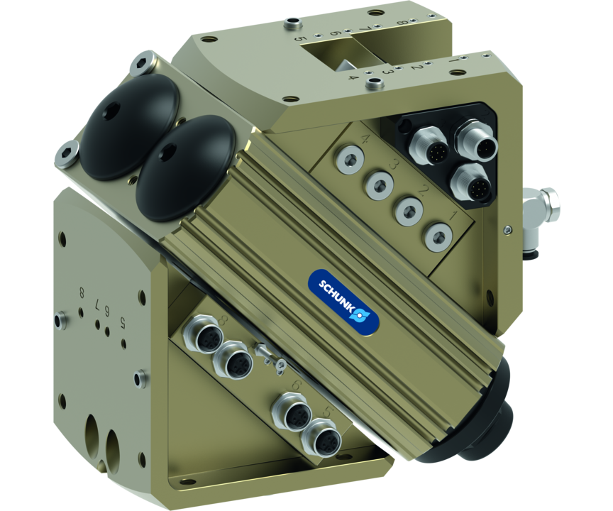
Swivel heads
Swivel head for simultaneous loading and unloading of workpieces with integrated fluid and electrical feed-through
The only swivel head with integrated electric rotary feed-through for automated machine loading.
8 electrical signals can be fed through without cables

Slide 3

Fast. Robust. High Performance.

Slide 4
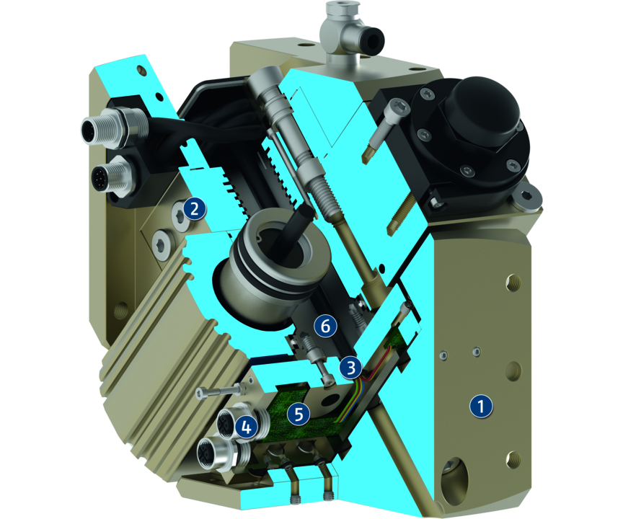
Principle of function
Functional description
When subjected to pressure, the two pneumatic pistons move their end faces in a straight line in their respective bores thus turning the pinion by means of the serrations on their sides.
The pinion is firmly connected to the drive head, and feeds through compressed air and electrical signals.
1
Output side
2
Media feed-through MDF
3
Electrical feed-through EDF
4
Connectors
5
Distributor board
6
Drive principle of pinions and racks

Slide 5
Advantages – Your benefits
Complete module with integrated fluid and electric feed-through eliminating unnecessary interfering contours
High damper performance due to the use of hydraulic shock absorbers this results in a significant reduction of wear and shorter loading times
Pre-assembled mounting kit for direct mounting of the inductive proximity switches
Media feed-through and drive connection via screw connection or hoseless direct connection possible for flexibility in all automation solutions

Slide 6
Technical data
Technical data overview
Size | Angle of rotation | Torque | Weight | Repeat accuracy
 | [°] | [Nm] | [kg] | [°]
20 | 180 | 3 | 2.2 | 0.05
25 | 180 | 4.6 | 2.6 | 0.05
30 | 180 | 9.5 | 4.5 | 0.05
35 | 180 | 13.3 | 4.3 | 0.05
40 | 180 | 19.1 | 6.9 | 0.05
50 | 180 | 50.2 | 17.6 | 0.05
60 | 180 | 69.9 | 21.2 | 0.05

