Slide 1

Product presentation
PHL-W
Long-stroke gripper

Slide 2
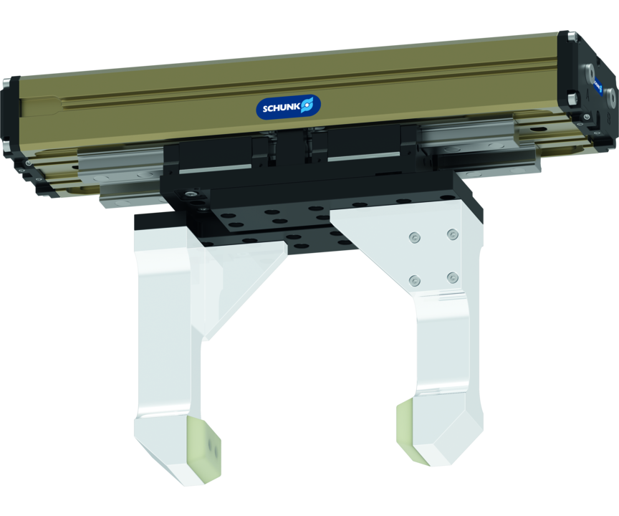
Long-stroke gripper
2-finger parallel gripper with long jaw stroke for large parts and/or a broad range of parts
Alternatively with multi-tooth guidance or profiled rail guide and flexible fastening conceptü
160 mm stroke per jaw

Slide 3

Flexible. Precise. Powerful.

Slide 4
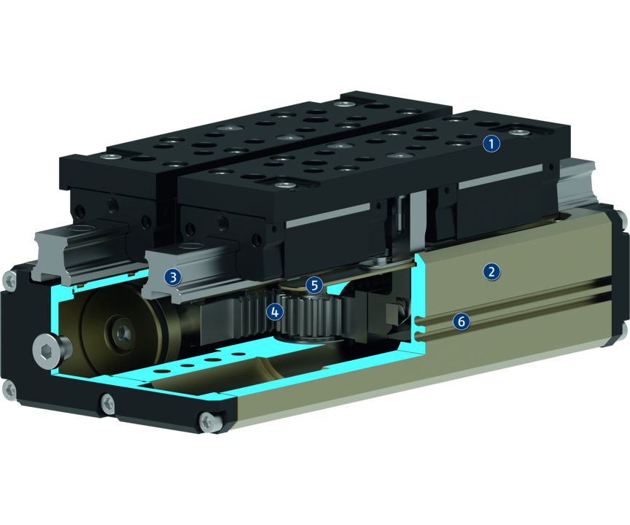
Principle of function
Functional description
By pressure actuation of the opposing piston, the base jaws are guided by a carrier on the piston, and are set in motion. The synchronization of the jaw stroke is done with a rack and pinion principle.
1
Base Jaw
2
Housing
3
Roller guide
4
Kinematics
5
Dust cover
6
Sensor system

Slide 5
Advantages – Your benefits
High maximum moments possible suitable for using long gripper fingers
Double piston rack and pinion principle for centric clamping
Fastening at one gripper side in two screw directions for universal and flexible gripper assembly
Air supply via hose-free direct connection or screw connections for flexible pressure supply in all automated systems
Comprehensive sensor accessory program for versatile querying possibilities and stroke position monitoring
Stroke versions for highest flexibility

Slide 6
Technical data
Technical data overview
Size | Stroke per jaw | Closing force | Opening force | Recommended workpiece weight | Weight | Max. permissible finger length
 | [mm] | [N] | [N] | [kg] | [kg] | [mm]
25 | 30 .. 60 | 500 .. 700 | 500 | 2.5 | 1.49 .. 2.21 | 180 .. 200
32 | 40 .. 80 | 840 .. 1170 | 840 | 4.2 | 3.43 .. 4.87 | 360 .. 400
40 | 50 .. 100 | 1300 .. 1880 | 1300 | 6.5 | 5.71 .. 8.39 | 450 .. 500
50 | 60 .. 120 | 2050 .. 3030 | 2050 | 10.25 | 9.24 .. 13.86 | 540 .. 600
63 | 80 .. 160 | 3100 .. 4630 | 3100 | 15.5 | 15.21 .. 23.55 | 720 .. 800

