Slide 1

Product presentation
Plug & Work portfolio FANUC
Modular System

Slide 2
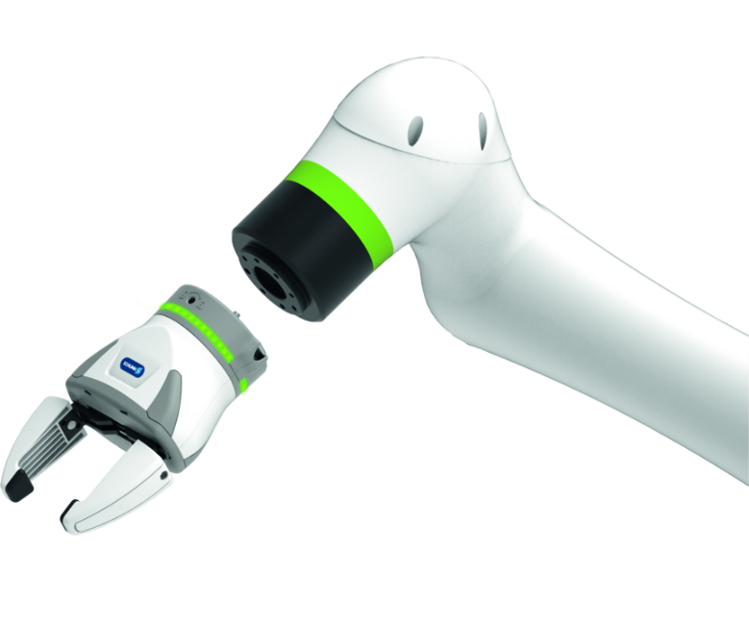
Modular System
The Plug & Work portfolio consists of electrically actuated grippers that are specifically adapted to the robot arms from FANUC.
The portfolio with the fastest integration into any Cobot application
Ready for operation in 10 minutes

Slide 3

Modular. Flexible. Easy.
Plug-in and adapted interface for the cobots from FANUC
For collaborative operation or conventional automation
Different SCHUNK grippers for a variety of applications

Slide 4
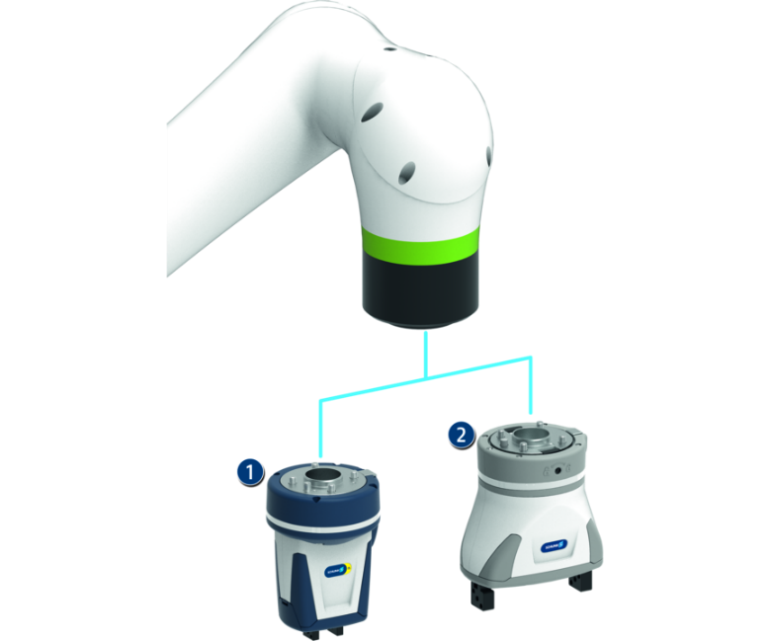
Principle of function
Functional description
All Plug & Work components are prepared for direct mechanical and electrical connection to the CR and CRX robot series from FANUC. Depending on the requirements, various grippers and end-of-arm components can be selected.
1
Co-act Gripper
2
Electric gripper

Slide 5
Advantages – Your benefits
Comprehensive portfolio consisting of various components and grippers for different applications for fast and easy entry into automation
Pre-assembled gripping unit with robot interface Therefore no mounting kits are required.
Plug & Work with interfaces suitable for certain robots from FANUC
Software modules for robot control are included in the scope of delivery for fast and easy commissioning
Certified SCHUNK Co-act grippers For quick and easy entry into th world of collaborative applications
Electric grippers with a long adjustable stroke and force range for flexible workpiece handling

Slide 6
Technical data
Technical data overview
Description | Stroke per jaw | Max. gripping force | Weight | Recommended workpiece weight
 | [mm] | [N] | [kg] | [kg]
Co-act EGP-C 25-N-N-FCR7 | 3 | 40 | 0.63 | 0.2
Co-act EGP-C 40-N-N-FCRXID | 6 | 140 | 0.59 | 0.7
Co-act EGP-C 40-N-N-FCRXEK | 6 | 140 | 0.86 | 0.7
Co-act EGP-C 40-N-N-FCR7 | 6 | 140 | 0.66 | 0.7
Co-act EGP-C 50-N-N-FCR7 | 8 | 215 | 1.22 | 1.05
Co-act EGP-C 64-N-N-FCRXID | 10 | 230 | 1.11 | 1.15
Co-act EGP-C 64-N-N-FCRXEK | 10 | 230 | 1.38 | 1.15
Co-act EGP-C 64-N-N-FCR7 | 10 | 230 | 1.38 | 1.15
EGH 80-IOL-N-FCRXEK Starter | 40 | 100 | 0.95 | 0.5

