Slide 1

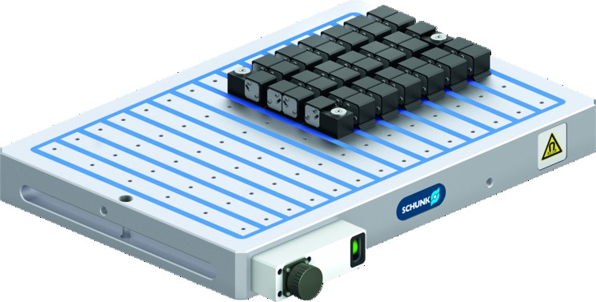
MAGNOS MFPS
Powerful Magnetic Chucks for thin and narrow Workpieces

Slide 2
MAGNOS MFPS
General information
Even permanent magnetic clamping force over the entire workpiece
Low vibration clamping
Deformation-free clamping
High lateral holding forces
Patented status display
Mono-block design
Clamping within a few seconds
Unique energy supply for MAG/DEMAG process
Control unit compatible with machine control system

Slide 3
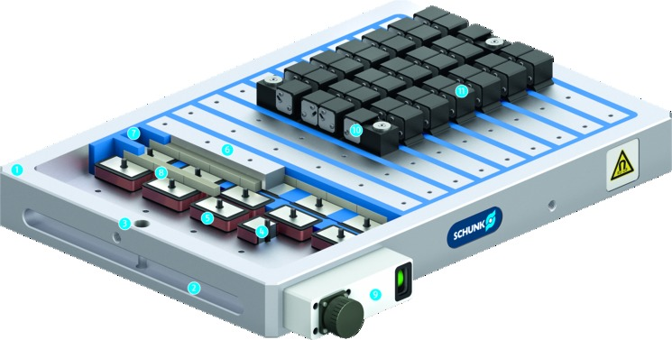
MAGNOS MFPS
Functional diagram
Solid base body
Mounting groove
Fastening bore
Invertible AINiCo magnets
Coil body, insulated version
Steel pole
Synthetic resin grounting
Neodymium magnets
Connection housing with status display
Fixed pairs of pole extensions
Flexible pairs of pole extensions
1
2
11
3
10
7
6
4
1
8
5
3
5
4
6
7
2
9
8
9
10
11

Slide 4
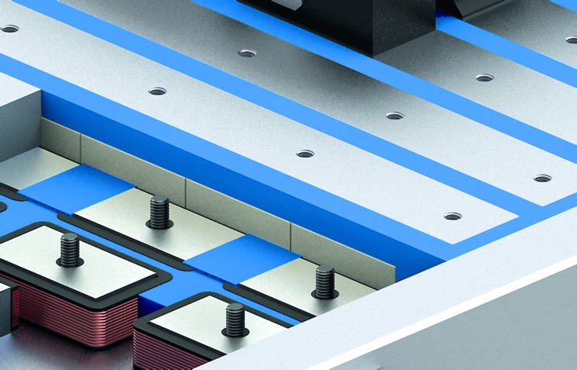
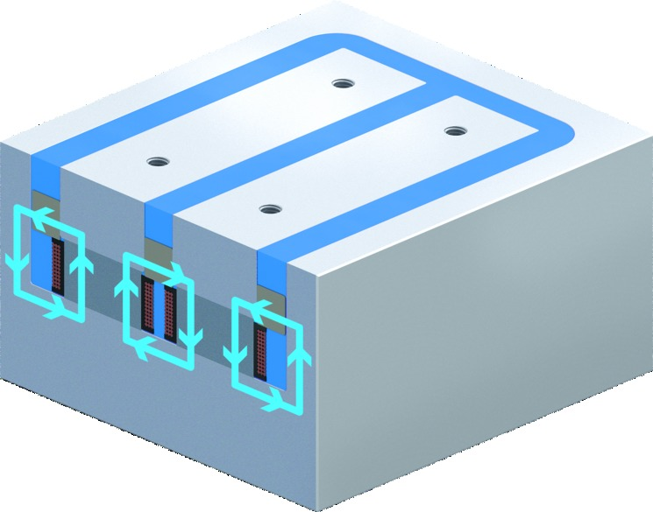
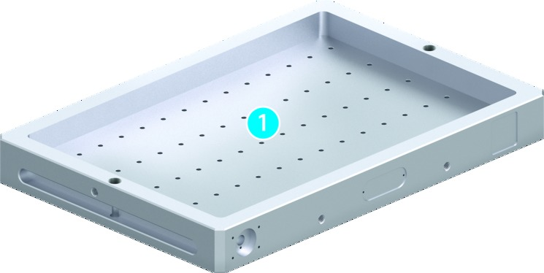
MAGNOS MFPS
Highlights
1
Solid base body
The stable base body is made in monoblock design in the latest machining centers. Its stability, rigidity and robustness prevent vibrations from forming in later operation, thus ensuring outstanding machining results, and a long service life.
Monoblock design of the base body
Synthetic resin filling
The synthetic resin filled under vacuum guarantees an unique insulation and magnetic life span of each plate. By means of this special high-end sealing process, the spaces between the poles are filled with high-strength synthetic resin.
→ Protection from corrosion
Magnetic double cycle – DEMAG status
The reversible-polarity magnets are reserved again by a further pulse. This „short-circuits“ the magnetic field inside the magnetic chuck and releases the workpiece.
1

Slide 5
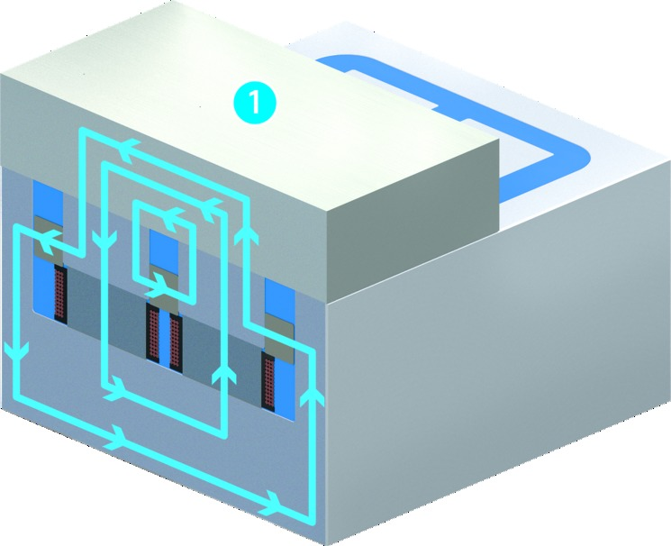
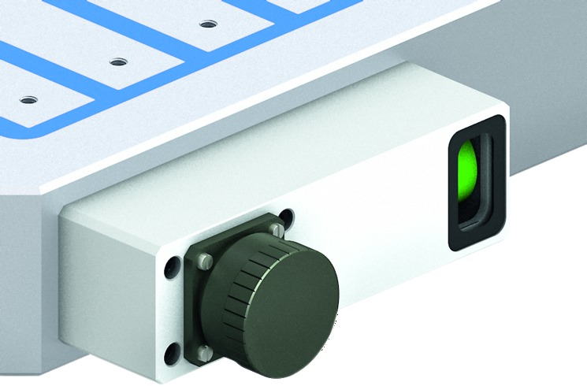
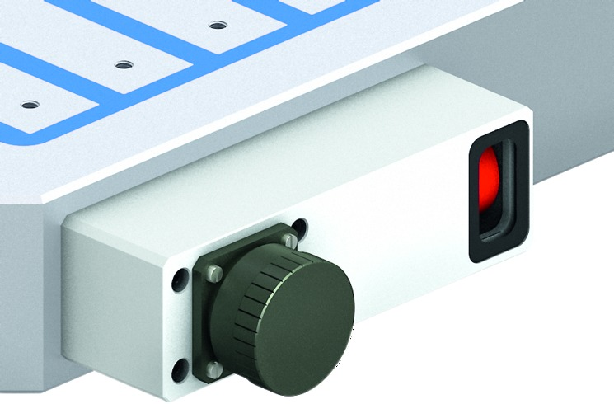
MAGNOS MFPS
Highlights
1
Magnetic double cycle – MAG status
These are reversed by short-term generation of an electromechanical field resulting from the windings around the reversible-polarity magnet. As a result, the magnetic field is directed outward and the workpiece is clamped on the magnetic chuck.
Workpiece
Visual display – MAG status
The magnetic chuck in the MAG-Mode is green on the status display. That means that the workpiece is clamped and the machining may be started.
Visual display – DEMAG status
The magnetic chuck in the DEMAG-Mode is red on the status display. That means that the workpiece is not clamped and the machining may not be started.
1

Slide 6
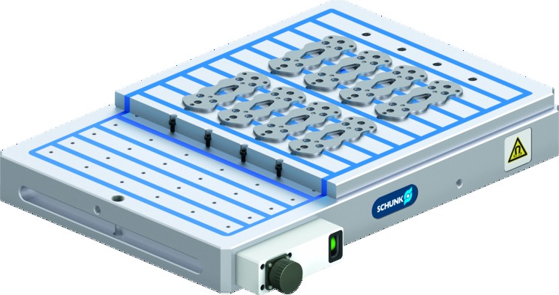
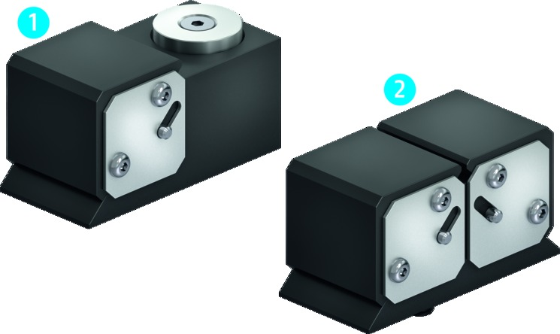
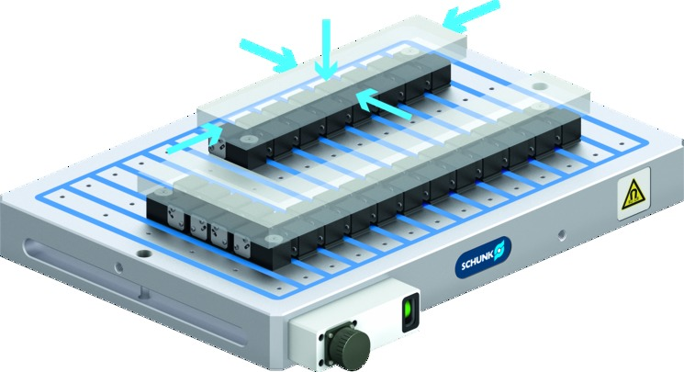
MAGNOS MFPS
Highlights
1
2
Pole plates
Pole plates are used for ensuring that the customer can mill the contours and special shapes. This allows the magnetic chuck to be quickly and easily adjusted to new clamping tasks without causing and damage to the magnetic chuck itself.
Pole extensions – pole pairs
Pole extensions ensure that the magnetic chuck locating surfaces are adapted naturally to the workpiece.
Fixed pole extensions
Flexible pole extensions
5-sided-workpiece machining in one set-up
As the workpieces can be placed flat onto the MAGNOS magnetic chuck, all five sides of the workpiece can be easily accessed and machined in one single setup.
1
2

Slide 7
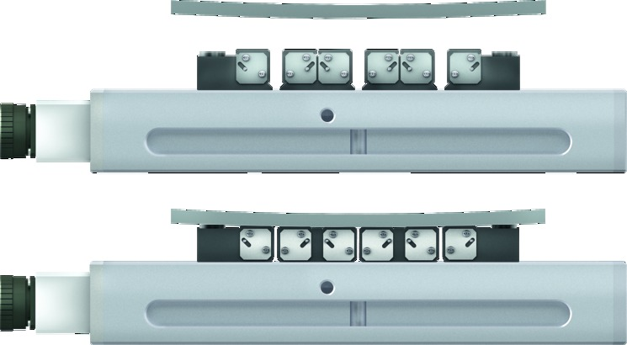

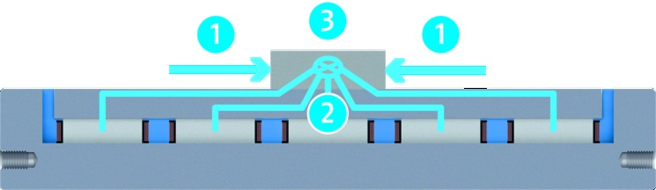
MAGNOS MFPS
Highlights
1
3
1
2
Adapts perfectly to the contours
Workpieces of any structure can be perfectly clamped with MAGNOS pole extensions. The pole extensions perfectly adapt to the workpiece contour.
→ Workpiece has an underlay
→ Stably positioned on the extensions
Covering poles
In the lateral direction, the multiple, maximum covering for north and south poles generates a strong holding force to prevent the workpiece from being pulled off.
→ A strong holding force in the cross direction
Force field line concentration
Due to the parallel pole technology, most force field lines of the magnetic field are passed through the workpiece to the other pole.
Resulting in a high lateral holding force
Magnetic field lines
Magnetic flow direction
1
2
3

