Slide 1

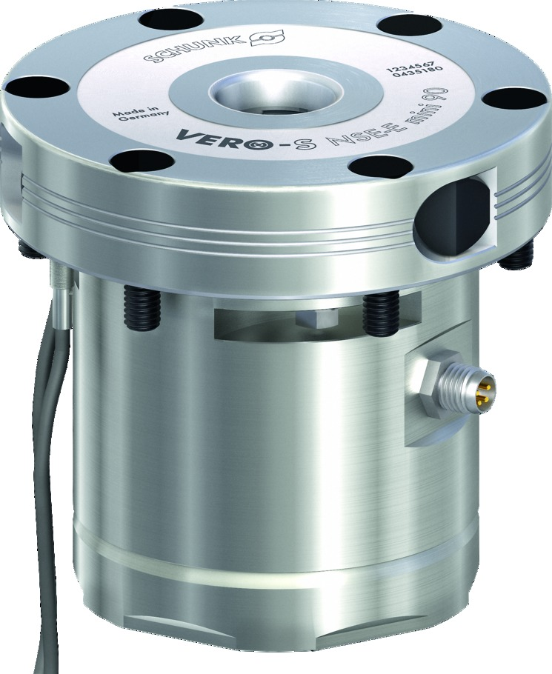
VERO-S NSE-E mini 90
24 V-Technology with minimum Energy Requirements

Slide 2
VERO-S NSE-E mini 90
General information
SCHUNK modular system
Electromechanical drive
All modules are operated with 24 V direct voltage
Positioning via short taper
Patented dual stroke system
Form-fit, self-retained locking
Corrosion-free stainless steel design
A consistent clamping pin size fits for all NSE-E mini-modules
Inductive clamping slide monitoring

Slide 3
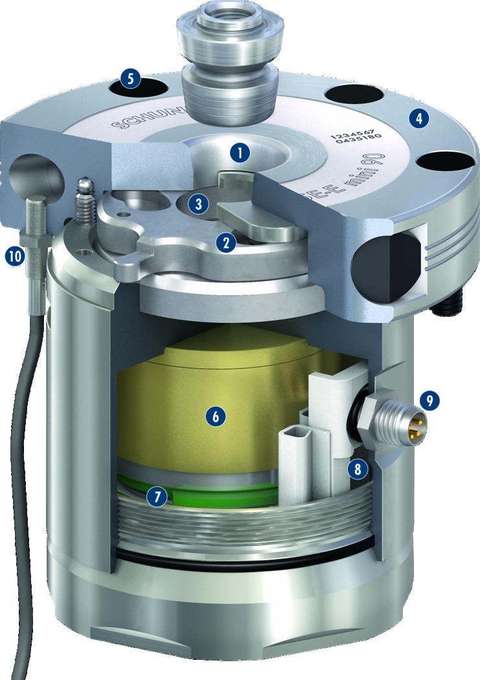
VERO-S NSE-E mini 90
Functional diagram
High-precision short taper centering
Patented dual stroke system
Large surfaces
Large flat surface
Cover caps for fastening screws
Gear
Electric motor
Integrated electronics
4-pin connection
Inductive proximity switches
5
1
4
2
1
3
3
2
10
4
5
6
6
9
7
8
8
7
9
10

Slide 4
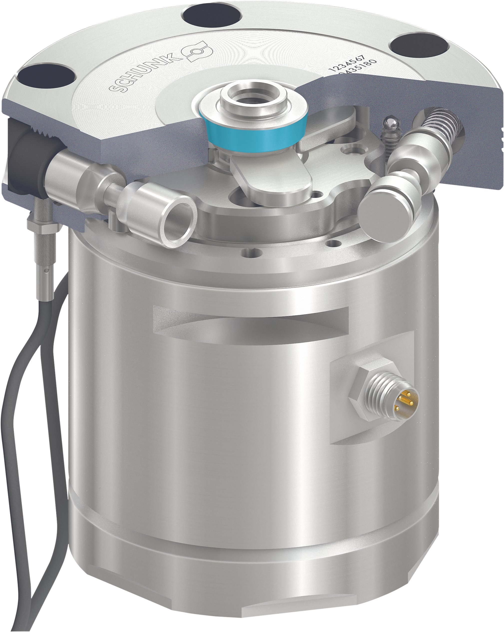
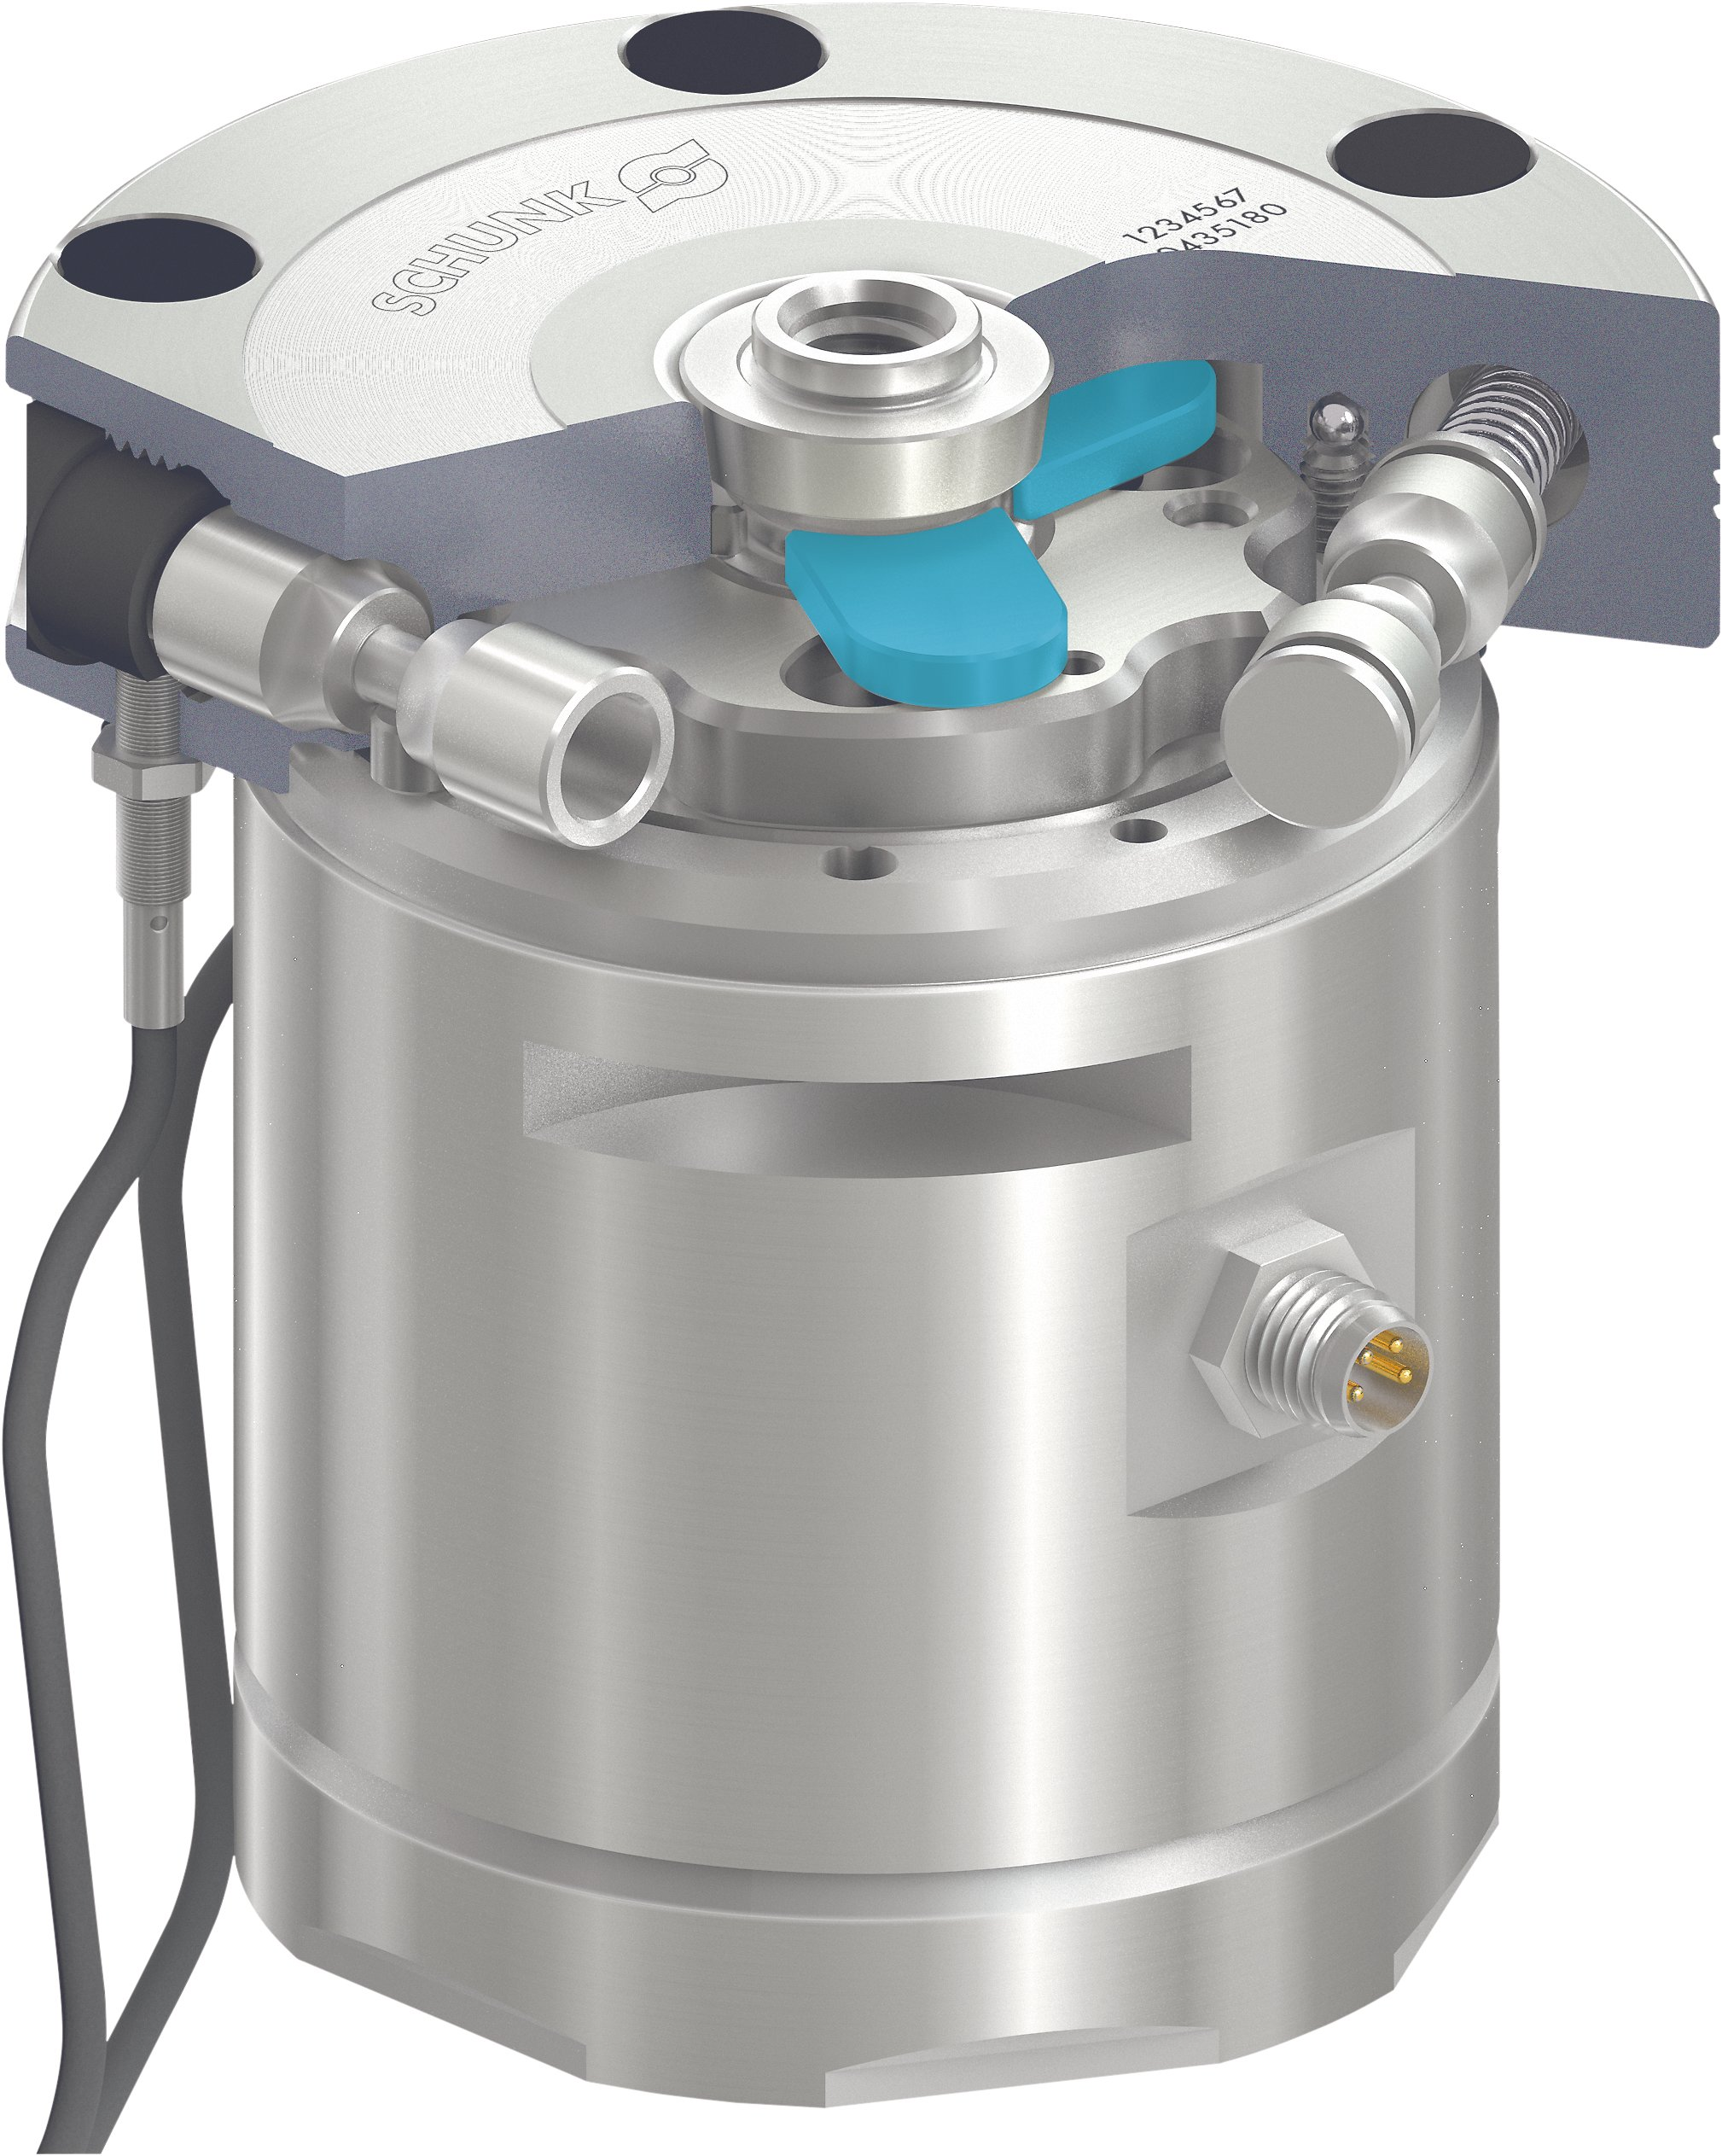
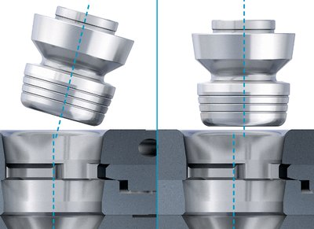
VERO-S NSE-E mini 90
Highlights
Centering via short taper
The precise short taper centering combined with the form-fit and self-retaining locking characterizes the SCHUNK quick-change pallet system.
Locking via clamping slides
Large contact surfaces between clamping slides and clamping pin ensure a low surface pressure, resulting in a long service life.
Simple joining – incredibly user-friendly
Entry radii on the clamping pin enable quick and safe joining even at a tilt angle and eccentricity.
Benefit: more user-friendly for manual and automated loading.

Slide 5
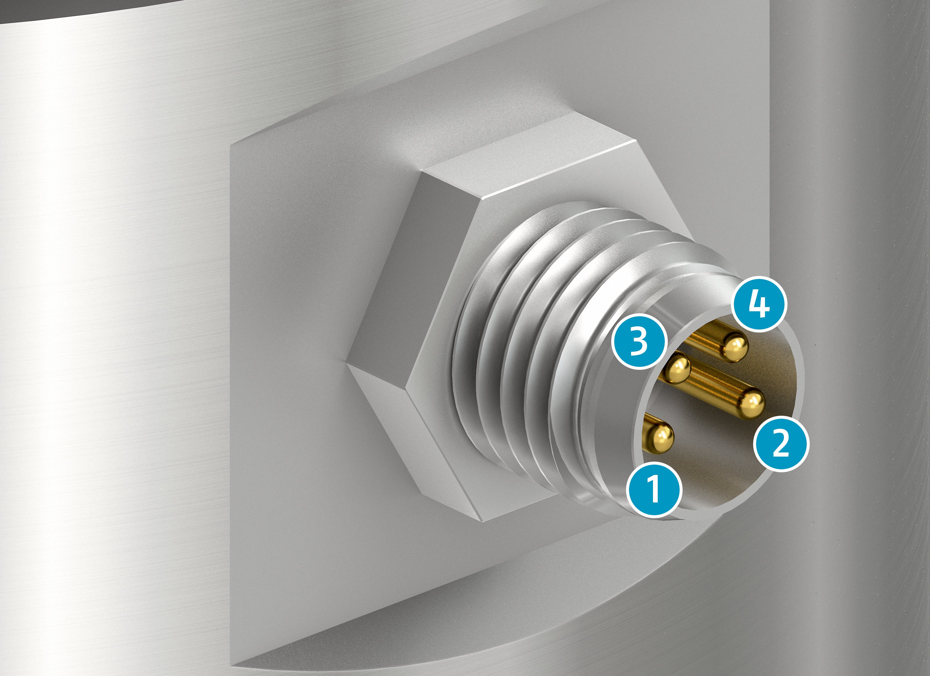
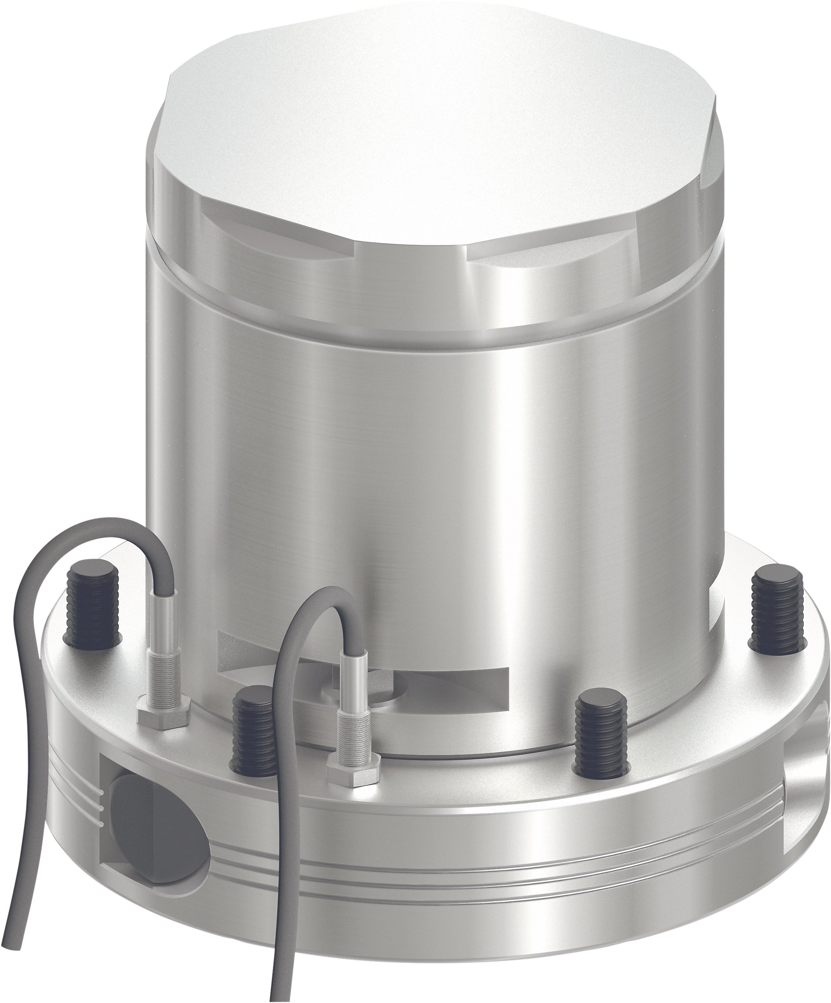
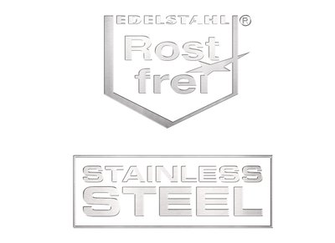
VERO-S NSE-E mini 90
Highlights
3
4
2
1
Control of the quick-change pallet system
The module is controlled via a 4-pin connection on the side. Using 24 V direct voltage, a brushless DC motor is actuated, which in a turn operates the module via a gear. → fluid-free actuation
+24V Mass
Open module Close module
Monitoring of the clamping slide position
For the IN-variants, the position of the clamping slide may be monitored via two inductive proximity switches. This monitoring ensures maximum process reliability with daily use of the NSE-E mini 90 modules.
Made of stainless steel – long service life
All functional components are made of hardened stainless steel.
1
2
3
4

