Slide 1

Toolholding Systems
Intermediate Sleeves

Slide 2
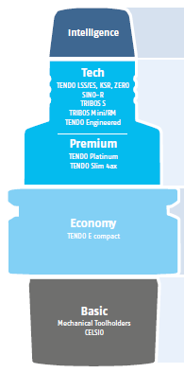
Product overview

Slide 3
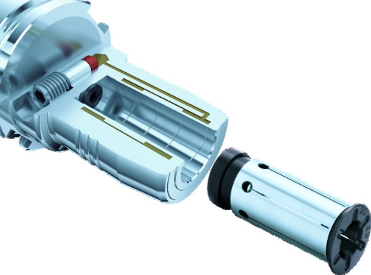
Intermediate Sleeves GZB-S
SCHUNK intermediate sleeves allow clamping of several different shank diameters with just one toolholder. The universal intermediate sleeves GZB-S are available in two versions: coolant-proof, tested and with innovative peripheral coolant channels. And both can be used in the SCHUNK toolholder systems TENDO, TRIBOS, SINO-R, and all standard hydraulic expansion toolholders
One for all

Slide 4

Intermediate Sleeves
Universal intermediate Sleeves GZB-S: a cool head for metal cutting
Proven technology, new perspectives
Universal intermediate Sleeves GZB-S is available in two versions:
Proven coolant-proof – KD (Coolant-proof up to 80 bar)
  available in Ø12, 20, 22, 25, 32, ½“, ¾“, 1 ¼“
with new innovative peripheral cooling – PK
  available in Ø8, 12, 20, 32, ½“, ¾“, 1 ¼“

Slide 5
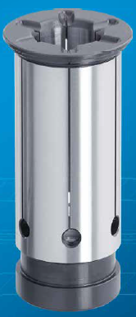
Advantages of Intermediate Sleeves GZB-S
Systematic cooling with peripheral cooling
Six coolant slots at the peripheral cooling
Special nozzle geometry
Optimal and directed supply of coolant or lubrication of the cutting edge
tripple effect:
significantly increase tool life
optimum chip removal by means of systematic coolant/lubricant rinsing
extremely improved machining results
Versatile length preadjustment due to adjustable intermediate stop
Peripheral cooling:
optimized coolant emission
systematic coolant flow
increased tool service life

Slide 6
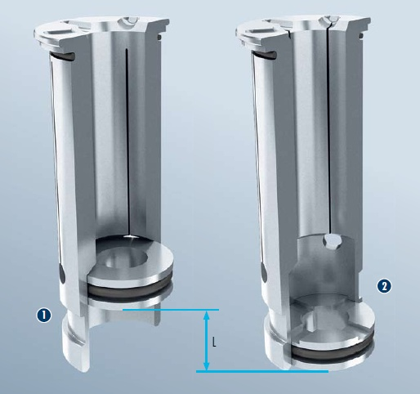
Advantages of Intermediate Sleeves GZB-S
  The tool length “L” can be flexibly adjusted via a movable intermediate sleeve.
  1: GZB-S for coolant-proof (Coolant-proof up to max. 80 bar)
  2: GZB-S with peripheral cooling (With peripheral cooling for optimized coolant emission, systematic coolant flow and increased tool service life)

