Slide 1

TRIBOS Mini ER | Polygonal clamping system for Turning applications

Slide 2
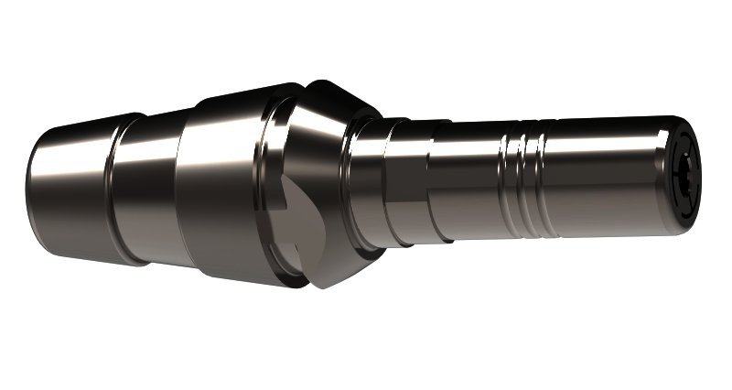
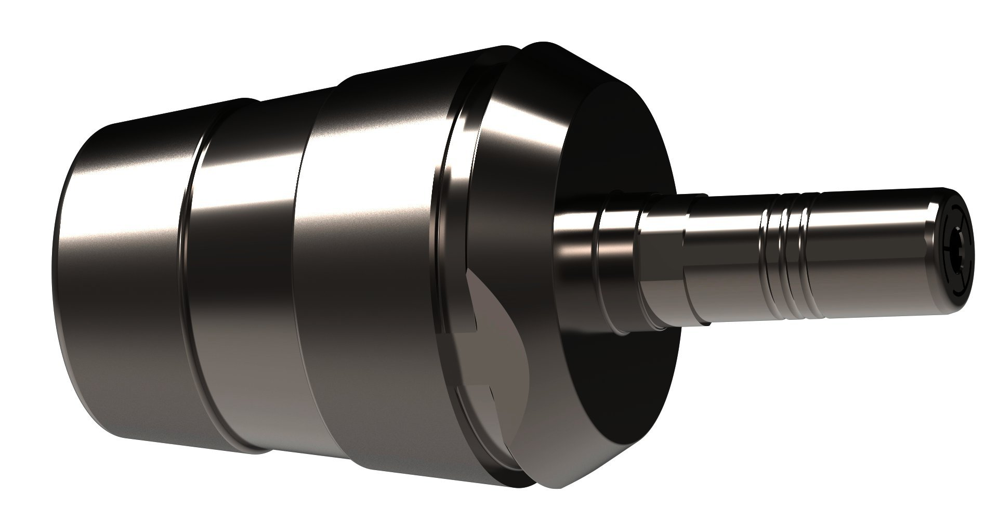
TRIBOS - Mini ER

Slide 3
The role of the toolholders in the production process
Vibration system
Machine spindle
Toolholder
Tool
Workpiece

Slide 4
Funktionsprinzip TRIBOS Technologie
1. Clamping diameter polygon-similar
By using the TRIBOS SVP clamping devices and the matching pressure actuation, the polygonal clamping diameter of the toolholder becomes round.
2. Clamping diameter becomes round
The tool shank is now easy to insert.
3. Inserting the tool shank
If the pressure on the clamping diameter eases off, then it will assume its polygonal shape again.
4. Tool clamped
The inserted tool shank is process-reliably clamped at a high repeat accuracy.

Slide 5
Polygonspanntechnik
Patented TRIBOS polygonal clamping technology for your lathe
Process reliability
direct clamping of smallest shanks.
Slim interfering contour
for machining in areas which are difficult to access.
Rotationally symmetrical design
for highest speeds and precise shape and position tolerances during filigree machining operations.
Maximum stability
for longer service life of turning tools.

Slide 6
Run-out accuracy
Absolute- & Repeat accuracy
Maximum measured run-out errors (bar) and span of individual measurements (line)
Concentricity deviation
75% lower dispersion of run-out repeat accuracy with
30% lower absolute accuracy

Slide 7
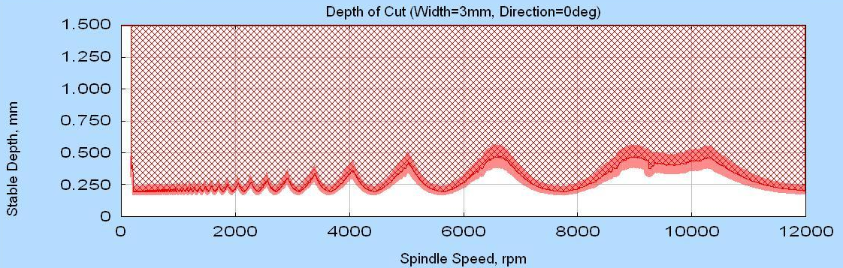
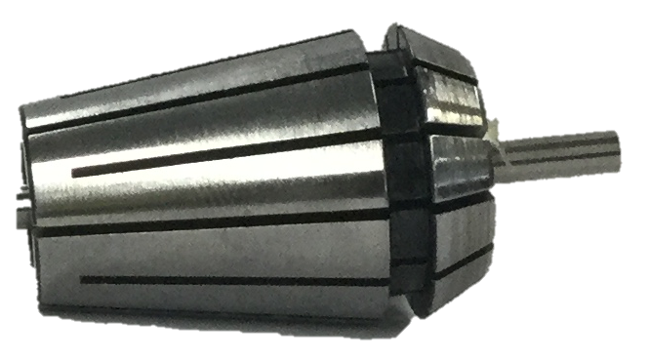
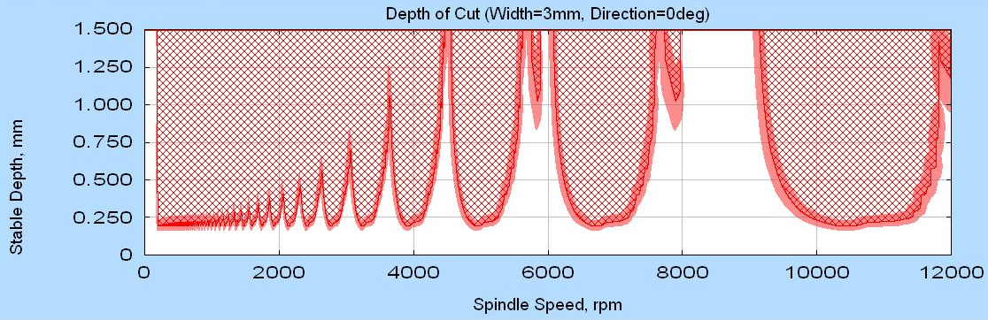
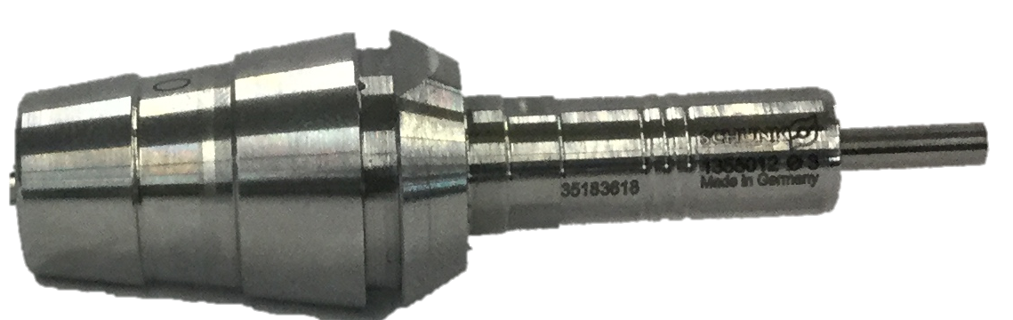
Stability comparison
Conclusion: with the TRIBOS ER, the stable speeds are very clearly pronounced. In these areas, the productivity can be increased compared to the conv. By an increased infeed

Slide 8
Set-up times
20 sec. parallel main time
0,02mm unclamped length
vs.
Tool change in machine room „under oil“
Estimate the unclamping length with the caliper gauge
Clamping force = Depending on the type of man

Slide 9
Advantages of TRIBOS - Mini ER
Run-out accuracy < 0,01 mm at 2,5 x D
Compatible with all conventional ER clamping nuts
Advantages opposite ER collet chucks:
Higher stability
Higher tool change accuracy
Produced bore shape is more accurate
Setting times / ease of operation

Slide 10
Examples: Clamping nuts
No new chucks needed!!!
Fits into any collet chucks of the most popular manufacturers
through optimization of the interface (ER) and contact surfaces.

Slide 11
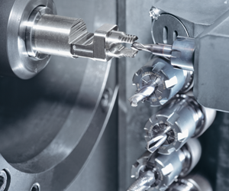
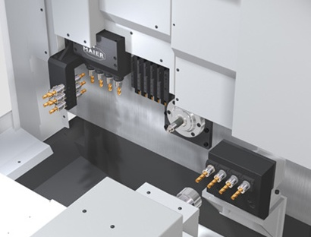
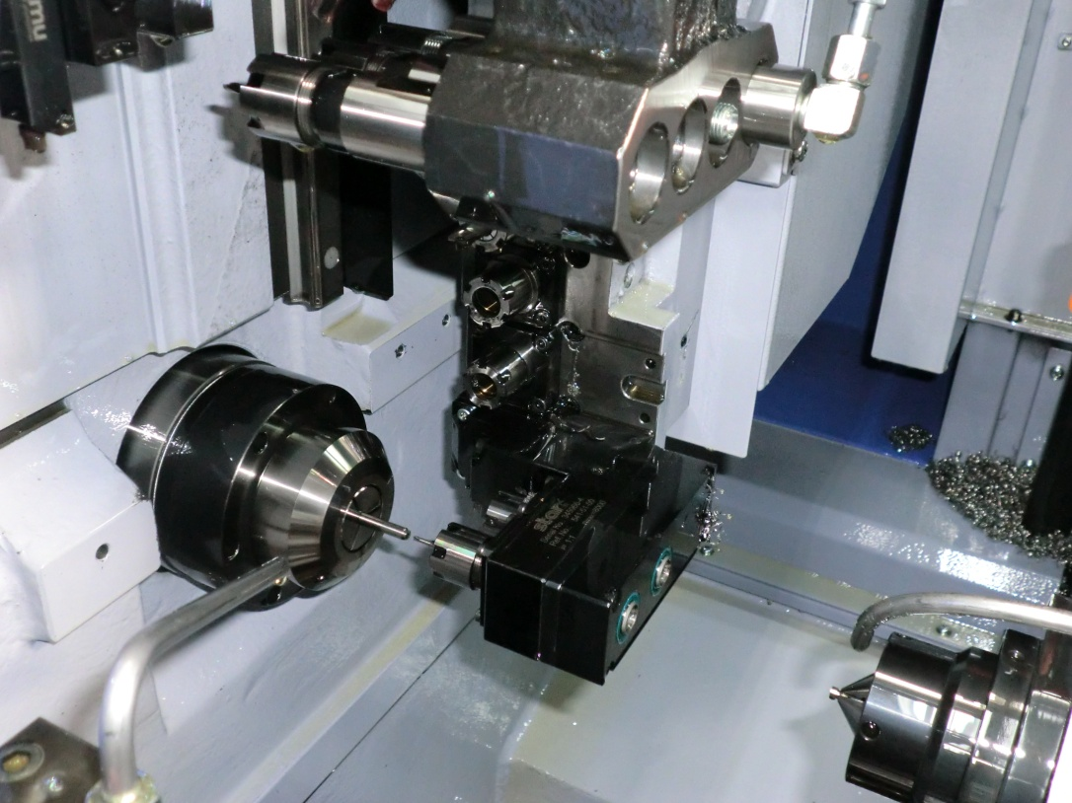
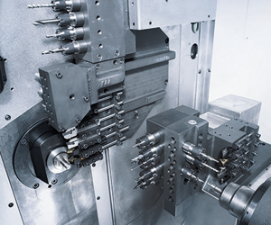
Machines and workspace
Examples:
Citizen
STAR
Index / Traub
Tornos
Maier
TRIBOS - Mini ER
For driven as well as fixed spindles
With ER interface.
BAZ
Robotics
Swiss type lathe
Lathes
etc.

Slide 12
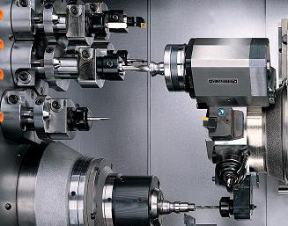
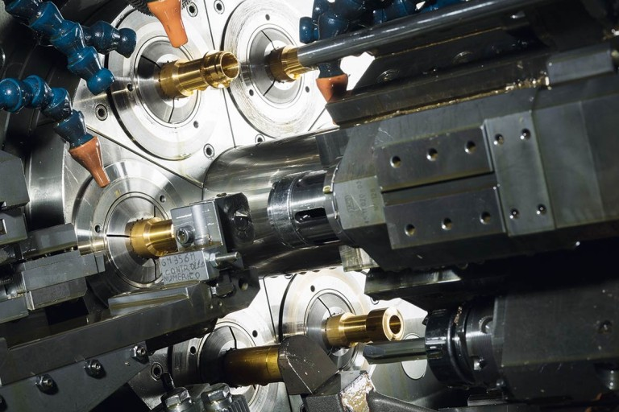
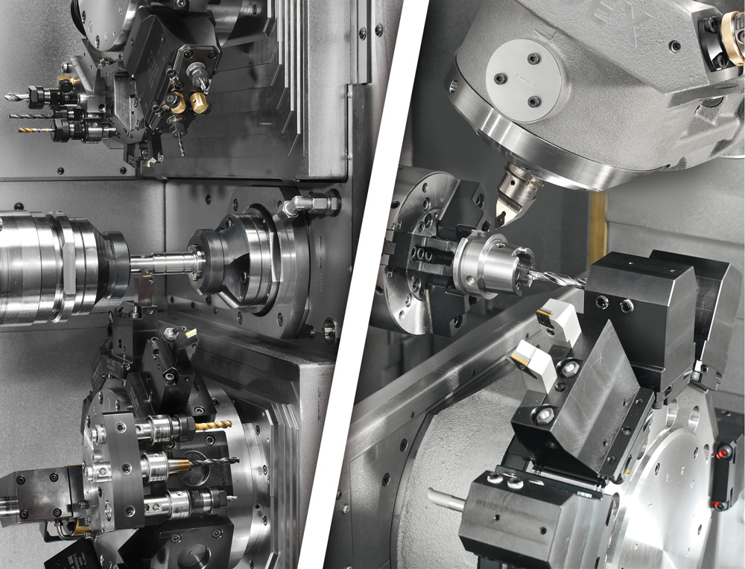
Unstable clamping of the tools for the purpose of accessibility
Due to large mold relief

Slide 13
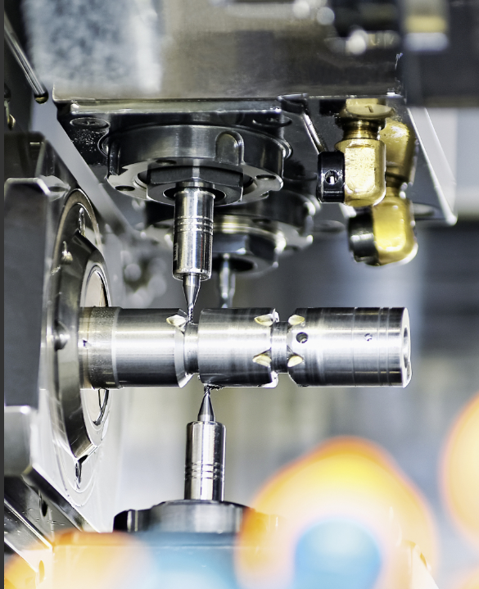
Solution: TRIBOS - MINI ER
Distance from spindle to turret
Short clamping of the tools
Stable clamping
Less interference contour
Less vibrations
High run-out properties
Repeat accuracy
Longer service life
Universally applicable
Fast set-up times
Less machine downtime
Low costs

Slide 14
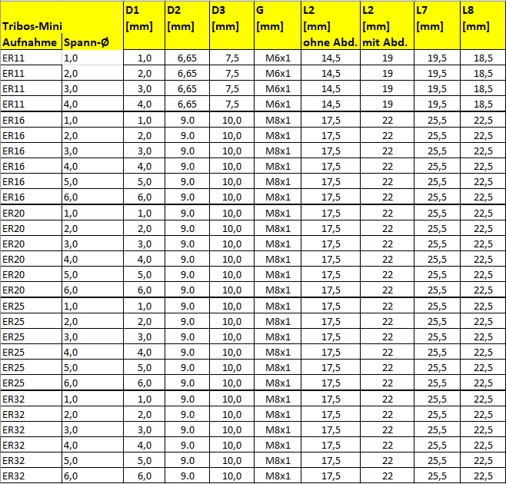
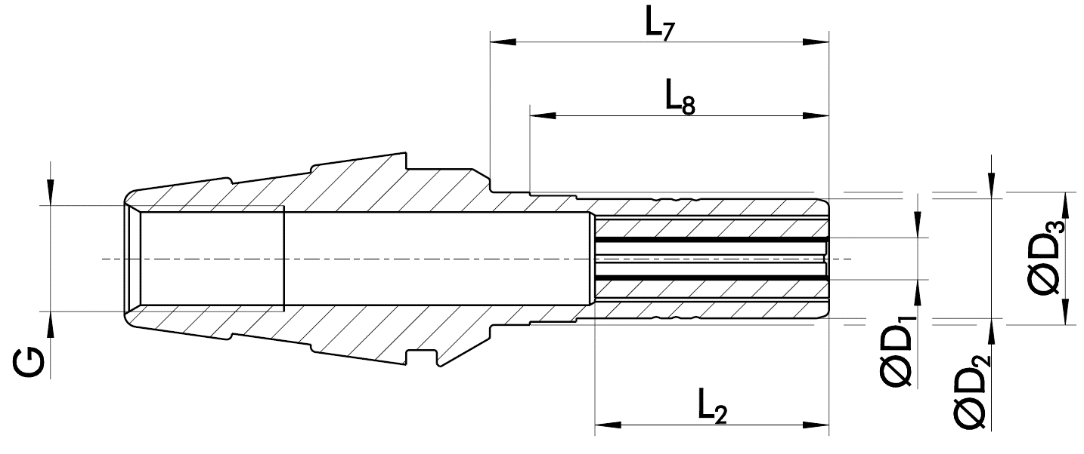
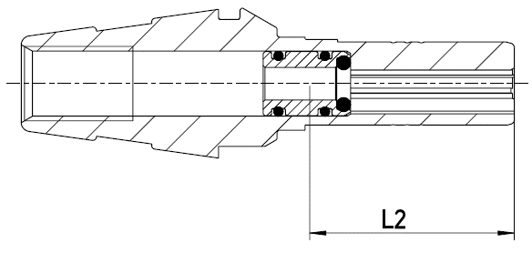
Dimensions TRIBOS - Mini ER
Clamping
diameter
Mounting
without
with

Slide 15
TRIBOS-ER blank concept
Prefabricated blanks in stock
Different interfaces in ER
Special diameters possible
Faster availability

