Slide 1
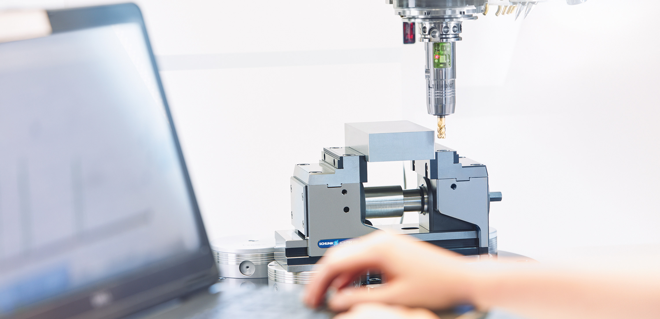
SCHUNK chuck jaw - basics

Slide 2
Content
Basics lathe chucks
Overview lathe chucks
Overview chuck jaws
SCHUNK range of chuck jaws- Your advantage!
Differentiation according to jaw interfaces
Interfaces
Basics chuck jaw
Functional principles of lathe chucks

Slide 3
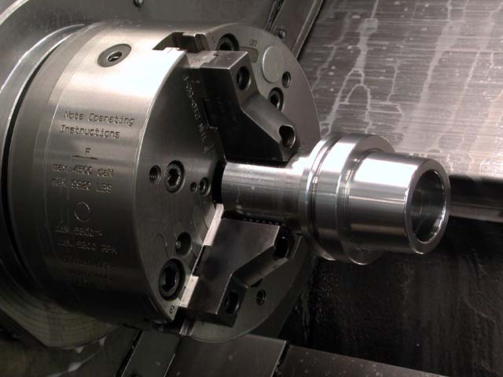
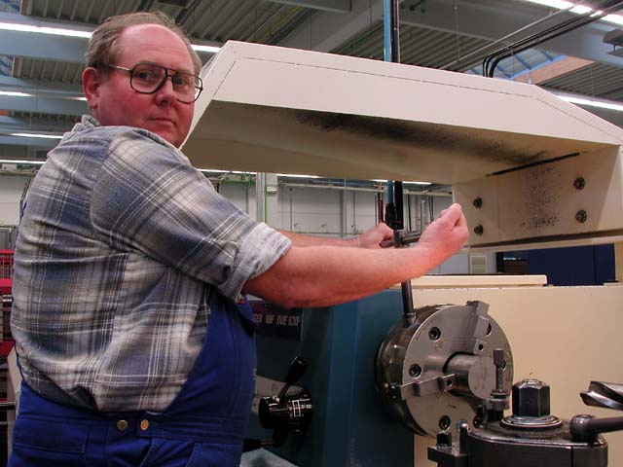
Overview lathe chucks
basic distinction
power chuck
manual lathe chucks

Slide 4
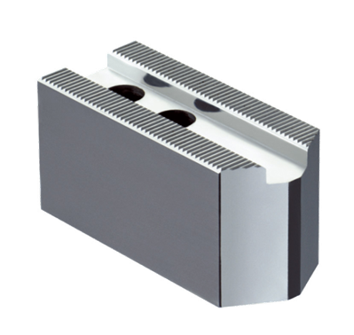
Functional principles of lathe chucks
The functional principle of the lathe chuck usually provides information about the types of chuck jaws that can be used.
Different base jaw types are installed in manual chucks and power chucks. These usually have different interfaces for top jaws.

Slide 5
Functional principles of lathe chucks
Functional principle power chuck
Wedge-hook chuck or wedge-bar chuck („quick-change chuck “)
Lathe chuck actuation:
  Hydraulic or
  Pneumatic
Interface between lathe chuck and chuck jaws:
  Wedge-hook chuck:
    Base jaws integrated in the lathe chuck, which are provided with guideways for the t-nuts
    Mounting of the top jaw on the base jaw with t-nuts
  Wedge-bar chuck:
    (One-piece) monoblock jaws or
    Combination of base jaw + top jaw

Slide 6
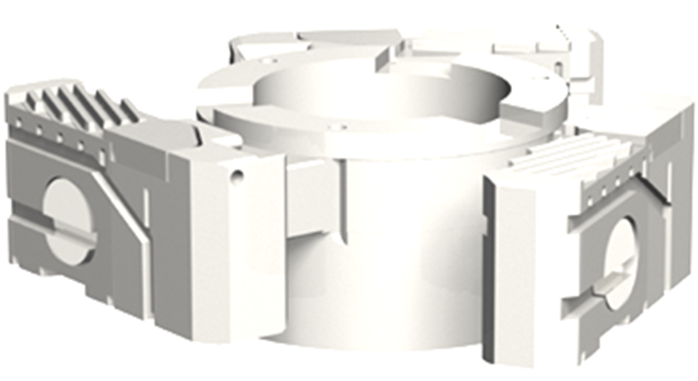
Functional principles of lathe chucks
Functional principles Wedge-bar power chuck
Wedge-bar power chuck with jaw quick-change
Lathe chuck operation: manual, with tool key
Usable clamping jaw types:
  (One-piece) Monoblock jaws or
  Combination of base jaw + top jaw

Slide 7
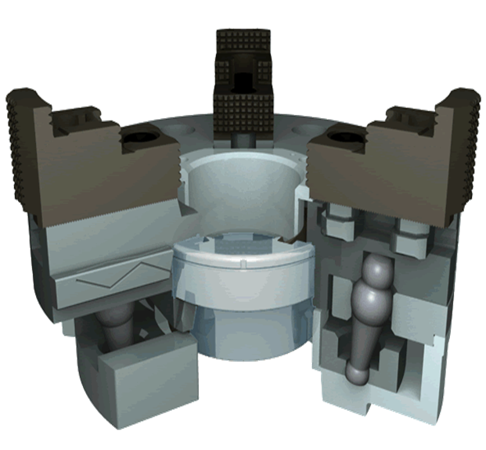
Functional principles of lathe chucks
Functional principles wedge-bar chuck
Lathe chuck actuation: by cylinder
Usable chuck jaw types:
  Top jaw with fine serration
  Top jaw with tongue and groove

Slide 8
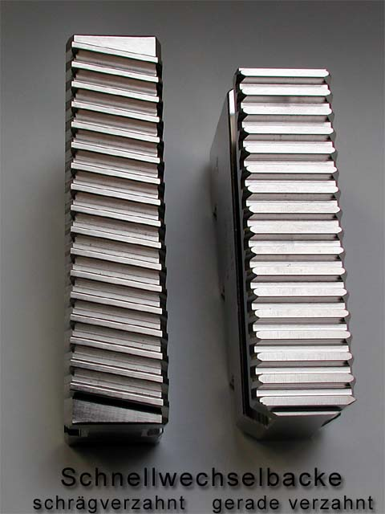
Interfaces
To be considered with wedge-bar chucks:
Interface on the chuck side
quick-change jaw
angled serration straight serration

Slide 9
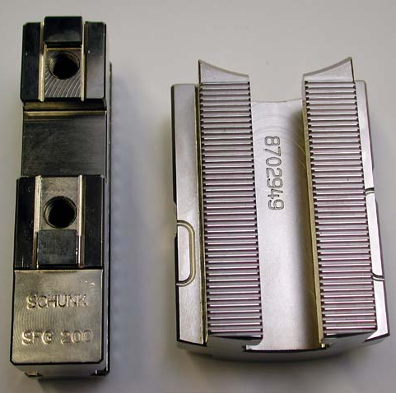
Interfaces
To be considered for all chucks:
Jaw interfaces for the top jaws
Tongue and groove Fine serration

Slide 10
Interfaces
Characteristics of the interfaces:
Tongue and groove:
  Higher reproducibility and thereby higher accuracy than, for example, with fine serration
  Only two options for positioning the top jaw on the base jaw, which limits the application/diameter range
  Therefore, base jaws with tongue and groove are usually used on wedge bar chucks where the base jaws are easily displaceable.
Fine serration:
  Higher forces can be transmitted due to the many teeth (Form fit)
  To set different diameters, the top jaws can be offset on the base jaws in many steps

Slide 11
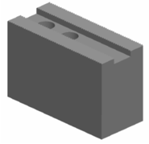
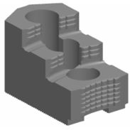
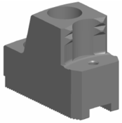
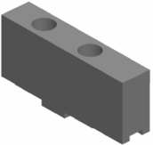
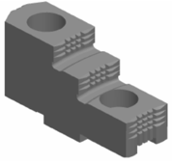
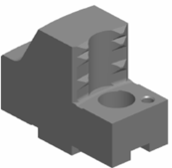
Differentiation according to jaw interface
 | Smooth jaw | Diamond serrated jaw | Claw jaw
with fine serration
with tongue and groove

Slide 12
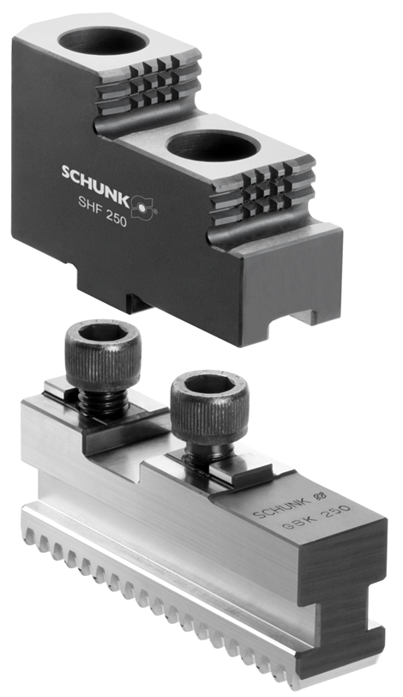
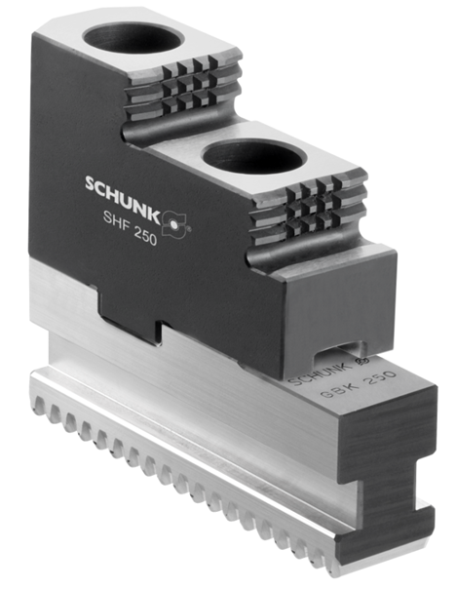
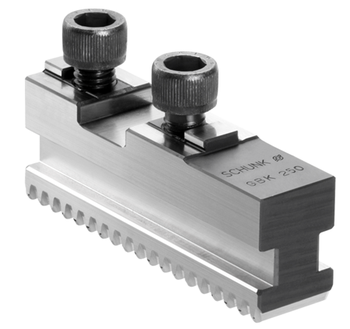
Differentiation according to jaw interface
Base jaw/ Top jaw
with tongue and groove

Slide 13
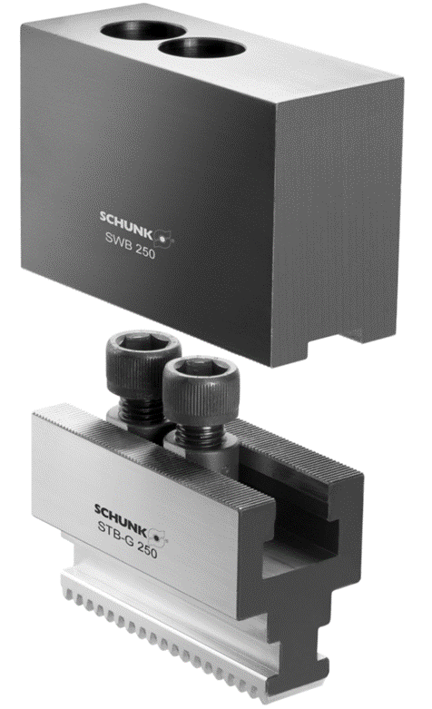
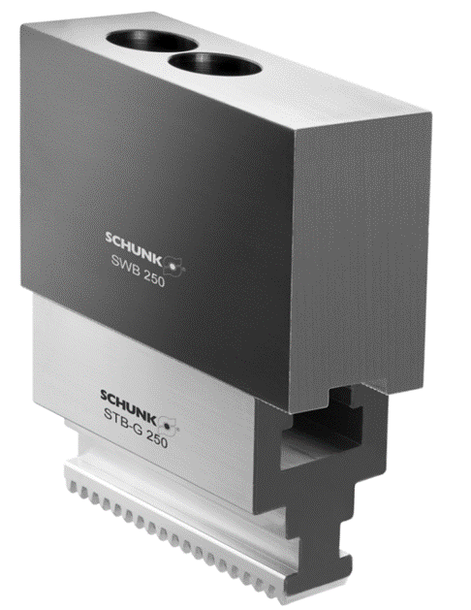
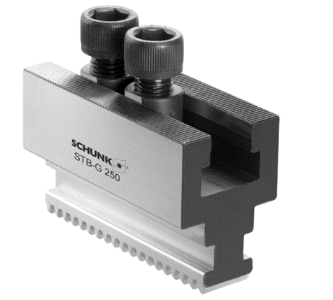
Differentiation according to jaw interface
Base jaw/ Top jaw
with fine serration

Slide 14
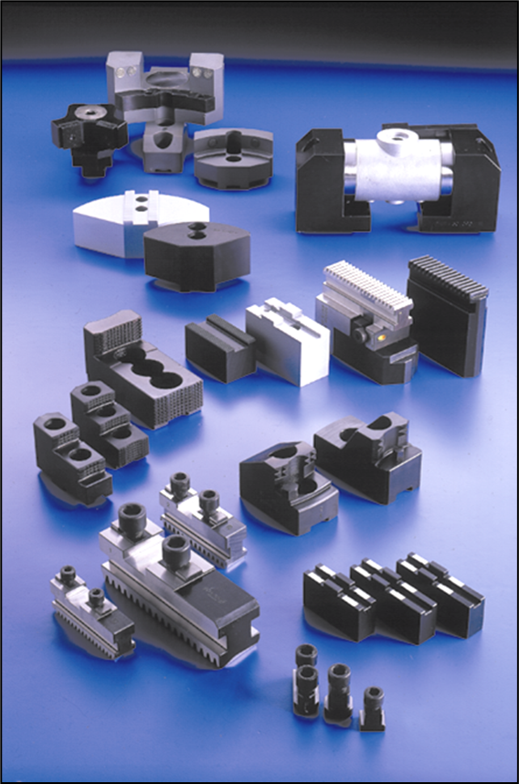
SCHUNK range of chuck jaws- Your advantage!
SCHUNK offers the world's largest
chuck jaw program for lathe chucks
Over 1200
different variants of
Standard-clamping jaws!
SCHUNK is the first manufacturer of chuck jaws,
that grinds nut and serration
SCHUNK produces in Germany with
skilled personnel and the most modern
CNC machines
SCHUNK offers 24-hour delivery service for all
standard jaws in stock

Slide 15



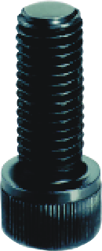
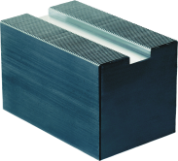
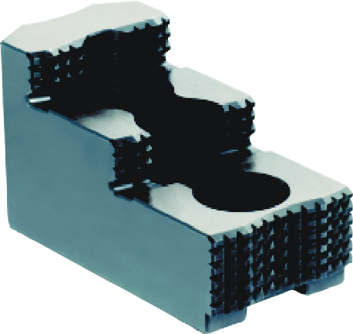
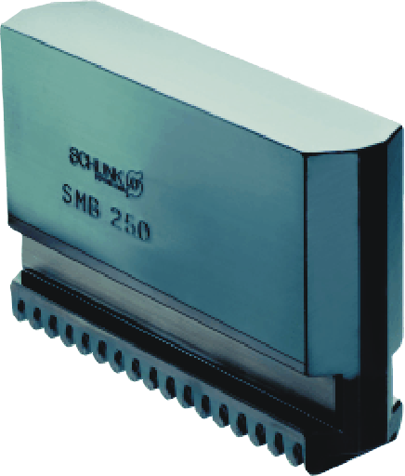
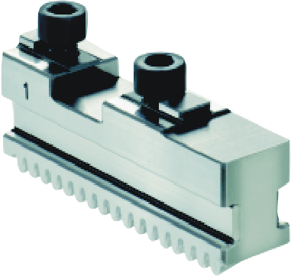

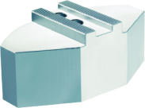
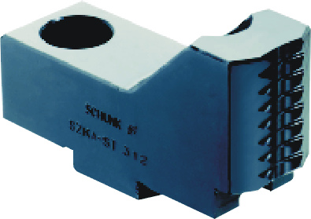
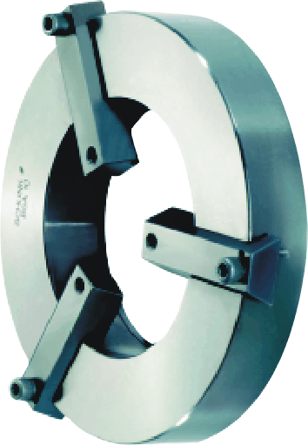
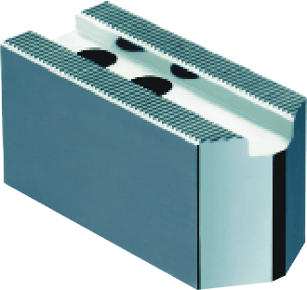
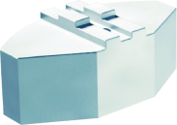
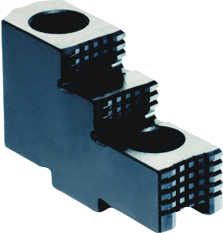
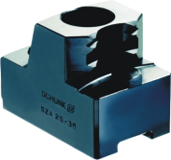
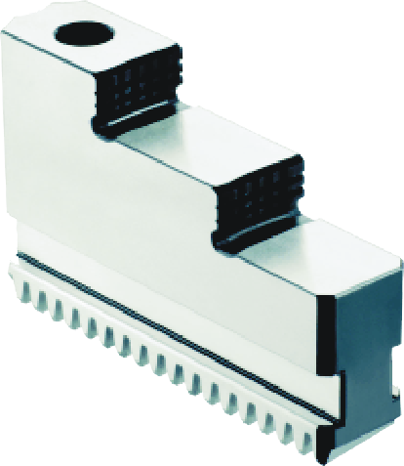
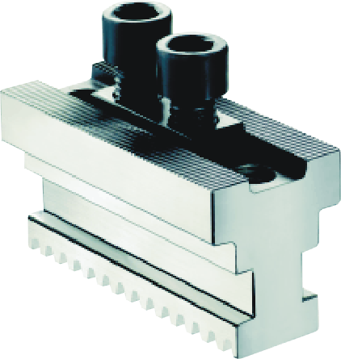
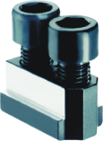
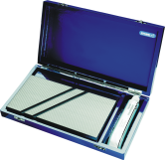
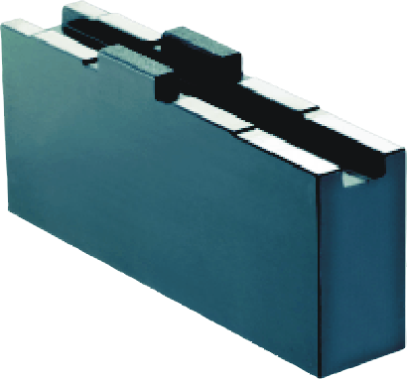
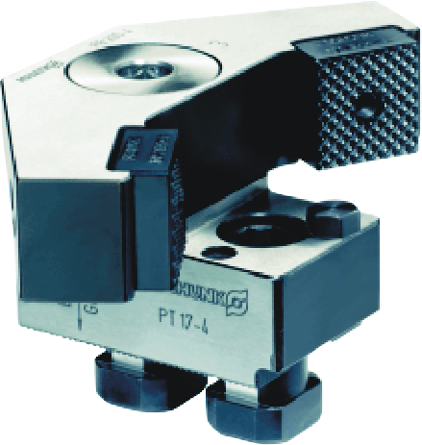
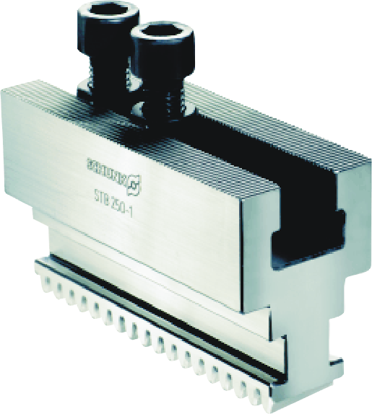
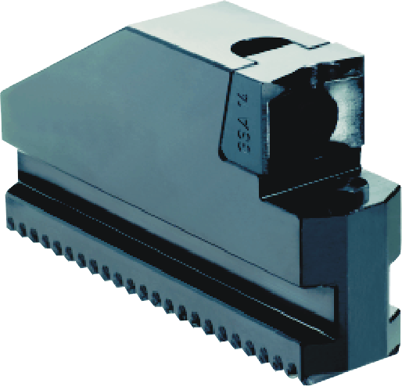
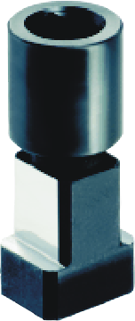

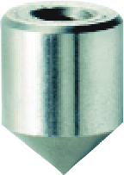
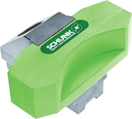
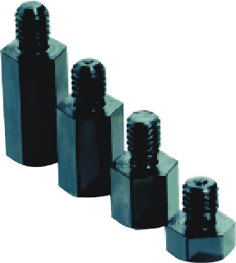
Übersicht Spannbacken
  Top jaws,
  soft
Full Grip- Top- and Pendulum jaws
Top jaws, hard
Monoblock-
and
Stepped block jaws
Base jaws
T-nuts
Accessories
Claw jaws

Slide 16
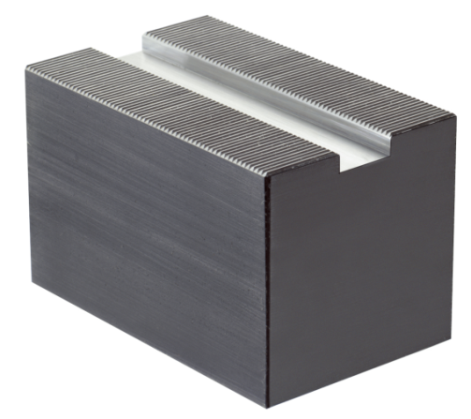
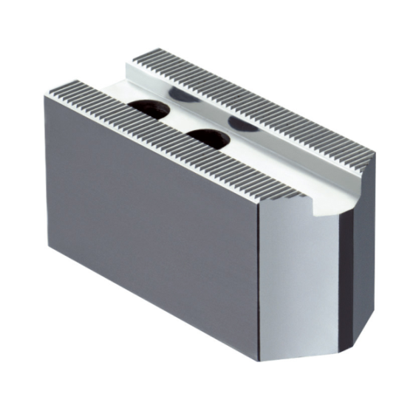
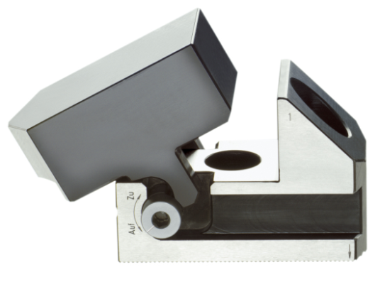
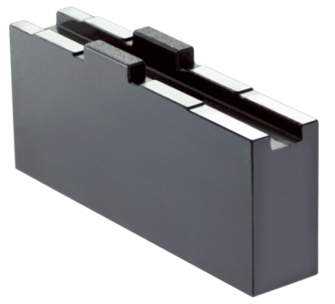
Overview chuck jaws
  Soft Top jaws with
  fine serration
Jaw blanks
Soft Top jaws with
tongue and groove
BWT/BWW-
Quick-change system with
soft Top jaws

Slide 17
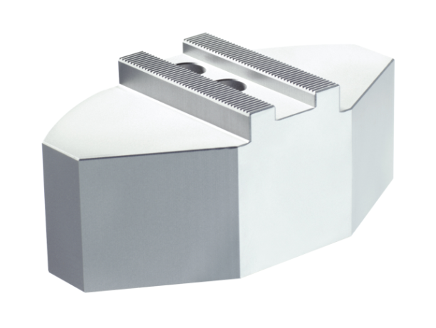



Overview chuck jaws
Soft Full Grip-
Top jaw with
  fine serration
Soft Full Grip-
Top jaw with
tongue and groove
Quentes 20
Pendulum jaw PNS

Slide 18




Overview chuck jaws
Claw jaws
for O.D. clamping
Claw jaws
for bar clamping
Claw jaws
for I.D. clamping.
System jaw SG mit with changeable clamping insert

Slide 19



Overview chuck jaws
Claw jaws type SZA

Slide 20


Overview chuck jaws
Stepped top jaws
with fine serration
Stepped top jaws
with tongue and groove

Slide 21


Overview chuck jaws
Soft block jaw
Hard stepped block jaw

Slide 22



Overview chuck jaws
Base Jaw with tongue and groove
Available versions:
standard
(straight or angled serration
Chuck interface)
with 1/2-tooth pitch
shortened Version
extended Version
wide base jaw
Base jaw with T-slot and fine serration 90°
Base jaw with Nut and
fine serration 1/16“ x 90°

Slide 23




Overview T-nuts
type NS
type NJ
type TS / TM
stepped slot nuts,
such as the NS 17 / 21

Slide 24







Chuck jaws accessories from von SCHUNK
clamping inserts and chuck tips
spare screws
workpiece stop
dress- and cleaning plate
jaw turning fixture
jaw turning rings

Slide 25


Universal top jaws

Slide 26

System claw jaw type SG

Slide 27

System claw jaw Type SG
consisting of supporting jaw with clamping inserts
for clamping rough and finished parts
standard clamping inserts:
  hard claw inserts for I.D. and O.D. clamping
  soft clamping inserts in two different widths
lower weight as system of supporting jaw/ top jaw
for straight or angled wedge bar serration
available as standard for:
  SMW/AUTOBLOK, FORKARDT, RÖHM and SCHUNK
  chuck sizes: 160 - 500 mm

Slide 28


QUENTES - fiberglass jaws

Slide 29

QUENTES - fiberglass jaws
advantage:
  high friction coefficient (of approx. 0.3 - 0.4)
  no clamping marks
  light and stable version
  complete workpiece contact
  standard types:
    Quentes 10 and Quentes 20

Slide 30




Pendulum jaws

Slide 31


Pendulum jaw PNS/PNK
bearing bolt
Pendulum body
Cylindrical pin
O-ring
Clamping insert
T-nuts
Supporting jaw
PNS
PNK-for quick-change chuck

Slide 32

Application example pendulum jaws
technical data:
jaw: PNS-F 400-2
chuck: 3 NHF 400
clamping force: 100 kN
workpiece: Rotguss,
ca. 220 mm x 180 mm x 50 mm
speed: 1320 U/min
adjustment: 0,3 mm
clamping depth: 3 - 4 mm
roundness after unclamping: 0,02 mm

Slide 33


Wedge-hook- and wedge-bar power chuck
wedge-hook-system wedge-bar power-system

