Slide 1
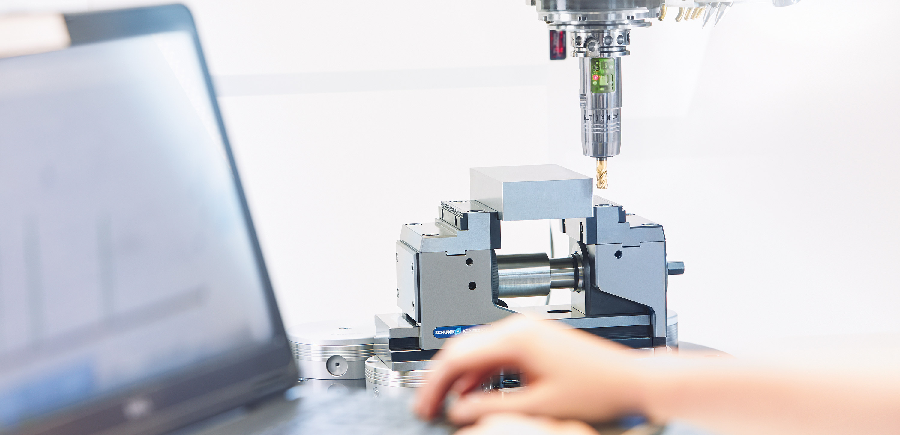
Toolholding Systems
Mechanical Toolholding Systems

Slide 2
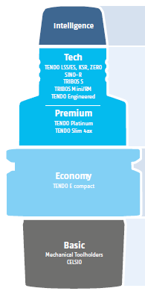
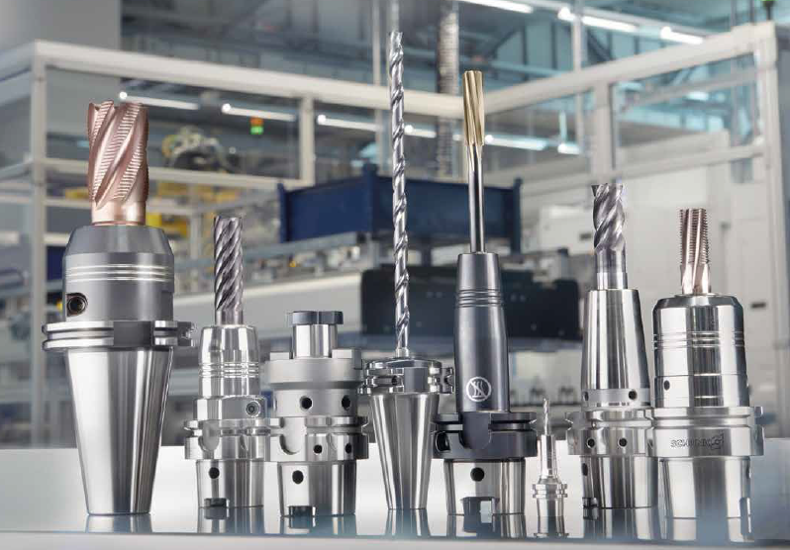
Product overview
SCHUNK CELSIO heatshrink chucks and extensions together with the
extensive range of mechanical tool
toolholders form the basis of the SCHUNK Total Tooling
complete program

Slide 3
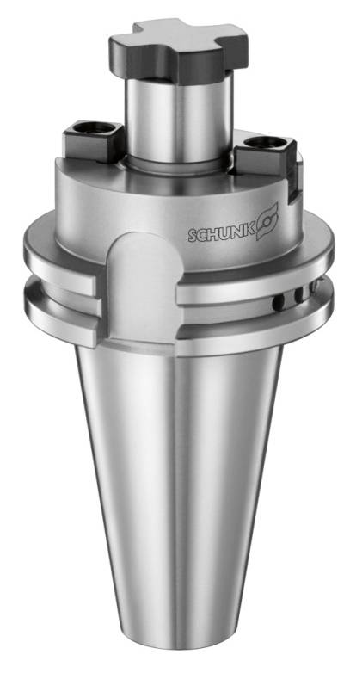
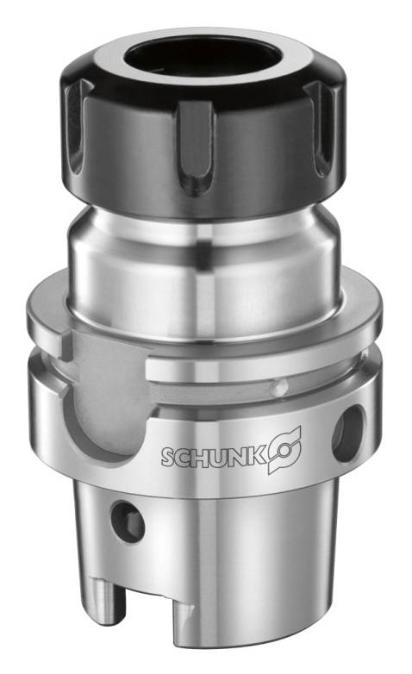
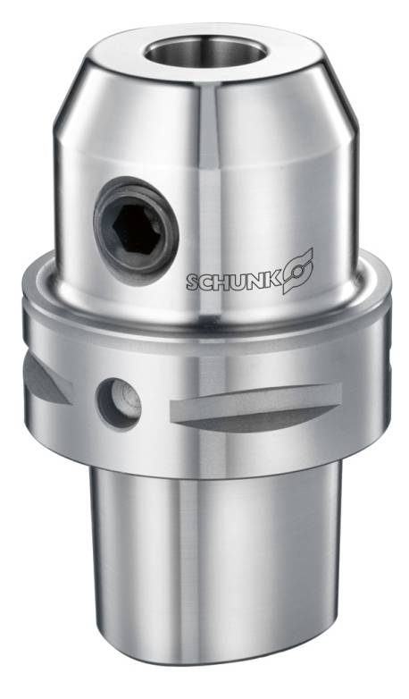
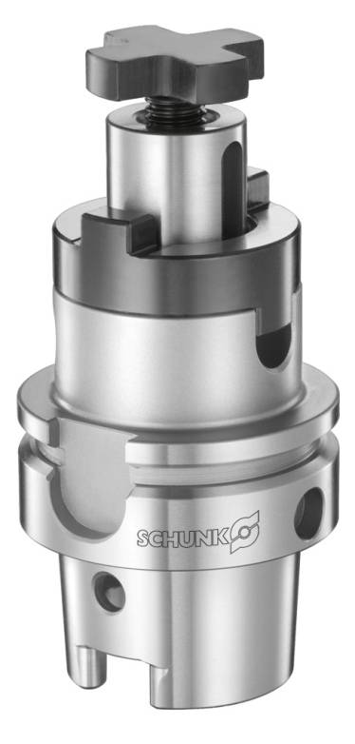
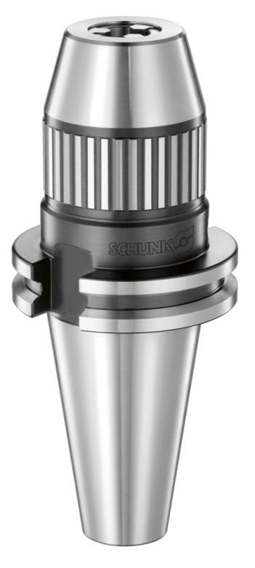
Mechanical toolholder

Slide 4
Mechanical toolholder
SCHUNK offers with:
ER collet chucks / ER Mini
ER P precision collet chucks
Weldon chucks
Whistle-Notch chucks
Face mill arbors
Combination shell end mill adapters
Tapered Screw-in Milling Cutter Mounting
CNC short drill chucks
a wide range of mechanical toolholders

Slide 5
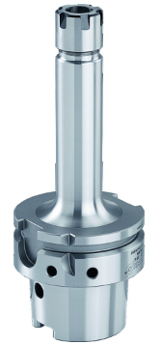
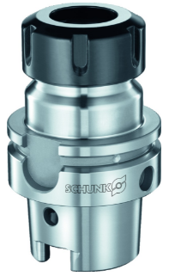
ER collet chucks – ER Mini
  The ER collet chuck is suitable for clamping tools with cylindrical shanks in collet chucks in accordance with DIN ISO 15488-B. Due to the large clamping range of the collet chucks, various shank tolerances can be clamped. The ER collet chuck mini also has an optimized interfering contour as well as providing excellent workpiece accessibility
  The clamping nut is included in the scope of delivery

Slide 6
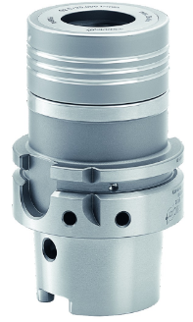
ER P Precision Collet Chucks
  The ER precision collet chucks is suitable for clamping tools with cylindrical shanks in collet chucks in accordance with DIN ISO 15488-B. Due to the large clamping range of the collet chucks, various shank tolerances can be clamped. Using a precision collet chuck, highest run-out accuracies of 3 microns can be attained
  The clamping nut is included in the scope of delivery

Slide 7
Weldon
  WELDON end mill holders can be used to safely clamp tools with a lateral clamping surface on the cylindrical shank. Due to the mounting of the clamping screw, the tool cannot twist or pull out. The mounting is suitable for clamping tools with cylindrical shanks in accordance with DIN 1835B and DIN 6535HB
  The clamping screw is included in the scope of delivery
  Tool cannot twist or pull out

Slide 8
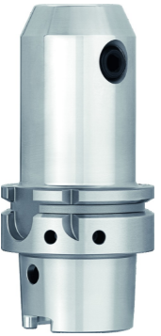
Whistle-Notch
  The whistle-notch mountings can be used to reliably clamp tools with a lateral clamping surface on the cylindrical shank. Due to the mounting of clamping screw, the tool cannot twist or pull out. For clamping tools with cylindrical shanks in accordance with DIN 1835E and DIN 6535E
  The clamping screw and length adjustment screw are included in the scope of delivery
  Tool cannot twist or pull out

Slide 9
Face mill arbors
  Face mill arbors are suitable for clamping end face mills and face mills, with crosswise slot in accordance with DIN 1880, from clamping diameter Ø 40 in accordance with DIN 2079 (four threaded holes). Due to the enlarged contact surface, milling cutters with a crosswise slot can be clamped quickly
  The clamping screw and driving keys are included in the scope of delivery

Slide 10
Combination shell end mill adapters
  The combination shell end mill adapter is a mechanical stationary chuck for rapid clamping of milling cutters with a longitudinal or crosswise slot
  Clamping screw and driving keys are included in the scope of delivery

Slide 11
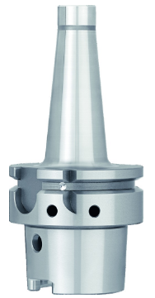
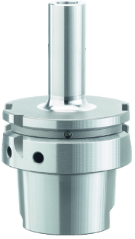
Milling cutter mounting – cylindrical/conical version
  Arbor for clamping screw-in milling cutters with thread

Slide 12
CNC short drill chucks
  CNC short drill chucks are suitable for clamping tools with a cylindrical shank in machining centers or CNC machines. Uninterrupted and quick tool change for tools with 1 to 16 mm shank diameters is possible in the machine – even with internal coolant supply. Scope of delivery with Allen key

