Slide 1

ROTA TPS
Pneumatic front-end chuck for stationary use

Slide 2
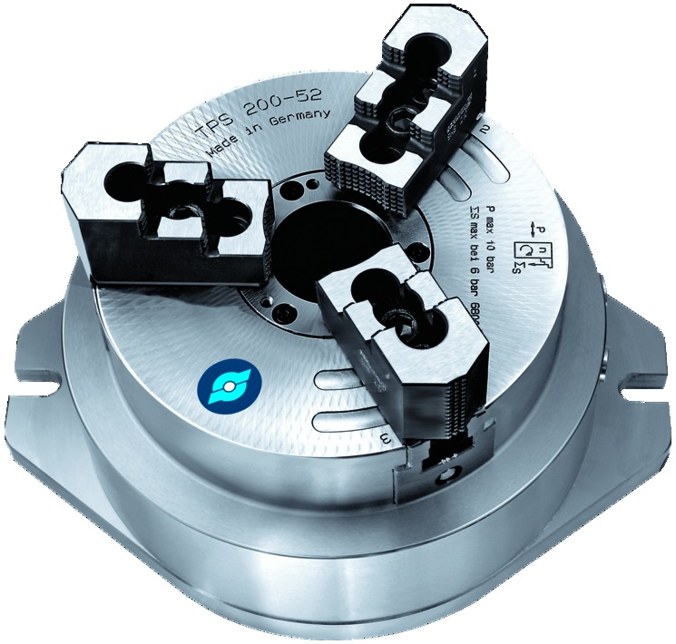
ROTA TPS
Advantages – Your benefits
Precision wedge hook pneumatic chuck for highest top-quality demands
Large chuck bore
High degree of efficiency of the wedge hook system
Optimized lubrication system
High clamping forces at system pressure
All sides of the functional parts are ground and hardened

Slide 3
ROTA TPS
Anwendungsbeispiel
Spannmittel:
Merkmale/Anwendung:

Slide 4
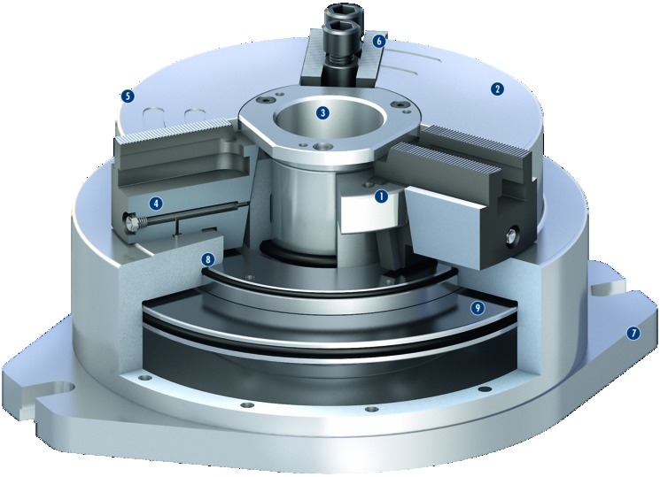
ROTA TPS
Functional diagram
6
Wedge hook drive
Hardened and extremely rigid base body
Large through-hole
Optimized lubrication system
Low height
Standard jaw interface
Adaptation to the machine table
Improved design which is insensitive to dirt
Pneumatic system
1
2
5
3
2
3
4
4
1
5
8
6
7
9
7
8
9

Slide 5
ROTA TPS
Variants
Technical data | ROTA TPS 125-26 | ROTA TPS 160-38 | ROTA TPS 200-52 | ROTA TPS 250-68 | ROTA TPS 315-90 | ROTA TPS 315-105
Max. clamping force [kN] | 22 | 39 | 68 | 105 | 140 | 100
Stroke/jaw [mm] | 3 | 4.2 | 4.2 | 5 | 5 | 5
Weight [kg] | 12 | 23 | 34 | 60 | 82 | 72

