Slide 1

ROTA NCK-S plus
Hydraulic power chuck for stationary use

Slide 2
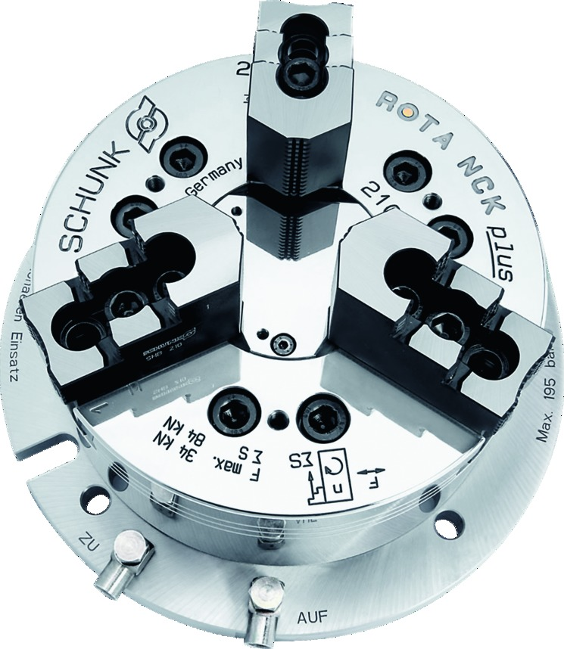
ROTA NCK-S plus
Advantages – Your benefits
Precision wedge hook power chuck for highest quality requirements
Excellent cost-performance ratio
High degree of efficiency of the wedge hook system
Optimized lubrication system
Integrated hydraulic cylinders
Base jaws with fine serration 1.5 mm x 60° and 1/16“ x 90° as standard
Low height
All sides of the functional parts are ground and hardened

Slide 3
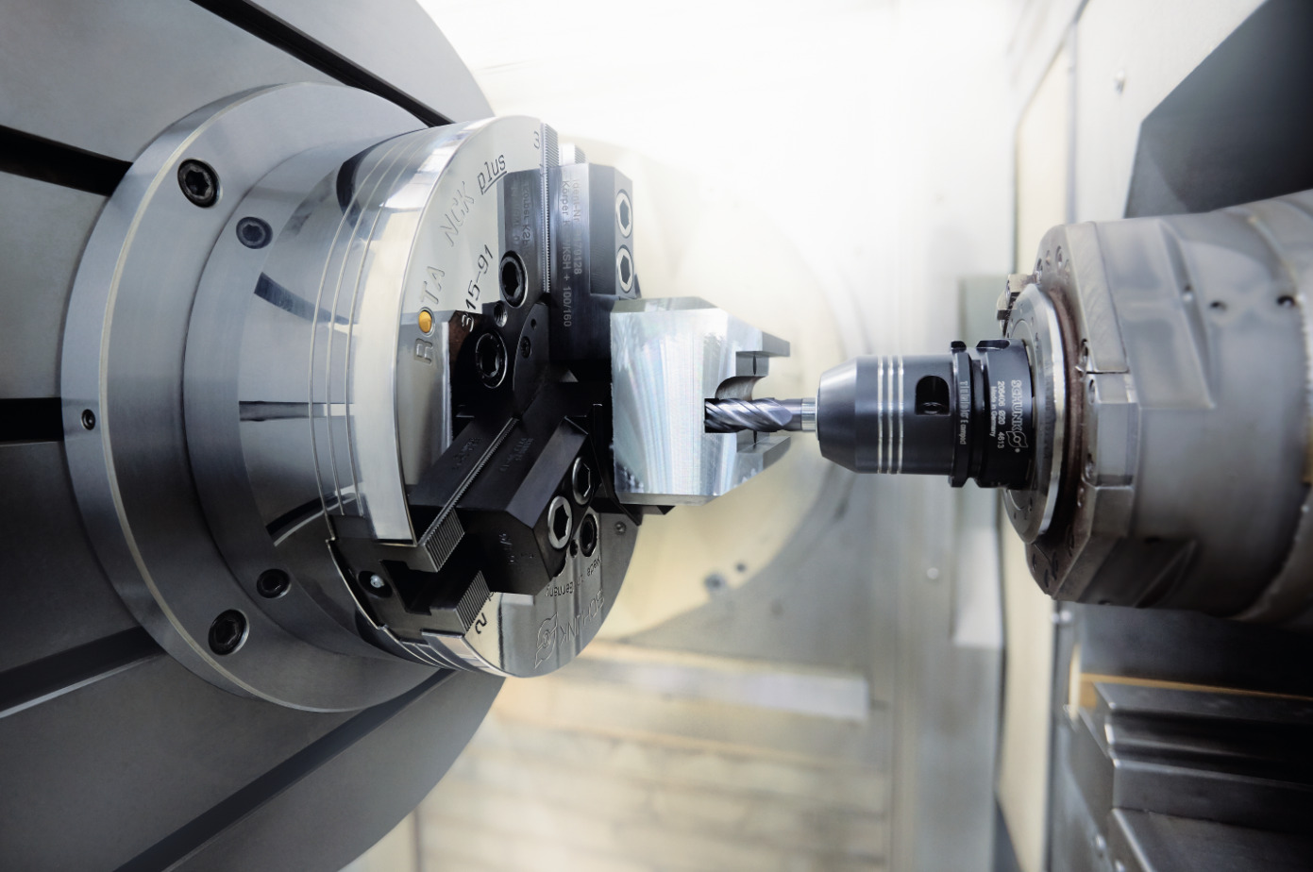
ROTA NCK-S plus
Example of application
Clamping device:
ROTA NCK-S plus 315 for stationary application.
Features/Application:
Lathe chuck with integrated hydraulic cylinder for automated manufacturing in milling centers.

Slide 4
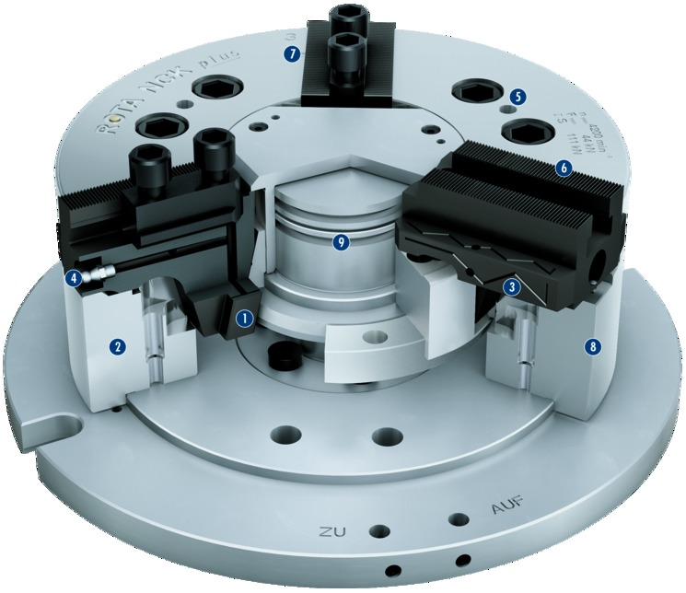
ROTA NCK-S plus
Functional diagram
7
Wedge hook drive
Hardened and extremely rigid base body
Long jaw guidance
Optimized lubrication system
Mounting thread
Base jaw serration
Jaw stroke display
Low height
Hydraulic system
5
1
2
6
3
4
9
5
4
3
6
1
2
8
7
8
9

Slide 5
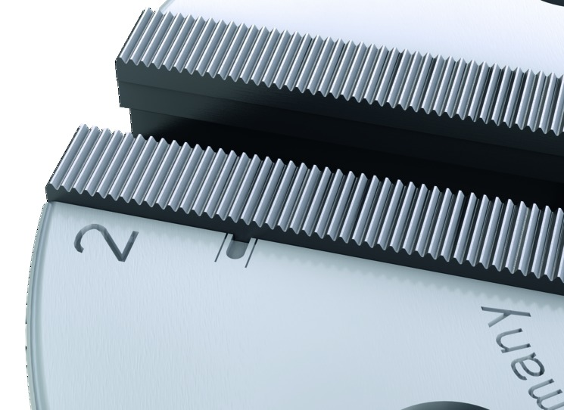
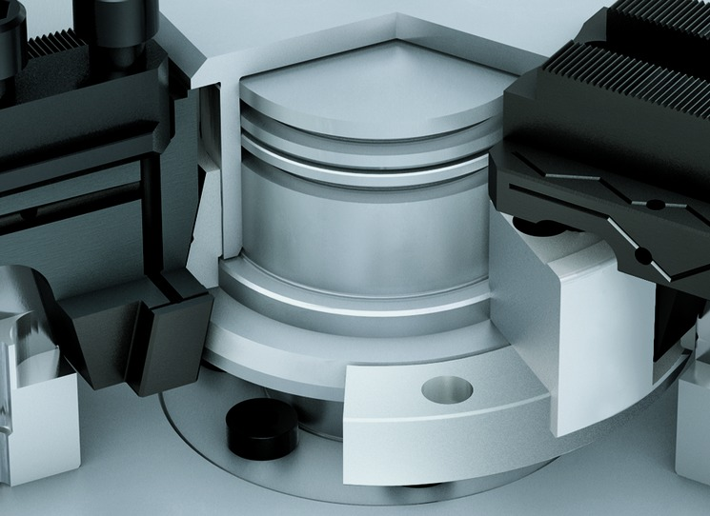
ROTA NCK-S plus
Highlights
Jaw stroke display
The jaw stroke control is an additional safety feature, which ensures safe workpiece clamping and simplifies the use of the chuck.
Long and precise piston guidance
For high clamping repeatability and long service life. All functional components used for force transmission are hardened and ground.

Slide 6
ROTA NCK-S plus
Variants
Technical data | ROTA NCK-S plus 165 | ROTA NCK-S plus 210 | ROTA NCK-S plus 250 | ROTA NCK-S plus 315
Actuation pressure [bar] | 195 | 195 | 120 | 120
Max. clamping force [kN] | 57 | 84 | 111 | 144
Stroke/jaw [mm] | 2.75 | 3.7 | 4.4 | 5.3
Weight [kg] | 20.1 | 31.2 | 47.6 | 72.4

