Slide 1

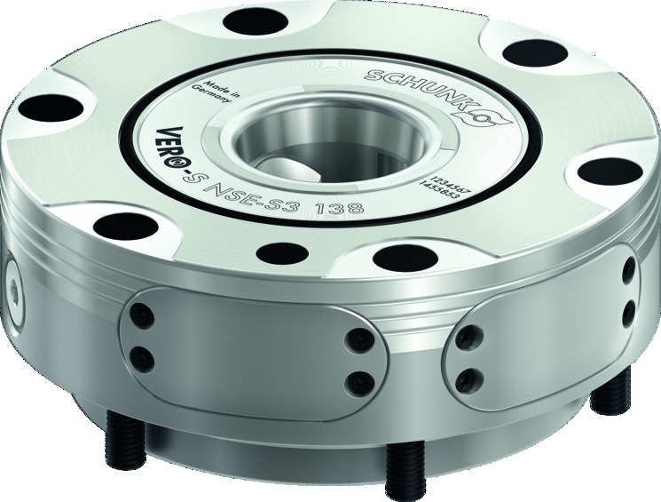
VERO-S NSE-S3
Sensory quick-change pallet module for a higher process transparency

Slide 2
VERO-S NSE-S3
Advantages – Your benefits
SCHUNK modular system
Pull-down force measurement via strain gauges
Integrated electrical monitoring of clamping slide positions and pallet presence
Optional cone seal
Positioning via short taper
Patented dual stroke sytsem for highest pull-down forces
Turbo integrated by default
Form-fit, self-retained locking
The modules are stainless and completely sealed
All modules can be operated with a system pressure of 6 bar

Slide 3
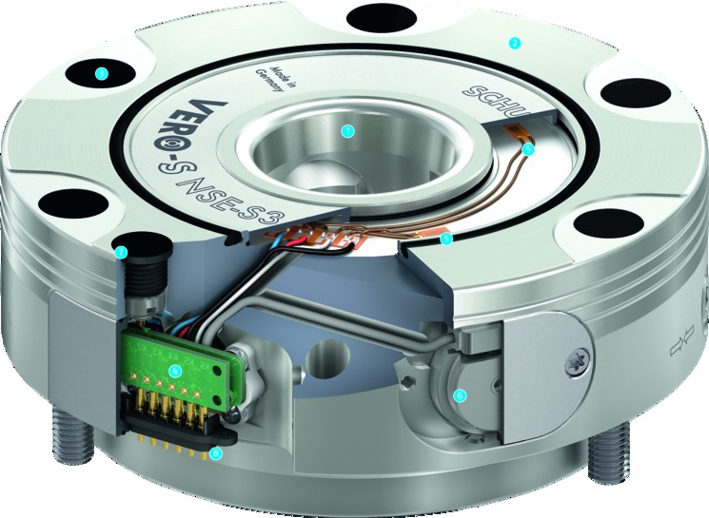
VERO-S NSE-S3
Functional diagram
High-precision short taper centering
Large flat surface
Cover caps for fastening screws
Integrated electronics
High-resolution strain gauge
Inductive analog sensor
Inductive proximity switches
Spring contacts
2
1
3
2
1
3
5
4
5
7
5
6
7
4
6
8
8

