Slide 1

MPG-plus with cover
Detailed presentation

Slide 2
Overview
Product presentation
Positioning in the SCHUNK portfolio
Target applications & industries
Design of the product
Scope of delivery
Accessories
Commissioning
Maintenance / Service

Slide 3
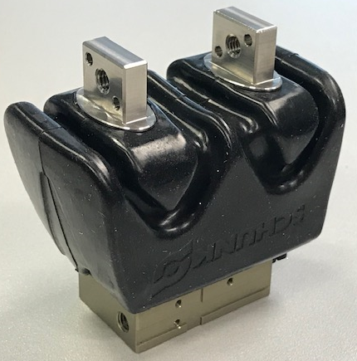
Product presentation
Main features
Cover protects the workpiece from the gripper (e.g. leaking grease)
Cover protects the gripper from splashing water
Cover protects the gripper from dust and dirt
Target applications
Workpiece handling in the food/pharmaceutical/medical sector "gray room”
Workpiece handling in dirty and dusty environments

Slide 4
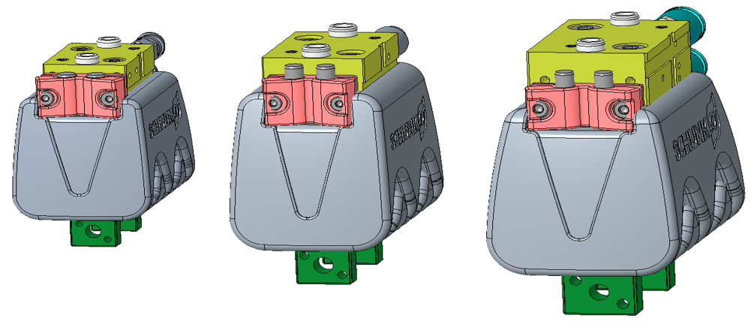
Product presentation
MPG-plus 25-HUE
MPG-plus 32-HUE
MPG-plus 40-HUE
Basic version
–AS-version
–IS-version
*Air connections are not included in scope of delivery

Slide 5
Product presentation
Gripper with cover
Spare part package Cover
ID | Name
1460566 | MPG-plus 25-HUE
1460568 | MPG-plus 25-AS-HUE
1460569 | MPG-plus 25-IS-HUE
1460630 | MPG-plus 32-HUE
1460632 | MPG-plus 32-AS-HUE
1460634 | MPG-plus 32-IS-HUE
1460637 | MPG-plus 40-HUE
1460639 | MPG-plus 40-AS-HUE
1460640 | MPG-plus 40-IS-HUE
ID | Name
1466542 | ETP HUE MPG-plus 25
1466544 | ETP HUE MPG-plus 32
1466546 | ETP HUE MPG-plus 40

Slide 6
Product presentation
Based on basic version
  → Cover can be retrofitted by using a retrofit kit
Cover material: silicone rubber
  → FDA suitable
Intermediate jaw made of stainless steel
  → For food/pharmaceutical/medical applications
  → Consider maximum finger-length and -mass!
Monitoring by using IN40 (no magnetic sensors, no FPS)
  → no additional mounting kit required
IP protection class IP54
Clean room certificate follows communication start

Slide 7
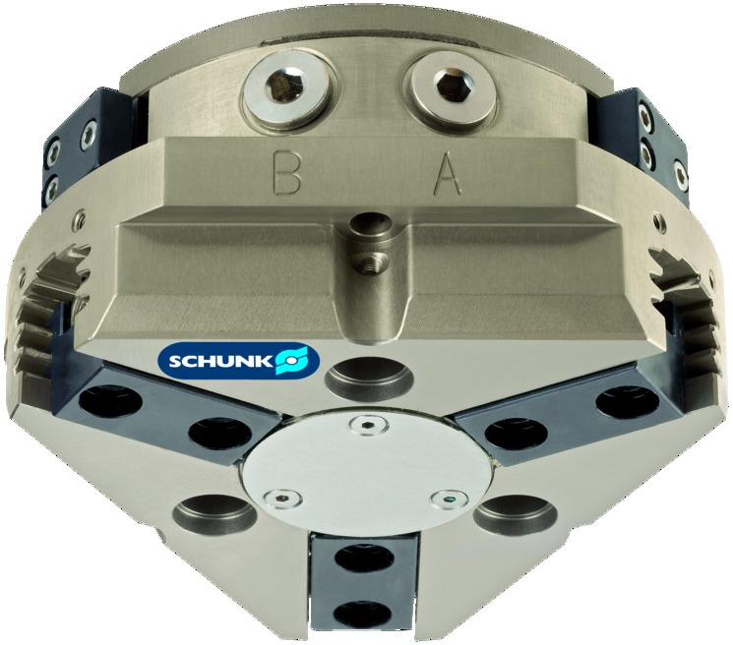
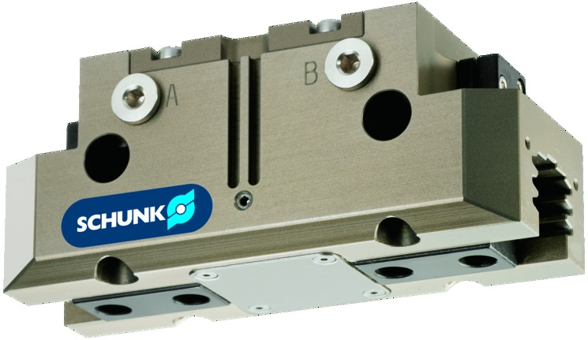
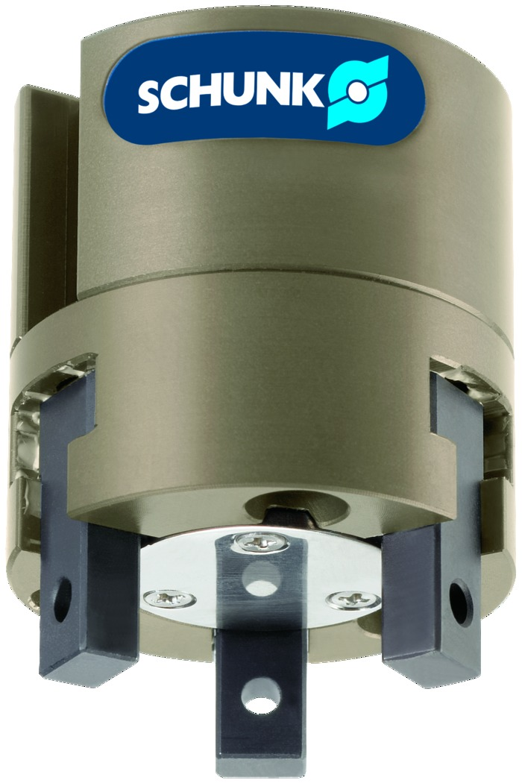
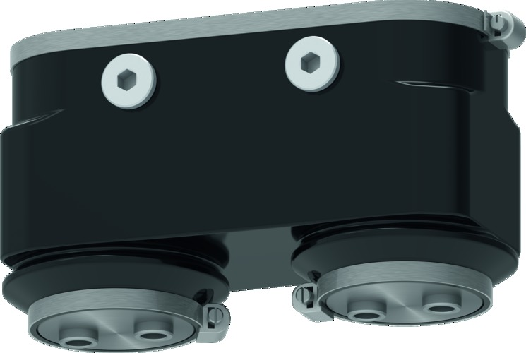
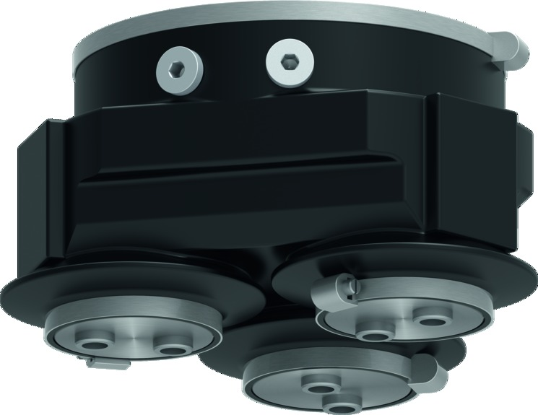
Positioning in the SCHUNK portfolio

Slide 8
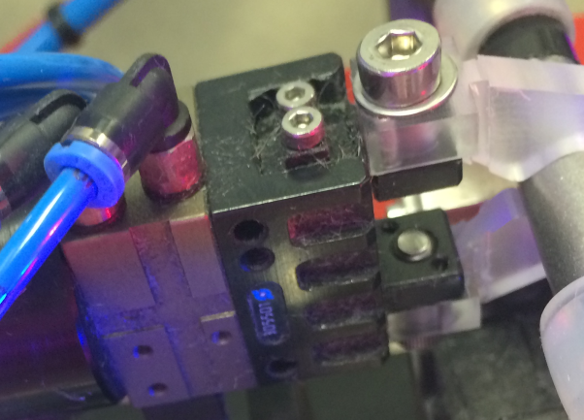
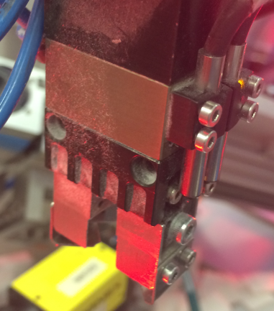
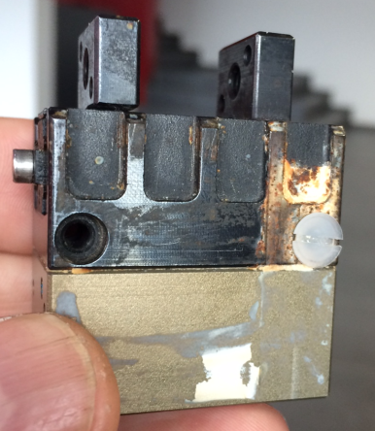

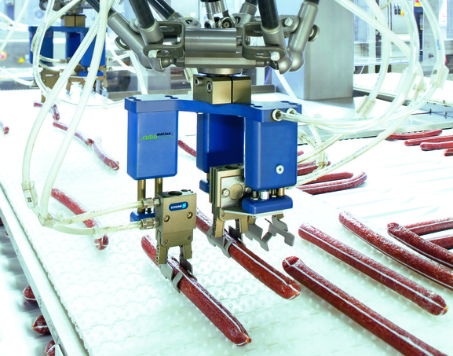
Target applications & industries
→ Cover as protection against dirt/corrosion
→ Protective cover against staining of the gripper
→ Protective cover to protect the workpiece
→ Protective cover to protect the gripper from splashing water
Handling during the cleaning of titanium screws under cleanroom conditions
Pick & place of products in the food industry

Slide 9
Target applications & industries
User report
Application picture
→ Infos to Nathalie Fiala / Oliver Schoch

Slide 10
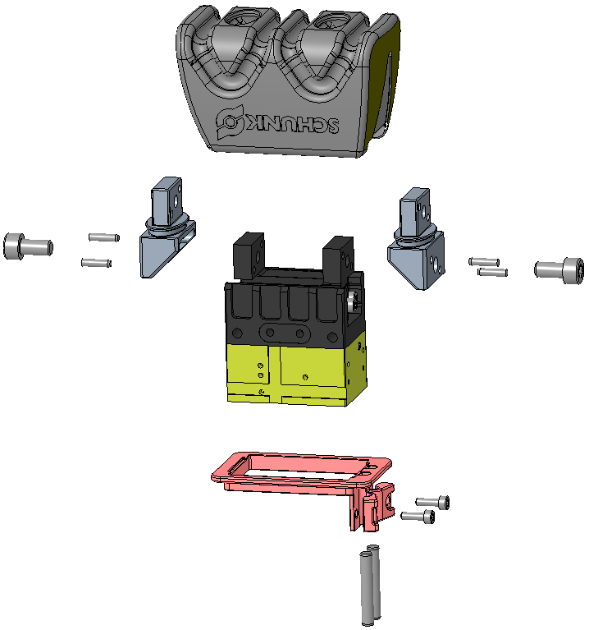
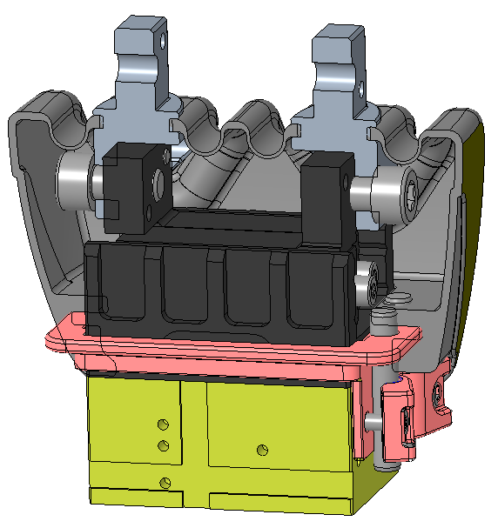
Design of the product

Slide 11
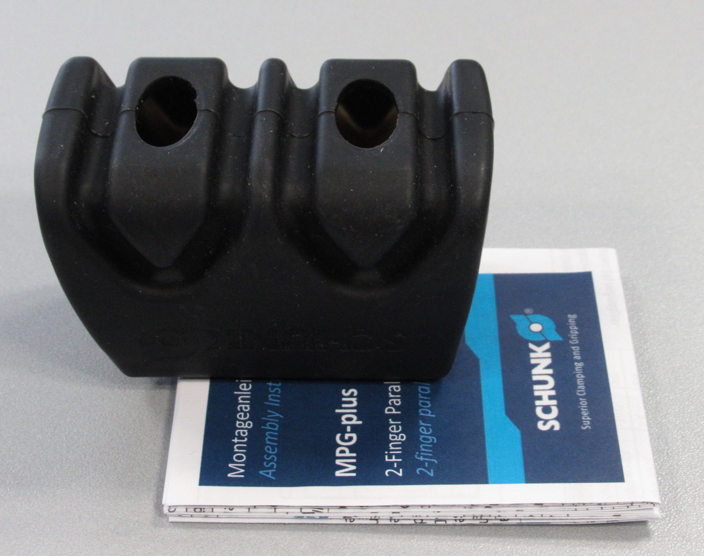
Scope of delivery
Gripper with cover
Spare part package Cover

Slide 12
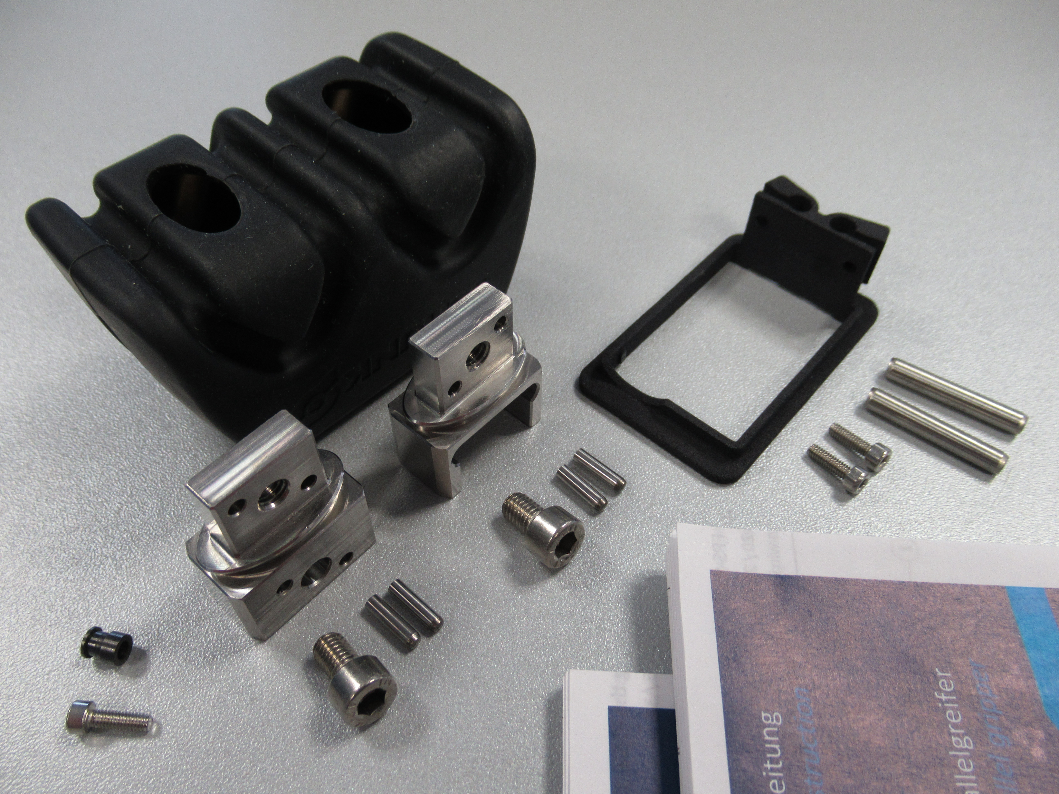
Scope of delivery
Nachrüst-Kit
1448888 HUE MPG-plus 40
1447533 | Schutzhülle MPG-plus 40 | 1 | ST
1458946 | ZBA MPG-plus 40 HUE | 2 | ST
1458949 | RAH MPG-plus 40 HUE LS | 1 | ST
9907484 | SCHRAUBEN DIN 912/A2 M 5,0 X 10 MM | 2 | ST
9682003 | ZYL. STIFT DIN 6325/ST 2,5 M6 X 10 MM | 4 | ST
9660408 | SCHRAUBEN DIN 912/A2 M 2,5 X 8 MM | 2 | ST
1463788 | Zyl. Stift ISO 2338/A4 4,0 M6 X 24 | 2 | ST
1465759 | Beipack MPG-PLUS 40-IN40 | 1 | ST

Slide 13
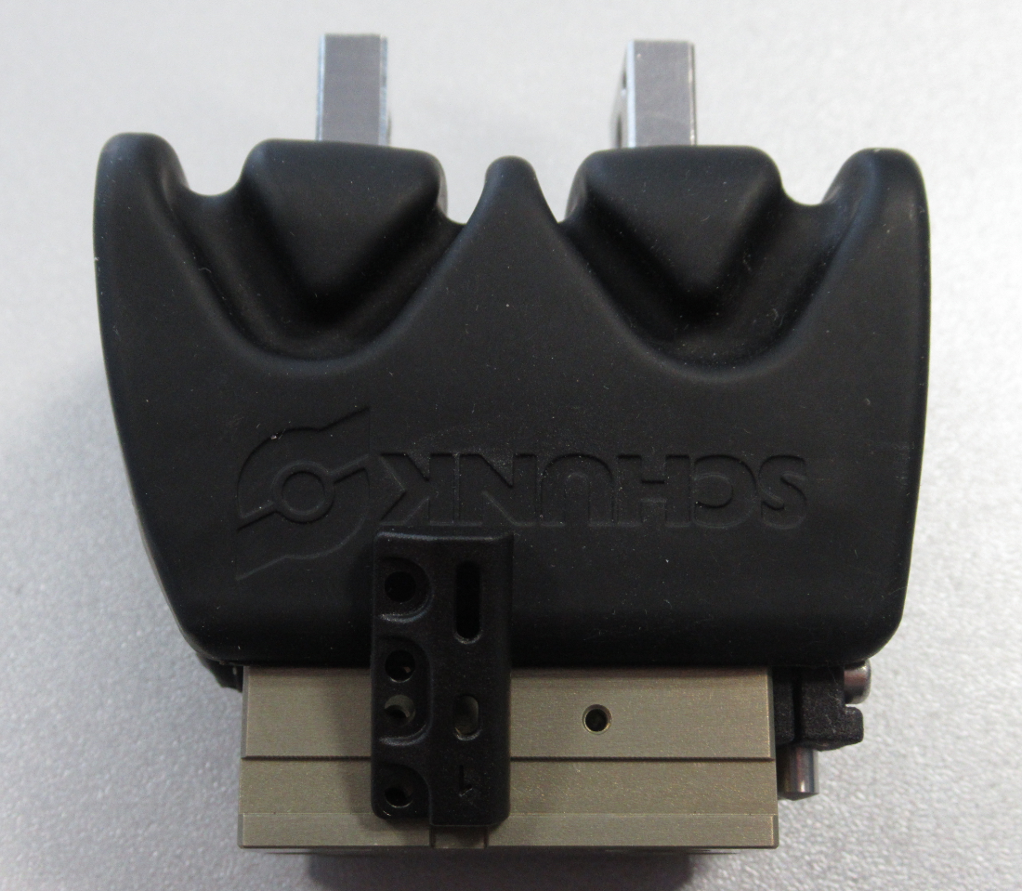
Accessories
No magnetic sensors
No FPS sensors
Inductive sensors only (IN40)
  No mounting kit needed
Accessory selection via website/webshop and complementary finder (SAP)
Please consider the information in the catalog

Slide 14
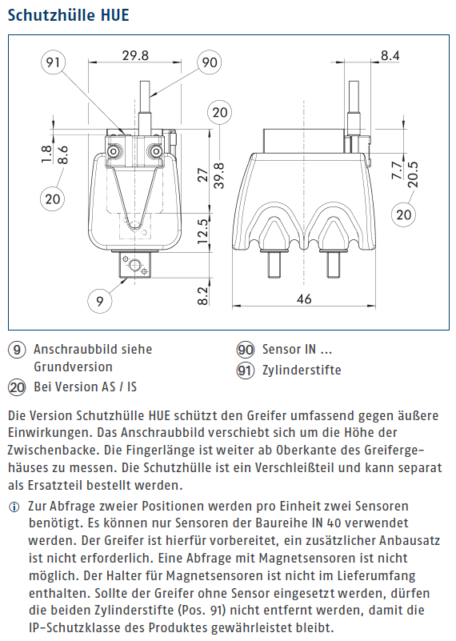
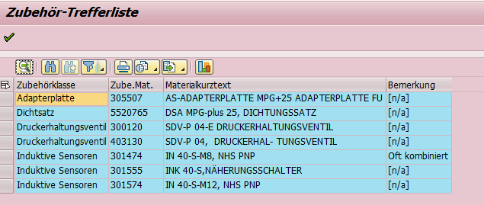
Accesories
Englischer Katalog
Komplementärfinder aktualisieren
→ BSWS-MPG-plus und Fingerrohlinge werden aktuell noch geprüft

Slide 15
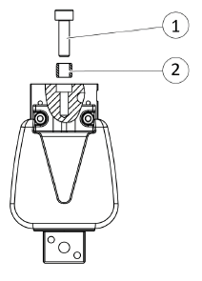
Commissioning
Only mounting from below
Side air connections and bottom direct connections
Torque for fastening the frame to the gripper 0.06Nm
Torque for fastening the intermediate jaw to the gripper (A2 screws)
Size | 25 | 32 | 40
Torque [Nm] | 2,2 | 4,3 | 4,3

Slide 16
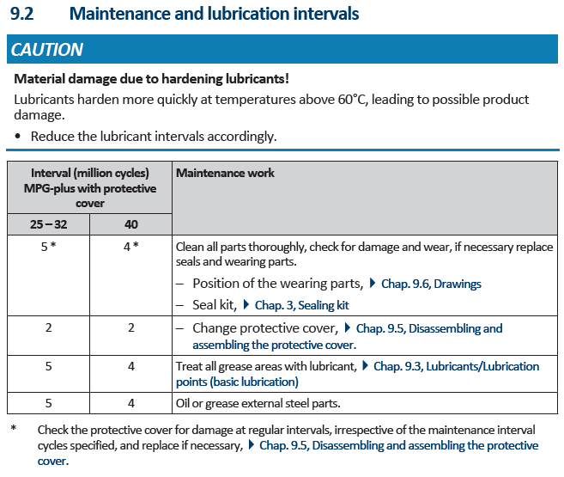
Maintenance / Service
Spare part package Cover
ID | Name
1466542 | ETP HUE MPG-plus 25
1466544 | ETP HUE MPG-plus 32
1466546 | ETP HUE MPG-plus 40

