Slide 1

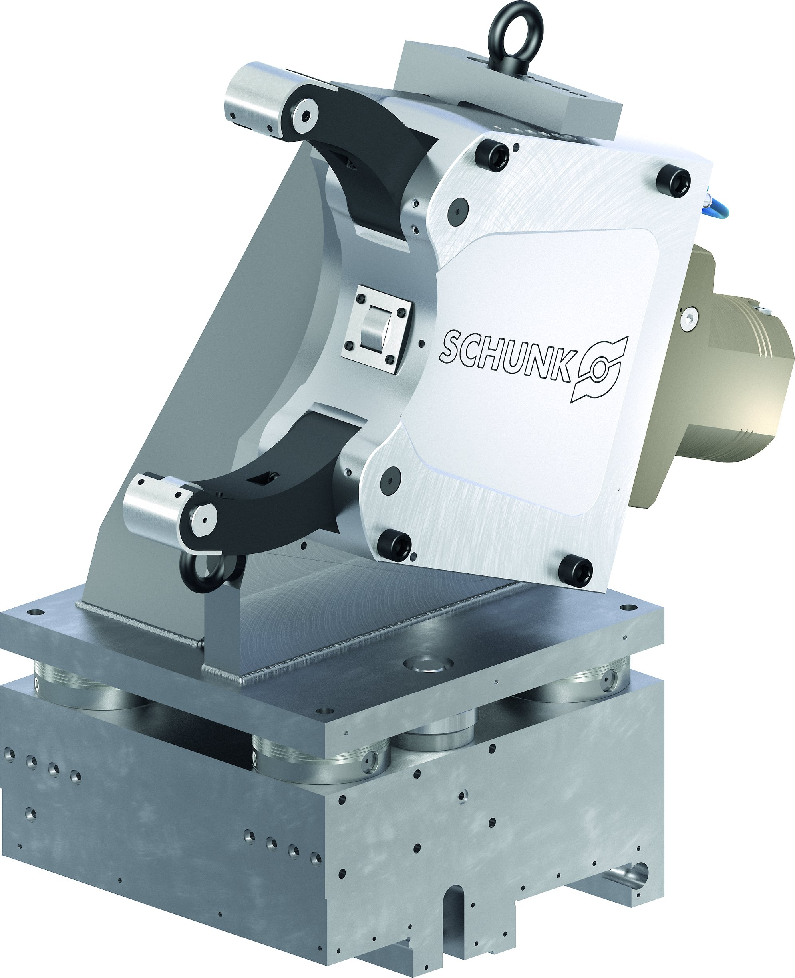
ZENTRICO LSW
Steady Rest Quick Change

Slide 2














Product overview
Gripping Systems
Clamping Technology
Chuck Jaws
Stationary Workholding
Lathe Chucks
Toolholders
Hydraulic Expansion Technology
Manual Lathe Chucks
Power Lathe Chucks with Jaw Quick-change System
Power Lathe Chucks with Through-hole
Power Lathe Chucks without Through-hole
Pneumatic Power Chucks
Steady Rests
Quick-change Systems
Customized Solutions

Slide 3
Challenges
Variants
Global
competition
Time
Time
Demand
Time
Flexibility and und set-up time optimization
heute
zukünftig

Slide 4
Overview
Quick-change Systems
ROTA FSW
ZENTRICO LSW

Slide 5
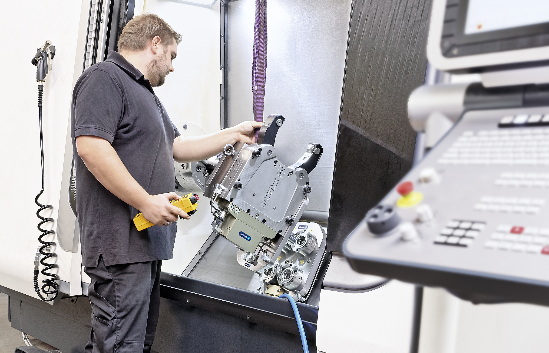
ZENTRICO LSW
Example of application
Clamping device:
THL plus 310 with quick-change system on the basis of VERO-S.
Features/Application:
Support of long, cylindrical workpieces on lathes. Optimum utilization of the machine room and highest flexibility thanks to the quick-change system.

Slide 6
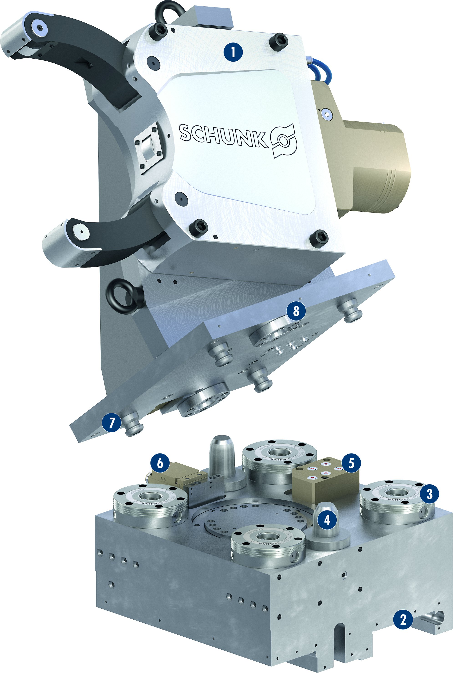
ZENTRICO LSW
1
1
Steady rest
Machine interface
VERO-S NSE plus modules
Centering cones
Media transfer
Inductive monitoring and transfer of the eletrical signal
Clamping pins
Centering ring
2
3
4
8
5
6
7
7
6
5
8
3
4
2

Slide 7



SCHUNK Services
Engineering
Dimensioning of special plates designed to the manufacturing specifications
Development of special solutions together with the customer
FEM analysis for critical components
Testing
Endurance tests with all new developments
Abrasion checking
Measurement of accuracy
Service
Initial operation of customer´s solution
Inspection and maintenance
Repairs

