Slide 1


ROTA NCM-L
Hybrid Chucks

Slide 2














Product overview
Gripping Systems
Clamping Technology
Chuck Jaws
Stationary Workholding
Lathe Chucks
Toolholders
Hydraulic Expansion Technology
Manual Lathe Chucks
Power Lathe Chucks with Jaw Quick-change System
Power Lathe Chucks with Through-hole
Power Lathe Chucks without Through-hole
Pneumatic Power Chucks
Steady Rests
Quick-change Systems
Customized Solutions

Slide 3





ROTA overview
Customized Solutions
ROTA NCM
ROTA NCM-L
ROTA HSA
ROTA DFF
ROTA BEV
ROTA 4B
ROTA HSH

Slide 4
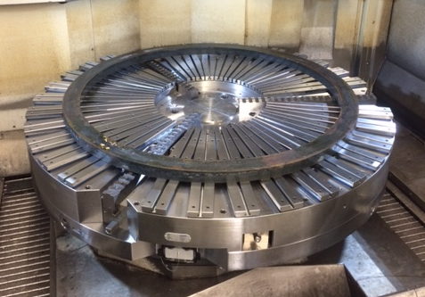
ROTA NCM-L
Example of application
Clamping device:
NCM-L 1600.
Features/Application:
The workpiece is centered via the integrated manual chuck and clamped via the magnetic chuck. Thin-walled rings can be clamped with minimum deformation.

Slide 5
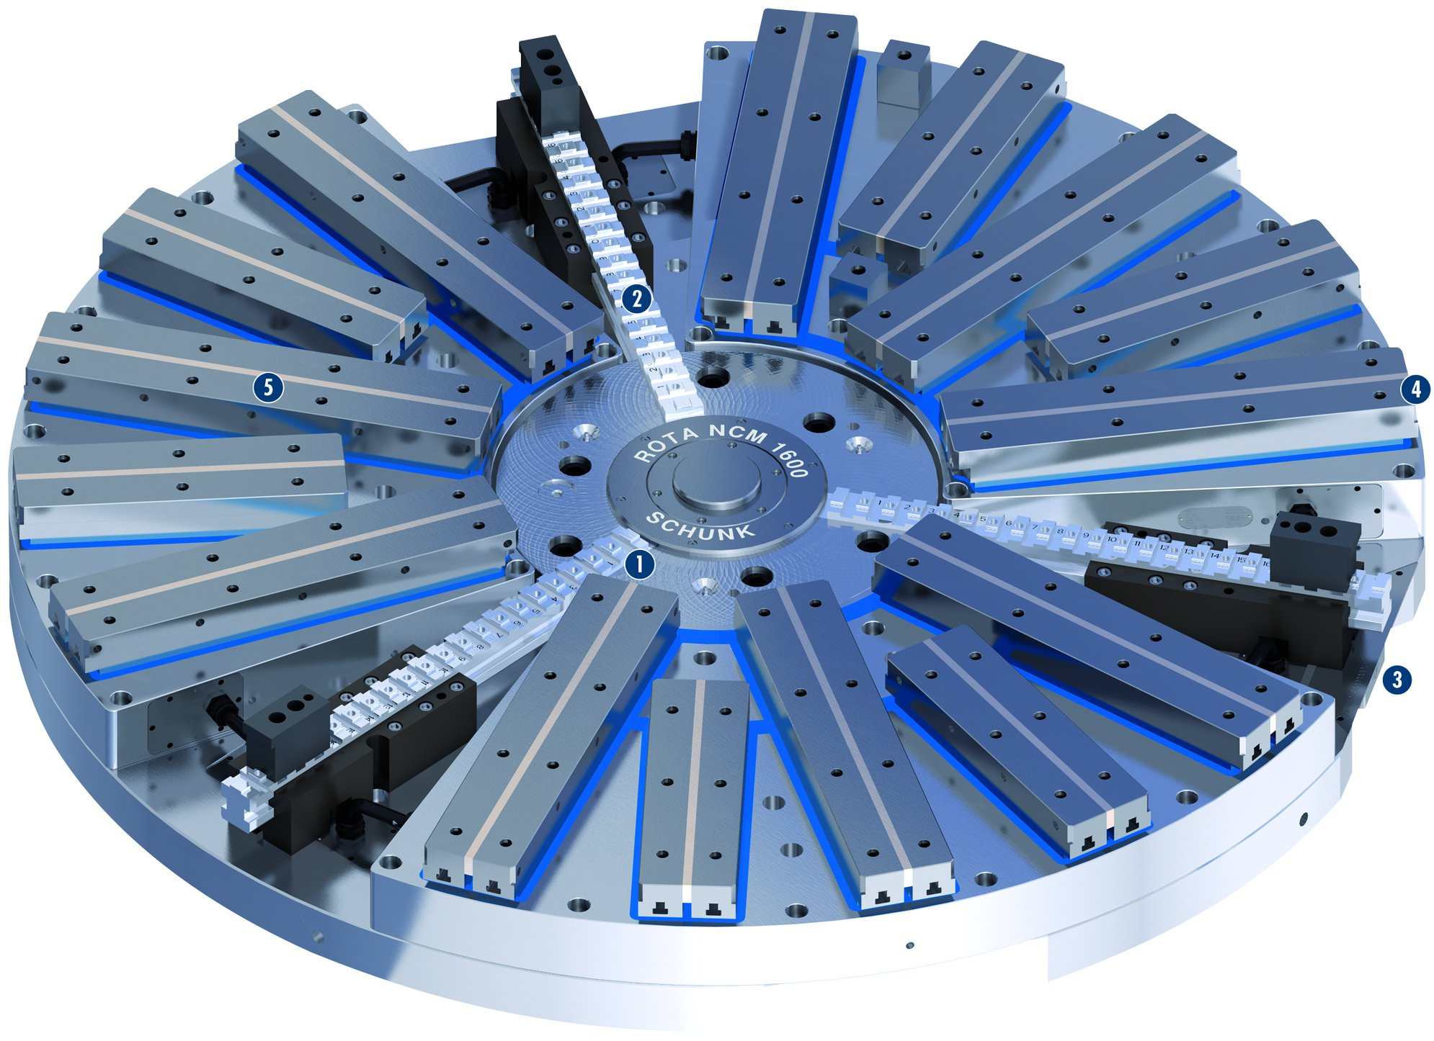
ROTA NCM-L
2
1
Centering chuck type ROTA-S plus
Long base jaws with standard jaw interface
Power supply
Actuation of the ROTA-S plus
Overwound/exchangeable pole shoes
5
4
2
1
3
4
3
5

Slide 6
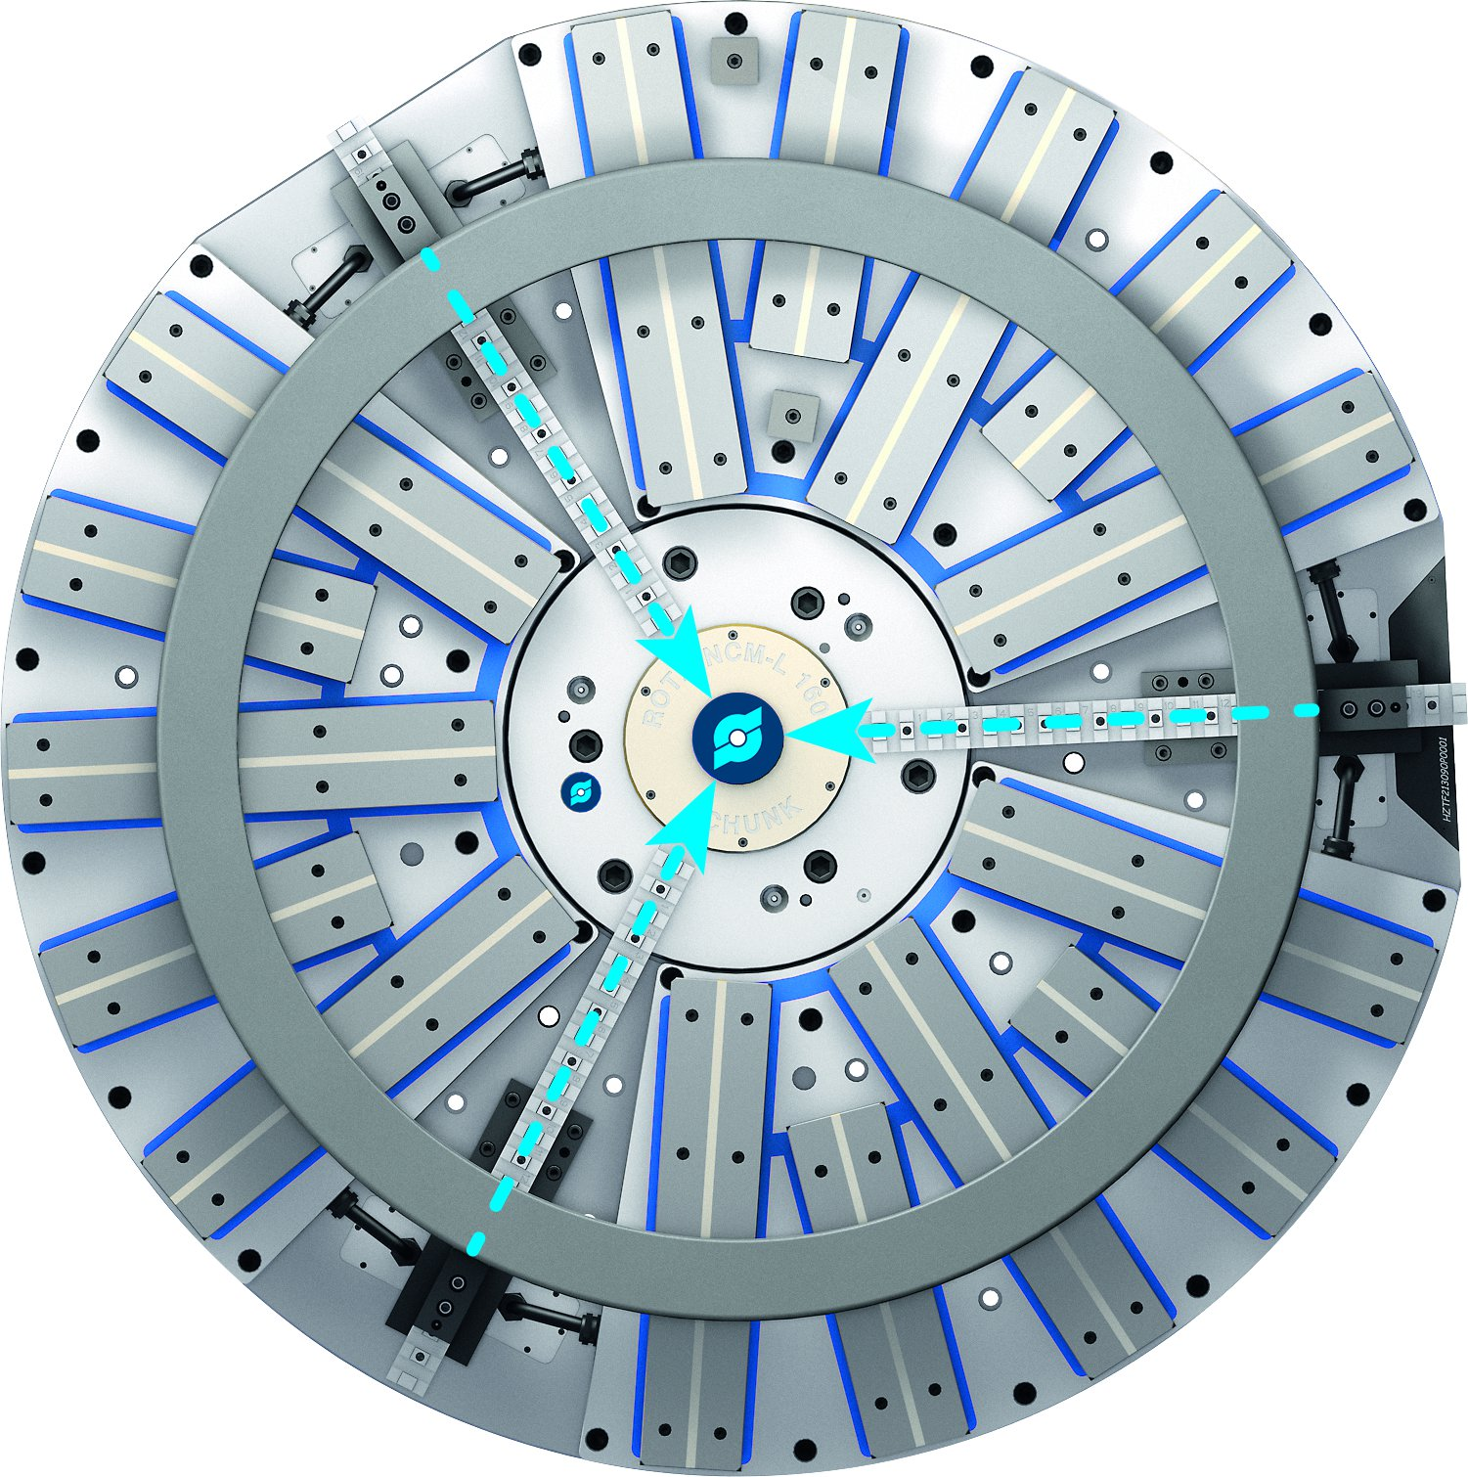
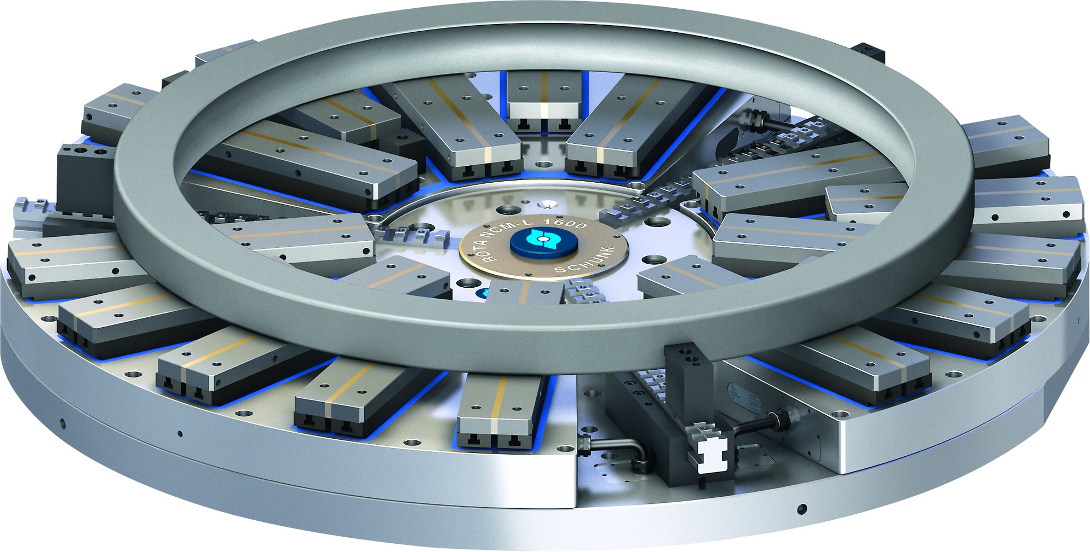
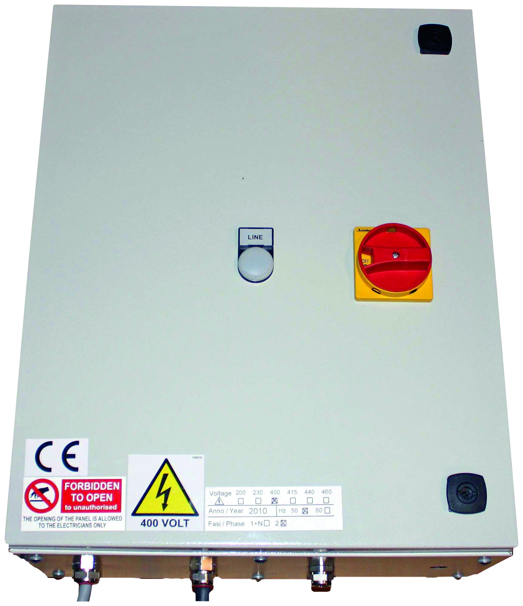
ROTA NCM-L
Secure hold due to permanent magnets and deformation-free clamping
Centered in seconds
Control unit (external)

Slide 7
Variants ROTA NCM-L
Technical Data | Centering force [kN] | Magnet clamping range [mm] | Centering chuck | Number of centering jaws [Nm] | Height [mm]
ROTA NCM-L 630 | 40 | 180-630 | ROTA-S plus 2.0 160 | 3 | 210
ROTA NCM-L 800 | 70 | 220-800 | ROTA-S plus 2.0 200 | 3 | 210
ROTA NCM-L 1000 | 100 | 340-1000 | ROTA-S plus 2.0 315 | 3 | 210
ROTA NCM-L 1500 | 150 | 525-1500 | ROTA-S plus 500 | 3 | 210
ROTA NCM-L 2000 | 150 | 525-2000 | ROTA-S plus 500 | 3 | 210
ROTA NCM-L 2500 | 150 | 525-2500 | ROTA-S plus 500 | 3 | 210

Slide 8




SCHUNK Services
Engineering
Dimensioning of special plates designed to the manufacturing specifications
Development of special solutions together with the customer
FEM analysis for critical components
Testing
Endurance tests with all new developments
Abrasion checking
Measurement of accuracy
Service
Initial operation of customer´s solution
Inspection and maintenance
Repairs

