Slide 1

Product presentation
SGC
Parallel gripper

Slide 2
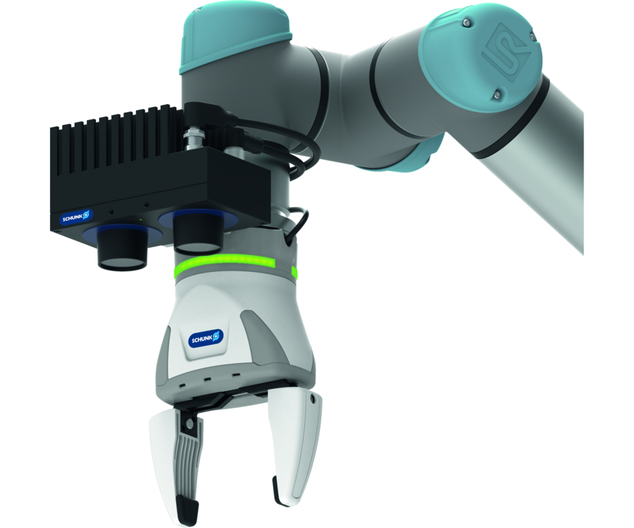
Parallel gripper
Application solution for gripping non position oriented workpieces consisting of camera system and gripper for simple automation with cobots.

Slide 3

Easy. Intelligent. Reliable.

Slide 4
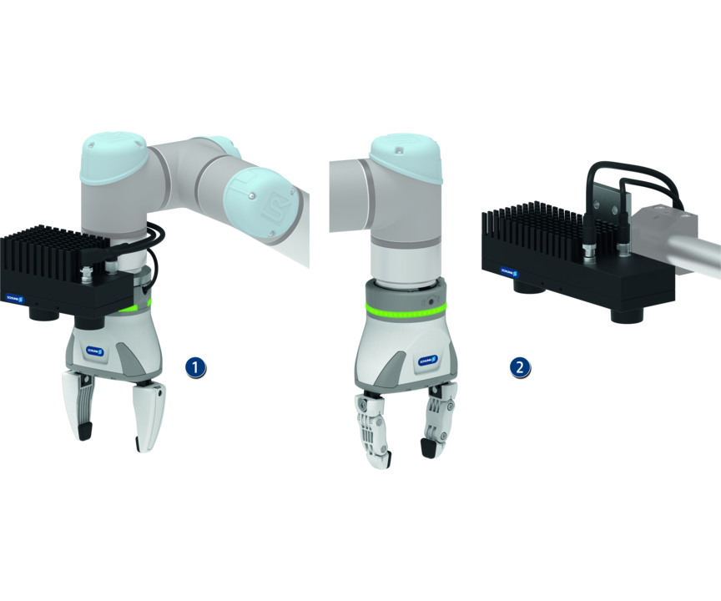
Principle of function
Functional description
The SGC application kit combines intelligent object recognition and flexible gripping in one intuitive set. The camera system reliably detects workpieces on a defined plane, even in poor lighting conditions, and calculates possible grips including collision checks. During workpiece detection, the software function "template matching" is used to search for previously defined objects in a scene. If these are detected, collision-free grips and the approached reference points are automatically calculated, transferred to the robot and the gripper is pre-positioned in the required position.
1
Dynamic Kit SGC-65-EGH-UR-D
2
Static Kit SGC-160-EGH-UR-S

Slide 5
Advantages – Your benefits
Vision and handling expertise from a single source for a reliable complete solution across the entire application
Complete, perfectly attuned set of hardware, software, and service for quick and easy commissioning
Intuitive user interface of the software for easy configuration of the application
Integrated anti-collision device between gripper and transport box for high process reliability and less downtimes
Plug & Work with the interfaces suitable for all robots from Universal Robots
Long and freely programmable gripper stroke for flexible handling of various workpieces

Slide 6
Technical data
Technical data overview
Description | Stroke per jaw | Min. gripping force | Max. gripping force | Max. permissible finger length | Recommended workpiece weight | Weight | Nominal voltage
 | [mm] | [N] | [N] | [mm] | [kg] | [kg] | [V]
SGC 160-EGH-UR-S | 40 | 50 | 100 | 70 | 0.5 | 0.95 | 24
SGC 65-EGH-UR-D | 40 | 50 | 100 | 70 | 0.5 | 0.95 | 24

