Slide 1

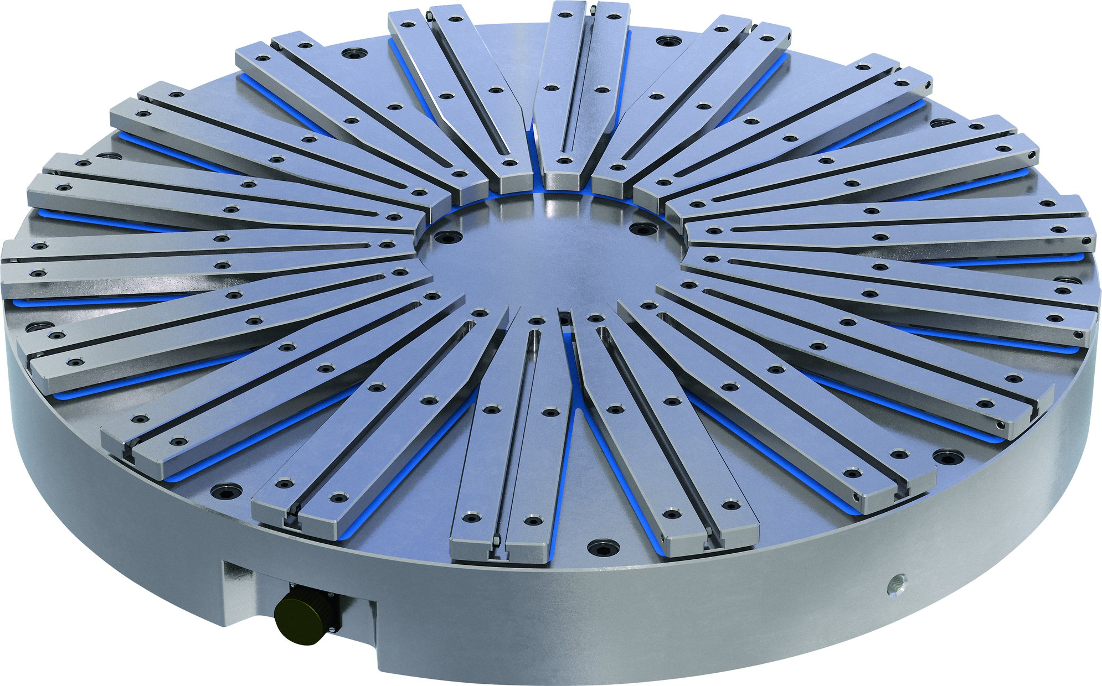
MAGNOS MTR I MGT
Magnetic Clamping Technology

Slide 2












Product Overview
Gripping Systems
Clamping Technology
Chuck Jaws
Lathe Chucks
Stationary Workholding
Toolholders
Hydraulic Expansion Technology
VERO-S
TANDEM
ROTA
KONTEC
Tombstones
MAGNOS

Slide 3



SCHUNK Services
Engineering
Dimensioning of special plates designed to the manufacturing specifications
Development of special solutions together with the customer
FEM analysis for critical components
Testing
Endurance tests with all new developments
Abrasion checking
Measurement of accuracy
Service
Initial operation of customer´s solution
Inspection and maintenance
Repairs

Slide 4
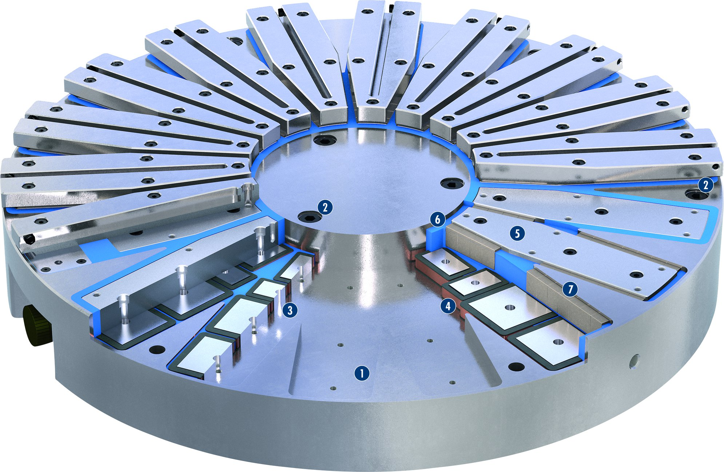
MAGNOS MTR
1
Solid base body
Fastening bore
Invertible AlNiCo magnets
Coil body, insulated version
Steel pole
Synthetic resin grounting
Neodymium magnets
2
3
4
2
5
2
6
6
5
7
7
3
4
1

Slide 5
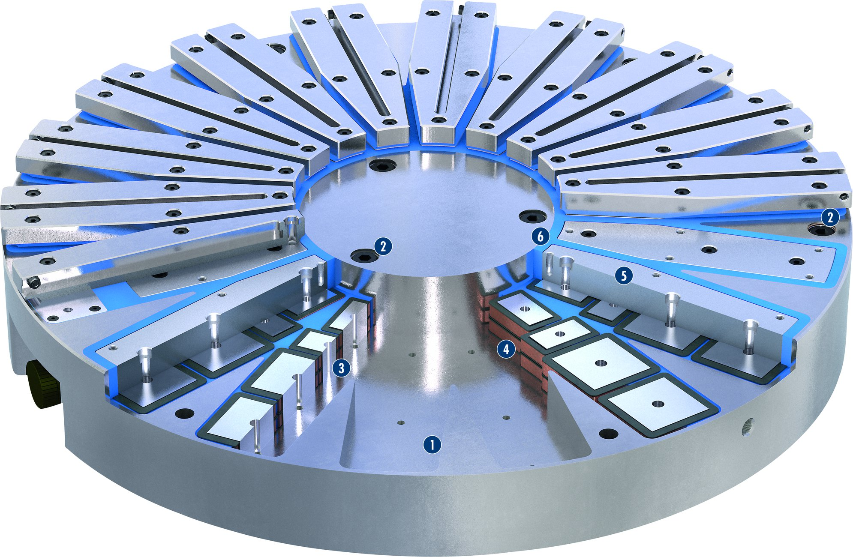
MAGNOS MGT
1
Solid base body
Fastening bore
Invertible AlNiCo magnets
Coil body, insulated version
Steel pole
Synthetic resin grounting
2
3
4
2
5
2
6
6
5
3
4
1

Slide 6
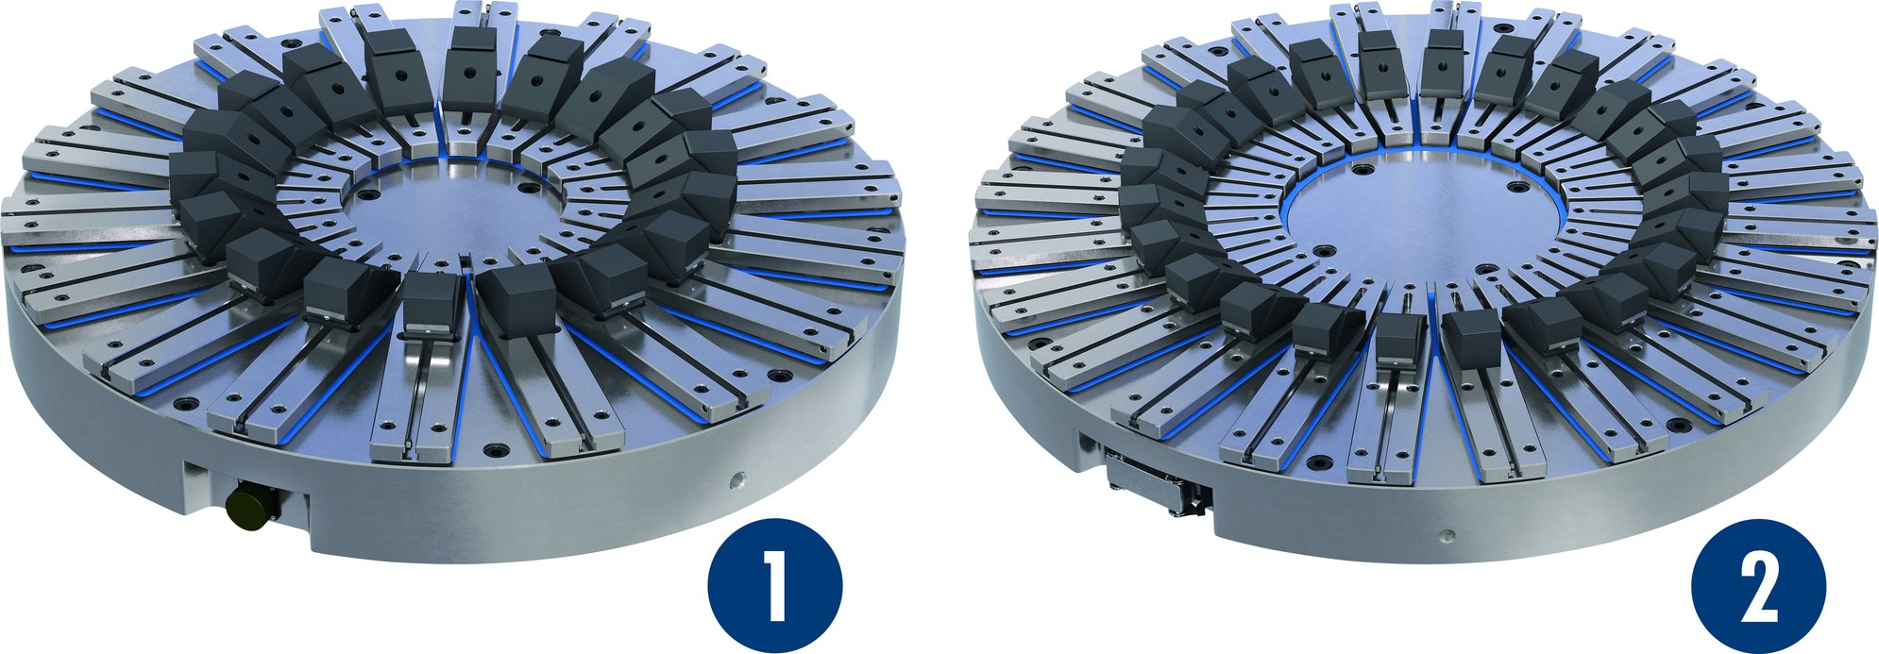
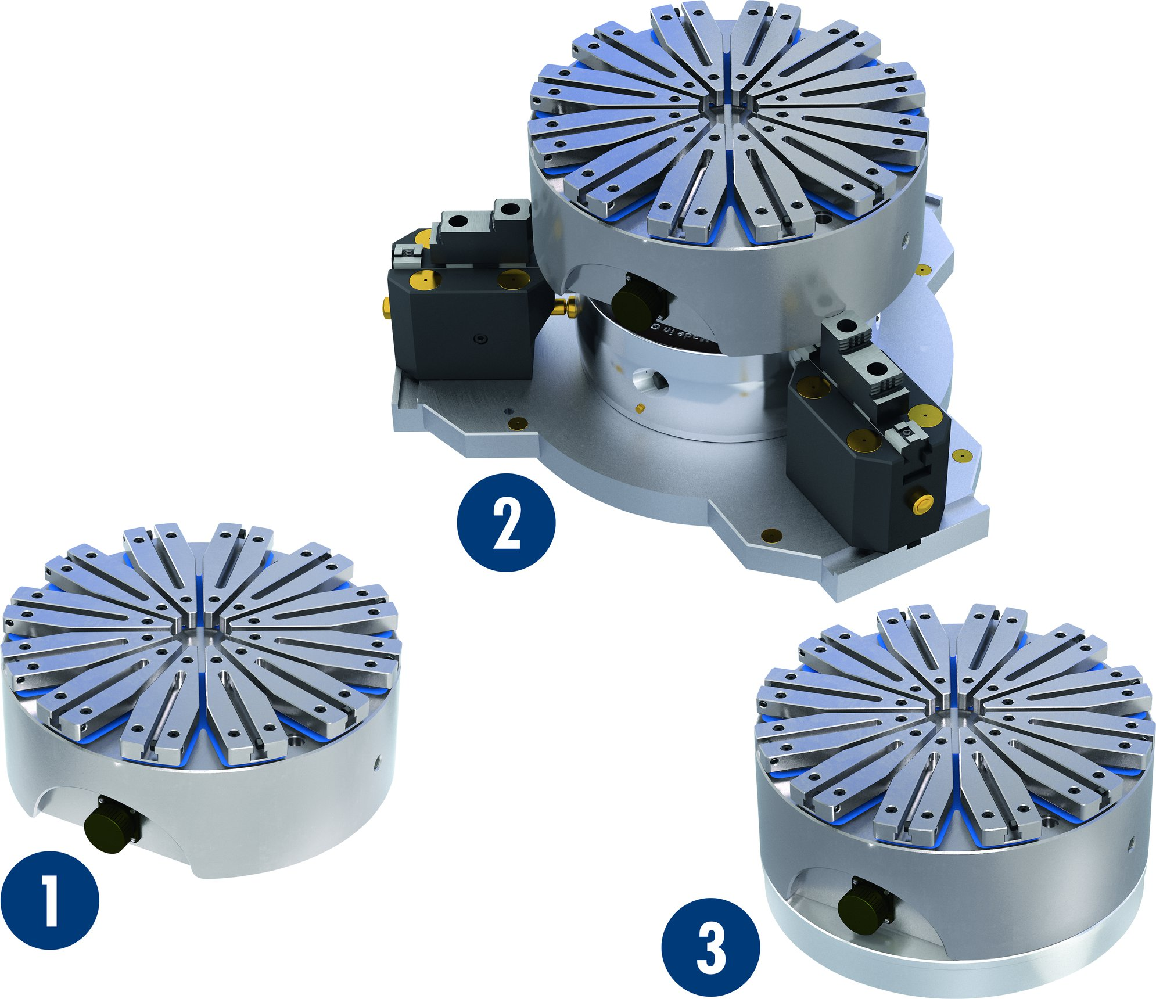
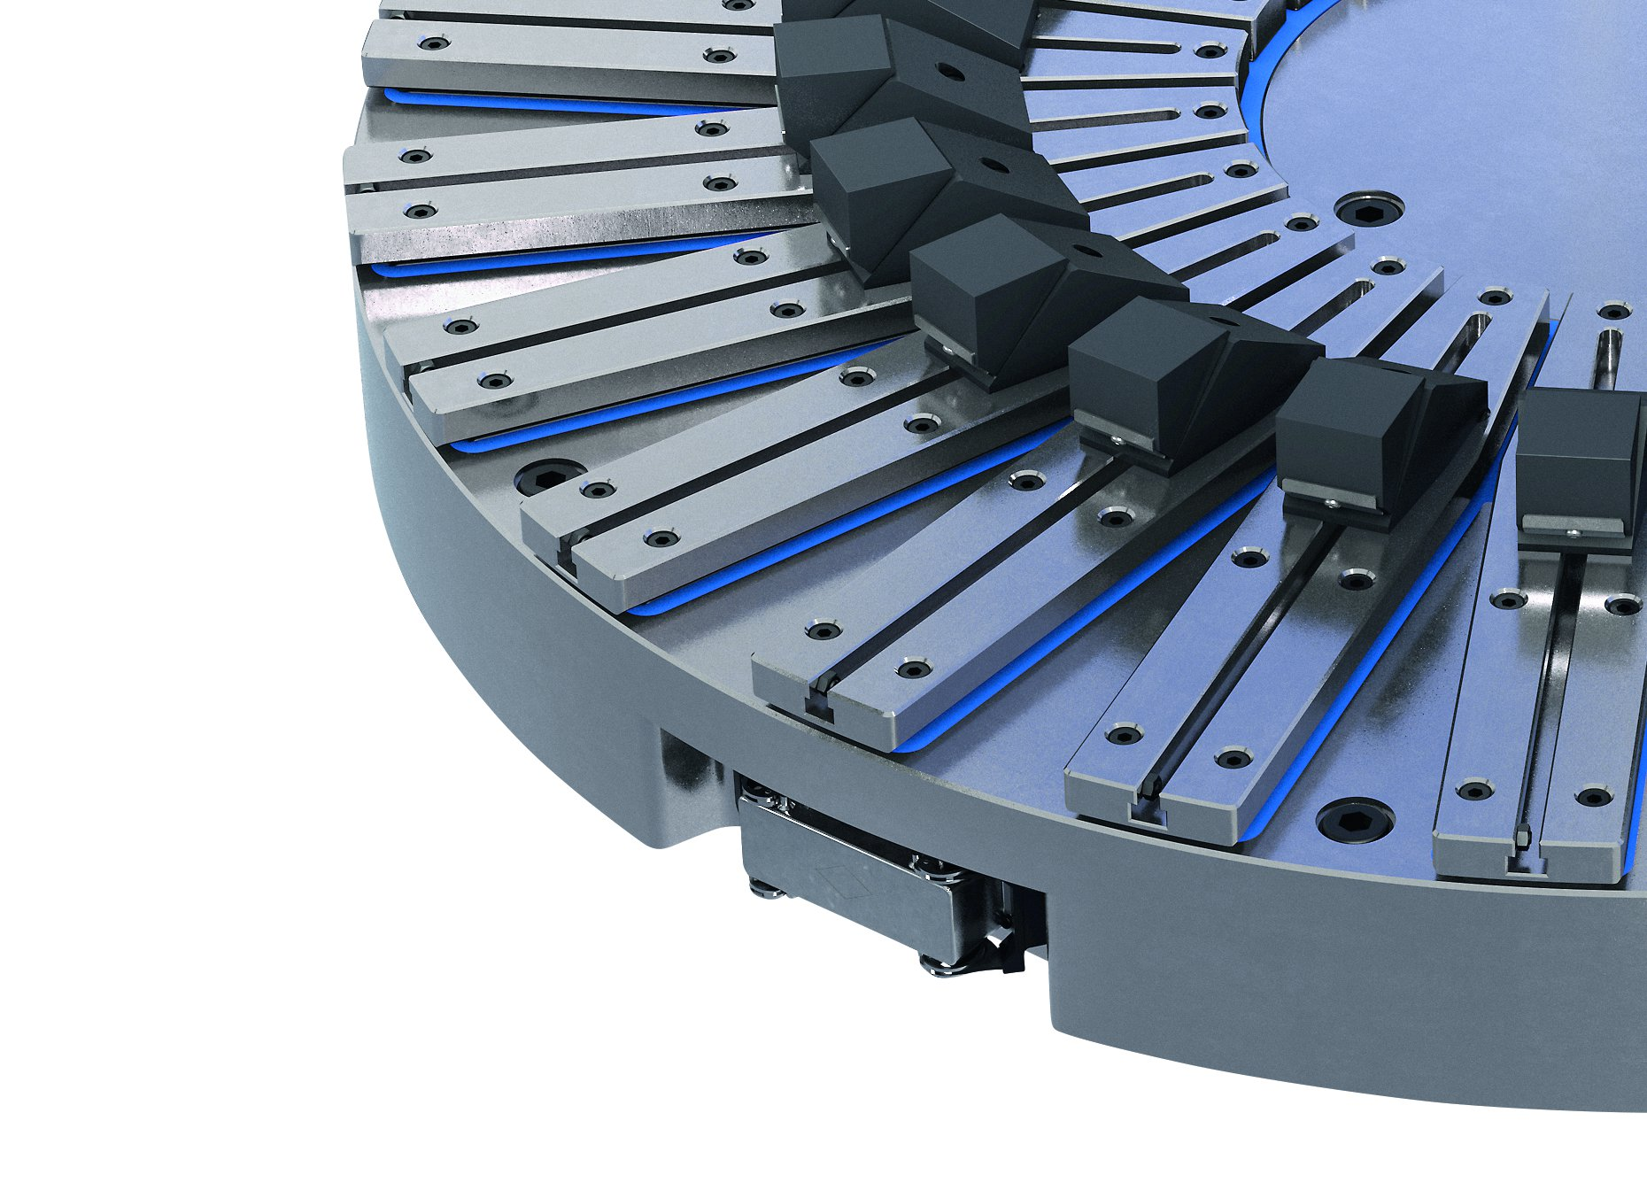
MAGNOS MTR/MGT
Function and mode of operation
Variant IC
1
MTR-IC
MGT-IC
2
1
2
Mounting options
Pole extensions
1
Direct fastening using fastening bores
Fastening to the jaw chuck
Fastening using an adapter flange
2
2
3
1
3

Slide 7

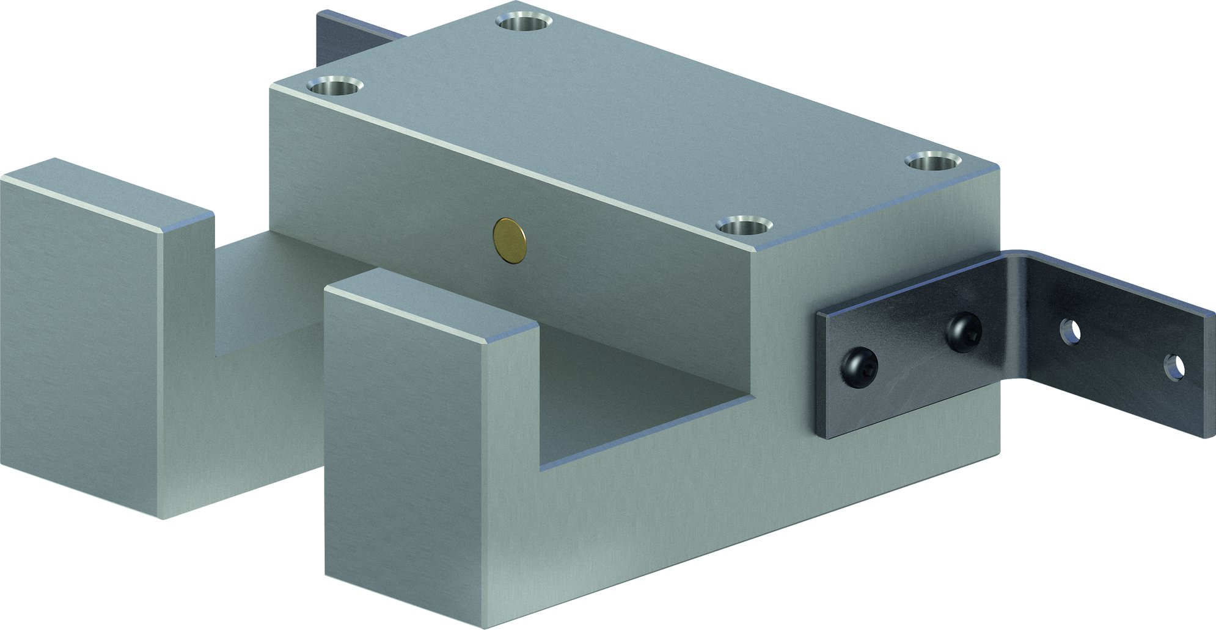
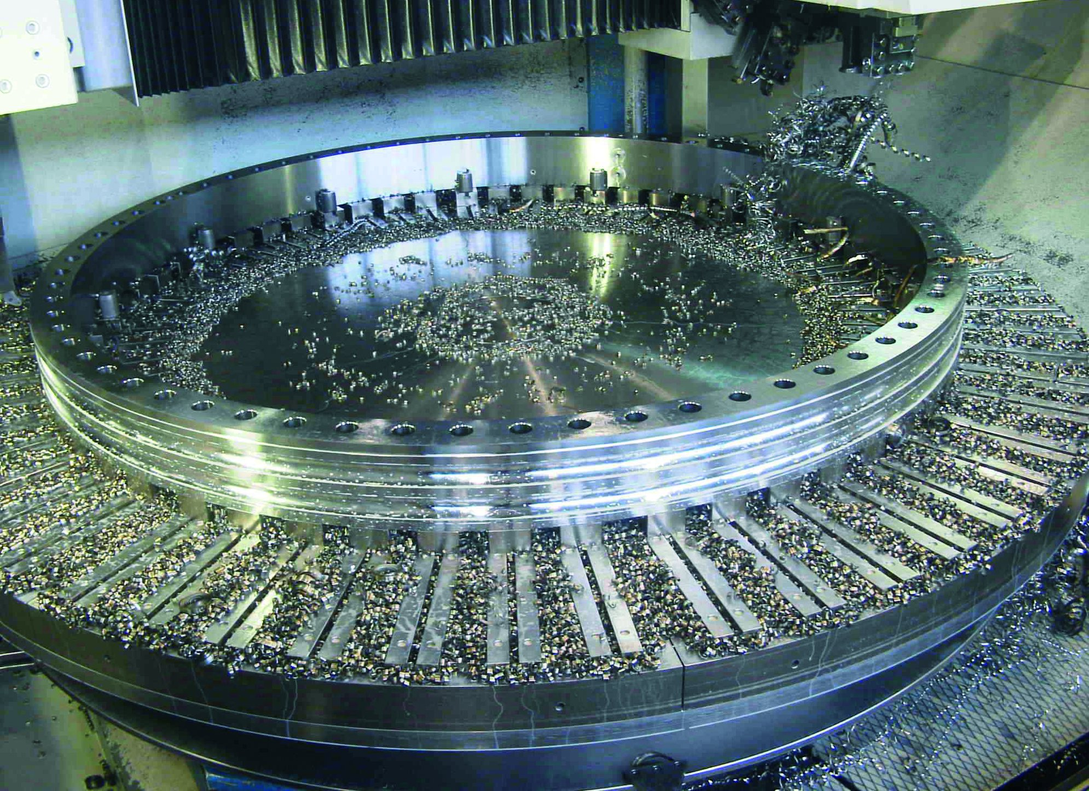
MAGNOS MTR/MGT
Shortest possible set-up times and a resulting increase in productivity
Docking station
Special sizes

Slide 8
Variants of MAGNOS MTR/MGT
Technical data | MTR-IC | MGT-IC
ØAD [mm]
ØID [mm]
H [mm] | 158 / 142 | 158 / 142
Max. clamping force [N/cm²] | 160 | 160
Number of poles | 12 / 18 | 12 / 18 / 24 / 32
Connection | 7-PIN | 7-PIN / ILME
Amount of channels | 1 / 2 | 1 / 3 / 6 / 8
Max. RPM [min⁻¹] | 400 – 1000 | 240 – 650

