Slide 1

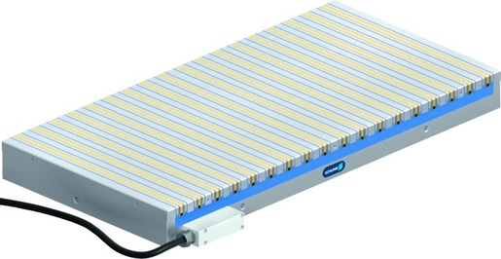
MAGNOS MSC
Magnetic Clamping Technology

Slide 2












Product Overview
Gripping Systems
Clamping Technology
Chuck Jaws
Lathe Chucks
Stationary Workholding
Toolholders
Hydraulic Expansion Technology
VERO-S
TANDEM
ROTA
KONTEC
Tombstones
MAGNOS

Slide 3



SCHUNK Services
Engineering
Dimensioning of special plates designed to the manufacturing specifications
Development of special solutions together with the customer
FEM analysis for critical components
Testing
Endurance tests with all new developments
Abrasion checking
Measurement of accuracy
Service
Initial operation of customer´s solution
Inspection and maintenance
Repairs

Slide 4
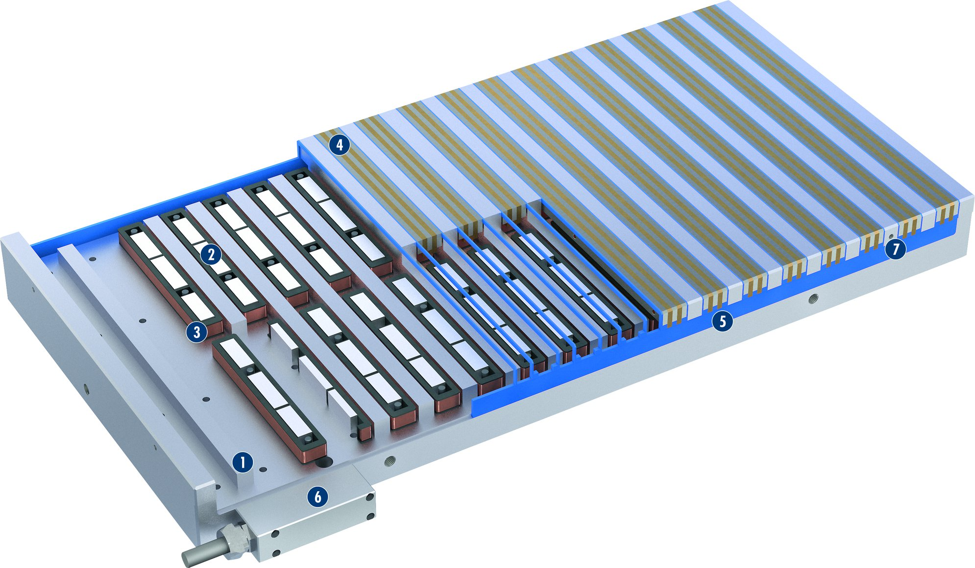
MAGNOS MSC-PM60D
1
Solid base body
Invertible AlNiCo magnets
Coil body, insulated version
Support segments
Synthetic resin grounting
Connection housing
Thread for stops
2
4
3
4
2
7
5
6
3
5
7
1
6

Slide 5
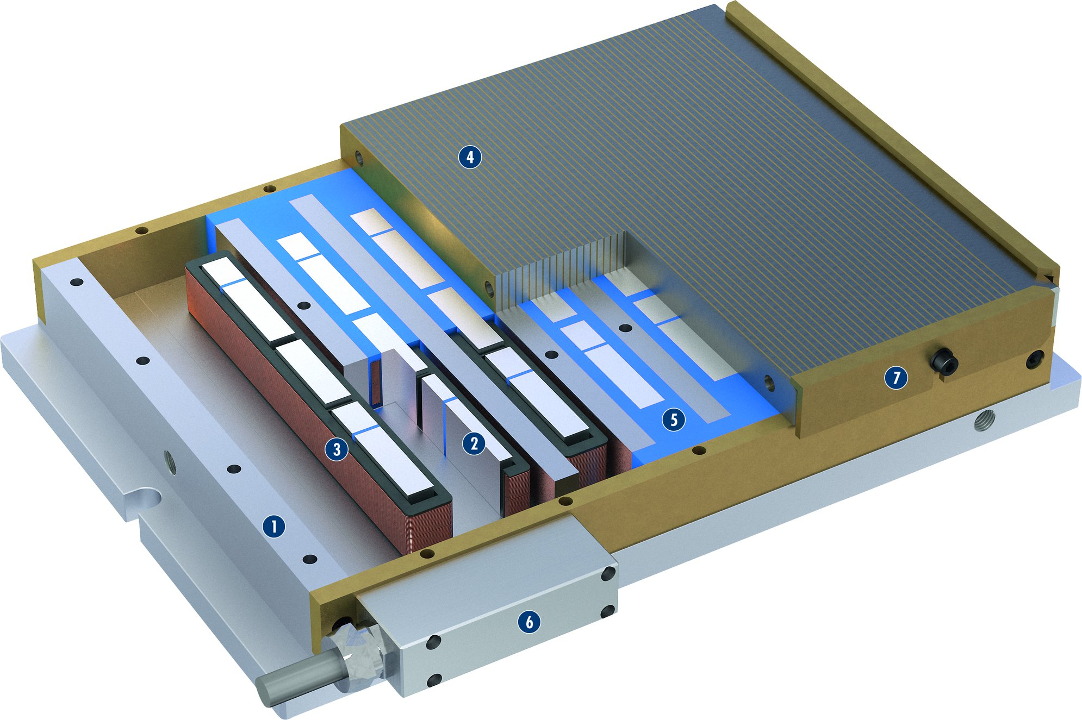
MAGNOS MSC-PM62F
1
Solid base body
Invertible AlNiCo magnets
Coil body, insulated version
Support plate
Synthetic resin grounting
Connection housing
Workpiece stop bar
2
4
3
4
5
6
7
7
2
5
3
1
6

Slide 6
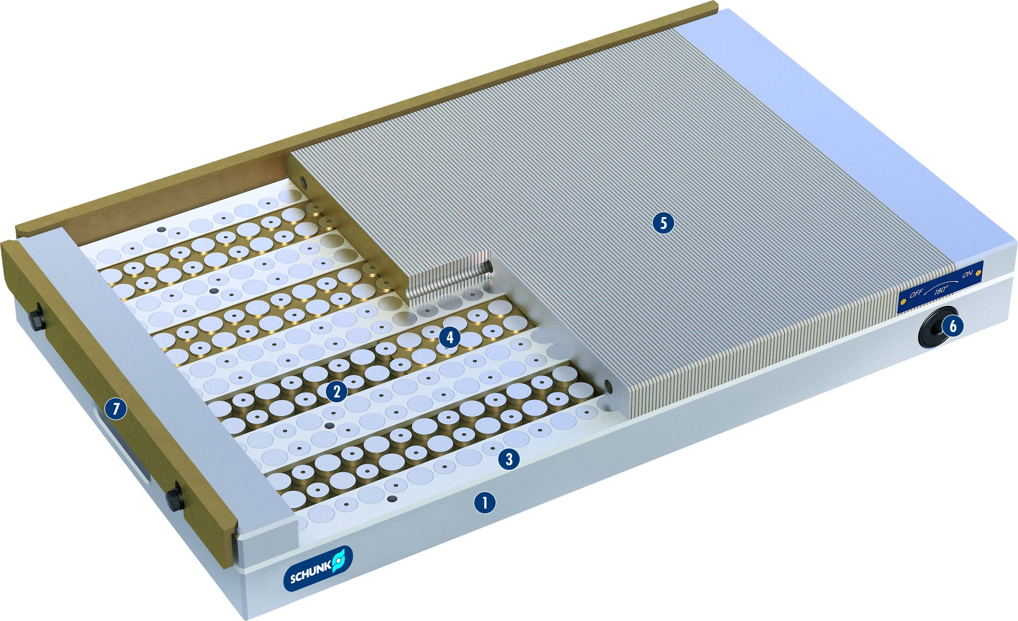
MAGNOS MSC-PM15
1
Solid base body
Permanent magnets with different polarity
Aluminum segments
Brass segments
Support plate
Connection with hexagon socket
Workpiece stop bar
2
3
5
4
5
4
6
6
7
2
7
3
1

Slide 7
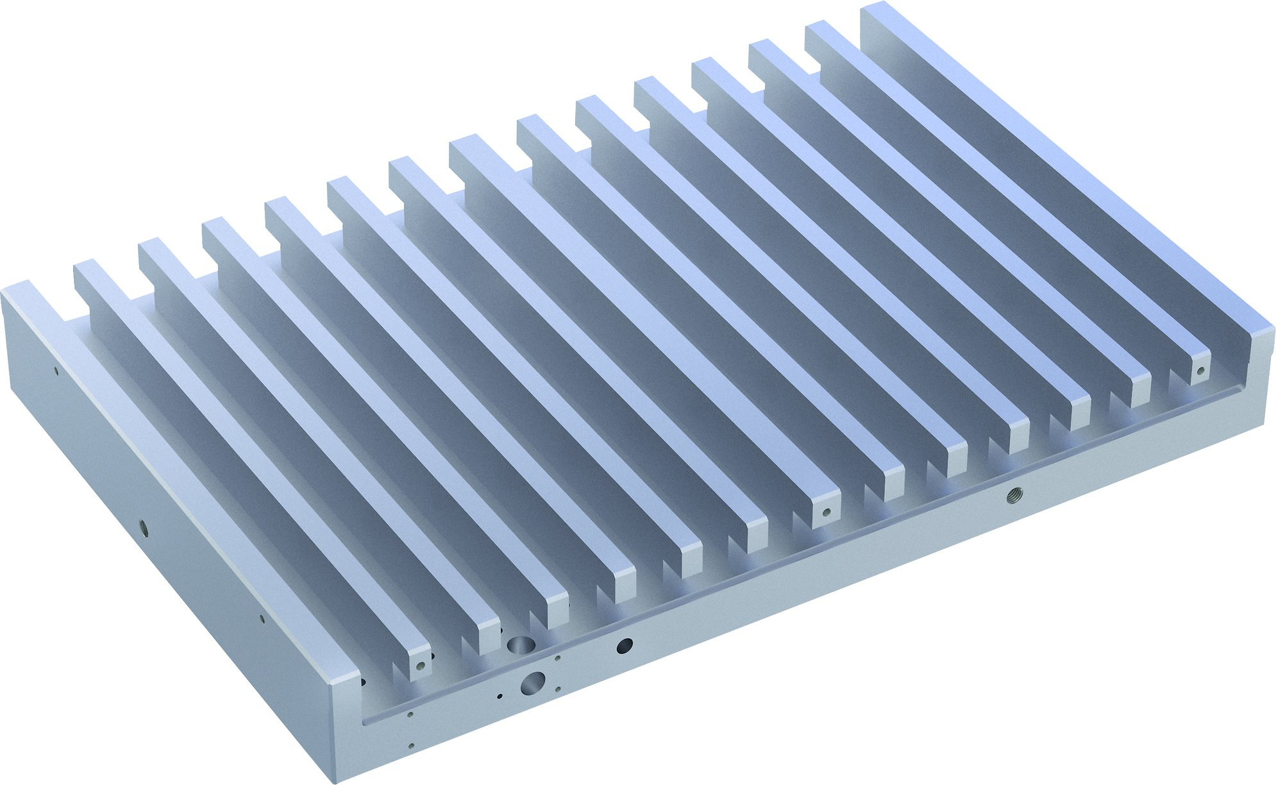
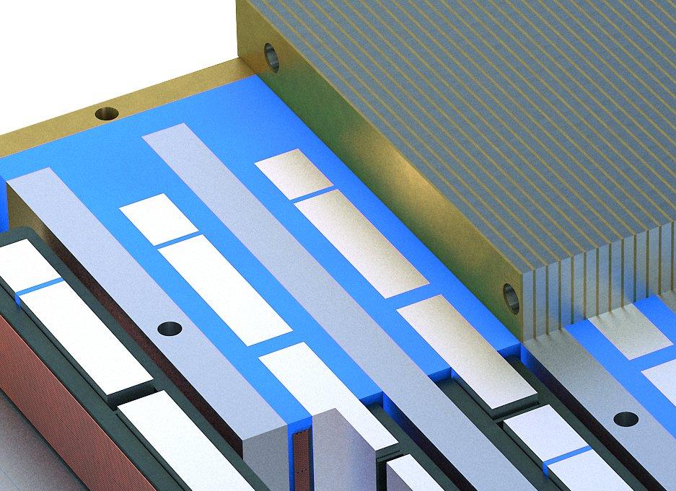
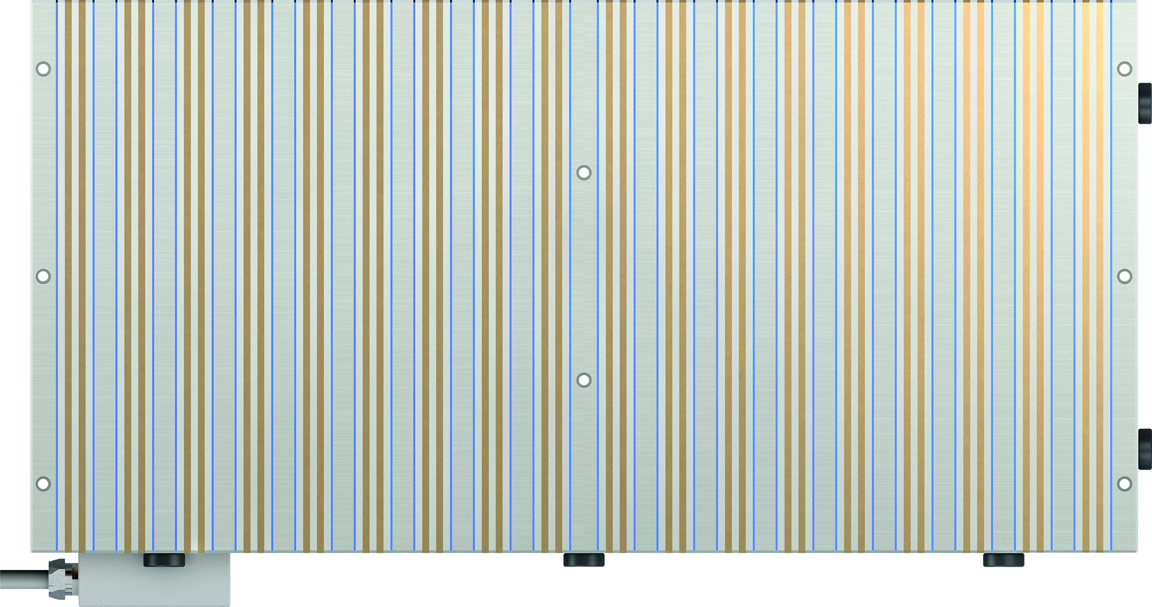
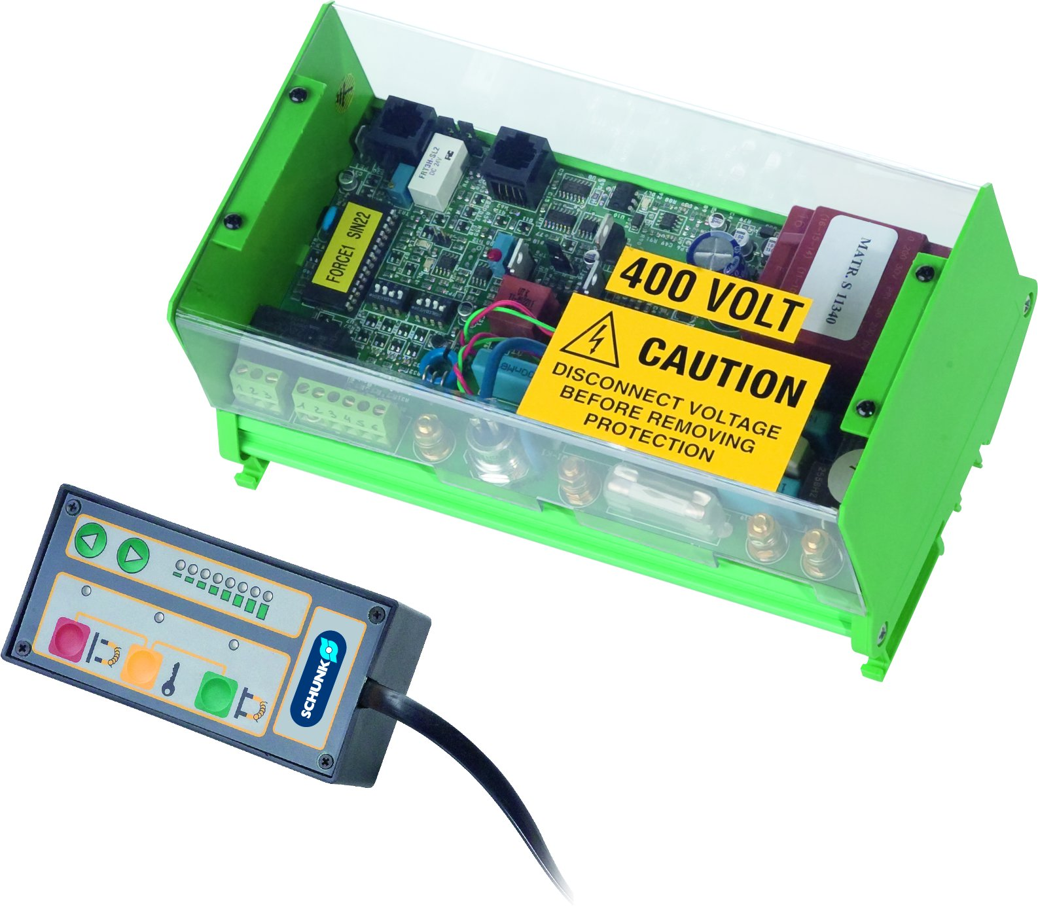
MAGNOS MSC
Solid base body
Synthetic resin filling
Through-bores
KEH P control unit

Slide 8

Variants of MAGNOS MSC
Technical data | MSC-PM60D | MSC-PM62F | MSC-PM15 | MSC-PM35
L [mm]
B [mm]
H [mm] | 71 | 81 | 52 / 60 | 68 / 78
Max. clamping force [N/cm²] | 75 | 75 | 75 | 80
Pole pitch | 5 mm + 5 mm | 3 mm + 0.8 mm | 1.5 mm + 0.8 mm
Number of poles |  |  |  | 10, 12, 14, 18
Connection | 4-PIN | 4-PIN
Amount of channels | 1 | 1

