Slide 1

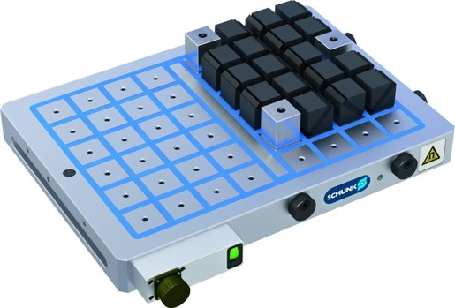
MAGNOS MFRS
Magnetic Clamping Technology

Slide 2












Product Overview
Gripping Systems
Clamping Technology
Chuck Jaws
Lathe Chucks
Stationary Workholding
Toolholders
Hydraulic Expansion Technology
VERO-S
TANDEM
ROTA
KONTEC
Tombstones
MAGNOS

Slide 3



SCHUNK Services
Engineering
Dimensioning of special plates designed to the manufacturing specifications
Development of special solutions together with the customer
FEM analysis for critical components
Testing
Endurance tests with all new developments
Abrasion checking
Measurement of accuracy
Service
Initial operation of customer´s solution
Inspection and maintenance
Repairs

Slide 4
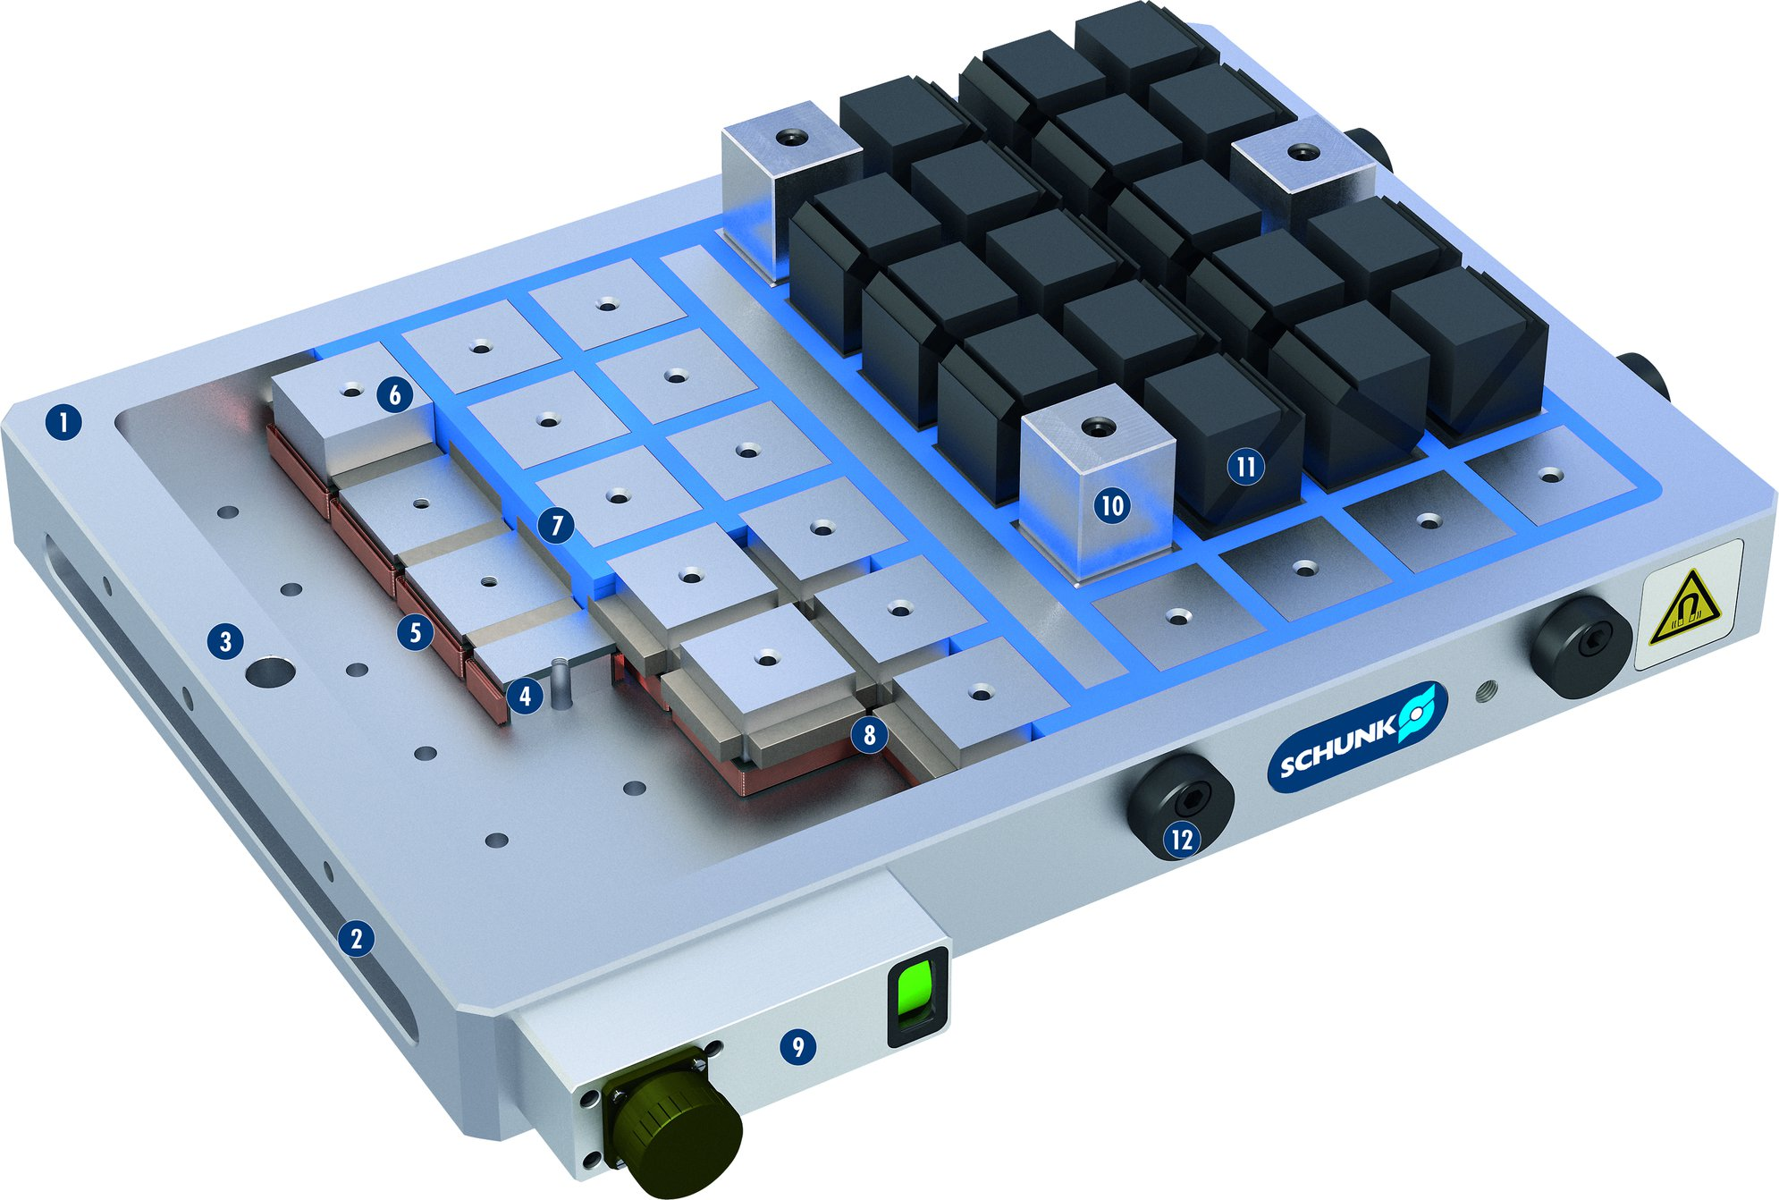
MAGNOS MFRS
1
Solid base body
Mounting groove
Fastening bore
Invertible AlNiCo magnets
Coil body, insulated version
Steel pole
Synthetic resin grounting
Neodymium magnets
Connection housing with status display
Fixed pole extensions
Flexible pole extensions
2
3
6
4
1
11
5
7
10
6
3
5
7
4
8
8
9
2
10
9
11

Slide 5
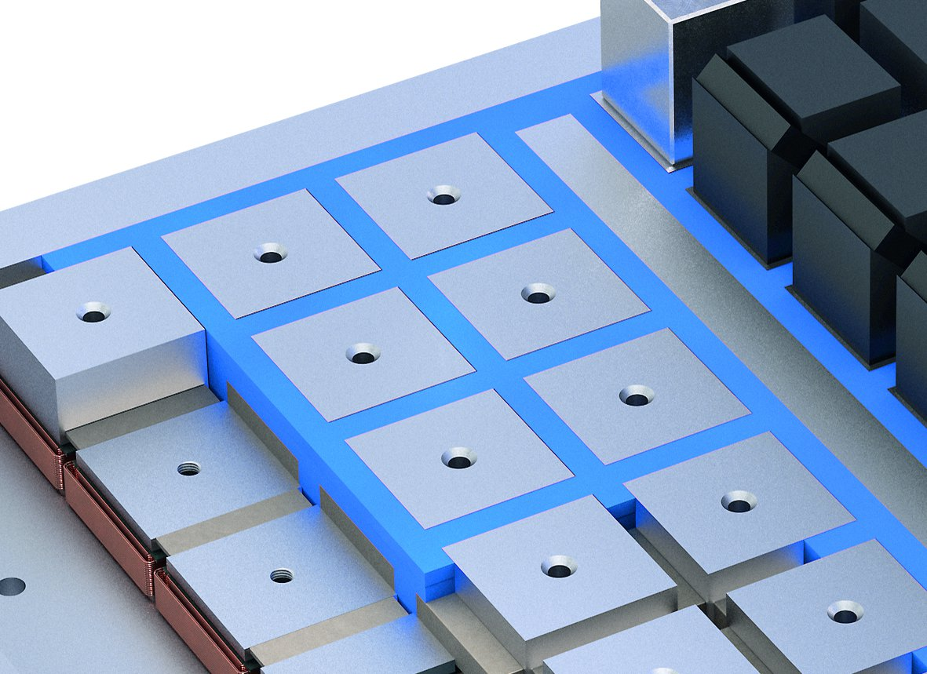
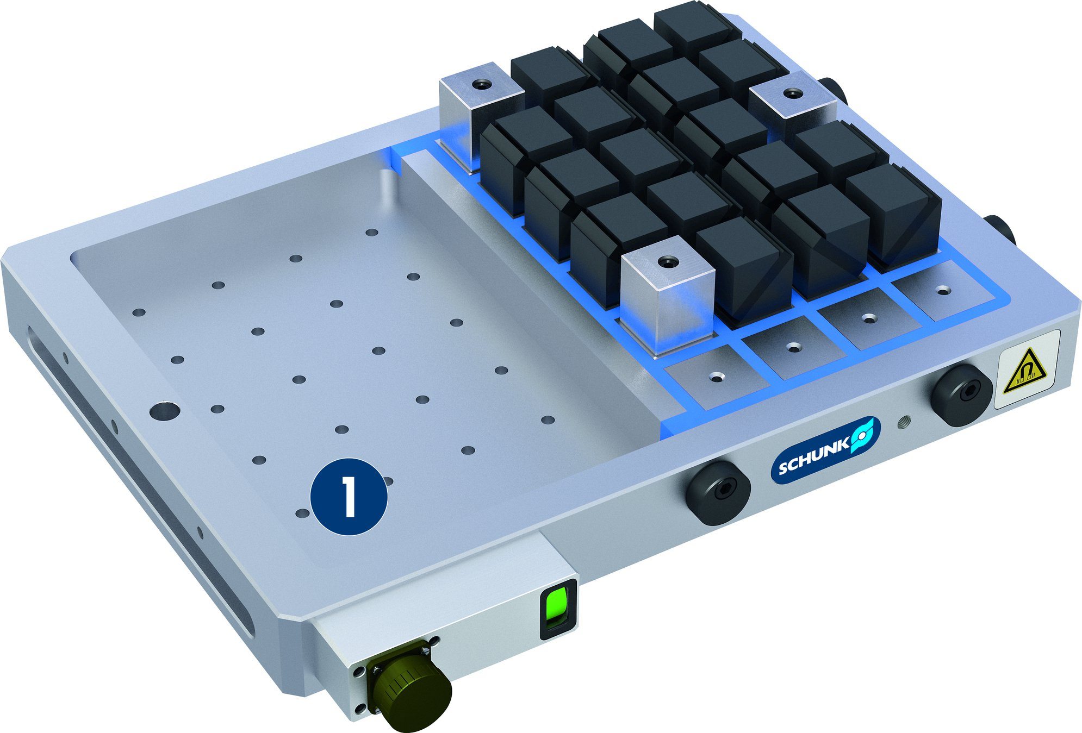
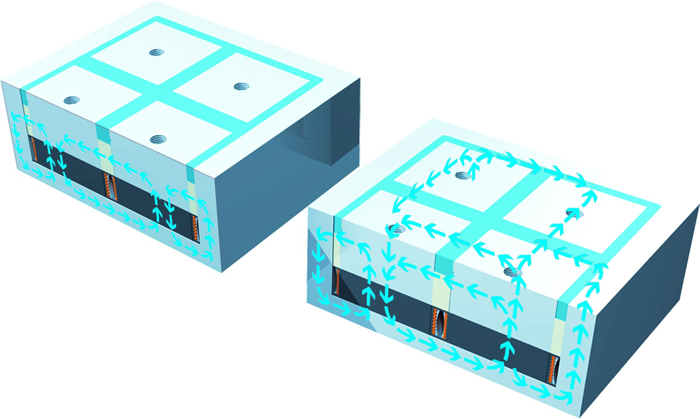
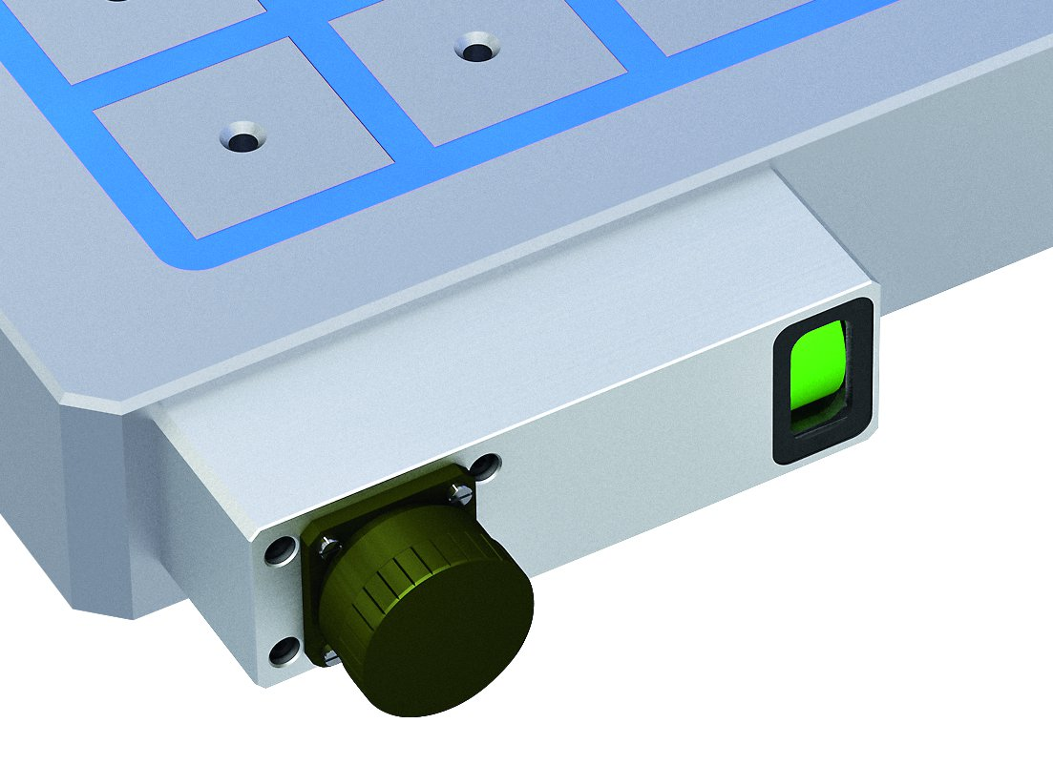
MAGNOS MFRS
Solid base body
Synthetic resin filling
1
1
Monoblock design of the base body
Magnetic double cycle
Visual display – MAG status

Slide 6
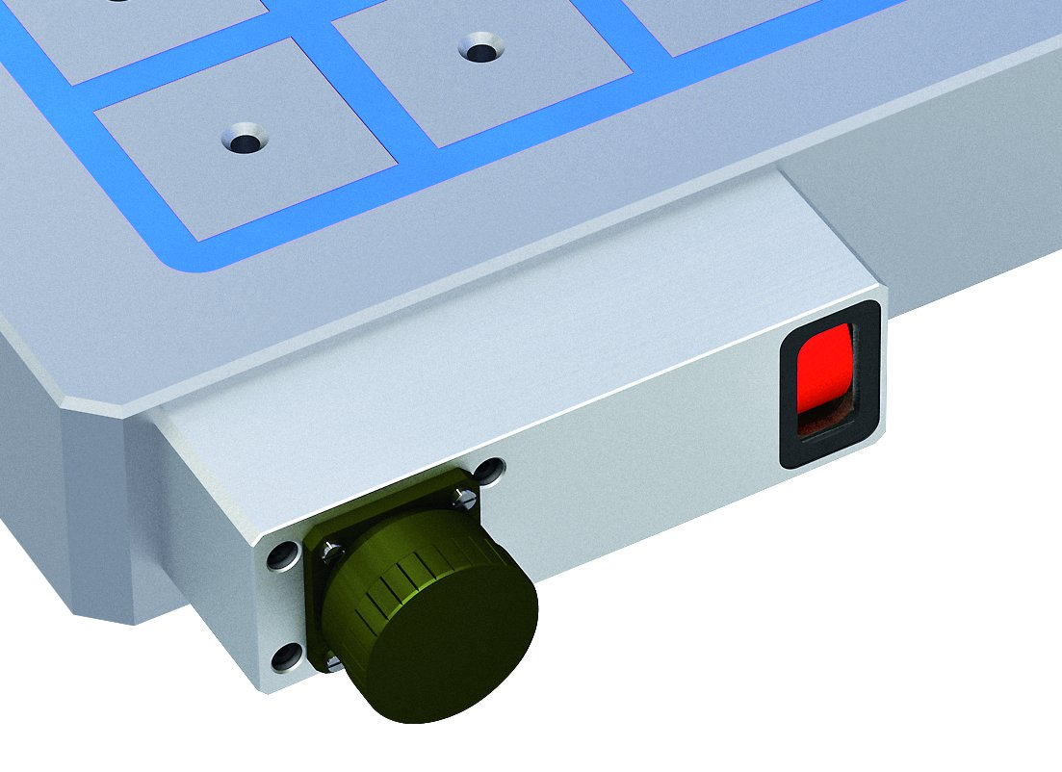
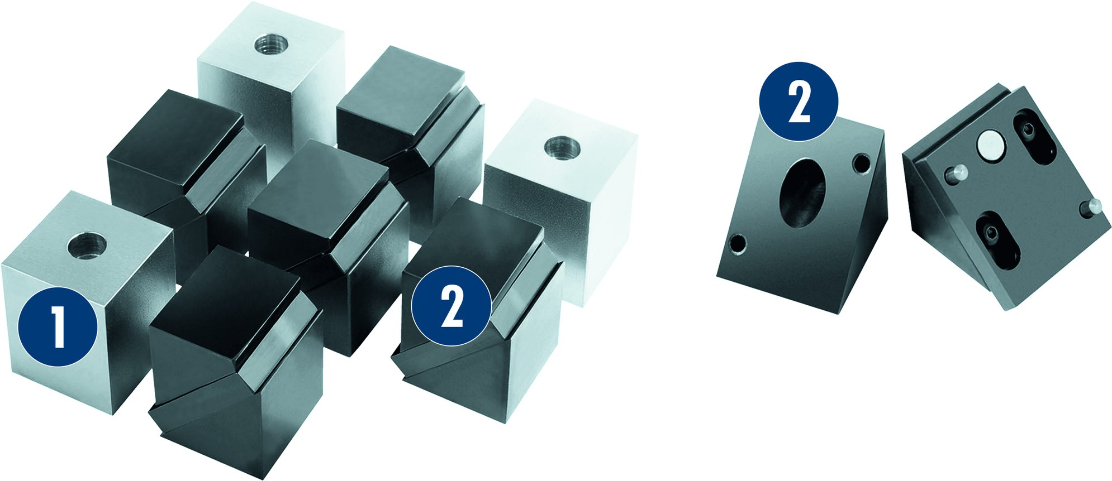
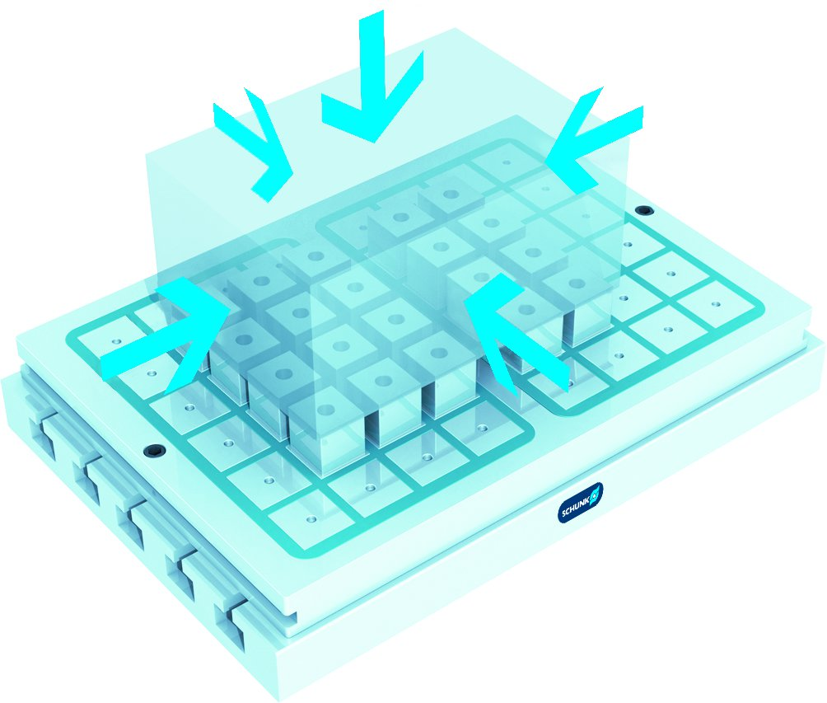
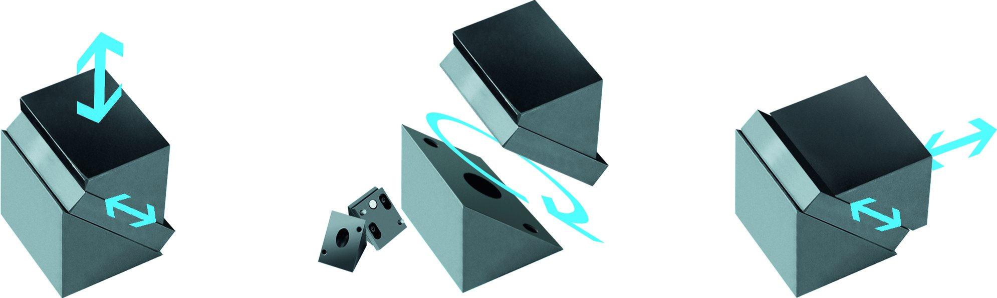
MAGNOS MFRS
Visual display – DEMAG status
Perfect support for workpieces
1
Fixed pole extensions
Flexible EASYTURN pole extensions
2
2
1
2
EASYTURN pole extensions – for vertical or horizontal use
5-sided workpiece machining in one set-up

Slide 7
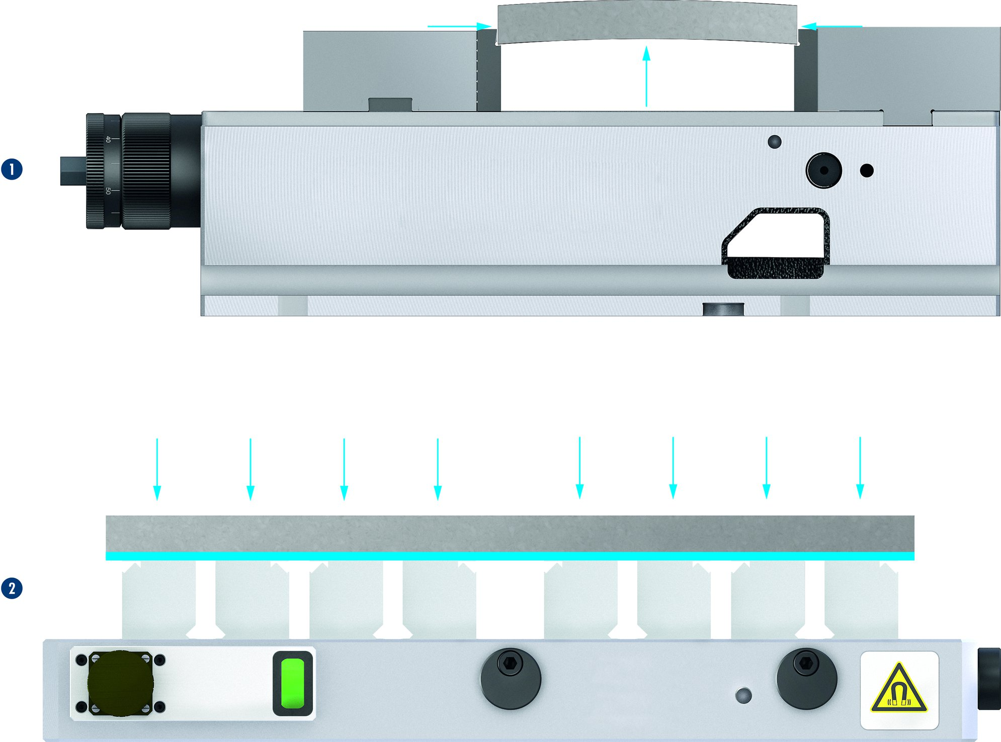
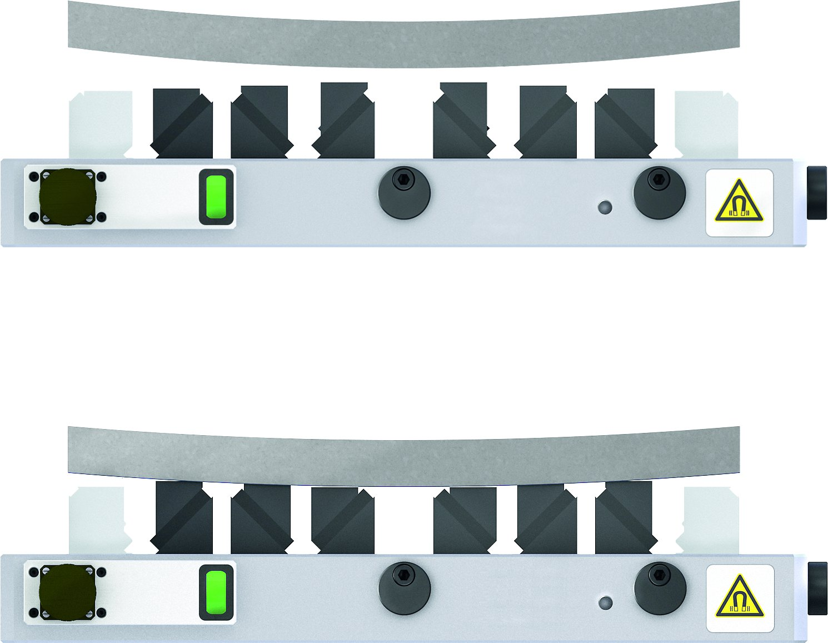

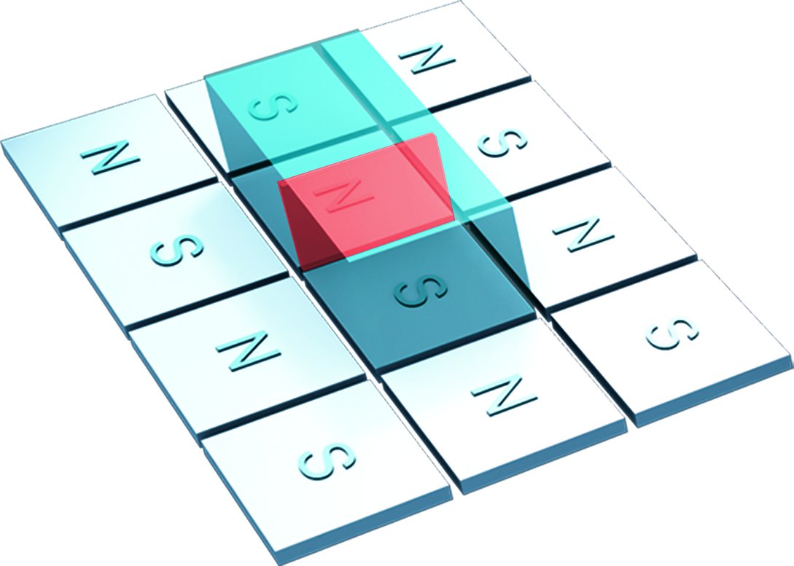
MAGNOS MFRS
No deformation due to gentle clamping
Adapts perfectly to the contours of the workpiece
1
Workpiece clamping with conventional clamping devices
Workpiece clamping with MAGNOS
1
2
2
Shortest possible set-up times and a resulting increase in productivity
Increasing clamping force by covering poles – two poles

Slide 8
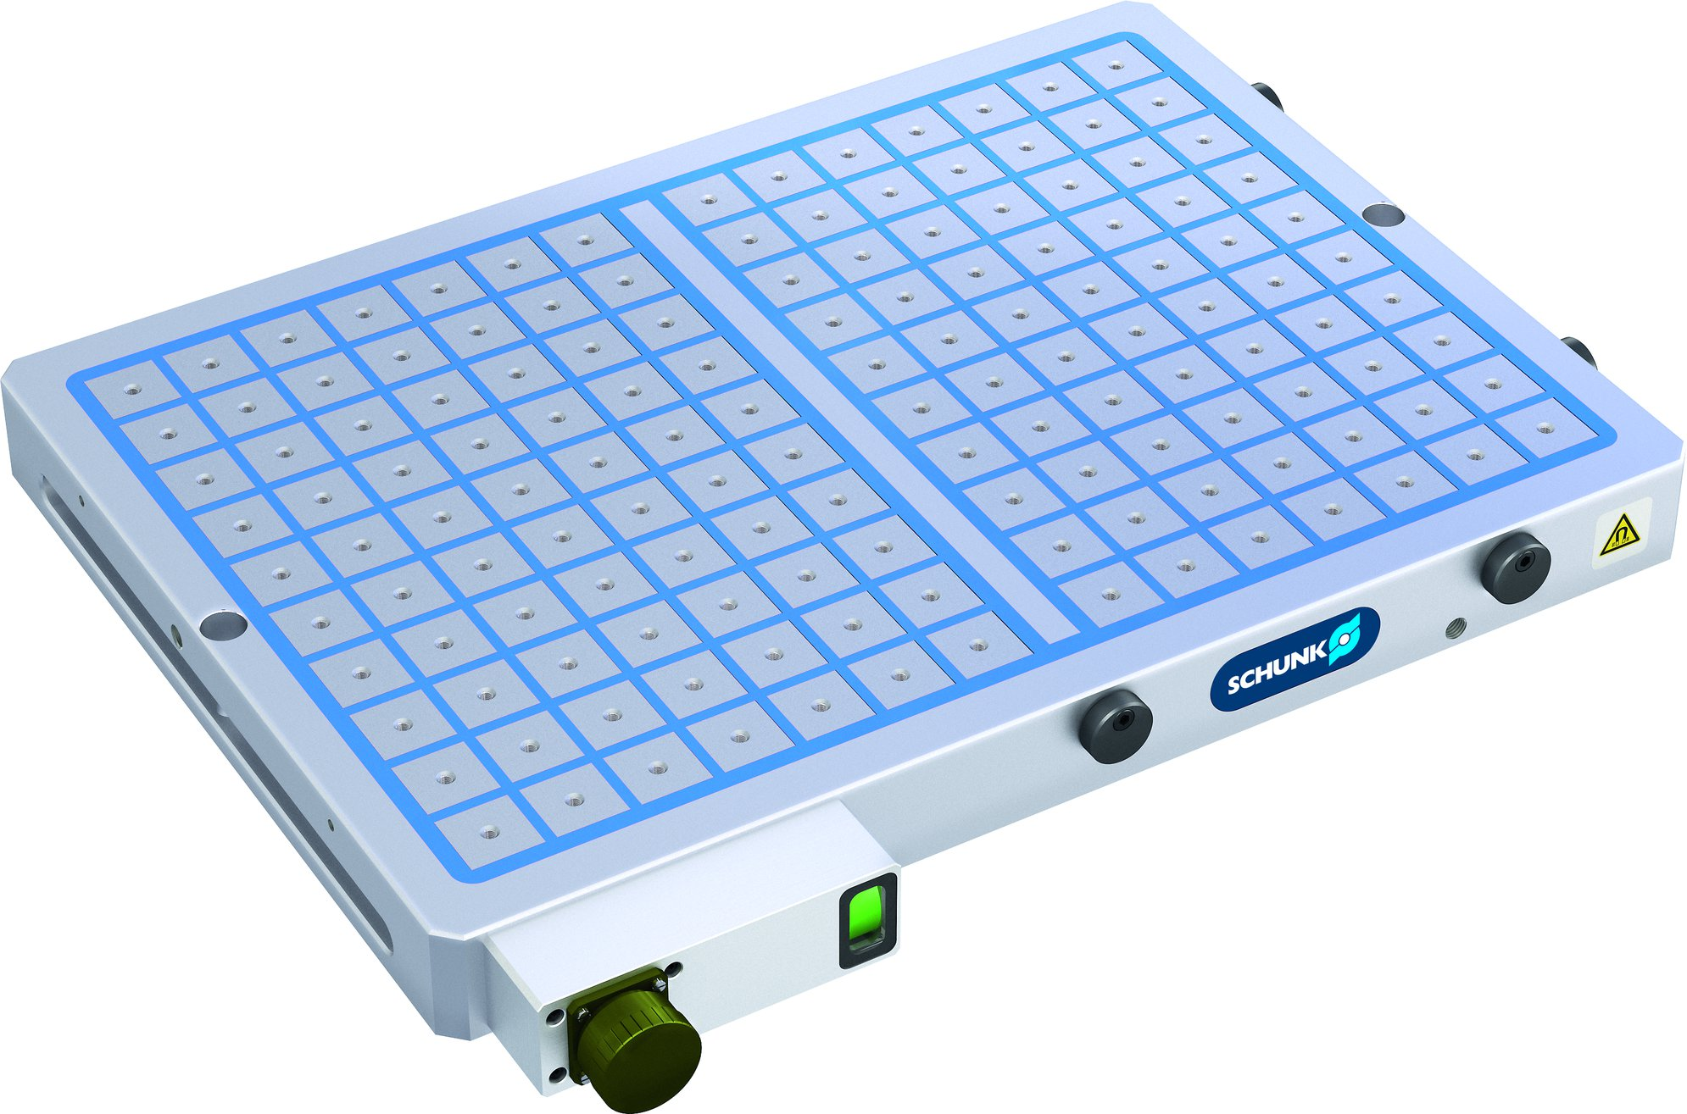
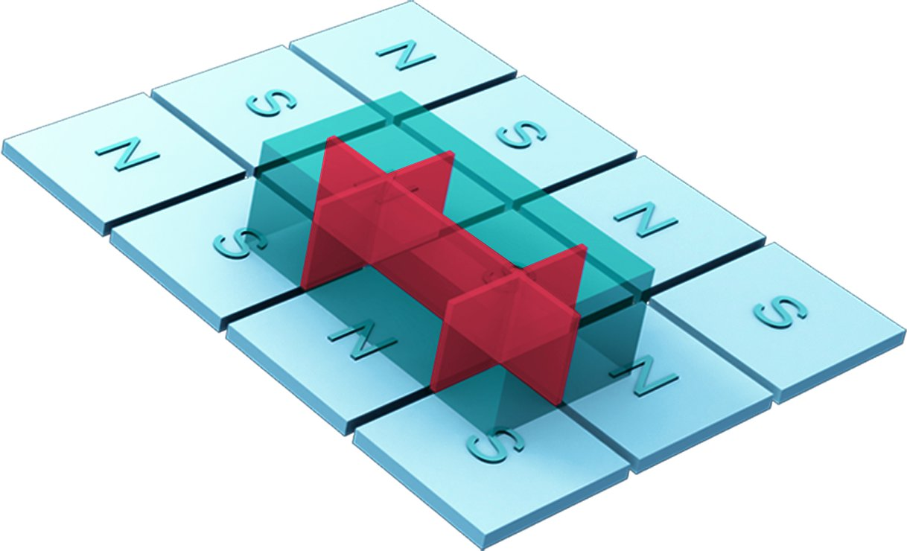
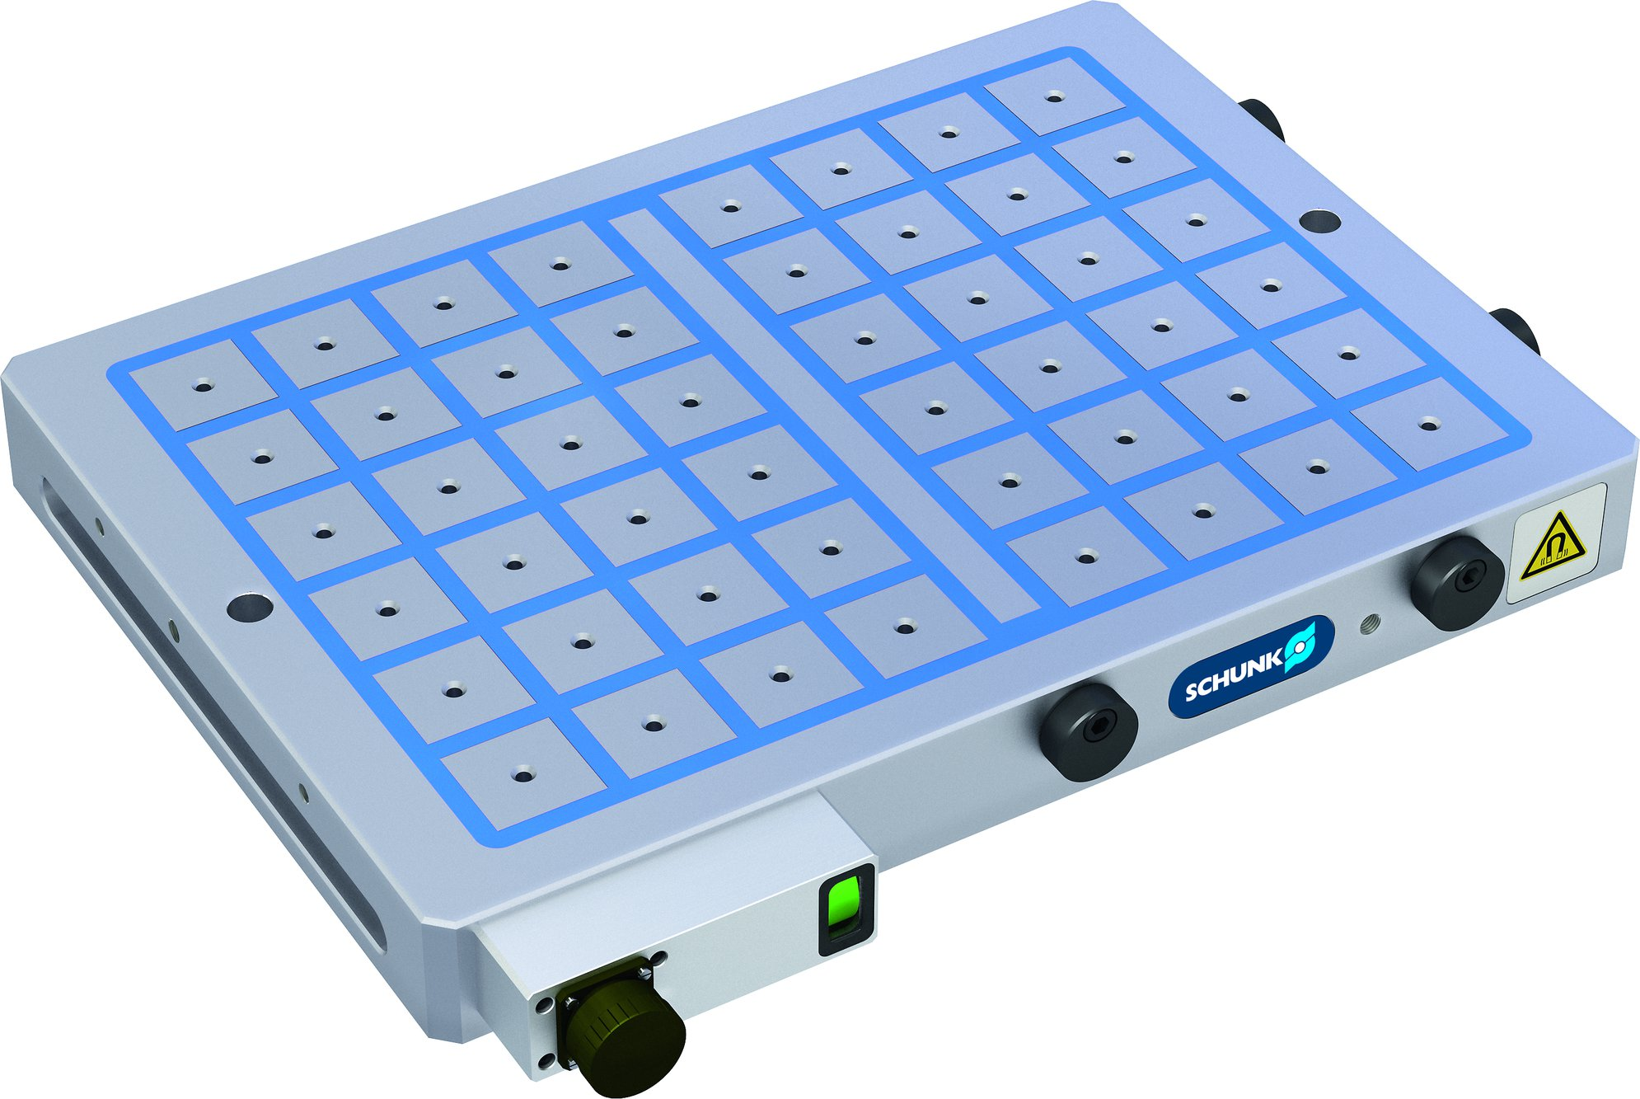
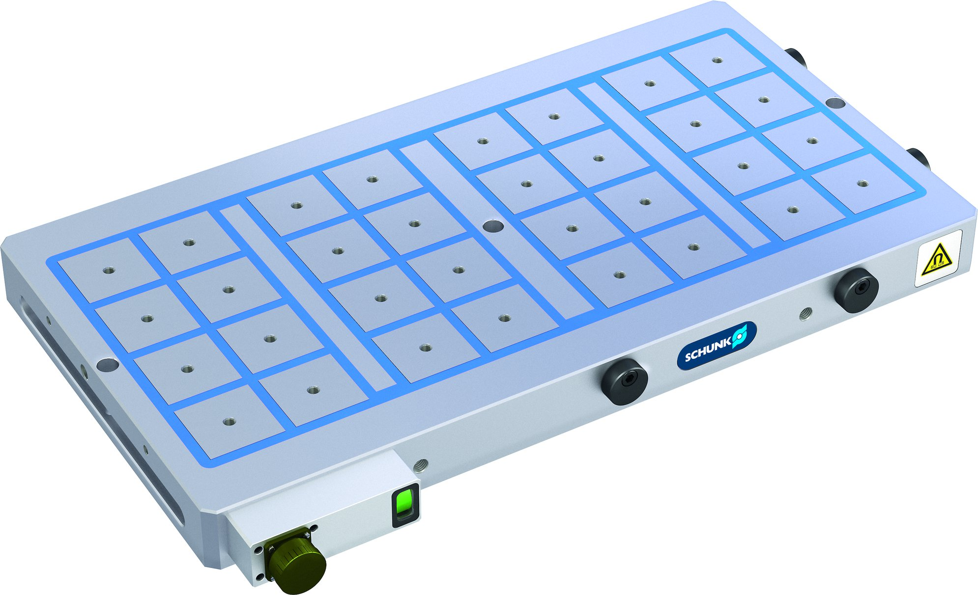
MAGNOS MFRS
Increasing clamping force by covering poles – six poles
SCHUNK MAGNOS pole size 32
SCHUNK MAGNOS pole size 50
SCHUNK MAGNOS pole size 70

Slide 9
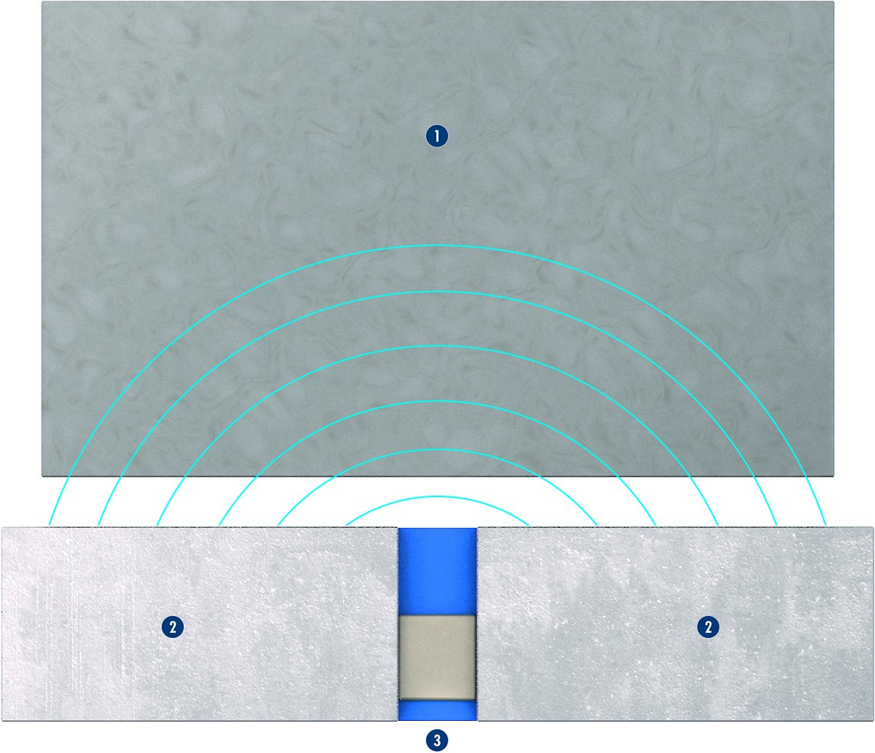
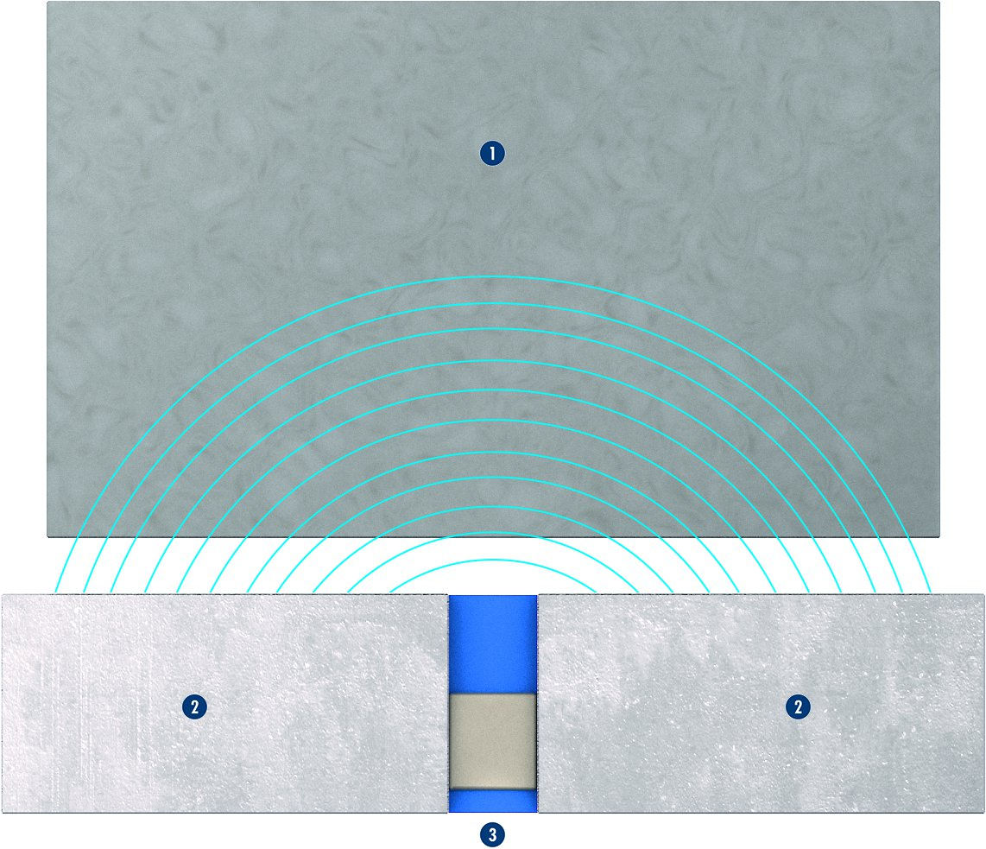
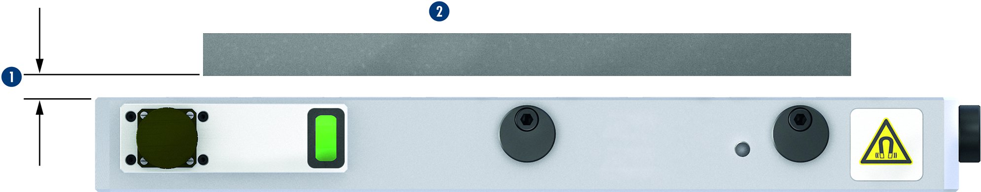
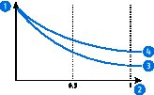
MAGNOS MFRS
Magnetic chuck type MFRS-A1
Magnetic chuck type MFRS-A2
1
1
1
Workpiece
Poles MFRS-A1
MFRS-A1
1
Workpiece
Poles MFRS-A2
MFRS-A2
2
2
3
3
2
2
2
2
3
3
Definition of air gap
Influence of the air gap on the magnetic clamping force
1
2
1
1
Magnetic clamping force [kN]
Air gap [mm]
MFRS-A1
MFRS-A2
3
Workpiece
Air gap
Magnetic chuck
4
2
1
3
3
2
3
2
4

Slide 10
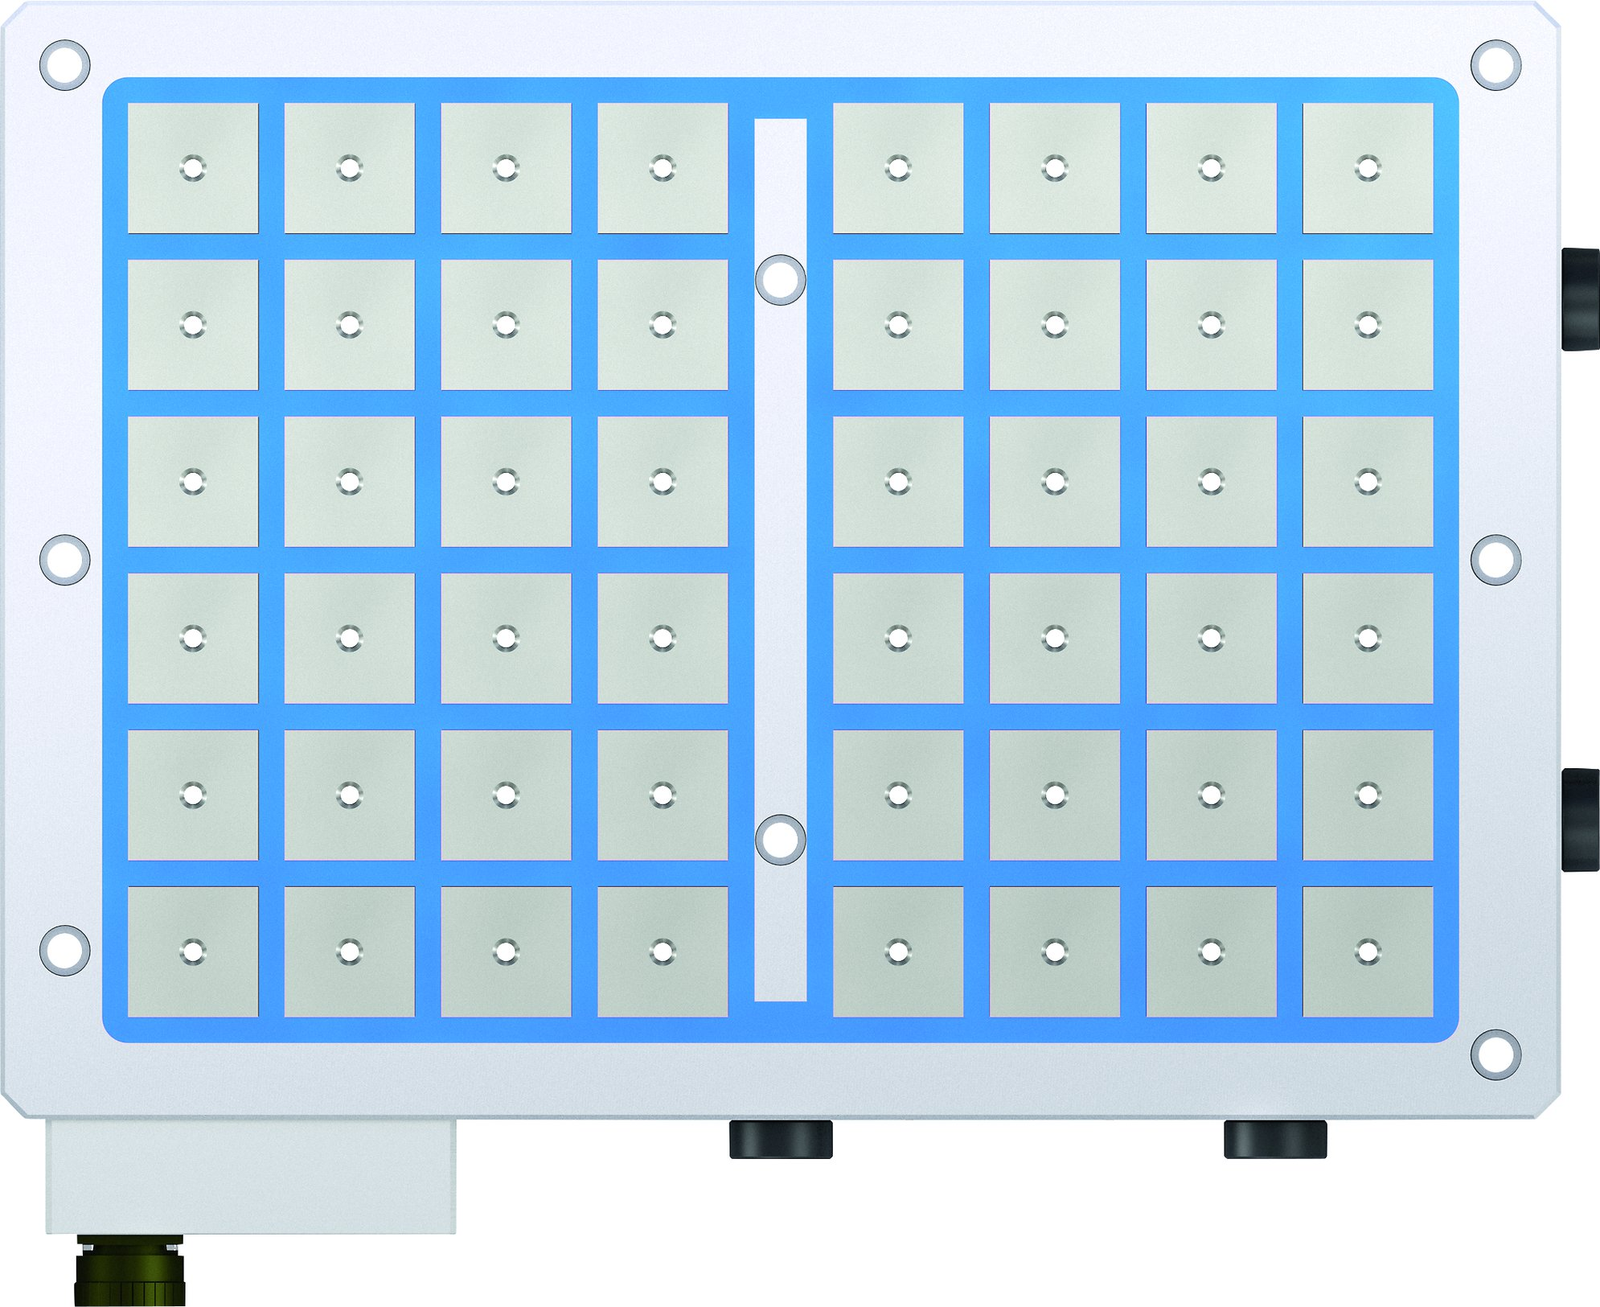
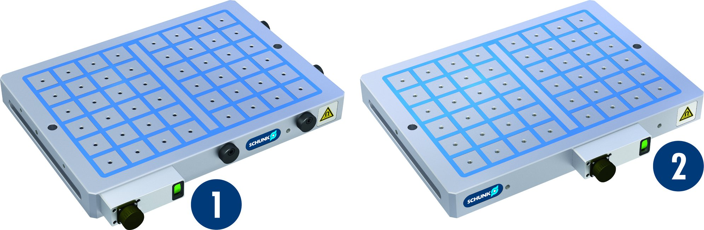
MAGNOS MFRS
Position of the connection (option)
Additional mounting bores (on option)
1
Standard connection
Customized connection in the middle
1
2
2

Slide 11
Variants of MAGNOS MFRS
Technical data | MFRS-A1-032 | MFRS-A1-050 | MFRS-A2-050 | MFRS-A1-070 | MFRS-A2-070 | MFRS-V-A1-050
L [mm]
B [mm]
H [mm] | 55 | 66 | 86 | 66 | 86 | 66
Max. clamping force [kN] | 26 – 154 | 63 – 377 | 63 – 377 | 123 – 554 | 123 – 385 | 63 – 314
Number of poles | 24 – 140 | 16 – 96 | 16 – 96 | 16 – 72 | 16 – 50 | 16 – 80
Connection | 4-PIN | 4-PIN | 4-PIN / 7-PIN | 4-PIN | 4-PIN / 7-PIN | 4-PIN
Amount of channels | 1 | 1 | 1 / 2 | 1 | 1 / 2 | 1

