Slide 1

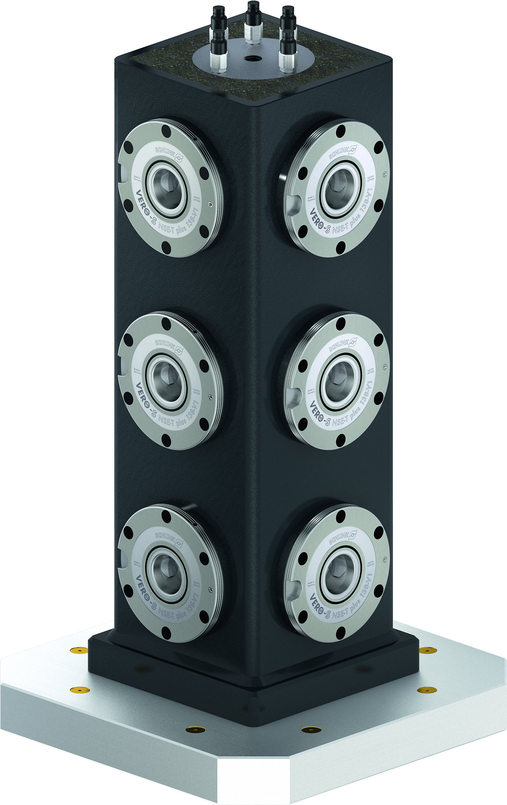
Hybrid Tombstones

Slide 2












Product overview
Gripping Systems
Clamping Technology
Chuck Jaws
Lathe Chucks
Stationary Workholding
Toolholders
Hydraulic Expansion Technology
VERO-S
TANDEM
ROTA
KONTEC
Tombstones
MAGNOS

Slide 3



SCHUNK Services
Engineering
Dimensioning of special plates designed to the manufacturing specifications
Development of special solutions together with the customer
FEM analysis for critical components
Testing
Endurance tests with all new developments
Abrasion checking
Measurement of accuracy
Service
Initial operation of customer´s solution
Inspection and maintenance
Repairs

Slide 4
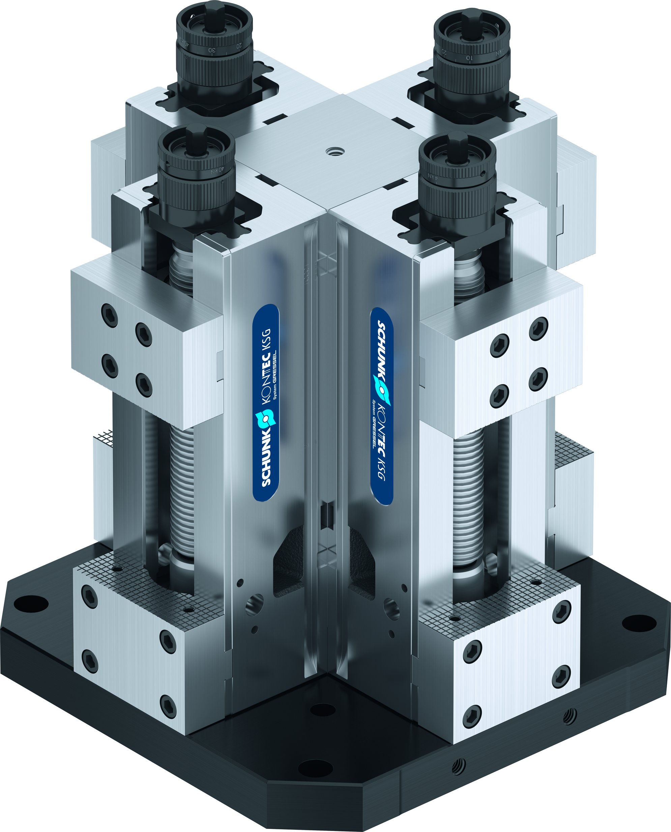
Overview
Tombstones
Hybrid Tombstones
Tombstones

Slide 5
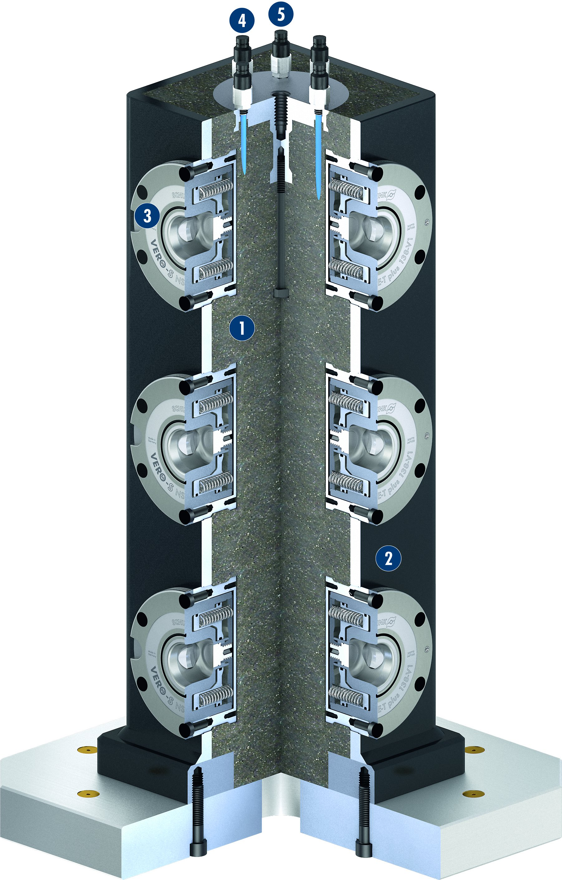
Hybrid Tombstones
4
5
3
1
Mineral cast filling
Steel coat
VERO-S NSE-T plus 138-V1 Module
Quick coupling opening modules
Fast coupling opening modules
Standardized base plate
1
2
3
4
5
2
6
6

Slide 6
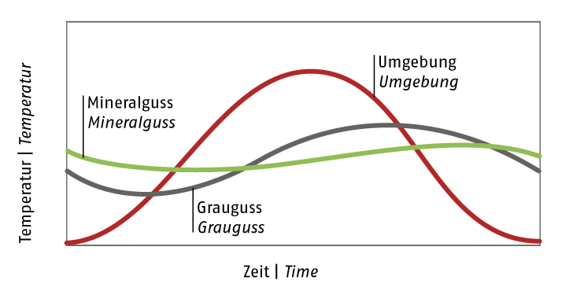
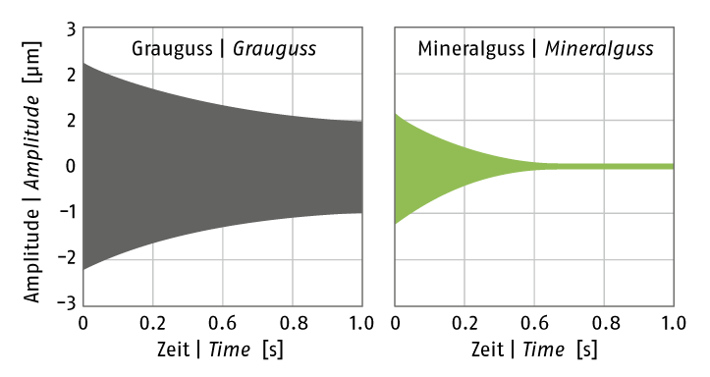
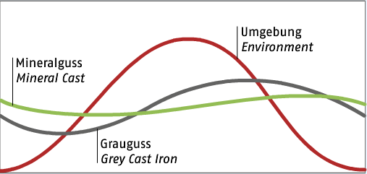
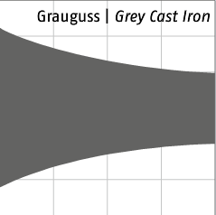
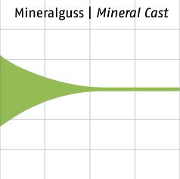
Hybrid Tombstones
Damping comparison of initiated vibrations
Temperature comparison

Slide 7
Variants of Hybrid tombstones
Technical Data | Palett size [mm] | Weight [kg]
VAT-AE-HY-plus 400 | 400 x 400 | 200
VAT-AE-HY-mini 300 | Ø 300 | 45

