Slide 1

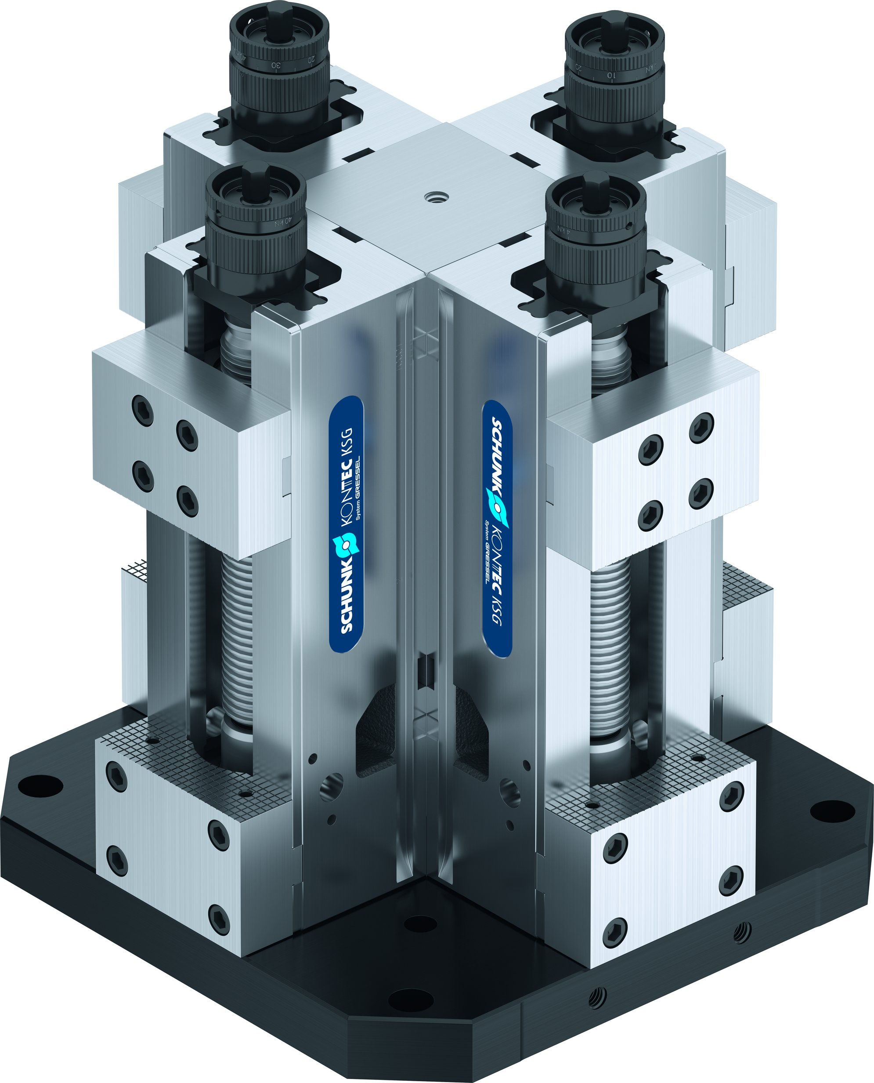
Tombstones

Slide 2












Product Overview
Gripping Systems
Clamping Technology
Chuck Jaws
Lathe Chucks
Stationary Workholding
Toolholders
Hydraulic Expansion Technology
VERO-S
TANDEM
ROTA
KONTEC
Tombstones
MAGNOS

Slide 3



SCHUNK Services
Engineering
Dimensioning of special plates designed to the manufacturing specifications
Development of special solutions together with the customer
FEM analysis for critical components
Testing
Endurance tests with all new developments
Abrasion checking
Measurement of accuracy
Service
Initial operation of customer´s solution
Inspection and maintenance
Repairs

Slide 4
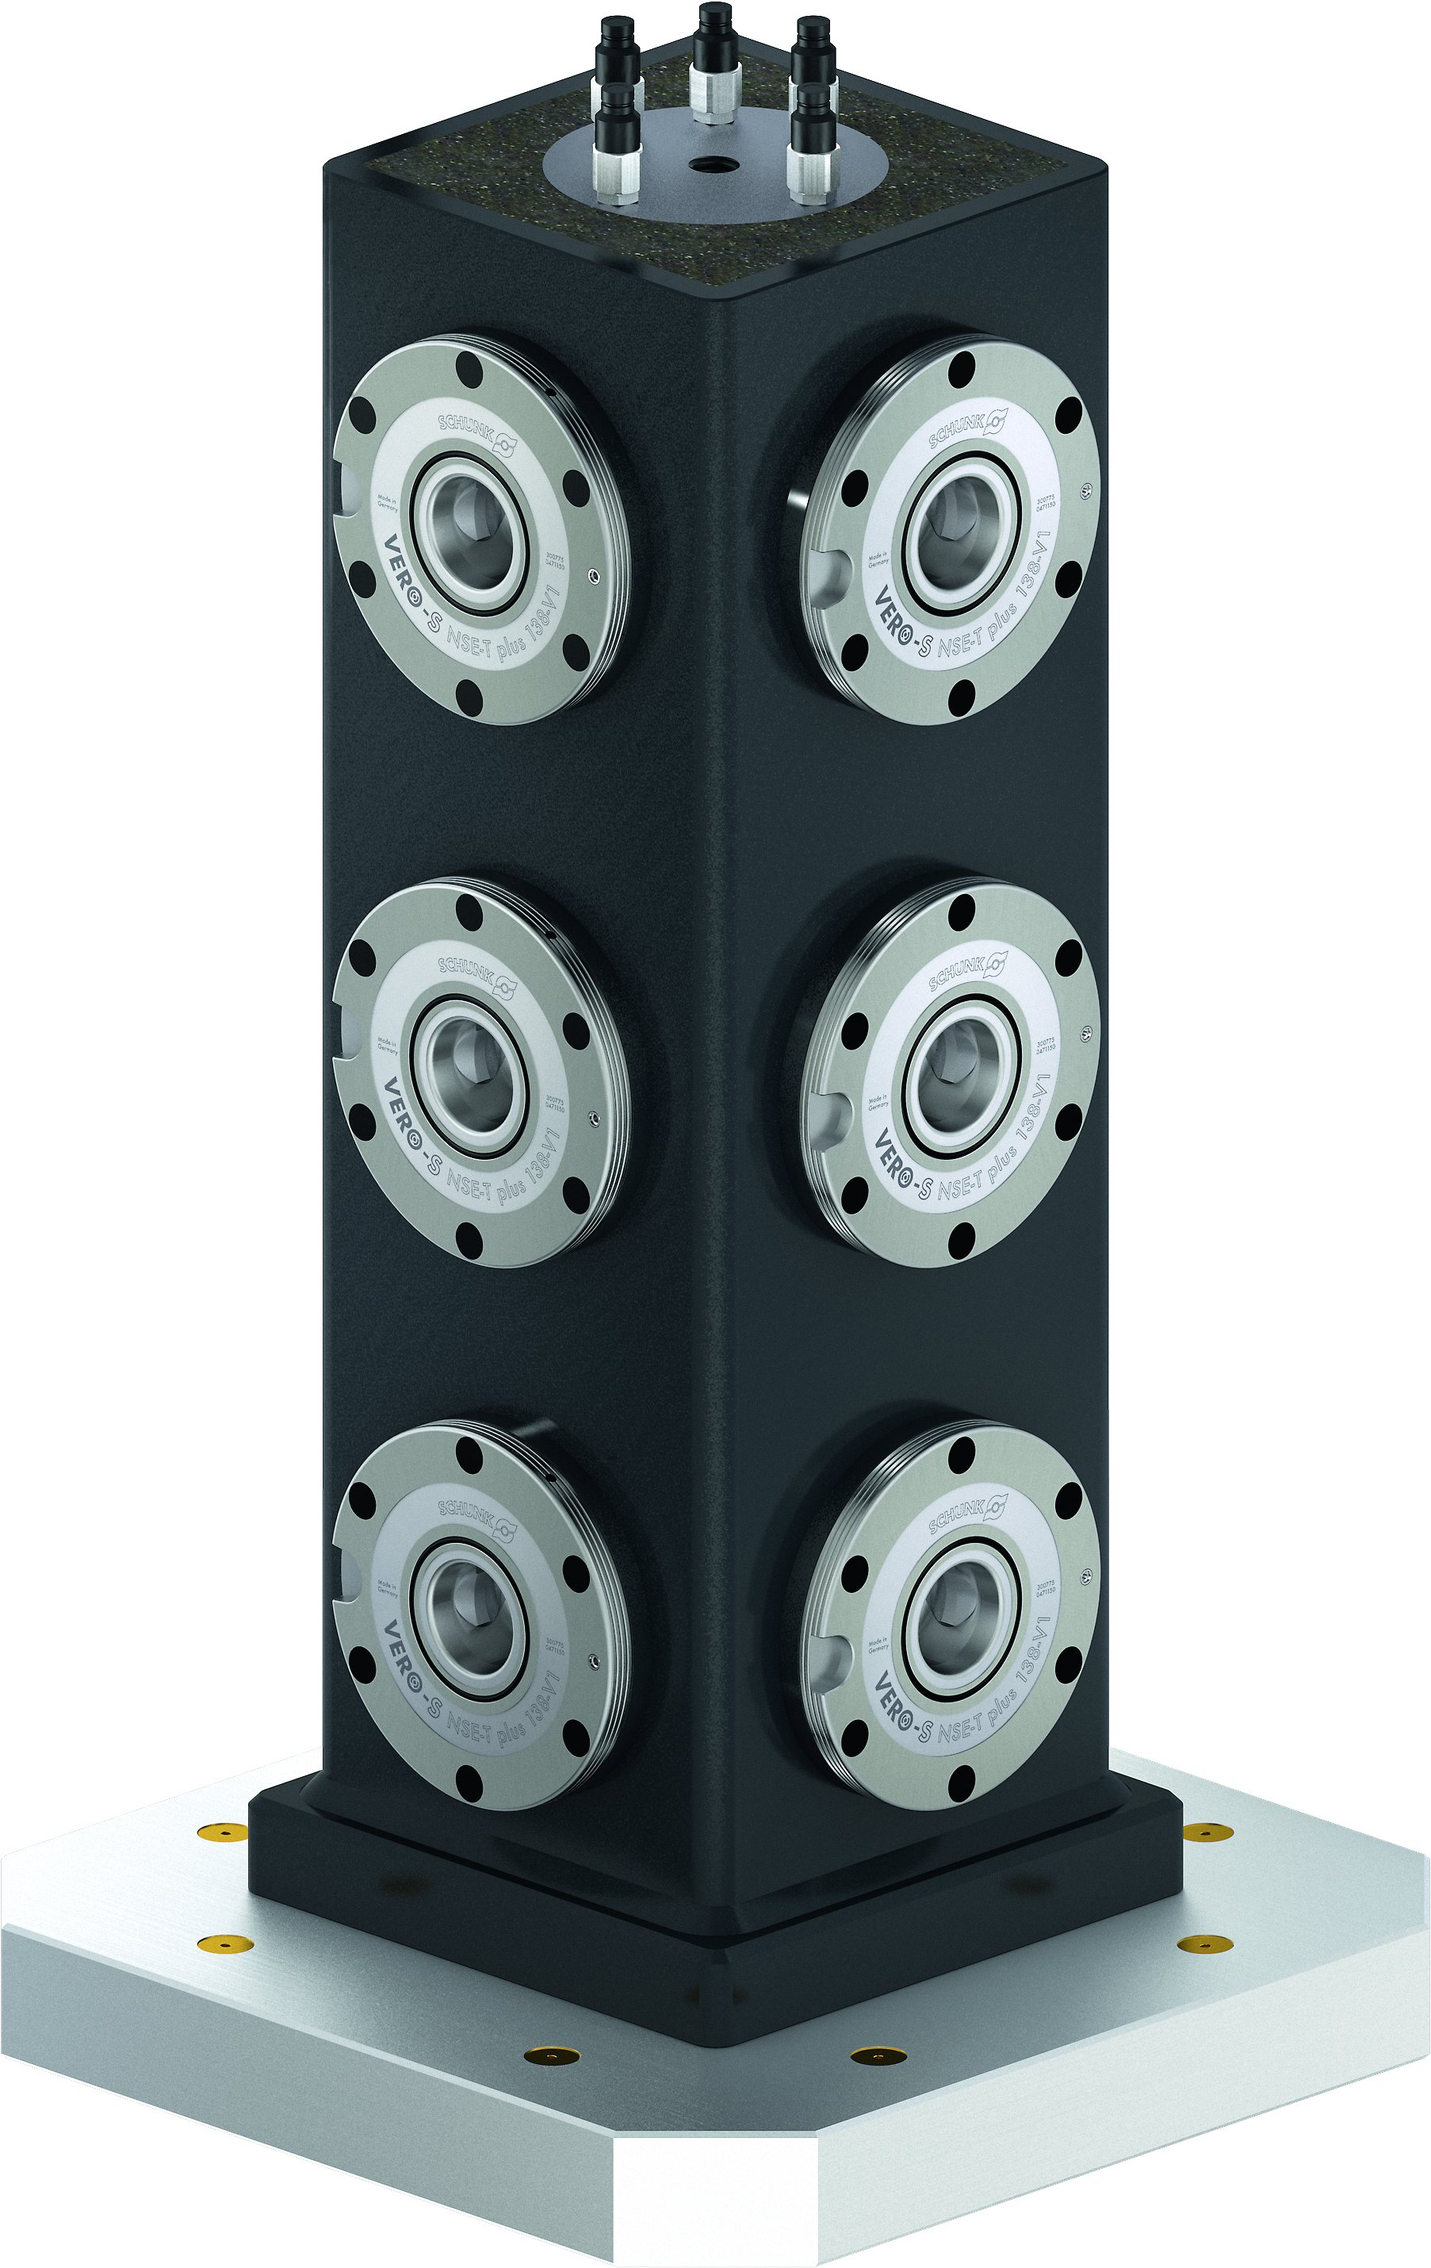
Overview
Tombstones
Hybrid Tombstones
Tombstones

Slide 5
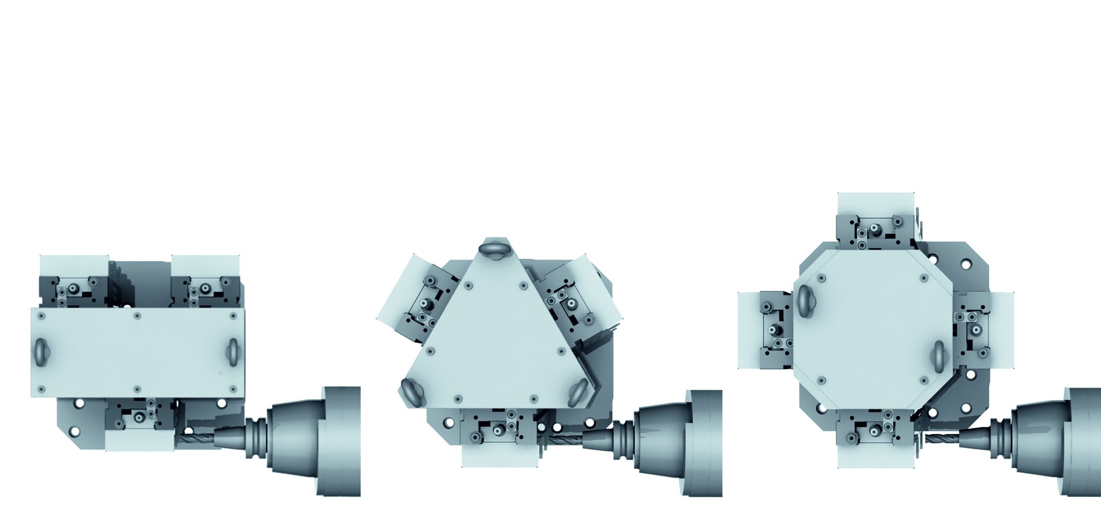
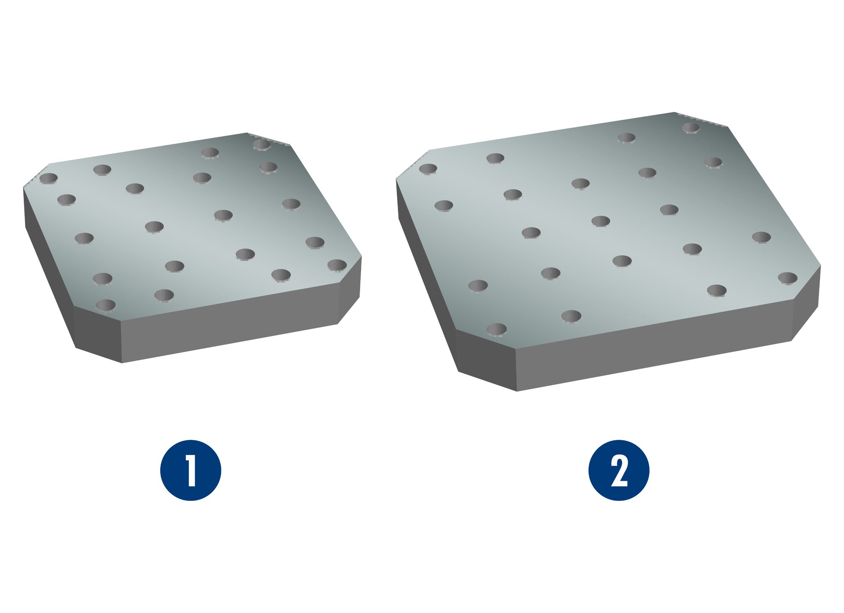
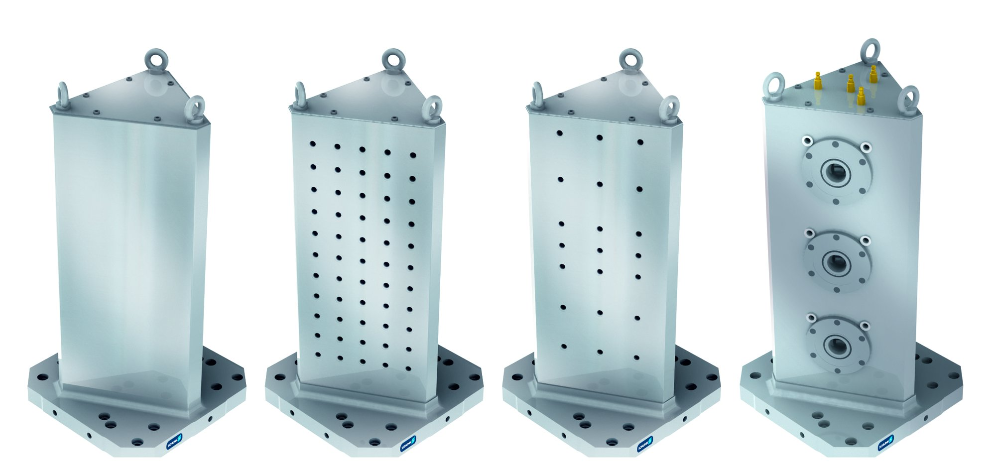
Tombstones
Selection of pallet size
Selection of the base profile
1
Pallet size
400 x 400 mm
Pallet size
500 x 500 mm
2
1
2
Selection of bore hole grid
1
Rough clamping surfaces without bore holes for finishing by customer
Standard bore hole grid, finely milled, with through-hole grid 50 mm
SCHUNK bore hole grid finely milled, reduced grid, for SCHUNK clamping devices
VERO-S tombstones with integrated clamping modules, clearance 200 mm
2
3
4
1
2
3
4

Slide 6
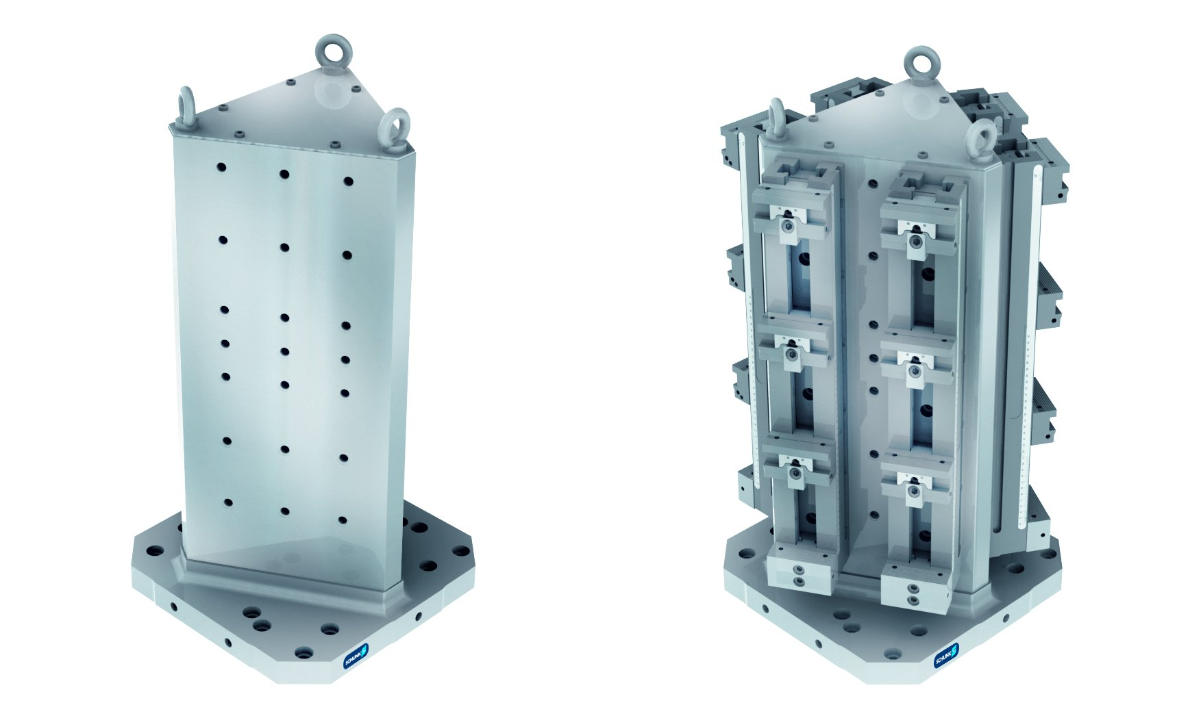
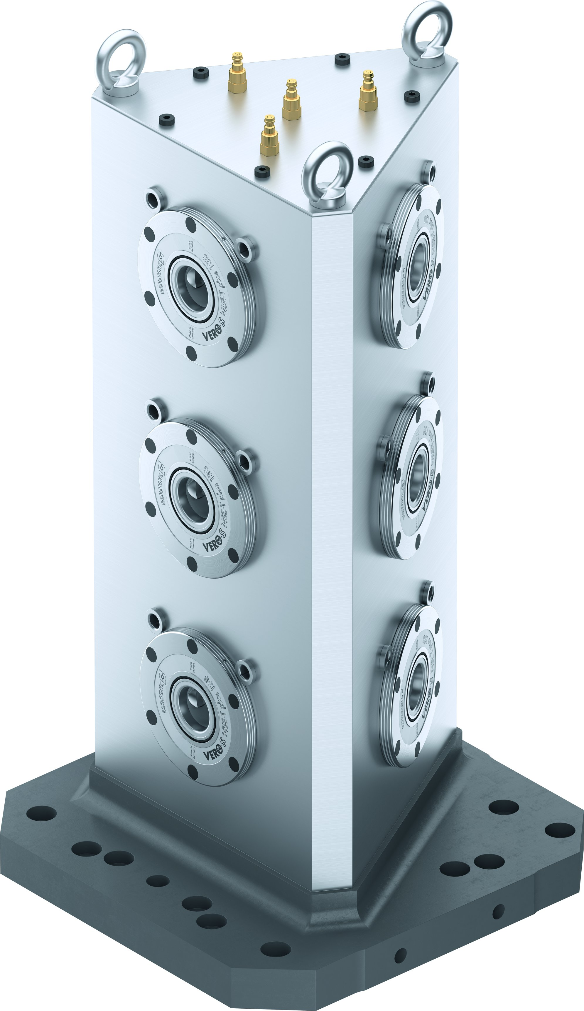
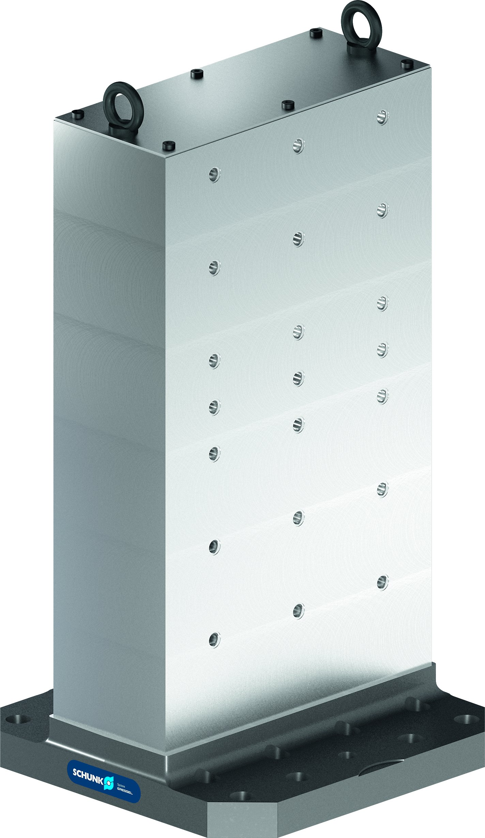
Tombstones
Selection of insertion
Tombstones with clamping vises
1
Without clamping devices
With clamping devices
2
1
2
VERO-S tombstones
Double angle tombstones

Slide 7
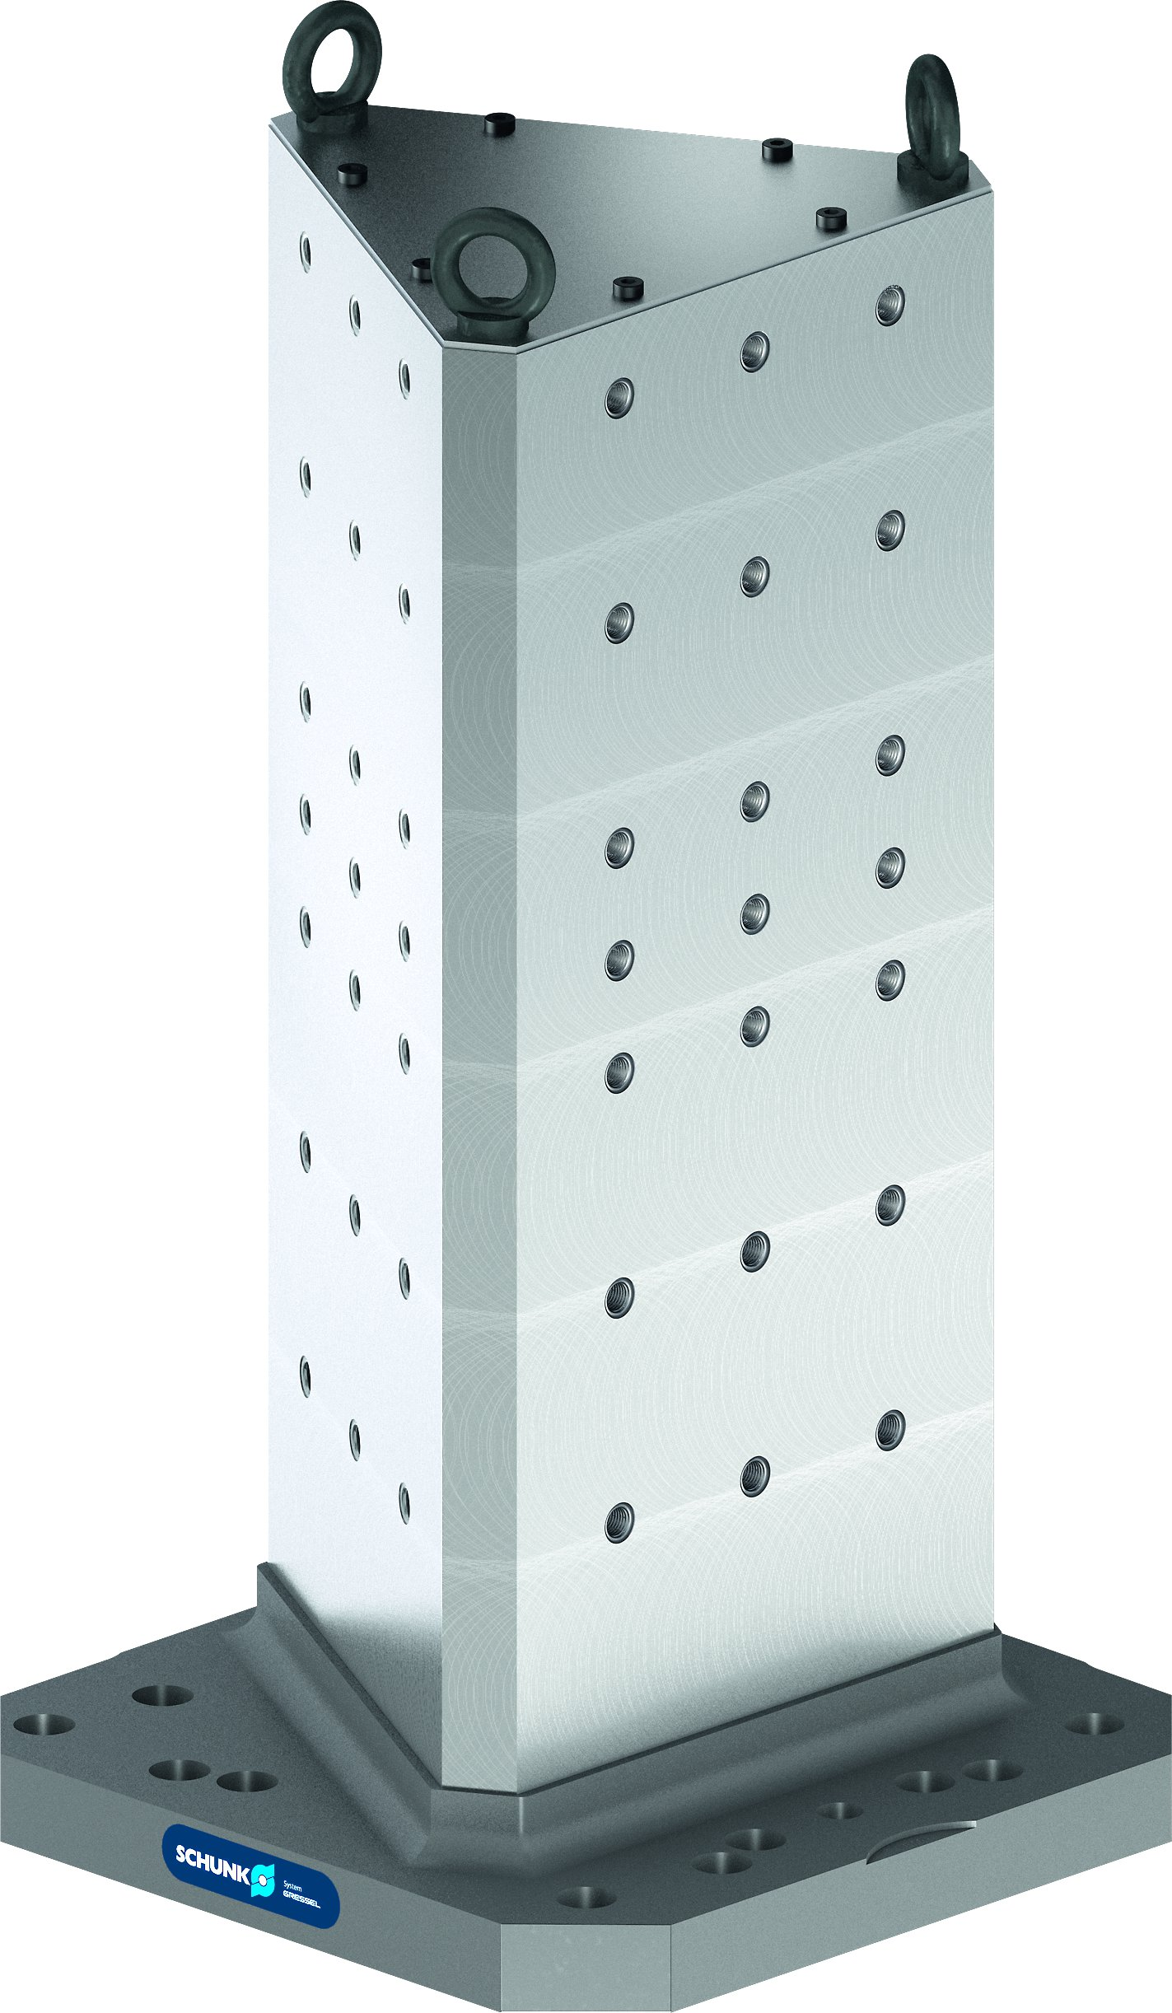
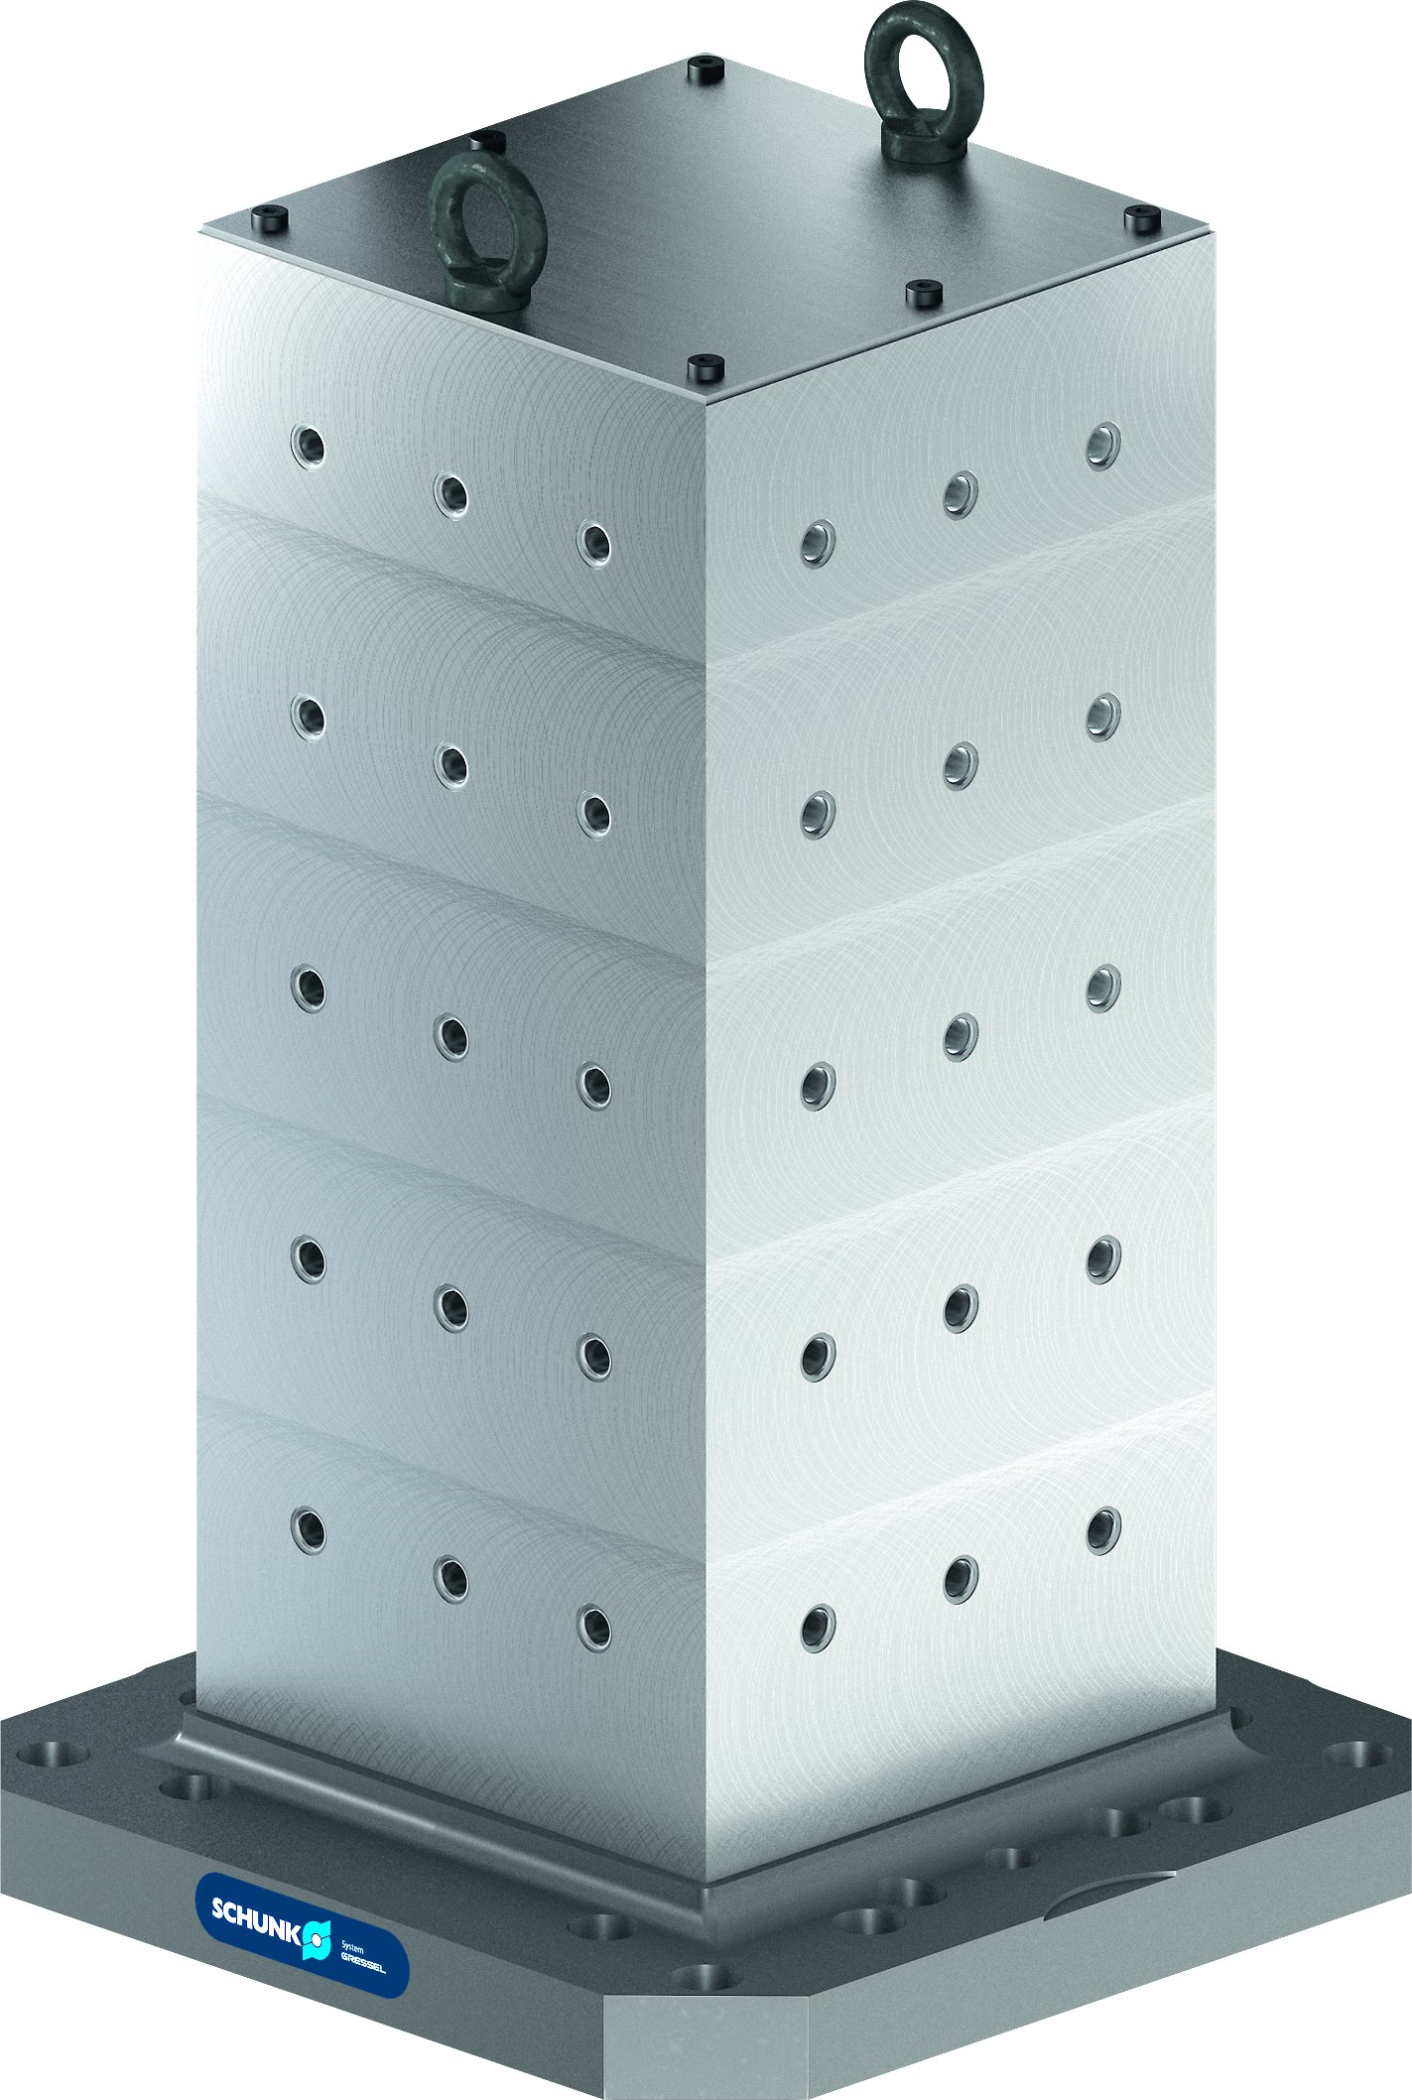
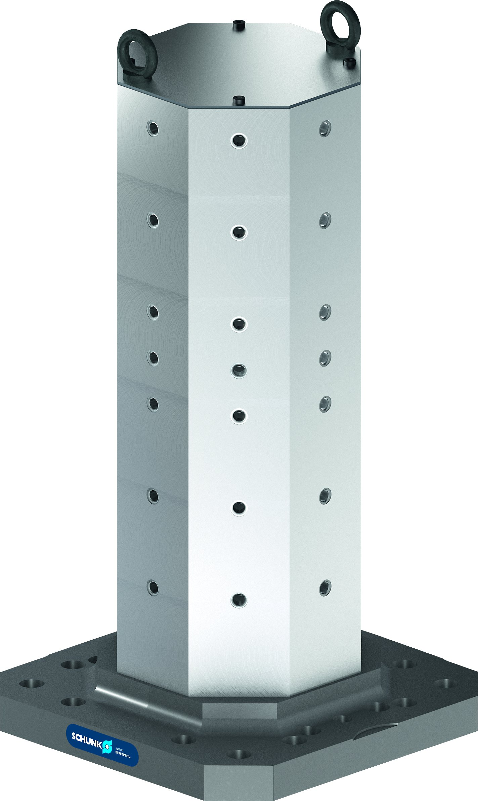
Tombstones
Triangle tombstones
Cube tombstones
Octangle tombstones

Slide 8

Variants of Tombstones
Technical Data | Palett size [mm] | Weight [kg]
Tombstones wiht Clamping Vises
SAT-KSD 4V 100 - 400 | 400 x 400 | 202
SAT-KSD 4V 125 - 400 | 400 x 400 | 236
SAT-KSD 4V 125 – 500 | 500 x 500 | 262
SAT-KSM2 4V 90 – 400 | 400 x 400 | 193
SAT-KSM2 4V 90 – 500 | 500 x 500 | 193
SAT-KSM2 8V 90 – 400 | 400 x 400 | 242
SAT-KSM2 8V 90 – 500 | 500 x 500 | 267
SAT-KSG 2V 100 | 250 x 250 | 56
SAT-KSG 2V 125 | 250 x 250 | 92
SAT-KSG 4V 100 – 400 | 400 x 400 | 148
SAT-KSG 4V 125 – 400 | 400 x 400 | 224
SAT-KSG 4V 125 – 500 | 500 x 500 | 252
Technical Data | Palett size [mm] | Weight [kg]
Tombstones wiht Clamping Vises
SAT-KSO 65 4V |  | 18.5
SAT-KSF plus 100 - 400 | 400 x 400 | 160
SAT-KSF plus 100 - 500 | 500 x 500 | 188
SAT-KSF plus 160 - 500 | 500 x 500 | 355
VERO-S Tombstones
VAT3-DW 400 | 400 x 400 | 220
VAT3-DW 500 | 500 x 500 | 248
VAT3-DR 400 | 400 x 400 | 196
VAT3-DR 500 | 500 x 500 | 223
VAT3-AE 400 | 400 x 400 | 197
VAT3-AE 500 | 500 x 500 | 224

Slide 9
Variants of Tombstones
Technical Data | Palett size [mm] | Weight [kg]
Double Angle Tombstones
SAT-DW-R 400 | 400 x 400 | 221
SAT-DW-R 500 | 500 x 500 | 235
SAT-DW-BR 400 | 400 x 400 | 220
SAT-DW-BR 500 | 500 x 500 | 225
SAT-DW-BRS 400 | 400 x 400 | 203
SAT-DW-BRS 500 | 500 x 500 | 228
Triangle Tombstones
SAT-DR-R 400 | 400 x 400 | 195
SAT-DR-R 500 | 500 x 500 | 225
SAT-DR-BR 400 | 400 x 400 | 175
SAT-DR-BR 500 | 500 x 500 | 205
SAT-DR-BRS 400 | 400 x 400 | 178
SAT-DR-BRS 500 | 500 x 500 | 208
Technical Data | Palett size [mm] | Weight [kg]
Cube Tombstones
SAT-W-R 400 | 400 x 400 | 180
SAT-W-R 500 | 500 x 500 | 320
SAT-W-BR 400 | 400 x 400 | 155
SAT-W-BR 500 | 500 x 500 | 262
SAT-W-BRS 400 | 400 x 400 | 157
SAT-W-BRS 500 | 500 x 500 | 265
Octangle Tombstones
SAT-AE-R 400 | 400 x 400 | 195
SAT-AE-R 500 | 500 x 500 | 220
SAT-AE-BRS4 400 | 400 x 400 | 180
SAT-AE-BRS4 500 | 500 x 500 | 205
SAT-AE-BRS8 400 | 400 x 400 | 160
SAT-AE-BRS8 500 | 500 x 500 | 185

