Slide 1


KONTEC KSX
Power-amplified-5-axis clamping vise

Slide 2












Product Overview
Gripping Systems
Clamping Technology
Chuck Jaws
Lathe Chucks
Stationary Workholding
Toolholders
Hydraulic Expansion Technology
VERO-S
TANDEM
ROTA
KONTEC
Tombstones
MAGNOS

Slide 3
Challenges
Depth of
production
Time
Flexibility
Global
competition
Time
Time
Increasing importance
of workpiece clamping
heute
zukünftig

Slide 4



SCHUNK Services
Engineering
Dimensioning of special plates designed to the manufacturing specifications
Development of special solutions together with the customer
FEM analysis for critical components
Testing
Endurance tests with all new developments
Abrasion checking
Measurement of accuracy
Service
Initial operation of customer´s solution
Inspection and maintenance
Repairs

Slide 5






KONTEC Portfolio
Single-acting Vise | Centric Clamping Vise | Multi Clamping Vise
Clamping towards a fixed jaw Fixed jaw as reference High repeat accuracy Especially suitable for workpieces with dimensioning from the side | Symmetric clamping Workpiece zero point is always in the center Optimum accessibility for 5-axis milling Especially suitable for workpieces with dimensioning from the center | Clamping of multiple workpieces Multifunctional usage Reduction of setup times Optimum usage of the machine table

Slide 6
KONTEC Portfolio
Max. Clamping force [kN]
Max. Clamping range [mm]
Jaw width
Jaw width

Slide 7











Fast adaption to new clamping tasks
System Jaws
Standard reversible jaw | Reversible jaw, grip -grip | Enlarged span width -VS | Aluminium jaw -AL
Adapter- and swivel plates -R | 5-axis standard jaw -5A / -5A-VS | 6-fold jaw -6B | Reversible jaw grip, smooth central jaw -ST
Chuck Jaws
Chuck jaw with locator pin | Spring plate, pull-down jaw | Prismatic jaw | Stepped jaw, grip

Slide 8



KONTEC Overview
Single-acting Vise
Centric Clamping Vise
Multi Clamping Vise

Slide 9



KONTEC Single-acting Vise
With force amplification
Without force amplification
KSG
Machine vise
KSC-F
Basic clamping vise
KSX
5-axis clamping vise
KSO
Clamping vise for small components

Slide 10
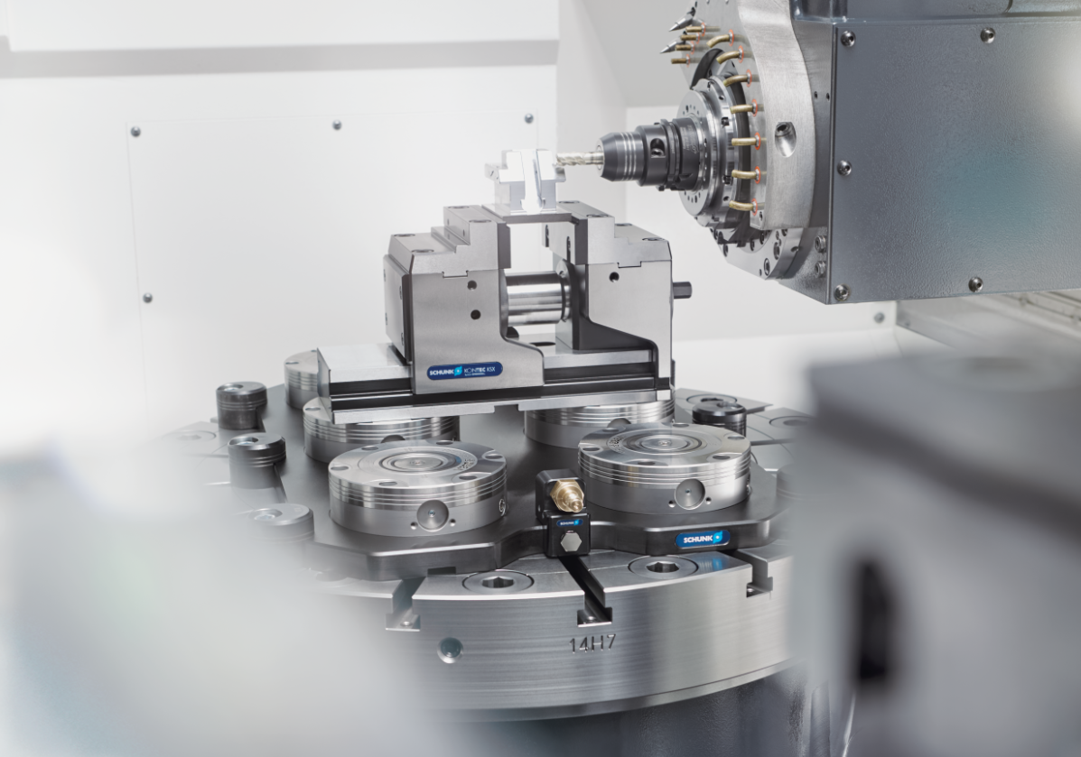
KONTEC KSX
Example of application

Slide 11
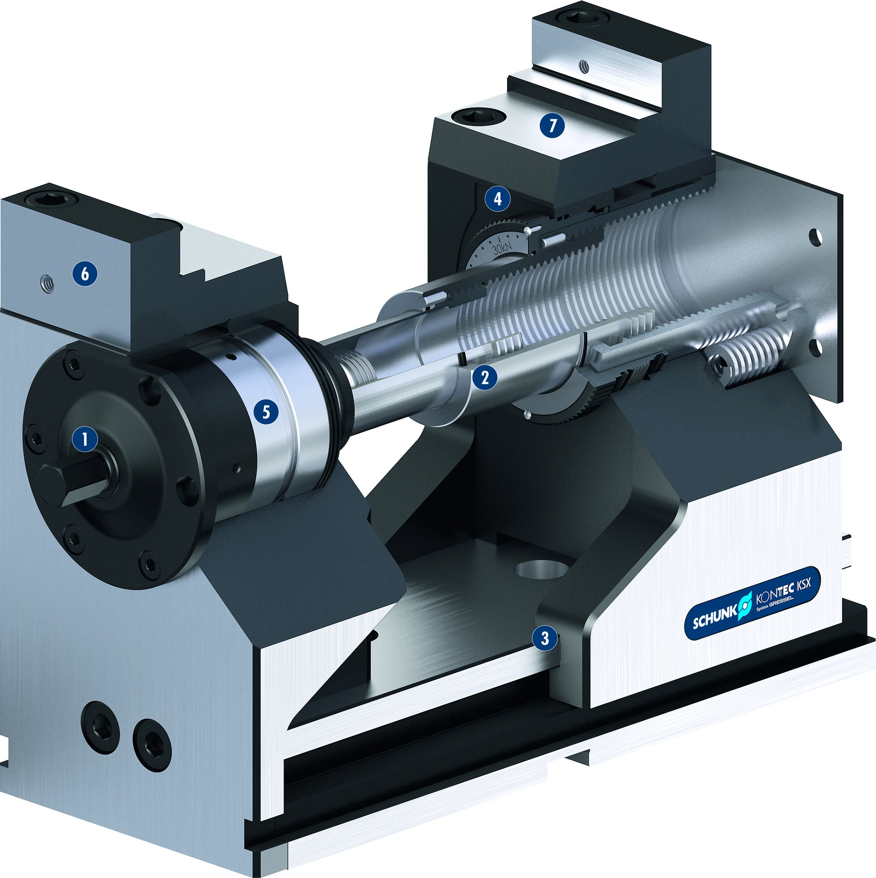
KONTEC KSX
7
4
High precision
Mechanical force transmission
Lever quick clamping
Continuous clamping force adjustment
Complete encapsulation + quick adjustment
Optimal accessibility
Diverse applications
1
1
2
3
5
4
2
3
5
6
6
7

Slide 12
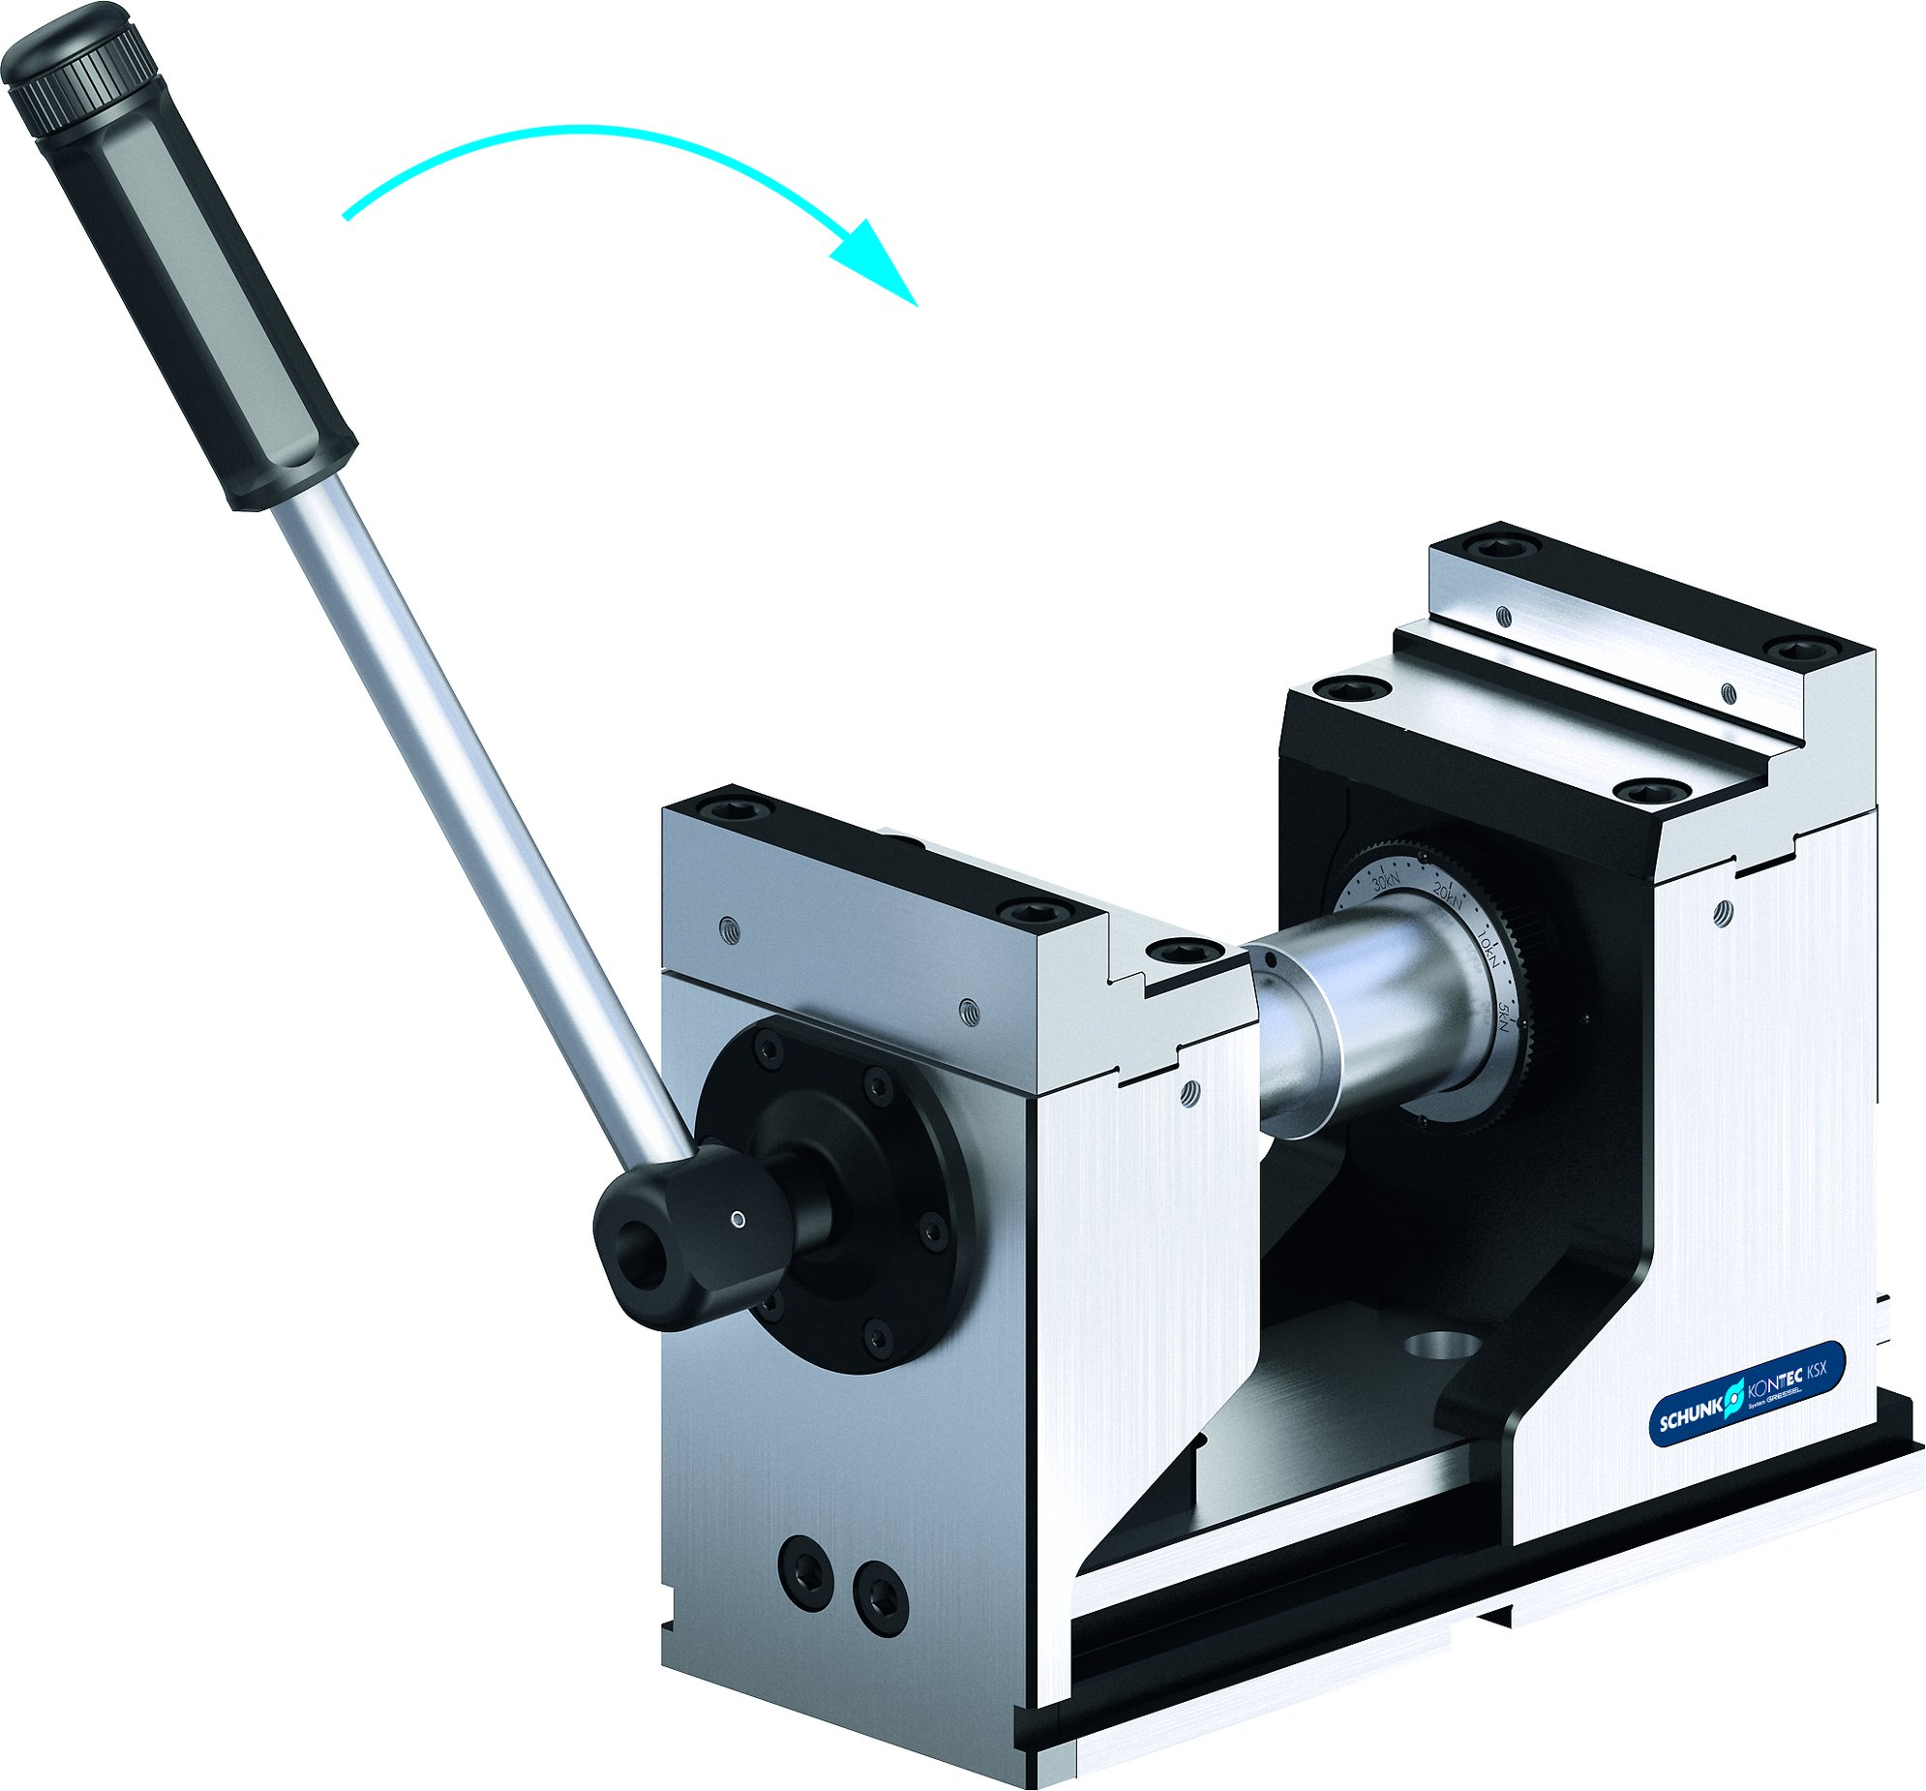
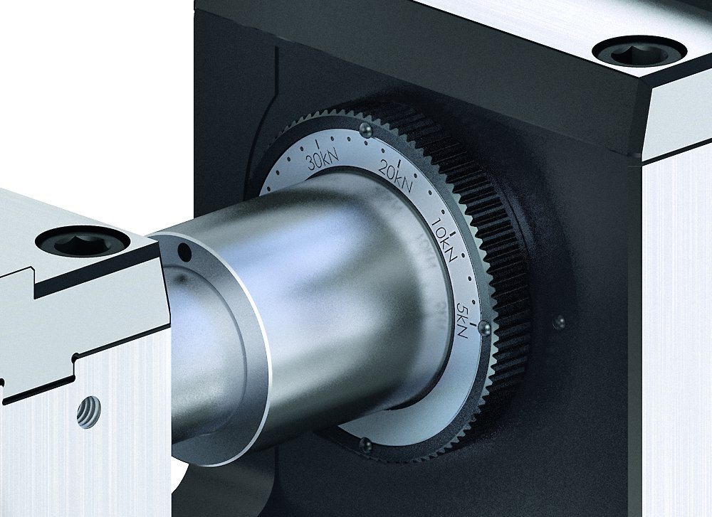
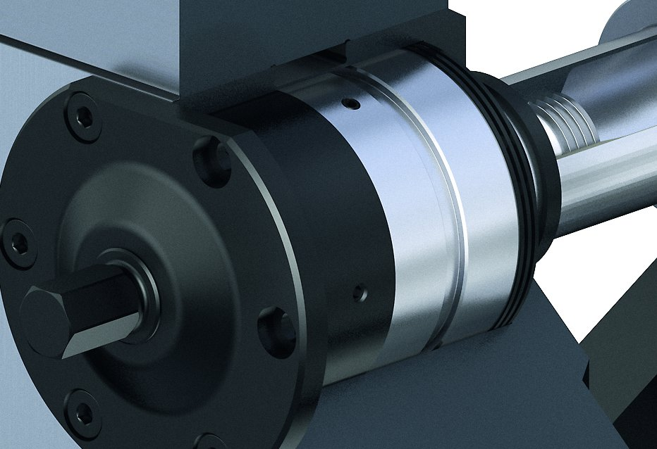
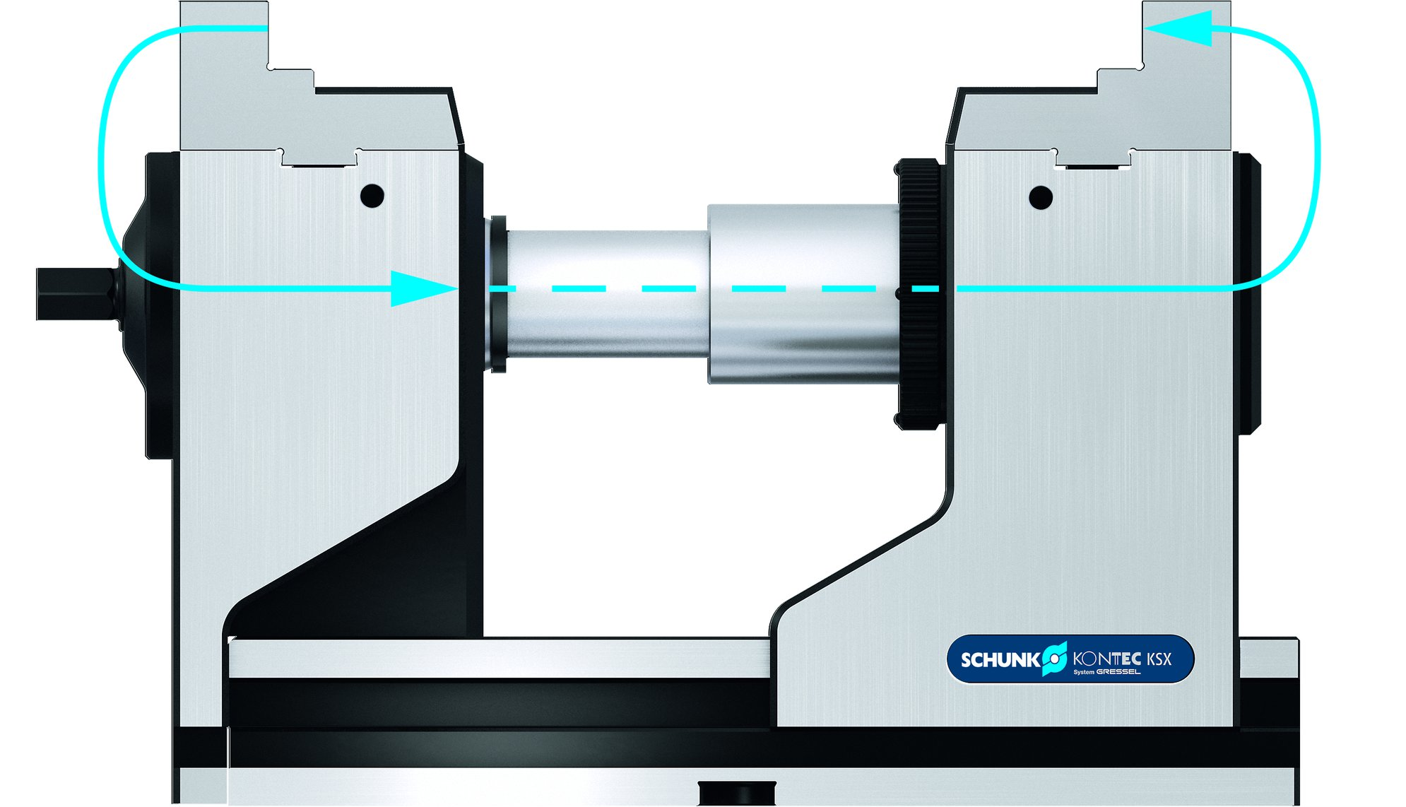
KONTEC KSX
Lever quick clamping
Continuously adjustable clamping force
Completely encapsulated force transmission box
Clamping by tension

Slide 13
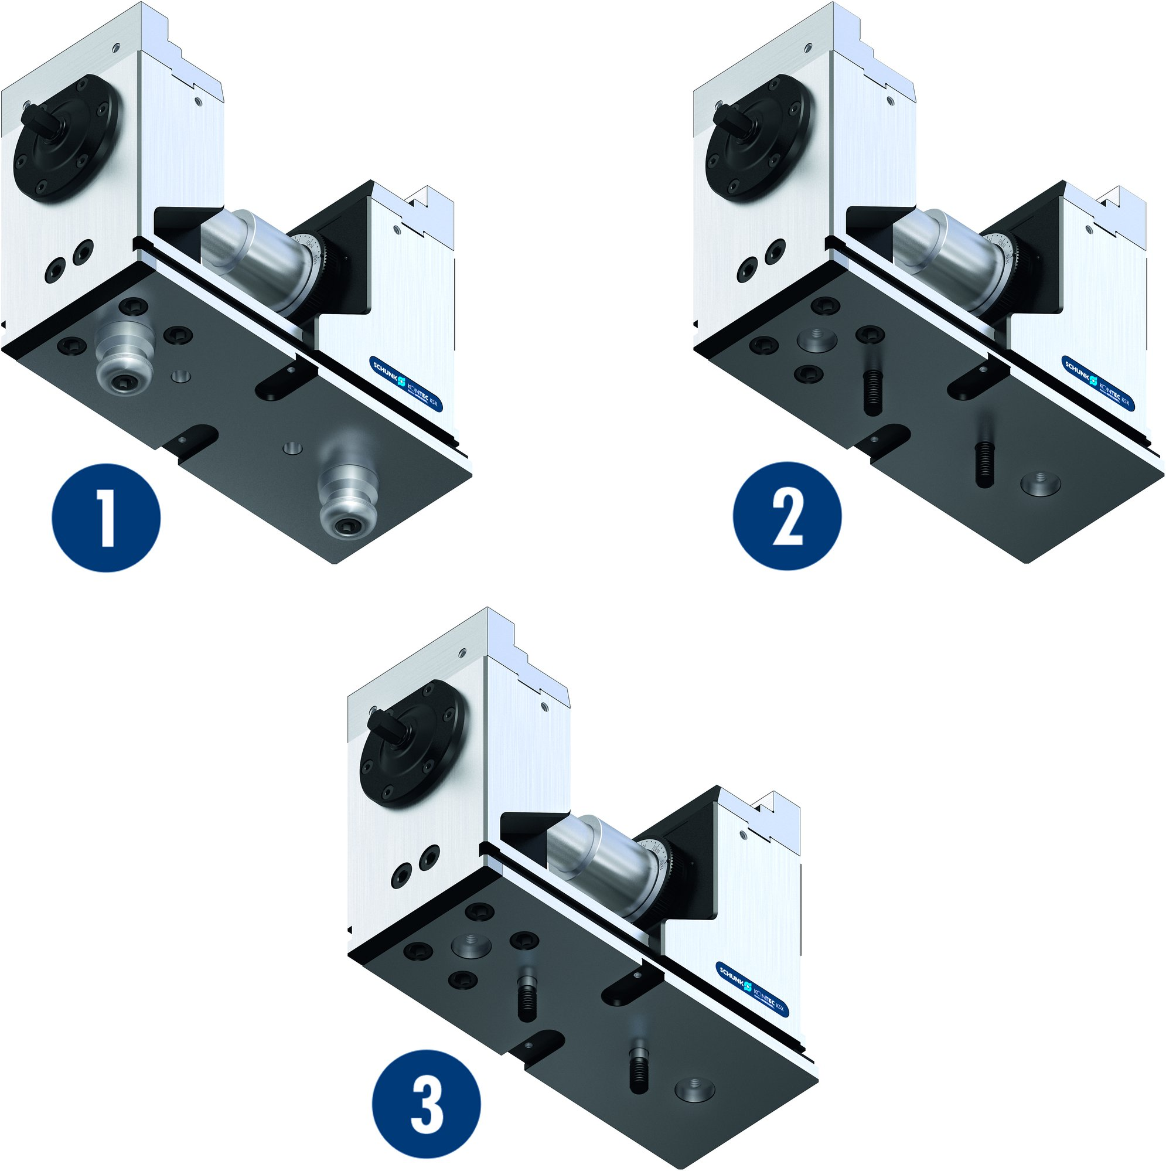
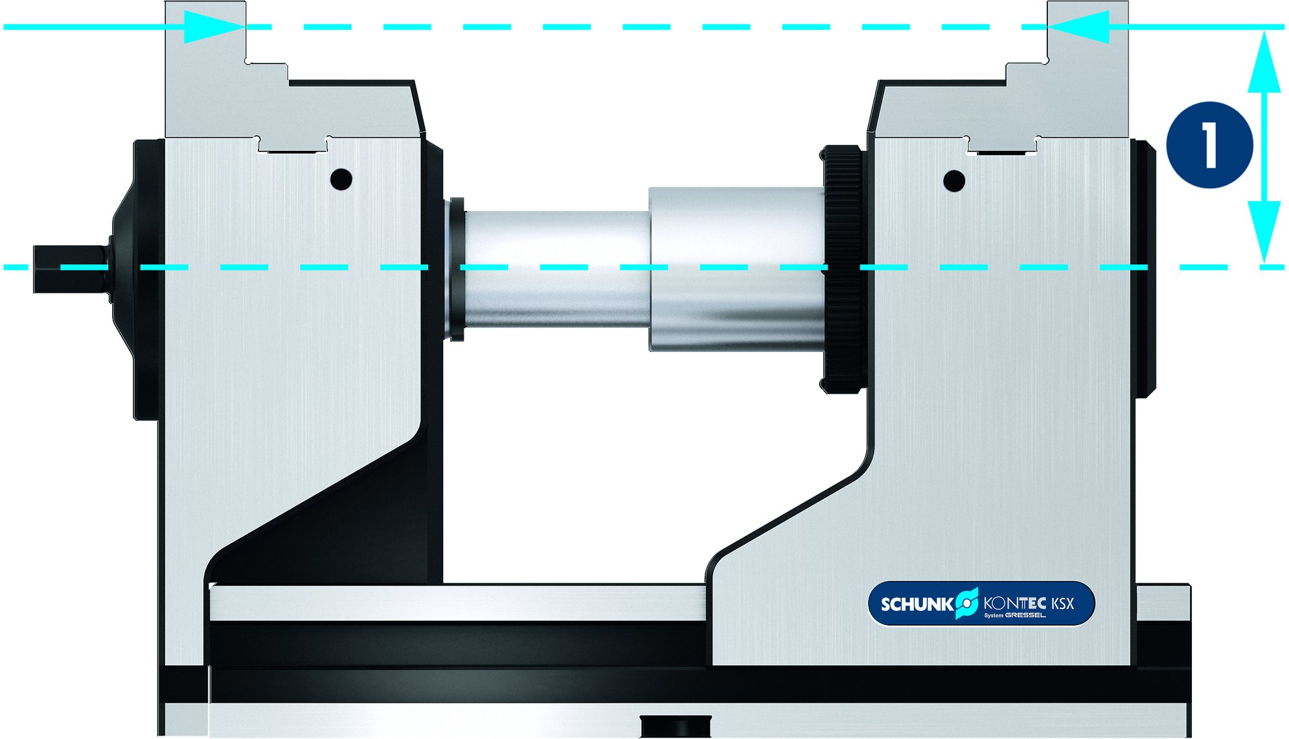
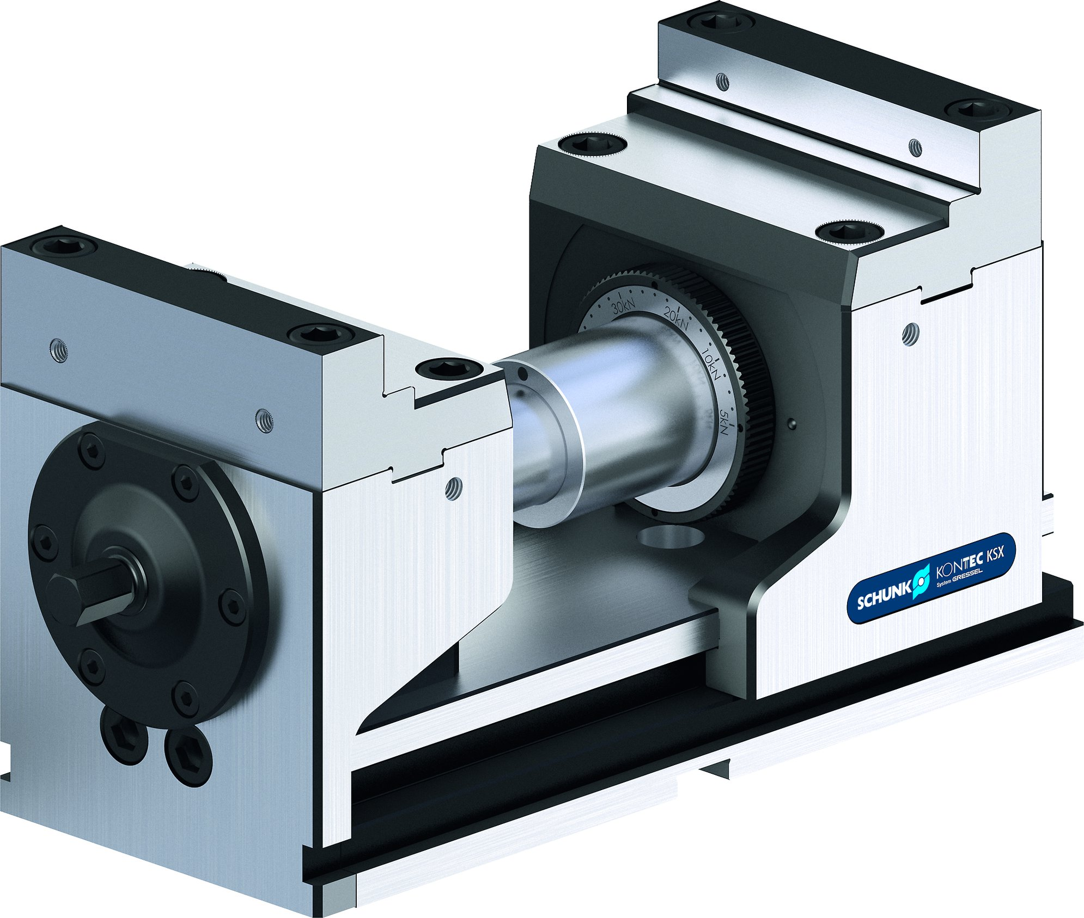
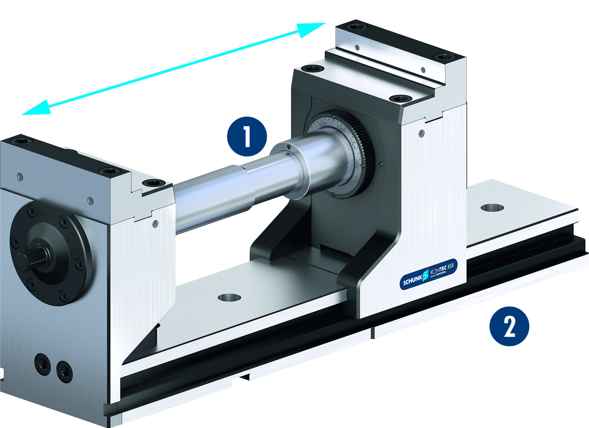
KONTEC KSX
Force transmission on equal level with the clamping position
Mounting options
1
Fastening via quick-change pallet system
Fastening using two screws
Fastening for positional orientation using fitting screws
1
1
Minimal distance from force transmission to clamping position
1
2
2
3
3
Low version
Can be extended to any length – maximum flexibility
1
Draw bar extension
Base body extension
1
2
2

Slide 14
Variants of KONTEC KSX
Technical data | KSX 125 |  | KSX AL 125 |  | KSX R 125 |  | KSX 6B 125 |  | KSX ZV*
Jaw width [mm] | 125 |  | 125 |  |  |  | 125 |  | 125
Height [mm] | 174 | 125 | 174 | 125 | 174 | 125 | 174 | 125 | 174 | 125
Clamping force [kN] | 5 - 40 |  | 5 – 40 |  | 5 – 40 |  | 5 – 40 |  | 5 - 40
Weight [kg] | 30.2 | 22.6 | 30.2 | 22.6 | 30.2 | 22.6 | 30.2 | 22.6 | 30.2 | 22.6
* Draw bar extension available in 125, 250, 375, 500 mm

