Slide 1

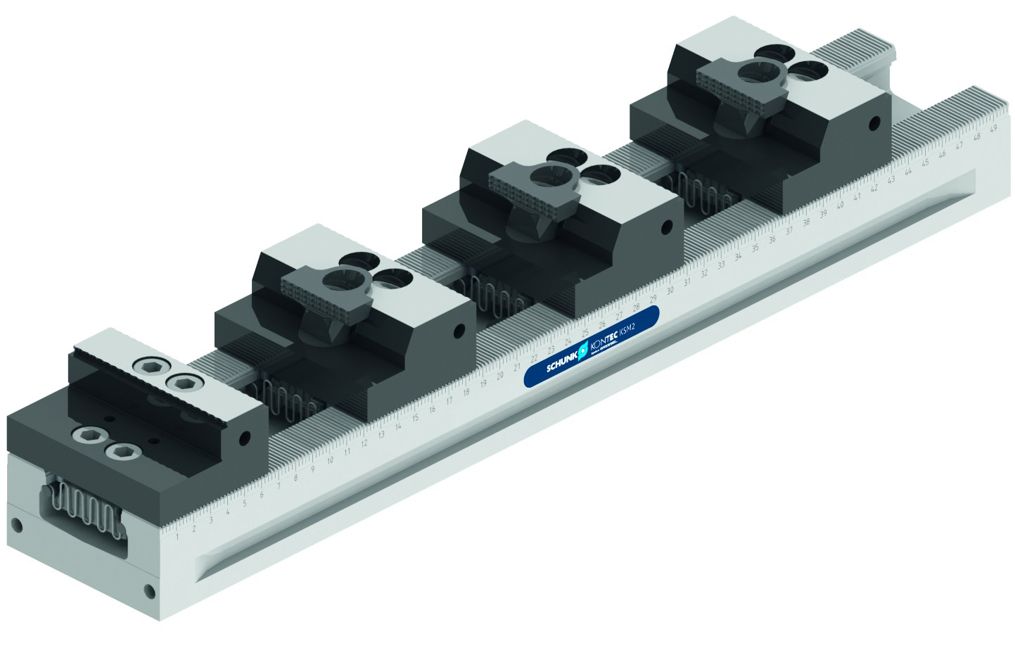
KONTEC KSM2
Multiple clamping system with jaw quick-change system

Slide 2












Product Overview
Gripping Systems
Clamping Technology
Chuck Jaws
Lathe Chucks
Stationary Workholding
Toolholders
Hydraulic Expansion Technology
VERO-S
TANDEM
ROTA
KONTEC
Tombstones
MAGNOS

Slide 3
Challenges
Depth of
production
Time
Flexibility
Global
competition
Time
Time
Increasing importance
of workpiece clamping
heute
zukünftig

Slide 4



SCHUNK Services
Engineering
Dimensioning of special plates designed to the manufacturing specifications
Development of special solutions together with the customer
FEM analysis for critical components
Testing
Endurance tests with all new developments
Abrasion checking
Measurement of accuracy
Service
Initial operation of customer´s solution
Inspection and maintenance
Repairs

Slide 5
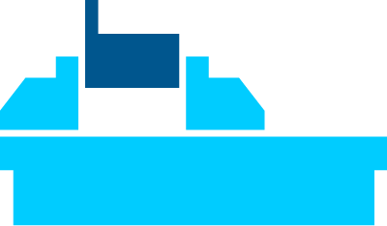
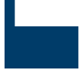



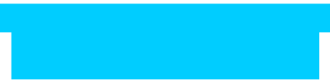
KONTEC Portfolio
Single-acting Vise | Centric Clamping Vise | Multi Clamping Vise
Clamping towards a fixed jaw Fixed jaw as reference High repeat accuracy Especially suitable for workpieces with dimensioning from the side | Symmetric clamping Workpiece zero point is always in the center Optimum accessibility for 5-axis milling Especially suitable for workpieces with dimensioning from the center | Clamping of multiple workpieces Multifunctional usage Reduction of setup times Optimum usage of the machine table

Slide 6
KONTEC Portfolio
Max. Clamping force [kN]
Max. Clamping range [mm]
Jaw width
Jaw width

Slide 7











Fast adaption to new clamping tasks
System Jaws
Standard reversible jaw | Reversible jaw, grip -grip | Enlarged span width -VS | Aluminium jaw -AL
Adapter- and swivel plates -R | 5-axis standard jaw -5A / -5A-VS | 6-fold jaw -6B | Reversible jaw grip, smooth central jaw -ST
Chuck Jaws
Chuck jaw with locator pin | Spring plate, pull-down jaw | Prismatic jaw | Stepped jaw, grip

Slide 8



KONTEC Overview
Single-acting Vise
Centric Clamping Vise
Multi Clamping Vise

Slide 9
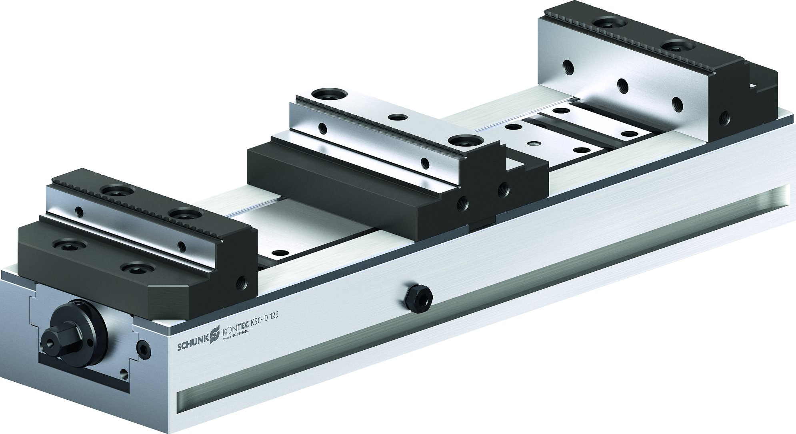
KONTEC Multi Clamping Vise
KSC-D
Basic Clamping Vise
KSM2
Clamping rail with jaw quick-change

Slide 10
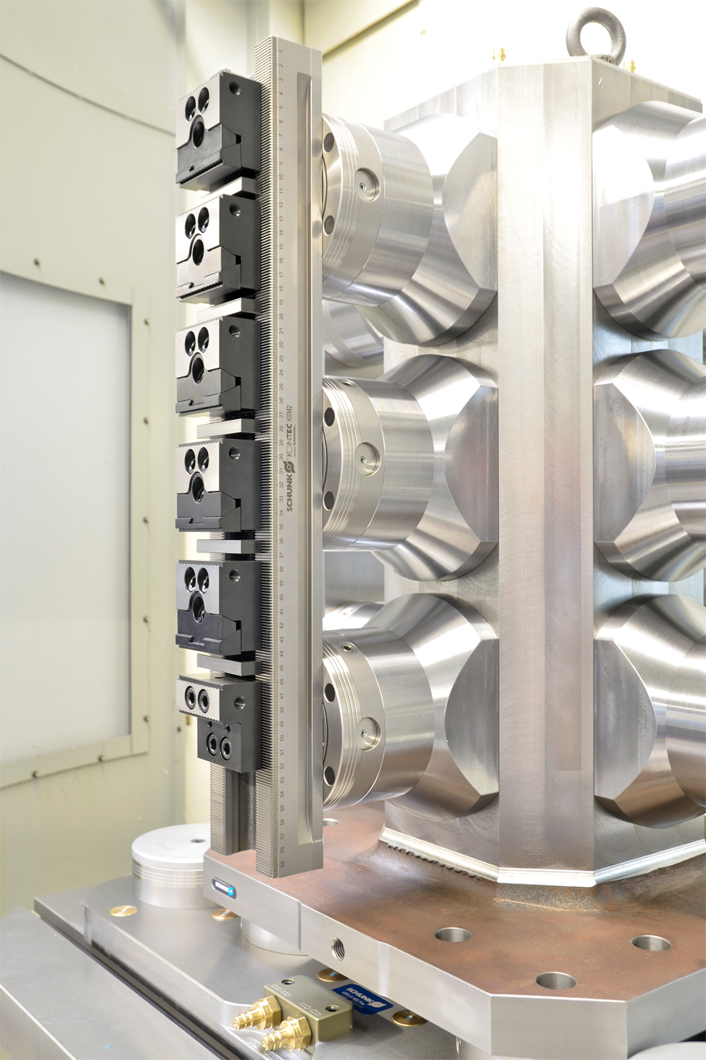
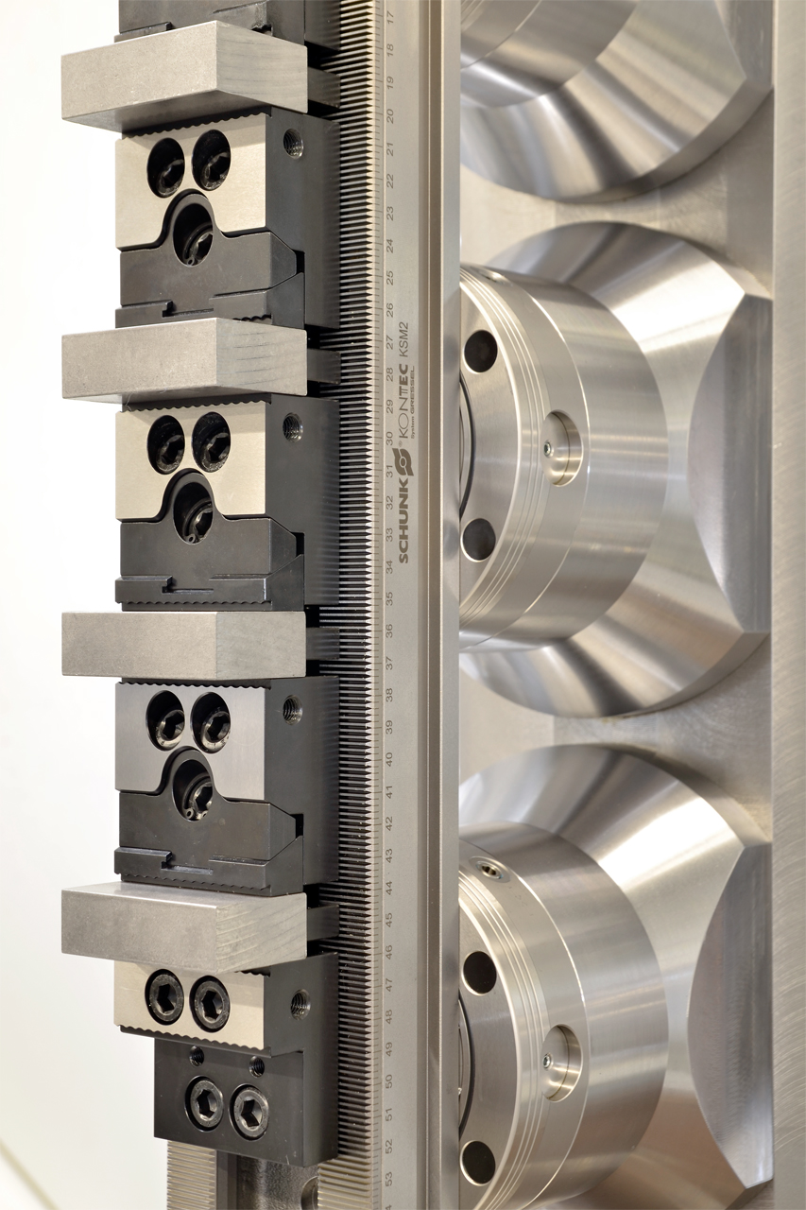
KONTEC KSM2
Example of application

Slide 11
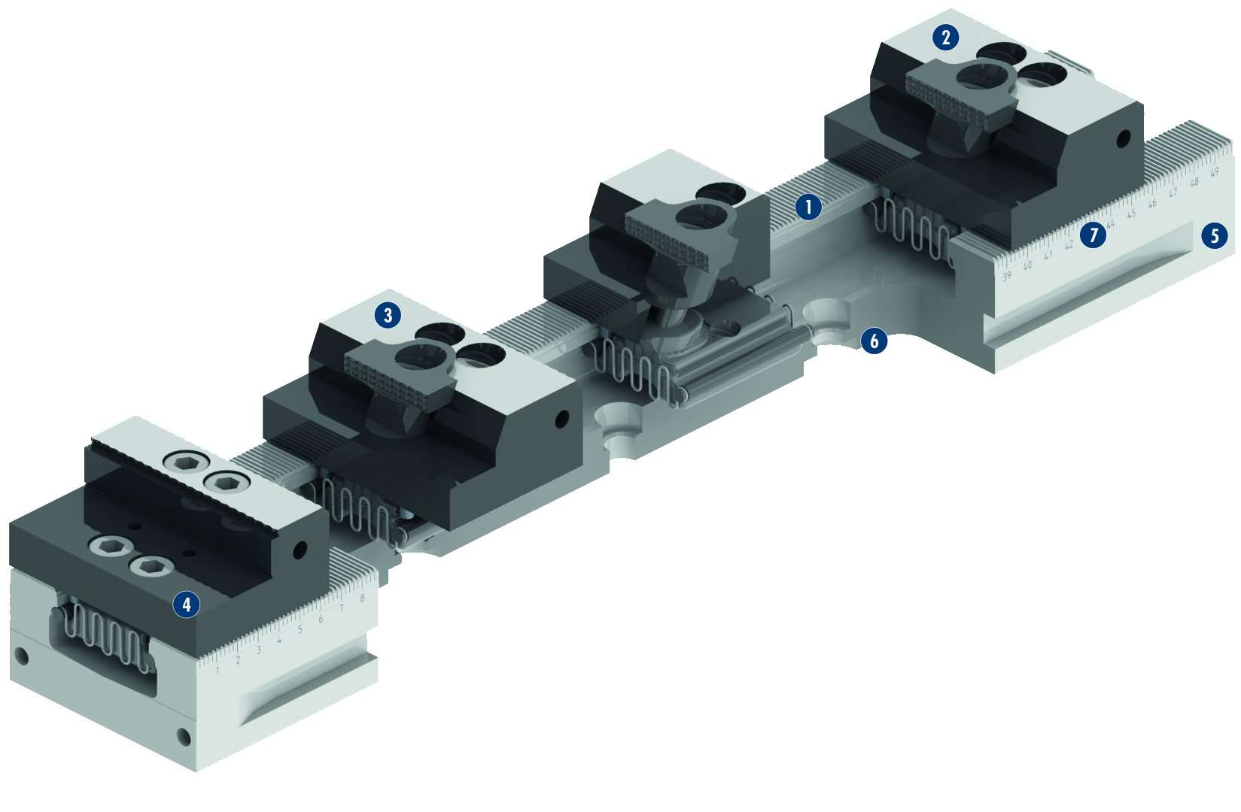
KONTEC KSM2
2
1
Hardened and ground serration
Vast chuck jaw program
Jaw positioning form above
Fixed jaw can be turned 180°
Extremely rigid clamping rail
VERO-S interface
Laser-etched ruler
1
7
5
2
3
3
6
4
5
6
7
4

Slide 12
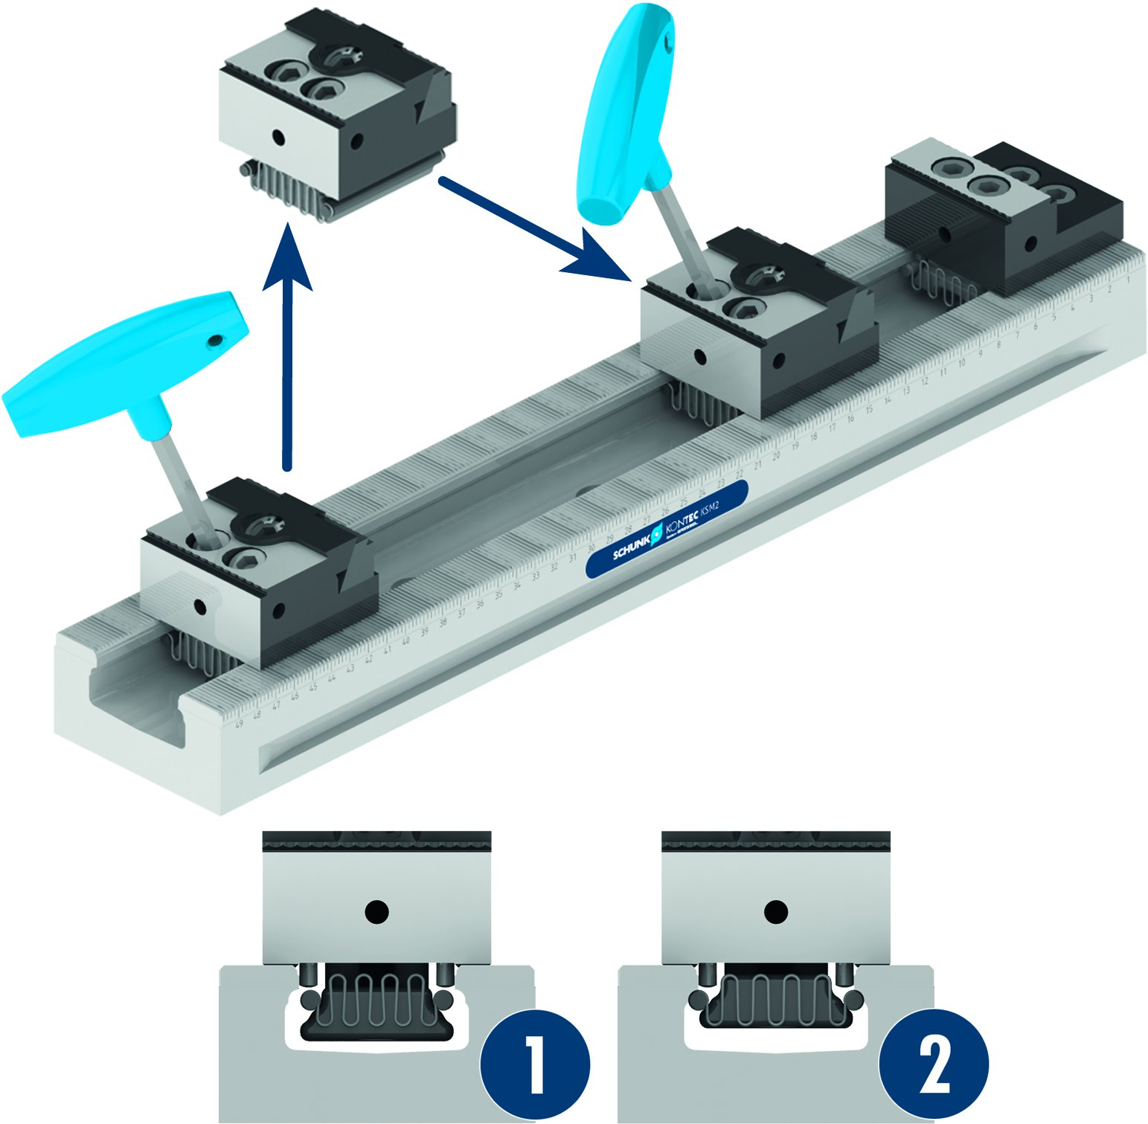
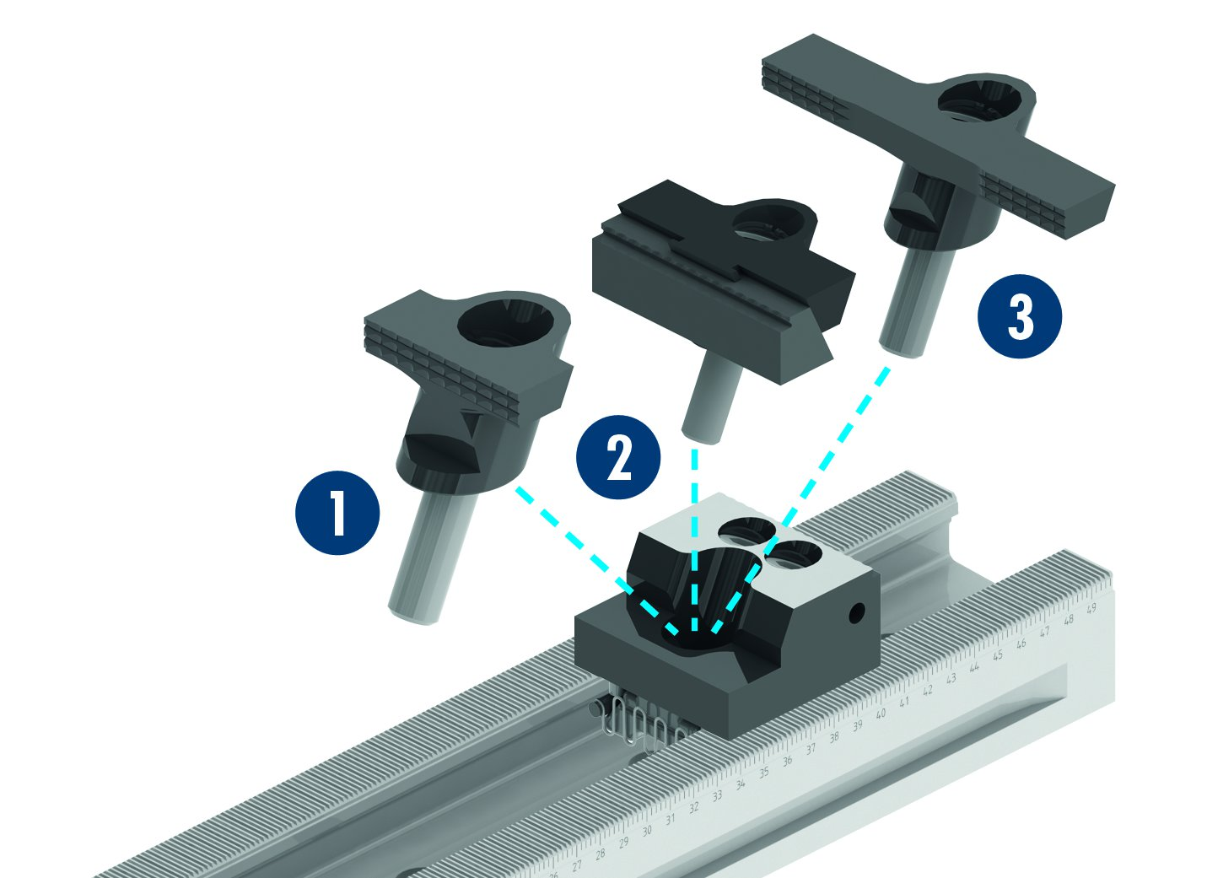

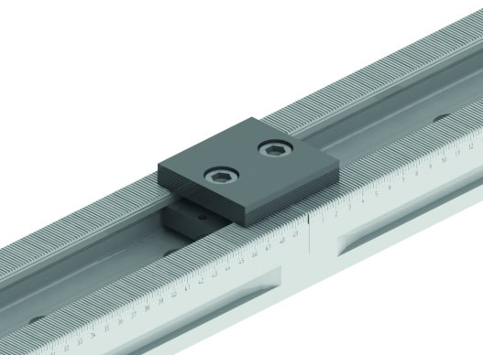
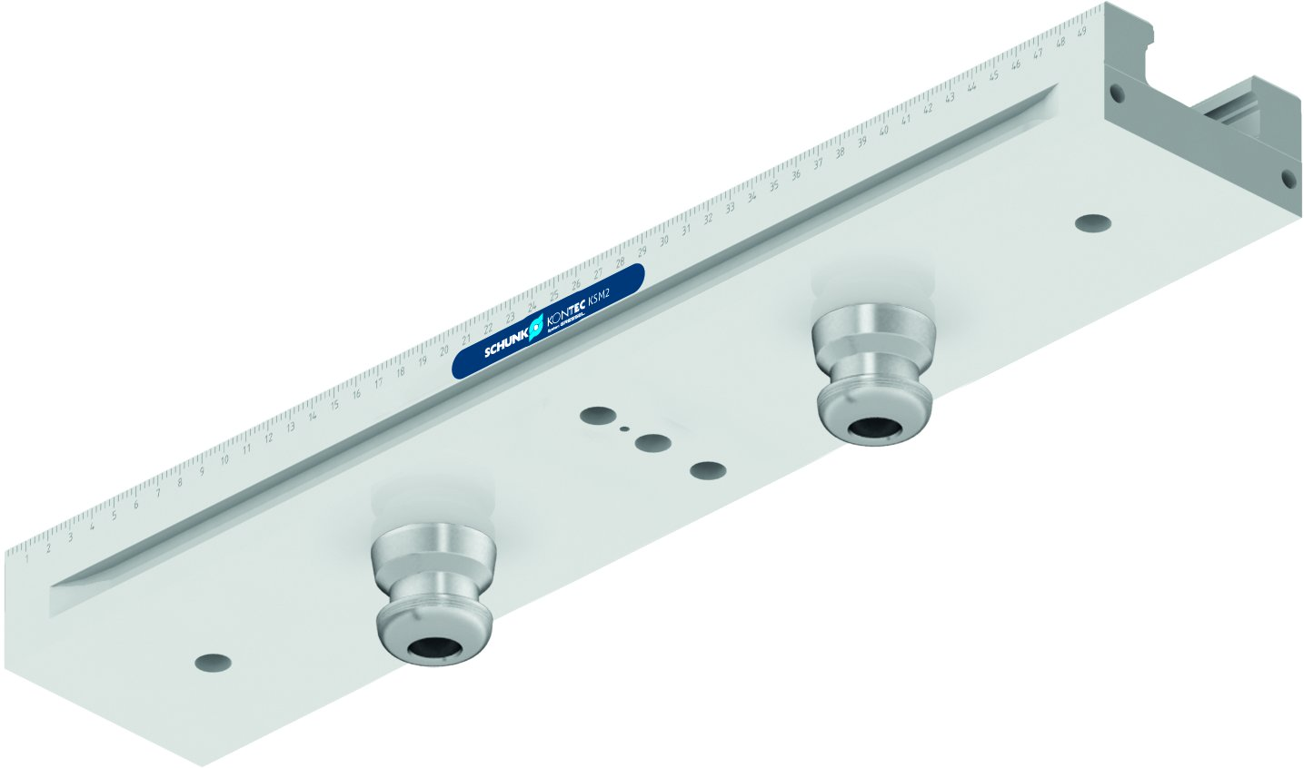
KONTEC KSM2
Jaw quick-change of the supporting jaws
Jaw quick-change of the chuck jaws
Pull-down jaw grip
Parallel jaw
Pendulum jaw grip with pull-down function
1
Release position
Clamping position
2
3
2
1
2
3
1
2
Connection of the clamping rails
Positioning the clamping rail via VERO-S quick-change pallet system

Slide 13
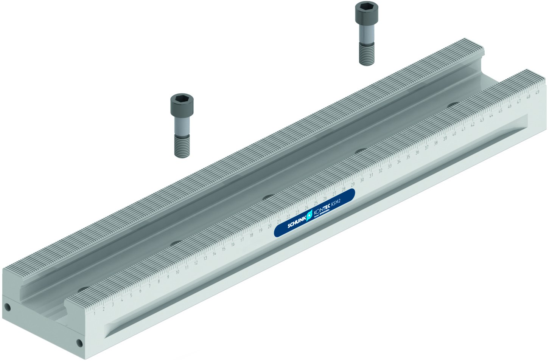
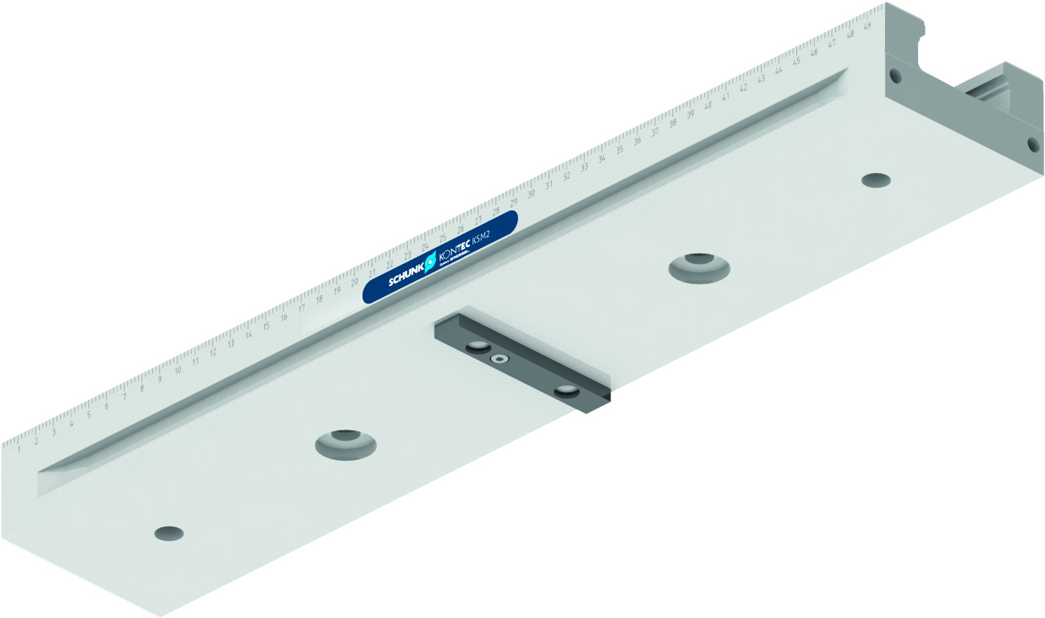
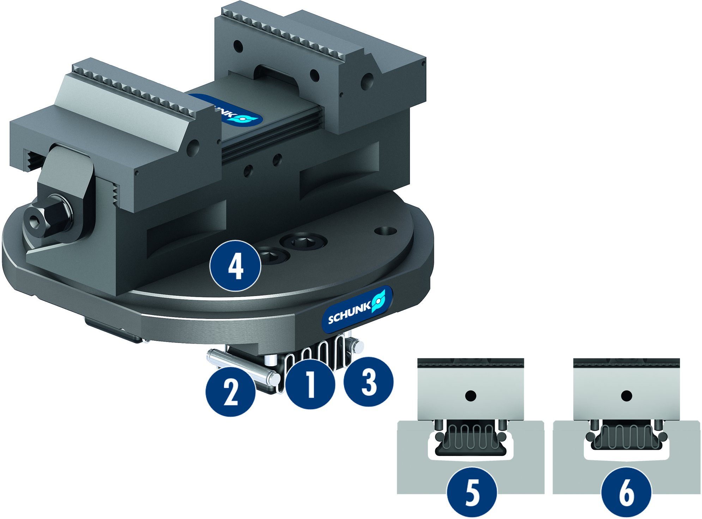
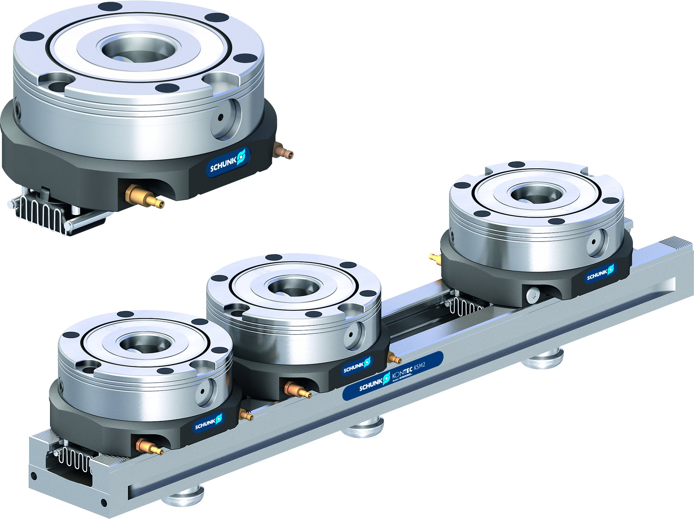
KONTEC KSM2
Positioning the clamping rail via grid holes
Positioning the clamping rail via grid holes
Adapter plates for KSM2 rails
KSM2 with APK VERO-S NSE plus 138-V1
1
Clamps
Locking roller for mounting the clamping device on the KSM2
Return spring for loosening the clamping mechanism
Freely accessible clamping
screws
Released position
Clamped position
2
4
3
2
1
3
4
5
6
5
6

Slide 14
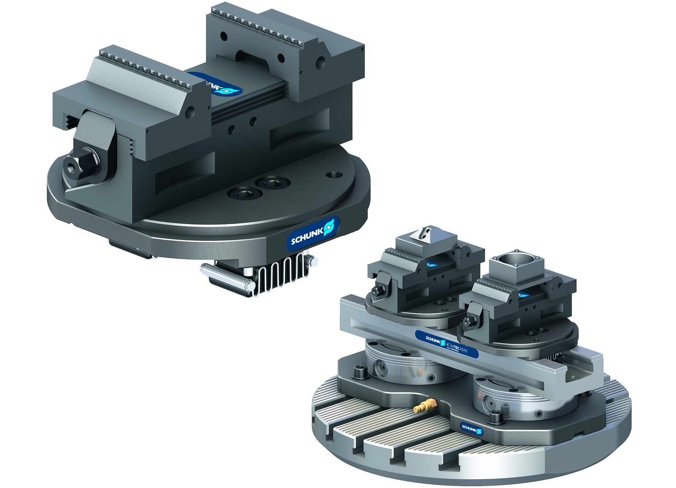
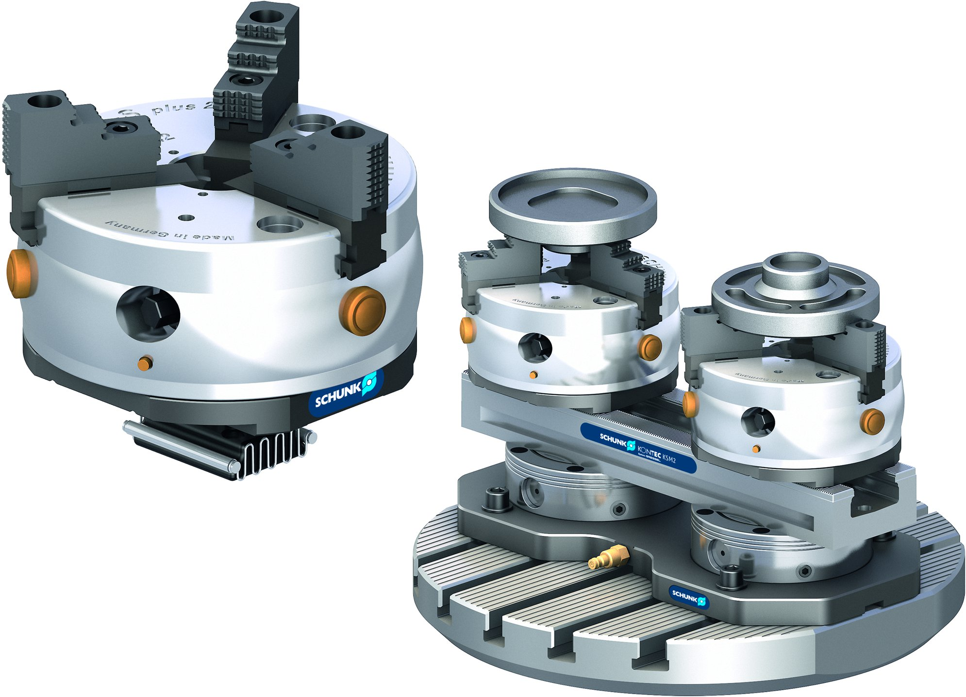
KONTEC KSM2
KSM2 with APK KONTEC KSC2
KSM2 with APK ROTA-S plus 2.0 160

Slide 15
Variants of KONTEC KSM2
Technical data | KSM2 90-260 | KSM2 90-400 | KSM2 90-500 | KSM2 90-600 | KSM2 90-650
Rail width [mm] | 90 | 90 | 90 | 90 | 90
Clamping force [kN] | 30 | 30 | 30 | 30 | 30
Max. torque [Nm] | 50 | 50 | 50 | 50 | 50
Weight [kg] | 5 | 7.7 | 9.6 | 11.5 | 12.5

