Slide 1


KONTEC KSG
Modular designed machine vise

Slide 2












Product Overview
Gripping Systems
Clamping Technology
Chuck Jaws
Lathe Chucks
Stationary Workholding
Toolholders
Hydraulic Expansion Technology
VERO-S
TANDEM
ROTA
KONTEC
Tombstones
MAGNOS

Slide 3
Challenges
Depth of
production
Time
Flexibility
Global
competition
Time
Time
Increasing importance
of workpiece clamping
heute
zukünftig

Slide 4



SCHUNK Services
Engineering
Dimensioning of special plates designed to the manufacturing specifications
Development of special solutions together with the customer
FEM analysis for critical components
Testing
Endurance tests with all new developments
Abrasion checking
Measurement of accuracy
Service
Initial operation of customer´s solution
Inspection and maintenance
Repairs

Slide 5






KONTEC Portfolio
Single-acting Vise | Centric Clamping Vise | Multi Clamping Vise
Clamping towards a fixed jaw Fixed jaw as reference High repeat accuracy Especially suitable for workpieces with dimensioning from the side | Symmetric clamping Workpiece zero point is always in the center Optimum accessibility for 5-axis milling Especially suitable for workpieces with dimensioning from the center | Clamping of multiple workpieces Multifunctional usage Reduction of setup times Optimum usage of the machine table

Slide 6
KONTEC Portfolio
Max. Clamping force [kN]
Max. Clamping range [mm]
Jaw width
Jaw width

Slide 7











Fast adaption to new clamping tasks
System Jaws
Standard reversible jaw | Reversible jaw, grip -grip | Enlarged span width -VS | Aluminium jaw -AL
Adapter- and swivel plates -R | 5-axis standard jaw -5A / -5A-VS | 6-fold jaw -6B | Reversible jaw grip, smooth central jaw -ST
Chuck Jaws
Chuck jaw with locator pin | Spring plate, pull-down jaw | Prismatic jaw | Stepped jaw, grip

Slide 8



KONTEC Overview
Single-acting Vise
Centric Clamping Vise
Multi Clamping Vise

Slide 9



KONTEC Single-acting Vise
With force amplification
Without force amplification
KSG
Machine vise
KSC-F
Basic clamping vise
KSX
5-axis clamping vise
KSO
Clamping vise for small components

Slide 10
KONTEC KSG
Anwendungsbeispiel
KONTEC:
Spannmittel:
Merkmale/Anwendung:

Slide 11
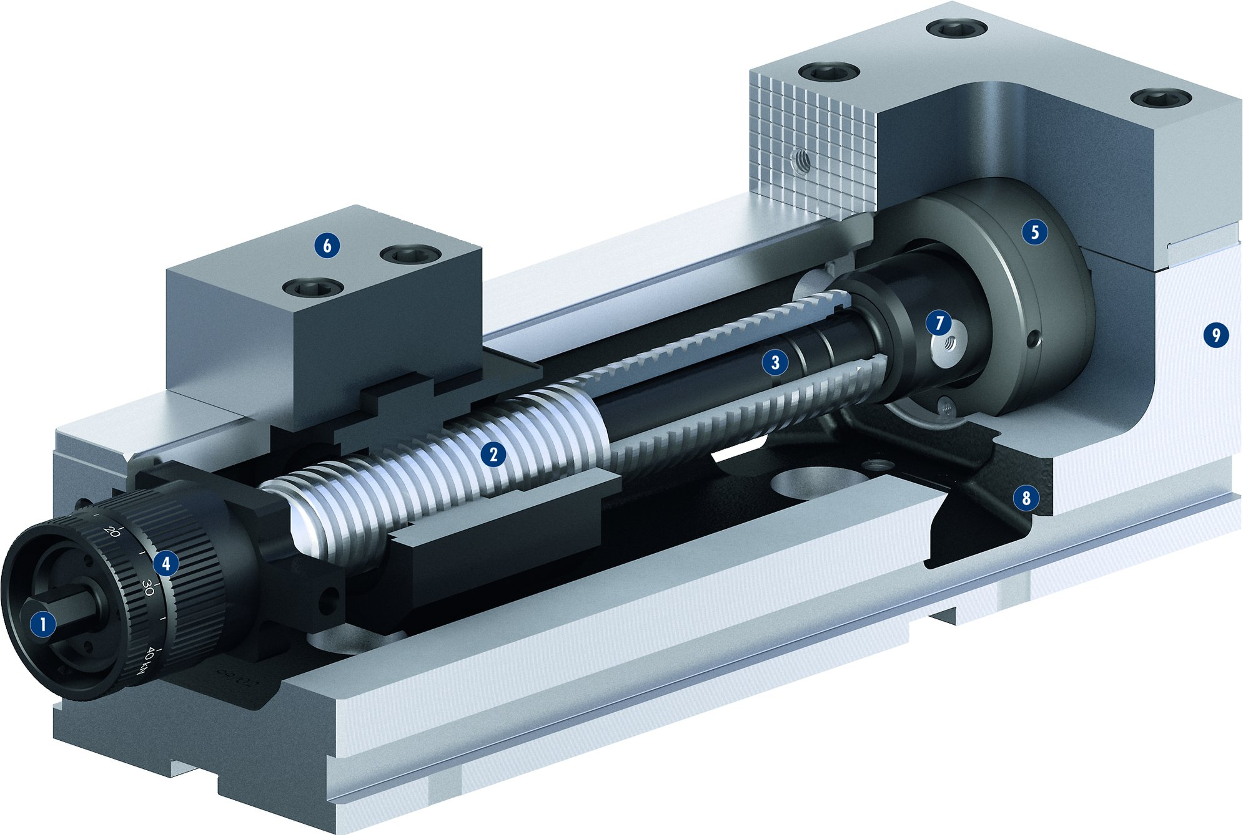
KONTEC KSG
1
Encapsulated force transmission
Trouble-free clamping
Versatile range of chuck jaws
Controlled clamping force
Precise base body
Cooling lubricant drain
Clamping force via drawbar
Lever quick clamping
Easy removal of spindle assembly group
2
3
1
3
9
5
4
7
5
2
6
6
7
4
8
8
9

Slide 12
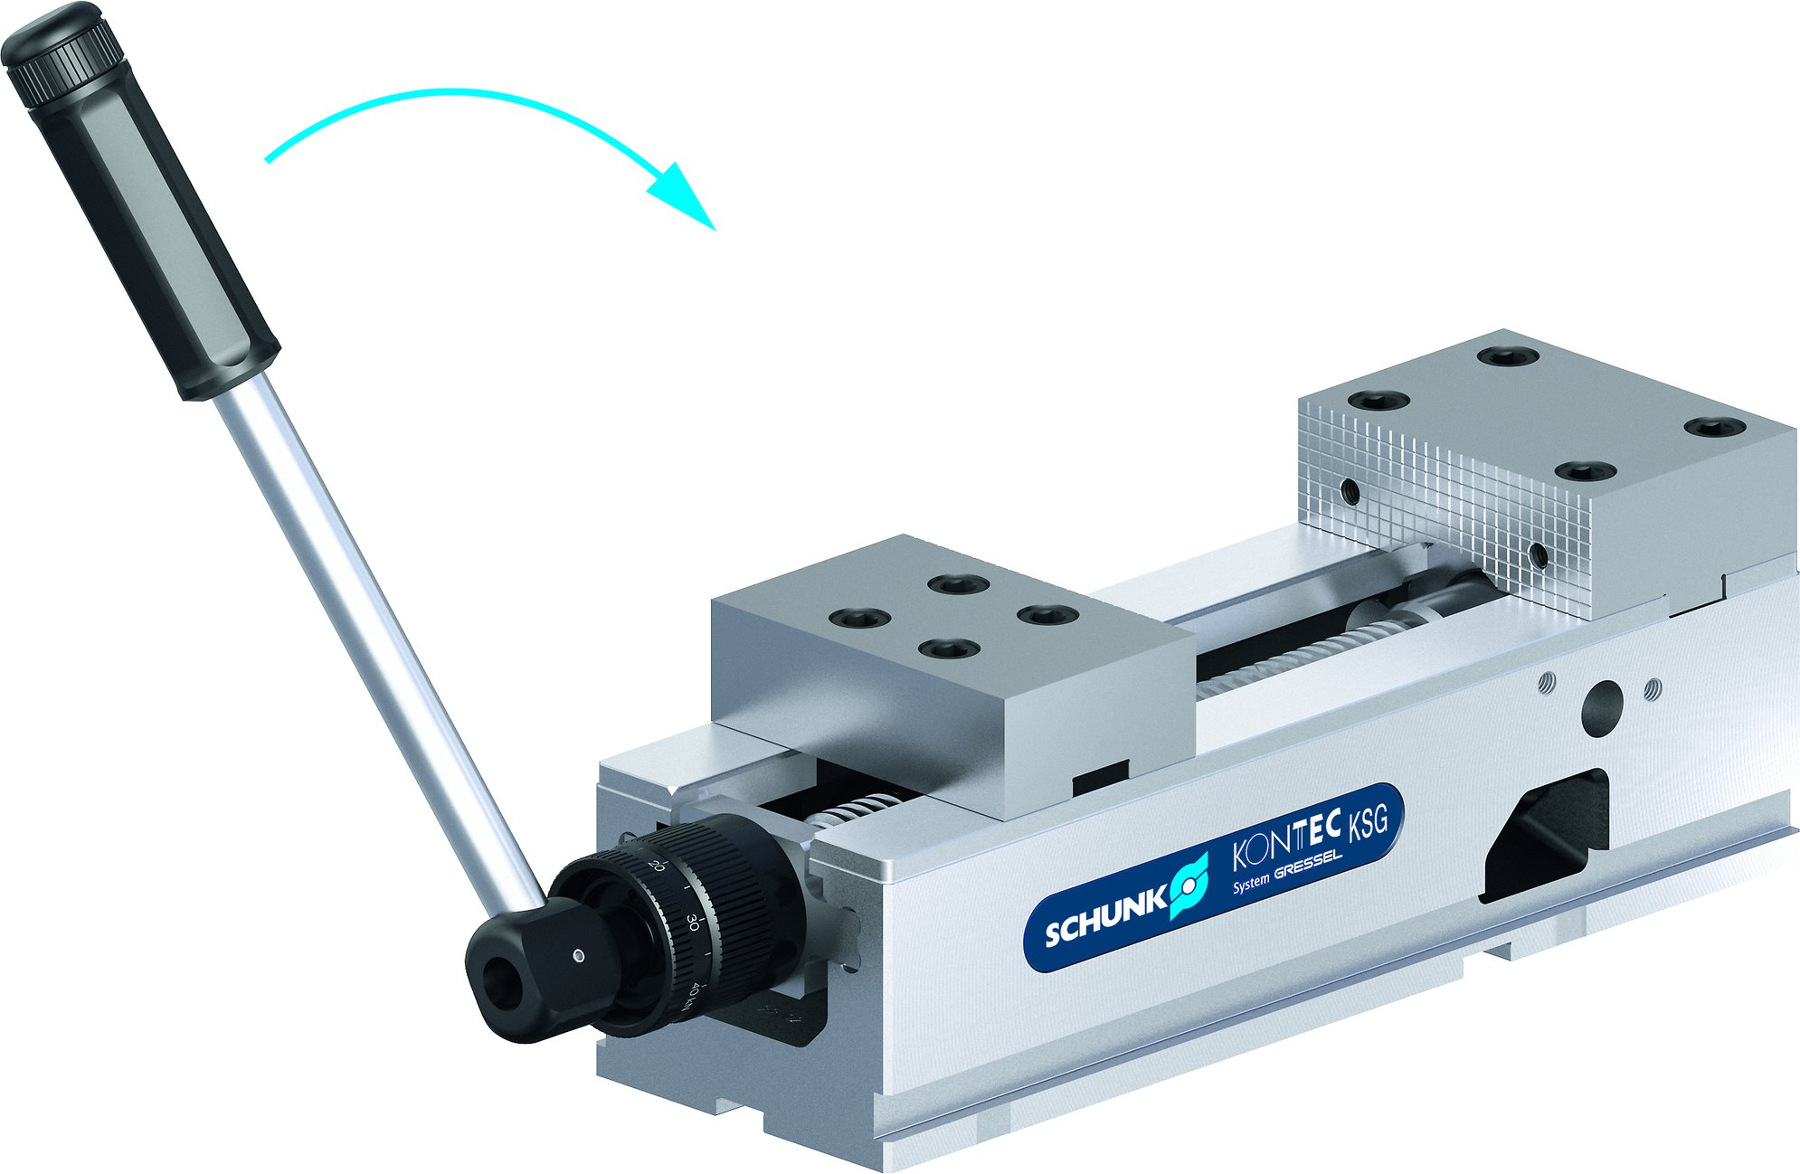
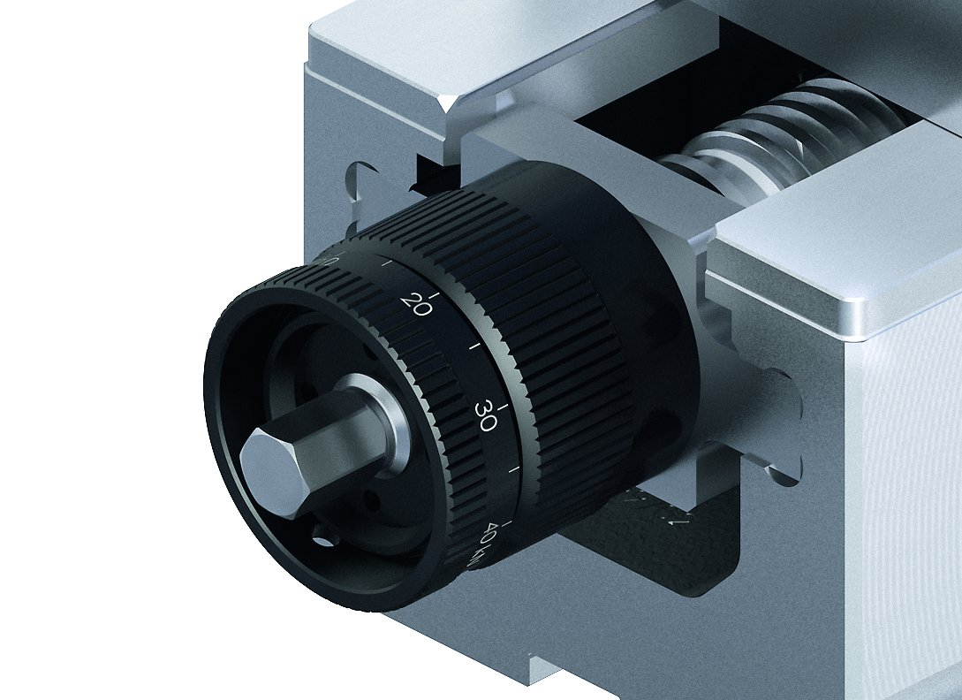
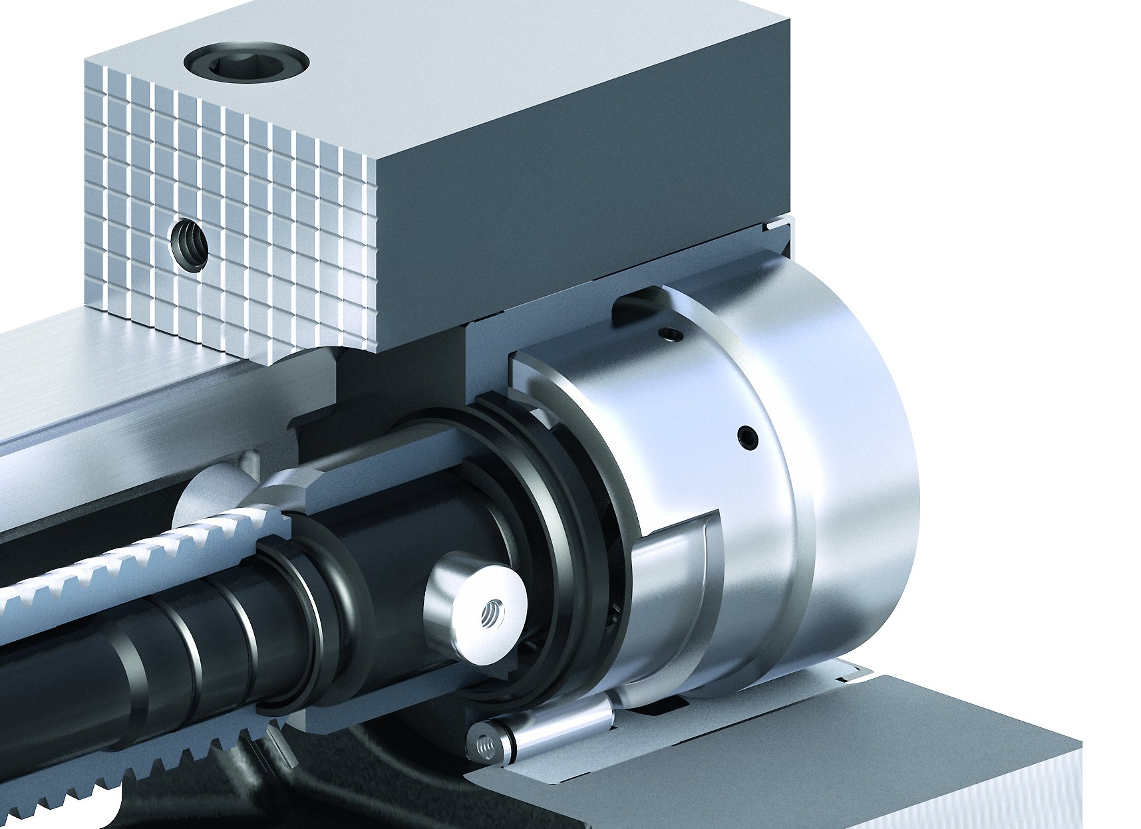
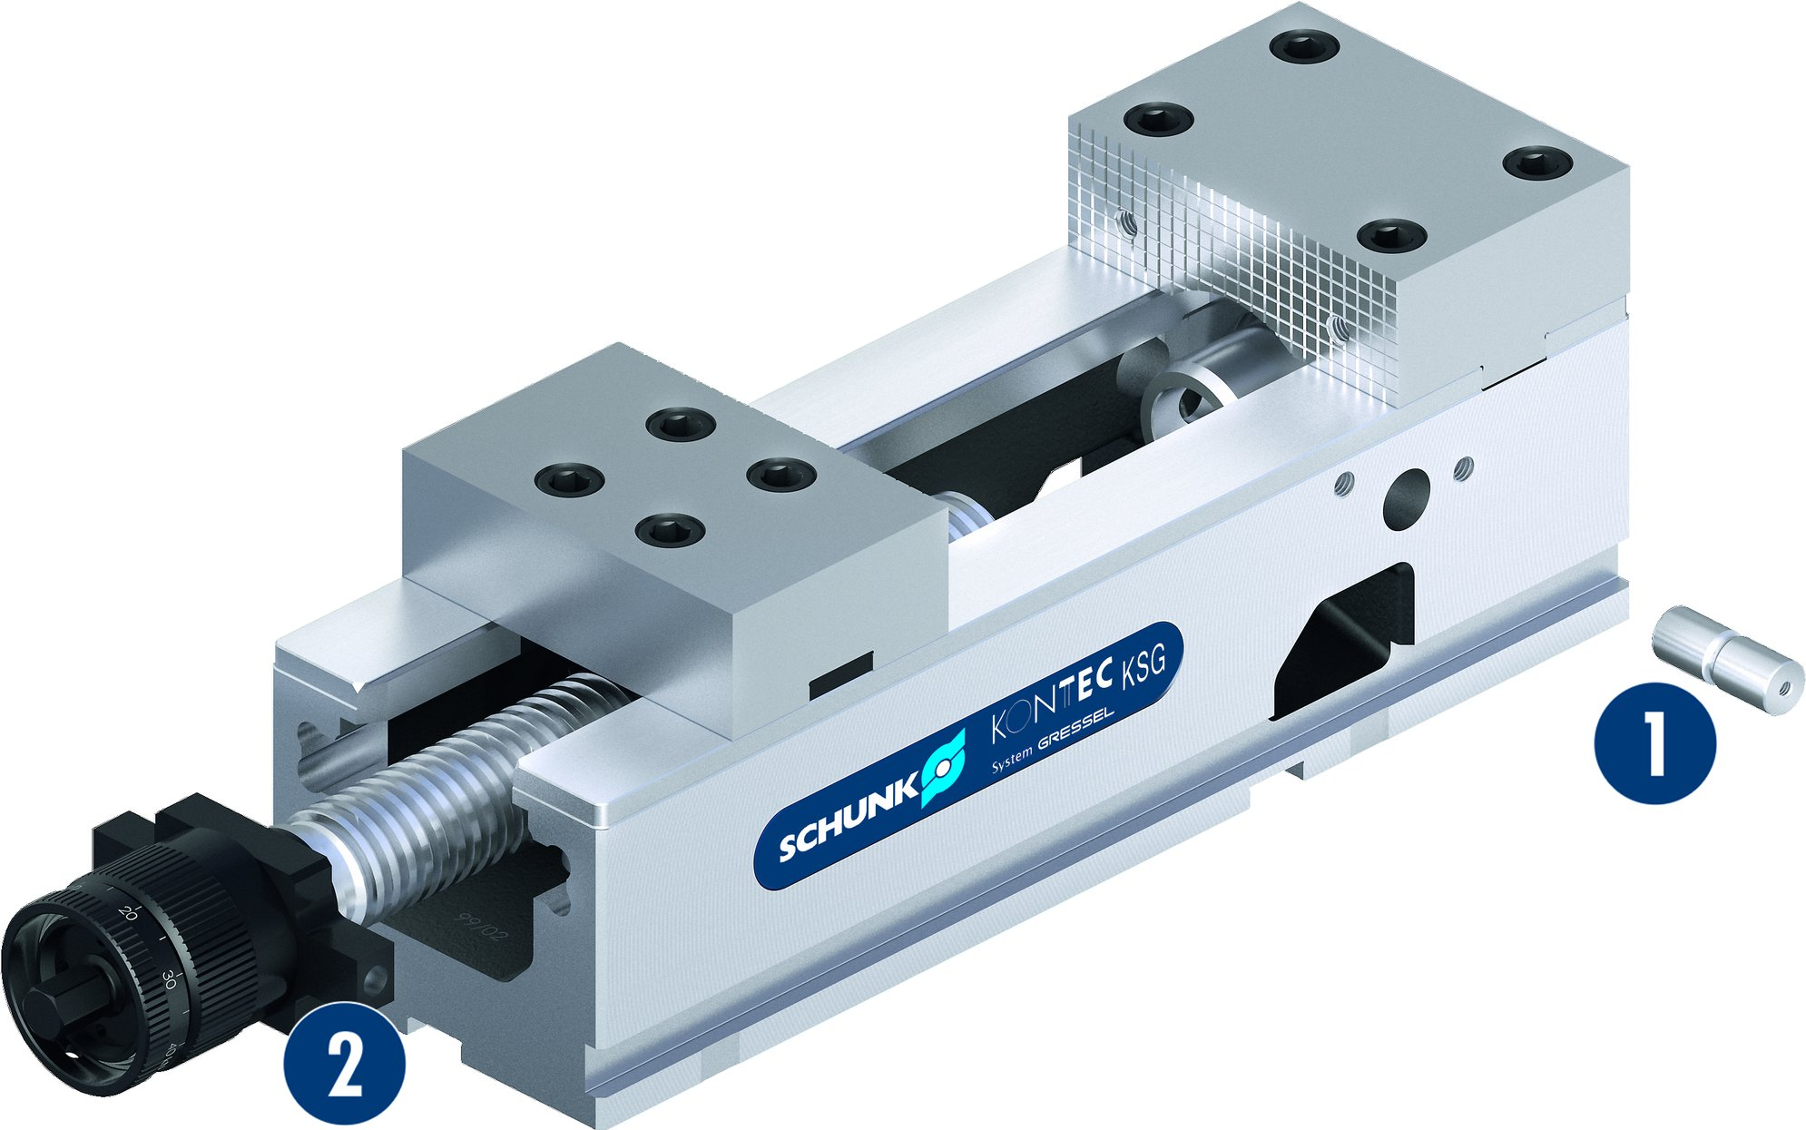
KONTEC KSG
Lever quick clamping
Continously adjustable clamping force
Completely encapsulated force transmission box
Can be cleanded and disassembled in just a few seconds
1
Coupling pin
Spindle assembly group
1
2
2

Slide 13
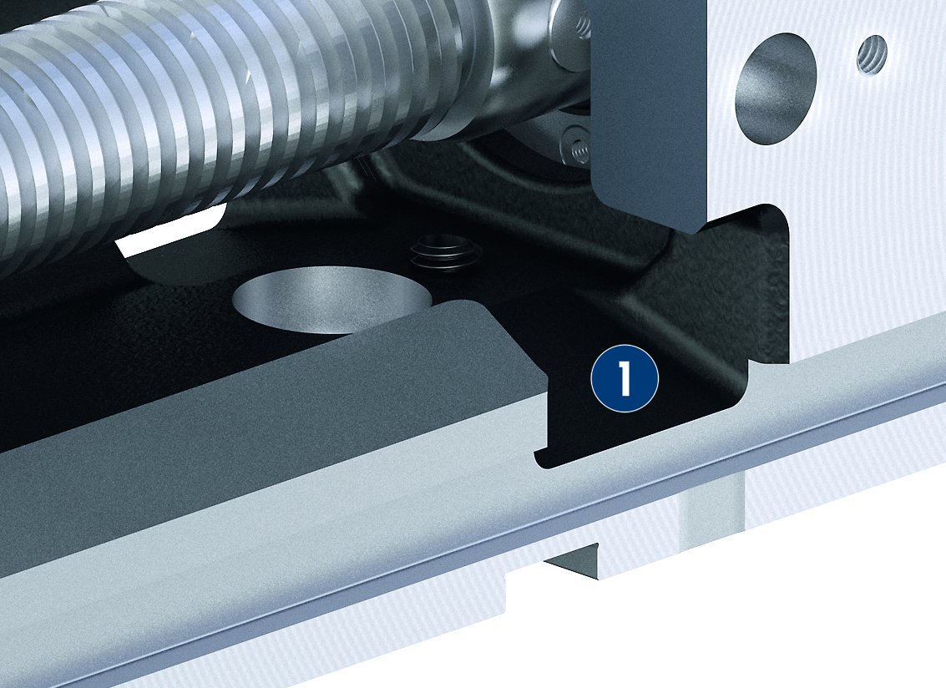
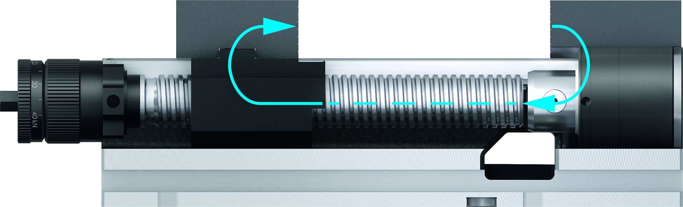
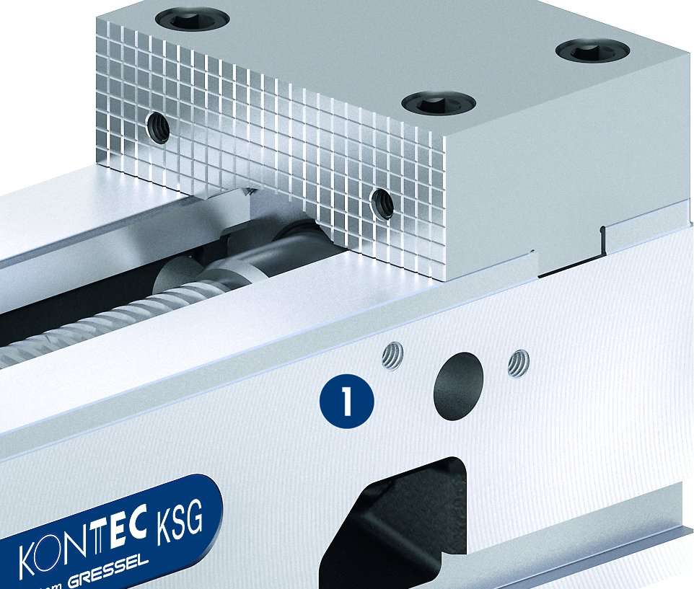
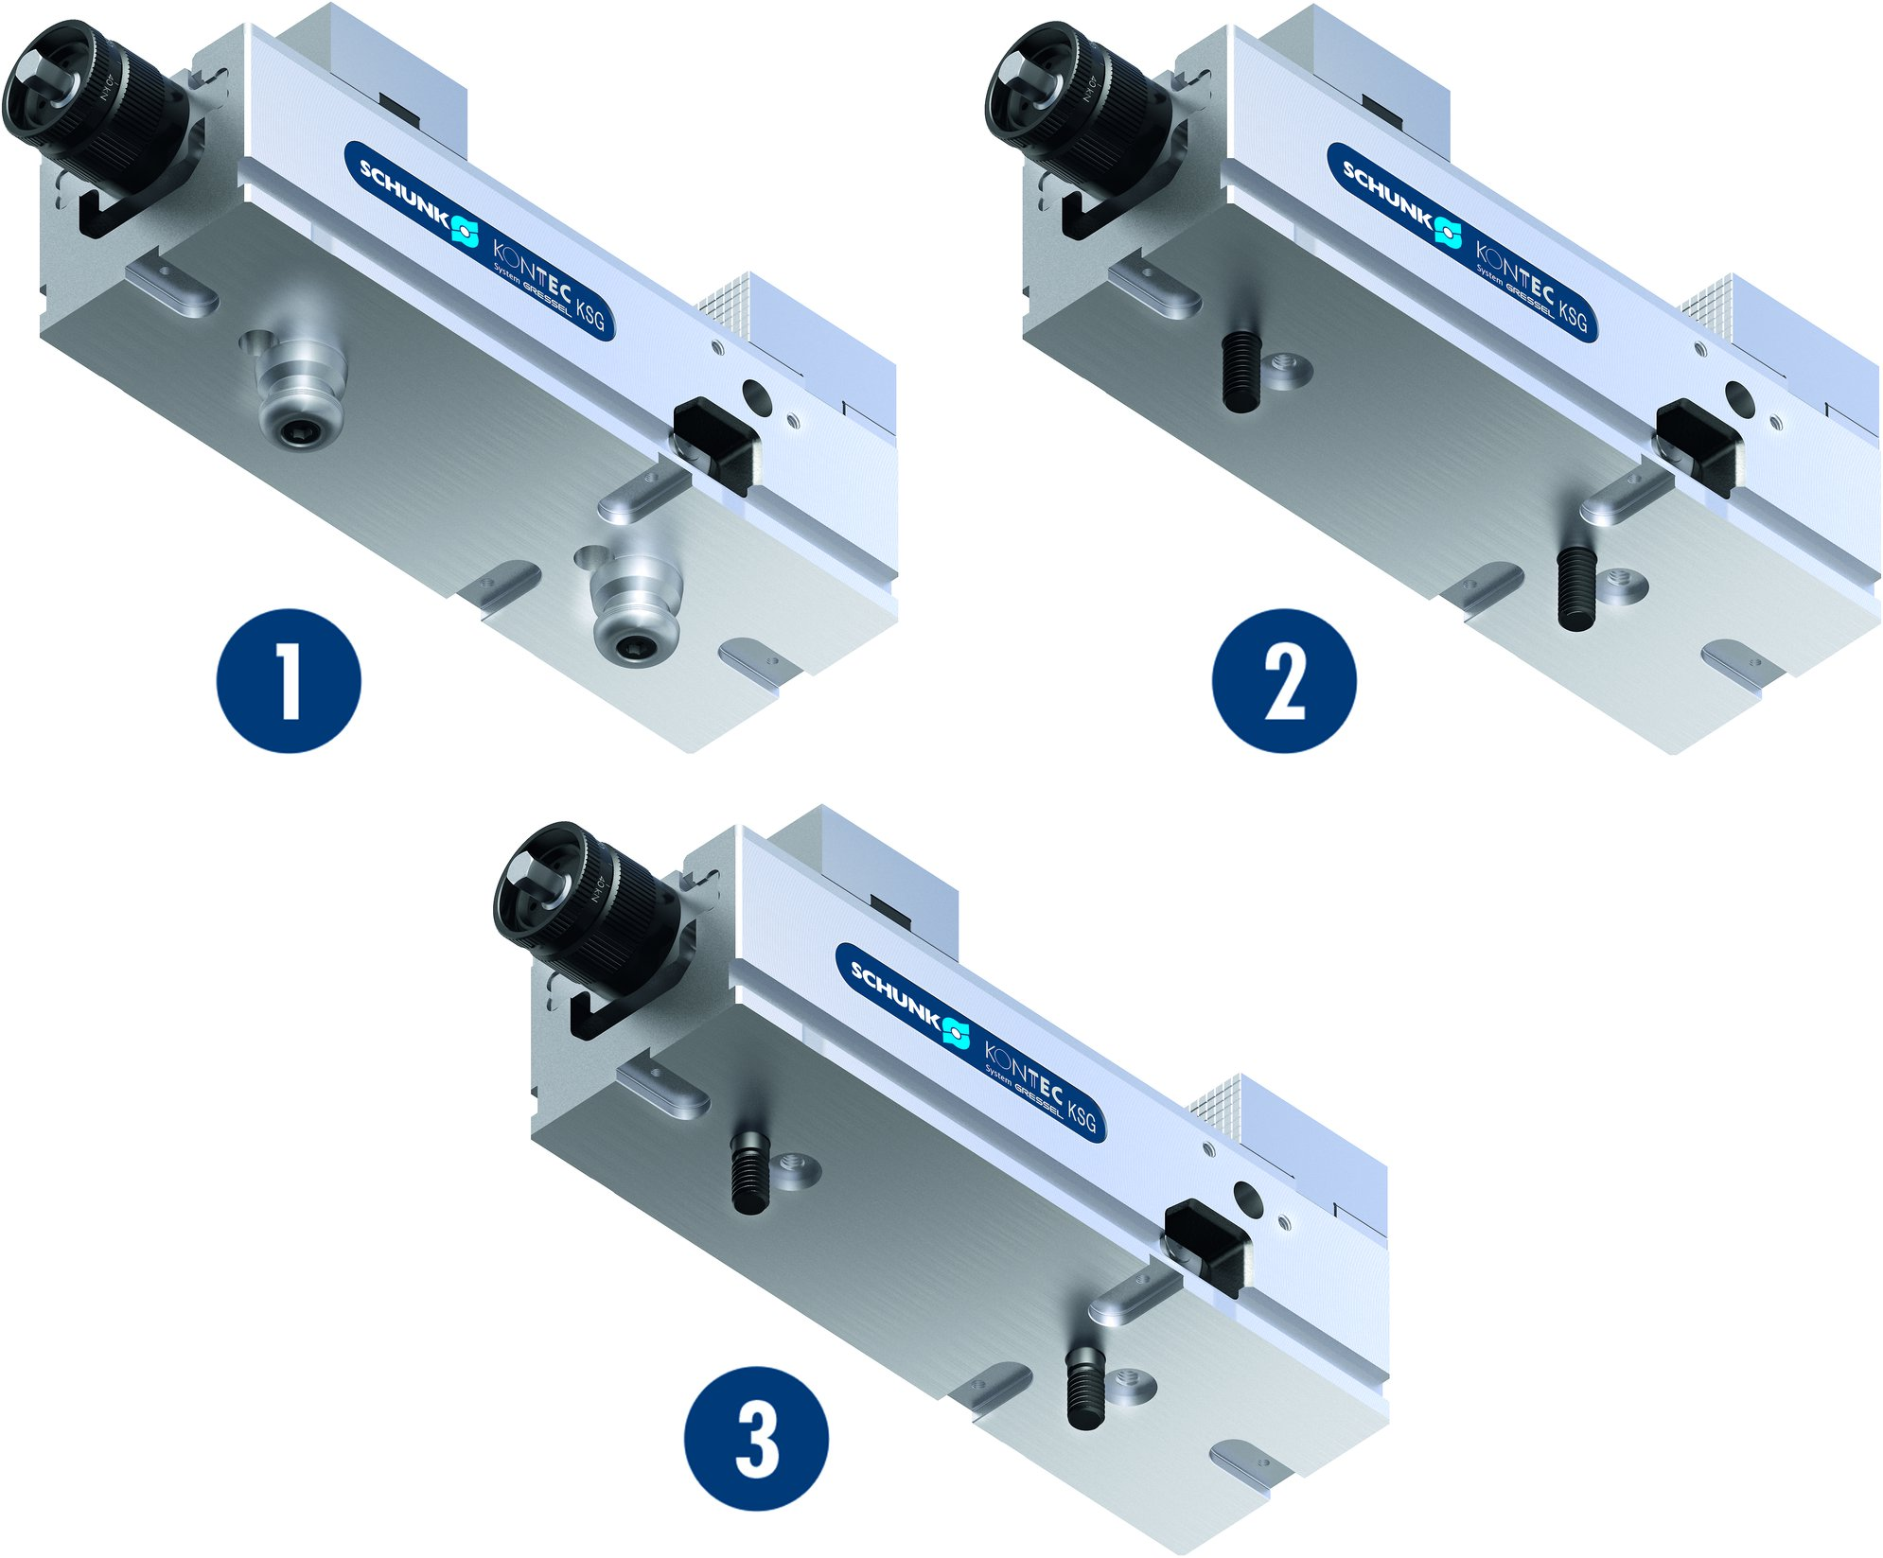
KONTEC KSG
Clamping by tension
Drainage slots
1
Drainage slot
1
Threads for workpiece stops in the base body
Mounting options
1
Fastening via quick-change pallet system
Fastening using two screws
Fastening for positional orientation using fitting screws
1
Thread for stops
1
2
2
1
3
3

Slide 14
Variants of KONTEC KSG
Technical data | KSG 100* | KSG 125* | KSG 160*
Jaw width [mm] | 100 | 125 | 160
Clamping force [kN] | 4 - 30 | 4 - 40 | 4 - 40
* Additionally available in -VS, -R, -5A-VS

