Slide 1


KONTEC KSC-F
The highly efficient all-rounder for raw and finished part machining

Slide 2












Product Overview
Gripping Systems
Clamping Technology
Chuck Jaws
Lathe Chucks
Stationary Workholding
Toolholders
Hydraulic Expansion Technology
VERO-S
TANDEM
ROTA
KONTEC
Tombstones
MAGNOS

Slide 3
Challenges
Depth of
production
Time
Flexibility
Global
competition
Time
Time
Increasing importance
of workpiece clamping
heute
zukünftig

Slide 4



SCHUNK Services
Engineering
Dimensioning of special plates designed to the manufacturing specifications
Development of special solutions together with the customer
FEM analysis for critical components
Testing
Endurance tests with all new developments
Abrasion checking
Measurement of accuracy
Service
Initial operation of customer´s solution
Inspection and maintenance
Repairs

Slide 5






KONTEC Portfolio
Single-acting Vise | Centric Clamping Vise | Multi Clamping Vise
Clamping towards a fixed jaw Fixed jaw as reference High repeat accuracy Especially suitable for workpieces with dimensioning from the side | Symmetric clamping Workpiece zero point is always in the center Optimum accessibility for 5-axis milling Especially suitable for workpieces with dimensioning from the center | Clamping of multiple workpieces Multifunctional usage Reduction of setup times Optimum usage of the machine table

Slide 6
KONTEC Portfolio
Max. Clamping force [kN]
Max. Clamping range [mm]
Jaw width
Jaw width

Slide 7











Fast adaption to new clamping tasks
System Jaws
Standard reversible jaw | Reversible jaw, grip -grip | Enlarged span width -VS | Aluminium jaw -AL
Adapter- and swivel plates -R | 5-axis standard jaw -5A / -5A-VS | 6-fold jaw -6B | Reversible jaw grip, smooth central jaw -ST
Chuck Jaws
Chuck jaw with locator pin | Spring plate, pull-down jaw | Prismatic jaw | Stepped jaw, grip

Slide 8



KONTEC Overview
Single-acting Vise
Centric Clamping Vise
Multi Clamping Vise

Slide 9



KONTEC Single-acting Vise
With force amplification
Without force amplification
KSG
Machine vise
KSC-F
Basic clamping vise
KSX
5-axis clamping vise
KSO
Clamping vise for small components

Slide 10
KONTEC KSC-F
Example of application
Spannmittel:
Merkmale/Anwendung:

Slide 11
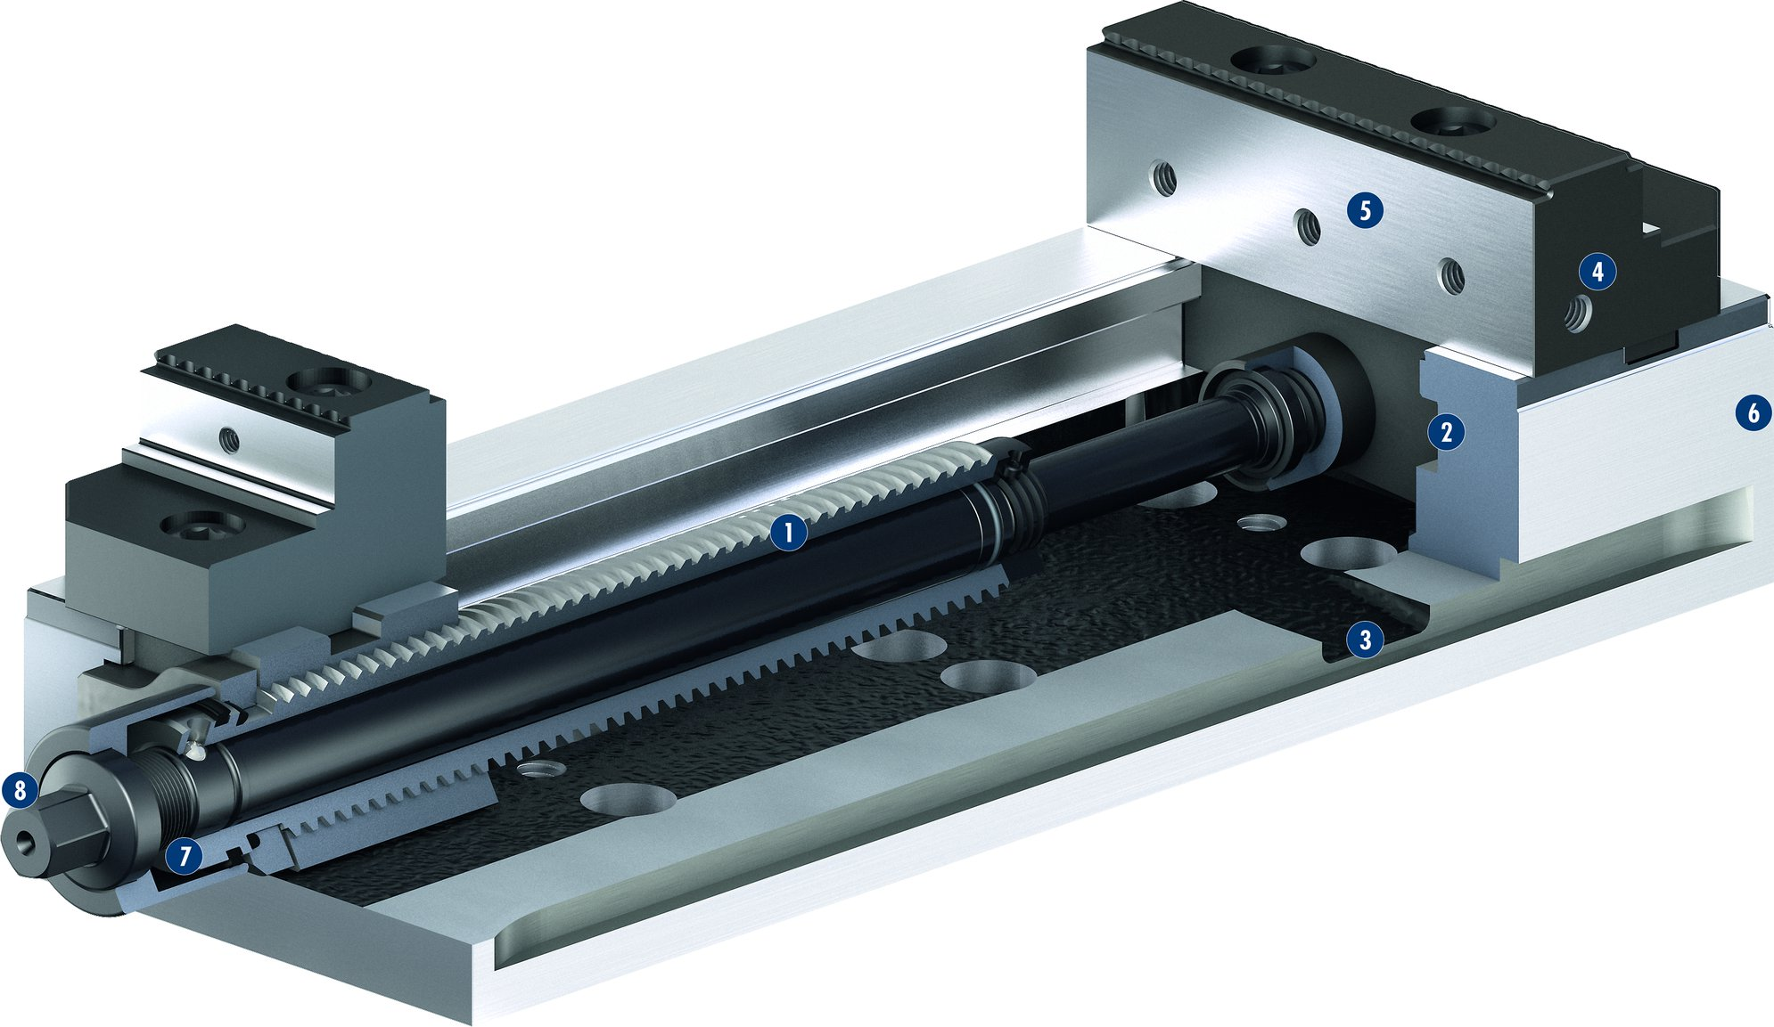
KONTEC KSC-F
1
Spindle drive
Long jaw guidance
Drainage slots
Mounting threads
Standard jaw interface
Low height
Mechanical force transmission
Operation via hexagon connection
5
4
2
3
2
6
4
1
5
3
6
8
7
7
8

Slide 12
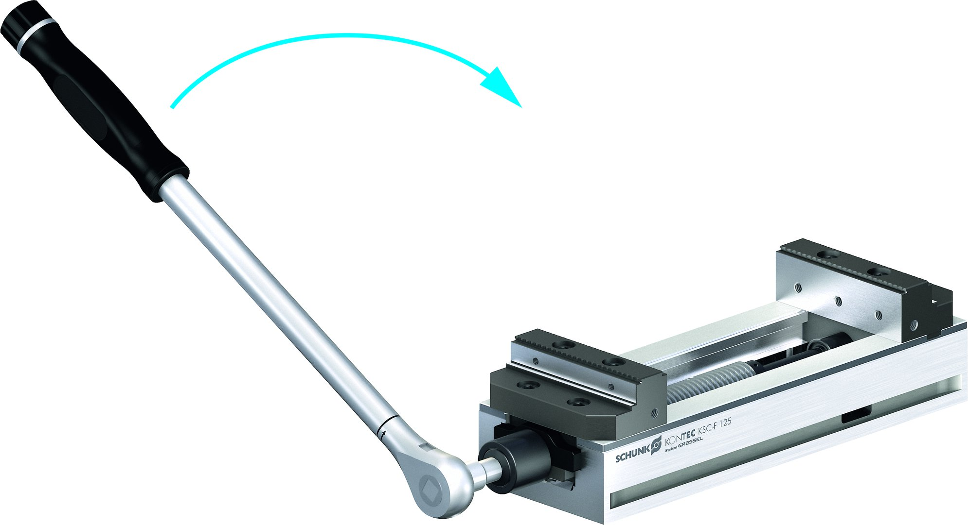
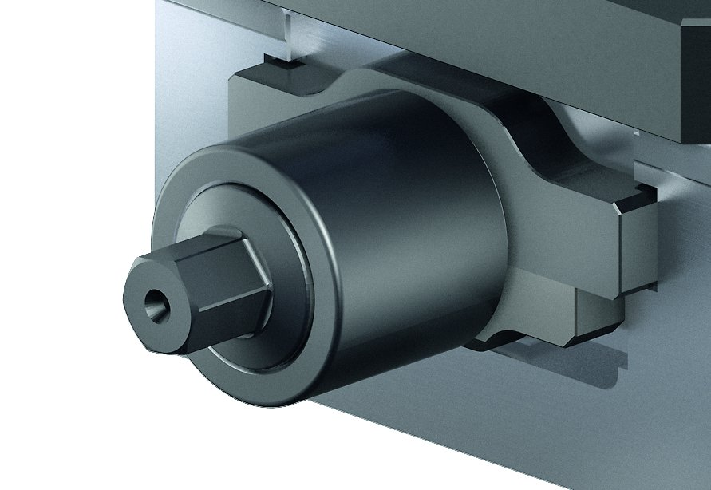
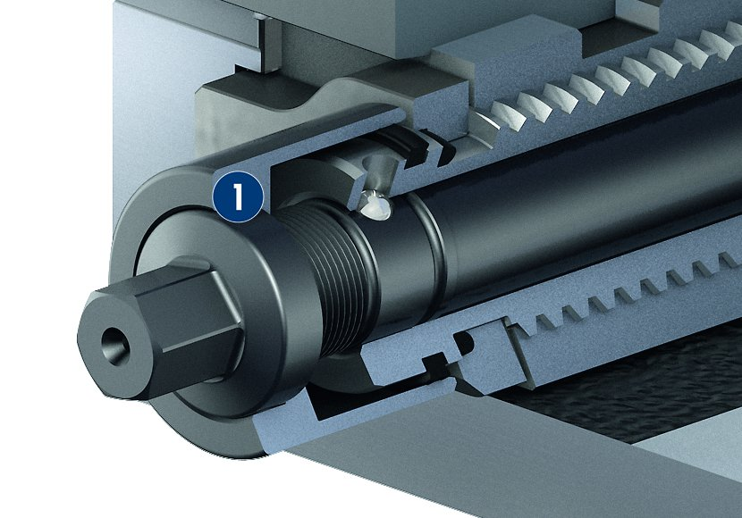
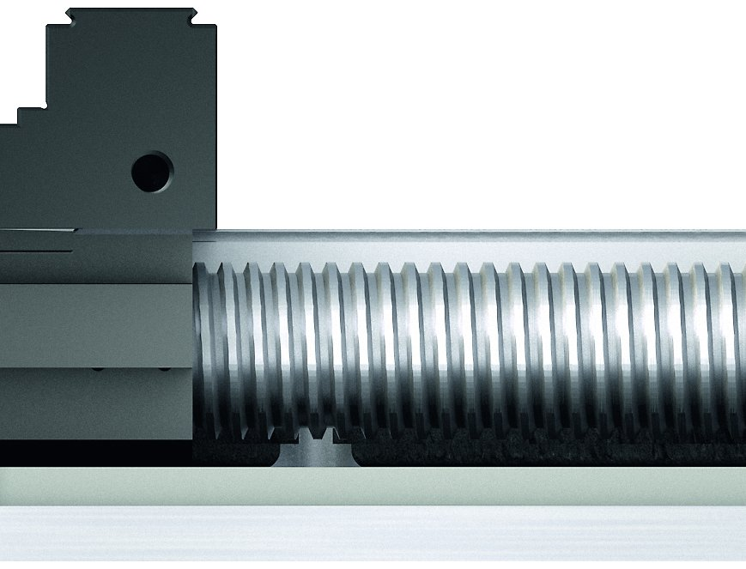
KONTEC KSC-F
Quick clamping
Actuation via hexagon nut
Force actuation via fine thread
Quick-adjustment of the clamping range
1
1
Fine thread

Slide 13
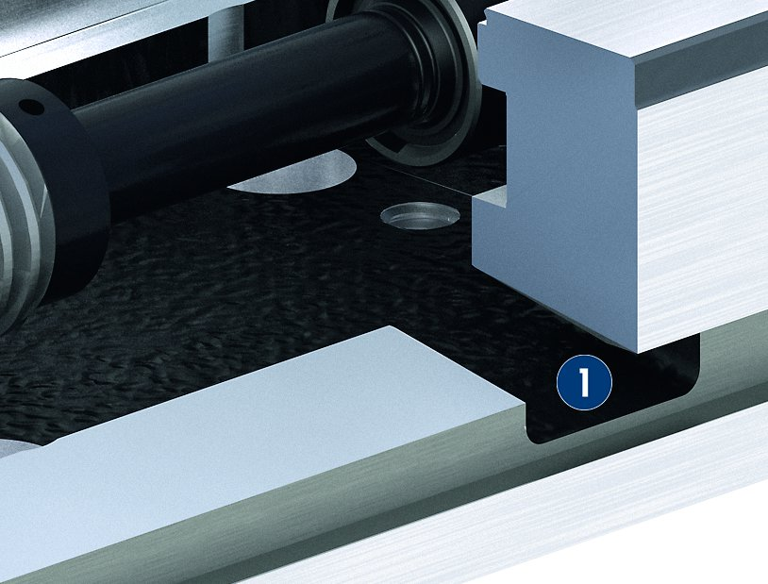
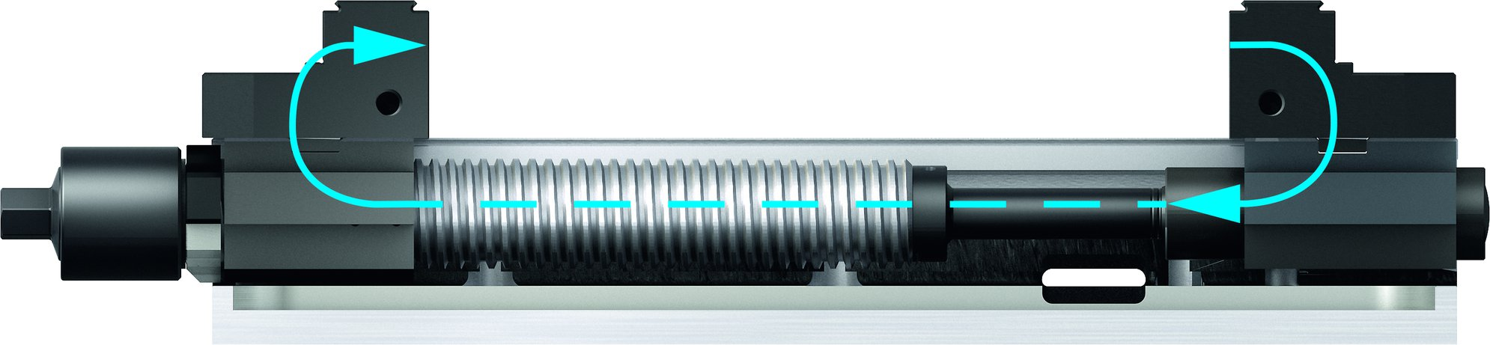
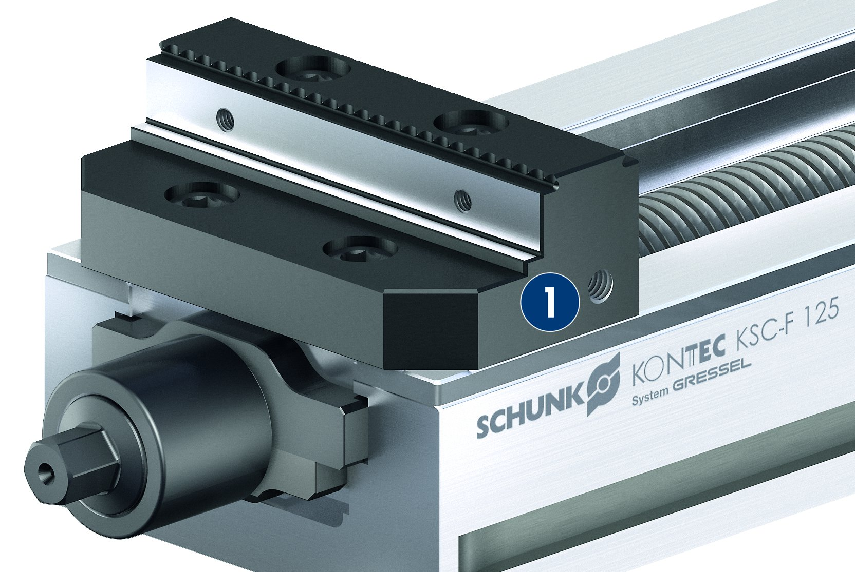
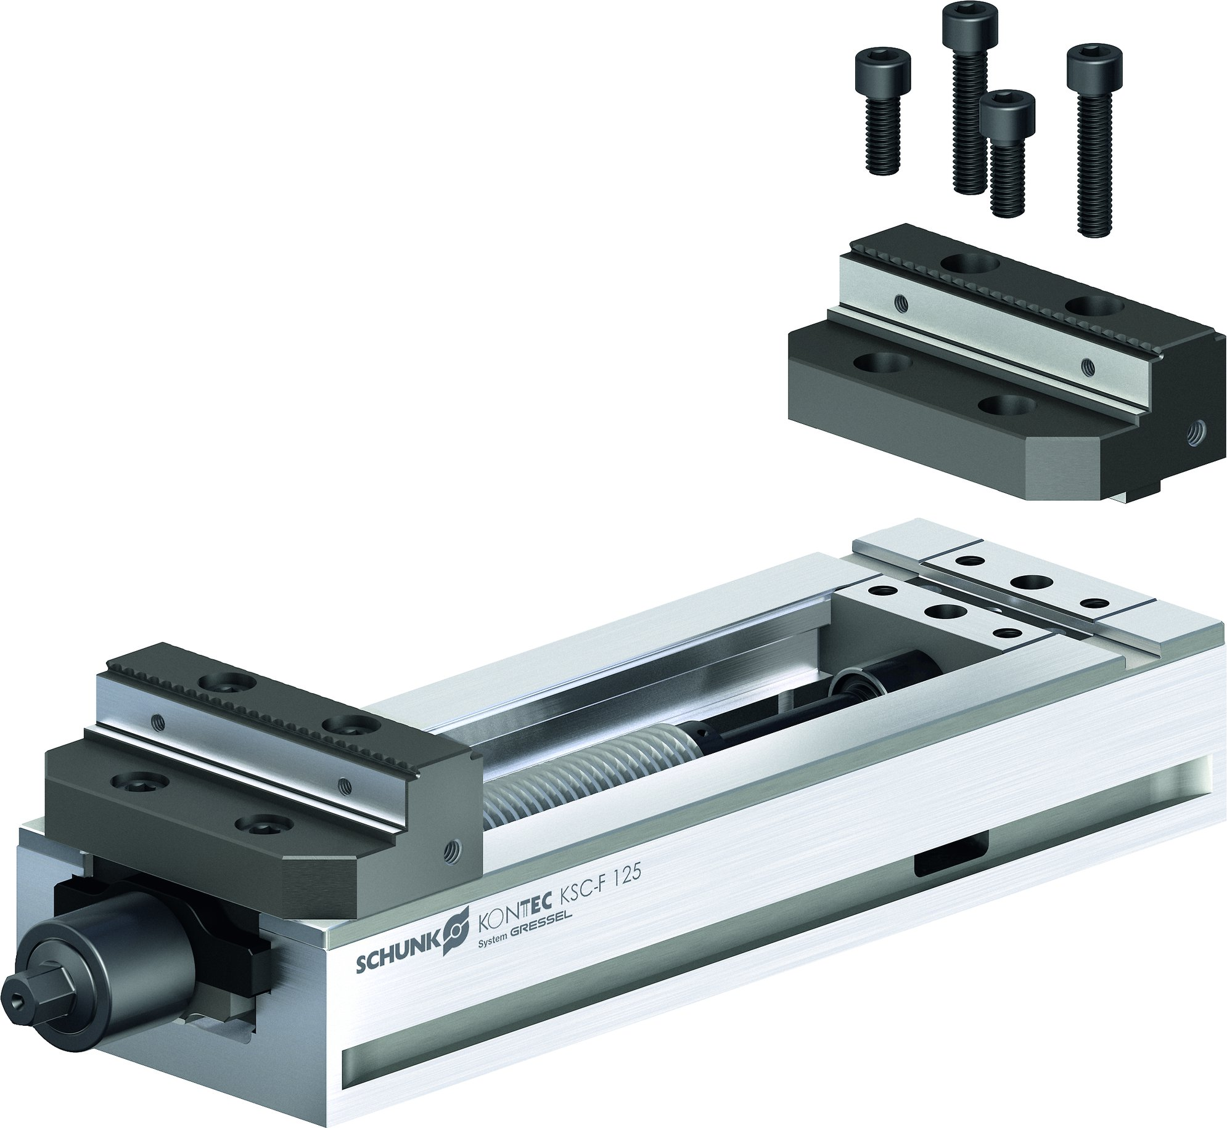
KONTEC KSC-F
Clamping by tension
Drainage slots
1
Drainage slot
1
Threads for stops in the base jaws
Clamping jaws with a very large clamping range
1
Thread for stops
1

Slide 14
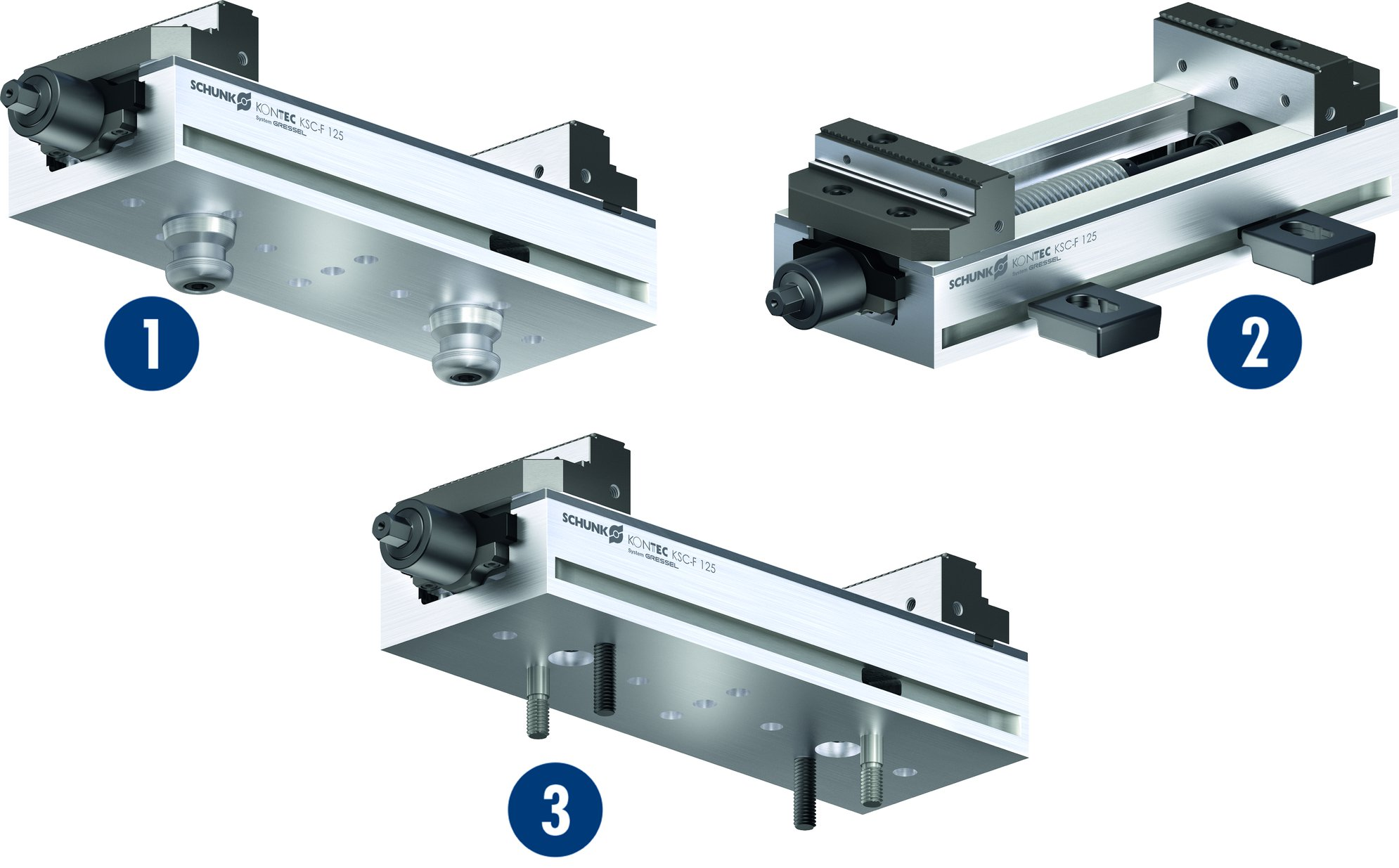
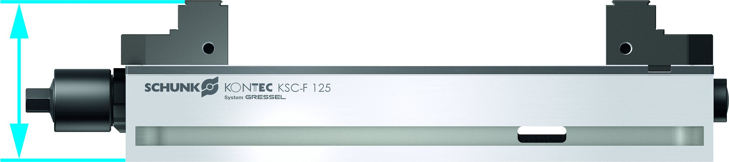
KONTEC KSC-F
Extremely flat design
Mounting options
1
Fastening via quick-change pallet system
Fastening via clamping claws
Fastening via screws
1
2
2
3
3

Slide 15
Variants of KONTEC KSC-F
Technical data | KSC-F 80-214* | KSC-F 125-362* | KSC-F 160-480*
Max. clamping force [kN] | 25 | 40 | 50
Max. torque [Nm] | 50 | 90 | 120
Weight [kg] | 5 | 15 | 28.5
* Additionally available in -grip, -AL, -R

