Slide 1

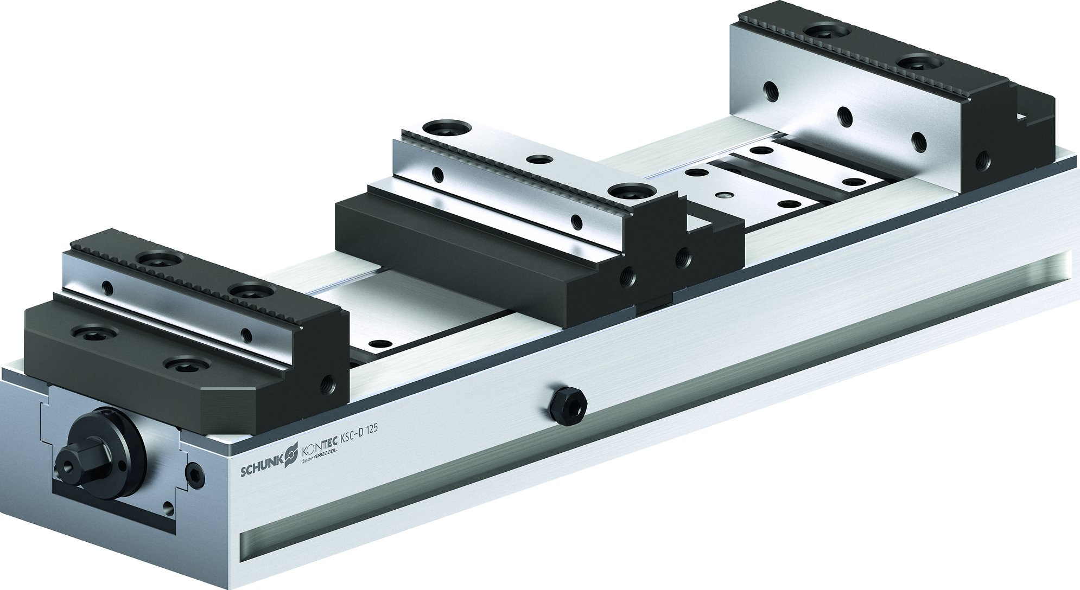
KONTEC KSC-D
Easy loading due to third hand function

Slide 2












Product Overview
Gripping Systems
Clamping Technology
Chuck Jaws
Lathe Chucks
Stationary Workholding
Toolholders
Hydraulic Expansion Technology
VERO-S
TANDEM
ROTA
KONTEC
Tombstones
MAGNOS

Slide 3
Challenges
Depth of
production
Time
Flexibility
Global
competition
Time
Time
Increasing importance
of workpiece clamping
heute
zukünftig

Slide 4



SCHUNK Services
Engineering
Dimensioning of special plates designed to the manufacturing specifications
Development of special solutions together with the customer
FEM analysis for critical components
Testing
Endurance tests with all new developments
Abrasion checking
Measurement of accuracy
Service
Initial operation of customer´s solution
Inspection and maintenance
Repairs

Slide 5






KONTEC Portfolio
Single-acting Vise | Centric Clamping Vise | Multi Clamping Vise
Clamping towards a fixed jaw Fixed jaw as reference High repeat accuracy Especially suitable for workpieces with dimensioning from the side | Symmetric clamping Workpiece zero point is always in the center Optimum accessibility for 5-axis milling Especially suitable for workpieces with dimensioning from the center | Clamping of multiple workpieces Multifunctional usage Reduction of setup times Optimum usage of the machine table

Slide 6
KONTEC Portfolio
Max. Clamping force [kN]
Max. Clamping range [mm]
Jaw width
Jaw width

Slide 7











Fast adaption to new clamping tasks
System Jaws
Standard reversible jaw | Reversible jaw, grip -grip | Enlarged span width -VS | Aluminium jaw -AL
Adapter- and swivel plates -R | 5-axis standard jaw -5A / -5A-VS | 6-fold jaw -6B | Reversible jaw grip, smooth central jaw -ST
Chuck Jaws
Chuck jaw with locator pin | Spring plate, pull-down jaw | Prismatic jaw | Stepped jaw, grip

Slide 8



KONTEC Overview
Single-acting Vise
Centric Clamping Vise
Multi Clamping Vise

Slide 9
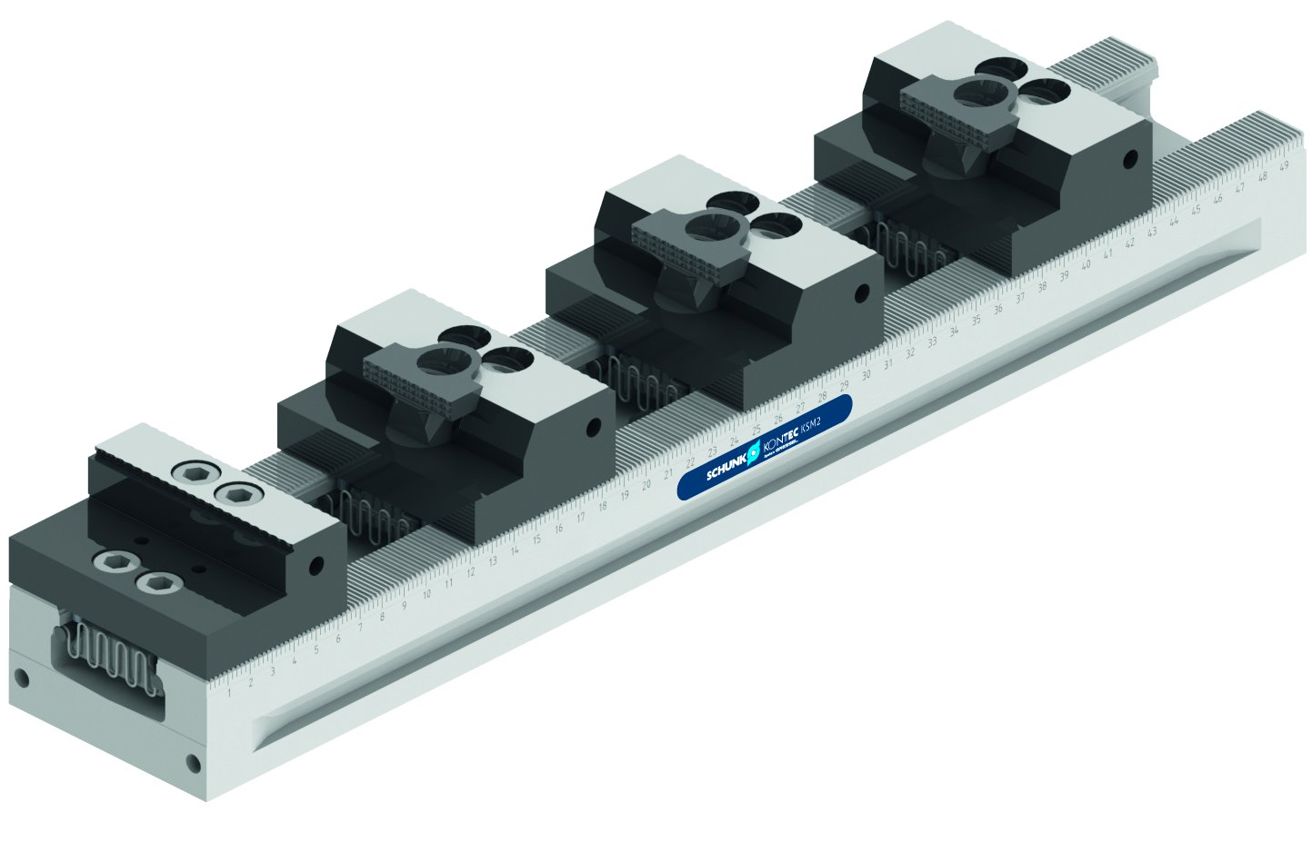
KONTEC Multi Clamping Vise
KSC-D
Basic Clamping Vise
KSM2
Clamping rail with jaw quick-change

Slide 10
KONTEC KSC-D
Example of application
Spannmittel:
Merkmale/Anwendung:

Slide 11
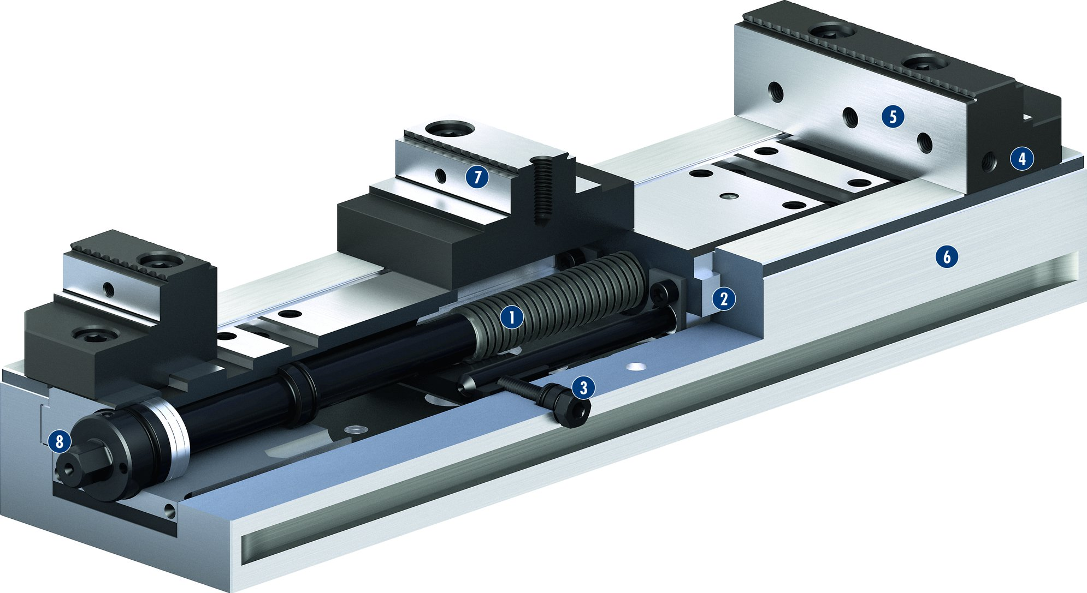
KONTEC KSC-D
1
Spindle drive
Long jaw guidance
Third-hand function
Mounting threads
Standard jaw interface
Low height
Central jaw
Operation via hexagon connection
5
2
7
4
3
6
4
1
2
5
6
3
7
8
8

Slide 12
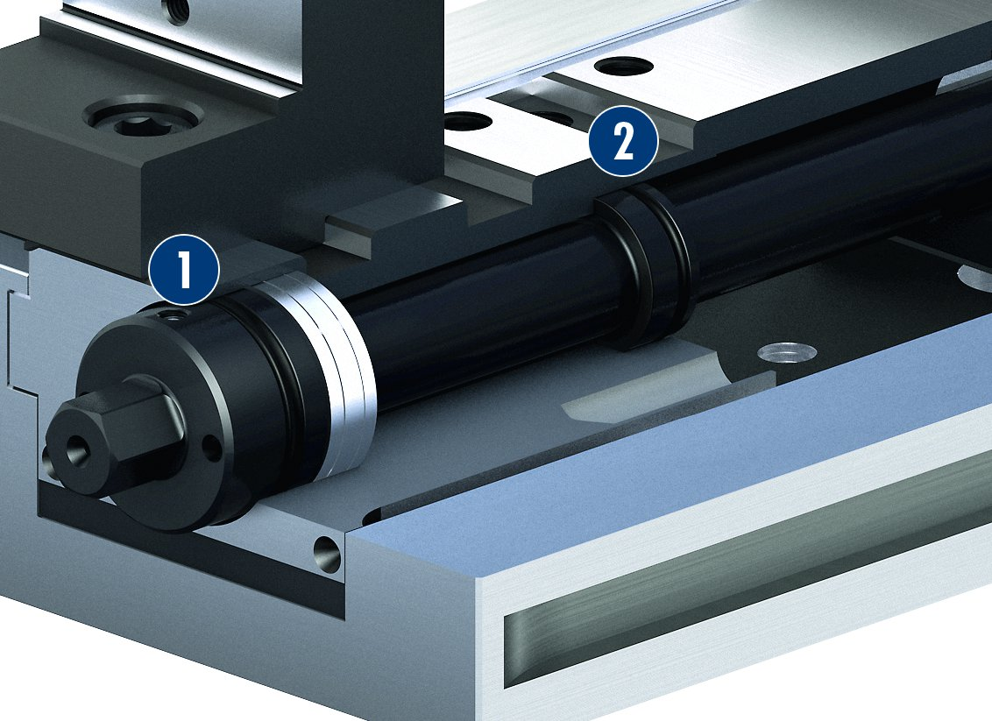
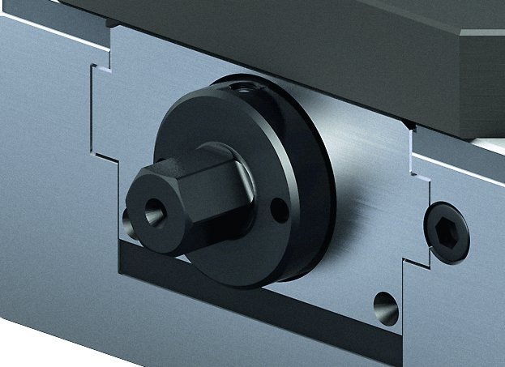
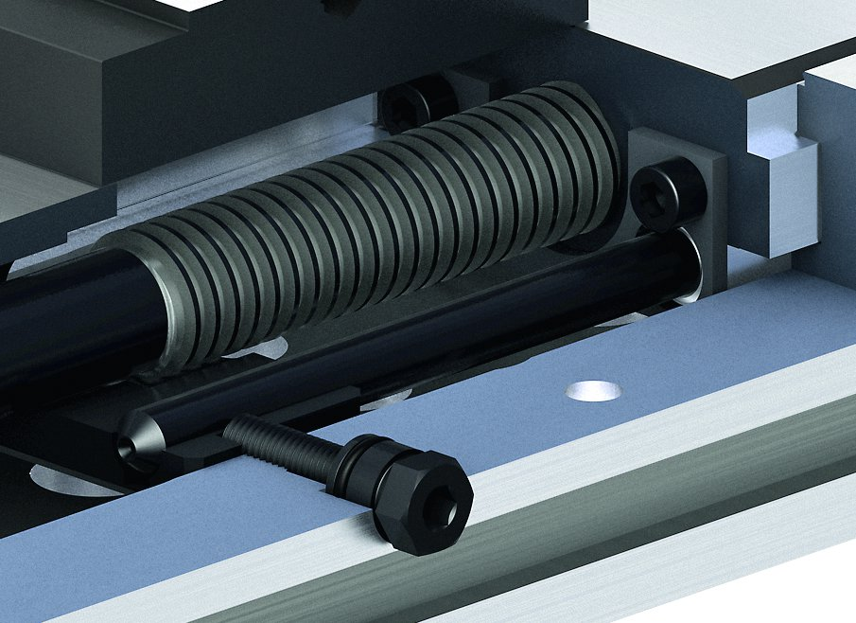
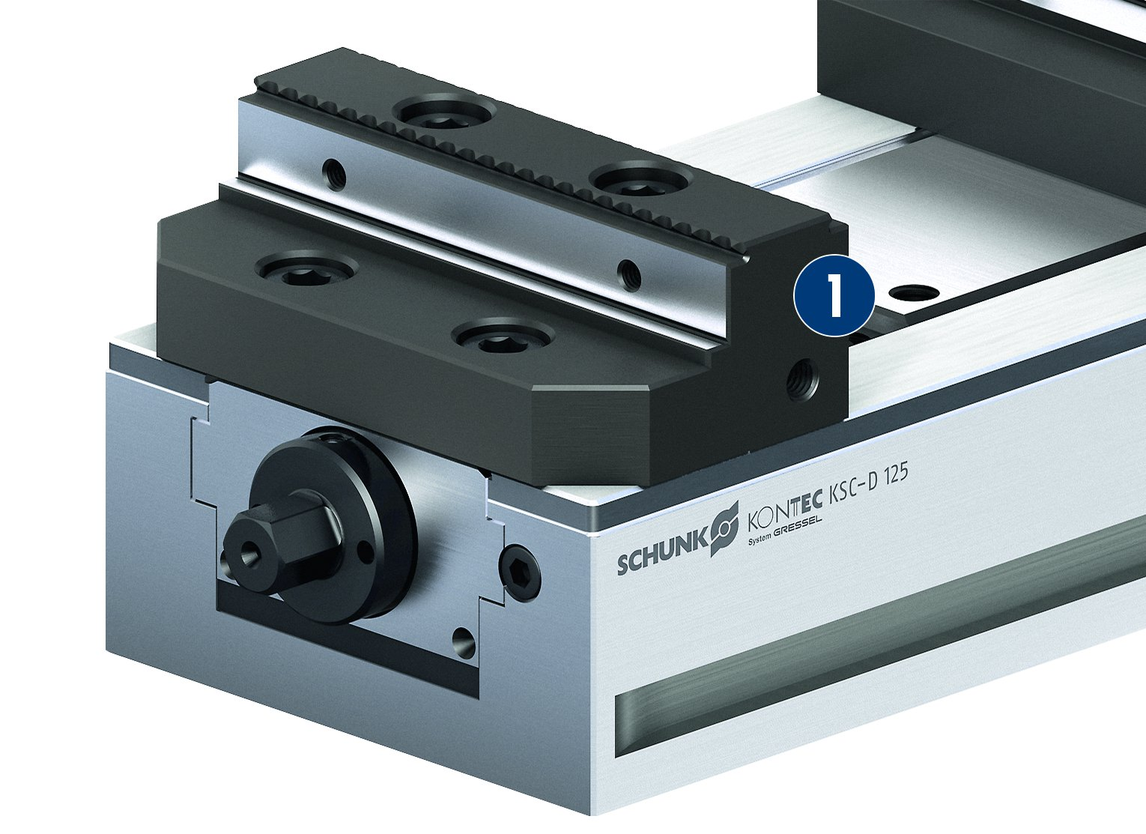
KONTEC KSC-D
Double encapsulated spindle
Actuation via hexagon nut
2
1
1
Sealing at the actuation
Sealing on the spindle bearing
2
Third-hand function
Threads for stops in the base jaws
1
1
Thread for stops

Slide 13
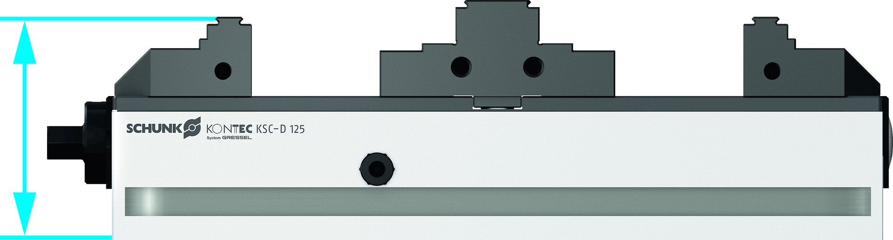
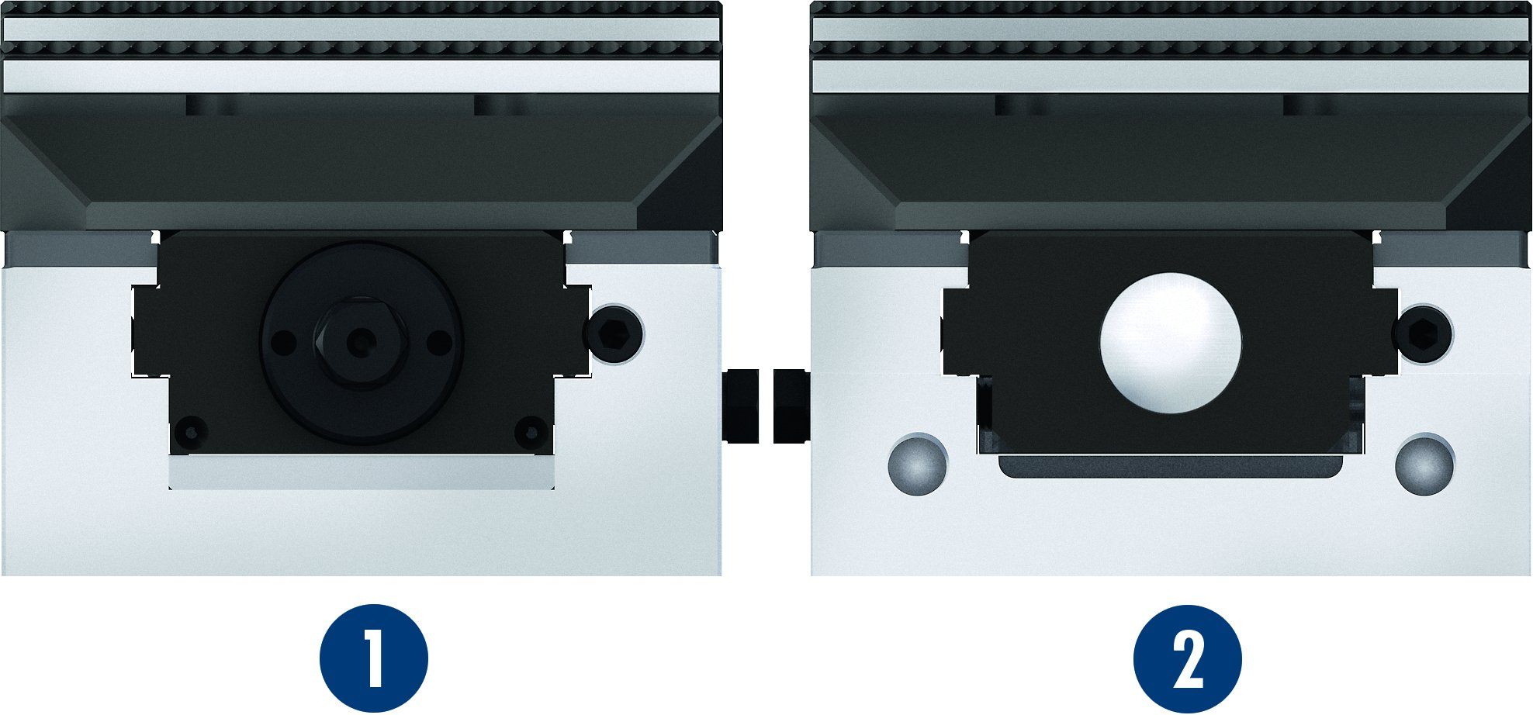
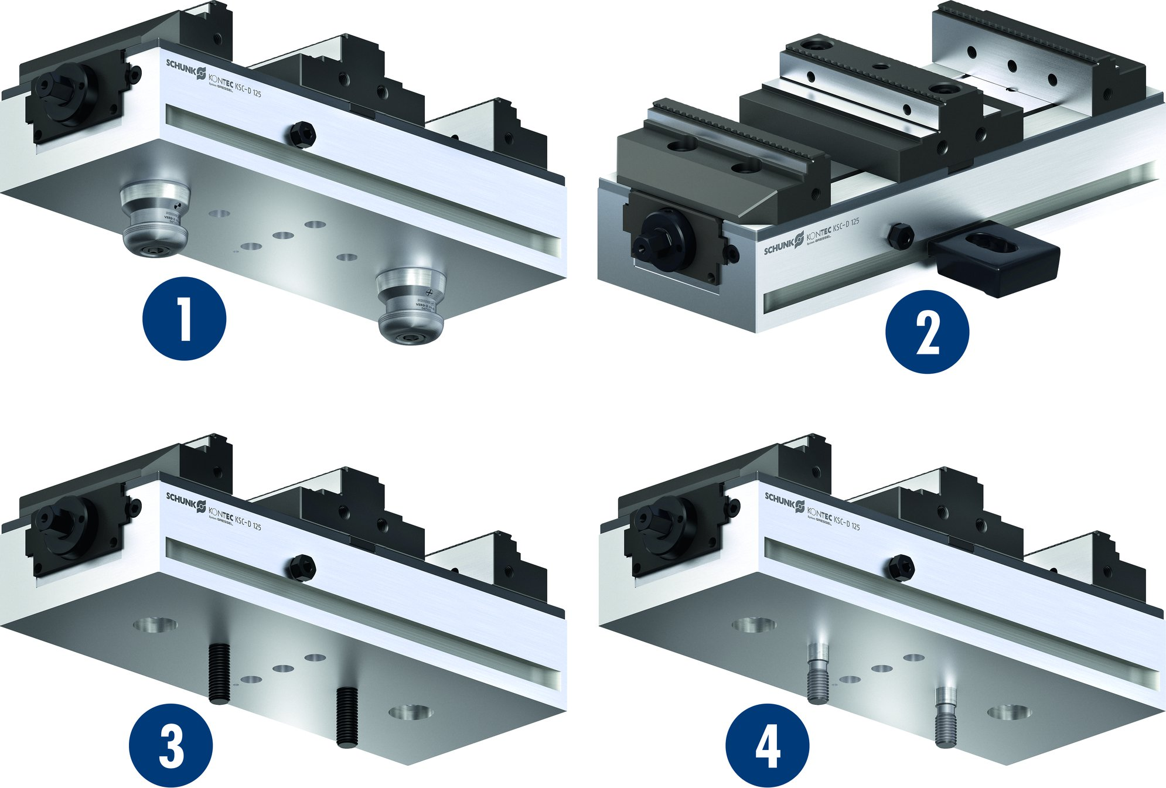
KONTEC KSC-D
Encapsulation of the base jaws
Extremely flat design
1
Upper jaw
Lower jaw
2
1
2
Mounting options
1
Fastening via quick-change pallet system
Fastening via clamping claws
Fastening via screws
Fastening via fitting screws
1
2
2
3
3
4
4

Slide 14
Variants of KONTEC KSC-D
Technical data | KSC-D 80-300* | KSC-D 125-320* | KSC-D 125-740*
Max. clamping force [kN] | 25 | 40 | 40
Max. torque [Nm] | 90 | 100 | 100
Weight [kg] | 8 | 14 | 34
* Additionally available in -grip, -ST, -AL, -R

