Slide 1


KONTEC KSC
Maximum precision and process reliability

Slide 2












Product Overview
Gripping Systems
Clamping Technology
Chuck Jaws
Lathe Chucks
Stationary Workholding
Toolholders
Hydraulic Expansion Technology
VERO-S
TANDEM
ROTA
KONTEC
Tombstones
MAGNOS

Slide 3
Challenges
Depth of
production
Time
Flexibility
Global
competition
Time
Time
Increasing importance
of workpiece clamping
heute
zukünftig

Slide 4



SCHUNK Services
Engineering
Dimensioning of special plates designed to the manufacturing specifications
Development of special solutions together with the customer
FEM analysis for critical components
Testing
Endurance tests with all new developments
Abrasion checking
Measurement of accuracy
Service
Initial operation of customer´s solution
Inspection and maintenance
Repairs

Slide 5






KONTEC Portfolio
Single-acting Vise | Centric Clamping Vise | Multi Clamping Vise
Clamping towards a fixed jaw Fixed jaw as reference High repeat accuracy Especially suitable for workpieces with dimensioning from the side | Symmetric clamping Workpiece zero point is always in the center Optimum accessibility for 5-axis milling Especially suitable for workpieces with dimensioning from the center | Clamping of multiple workpieces Multifunctional usage Reduction of setup times Optimum usage of the machine table

Slide 6
KONTEC Portfolio
Max. Clamping force [kN]
Max. Clamping range [mm]
Jaw width
Jaw width

Slide 7











Fast adaption to new clamping tasks
System Jaws
Standard reversible jaw | Reversible jaw, grip -grip | Enlarged span width -VS | Aluminium jaw -AL
Adapter- and swivel plates -R | 5-axis standard jaw -5A / -5A-VS | 6-fold jaw -6B | Reversible jaw grip, smooth central jaw -ST
Chuck Jaws
Chuck jaw with locator pin | Spring plate, pull-down jaw | Prismatic jaw | Stepped jaw, grip

Slide 8



KONTEC Overview
Single-acting Vise
Centric Clamping Vise
Multi Clamping Vise

Slide 9
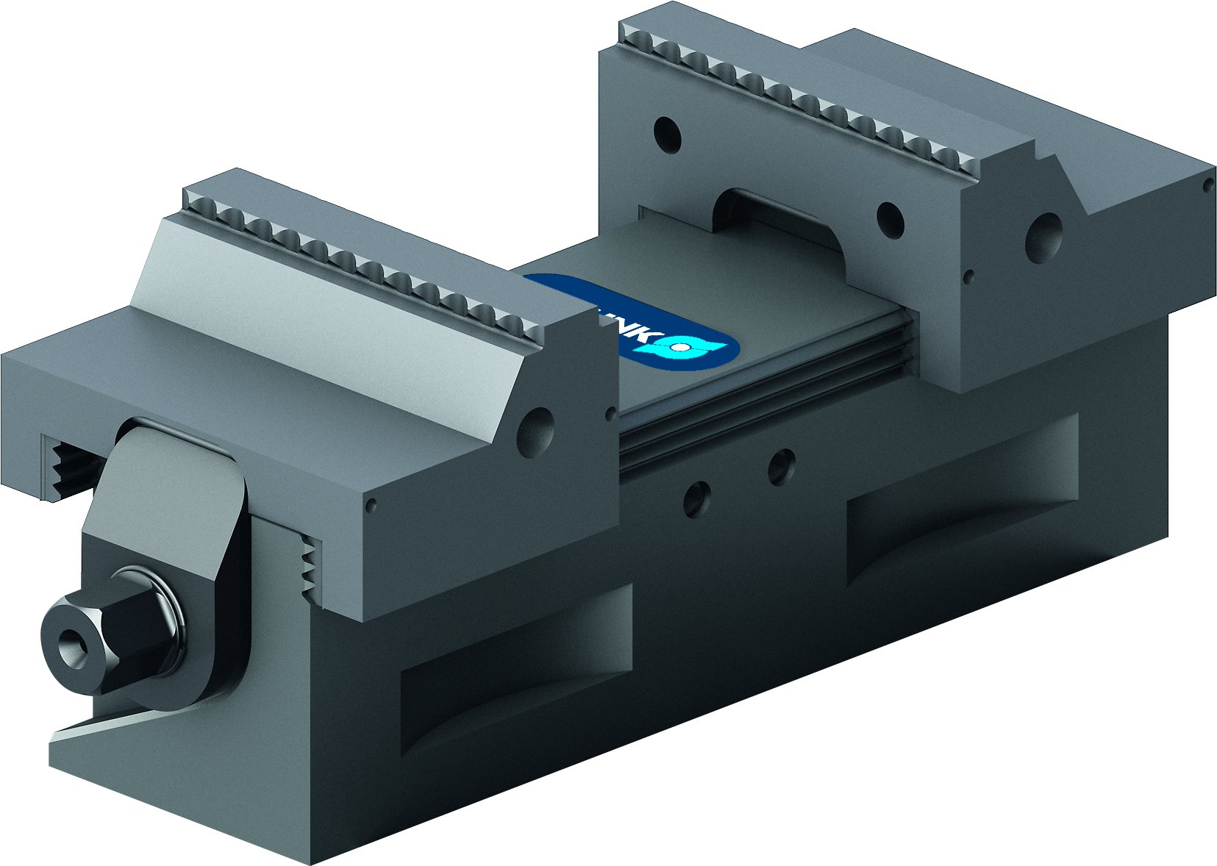
KONTEC Centric Clamping Vise
KSC
Basic Clamping Vise
KSC2
Clamping vise for small components

Slide 10
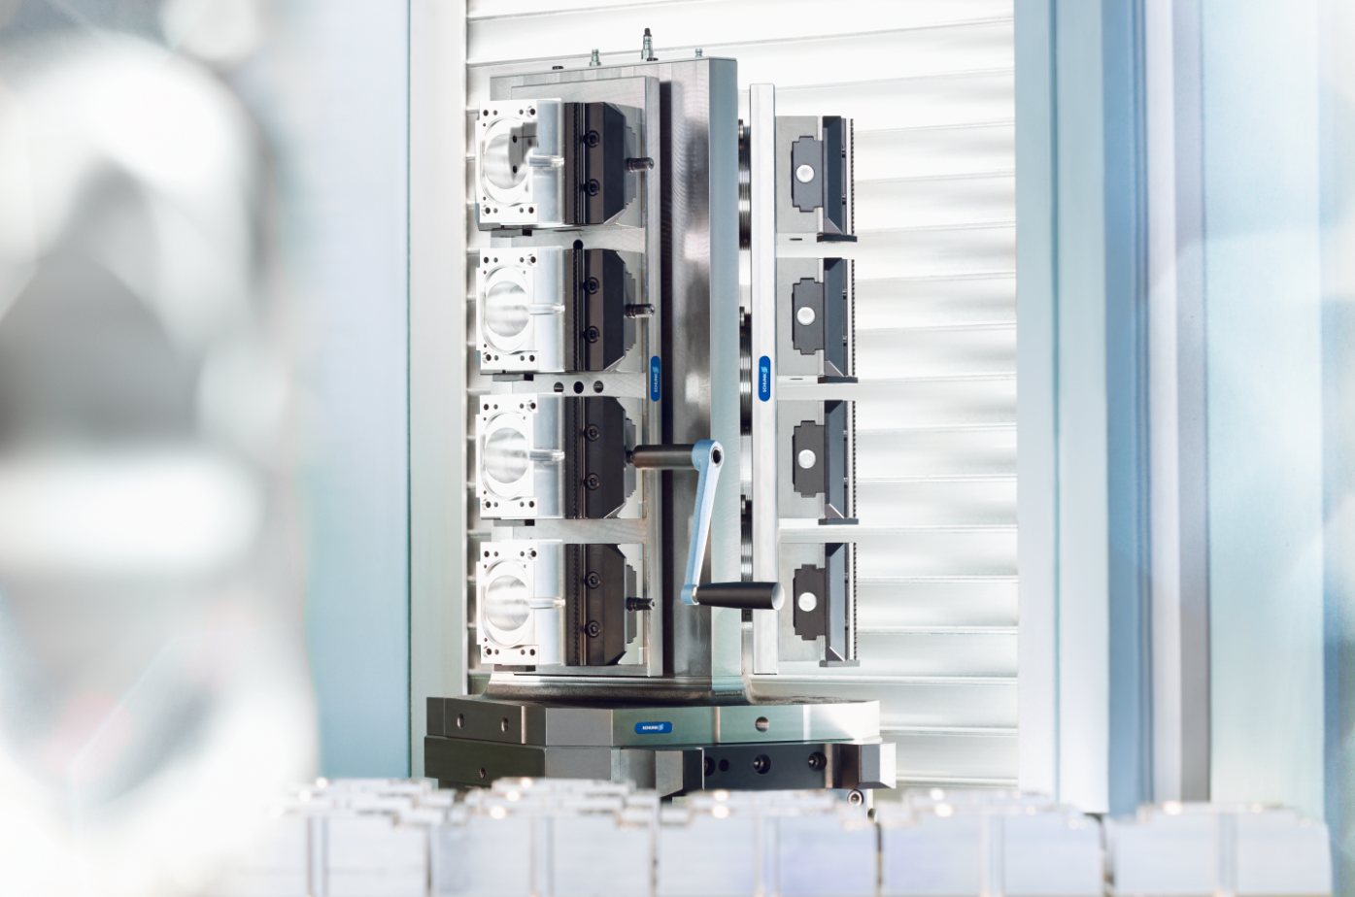
KONTEC KSC
Example of application

Slide 11
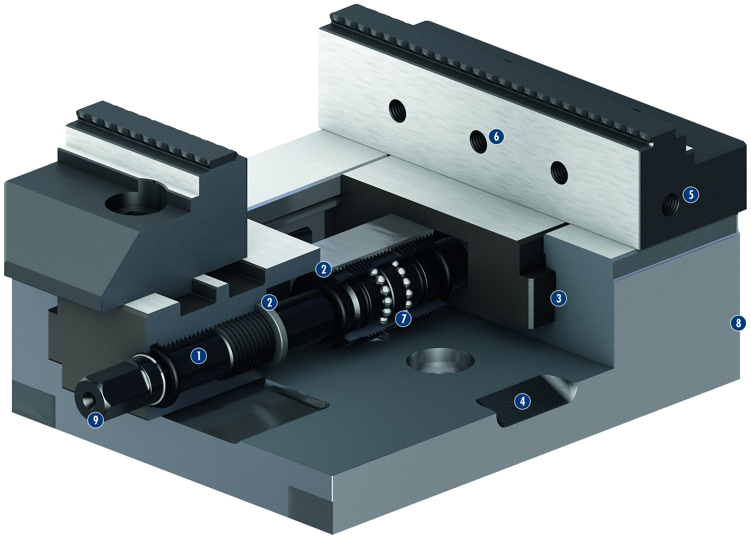
KONTEC KSC
1
Spindle drive
Double encapsulated spindle
Long jaw guidance
Drainage slots
Mounting threads
Standard jaw interface
Ball bearing mounted, backlash-free spindle
Low height
Operation via hexagon connection
6
2
3
5
4
5
2
6
2
7
3
8
7
1
9
4
8
9

Slide 12
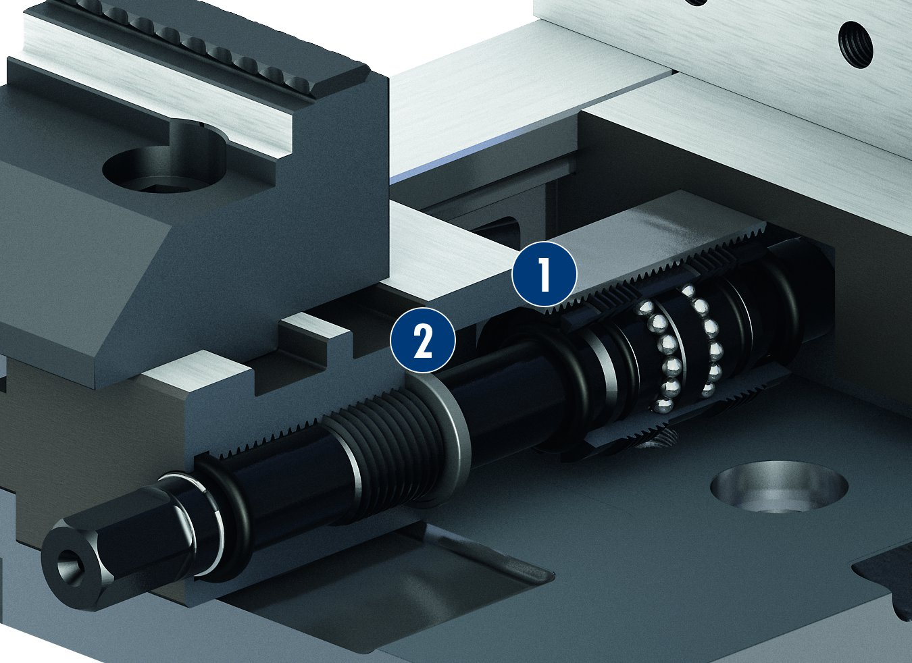
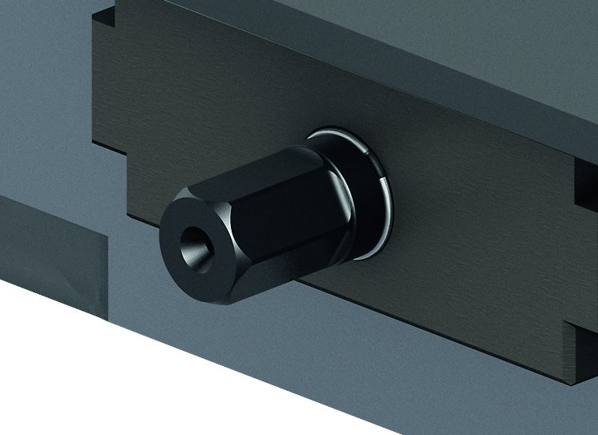
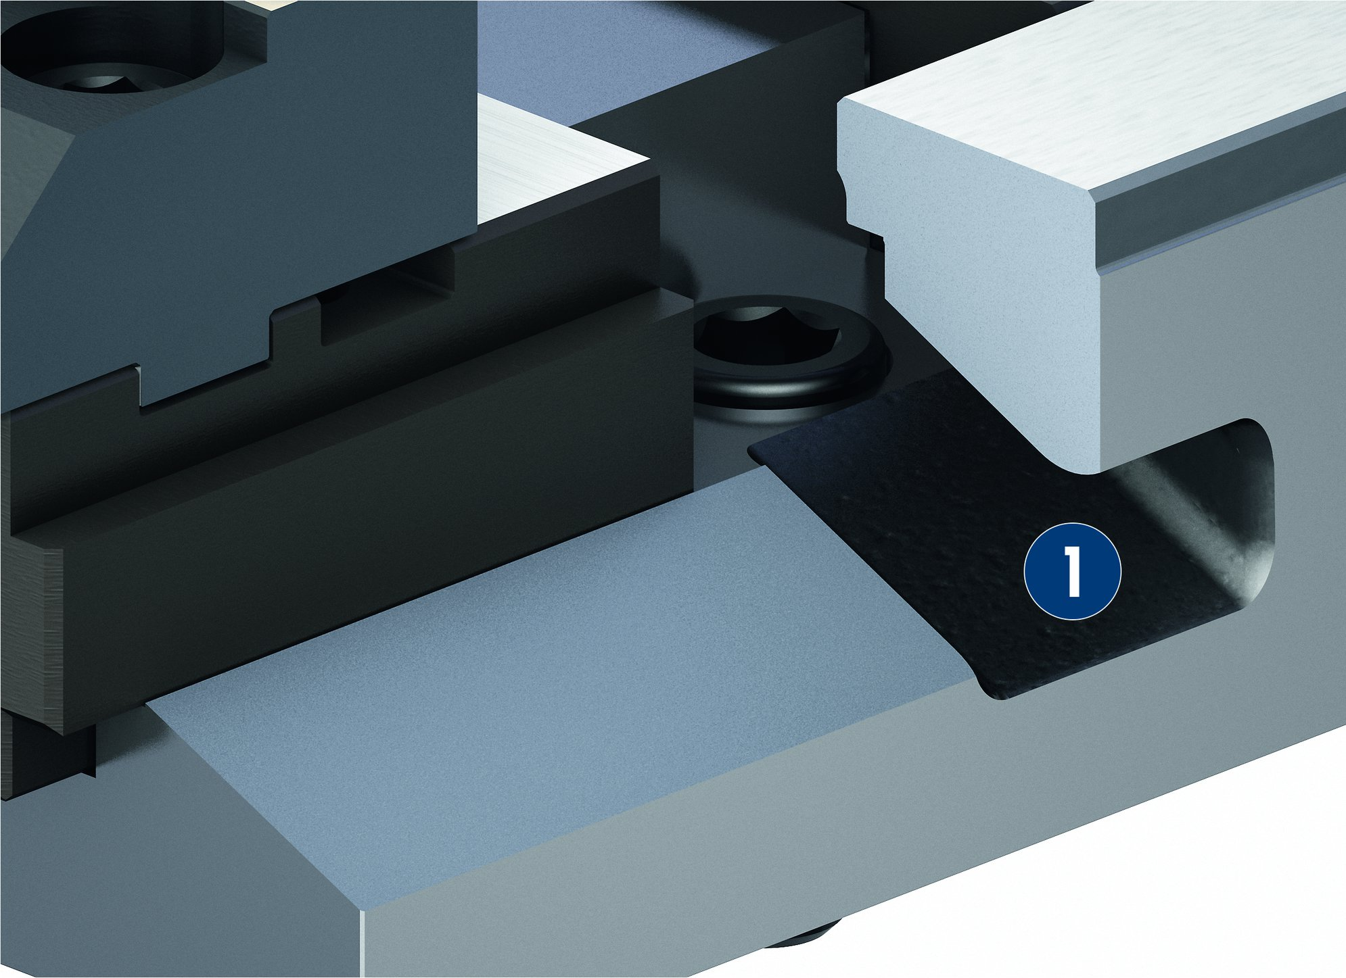
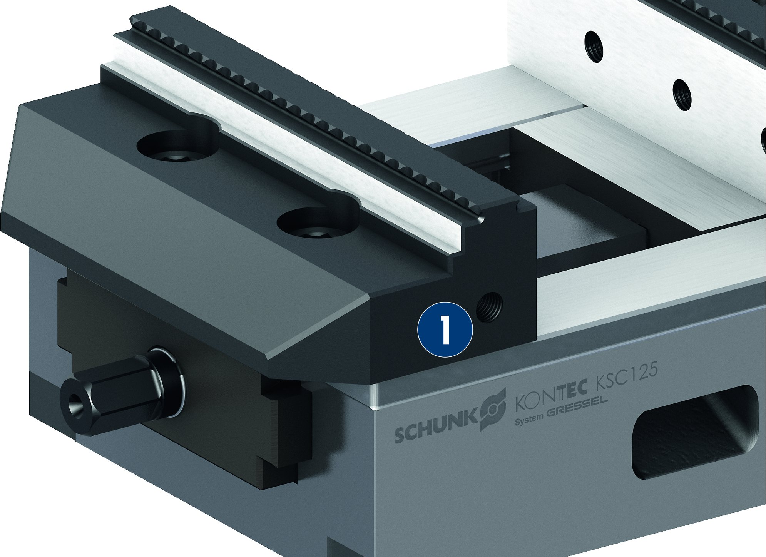
KONTEC KSC
Double encapsulated spindle
Actuation via hexagon nut
1
Sealing on the spindle bearing
Sealing on the gear
1
2
2
Drainage slots
Threads for stops in the base jaws
1
Drainage slot
1
Thread for stops
1
1

Slide 13
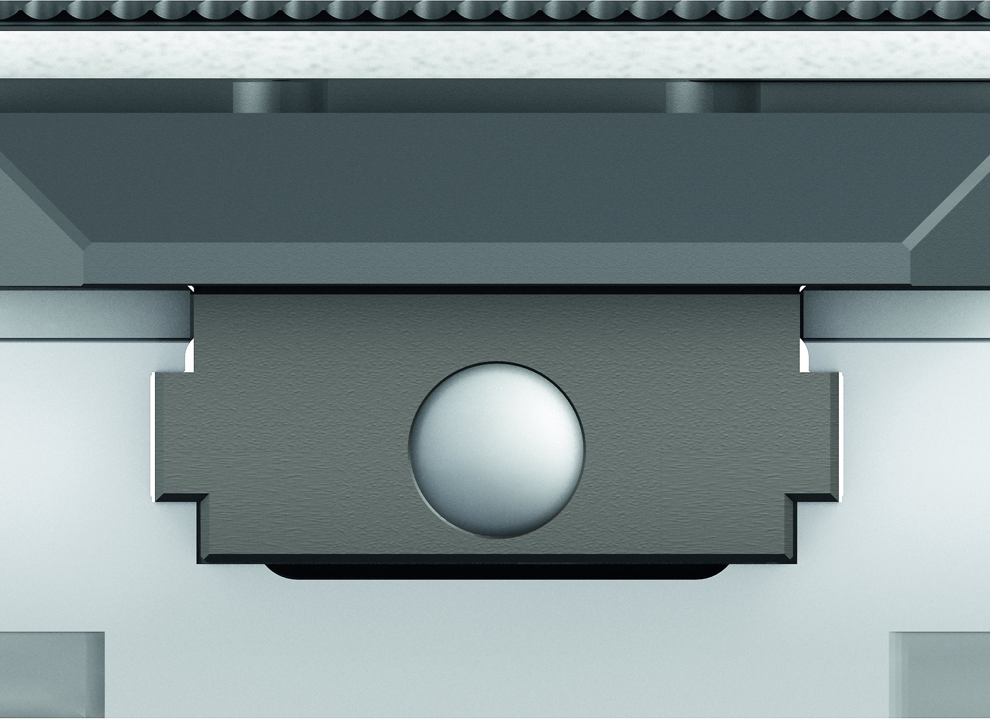
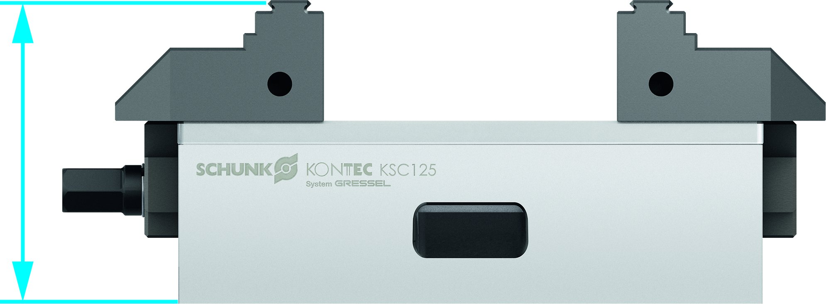
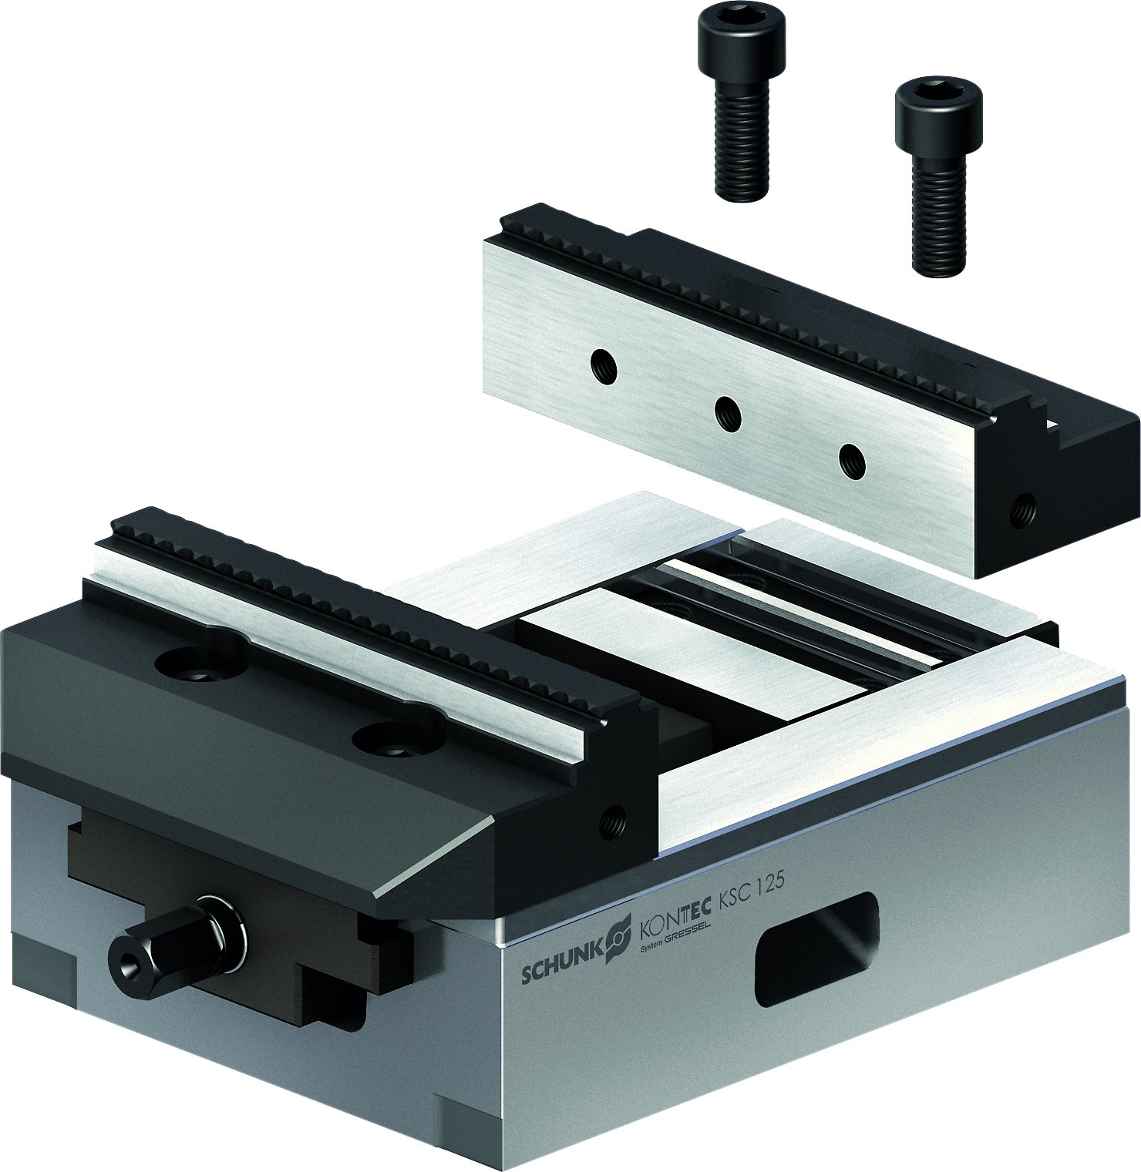
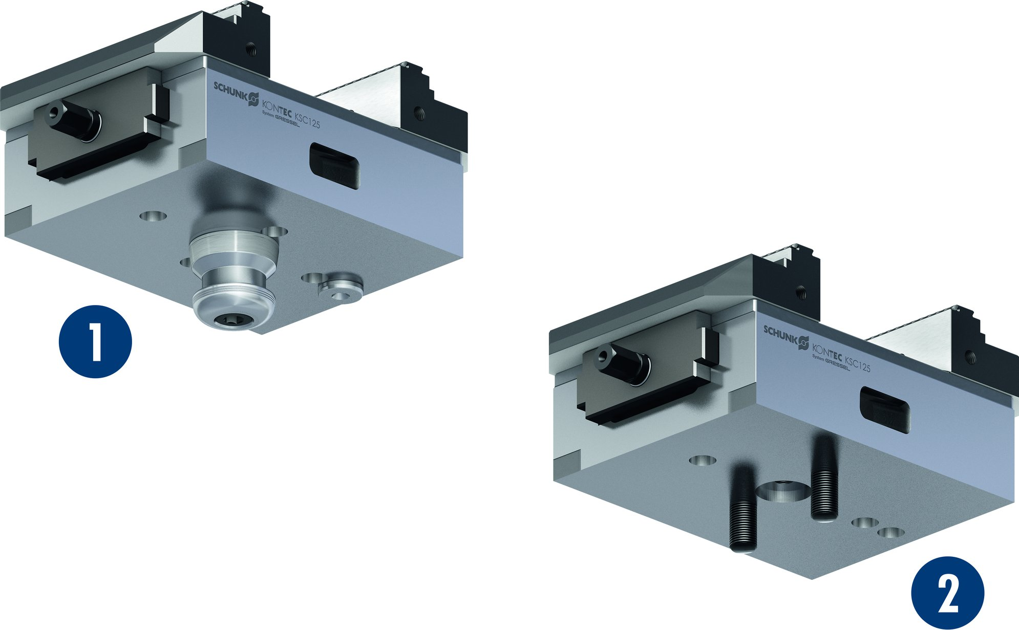
KONTEC KSC
Wide jaw guidance and base jaws fitted into the body
Extremely flat design
Jaw change with just two screws
Mounting options
1
Fastening via quick-change pallet system
Fastening via screws
2
1
2

Slide 14
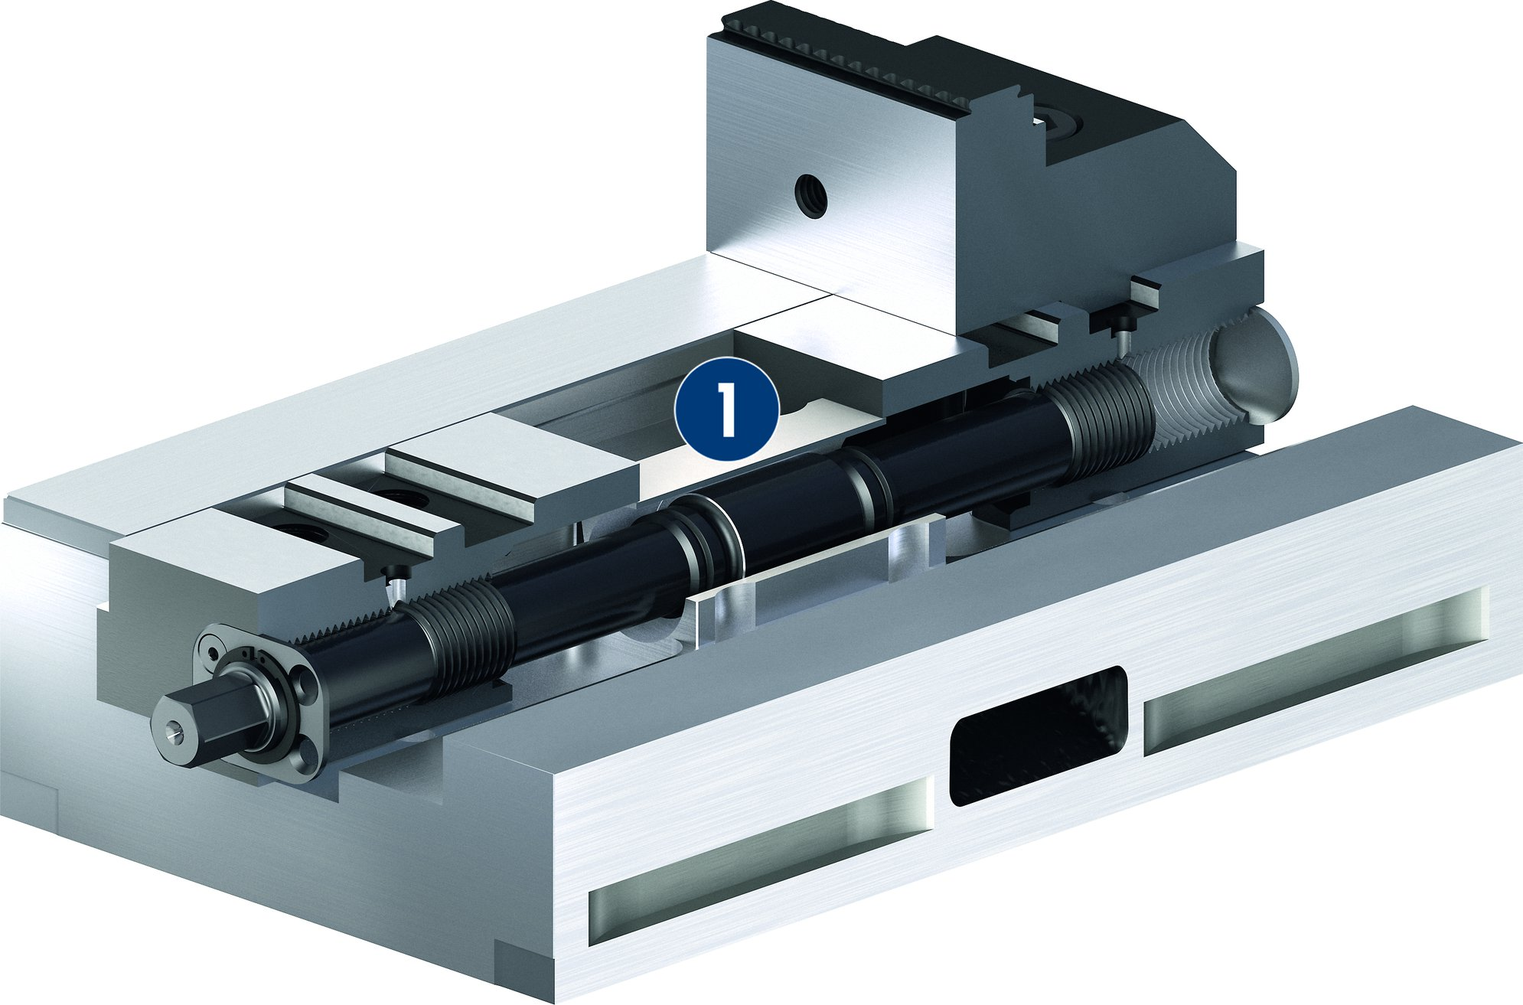
KONTEC KSC
Floating version
1
1
Floating bearing

Slide 15
Variants of KONTEC KSC
Technical data | KSC 80-130*¹ | KSC 125-160*² | KSC 125-300*² | KSC 160-280*³ | KSC 160-480*³
Max. clamping force [kN] | 25 | 35 | 35 | 50 | 50
Max. torque [Nm] | 90 | 100 | 100 | 175 | 175
Weight [kg] | 3 | 6.4 | 11.8 | 21 | 35
*¹ Aditionally available in -grip, -AL and -R
*² Aditionally availavle in -grip, -VS, -AL, -R, -6B and -5A
*³ Aditionally available in -grip, -AL, -R and -5A

