Slide 1

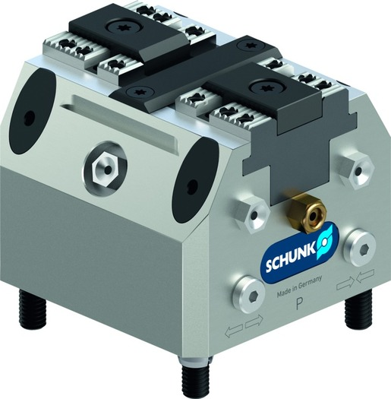
TANDEM KSP plus
Clamping Force Blocks I pneumatic

Slide 2












Product Overview
Gripping Systems
Clamping Technology
Chuck Jaws
Lathe Chucks
Stationary Workholding
Toolholders
Hydraulic Expansion Technology
VERO-S
TANDEM
ROTA
KONTEC
Tombstones
MAGNOS

Slide 3
Challenges
Variants
Automation
Time
Time
Required
accuracy
Global
competition
Time
Time
Increasing relevance of the set-up process
heute
zukünftig

Slide 4


TANDEM Clamping Force Blocks
High workpiece density at small space
Optimum accessibility of the machine spindle to the workpiece
High duration at low non-productive times per workpiece

Slide 5







TANDEM Overview
Actuation Types | Pneumatic (KSP plus) | Hydraulic (KSH plus) | Manually (KSA plus) | Spring-loaded (KSF plus)
Variants | Standard stroke | Long stroke (-LH) | With fixed jaw (-F)

Slide 6
TANDEM Portfolio
Max. clamping force [kN]
Stroke/jaw [mm]
Size
Size

Slide 7







TANDEM Jaw Program
Top Jaws Blank
Mounting: via tongue and groove | Mounting: via fine serrations 1,5 x 60°
KTR / KTR-H | STR / STR-H | STR-S
Supporting Jaws + SCHUNK Jaw Program
TBA-D | Chuck Jaws

Slide 8



SCHUNK Services
Engineering
Dimensioning of special plates designed to the manufacturing specifications
Development of special solutions together with the customer
FEM analysis for critical components
Testing
Endurance tests with all new developments
Abrasion checking
Measurement of accuracy
Service
Initial operation of customer´s solution
Inspection and maintenance
Repairs

Slide 9




TANDEM Overview
Pneumatic
Hydraulic
Manual
Spring force

Slide 10
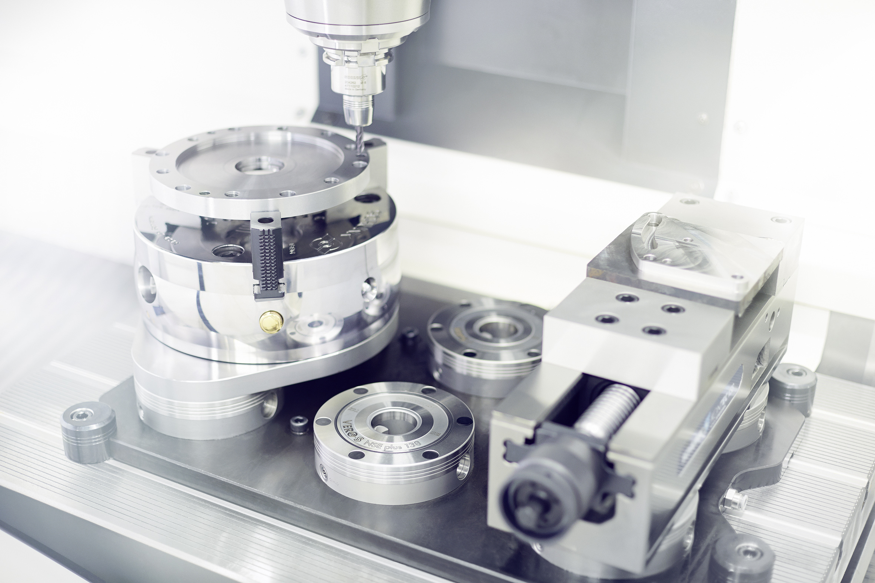
TANDEM KSP plus
Application Example

Slide 11
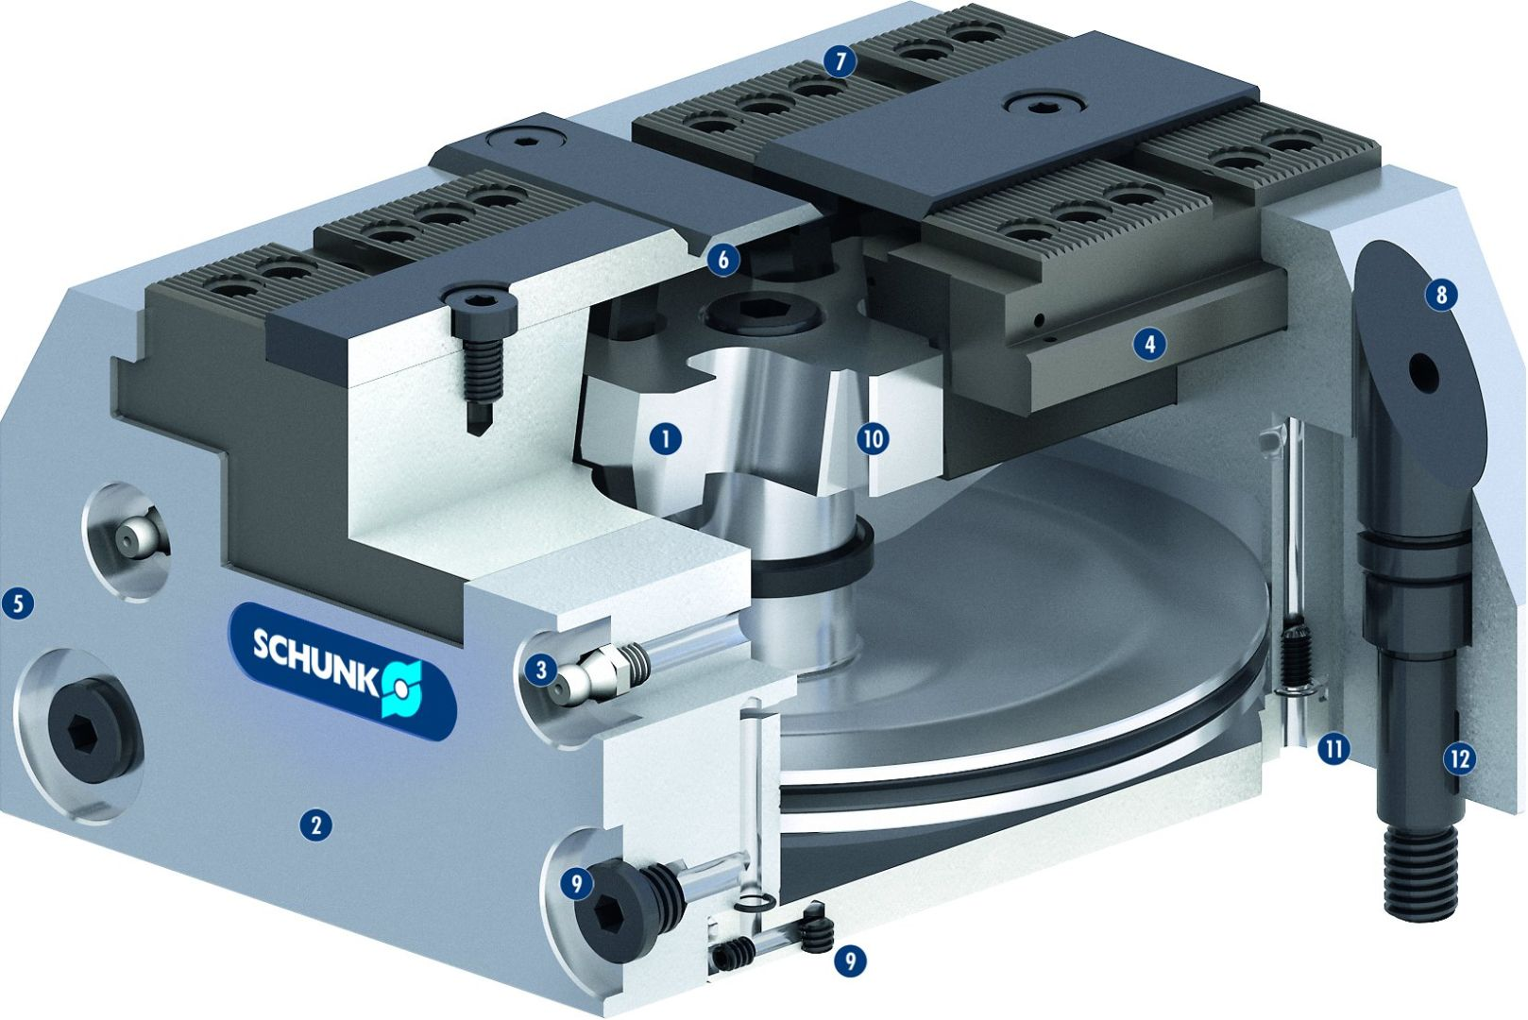

TANDEM KSP plus
1
Wedge hook drive
Hardened and extremely rigid base body
Optimized lubrication system
Long jaw guidance
Low height
Improved design which is insensitive to dirt
Standard chuck jaw interface
Optimized outside contour
Control of the clamping modules
Chuck pistons guided in the body
Lubrication channels in the cover plate
Fitting screws available as an option
2
7
3
6
4
8
5
4
1
10
6
5
7
5
8
3
11
12
9
2
10
9
11
12

Slide 12
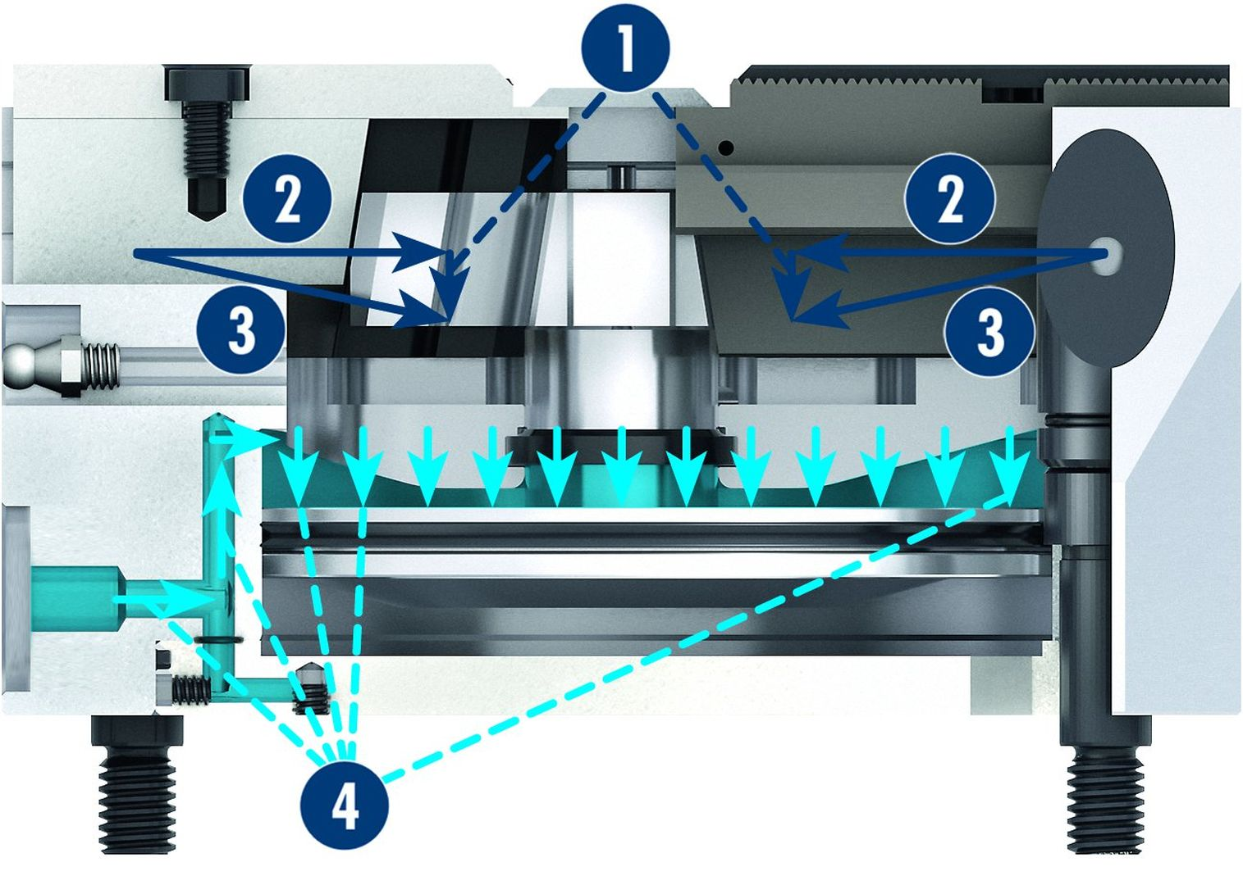

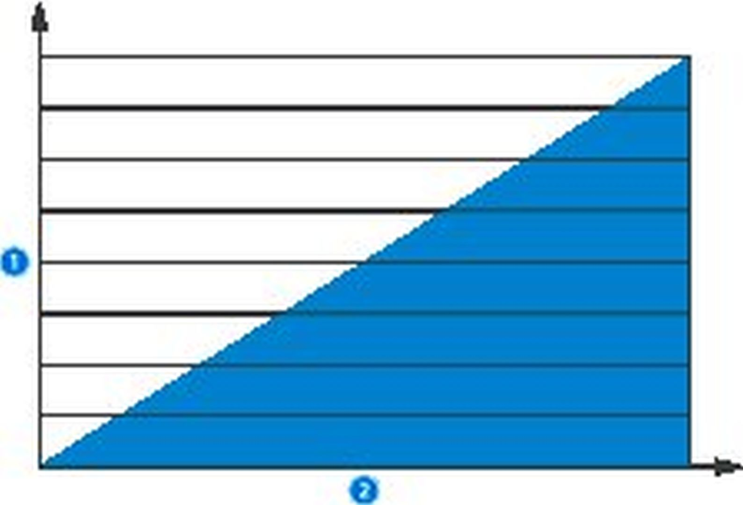
TANDEM KSP plus
Force Flow in the KSP plus
1
1
Actuating force depending on the pneumatic pressure and piston area
Clamping force depending on the actuating force and the transmission ratio
Normal force between the base jaw and chuck body
Pneumatic pressure
2
2
3
3
2
3
4
4
Clamping Force dependent on the
Actuation Pressure
Z-version (optional)
1
1
Clamping force
Actuation force
1
Positioning bore
1
2
2
1

Slide 13



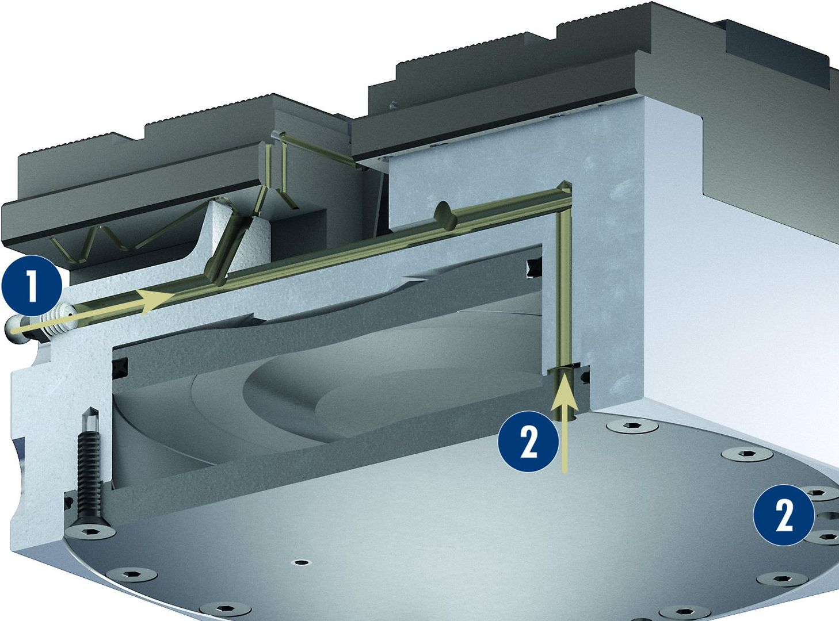
TANDEM KSP plus
Chip-repellent design
Cover plugs for the mounting screws
Alignment edge
Lubrication system
1
Manual lubrication
Central lubrication
1
2
2
2

Slide 14
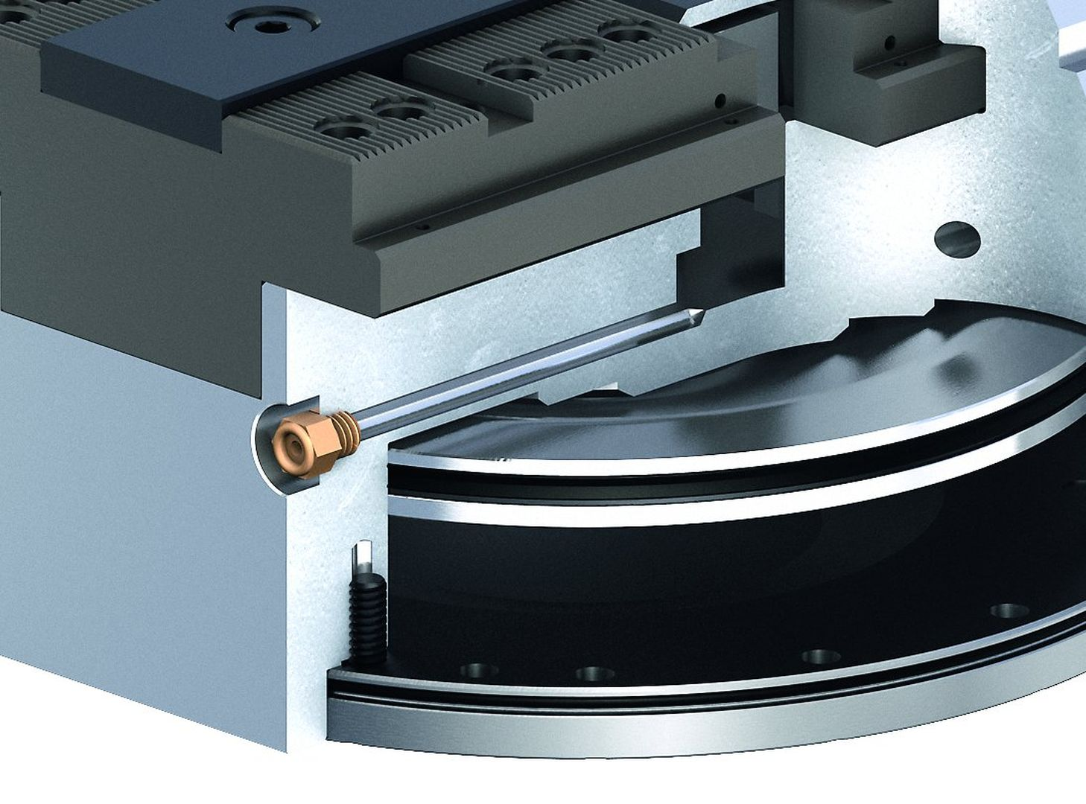
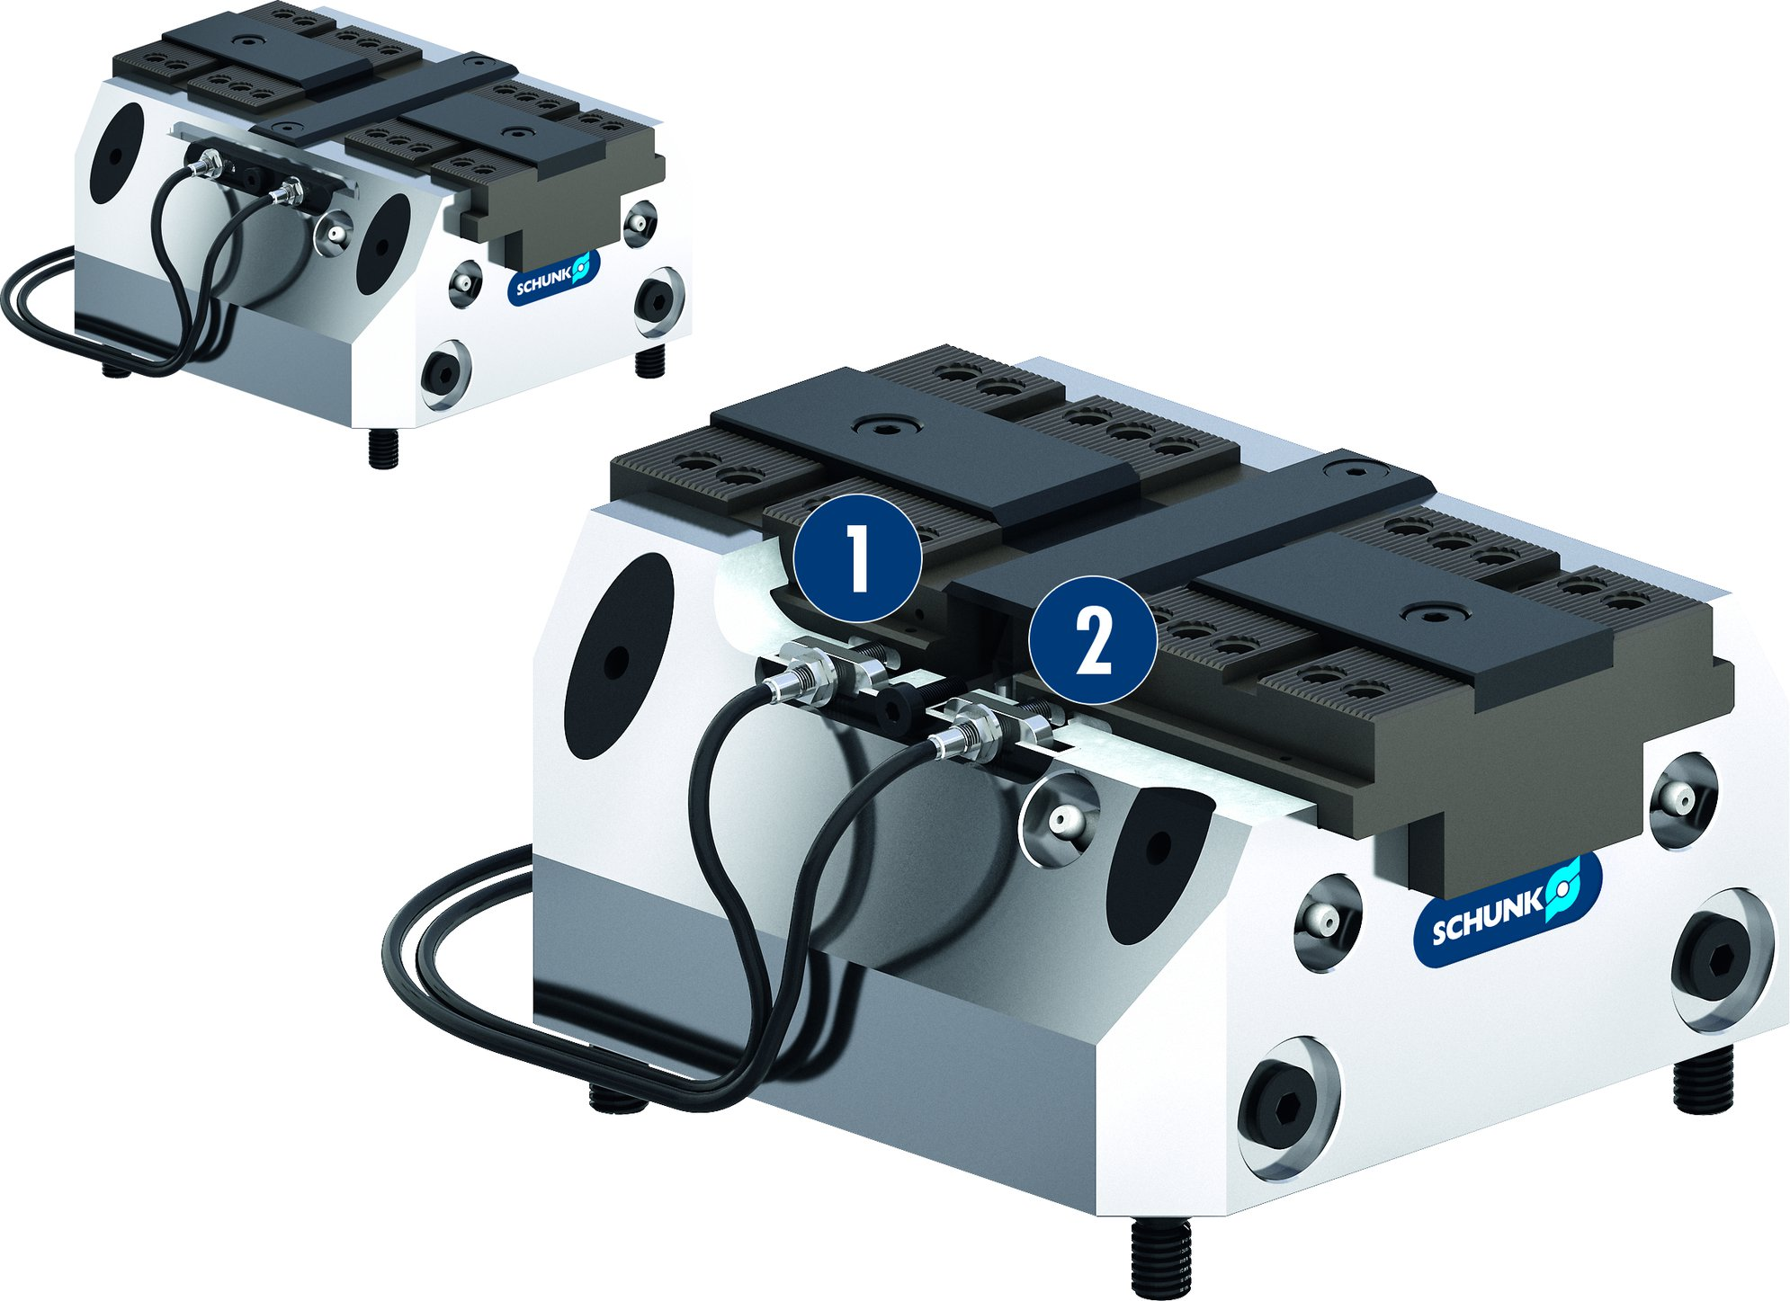
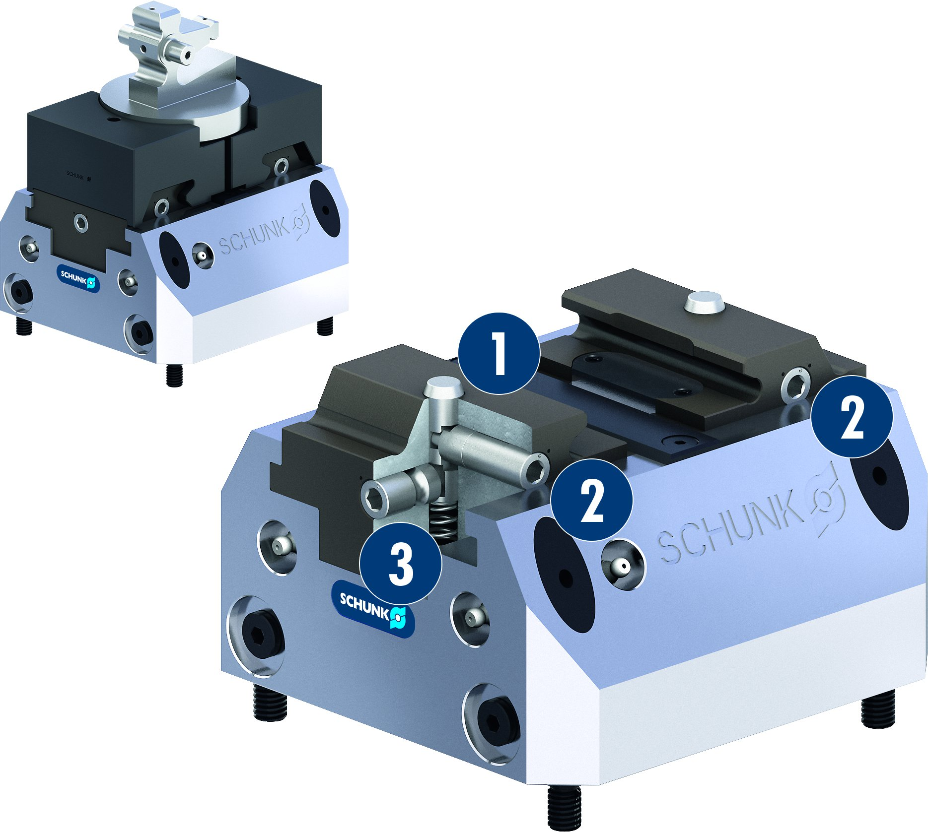
TANDEM KSP plus
Coolant drain hole
Version IN –
know whether opened or clamped
1
Inductive proximity switch for monitoring „clamped“
Inductive proximity switch for monitoring „opened“
1
2
2
BWM variant
1
Locking pin for jaw mounting
Side access to changing mechanism
Front access to changing mechanism
1
2
2
2
3
3

Slide 15
Variants of TANDEM KSP plus
Technical data | KSP plus 64 |  |  | KSP plus 100 |  |  | KSP plus 160 |  |  | KSP plus 250
 | KSP | KSP-LH | KSP-F | KSP | KSP-LH | KSP-F | KSP | KSP-LH | KSP-F | KSP | KSP-LH | KSP-F
Stroke/jaw [mm] | 2 | 4 | 4 | 2 | 6 | 4 | 3 | 8 | 6 | 5 | 15 | 10
Clamping force [kN] | 4.5 | 2.3 | 4 | 18 | 8 | 18 | 45 | 20 | 45 | 55 | 20 | 55
Max. pressure [bar] | 9 | 9 | 9 | 9 | 9 | 9 | 9 | 9 | 9 | 6 | 6 | 6
Repeat accuracy vise [mm] | 0.01 | 0.01 | 0.01 | 0.01 | 0.01 | 0.01 | 0.02 | 0.02 | 0.02 | 0.03 | 0.03 | 0.03
Max. jaw height [mm] | 60 | 120 | 60 | 60 | 150 | 60 | 60 | 200 | 60 | 150 | 500 | 150
Air consumption per double stroke at 6 bar [cm³] | 220 | 260 | 220 | 1000 | 1000 | 1000 | 3400 | 3400 | 3400 | 9000 | 9000 | 9000
Closing/opening time [s] | 0.1 | 0.1 | 0.1 | 0.2 | 0.2 | 0.2 | 0.4 | 0.4 | 0.4 | 1 | 1 | 1
Weight [kg] | 1.5 | 1.5 | 1.5 | 4 | 4 | 4 | 11 | 11 | 11 | 32 | 32 | 32

