Slide 1

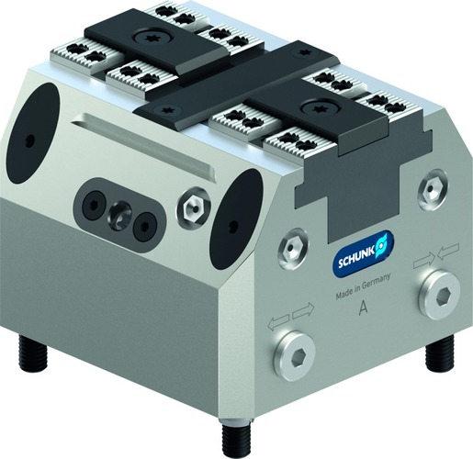
TANDEM KSA plus
Clamping Force Blocks I manually operated

Slide 2












Product Overview
Gripping Systems
Clamping Technology
Chuck Jaws
Lathe Chucks
Stationary Workholding
Toolholders
Hydraulic Expansion Technology
VERO-S
TANDEM
ROTA
KONTEC
Tombstones
MAGNOS

Slide 3
Challenges
Variants
Automation
Time
Time
Required
accuracy
Global
competition
Time
Time
Increasing relevance of the set-up process
heute
zukünftig

Slide 4


TANDEM Clamping Force Blocks
High workpiece density at small space
Optimum accessibility of the machine spindle to the workpiece
High duration at low non-productive times per workpiece

Slide 5







TANDEM Overview
Actuation Types | Pneumatic (KSP plus) | Hydraulic (KSH plus) | Manually (KSA plus) | Spring-loaded (KSF plus)
Variants | Standard stroke | Long stroke (-LH) | With fixed jaw (-F)

Slide 6
TANDEM Portfolio
Max. clamping force [kN]
Stroke/jaw [mm]
Size
Size

Slide 7







TANDEM Jaw Program
Top Jaws Blank
Mounting: via tongue and groove | Mounting: via fine serrations 1,5 x 60°
KTR / KTR-H | STR / STR-H | STR-S
Supporting Jaws + SCHUNK Jaw Program
TBA-D | Chuck Jaws

Slide 8



SCHUNK Services
Engineering
Dimensioning of special plates designed to the manufacturing specifications
Development of special solutions together with the customer
FEM analysis for critical components
Testing
Endurance tests with all new developments
Abrasion checking
Measurement of accuracy
Service
Initial operation of customer´s solution
Inspection and maintenance
Repairs

Slide 9




TANDEM Overview
Pneumatic
Hydraulic
Manual
Spring force

Slide 10
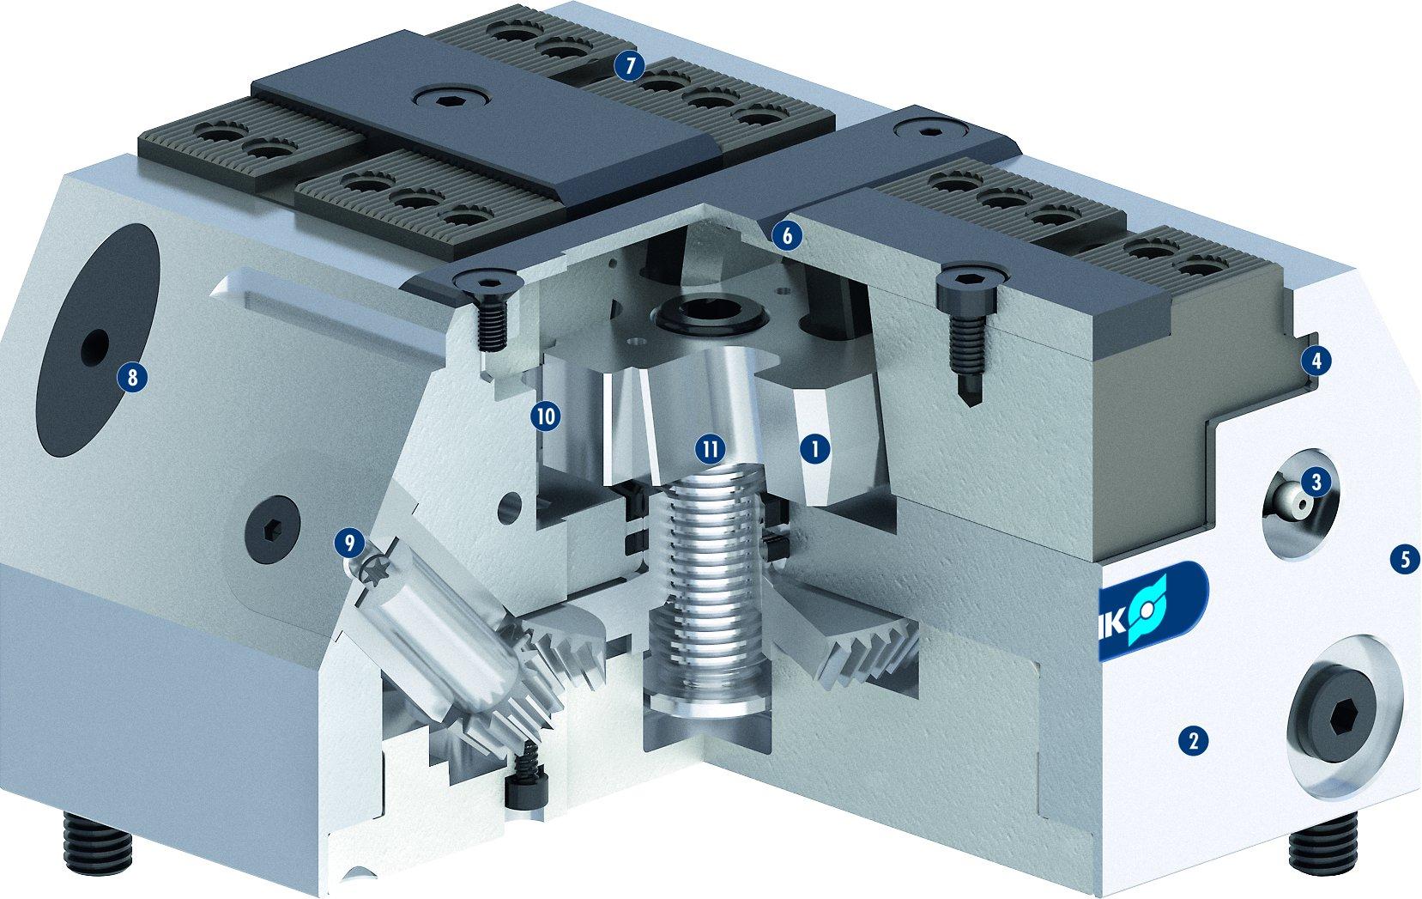

TANDEM KSA plus
1
Wedge hook drive
Hardened and extremely rigid base body
Optimized lubrication system
Long jaw guidance
Low height
Improved design which is insensitive to dirt
Standard chuck jaw interface
Optimized outside contour
Control of the clamping modules
Chuck pistons guided in the body
Manually actuated system with large gear ratio
7
2
3
6
4
8
4
5
10
11
1
6
3
5
7
8
2
9
10
11

Slide 11
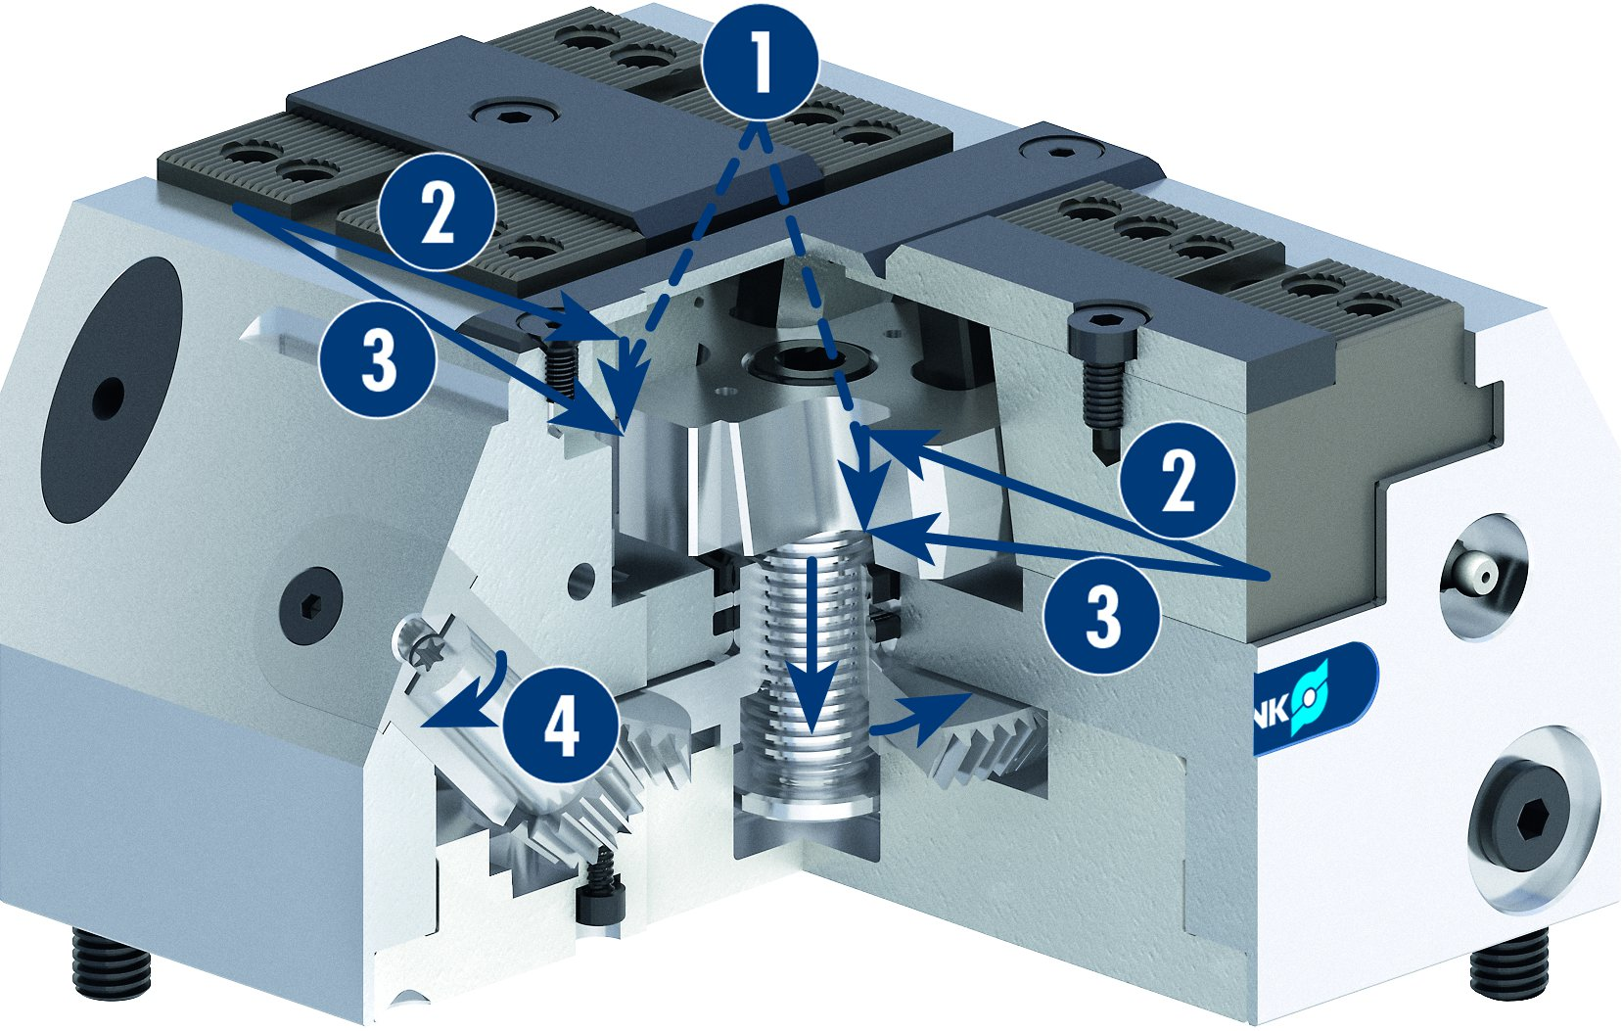



TANDEM KSA plus
Force Flow in the KSA plus
1
1
Actuating force depending on the applied torque
Clamping force depending on the actuating force and the transmission ratio
Normal force between the base jaw and chuck body
Torque on the pinion
2
2
3
2
3
3
4
4
Z-version (optional)
Chip-repellent design
1
Positioning bore
1

Slide 12


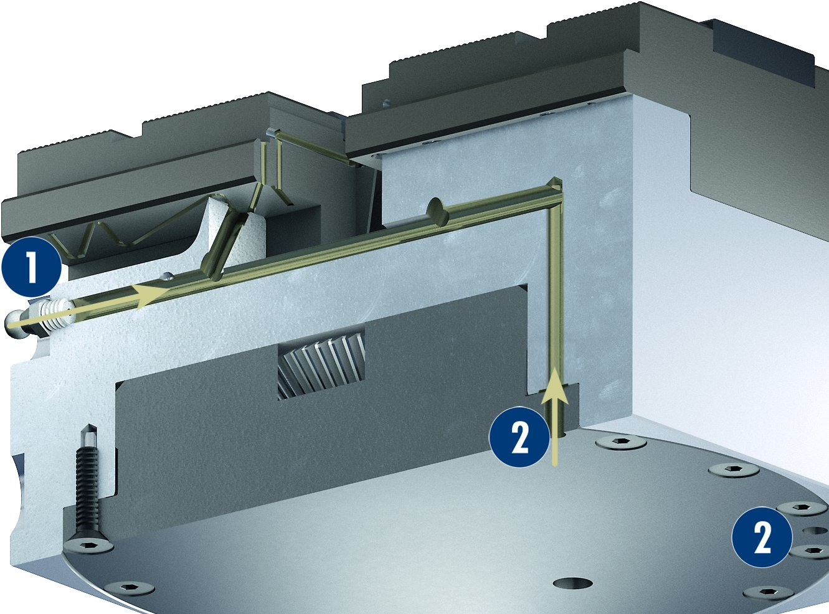
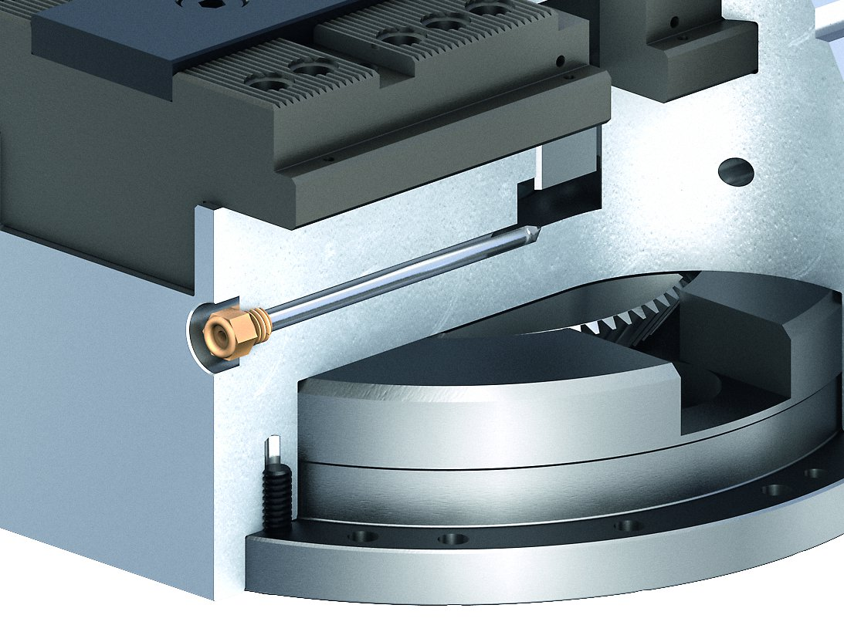
TANDEM KSA plus
Cover plugs for the mounting screws
Alignment edge
Lubrication system
Coolant drain hole
1
Manual lubrication
Central lubrication
1
2
2
2

Slide 13
Variants of TANDEM KSA plus
Technical data | KSA plus 100 |  |  | KSA plus 160
 | KSA | KSA-LH | KSA-F | KSA | KSA-LH | KSA-F
Stroke/jaw [mm] | 2 | 6 | 4 | 3 | 8 | 6
Clamping force [kN] | 18 | 8 | 18 | 45 | 20 | 45
Max. torque [Nm] | 8 | 8 | 8 | 15 | 15 | 15
Repeat accuracy vise [mm] | 0.01 | 0.01 | 0.01 | 0.02 | 0.02 | 0.02
Max. jaw height [mm] | 60 | 60 | 60 | 60 | 60 | 60
Weight [kg] | 5 | 5 | 5 | 14 | 14 | 14

