Slide 1

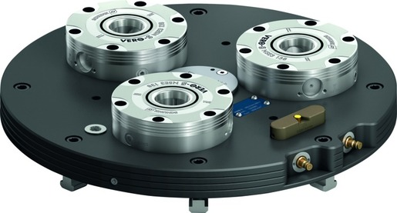
VERO-S NSL3 turn
Suitable for use with all standard milling-turning centers

Slide 2












Product Overview
Gripping Systems
Clamping Technology
Chuck Jaws
Lathe Chucks
Stationary Workholding
Toolholders
Hydraulic Expansion Technology
VERO-S
KONTEC
TANDEM
ROTA
MAGNOS
PLANOS

Slide 3
Challenges
Variants
Quantities
Required accuracy
Time
Time
Time
Product life cycle
Demand
Global competition
Time
Time
Time
Increasing relevance of the set-up process
heute
zukünftig

Slide 4

VERO-S – the set-up time optimizer

Slide 5
Potential for savings
Set-up costs
without VERO-S
Set-up costs [€]
Set-up costs
with VERO-S
0
Number of set-up procedures
Notes:
5 min Rüstzeit pro Rüstvorgang mit VERO-S
25 min Rüstzeit pro Rüstvorgang ohne VERO-S
60€/h Maschinenkosten

Slide 6

Amortisation
Calculation for set-up costs | Case 1 | Case 2
Investment in SCHUNK VERO-S [€] | 5.000 | 10.000
Time per set-up procedure without VERO-S [min] | 25
Time per set-up procedure with VERO-S [min] | 5
Machine costs [€/h] | 60
Number of set-up procedures per day | 5
Working days per month | 20
Working days per year | 240
Payback Time
Set-up procedures | 250 | 500
Working days | 50 | 100
Months | 2,5 | 5
Years | 0,21 | 0,42
Even for older machines, the investment in SCHUNK VERO-S quick change pallet system amortizes within a minimum of time.
Thanks to the consistent interface of the clamping pin, the existing clamping devices can easily be integrated in the new system.

Slide 7
Consistency of pull-down and holding forces
 | Pull-down force [N] |  | Holding force [N] |  |  |  |  |  |  | Recommended machines
 | Without Turbo | With Turbo | SPx mikro 10 |  | SPx mini 20 |  | SPx 40
 |  |  | M3 | M4 | M6 | M8 | M10 | M12 | M16
NSE mikro | 150 | 400 | 3.000 | 5.000
NSE mini 90 | 500 | 1.500 |  |  | 15.000 | 25.000
NSE mini 90-25 | 1.500 | 6.000
NSE3 138 | 8.000 | 28.000 |  |  |  |  | 35.000 | 50.000 | 75.000
F_{pull-down}
F_{Hold}
100
80
HSK-Size
63
50
40
32
NSE mikro
NSE mini 90
NSE3 138

Slide 8

VERO-S modular system

Slide 9



SCHUNK Services
Engineering
Dimensioning of special plates designed to the manufacturing specifications
Development of special solutions together with the customer
FEM analysis for critical components
Testing
Endurance tests with all new developments
Abrasion checking
Measurement of accuracy
Service
Initial operation of customer´s solution
Inspection and maintenance
Repairs

Slide 10






VERO-S Overview
General milling applications
Direct workpiece clamping
Milling and turning applications
Easy milling applications
Automated machine loading
Further applications

Slide 11
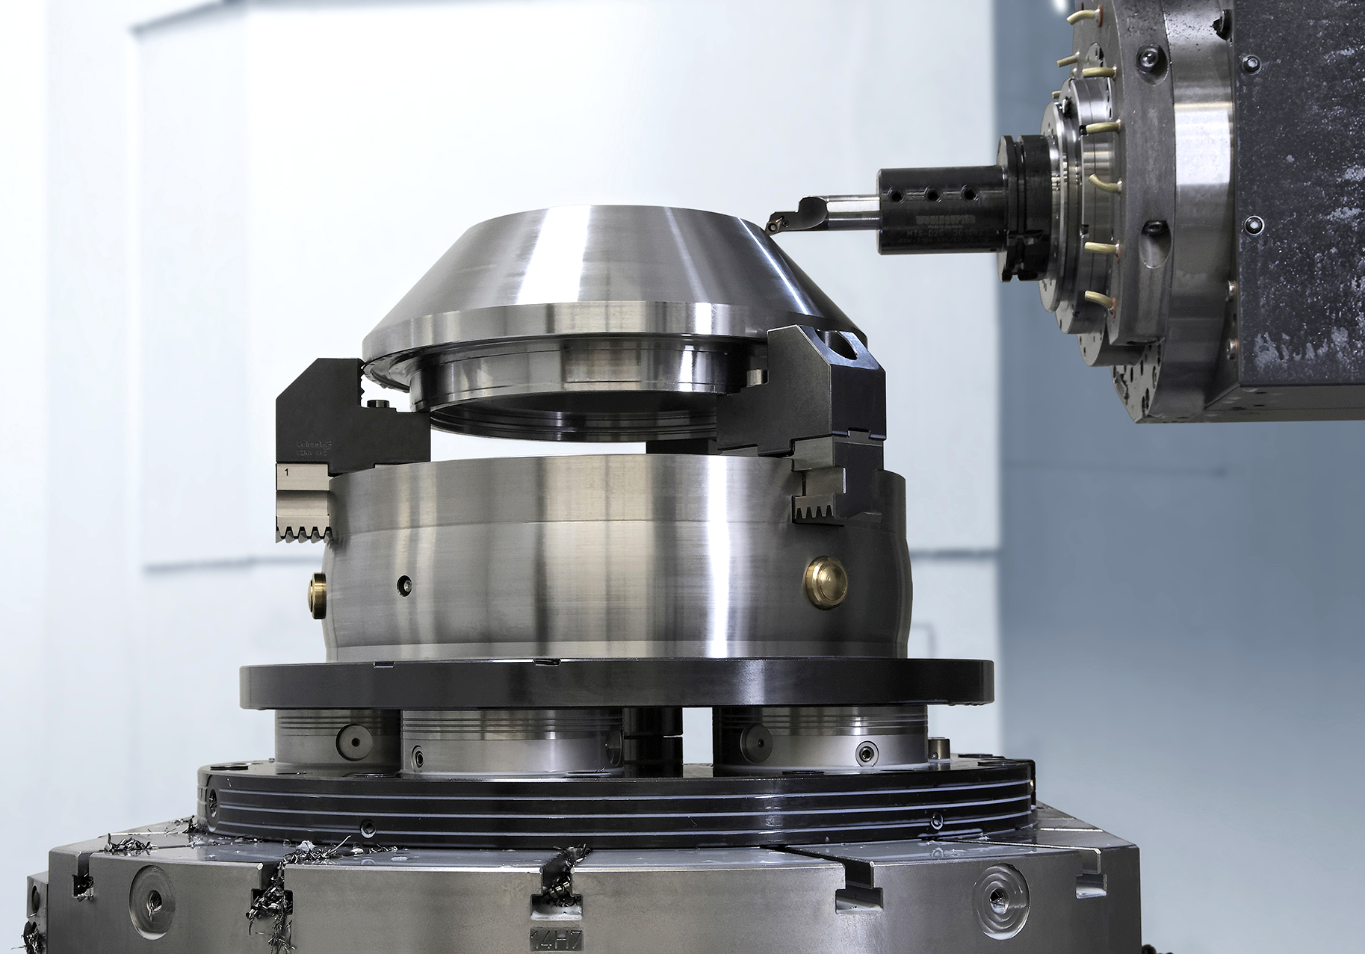
VERO-S NSL3 turn
Example of application
VERO-S:
Standard NSL turn 5-way clamping station.
Clamping device:
Manual chuck ROTA-S plus 2.0.
Features/Application:
The clamping device resp. the workpiece is centered via the highly precise flex cone in the center of the clamping station. The flex cone offers radial rigidity and axial flexibility.
The pull-down force is increased by the Turbo function that is integrated in the standard version. Rotational speed of up to 2000/min is possible.

Slide 12

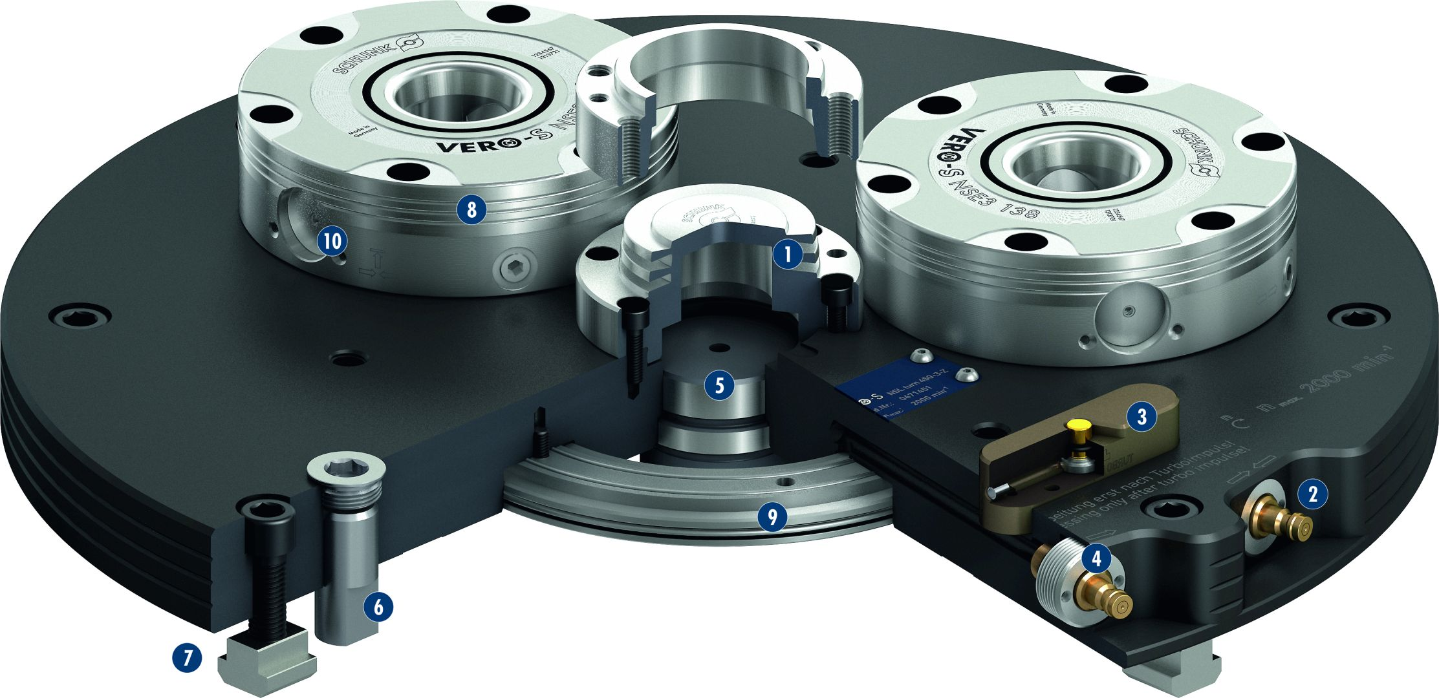
VERO-S NSL3 turn
1
Highly precise flex taper centering
Turbo function
Indicator pin
Pneumatic system
Alignment with centering bolts
Mounting using alignment bolts
Mounting via T-nuts
NSE3 138 quick-change pallet system
Ring-shaped air distribution
Orientation of the clamping slides always tangential
2
3
4
5
8
6
10
1
7
5
3
8
9
2
9
4
6
10
7

Slide 13
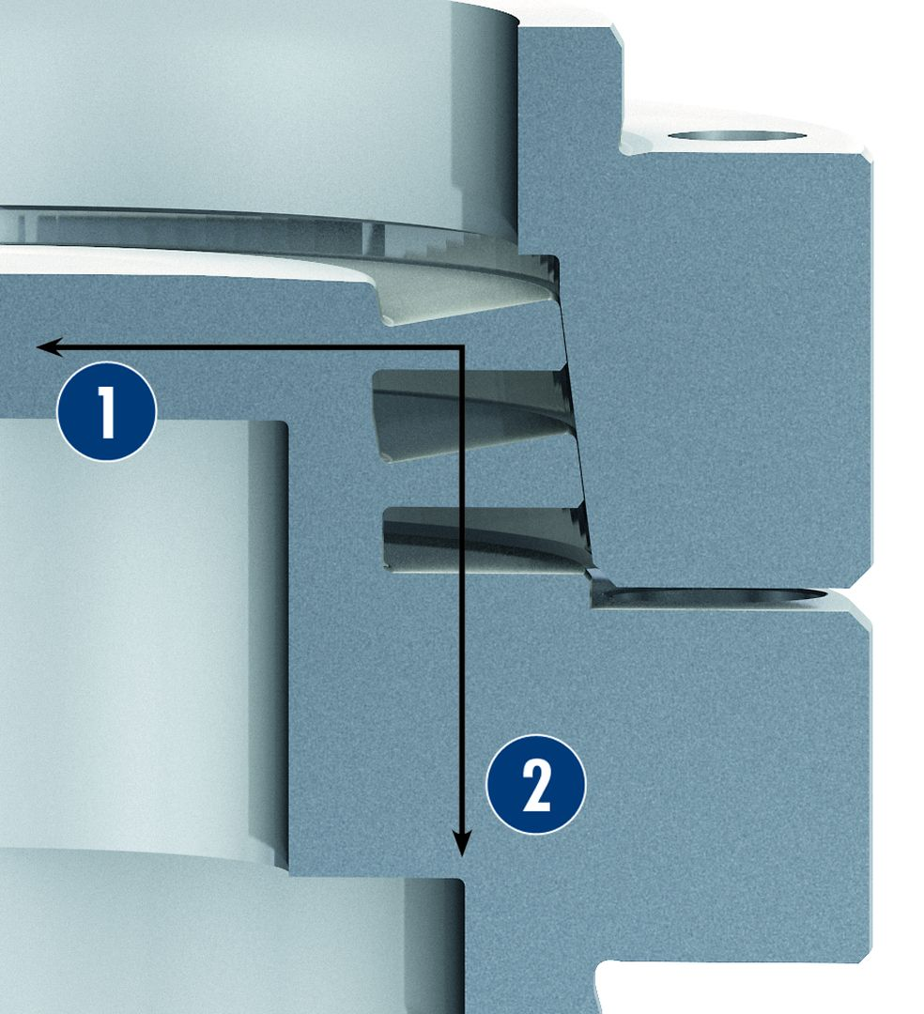
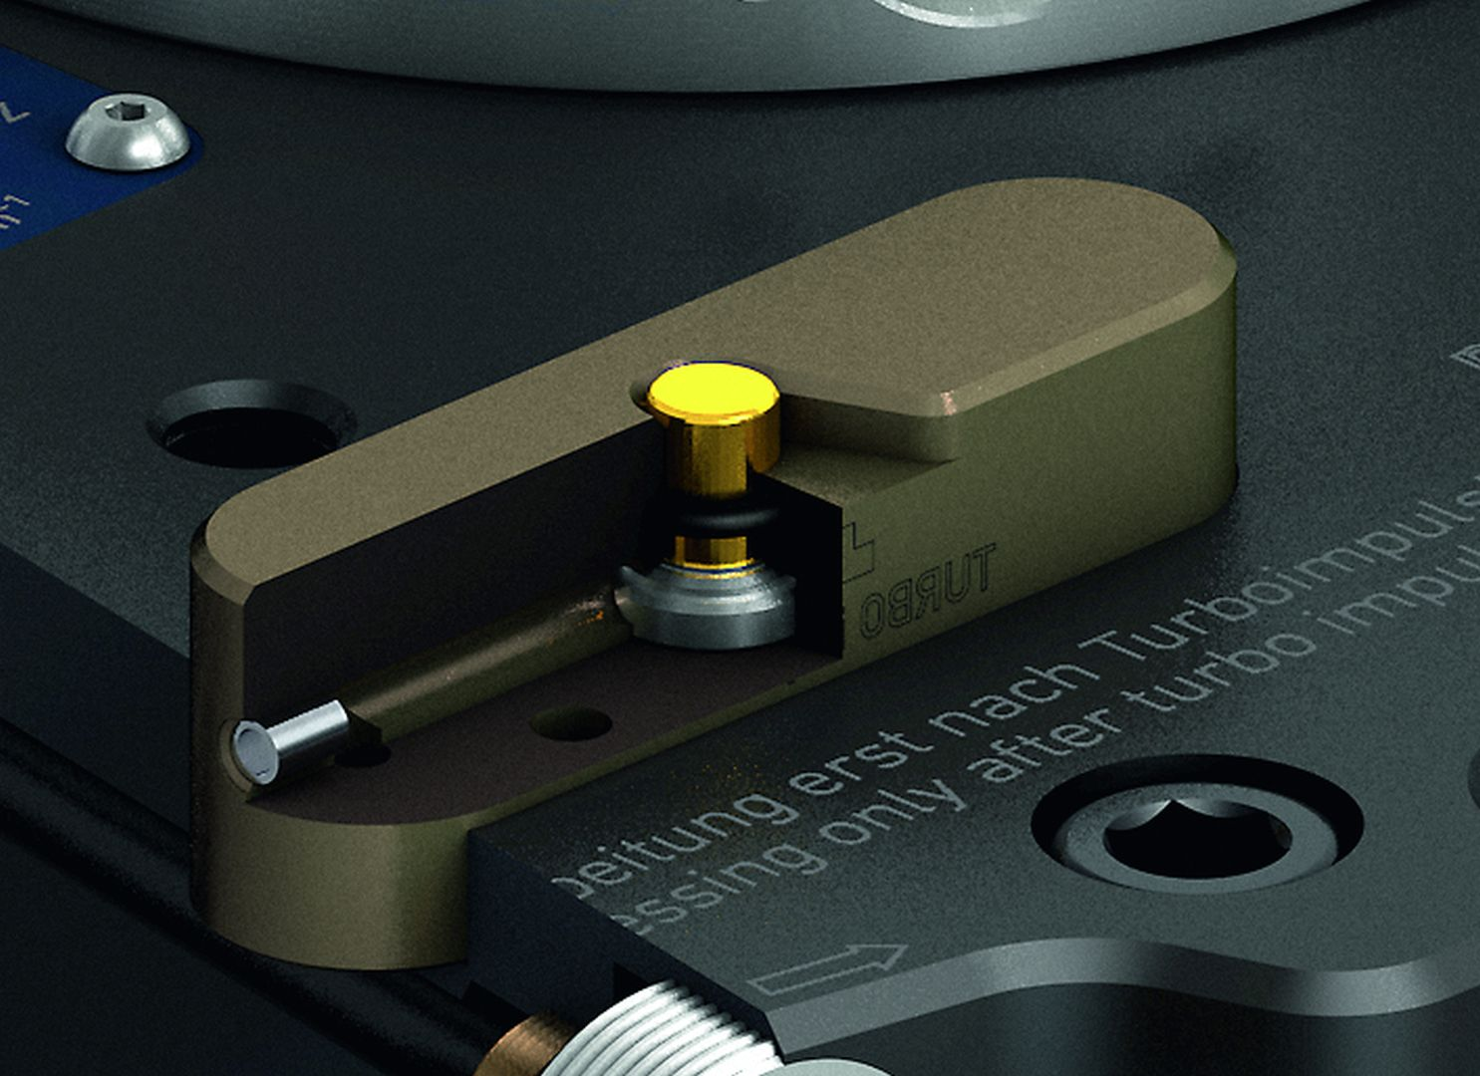
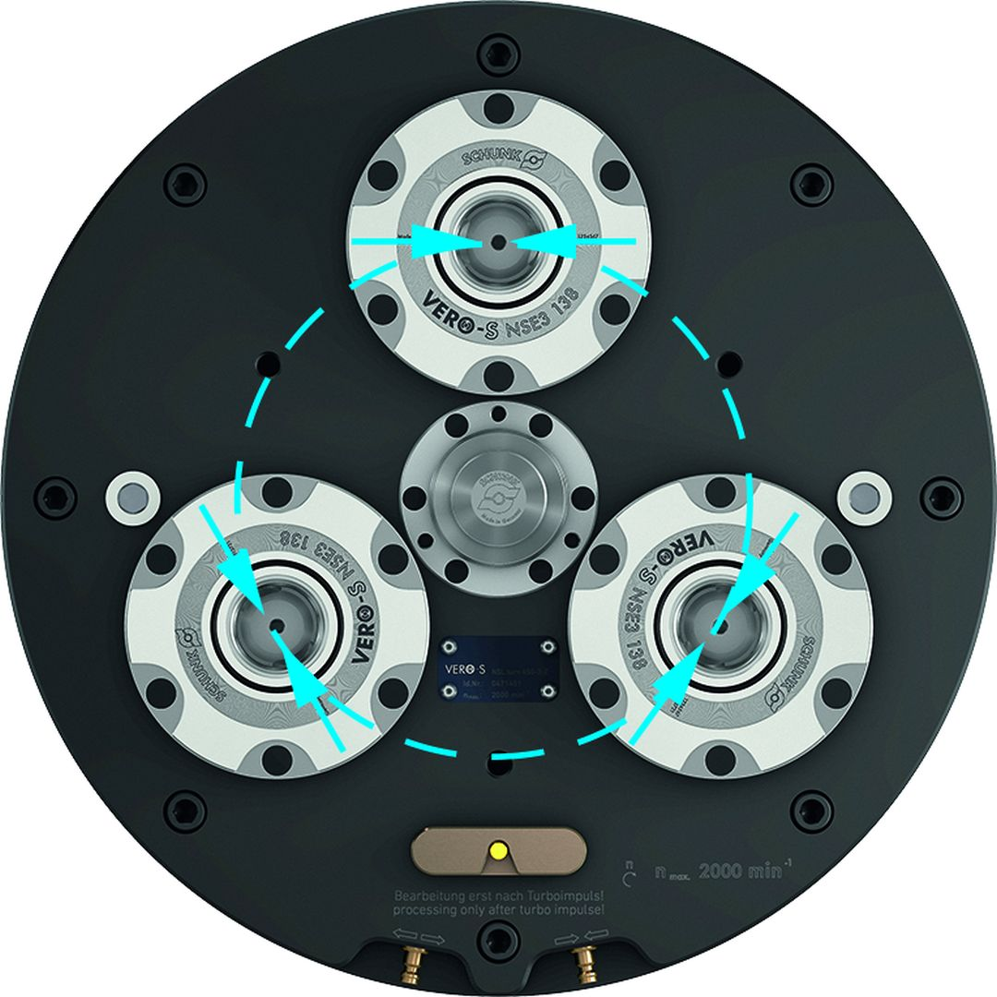
VERO-S NSL3 turn
Flex taper
Visual display of the turbo function
1
1
Radially rigid
Axially flexible
2
2
Clamping slide arrangement

Slide 14
Variants VERO-S NSL3 turn
Technical Data | NSL3 turn 450-3 | NSL3 turn 450-3-Z | NSL3 turn 570-5 | NSL3 turn 570-5-Z
Diameter [mm] | 450 | 450 | 570 | 570
Pull-down force with turbo [kN] | 75 | 75 | 125 | 125
Unlocking pressure [bar] | 6 | 6 | 6 | 6
Run-out accuracy [mm] | < 0.02 | < 0.01 | < 0.02 | < 0.01
Max. rotational speed [1/min] | 2000 | 2000 | 1400 | 1400
Weight [kg] | 50 | 51 | 90 | 91

