Slide 1

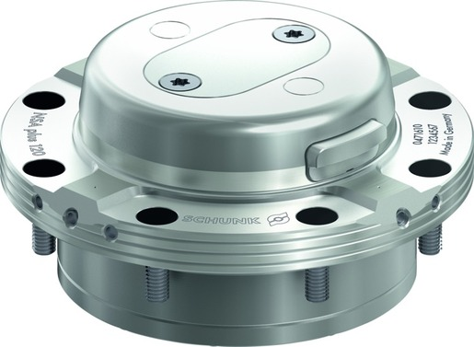
VERO-S NSA plus
The specialist for automated production

Slide 2












Product Overview
Gripping Systems
Clamping Technology
Chuck Jaws
Lathe Chucks
Stationary Workholding
Toolholders
Hydraulic Expansion Technology
VERO-S
KONTEC
TANDEM
ROTA
MAGNOS
PLANOS

Slide 3
Challenges
Variants
Quantities
Required accuracy
Time
Time
Time
Product life cycle
Demand
Global competition
Time
Time
Time
Increasing relevance of the set-up process
heute
zukünftig

Slide 4

VERO-S – the set-up time optimizer

Slide 5
Potential for savings
Set-up costs
without VERO-S
Set-up costs [€]
Set-up costs
with VERO-S
0
Number of set-up procedures
Notes:
5 min Rüstzeit pro Rüstvorgang mit VERO-S
25 min Rüstzeit pro Rüstvorgang ohne VERO-S
60€/h Maschinenkosten

Slide 6

Amortisation
Calculation for set-up costs | Case 1 | Case 2
Investment in SCHUNK VERO-S [€] | 5.000 | 10.000
Time per set-up procedure without VERO-S [min] | 25
Time per set-up procedure with VERO-S [min] | 5
Machine costs [€/h] | 60
Number of set-up procedures per day | 5
Working days per month | 20
Working days per year | 240
Payback Time
Set-up procedures | 250 | 500
Working days | 50 | 100
Months | 2,5 | 5
Years | 0,21 | 0,42
Even for older machines, the investment in SCHUNK VERO-S quick change pallet system amortizes within a minimum of time.
Thanks to the consistent interface of the clamping pin, the existing clamping devices can easily be integrated in the new system.

Slide 7
Consistency of pull-down and holding forces
 | Pull-down force [N] |  | Holding force [N] |  |  |  |  |  |  | Recommended machines
 | Without Turbo | With Turbo | SPx mikro 10 |  | SPx mini 20 |  | SPx 40
 |  |  | M3 | M4 | M6 | M8 | M10 | M12 | M16
NSE mikro | 150 | 400 | 3.000 | 5.000
NSE mini 90 | 500 | 1.500 |  |  | 15.000 | 25.000
NSE mini 90-25 | 1.500 | 6.000
NSE3 138 | 8.000 | 28.000 |  |  |  |  | 35.000 | 50.000 | 75.000
F_{pull-down}
F_{Hold}
100
80
HSK-Size
63
50
40
32
NSE mikro
NSE mini 90
NSE3 138

Slide 8

VERO-S modular system

Slide 9



SCHUNK Services
Engineering
Dimensioning of special plates designed to the manufacturing specifications
Development of special solutions together with the customer
FEM analysis for critical components
Testing
Endurance tests with all new developments
Abrasion checking
Measurement of accuracy
Service
Initial operation of customer´s solution
Inspection and maintenance
Repairs

Slide 10






VERO-S Overview
General milling applications
Direct workpiece clamping
Milling and turning applications
Easy milling applications
Automated machine loading
Further applications

Slide 11
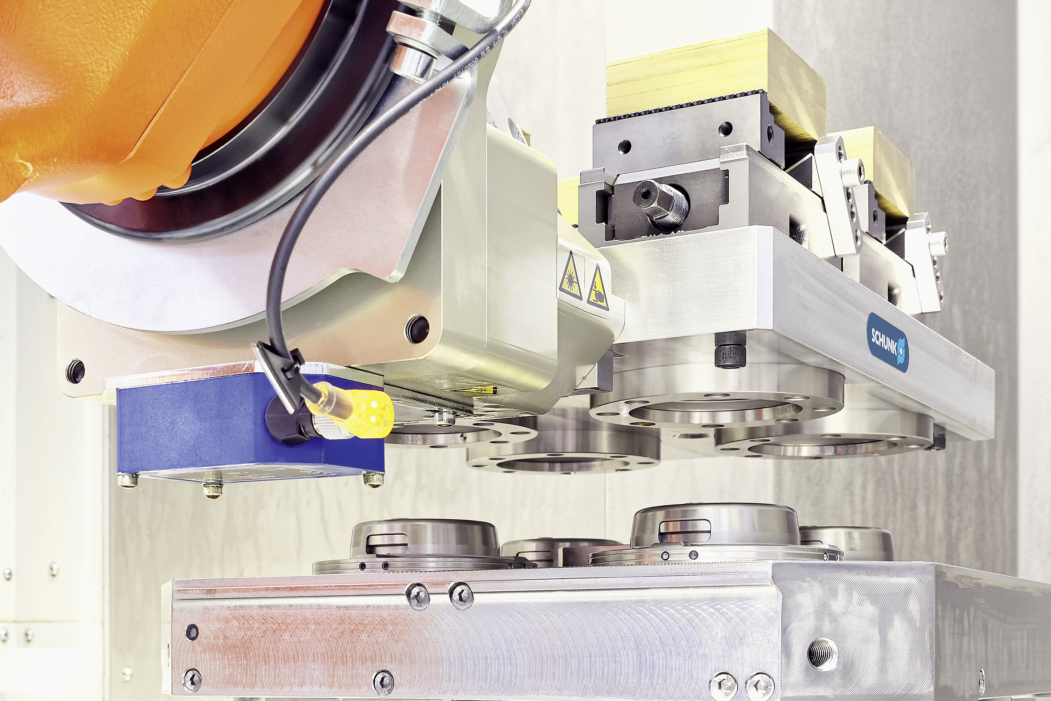
VERO-S NSA plus
Example of application
VERO-S:
Special 4-way clamping station with NSA plus 120 clamping modules, Robot coupling NSR maxi, Pallet coupling PKL maxi.
Clamping device:
Clamping pallet with KONTEC KSC 125-160.
Features/Application:
Thanks to the monitoring systems of the clamping station, VERO-S is best suited for automated loading and unloading.

Slide 12

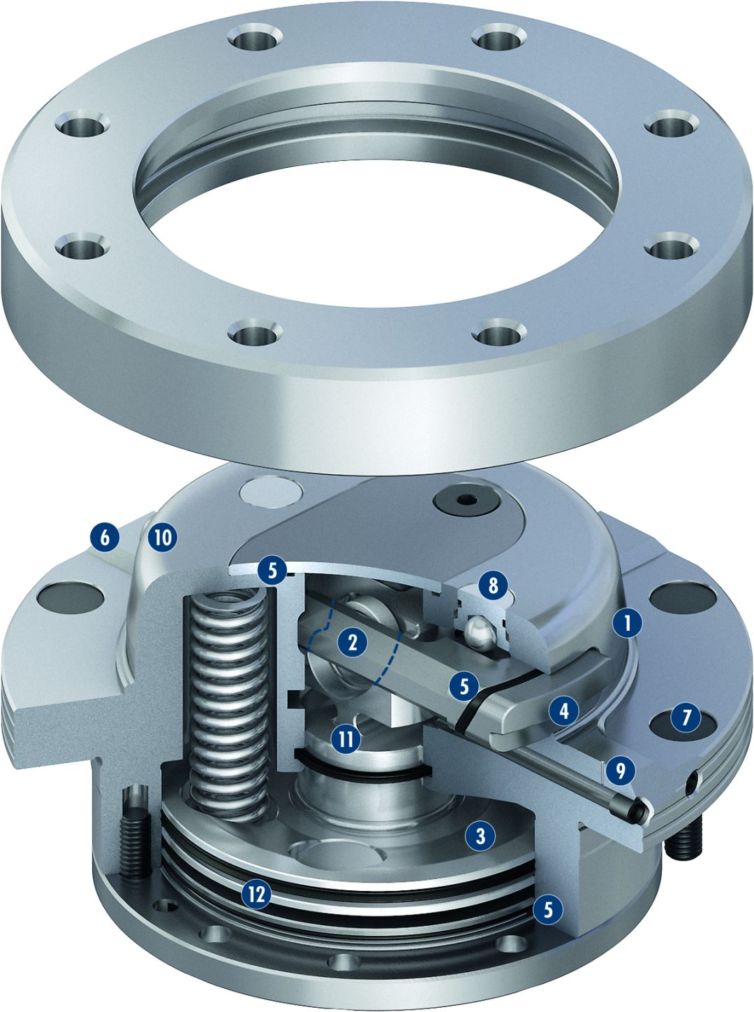
VERO-S NSA plus
1
High-precision short taper centering
Patented dual stroke system
Turbo function
Large surfaces
Completely sealed system
Flat work surface at outer diameter
Cover caps for mounting screws
Lifting function when opening the modules
Contact monitoring
Entry radii on the module
Flexible piston
Pneumatic system
2
3
4
5
6
7
6
10
8
5
8
2
1
5
9
11
4
7
10
9
3
11
12
12
5

Slide 13
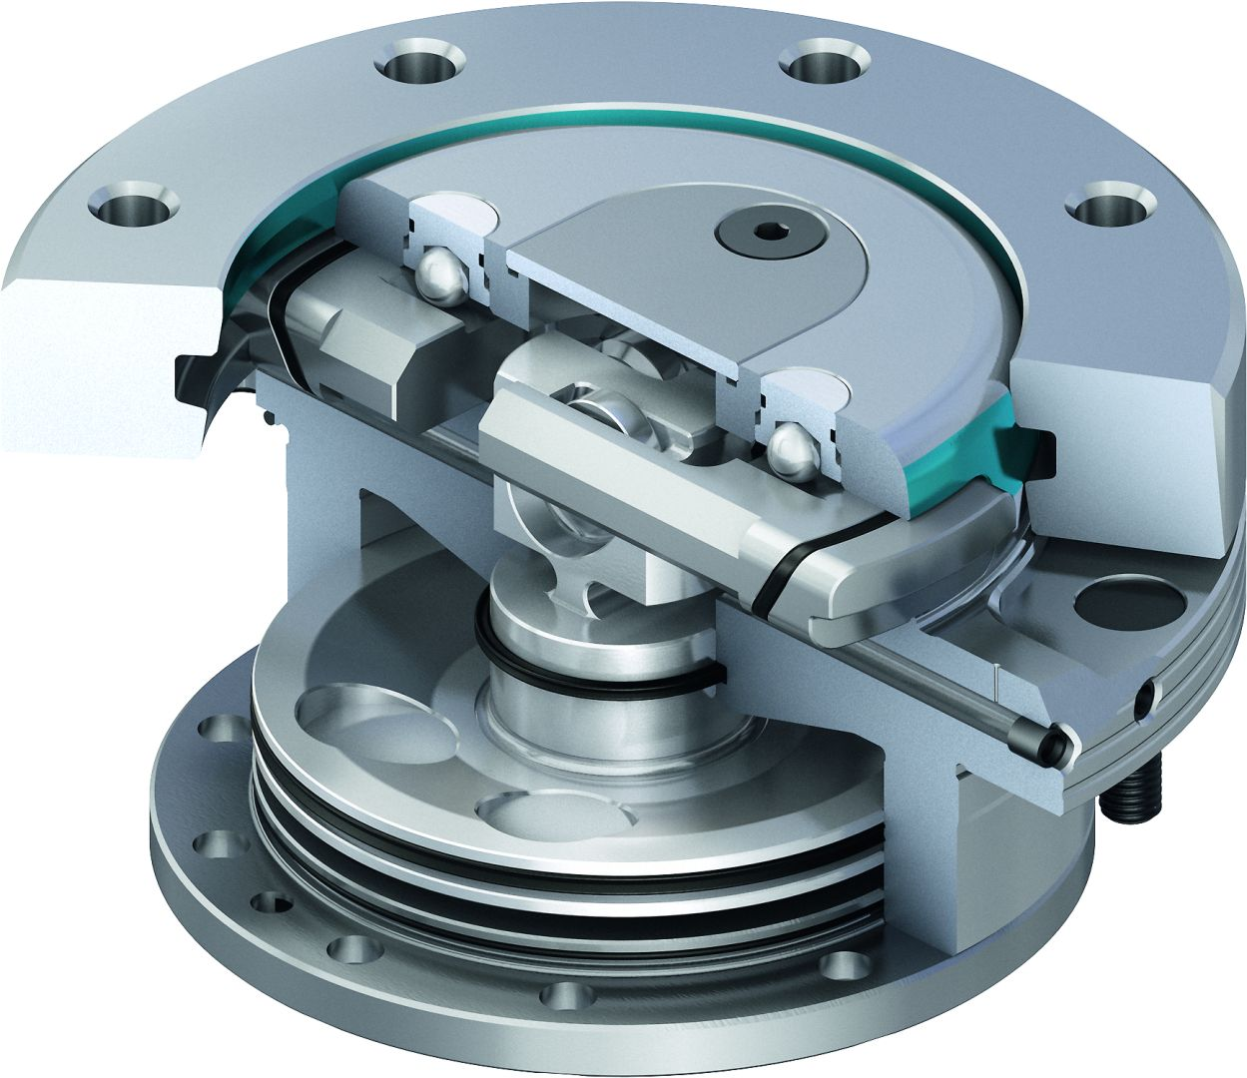

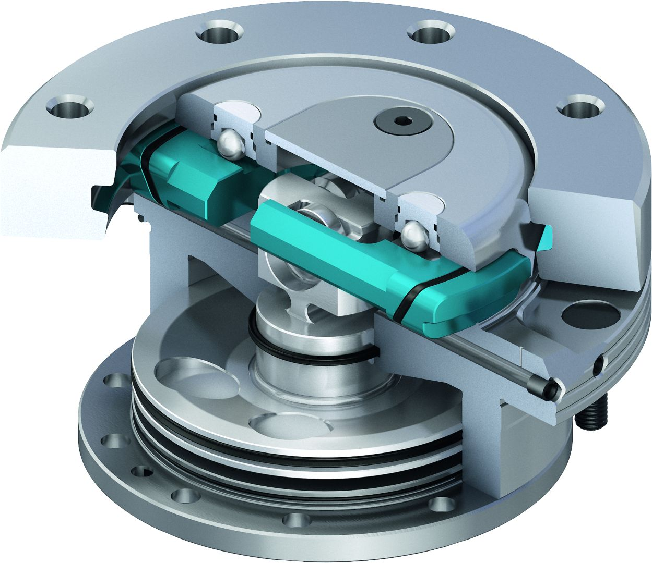
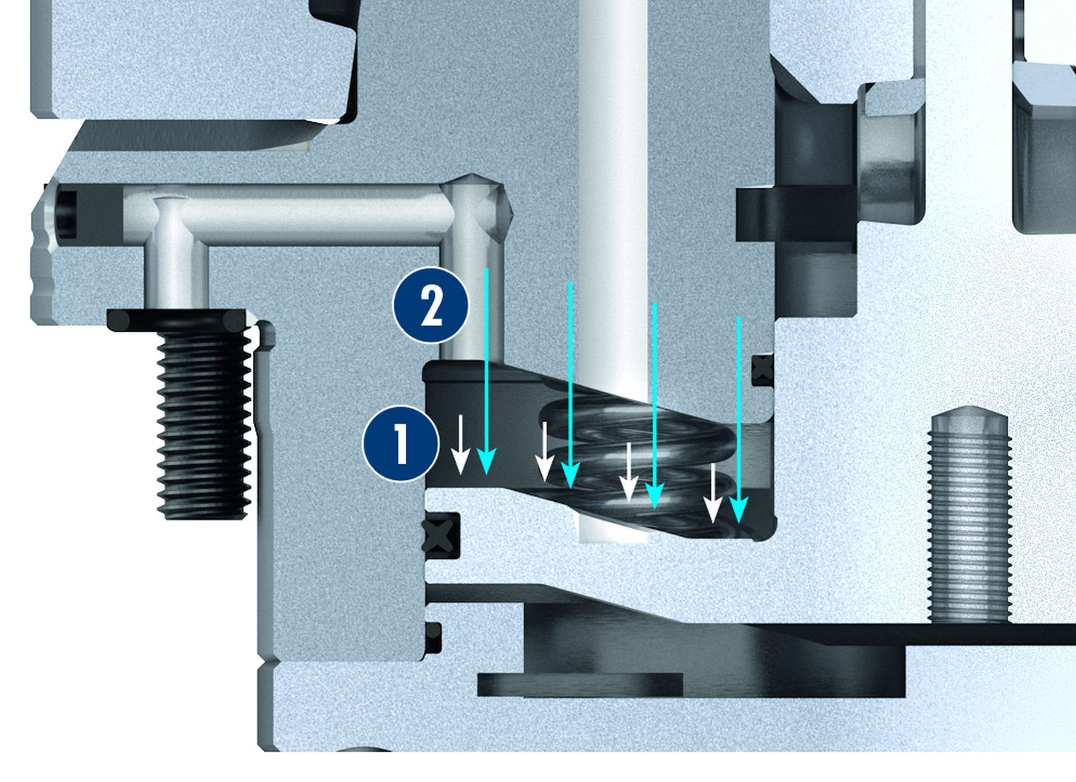
VERO-S NSA plus
Comparison: Pull-down force spring clamping and turbo funtion
Centering via short taper
Pull-down force
Turbo function
max. 15 kN
Spring force clamping
max. 5 kN
Actuation pressure of the turbo function
Locking via clamping slide
Integrated turbo function
2
1
Spring force
Additional force, resulting from the turbo function
1
2

Slide 14
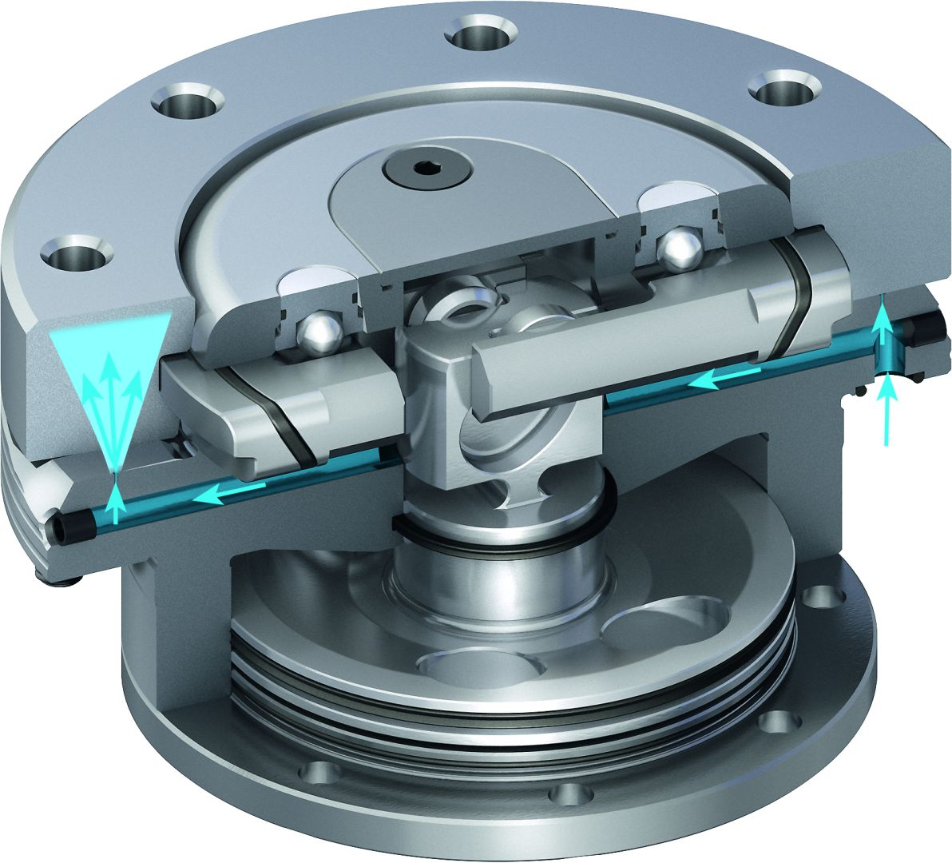
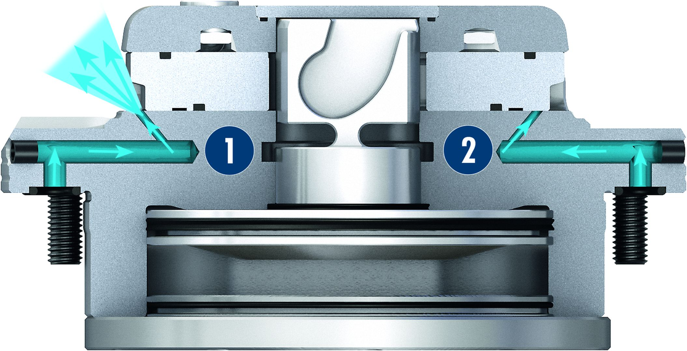
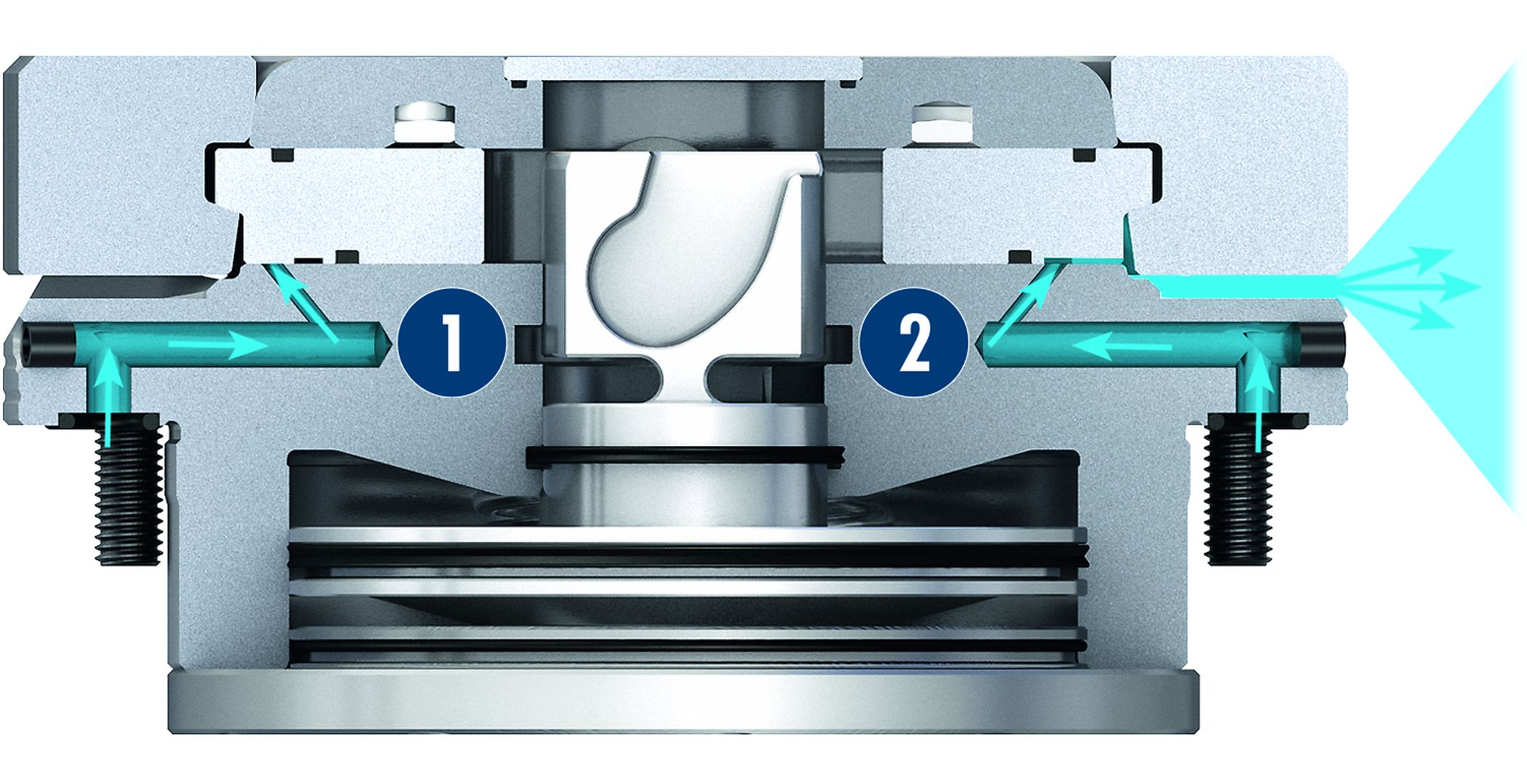
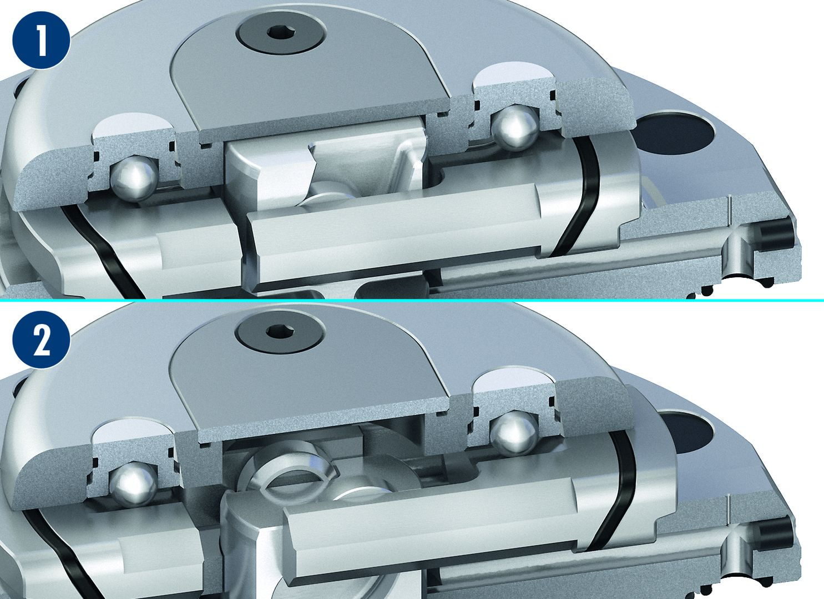
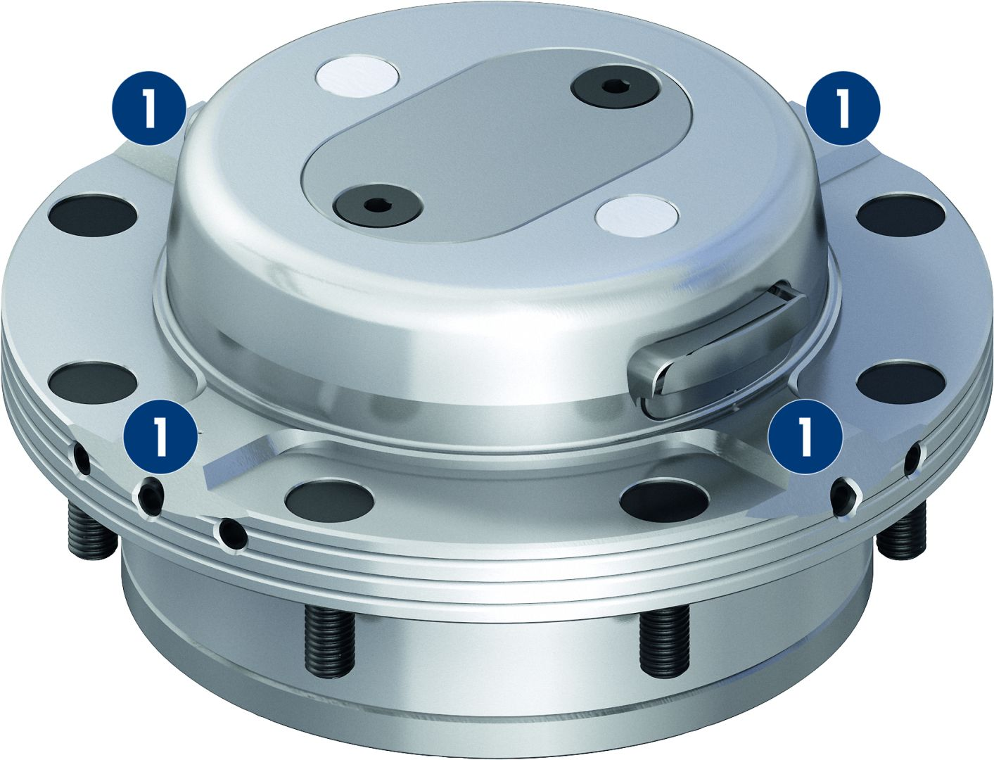
VERO-S NSA plus
Monitoring of the clamping slide position via the dynamic pressure
Cleaning and monitoring the flat work surface
Opened condition
Locked condition
Lifting function
Flat work surface at outer diameter
1
1
Clamping module opened – the lifting function lifts the pallet.
Clamping module closed – the lifting function is pushed back by the weight of the pallet.
1
1
1
Contact surfaces
2
2
1
1

Slide 15
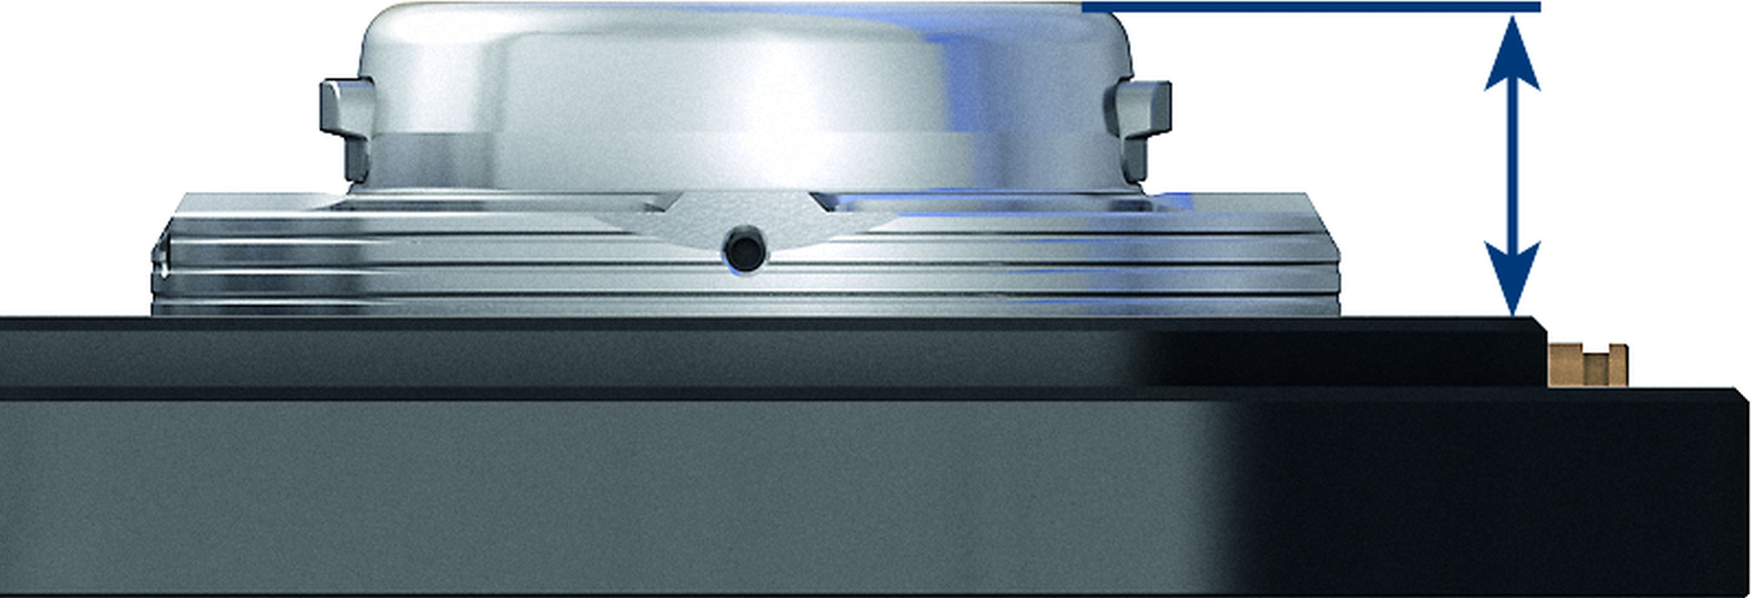
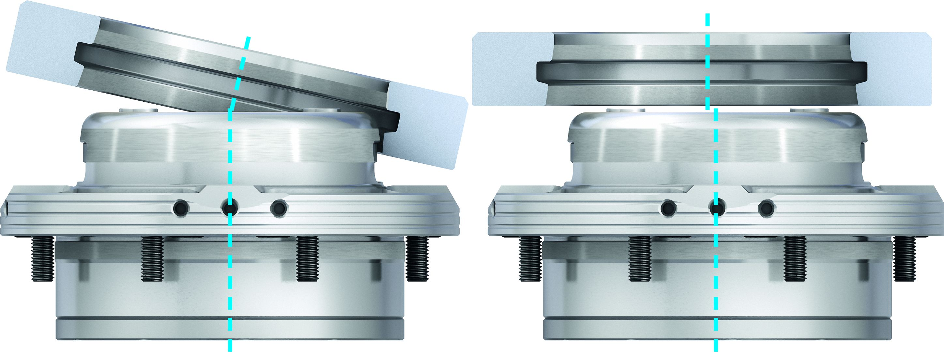
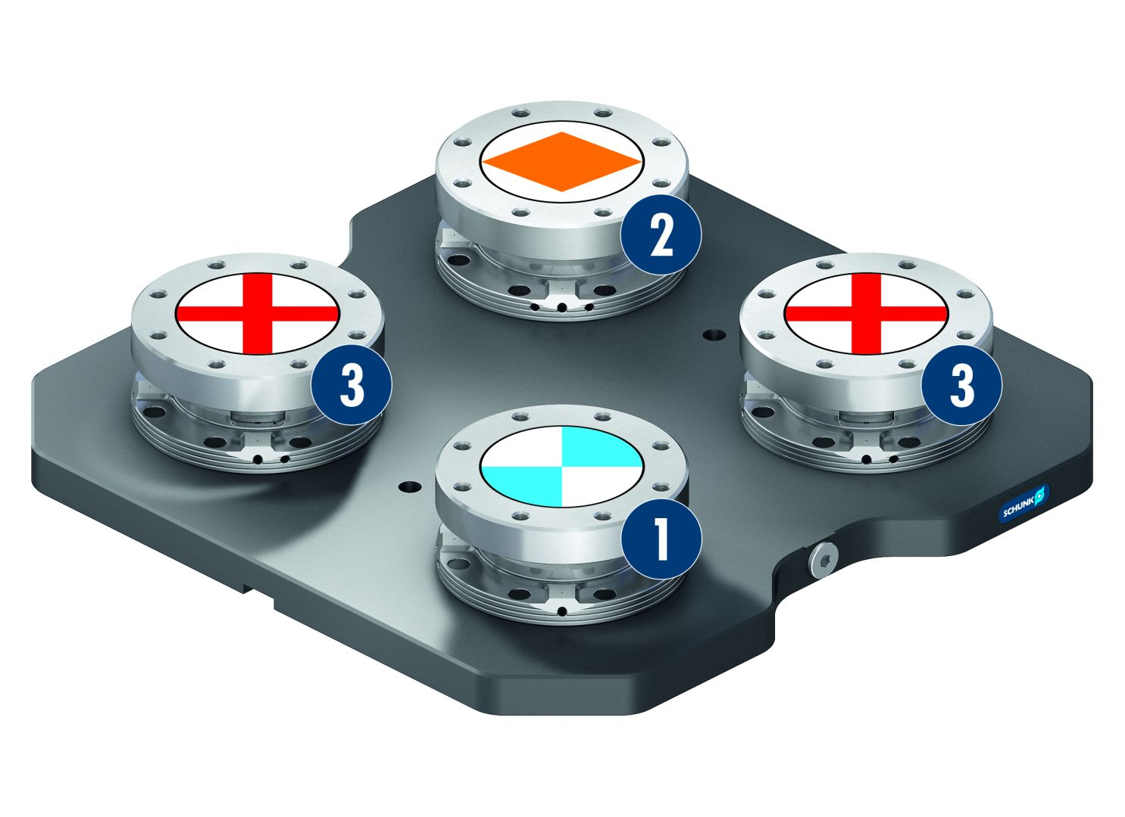
VERO-S NSA plus
Extremely flat design
Easy positioning – more user friendly
Configuration of clamping rings type A, B und C
2
1
Typ A fixed
Typ B positioned
Typ C with centering play
3
3
2
3
1

Slide 16
Variants VERO-S NSA plus
Technical Data | NSA plus 120 | NSA plus 160
Diameter [mm] | 118 | 158
Pull-down force [kN] | 3 | 5
Pull-down force with turbo [kN] | 9 | 15
Unlocking pressure [bar] | 6 | 6
Repeat accuracy [mm] | < 0.005 | < 0.005
Lifting force [kN] | 1 | 2
Weight [kg] | 2.5 | 5.8

