Slide 1

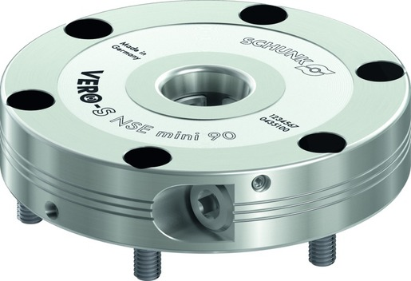
VERO-S NSE mini
The extremely flat, pneumatic quick-change pallet system

Slide 2












Product Overview
Gripping Systems
Clamping Technology
Chuck Jaws
Lathe Chucks
Stationary Workholding
Toolholders
Hydraulic Expansion Technology
VERO-S
KONTEC
TANDEM
ROTA
MAGNOS
PLANOS

Slide 3
Challenges
Variants
Quantities
Required accuracy
Time
Time
Time
Product life cycle
Demand
Global competition
Time
Time
Time
Increasing relevance of the set-up process
heute
zukünftig

Slide 4

VERO-S – the set-up time optimizer

Slide 5
Potential for savings
Set-up costs
without VERO-S
Set-up costs [€]
Set-up costs
with VERO-S
0
Number of set-up procedures
Notes:
5 min Rüstzeit pro Rüstvorgang mit VERO-S
25 min Rüstzeit pro Rüstvorgang ohne VERO-S
60€/h Maschinenkosten

Slide 6

Amortisation
Calculation for set-up costs | Case 1 | Case 2
Investment in SCHUNK VERO-S [€] | 5.000 | 10.000
Time per set-up procedure without VERO-S [min] | 25
Time per set-up procedure with VERO-S [min] | 5
Machine costs [€/h] | 60
Number of set-up procedures per day | 5
Working days per month | 20
Working days per year | 240
Payback Time
Set-up procedures | 250 | 500
Working days | 50 | 100
Months | 2,5 | 5
Years | 0,21 | 0,42
Even for older machines, the investment in SCHUNK VERO-S quick change pallet system amortizes within a minimum of time.
Thanks to the consistent interface of the clamping pin, the existing clamping devices can easily be integrated in the new system.

Slide 7
Consistency of pull-down and holding forces
 | Pull-down force [N] |  | Holding force [N] |  |  |  |  |  |  | Recommended machines
 | Without Turbo | With Turbo | SPx mikro 10 |  | SPx mini 20 |  | SPx 40
 |  |  | M3 | M4 | M6 | M8 | M10 | M12 | M16
NSE mikro | 150 | 400 | 3.000 | 5.000
NSE mini 90 | 500 | 1.500 |  |  | 15.000 | 25.000
NSE mini 90-25 | 1.500 | 6.000
NSE3 138 | 8.000 | 28.000 |  |  |  |  | 35.000 | 50.000 | 75.000
F_{pull-down}
F_{Hold}
100
80
HSK-Size
63
50
40
32
NSE mikro
NSE mini 90
NSE3 138

Slide 8

VERO-S modular system

Slide 9



SCHUNK Services
Engineering
Dimensioning of special plates designed to the manufacturing specifications
Development of special solutions together with the customer
FEM analysis for critical components
Testing
Endurance tests with all new developments
Abrasion checking
Measurement of accuracy
Service
Initial operation of customer´s solution
Inspection and maintenance
Repairs

Slide 10






VERO-S Overview
General milling applications
Direct workpiece clamping
Milling and turning applications
Easy milling applications
Automated machine loading
Further applications

Slide 11
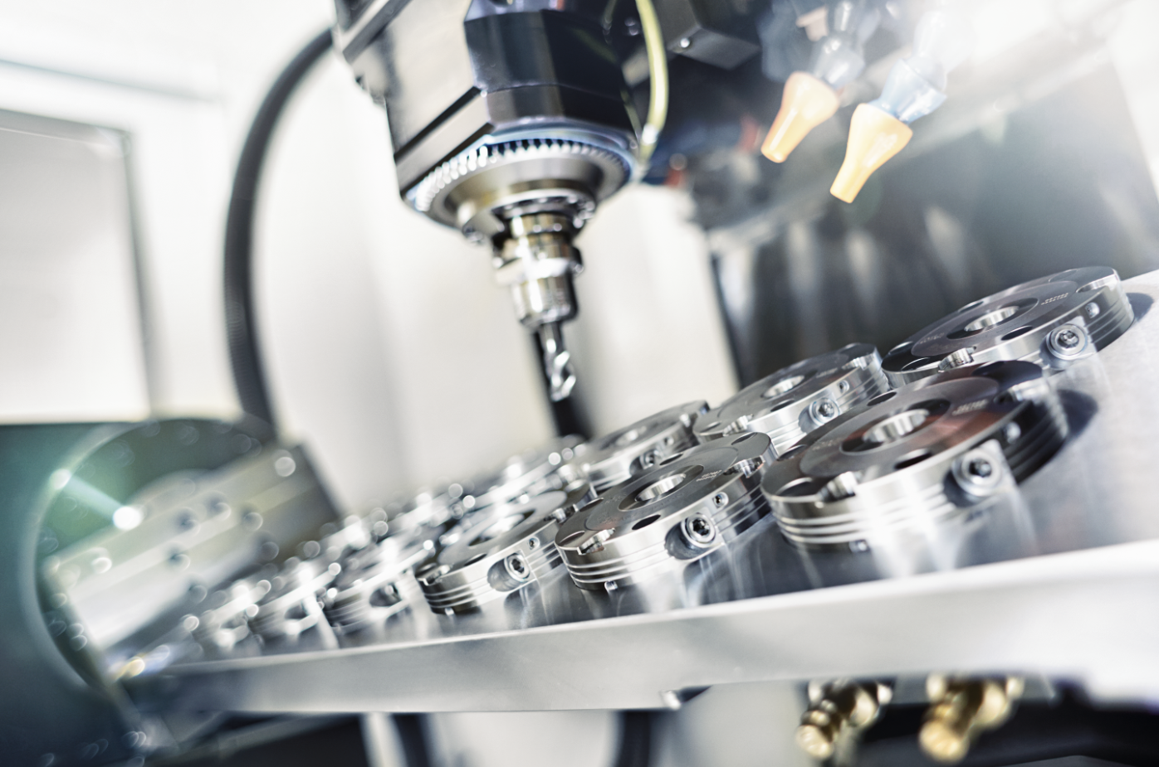
VERO-S NSE mini
Example of application
VERO-S:
Special 12-way clamping station with NSE mini 90 modules.
Features/Application:
Extrem flat buildup of the clamping station allows a higher utilization of the machinig area.

Slide 12

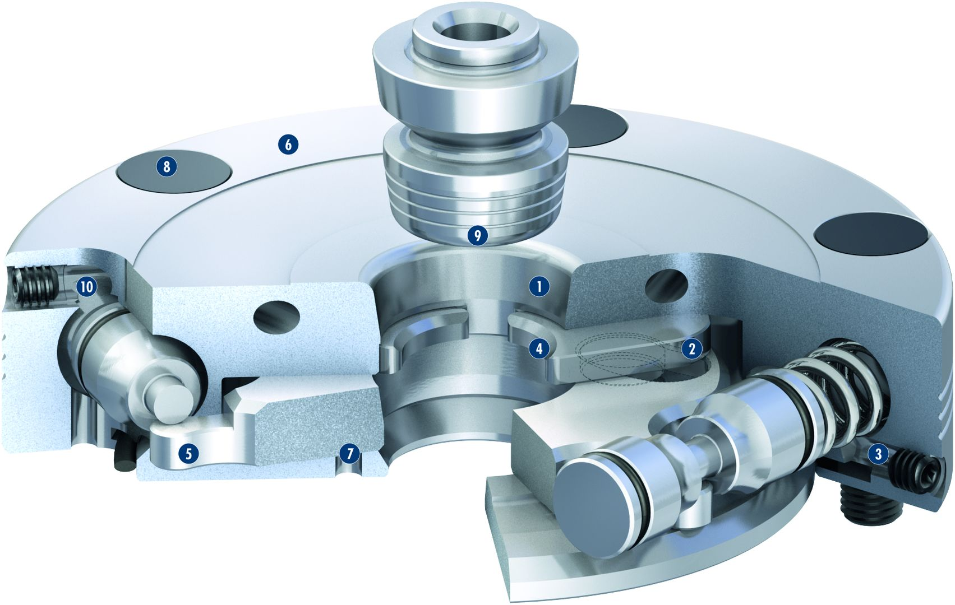
VERO-S NSE mini
1
High-precision short taper centering
Patentented dual stroke system
Turbo function
Large surfaces
Patentented drive concept
Large flat surface
Monitoring of the clamping slide position
Cover caps for mounting screws
Entry radii on the clamping pin
Pneumatic system
2
3
6
4
8
5
9
6
10
1
7
4
2
8
5
7
3
9
10

Slide 13
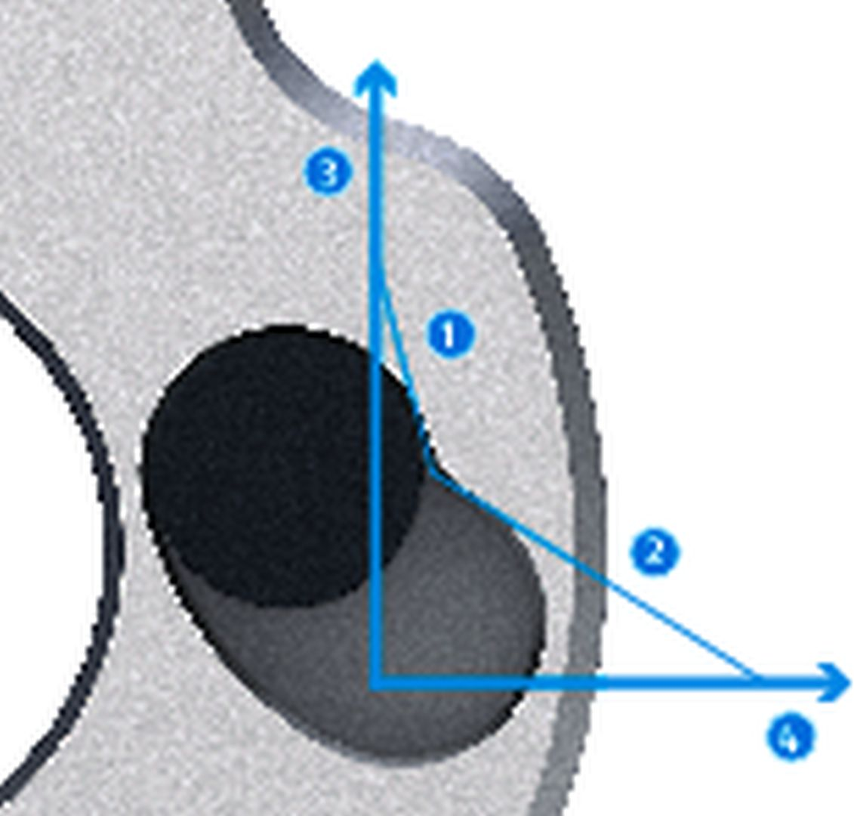
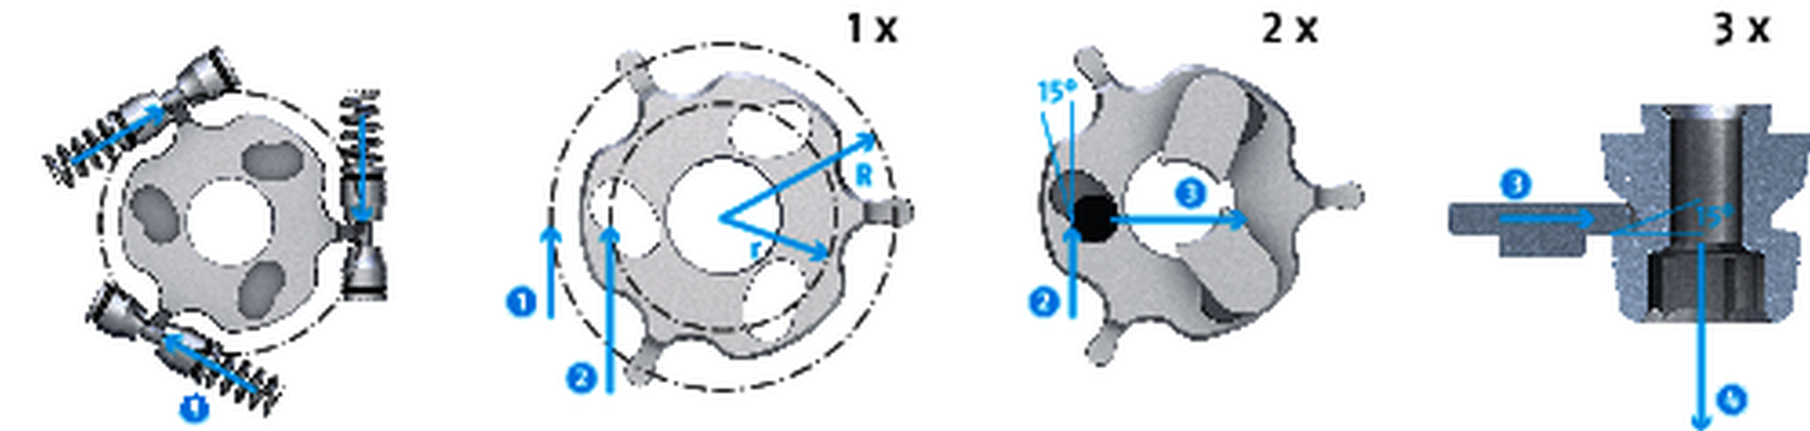
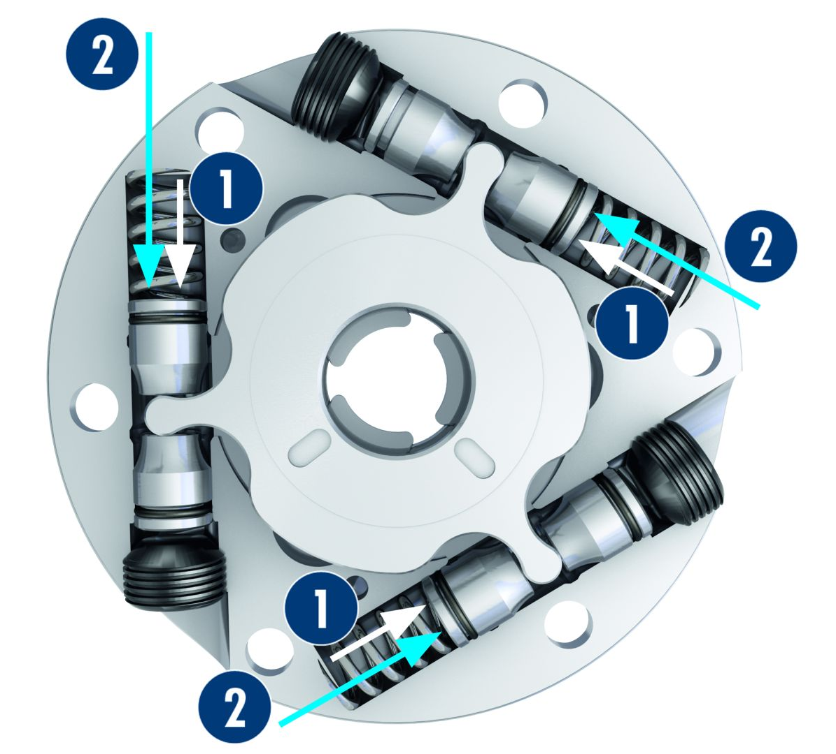

VERO-S NSE mini
Patented drive concept in confined spaces
Patented drive concept: Triple force transmission
3
1
Clamping stroke
Fast stroke
Force
Travel
3
3
1
2
1
2
3
1
2
4
2
4
1
Actuation force
Force on the drive ring
Force on the clamping slide
Pull-down force
3
4
2
4
Integrated Turbo funtion
Comparison: Pull-down force spring clamping and turbo funtion
2
1
Pull-down force
Turbo function
max. 1500 N
2
1
Spring force
Additional force, resulting from the turbo function
1
2
Spring force clamping
max. 500 N
1
Actuation pressure of the turbo function
2

Slide 14
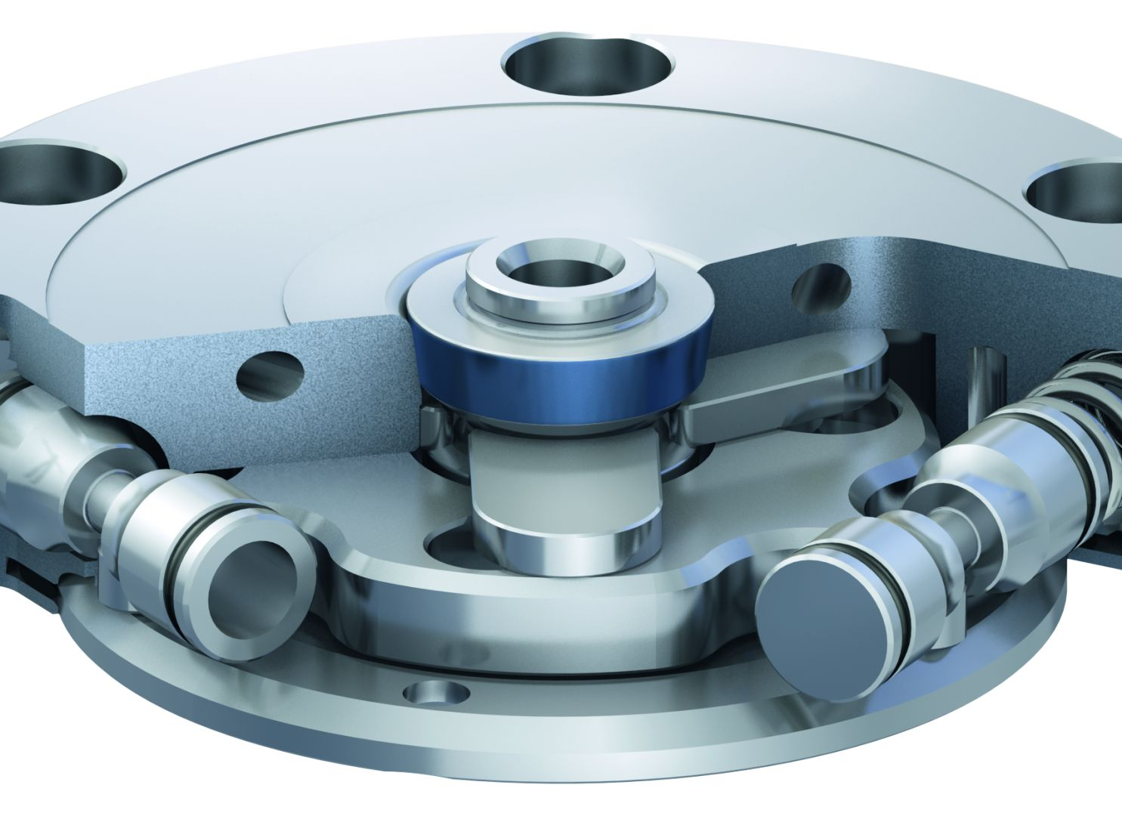
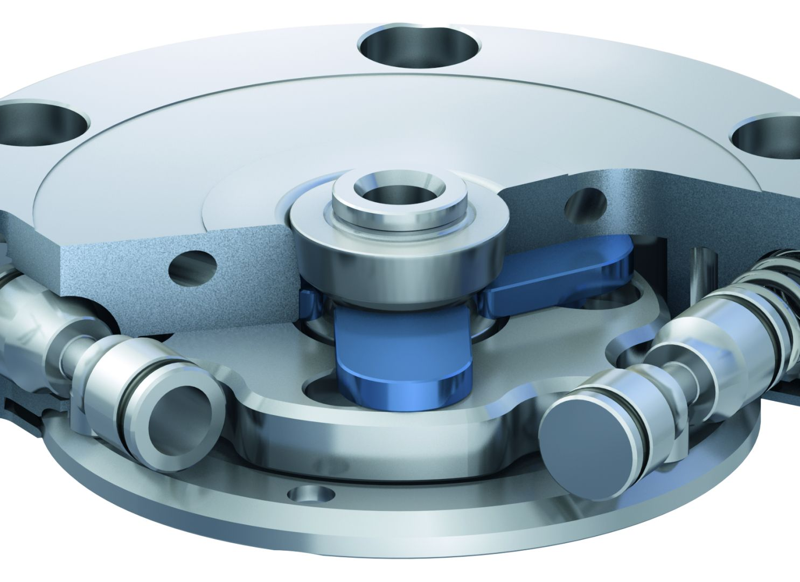
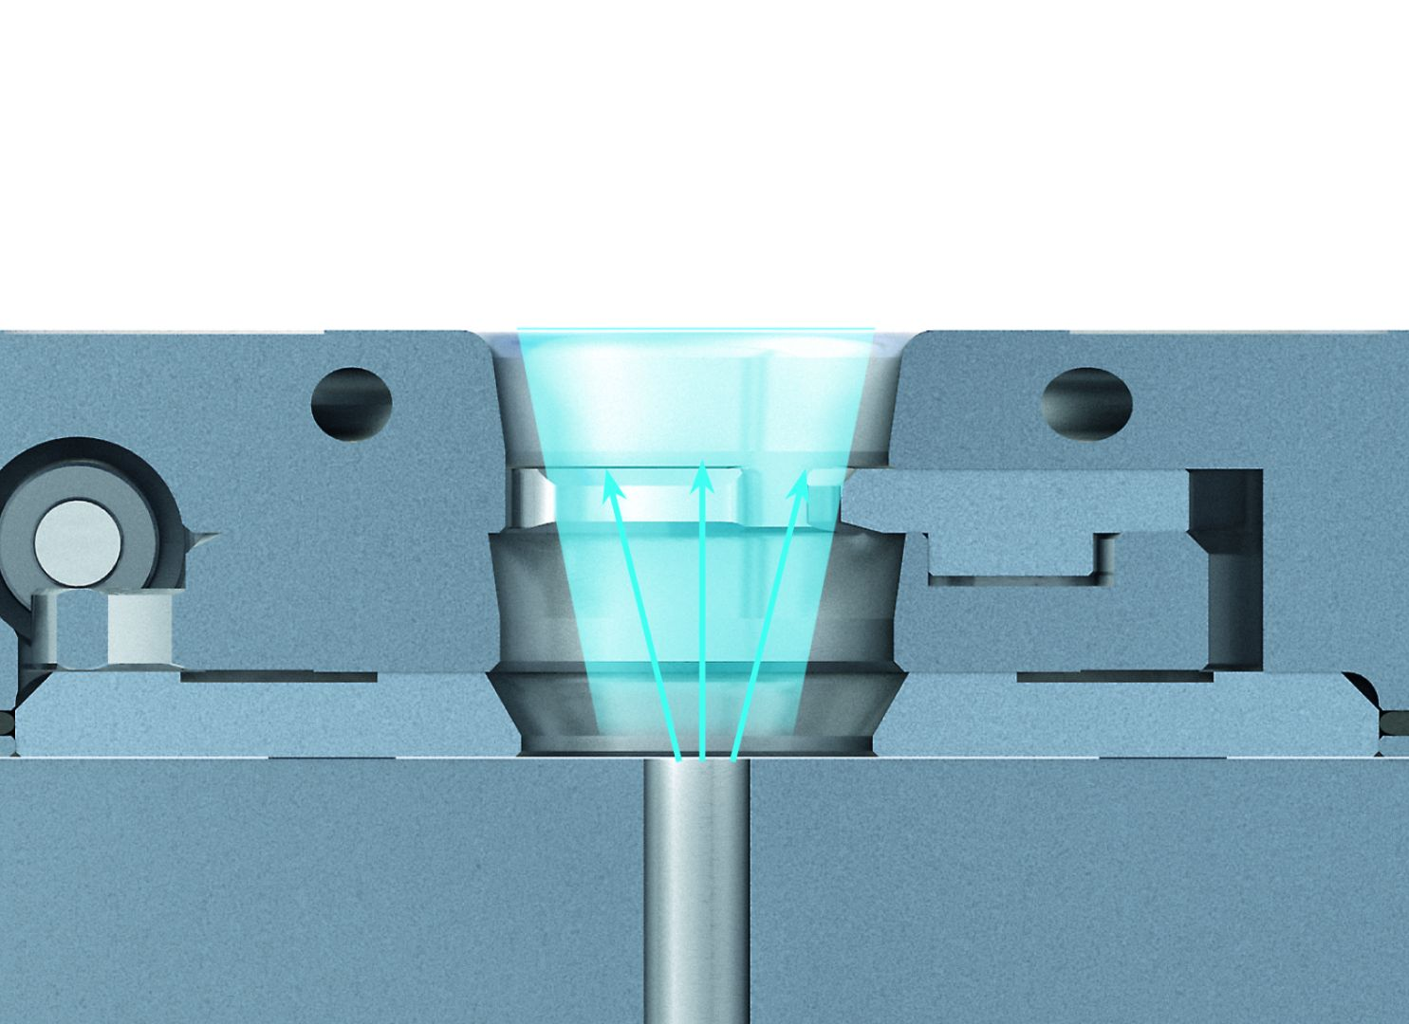
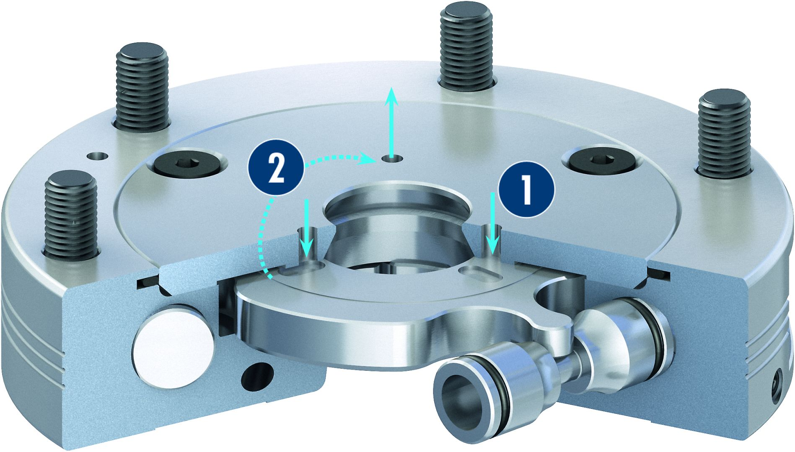
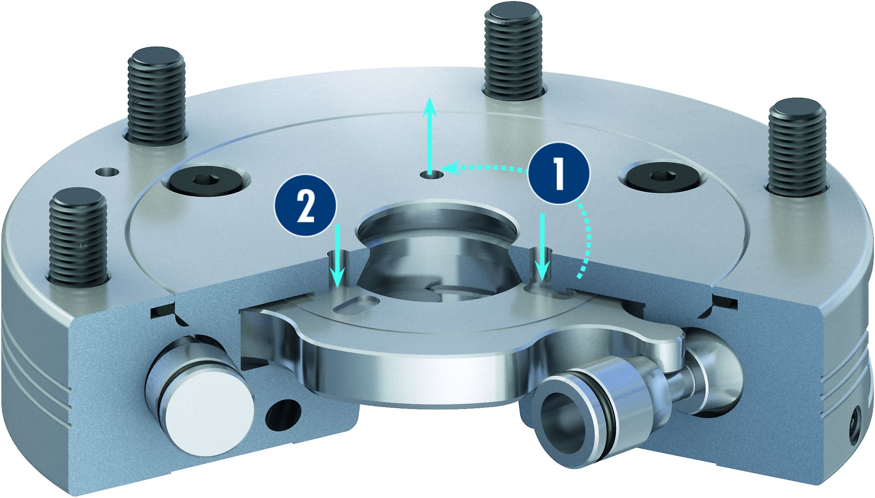
VERO-S NSE mini
Centering via short taper
Locking via clamping slide
Monitoring of the clamping slide position via dynamic pressure
Air purge connection
Opened condition
Locked condition

Slide 15
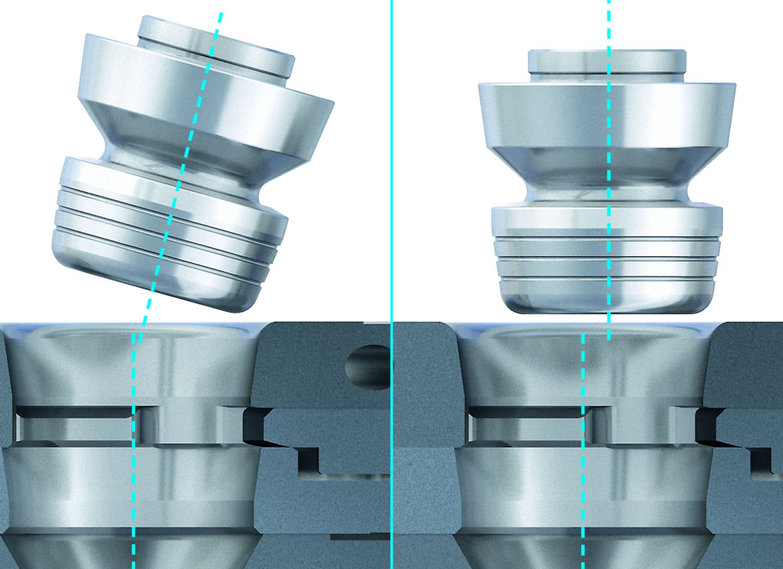
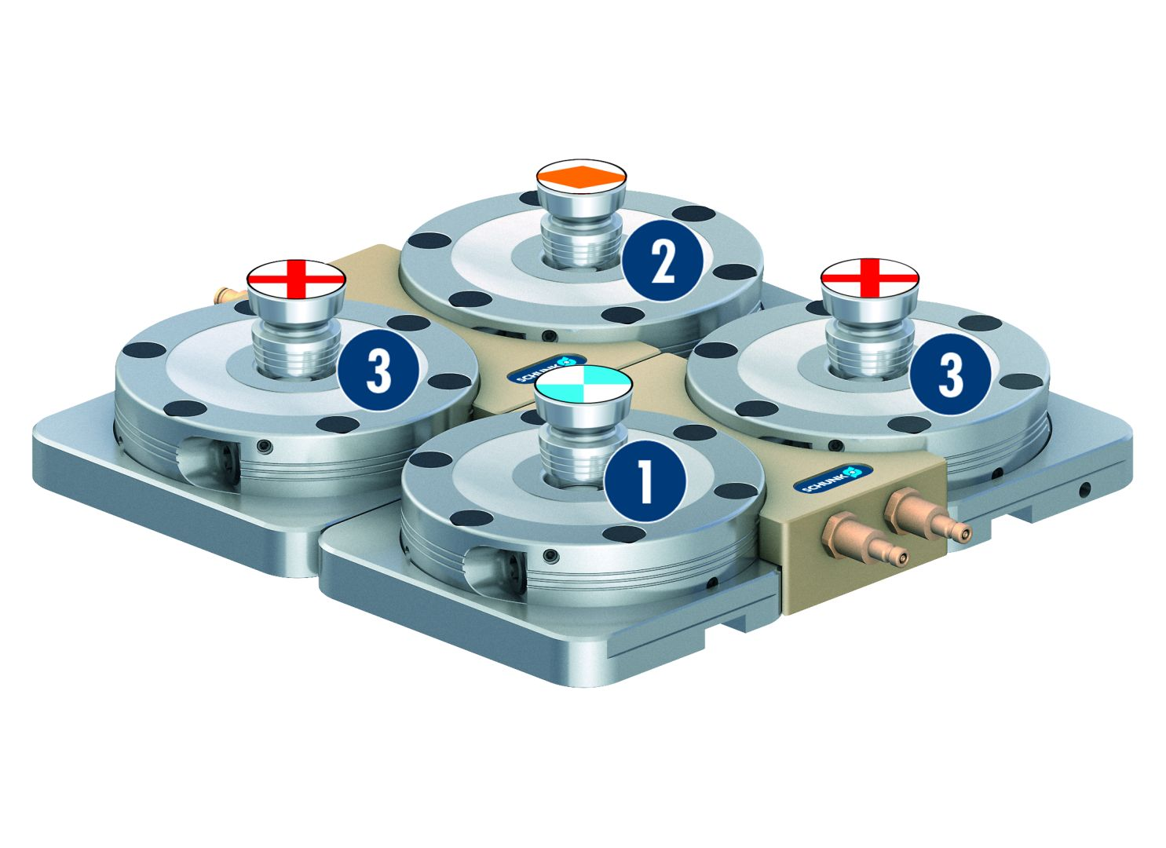
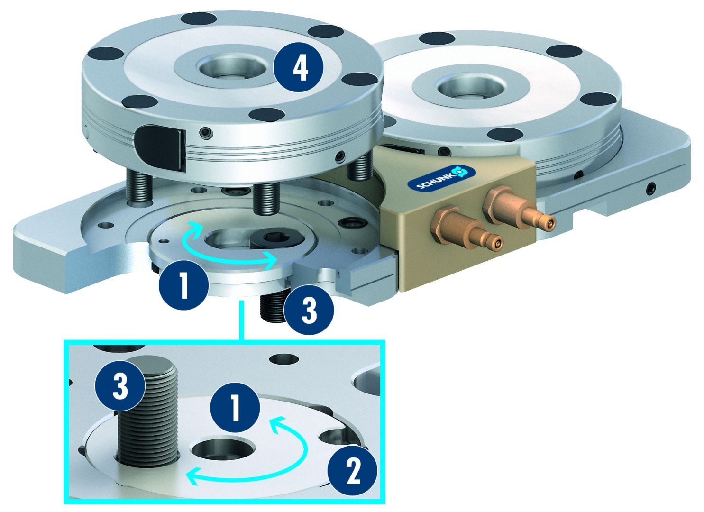
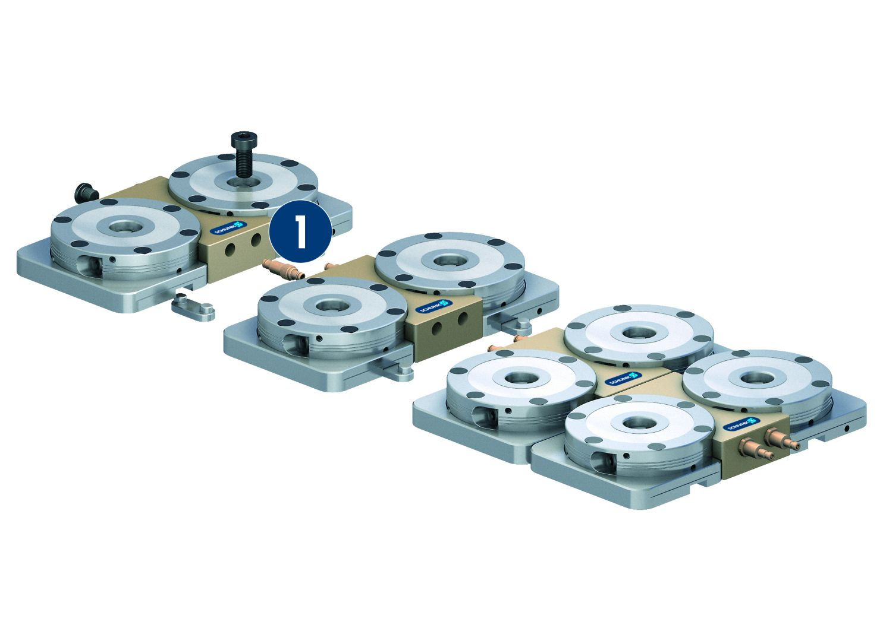
VERO-S NSE mini
Easy positioning – more user friendly
Configuration of clamping pins type A, B and C
2
1
Typ A fixed
Typ B positioned
Typ C with centering play
3
3
2
1
3
Saves space through compact design
Variability due to the modular system
1
Conical spring washer for fastening
Clamp screw for presetting to the T-slot of the machine table
Fastening screw for attachment on the machine table
NSE mini 90 module
4
2
1
1
Adapter for air coupling
1
3
3
3
1
2
4

Slide 16
Variants VERO-S NSE mini
Technical Data | NSE mini | NSE-M mini 90 | NSE mini 90-V1 | NSE-M mini 90-V1 | NSE mini 90-25 | NSE mini 90-25-V10
Diameter [mm] | 90 | 90 | 90 | 90 | 90 | 90
Pull-down force [N] | 500 | 1000 | 500 | 1000 | 1500 | 1500
Pull-down force with turbo [N] | 1500 |  | 1500 |  | 6000 | 6000
Unlocking pressure [bar] | 6 |  | 6 |  | 6 | 6
Unlocking torque [Nm] |  | 10 |  | 10
Repeat accuracy [mm] | < 0.005 | < 0.005 | < 0.005 | < 0.005 | < 0.005 | < 0.005
Weight [kg] | 1 | 1 | 1 | 1 | 1.3 | 1.3

Slide 17
Variants VERO-S NSL mini
Technical Data | NSL mini 100-1 V1 | NSL mini 100-2 | NSL mini 100-3 | NSL mini 100-4
Length [mm] | 100 | 200 | Durchmesser: 230 | 200
Width [mm] | 100 | 100 |  | 200
Pull-down force [N] | 500 | 1000 | 1500 | 2000
Pull-down force with turbo [N] | 1500 | 3000 | 4500 | 6000
Unlocking pressure [bar] | 6 | 6 | 6 | 6
Weight [kg] | 1.7 | 3.5 | 6 | 7

