Slide 1

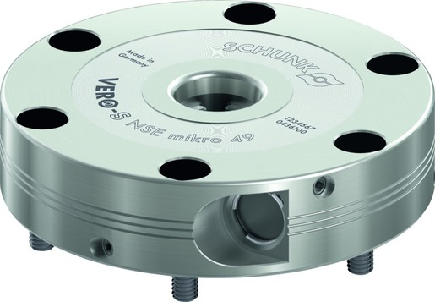
VERO-S NSE mikro
The world‘s flattest quick-change pallet module

Slide 2












Product Overview
Gripping Systems
Clamping Technology
Chuck Jaws
Lathe Chucks
Stationary Workholding
Toolholders
Hydraulic Expansion Technology
VERO-S
KONTEC
TANDEM
ROTA
MAGNOS
PLANOS

Slide 3
Challenges
Variants
Quantities
Required accuracy
Time
Time
Time
Product life cycle
Demand
Global competition
Time
Time
Time
Increasing relevance of the set-up process
heute
zukünftig

Slide 4

VERO-S – the set-up time optimizer

Slide 5
Potential for savings
Set-up costs
without VERO-S
Set-up costs [€]
Set-up costs
with VERO-S
0
Number of set-up procedures
Notes:
5 min Rüstzeit pro Rüstvorgang mit VERO-S
25 min Rüstzeit pro Rüstvorgang ohne VERO-S
60€/h Maschinenkosten

Slide 6

Amortisation
Calculation for set-up costs | Case 1 | Case 2
Investment in SCHUNK VERO-S [€] | 5.000 | 10.000
Time per set-up procedure without VERO-S [min] | 25
Time per set-up procedure with VERO-S [min] | 5
Machine costs [€/h] | 60
Number of set-up procedures per day | 5
Working days per month | 20
Working days per year | 240
Payback Time
Set-up procedures | 250 | 500
Working days | 50 | 100
Months | 2,5 | 5
Years | 0,21 | 0,42
Even for older machines, the investment in SCHUNK VERO-S quick change pallet system amortizes within a minimum of time.
Thanks to the consistent interface of the clamping pin, the existing clamping devices can easily be integrated in the new system.

Slide 7
Consistency of pull-down and holding forces
 | Pull-down force [N] |  | Holding force [N] |  |  |  |  |  |  | Recommended machines
 | Without Turbo | With Turbo | SPx mikro 10 |  | SPx mini 20 |  | SPx 40
 |  |  | M3 | M4 | M6 | M8 | M10 | M12 | M16
NSE mikro | 150 | 400 | 3.000 | 5.000
NSE mini 90 | 500 | 1.500 |  |  | 15.000 | 25.000
NSE mini 90-25 | 1.500 | 6.000
NSE3 138 | 8.000 | 28.000 |  |  |  |  | 35.000 | 50.000 | 75.000
F_{pull-down}
F_{Hold}
100
80
HSK-Size
63
50
40
32
NSE mikro
NSE mini 90
NSE3 138

Slide 8

VERO-S modular system

Slide 9



SCHUNK Services
Engineering
Dimensioning of special plates designed to the manufacturing specifications
Development of special solutions together with the customer
FEM analysis for critical components
Testing
Endurance tests with all new developments
Abrasion checking
Measurement of accuracy
Service
Initial operation of customer´s solution
Inspection and maintenance
Repairs

Slide 10






VERO-S Overview
General milling applications
Direct workpiece clamping
Milling and turning applications
Easy milling applications
Automated machine loading
Further applications

Slide 11

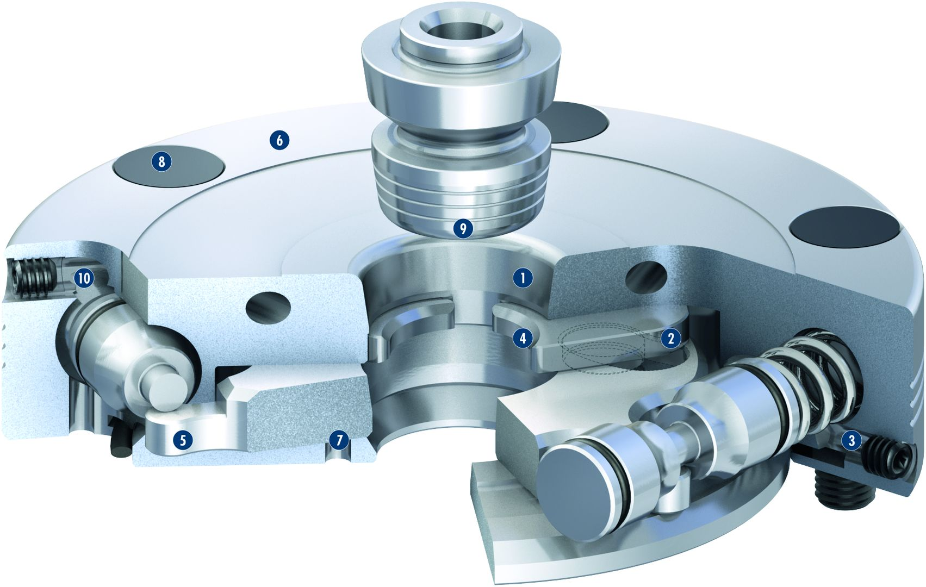
VERO-S NSE mikro
1
High-precision short taper centering
Patentented dual stroke system
Turbo function
Large surfaces
Patentented drive concept
Large flat surface
Monitoring of the clamping slide position
Cover caps for mounting screws
Entry radii on the clamping pin
Pneumatic system
2
3
6
4
8
5
9
6
10
1
7
4
2
8
5
7
3
9
10

Slide 12
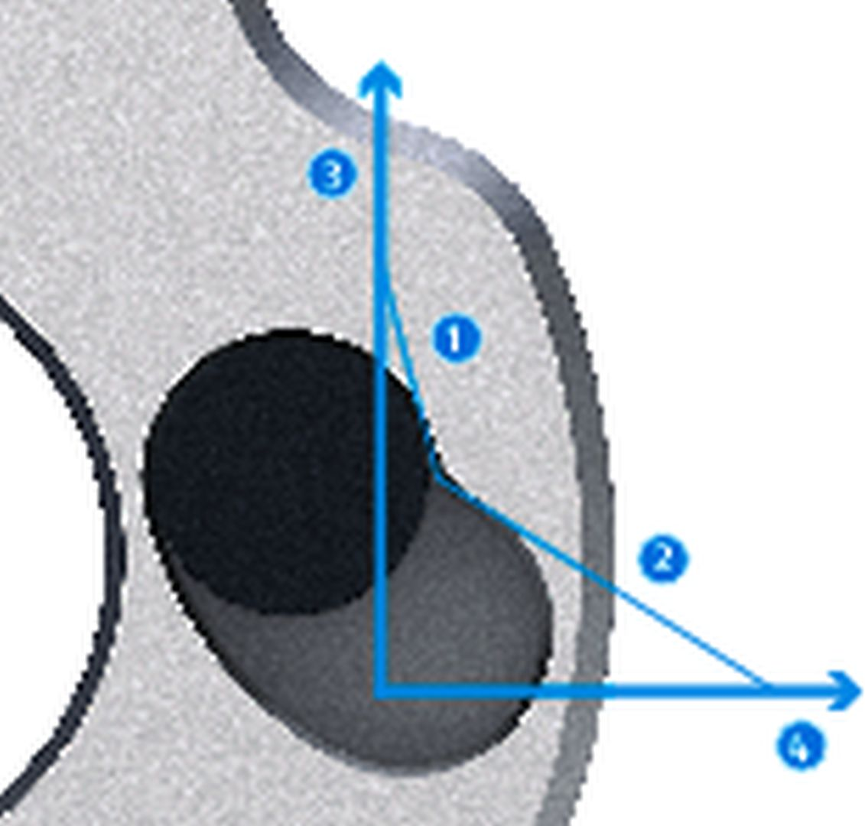
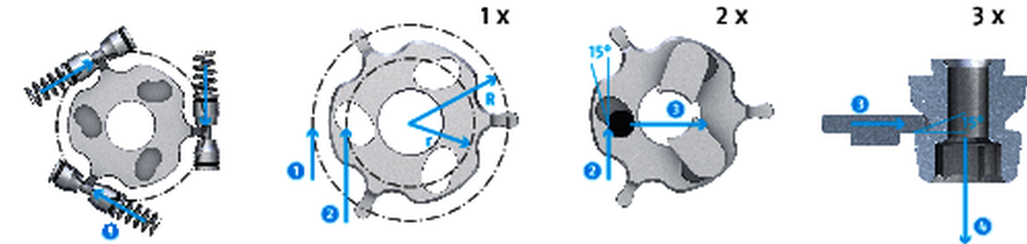
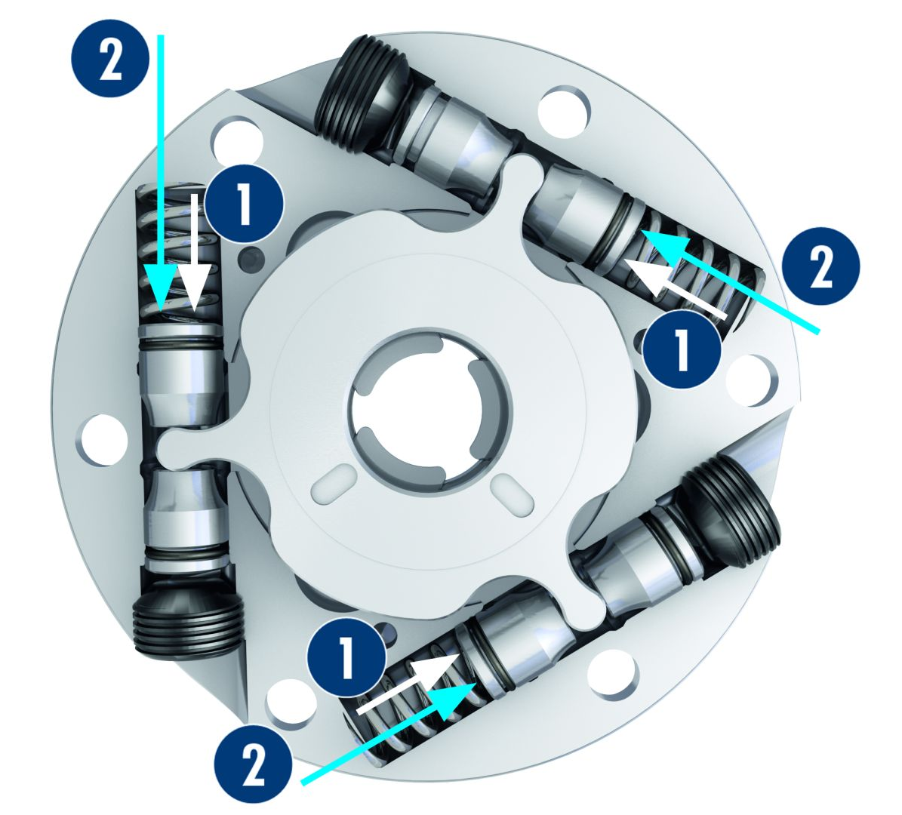

VERO-S NSE mikro
Patented drive concept in confined spaces
Patented drive concept: Triple force transmission
3
1
Clamping stroke
Fast stroke
Force
Travel
3
3
1
2
1
3
2
1
2
4
2
4
1
Actuation force
Force on the drive ring
Force on the clamping slide
Pull-down force
3
4
2
4
Integrated turbo function
Comparison: Pull-down force spring clamping and turbo funtion
2
1
Pull-down force
Turbo function
max. 400 N
2
1
Spring force
Additional force, resulting from the turbo function
1
2
Spring force clamping
max. 150 N
1
Actuation pressure of the turbo function
2

Slide 13
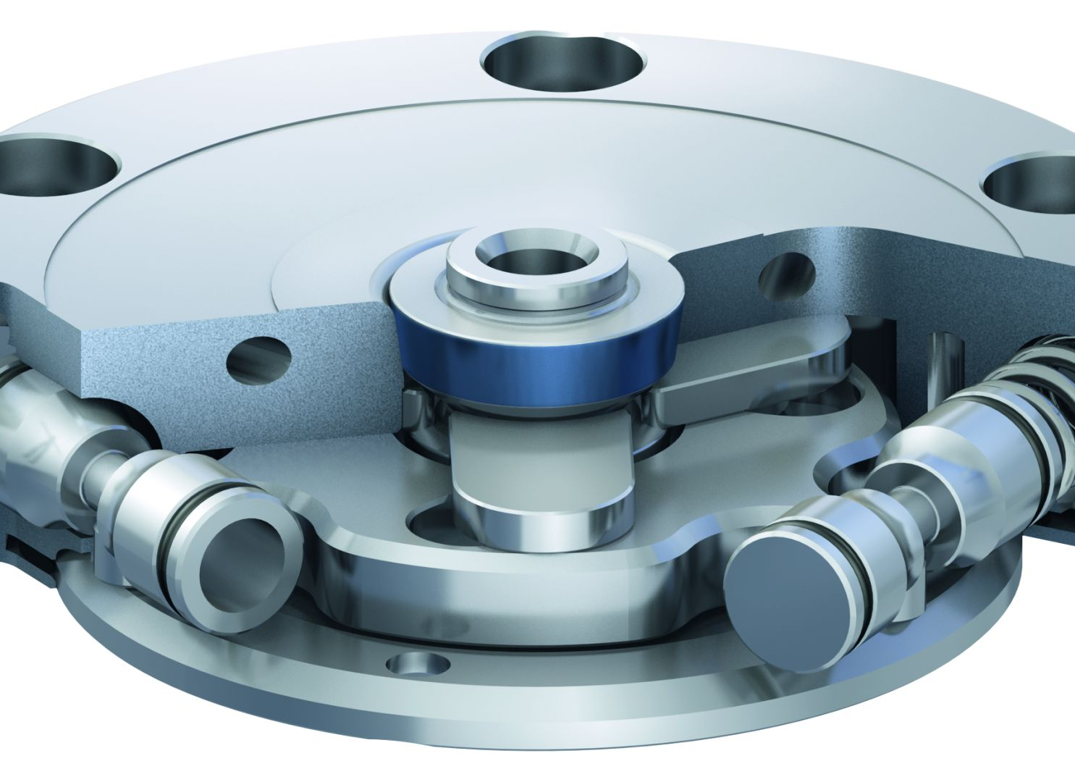
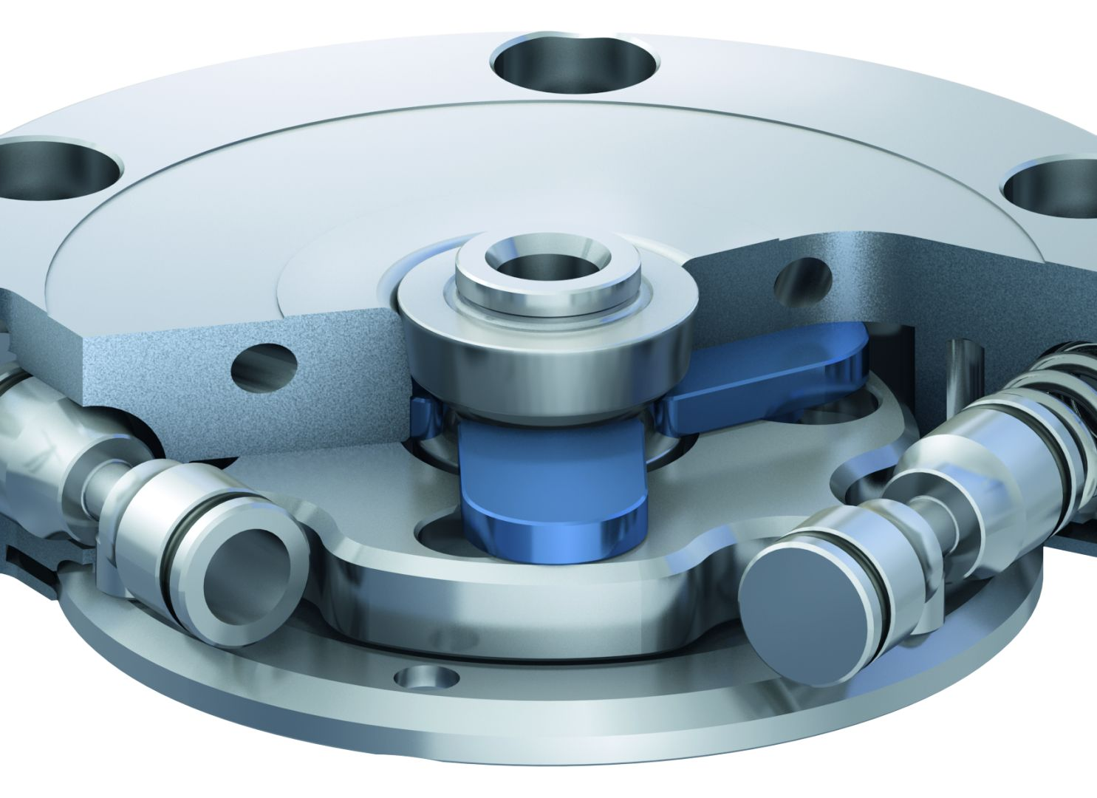
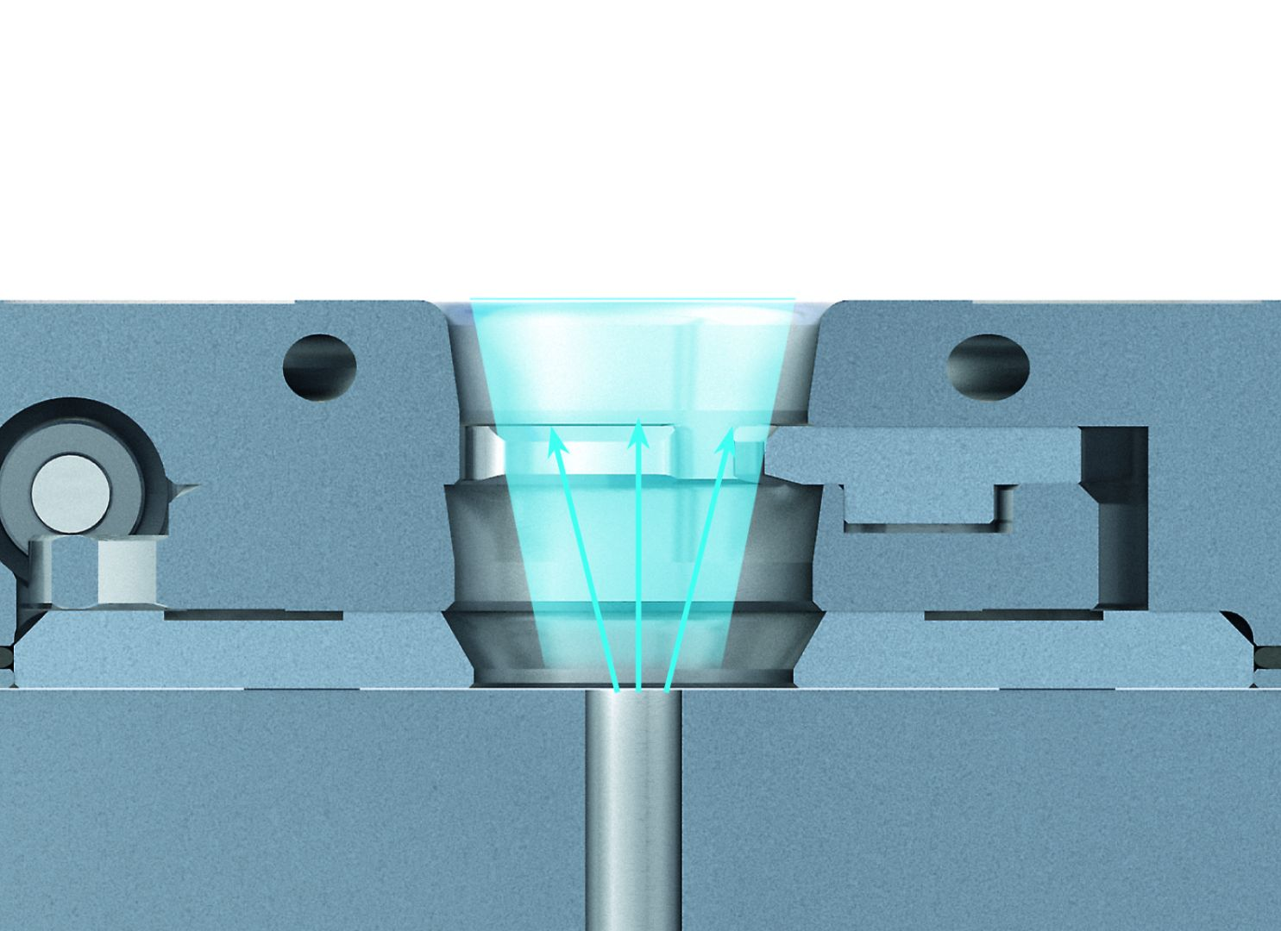
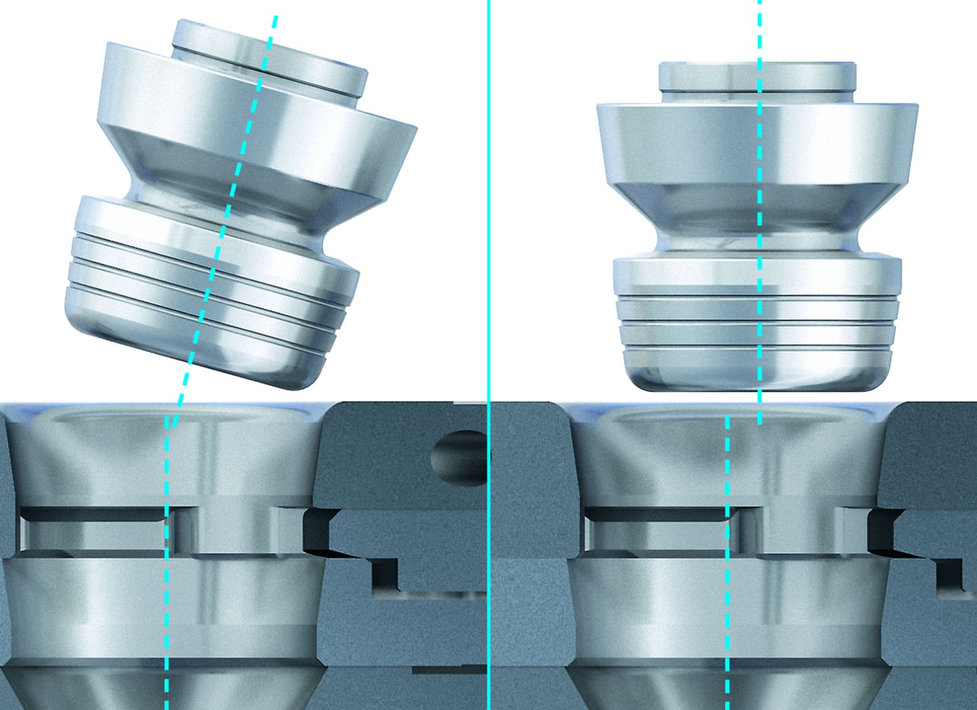
VERO-S NSE mikro
Centering via short taper
Locking via clamping slide
Air purge connection
Easy positioning – more user friendly

Slide 14
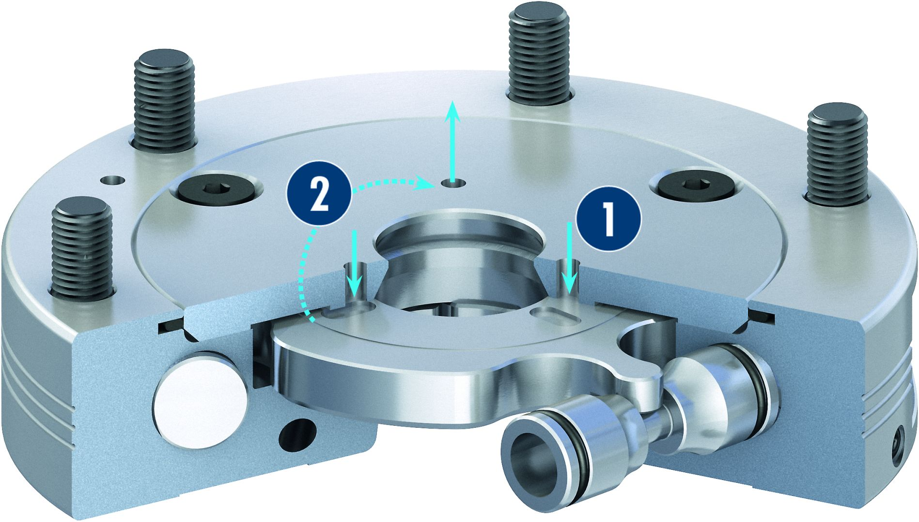
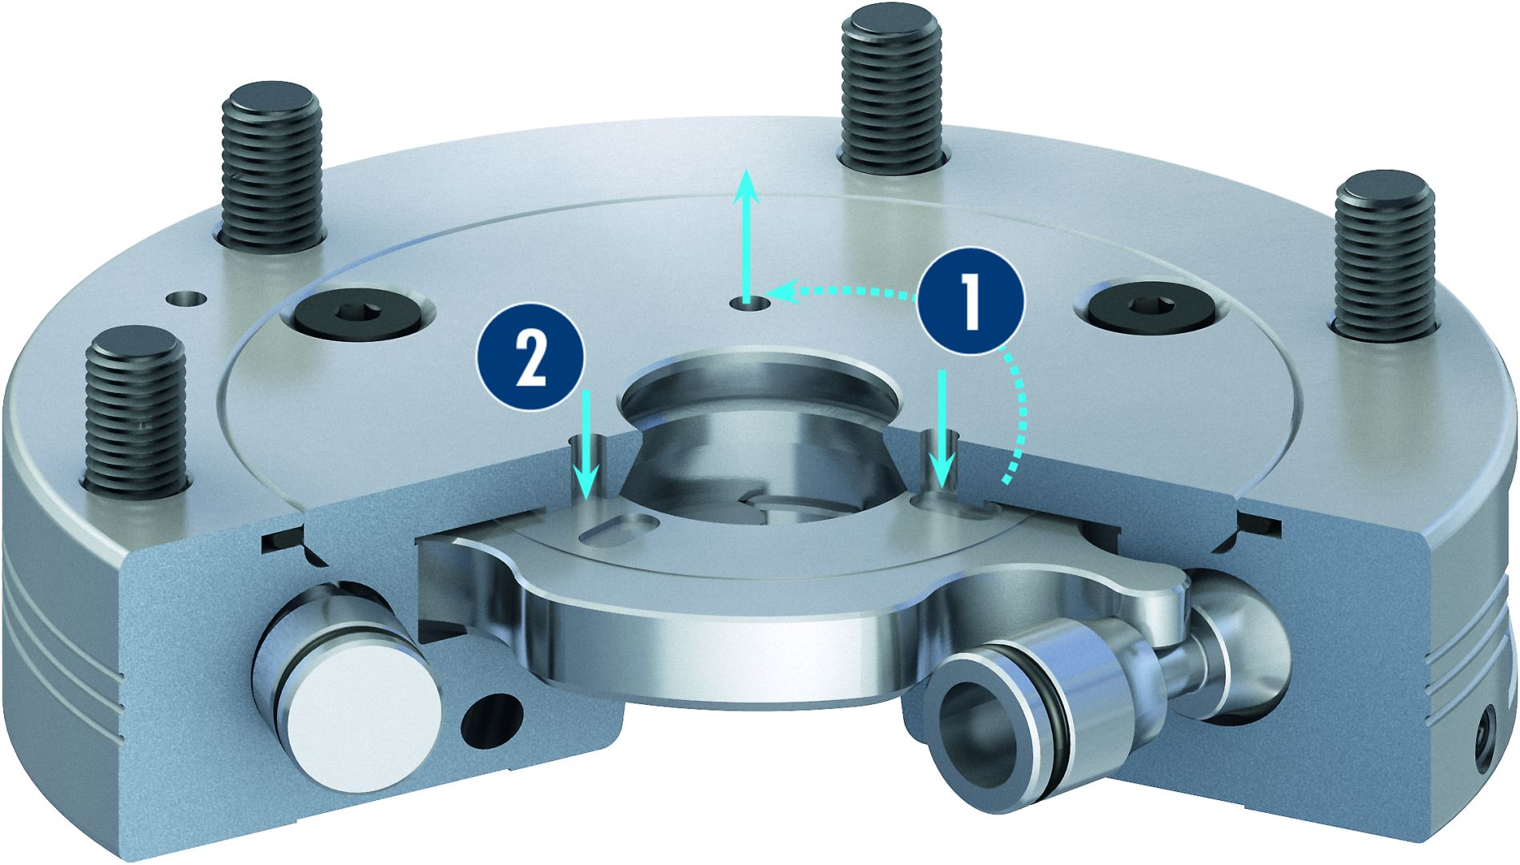
VERO-S NSE mikro
Monitoring of the clamping slide position via dynamic pressure
Opened condition
Locked condition

Slide 15
Variants VERO-S NSE mikro
Technical Data | NSE mikro | NSE mikro 49-V10
Diameter [mm] | 49 | 49
Pull-down force [N] | 150 | 150
Pull-down force with turbo [N] | 400 | 400
Unlocking bar [bar] | 6 | 6
Repeat accuracy [mm] | < 0.005 | < 0.005
Weight [kg] | 0.2 | 0.2

