Slide 1


ROTA FSW
Chuck quick change

Slide 2













Product overview
Gripping Systems
Clamping Technology
Chuck Jaws
Stationary Workholding
Lathe Chucks
Toolholders
Hydraulic Expansion Technology
Manual Lathe Chucks
Power Lathe Chucks with Jaw Quick-change System
Power Lathe Chucks with Through-hole
Power Lathe Chucks without Through-hole
Pneumatic Power Chucks
Steady Rests
Quick-change Systems
Customized Solutions

Slide 3
Challenges
Variants
Global
competition
Time
Time
Demand
Time
Flexibility and und set-up time optimization
heute
zukünftig

Slide 4
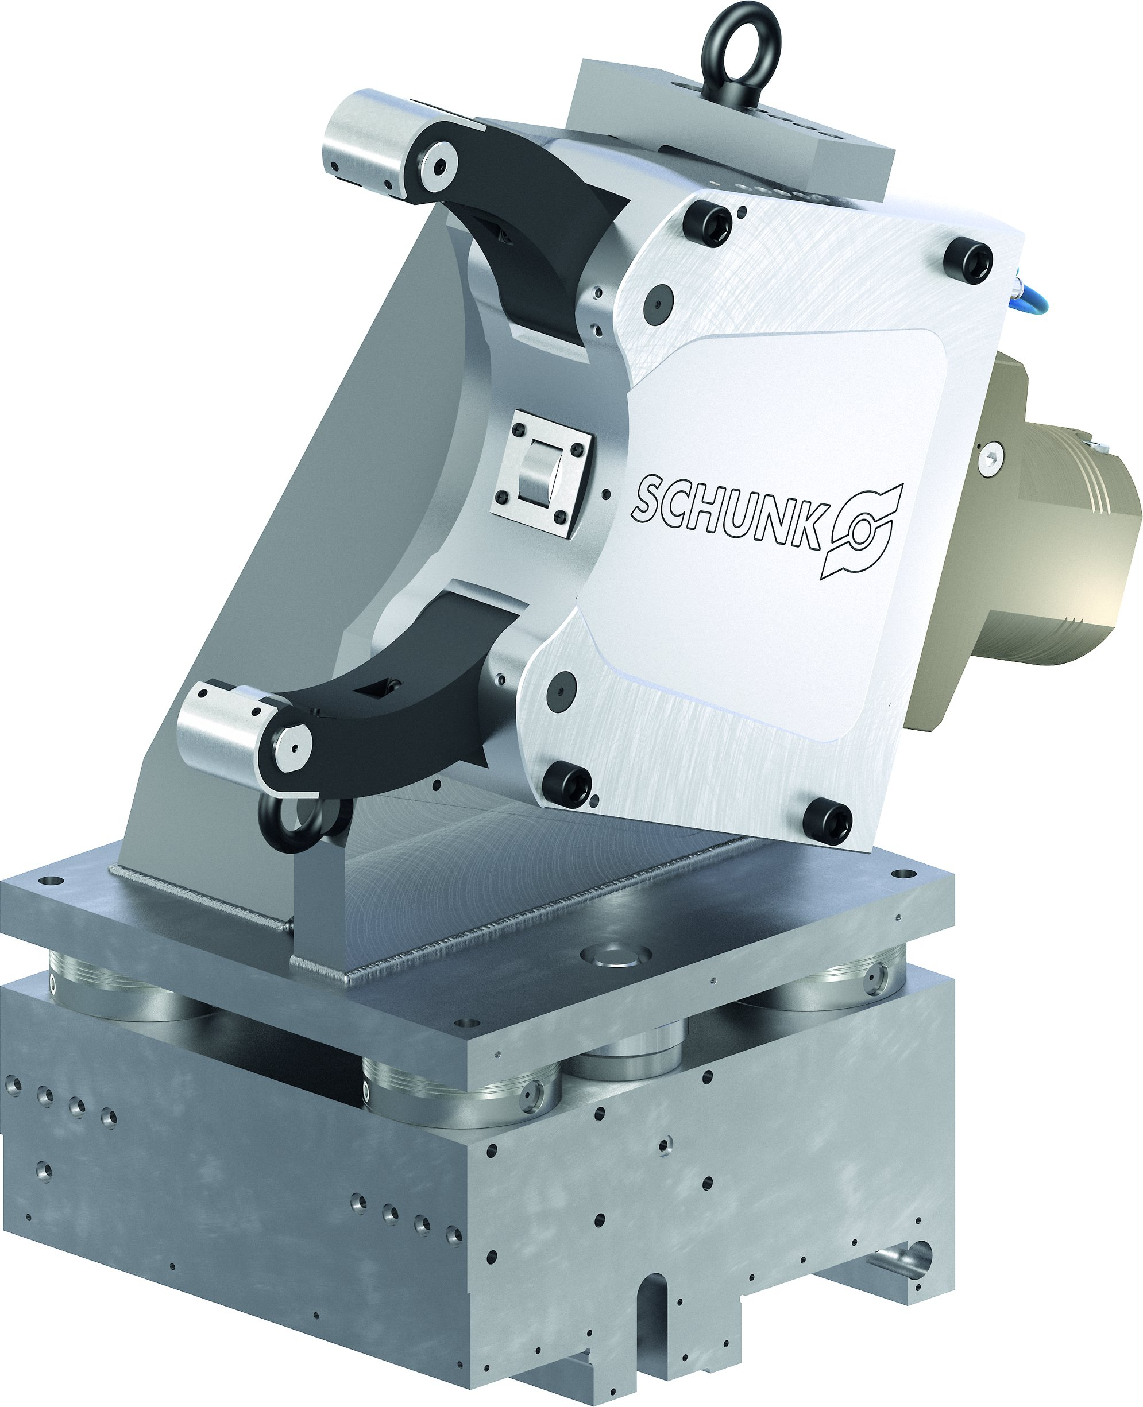
Overview
Quick-change Systems
ROTA FSW
ZENTRICO LSW

Slide 5
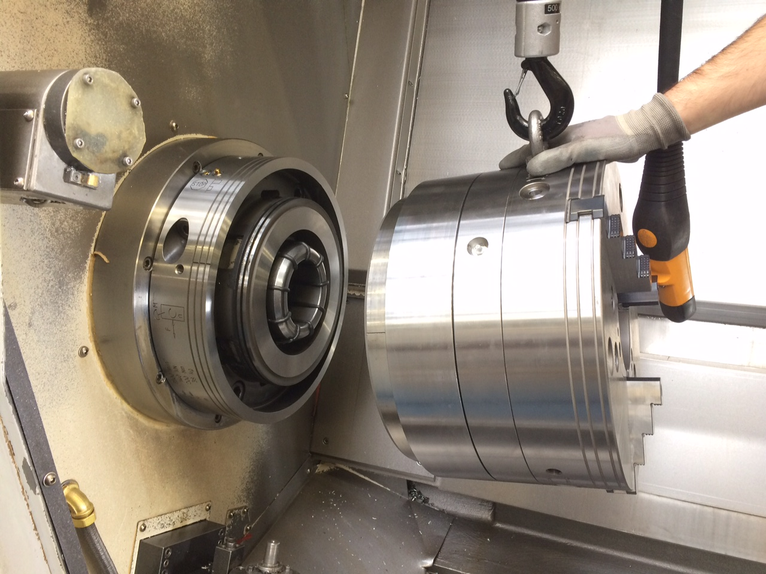
ROTA FSW
Example of application
Clamping device:
ROTA THW 500 in combination with FSW system on Doosan Puma 500.
Features/Application:
Fast and precise jaw change. Highest flexibility thanks to the quick-change system FSW. Chuck change by operating one screw.

Slide 6
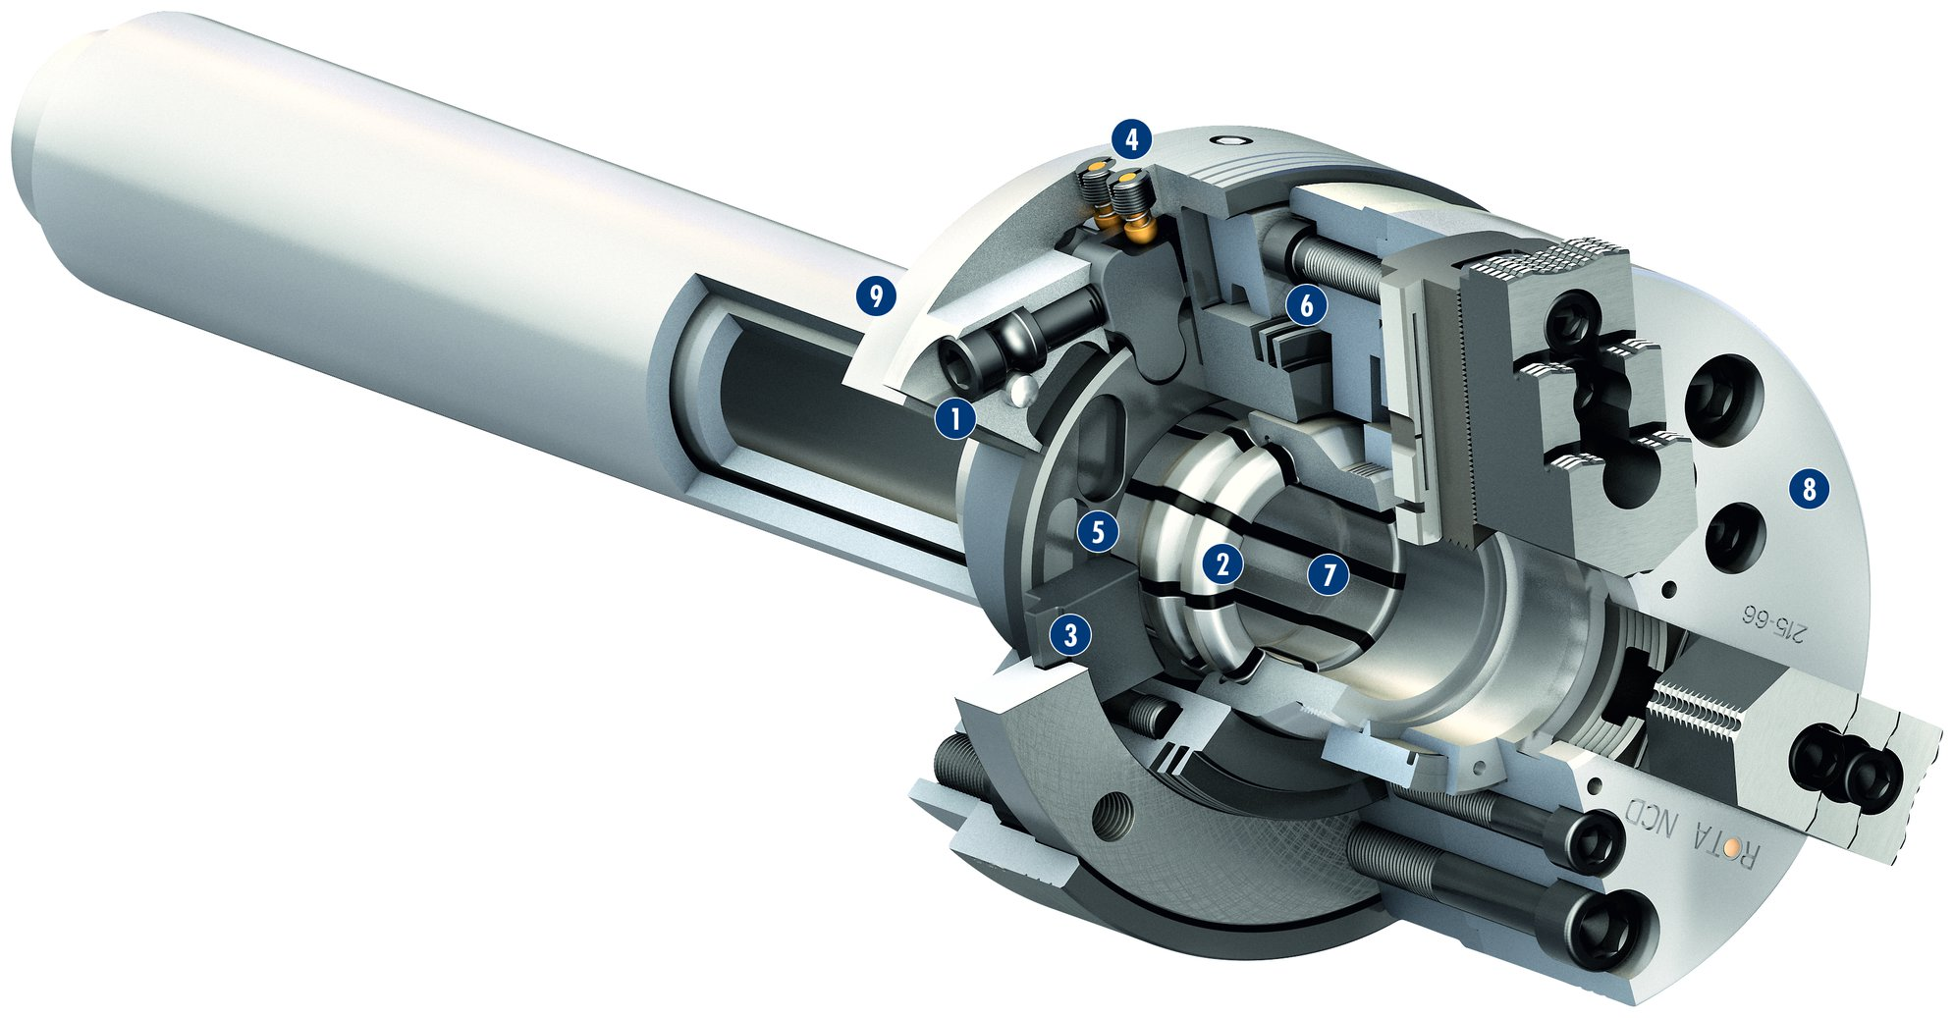
ROTA FSW
1
Operation via hexagon connection
Flexible adapter
Large surfaces
Indicator pins
Patented drive concept
Highly precise flexible taper centering
Dirt-resistant design
Lathe chuck
Machine spindle
4
2
3
9
6
4
1
5
5
8
2
7
6
3
7
8
9

Slide 7
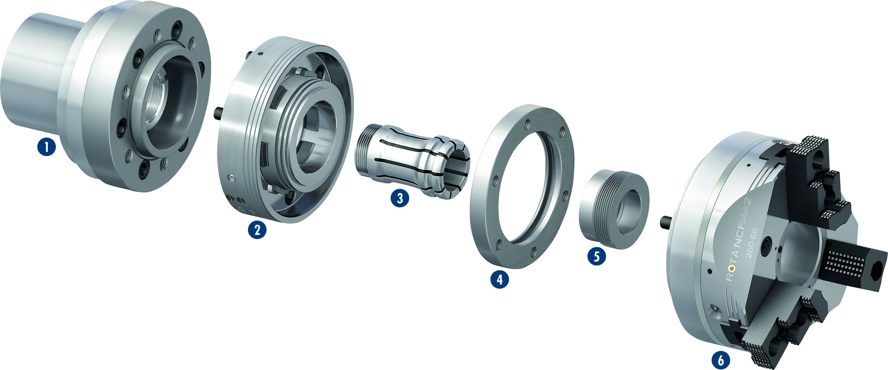
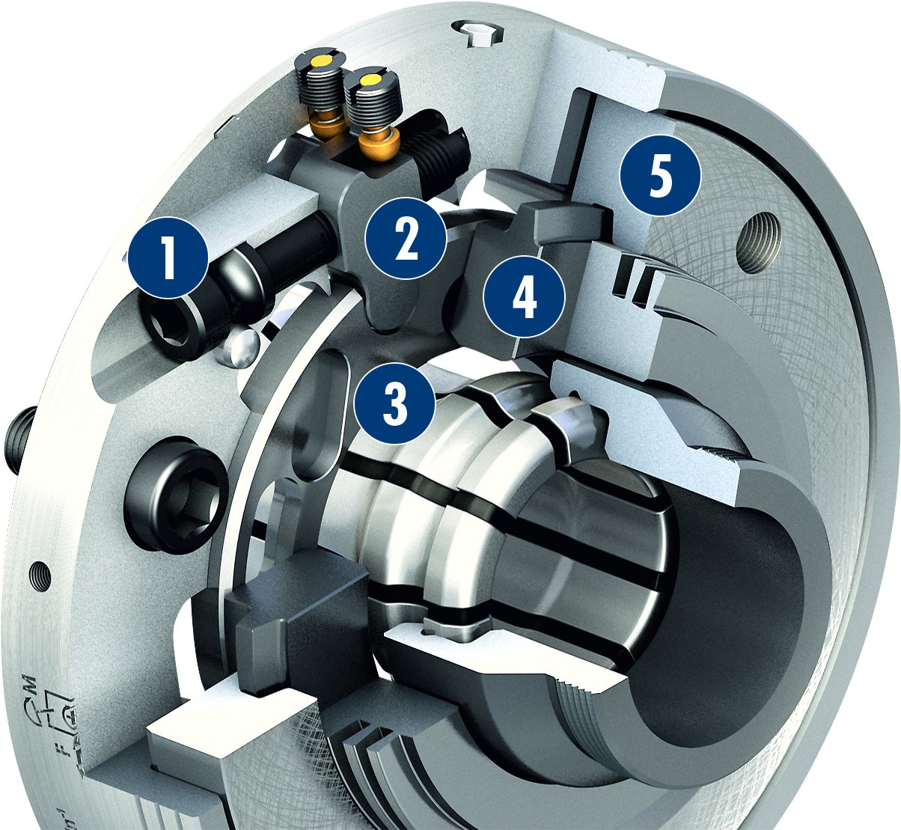
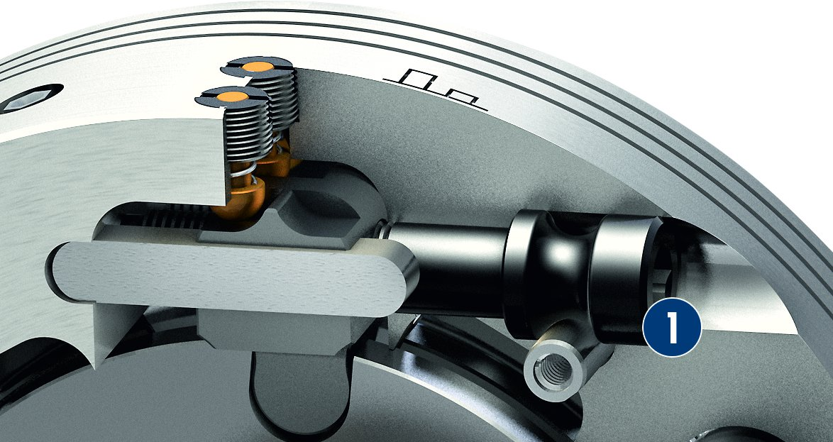
ROTA FSW
Exploded view of the Chuck Quick-change System
1
Spindle
Chuck quick-change
Flexible adapter
Clamping ring
Draw tube adapter
Lathe chuck
1
2
3
3
2
4
4
5
5
6
6
Actuation for changing and clamping with just one screw
Patented drive concept
1
Screw
Lever
Drive ring
Clamping slide
Clamping ring
2
5
1
Actuating screw
1
4
2
3
3
1
4
5

Slide 8
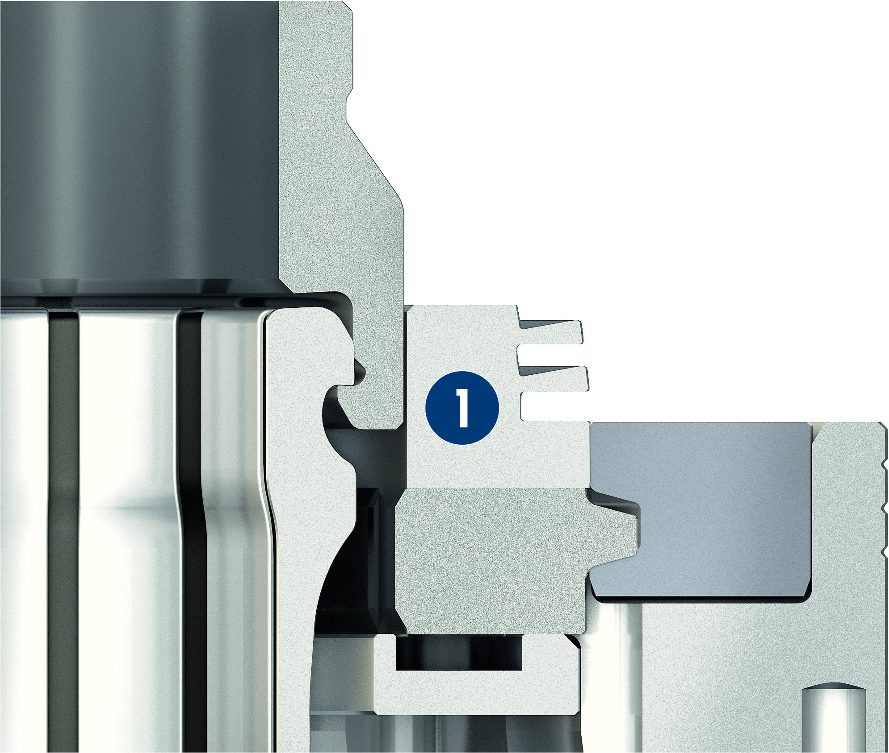
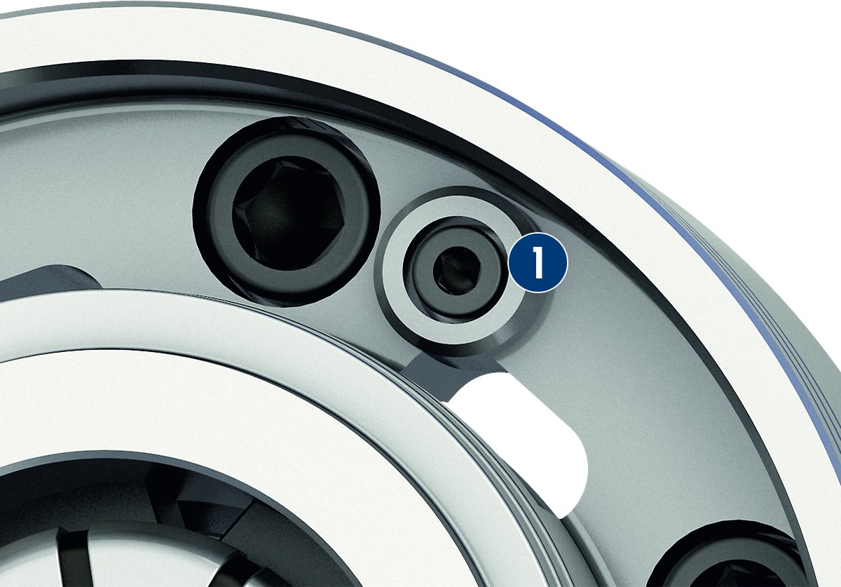
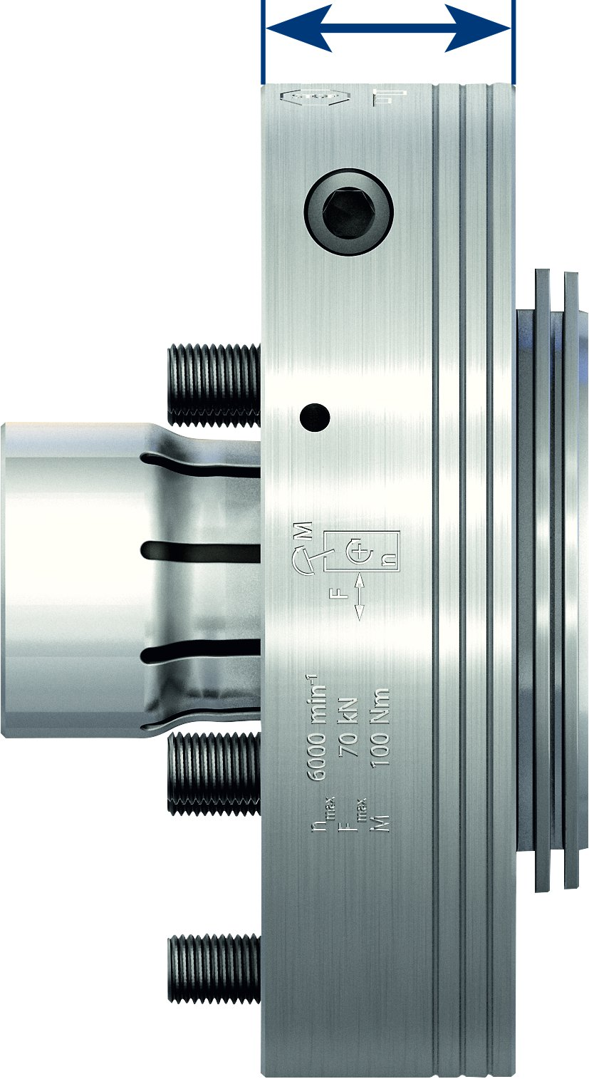
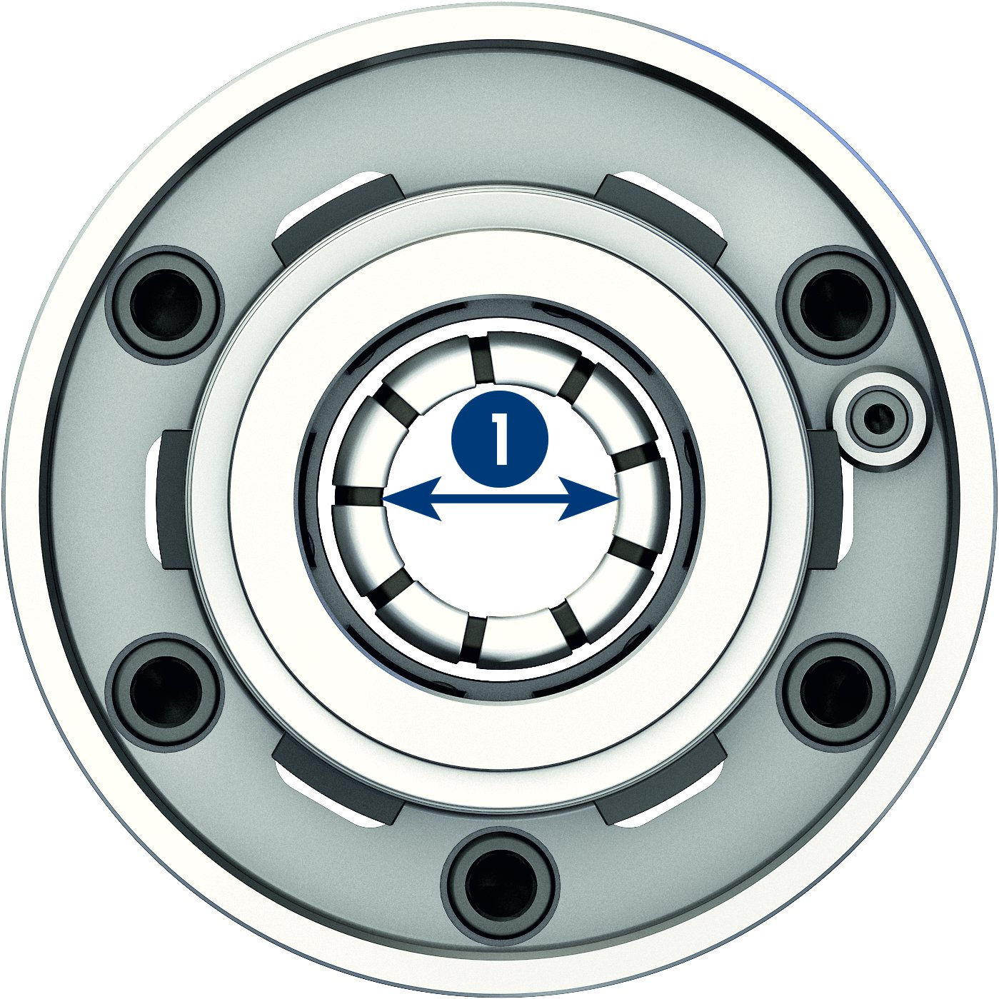
ROTA FSW
Patented flexible taper for maximum centering accuracy
Change without twisting the chuck
1
Flexible taper
1
1
Positioning block
1
Low height
Flexible adapter with large through-hole
1
1
Through-hole

Slide 9
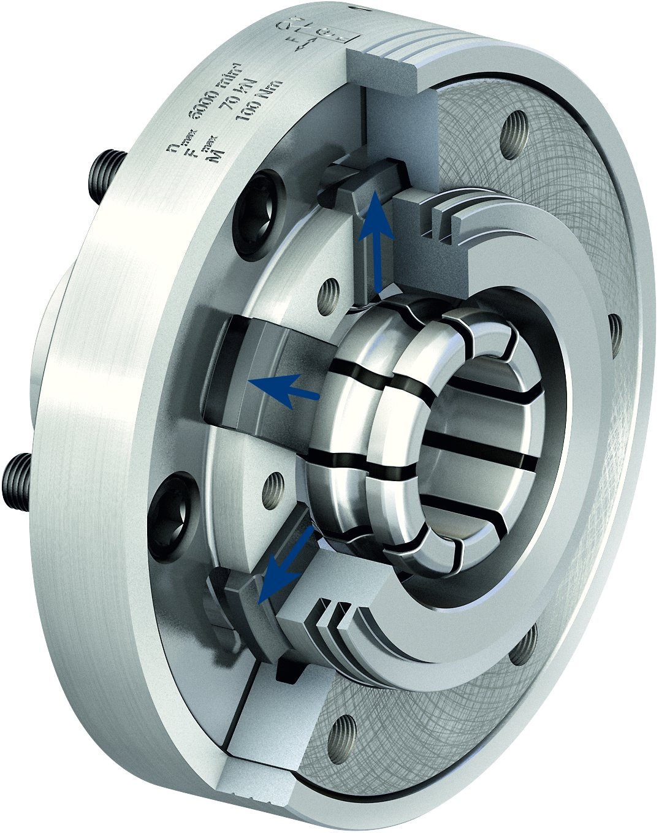
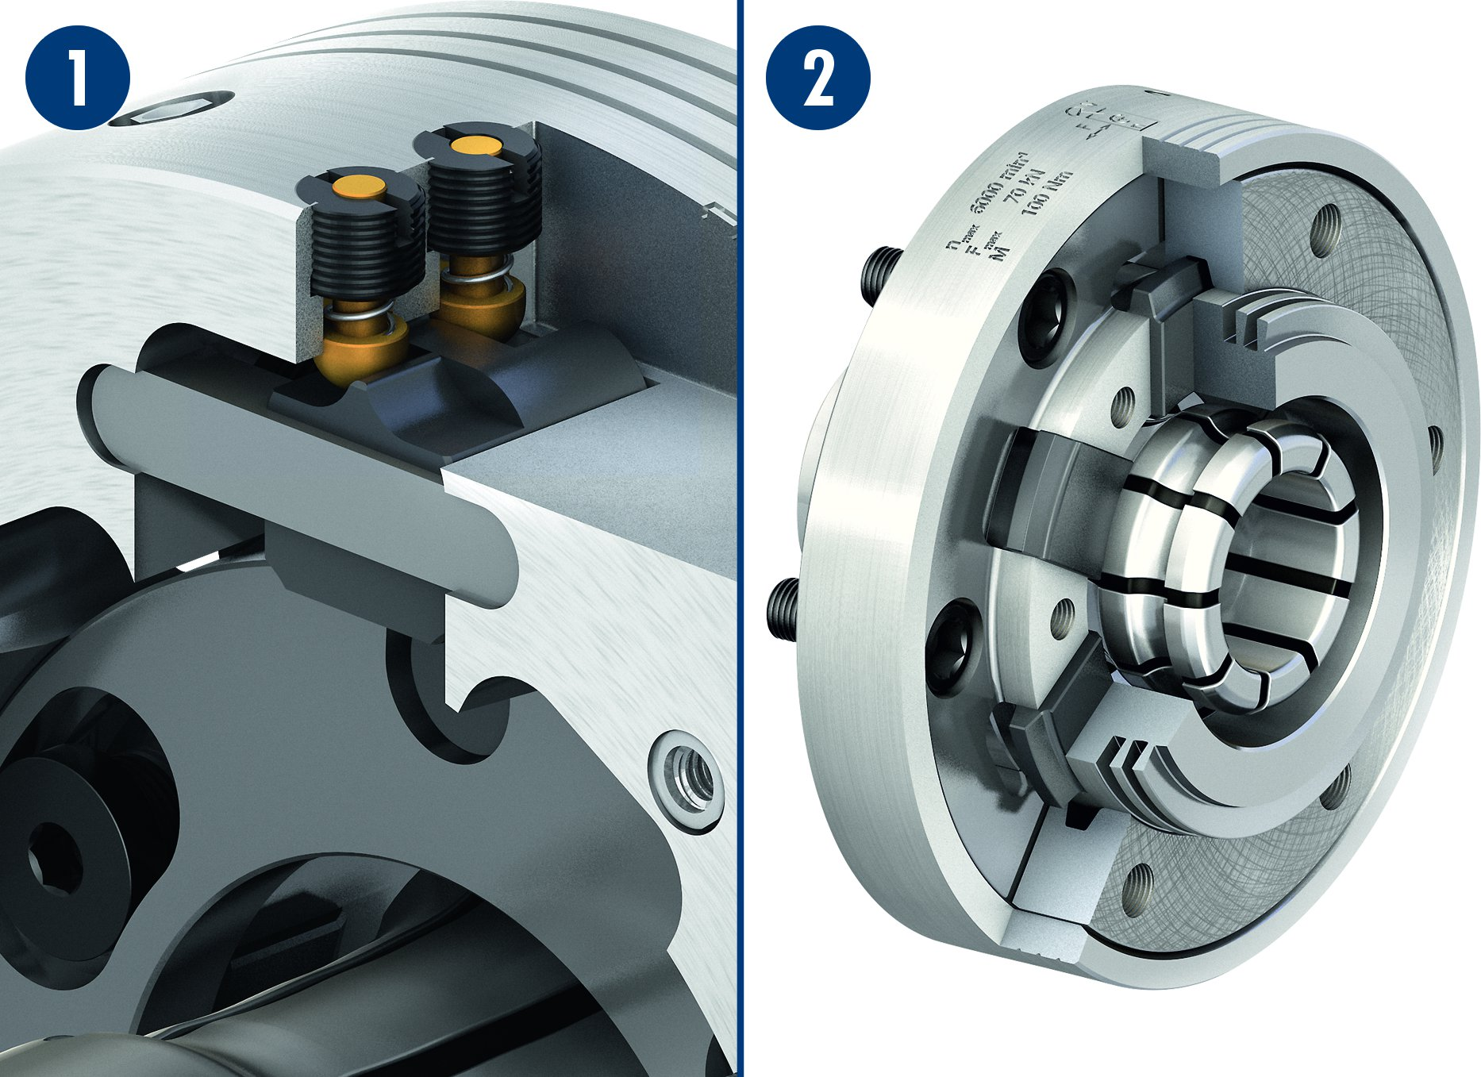
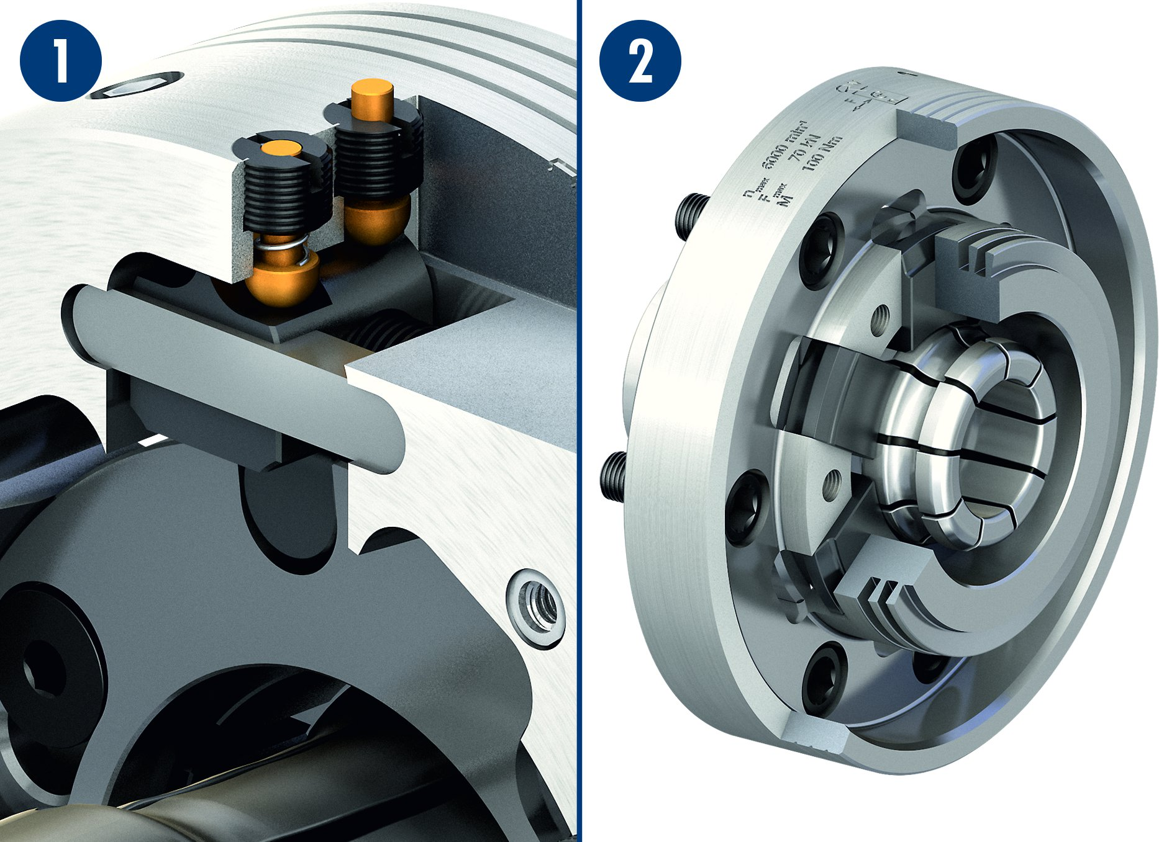
ROTA FSW
Higher pull-down force under rotation
Clamping position
1
2
1
Visual display
Clamping position of the FSW
2
Change position
1
2
1
Visual display
FSW change position
2

Slide 10
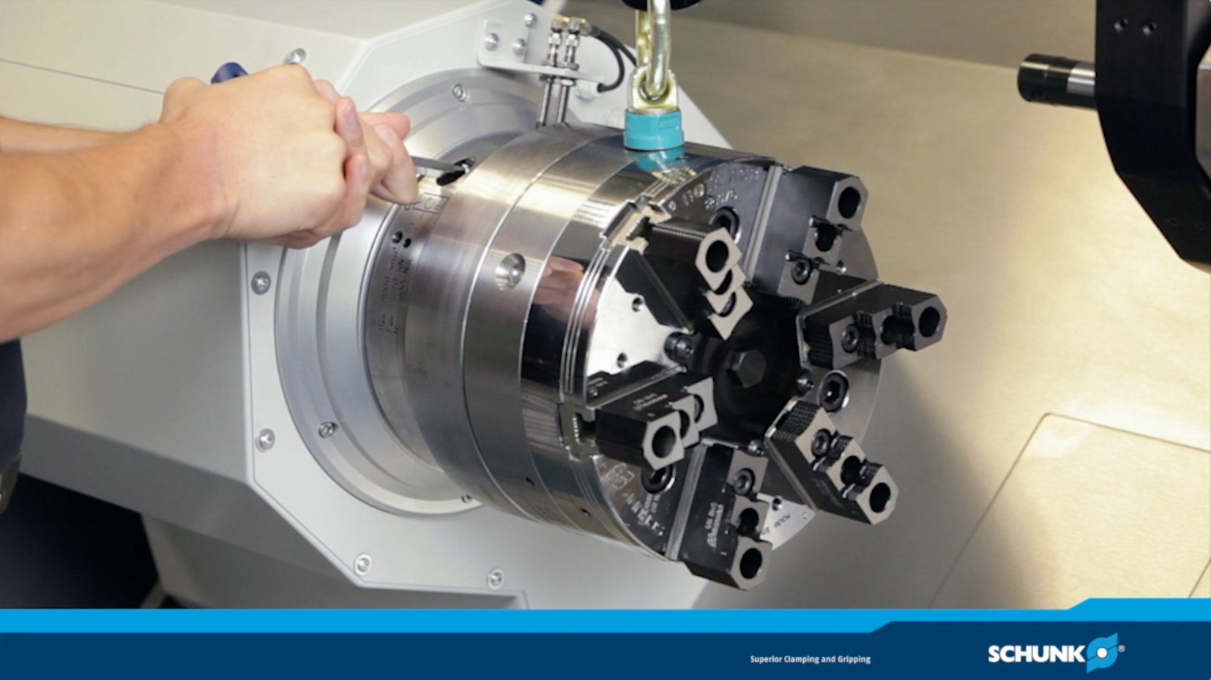
ROTA FSW

Slide 11
Variants of ROTA FSW
Technical data | ROTA FSW A8 | ROTA FSW A11 | ROTA FSW A15
Max. RPM [min⁻¹] | 6000 | 4200 | 3500
Max. actuating force [kN] | 70 | 133 | 140
Max. actuating force [Nm] | 100 | 150 | 200

Slide 12



SCHUNK Services
Engineering
Dimensioning of special plates designed to the manufacturing specifications
Development of special solutions together with the customer
FEM analysis for critical components
Testing
Endurance tests with all new developments
Abrasion checking
Measurement of accuracy
Service
Initial operation of customer´s solution
Inspection and maintenance
Repairs

