Slide 1

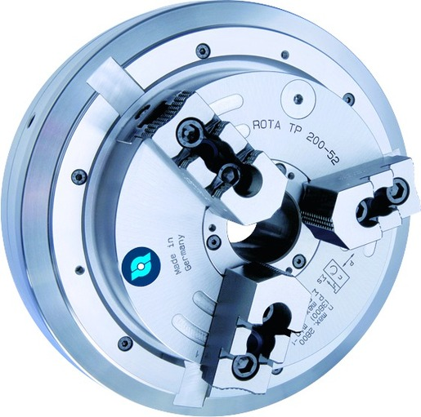
ROTA TP
Pneumatic Power Chucks

Slide 2














Product overview
Gripping Systems
Clamping Technology
Chuck Jaws
Stationary Workholding
Lathe Chucks
Toolholders
Hydraulic Expansion Technology
Manual Lathe Chucks
Power Lathe Chucks with Jaw Quick-change System
Power Lathe Chucks with Through-hole
Power Lathe Chucks without Through-hole
Pneumatic Power Chucks
Steady Rests
Quick-change Systems
Customized Solutions

Slide 3

Pneumatic Power Chucks
Application

Slide 4



ROTA overview
Pneumatic Power Chucks
ROTA TP
ROTA TB
ROTA TB-LH
ROTA TB2
ROTA TB2-LH

Slide 5
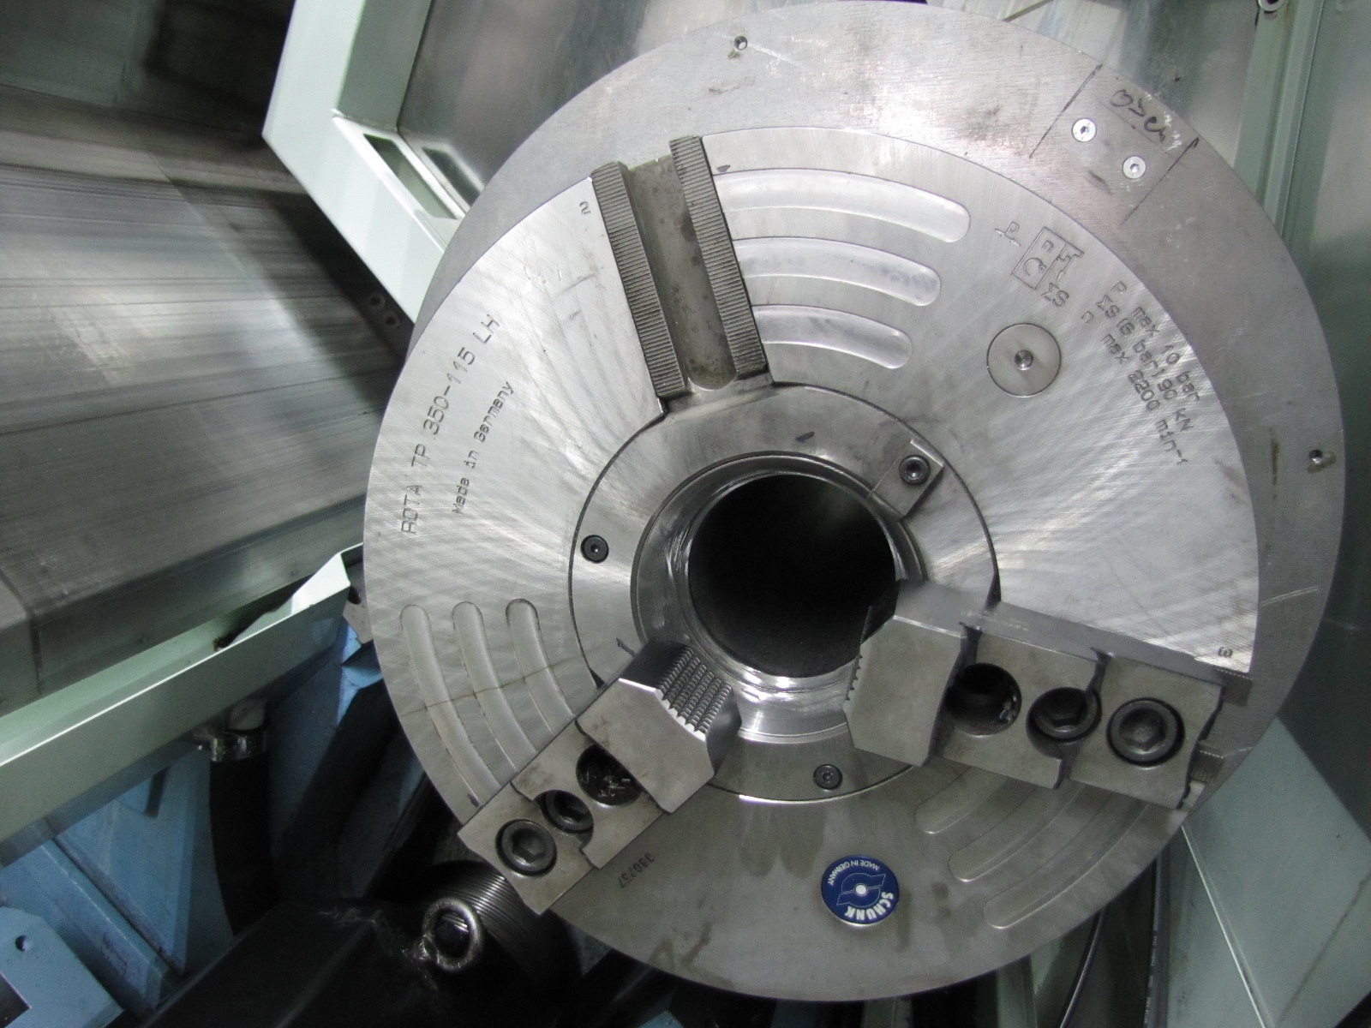
ROTA TP
Example of application
Clamping device:
ROTA TP 315-115 LH incl. special center sleeve.
Features/Application:
Pneumatic power chuck with integrated cylinder for O.D. clamping of pipes. Special center sleeve with feed chamfer and high dual stroke system enable save loading of the workpieces.

Slide 6
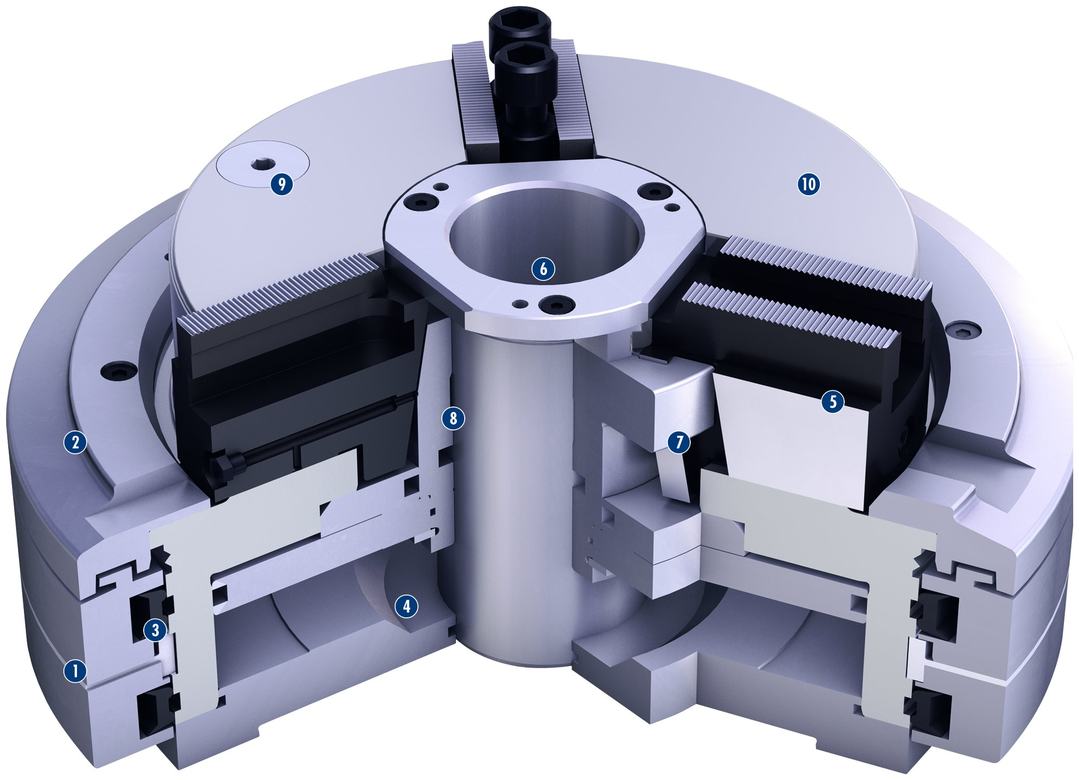
ROTA TP
1
Distributor ring
Distributor ring cover
Profile sealing rings
Pneumatic cylinder integrated in the chuck
Very stable base jaw
Very large through-hole
Very stable wedge hook
Long piston guidance
Integrated safety valve
One-piece, rigid chuck body
2
9
10
3
6
4
5
8
5
6
2
7
7
8
4
9
3
10
1

Slide 7
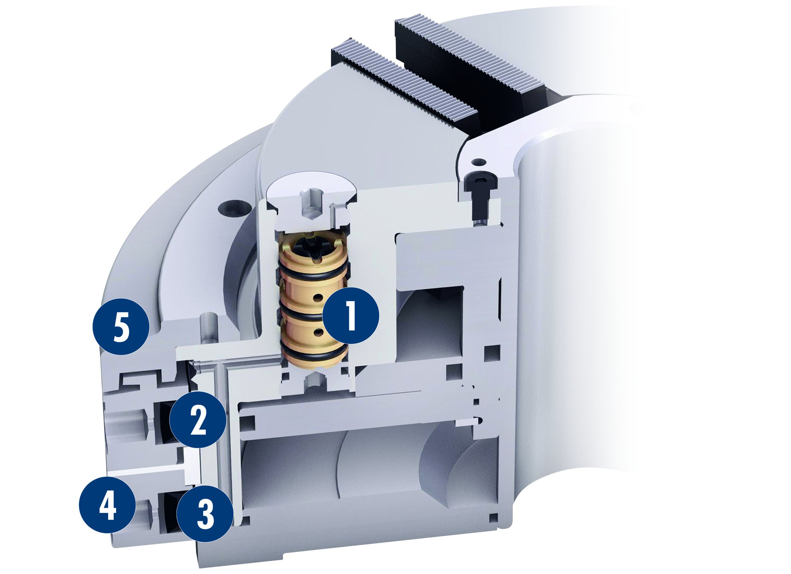
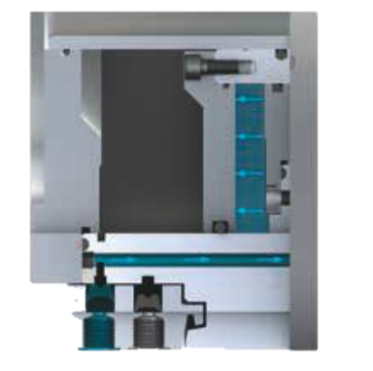
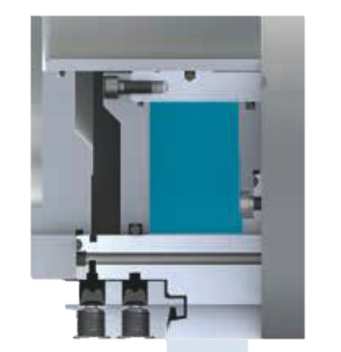
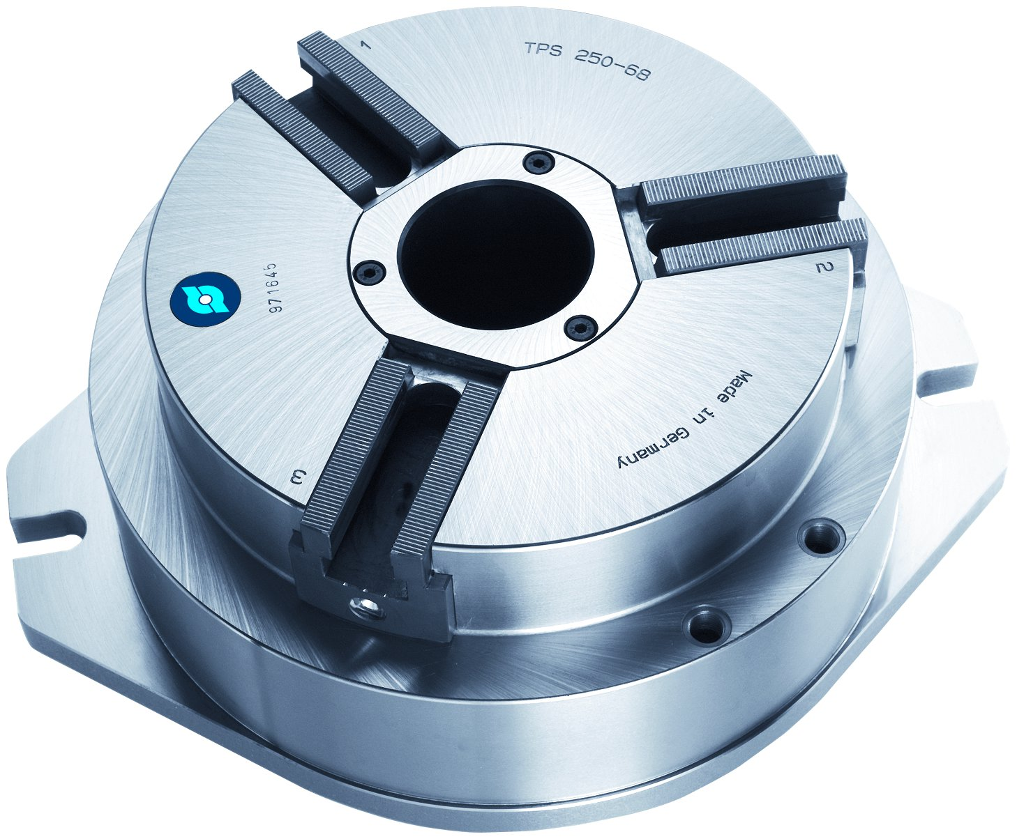
ROTA TP
Control of the self-contained power chucks
Clamping and opening is only possible at standstill
1
Double check valve
Profile sealing ring
Profile sealing ring
Distributor ring
Distributor ring cover
2
1
3
5
2
4
4
3
5
The SCHUNK profile seal lifts itself through its own elasticity
Also available for stationary applications

Slide 8
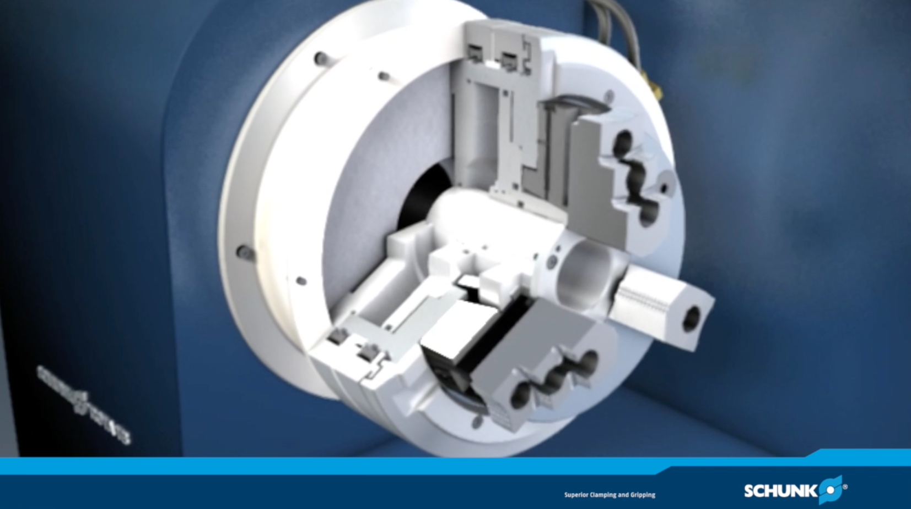
ROTA TP/TB

Slide 9
Variants ROTA TP
Technical Data | Max. RPM 1 [min⁻¹] | Max. clamping force (at 6 bar) [kN] | Stroke/jaw [mm] | Through-hole [mm]
ROTA TP 125-26 | 4000 | 22 | 3 | 26
ROTA TP 160-38 | 3500 | 39 | 4.2 | 38
ROTA TP 200-52 | 2800 | 68 | 4.2 | 52
ROTA TP 250-68 | 2200 | 105 | 5 | 68
ROTA TP 315-90 | 1800 | 140 | 5 | 90
ROTA TP 315-105 | 2200 | 100 | 5 | 105
ROTA TP 350-115 | 2200 | 90 | 5 | 115
ROTA TP-LH 350-115 | 2200 | 90 | 15 | 115

Slide 10



SCHUNK Services
Engineering
Dimensioning of special plates designed to the manufacturing specifications
Development of special solutions together with the customer
FEM analysis for critical components
Testing
Endurance tests with all new developments
Abrasion checking
Measurement of accuracy
Service
Initial operation of customer´s solution
Inspection and maintenance
Repairs

