Slide 1


ROTA TB2-LH
Pneumatic Power Chucks

Slide 2














Product overview
Gripping Systems
Clamping Technology
Chuck Jaws
Stationary Workholding
Lathe Chucks
Toolholders
Hydraulic Expansion Technology
Manual Lathe Chucks
Power Lathe Chucks with Jaw Quick-change System
Power Lathe Chucks with Through-hole
Power Lathe Chucks without Through-hole
Pneumatic Power Chucks
Steady Rests
Quick-change Systems
Customized Solutions

Slide 3

Pneumatic Power Chucks
Application

Slide 4


ROTA overview
Pneumatic Power Chucks
ROTA TP
ROTA TB
ROTA TB-LH
ROTA TB2
ROTA TB2-LH

Slide 5
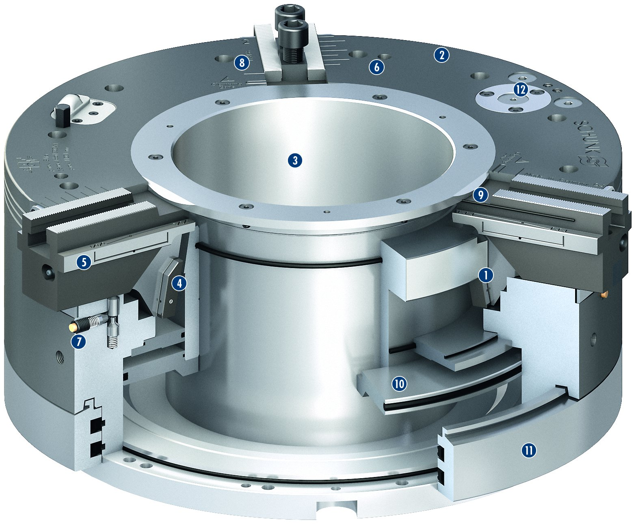
ROTA TB2-LH
2
1
Wedge hook drive
Corrosion-resistant, coated and extremely rigid base body
Very large through-hole
Dual stroke system
Optimized lubrication system
Mounting threads
Indicator pin
Jaw stroke display
Sealed base jaw guidance
Pneumatic cylinder integrated in the chuck
Static distributor ring
Pressure maintenance valve
8
6
12
2
3
3
4
9
5
6
5
1
7
4
8
7
9
10
10
11
11
12

Slide 6
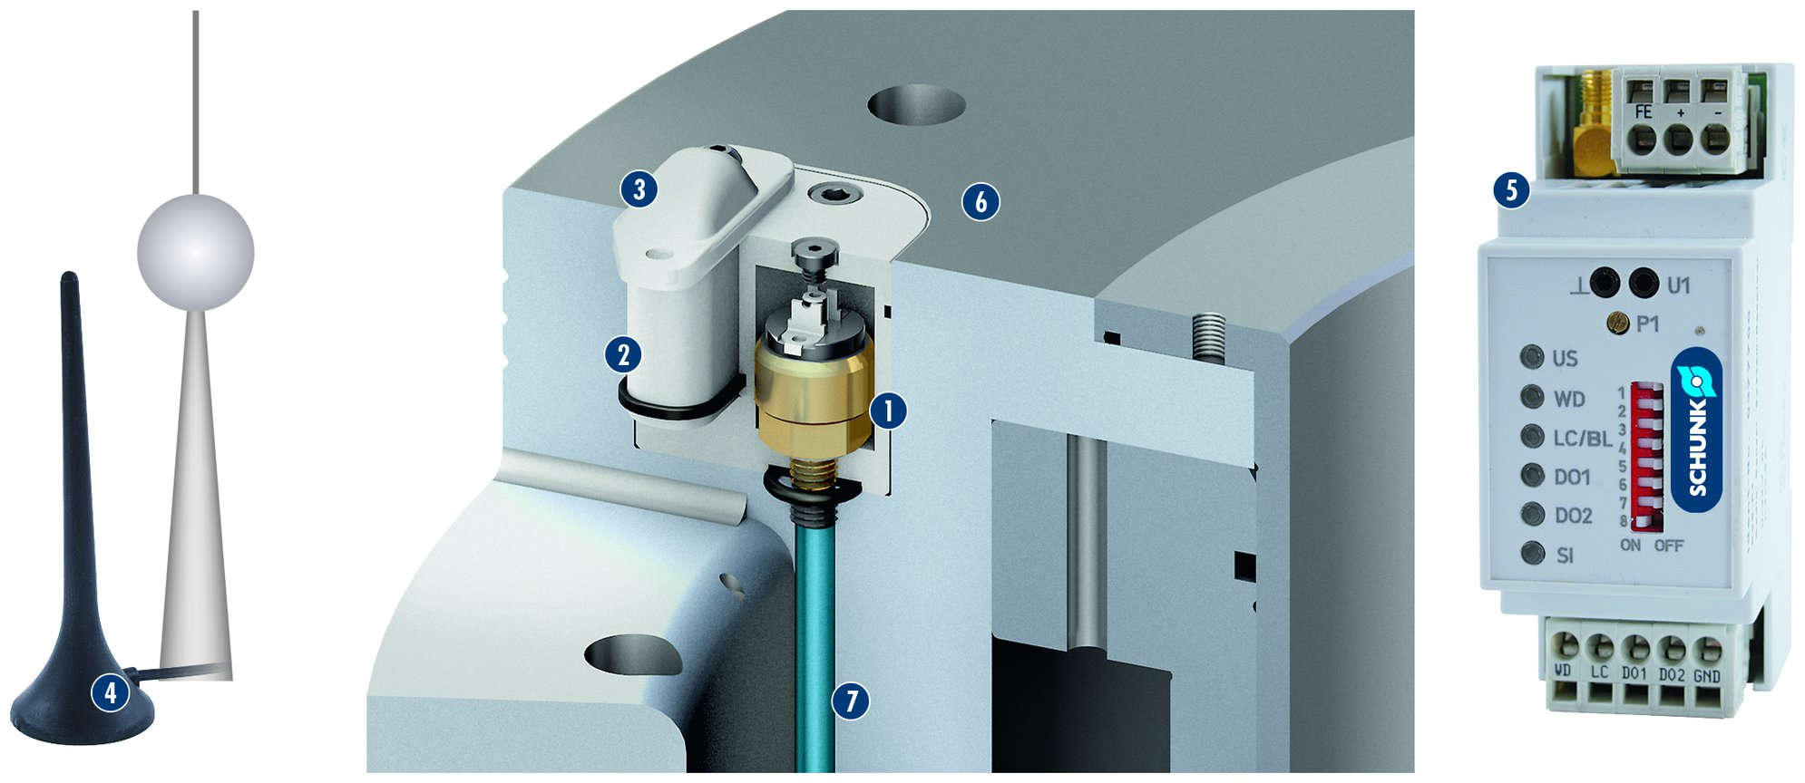
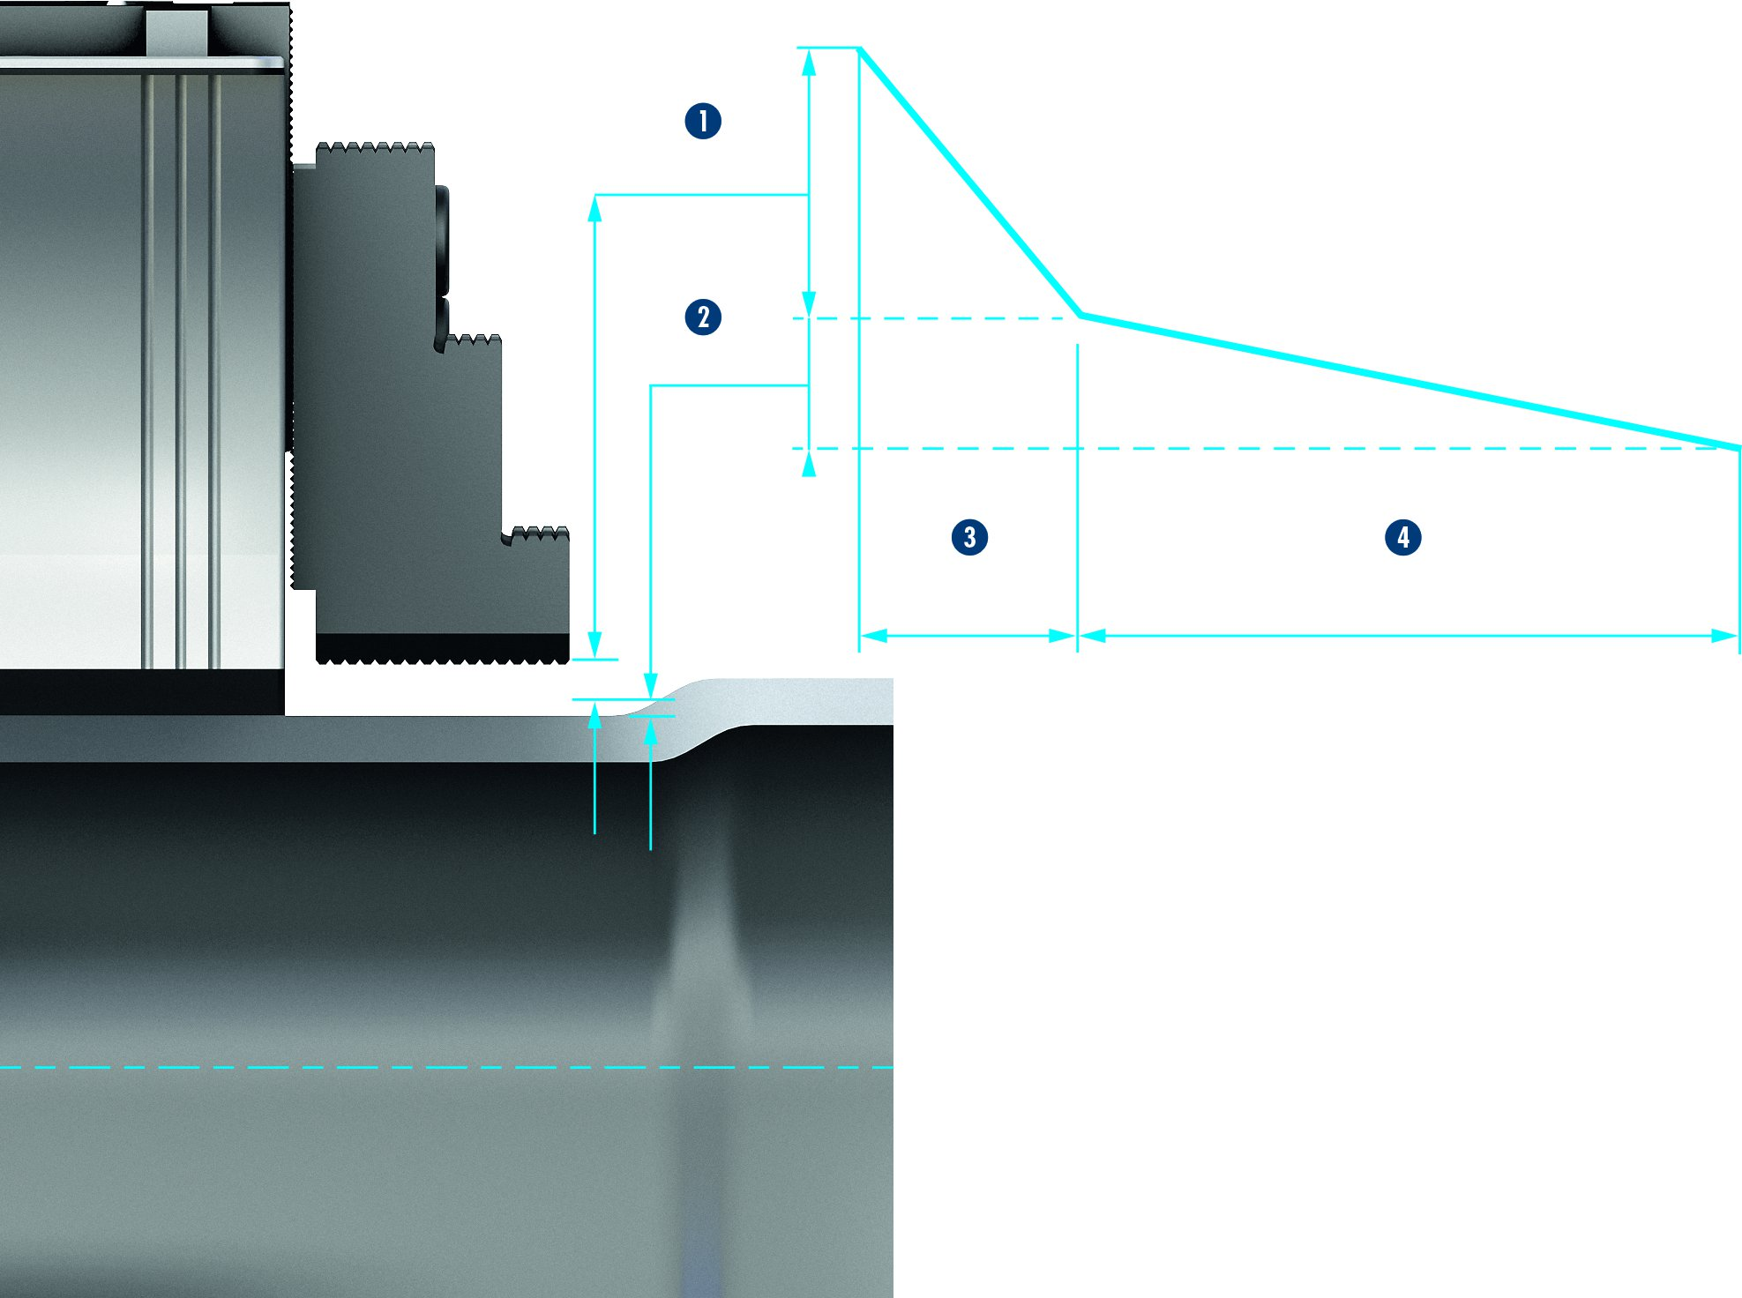
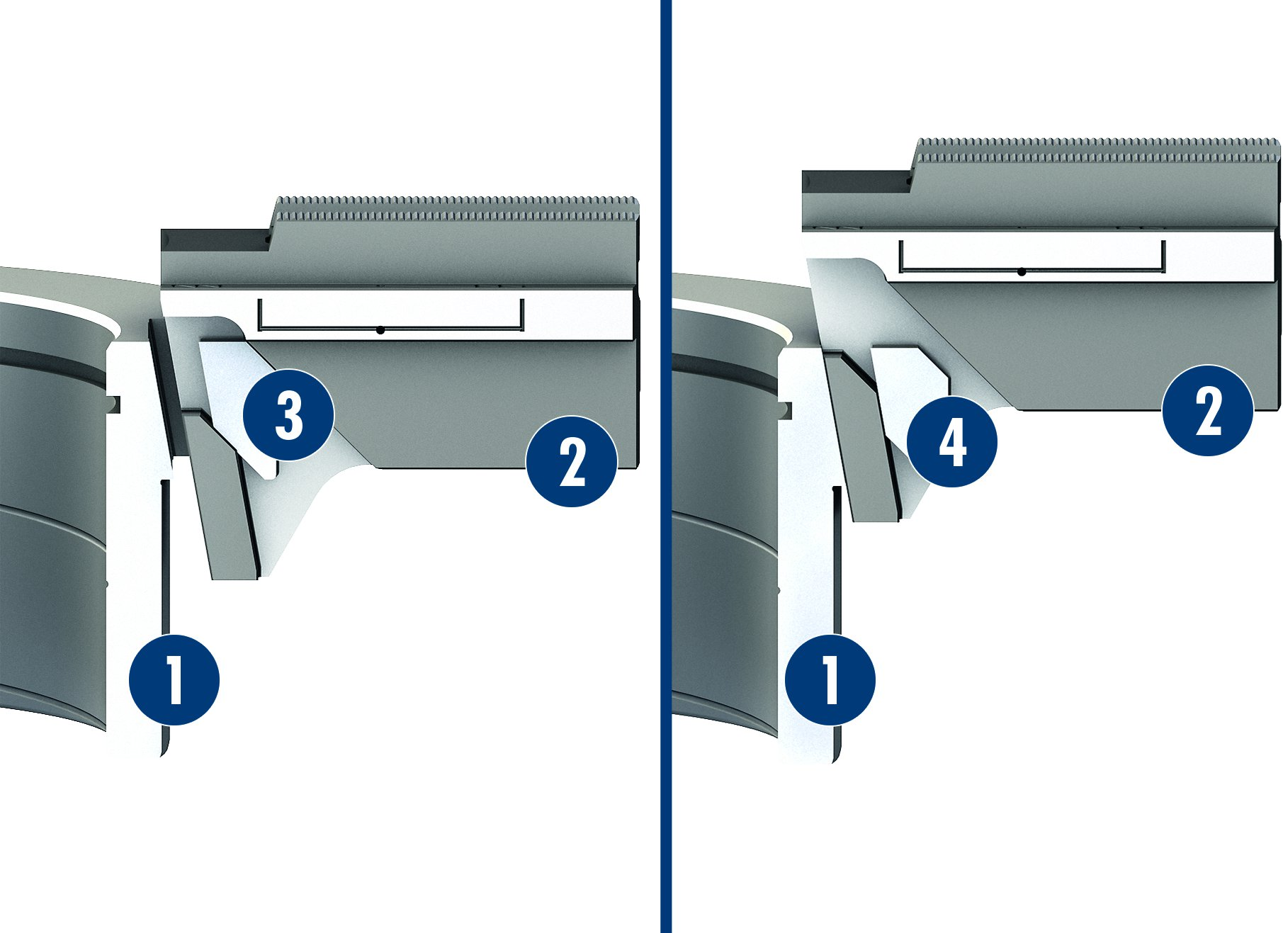
ROTA TB2-LH
RSS-P1: Wireless Clamping Pressure Control
1
Pressure sensor connected with the cylinder
Transmitter unit
Protection cover
Receiver antenna
Receiver
Chuck body ROTA TB2-LH made out of steel
Channel bores
3
6
5
2
3
2
4
1
5
6
4
7
7
Functional Principle of the Dual Stroke System (Jaw Fast and Clamping Stroke)
Dual stroke system
1
1
Chuck piston
Base jaw
Jaw fast stroke
Clamping stroke
2
1
Jaw fast stroke
Clamping stroke
Fast movement
Slow movement
3
2
2
3
4
2
2
4
3
3
1
1
4
4

Slide 7
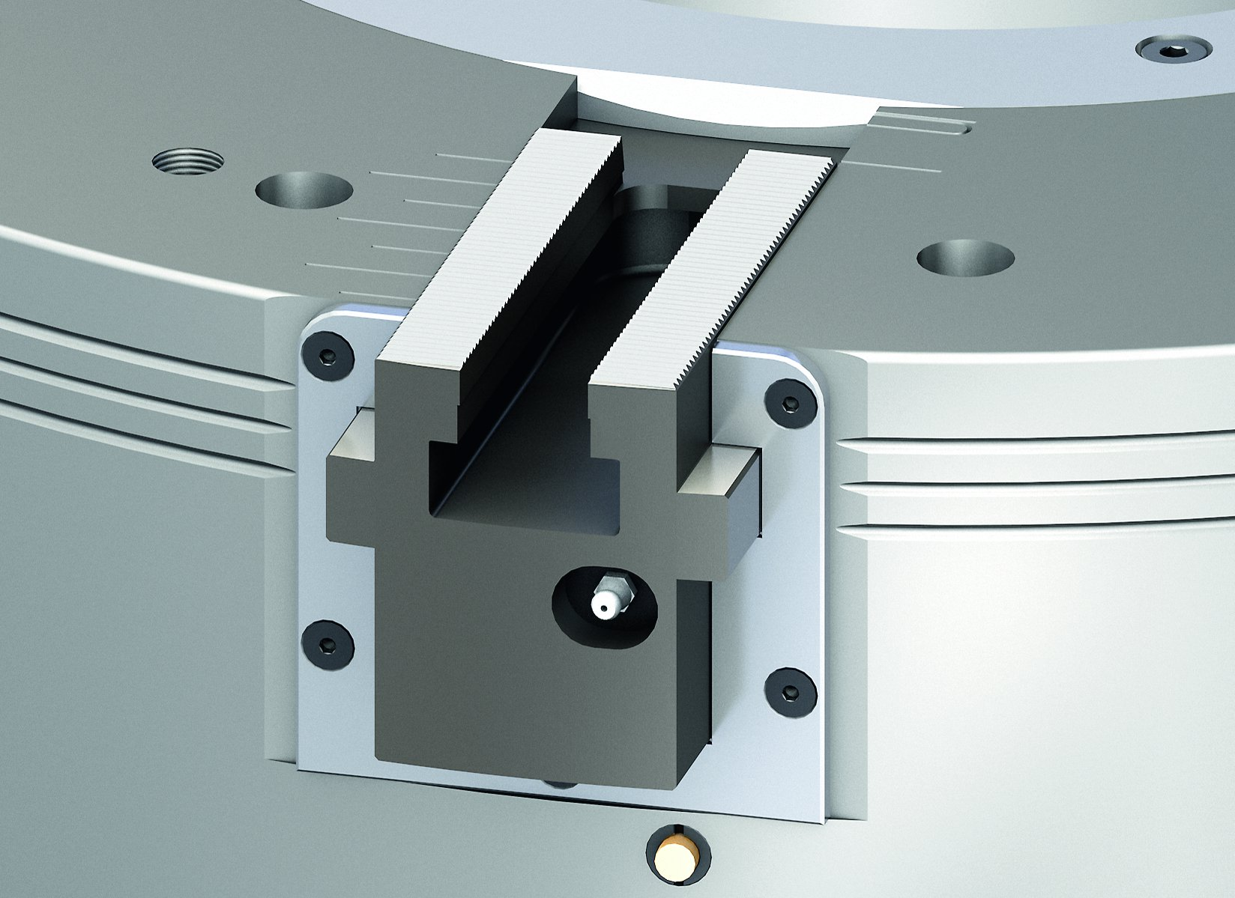
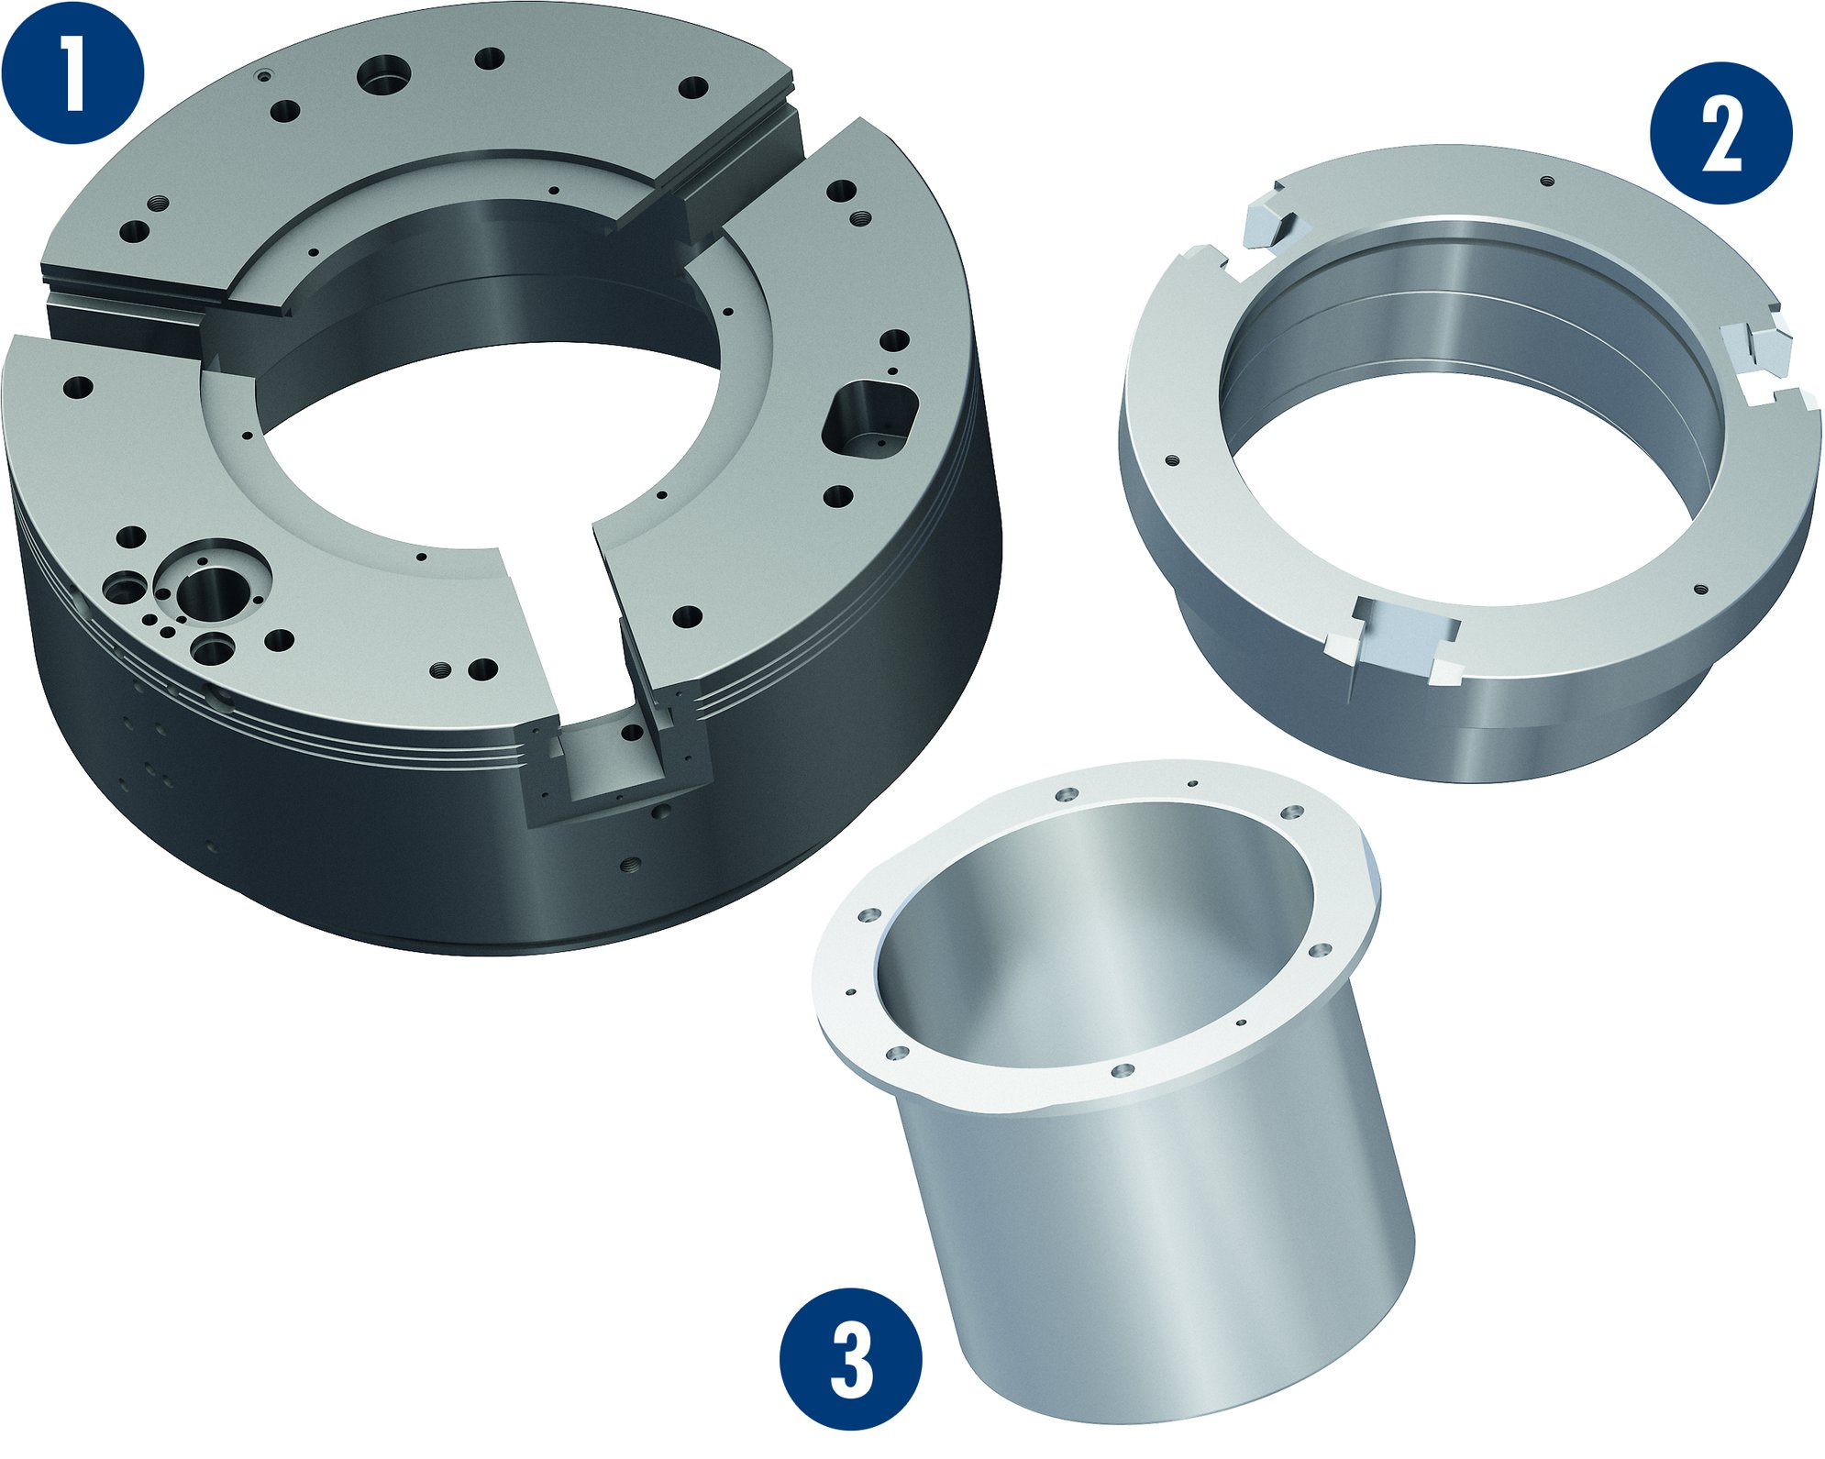
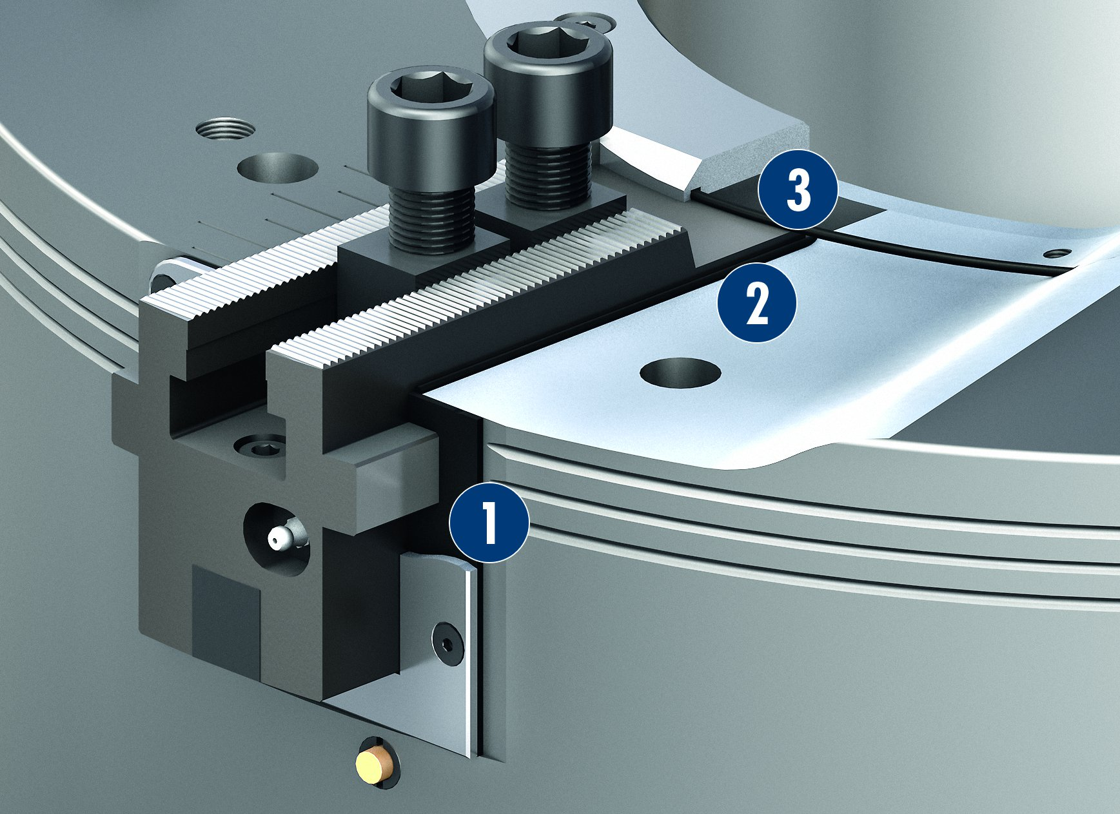
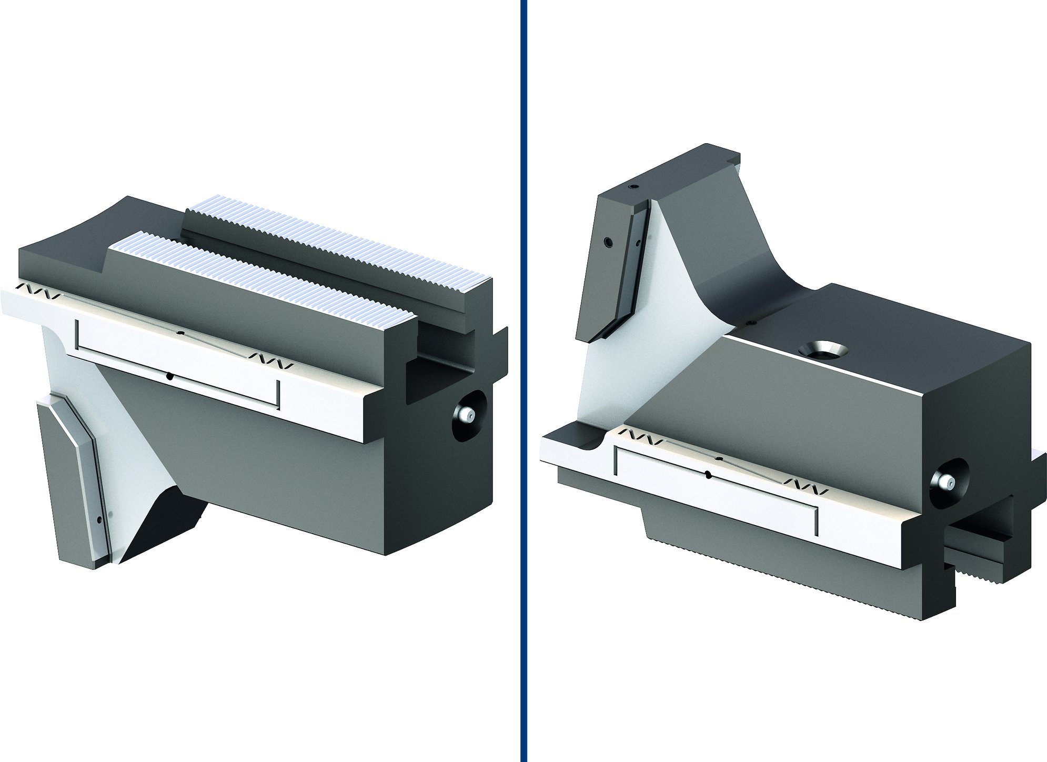
ROTA TB2-LH
Corrosion resistant components
Base jaw guidance
1
2
1
Body
Piston
Center sleeve
2
3
3
Sealed base jaw guidance
Optimized lubrication system
3
1
Front-end profile sealing element
Sealing element
O-ring
2
2
1
3

Slide 8
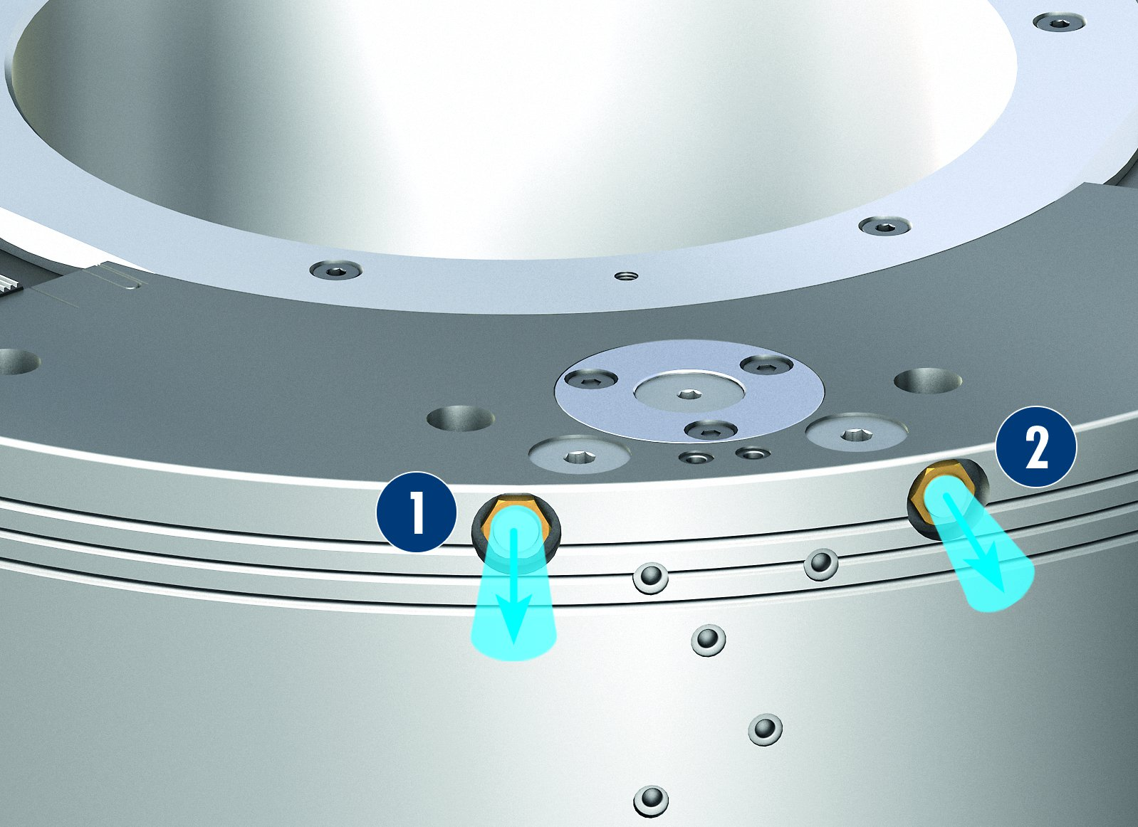
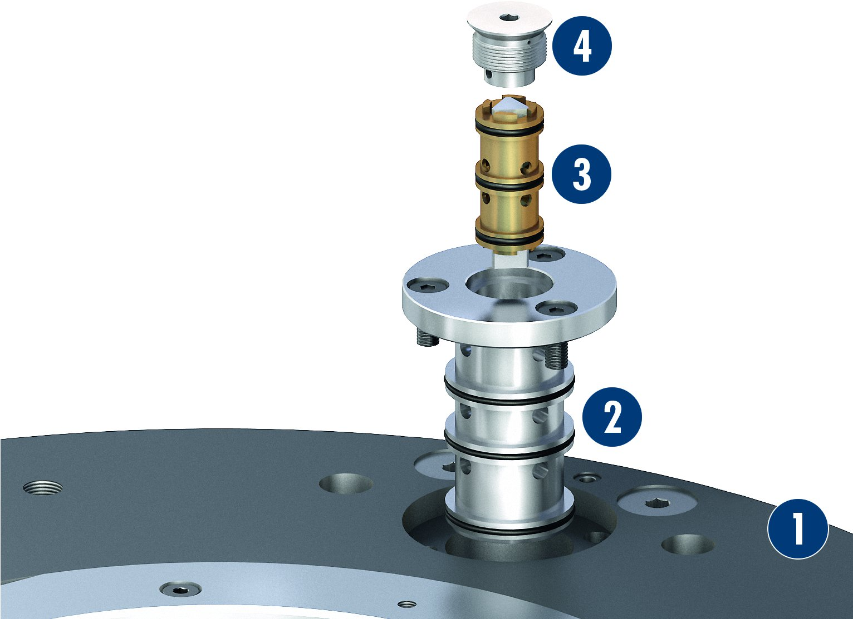
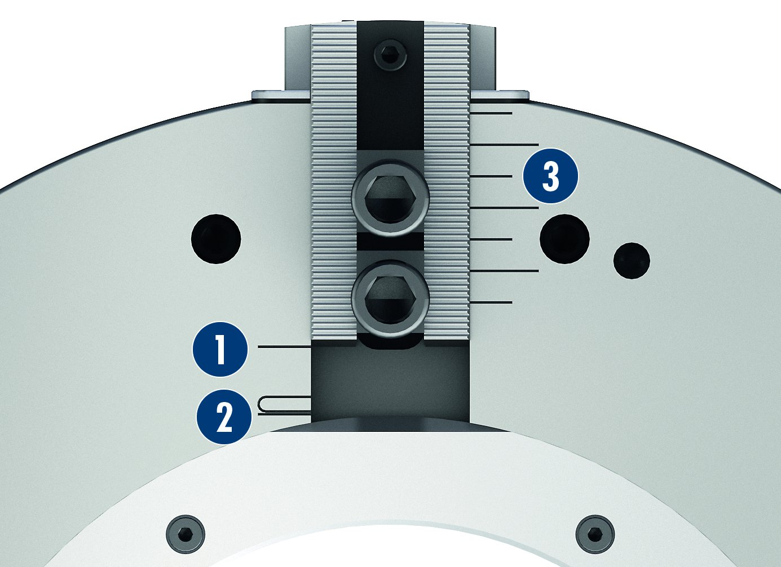
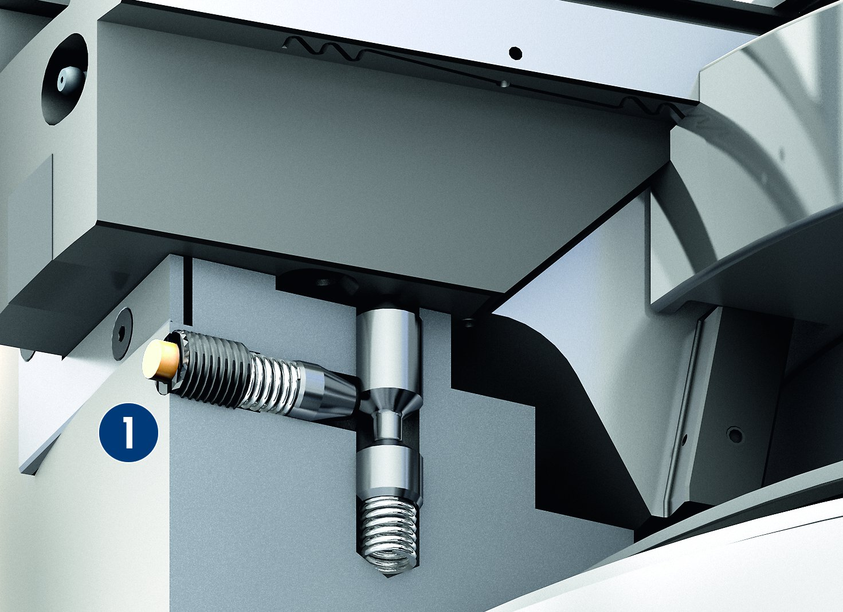
ROTA TB2-LH
Fast ventilation
Exchangeable valve
4
1
Chuck body
Valve insert
Pressure maintenance
Valve
Sealing cap
3
1
Escaping air
Escaping air
2
1
2
2
3
2
1
4
Jaw stroke display
Visual monitoring of the dual stroke system
3
1
Chuck opened
Clamping stroke range
Visual display
1
Visual indicator pin LH version
2
1
2
1
3

Slide 9
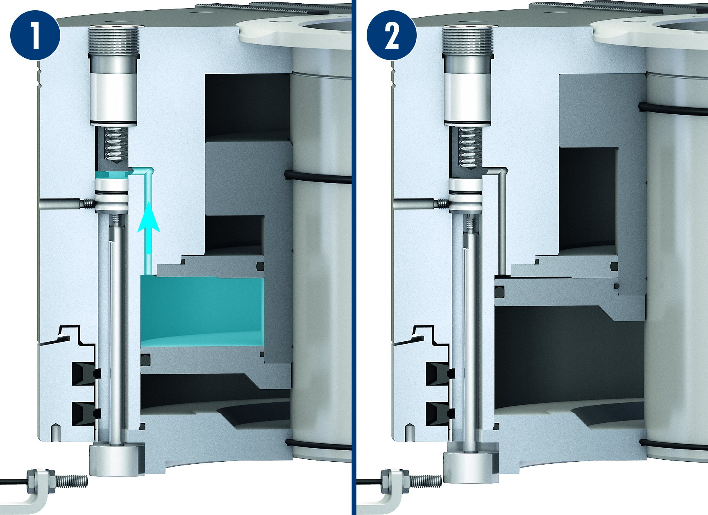
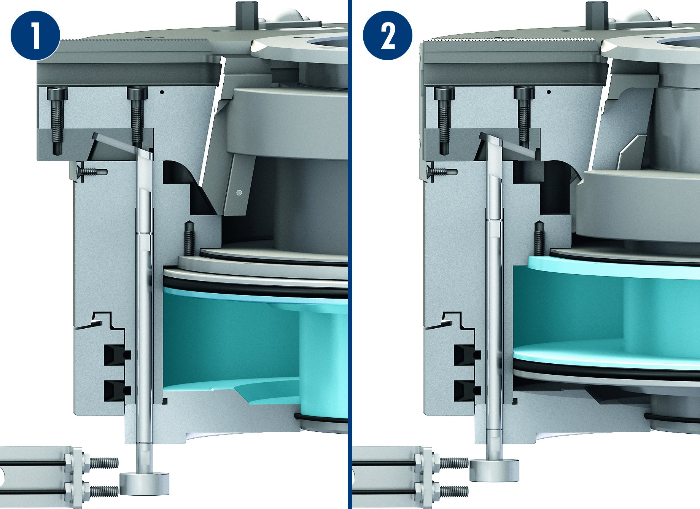
ROTA TB2-LH
Pressure monitoring via sensor (optional)
Stroke monitoring of the clamping jaws – knowledge whether opened or clamped (optional)
1
2
1
Sufficient operating pressure is present
Pressure loss
1
2
1
Chuck completely opened
Chuck in clamping position on the clamping stroke
2
2

Slide 10
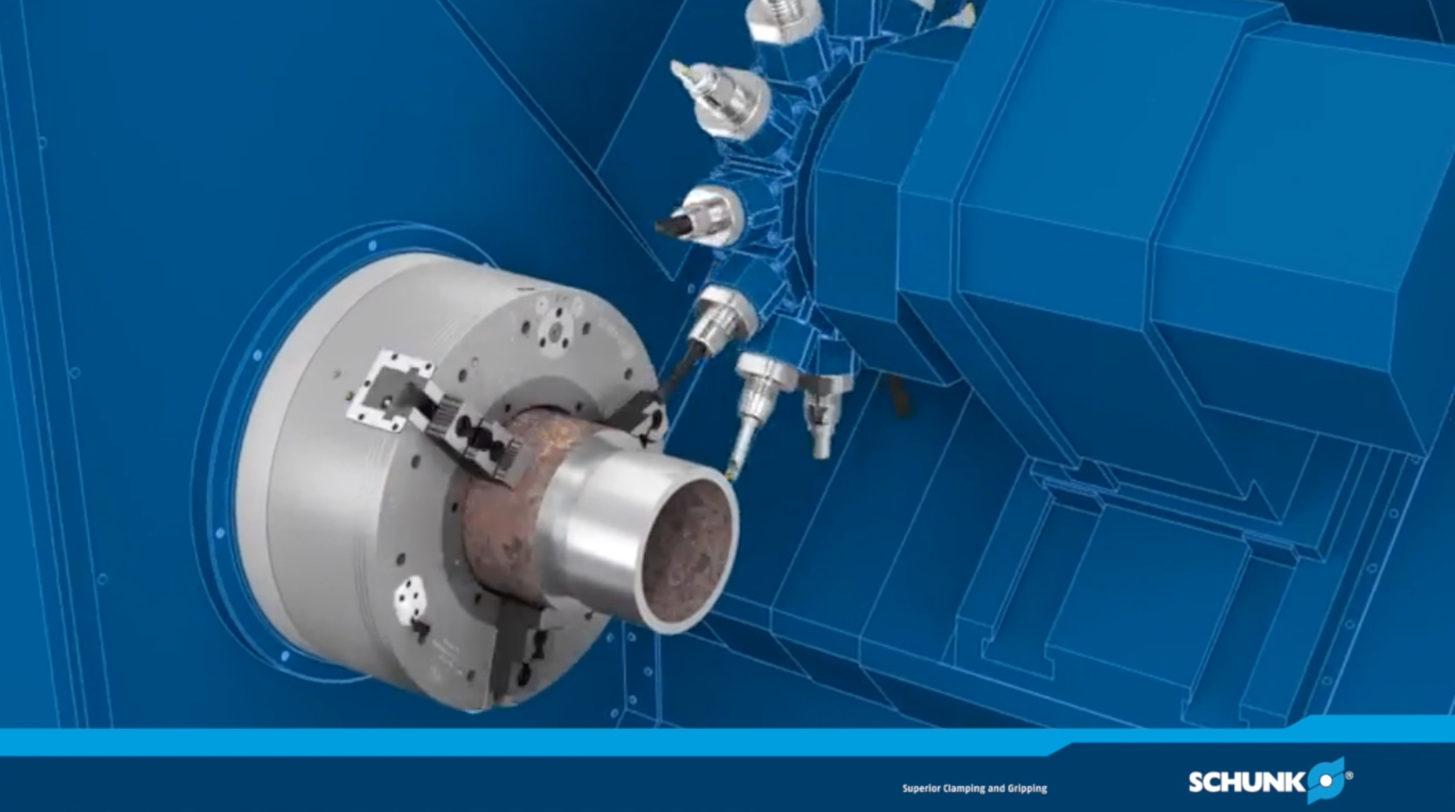
ROTA TB2-LH

Slide 11
Variants ROTA TB2-LH
Technische Daten | Max. RPM [min⁻¹] | Max. clamping force (at 6 bar) [kN] | stroke/jaw [mm] | Through-hole [mm]
ROTA TB2 470-185 LH | 1300 | 115 | 20 | 185
ROTA TB2 570-230 LH | 1300 | 220 | 25.4 | 230
ROTA TB2 600-275 LH | 1100 | 200 | 25.4 | 275
ROTA TB2 630-275 LH | 1000 | 200 | 38.1 | 275
ROTA TB2 685-325 LH | 900 | 280 | 25.4 | 325
ROTA TB2 850-375 LH | 750 | 240 | 25.4 | 375
ROTA TB2 1000-560 LH | 500 | 240 | 25.4 | 560

Slide 12




SCHUNK Services
Engineering
Dimensioning of special plates designed to the manufacturing specifications
Development of special solutions together with the customer
FEM analysis for critical components
Testing
Endurance tests with all new developments
Abrasion checking
Measurement of accuracy
Service
Initial operation of customer´s solution
Inspection and maintenance
Repairs

