Slide 1


ROTA TB2
Pneumatic Power Chucks

Slide 2













Product overview
Gripping Systems
Clamping Technology
Chuck Jaws
Stationary Workholding
Lathe Chucks
Toolholders
Hydraulic Expansion Technology
Manual Lathe Chucks
Power Lathe Chucks with Jaw Quick-change System
Power Lathe Chucks with Through-hole
Power Lathe Chucks without Through-hole
Pneumatic Power Chucks
Steady Rests
Quick-change Systems
Customized Solutions

Slide 3

Pneumatic Power Chucks
Application

Slide 4



ROTA overview
Pneumatic Power Chucks
ROTA TP
ROTA TB
ROTA TB-LH
ROTA TB2
ROTA TB2-LH

Slide 5
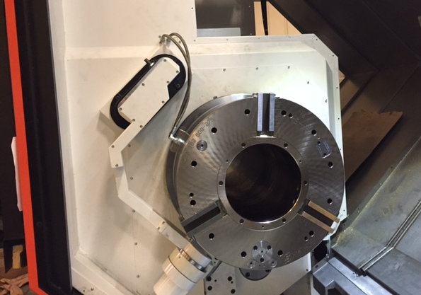
ROTA TB2
Example of application
Clamping device:
ROTA TB2 600-275.
Features/Application:
Pneumatic power chuck with integrated cylinder of the newest generation. Optimized sealing prevents the penetration of dirt, coated functional components ensure a long service life and fast ventilation allow shorter cycle times.
Extra large through-hole for O.D. clamping of pipes with big diameter.

Slide 6
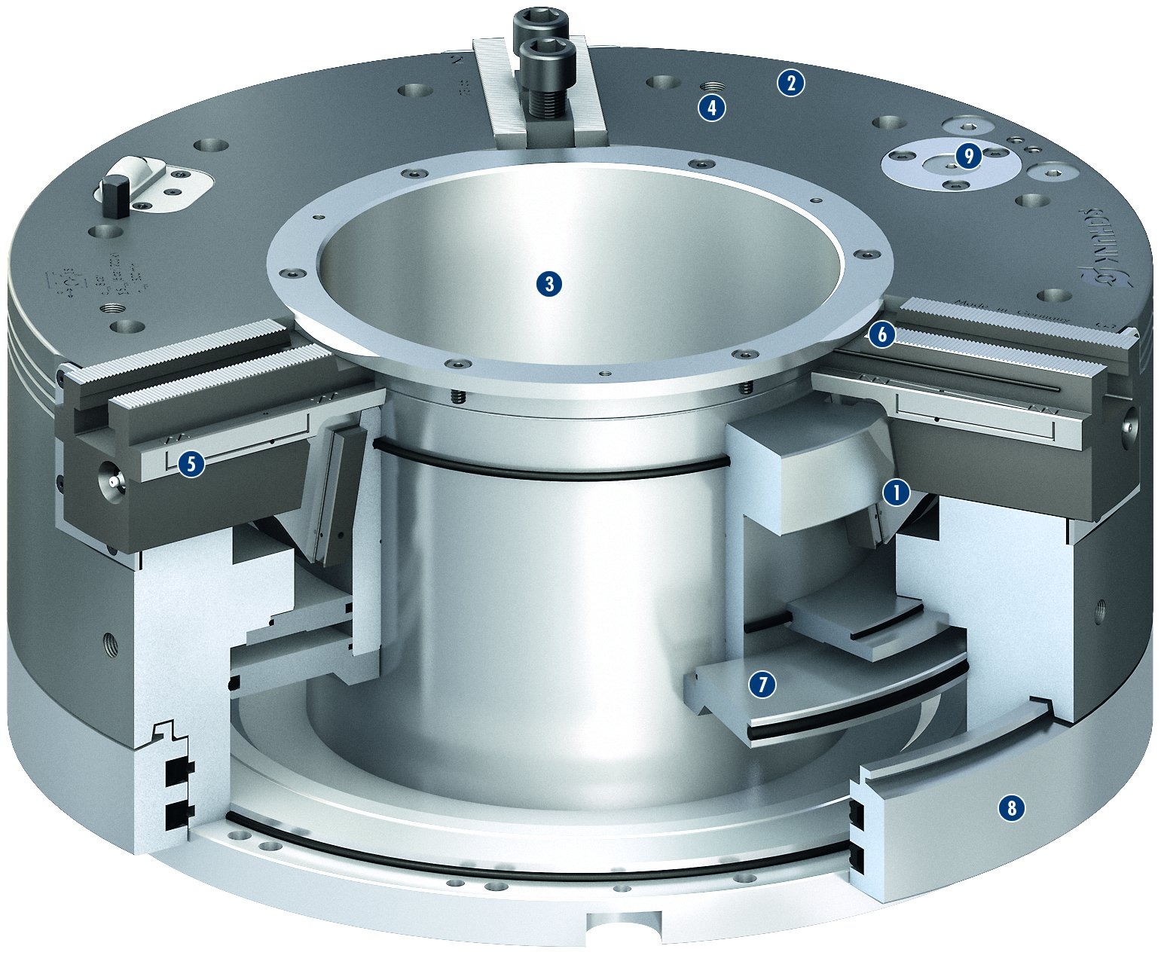
ROTA TB2
2
4
9
1
Wedge hook drive
Corrosion-resistant, coated and extremely rigid base body
Very large through-hole
Mounting threads
Optimized lubrication system
Sealed base jaw guidance
Pneumatic cylinder integrated in the chuck
Static distributor ring
Pressure maintenance valve
2
3
6
3
4
5
5
1
6
7
7
8
9
8

Slide 7
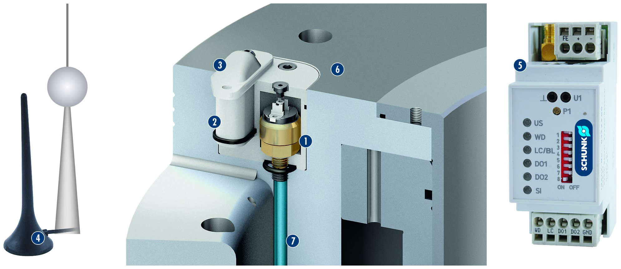
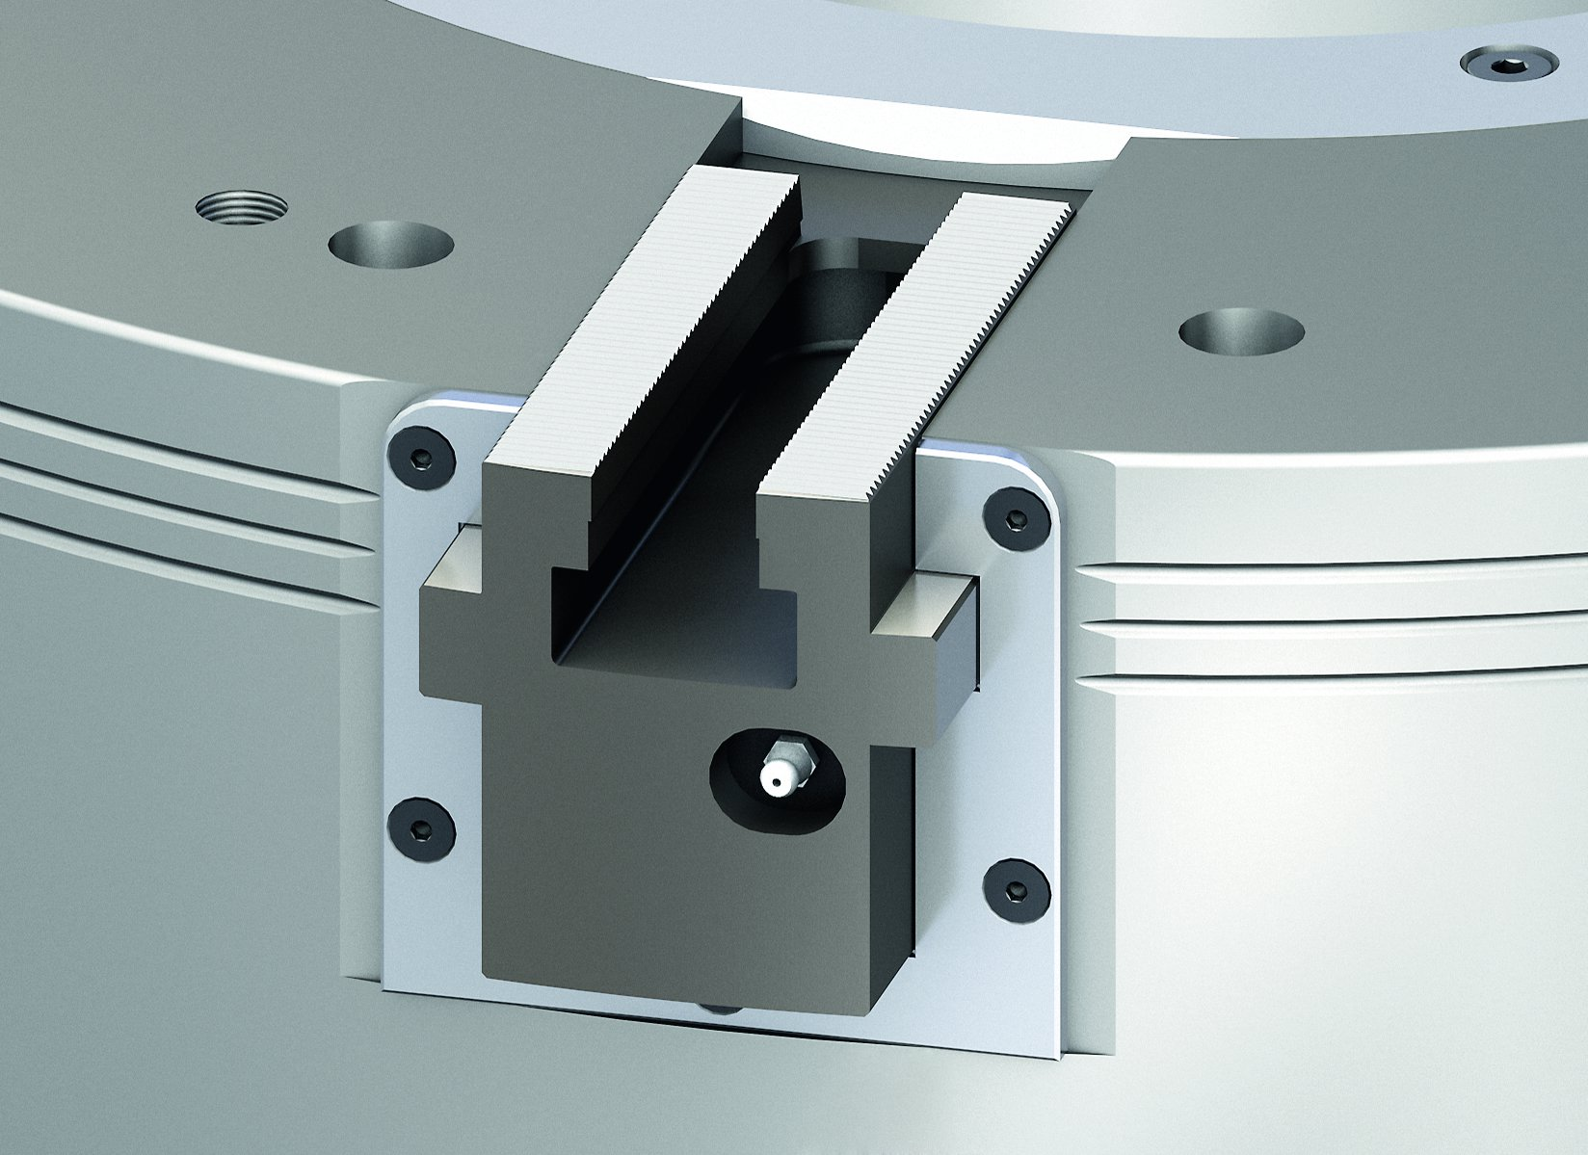
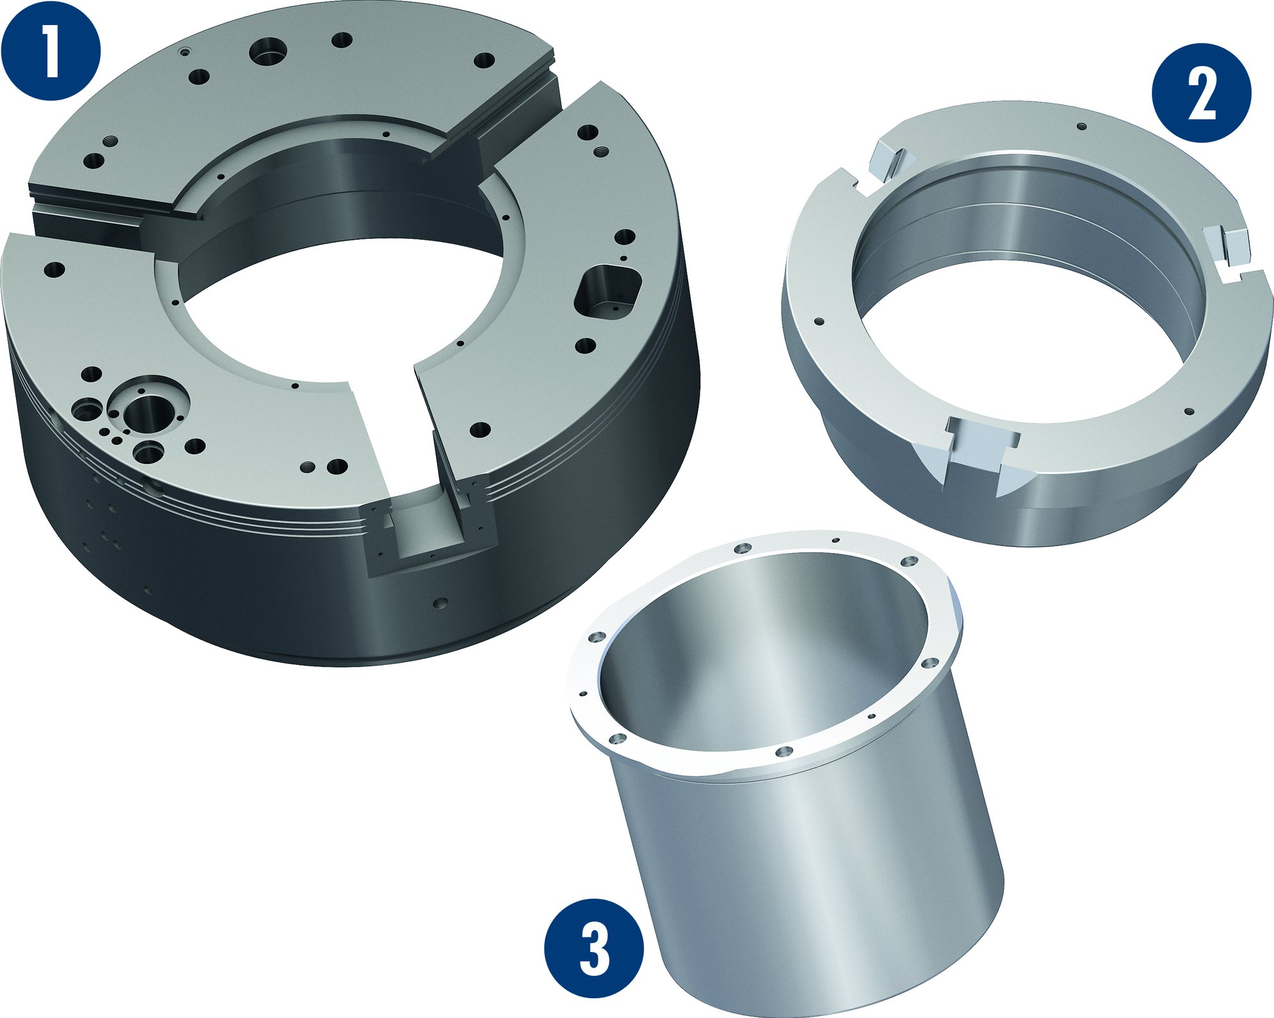
ROTA TB2
RSS-P1: Wireless Clamping Pressure Control
1
Pressure sensor connected with the cylinder
Transmitter unit
Protection cover
Receiver antenna
Receiver
Chuck body ROTA TB2 made out of steel
Channel bores
3
6
5
2
3
2
4
1
5
6
4
7
7
Corrosion resistant components
Base jaw guidance
1
2
1
Body
Piston
Center sleeve
2
3
3

Slide 8
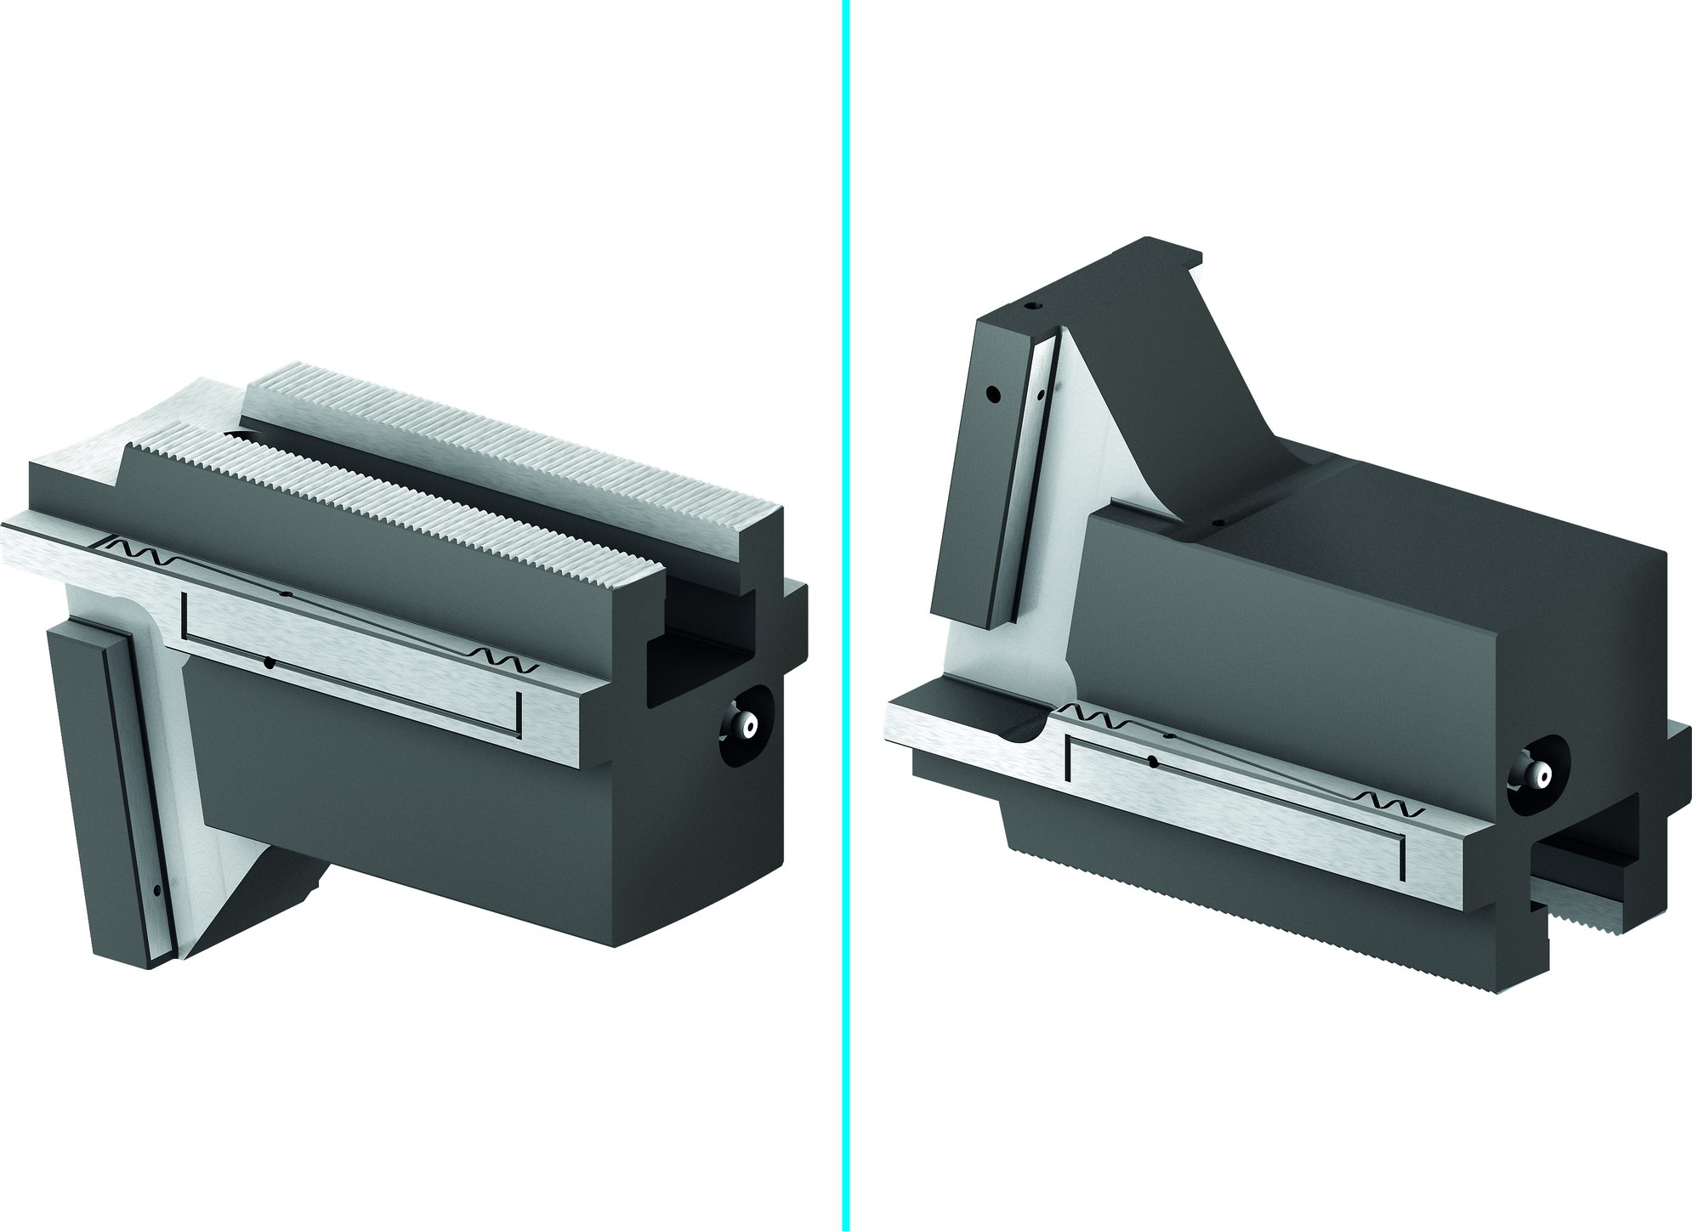
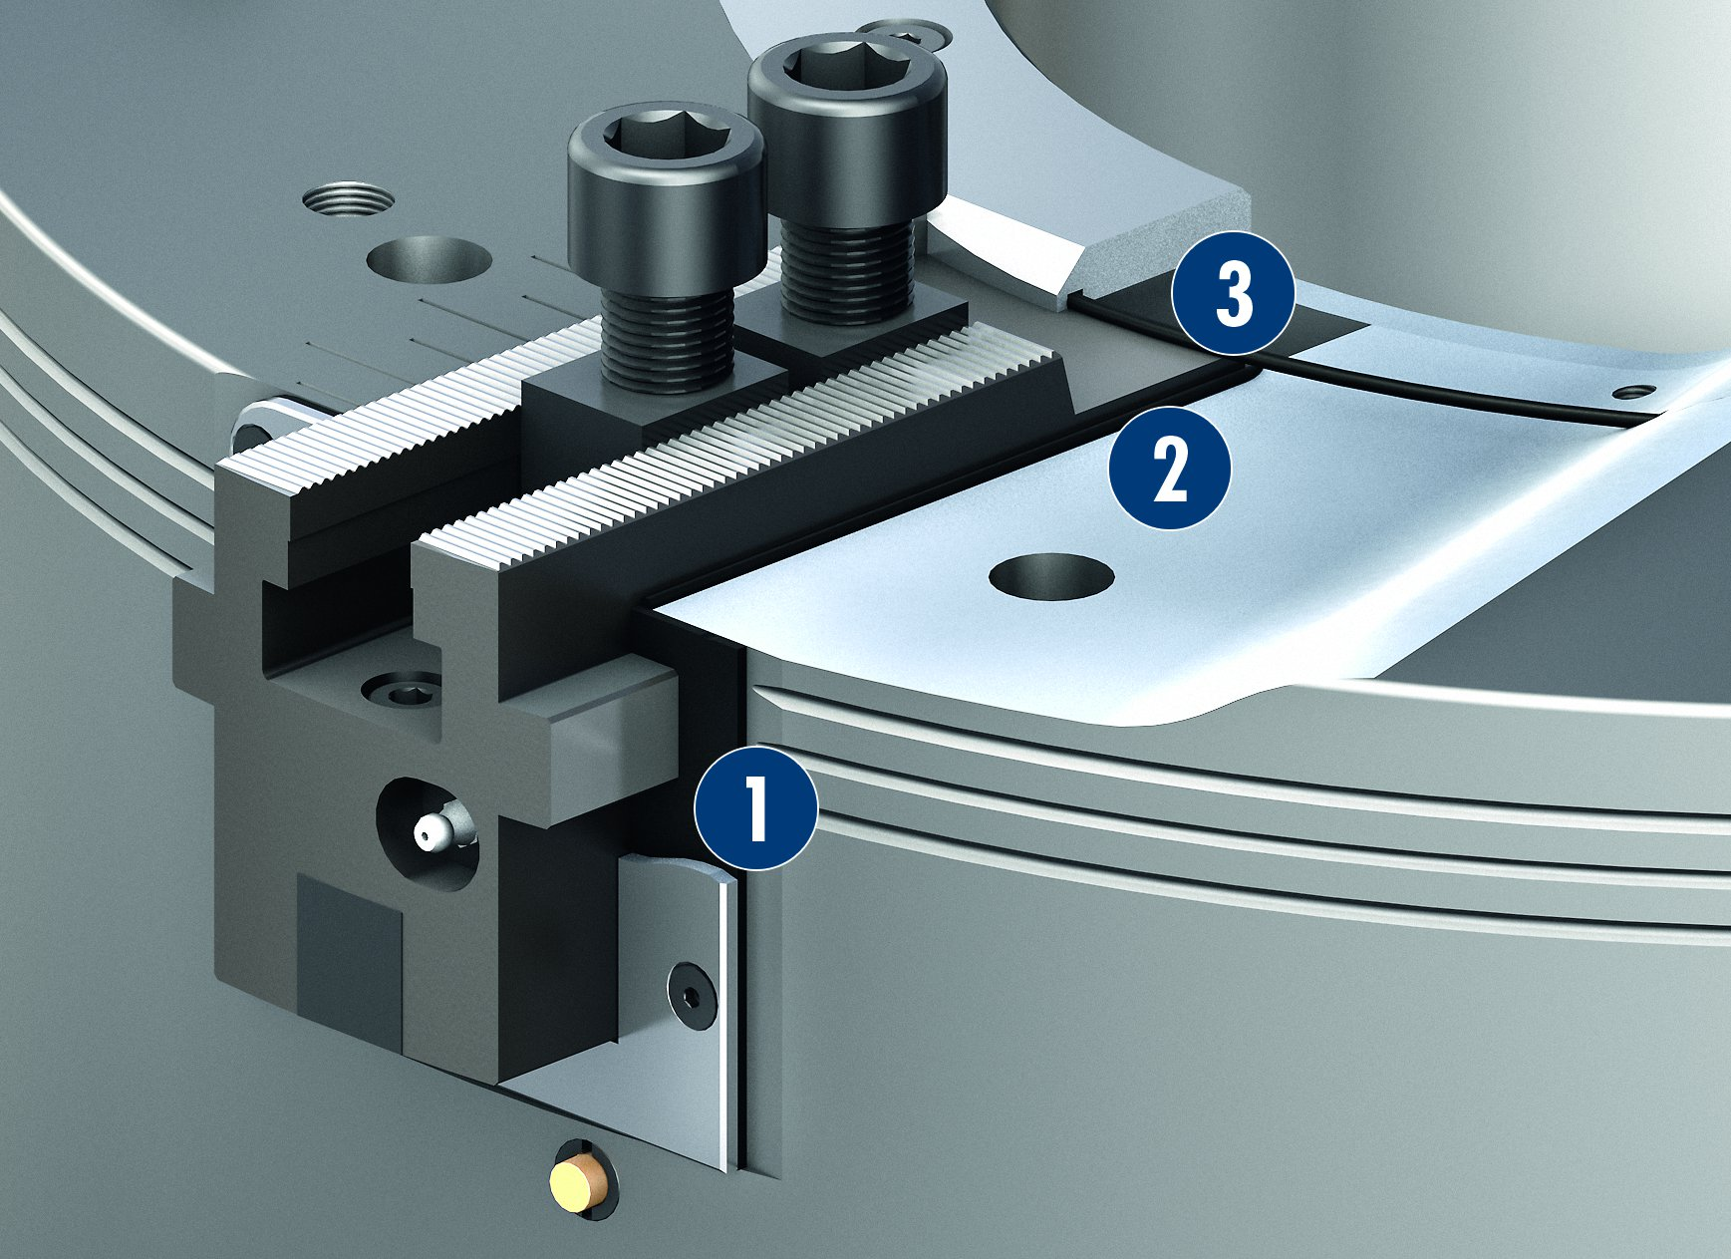
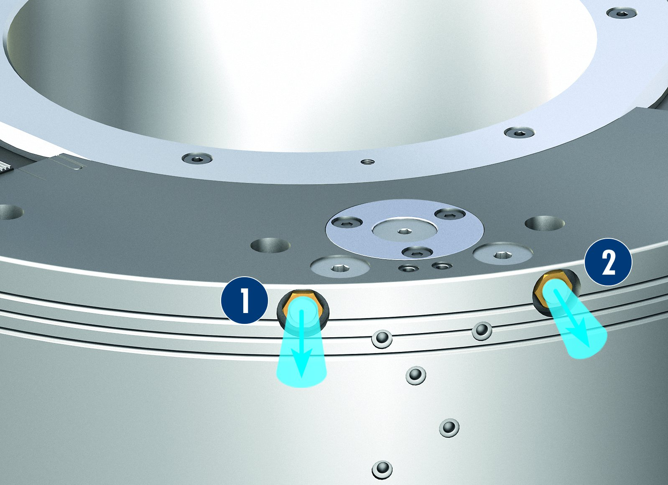
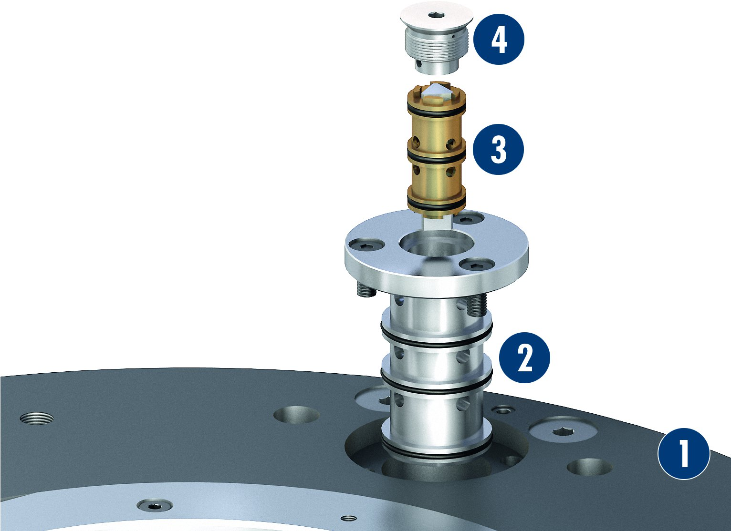
ROTA TB2
Sealed base jaw guidance
Optimized lubrication system
3
1
Front-end profile sealing element
Sealing element
O-ring
2
2
1
3
Fast ventilation
Exchangeable valve
4
1
Chuck body
Valve insert
Pressure maintenance valve
Sealing cap
1
Escaping air
Escaping air
3
2
1
2
2
3
2
1
4

Slide 9
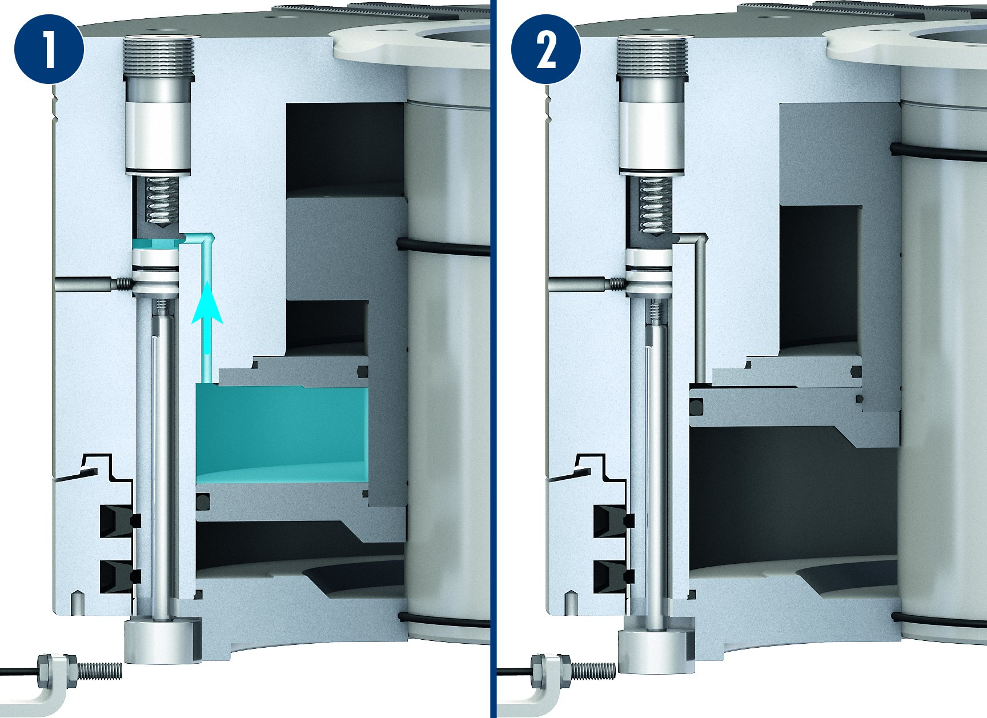
ROTA TB2
Pressure monitoring via sensor (optional)
1
2
1
Sufficient operating pressure is present
Pressure loss
2

Slide 10
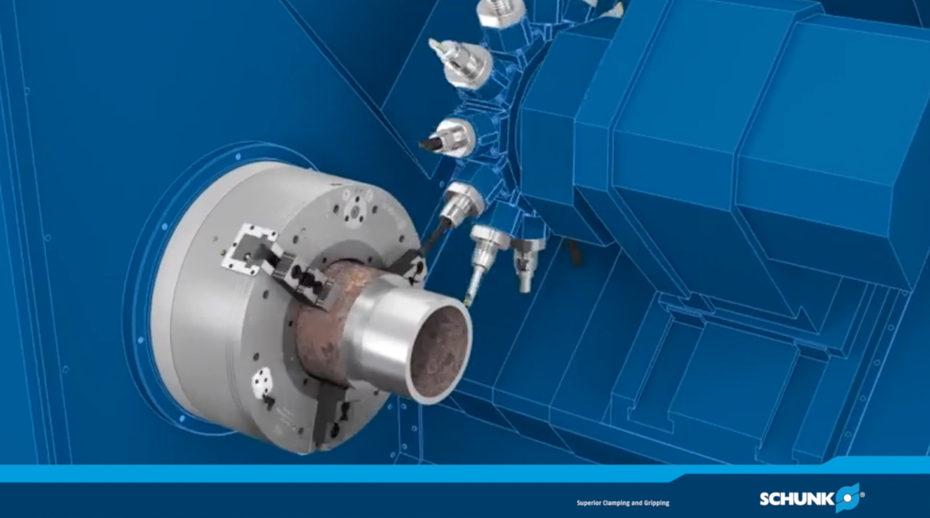
ROTA TB2

Slide 11
Variants ROTA TB2
Technische Daten | Max. RPM [min⁻¹] | Max. clamping force (at 6 bar) [kN] | stroke/jaw [mm] | Through-hole [mm]
ROTA TB2 470-140 | 1700 | 180 | 7 | 140
ROTA TB2 470-185 | 1700 | 115 | 7 | 185
ROTA TB2 570-230 | 1300 | 220 | 11.7 | 230
ROTA TB2 600-275 | 1300 | 200 | 11.7 | 275
ROTA TB2 685-325 | 1000 | 280 | 10 | 325
ROTA TB2 850-375 | 750 | 240 | 11.8 | 375
ROTA TB2 1000-560 | 500 | 240 | 12.8 | 560

Slide 12



SCHUNK Services
Engineering
Dimensioning of special plates designed to the manufacturing specifications
Development of special solutions together with the customer
FEM analysis for critical components
Testing
Endurance tests with all new developments
Abrasion checking
Measurement of accuracy
Service
Initial operation of customer´s solution
Inspection and maintenance
Repairs

