Slide 1


ROTA NCA
Power Lathe Chucks with Through-hole

Slide 2













Product overview
Gripping Systems
Clamping Technology
Chuck Jaws
Stationary Workholding
Lathe Chucks
Toolholders
Hydraulic Expansion Technology
Manual Lathe Chucks
Power Lathe Chucks with Jaw Quick-change System
Power Lathe Chucks with Through-hole
Power Lathe Chucks without Through-hole
Pneumatic Power Chucks
Steady Rests
Quick-change Systems
Customized Solutions

Slide 3
Challenges
Process dynamics
Technnological
progress
time
time
Energy consumption
time
Requirements on the clamping fixture: efficiency, flexibility and…
heute
zukünftig

Slide 4




ROTA overview
Power Lathe Chucks with Through-hole
ROTA NCE
ROTA NCA
ROTA NC plus 2/NCF plus 2
ROTA NCD
ROTA NCK plus

Slide 5
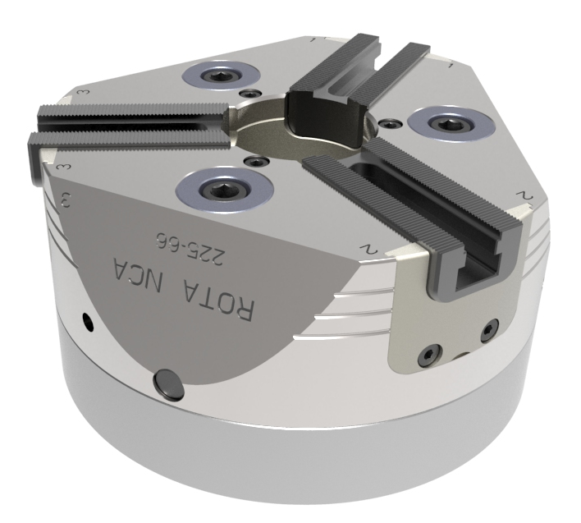
ROTA NCA

Slide 6
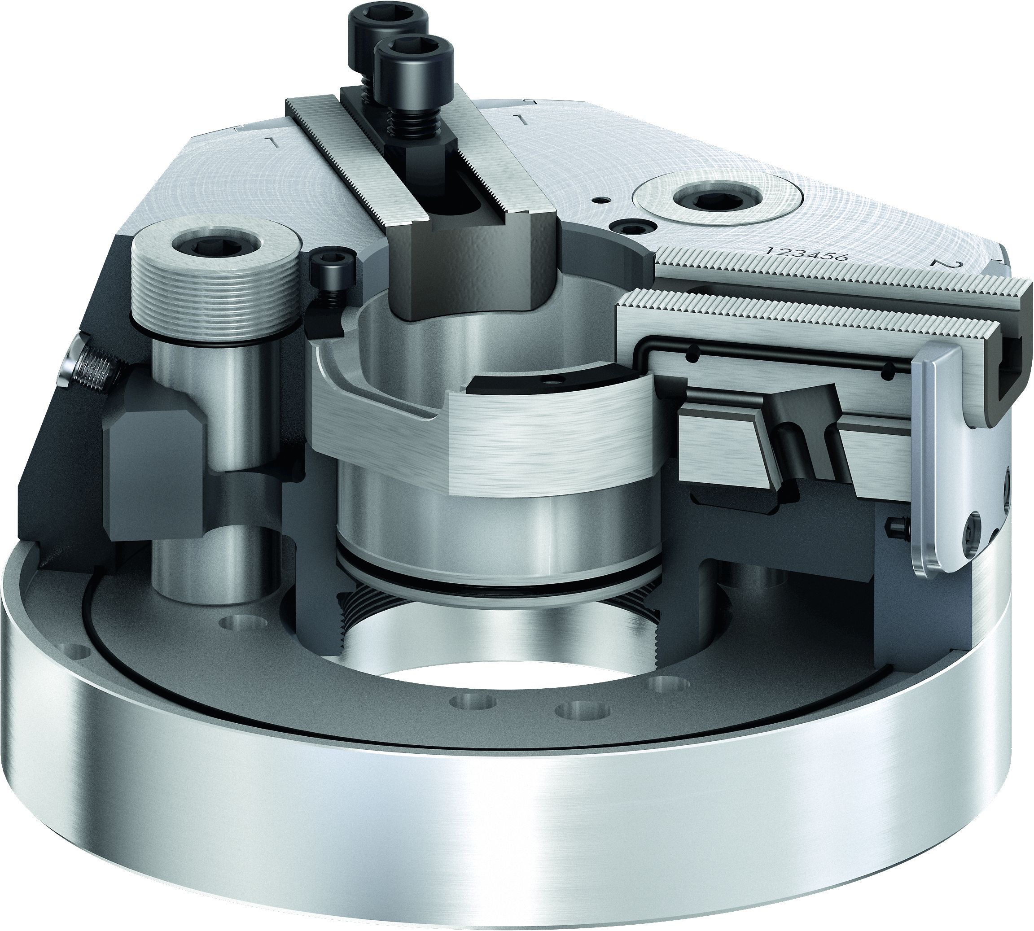
ROTA NCA
2
7
4
1
Wedge hook drive
Hardened and extremely rigid base body
Large through-hole
Fastening threads for workpiece stops
Standard base jaw serration
Sealing for longer maintenance intervals
Weight-reduced design
5
3
2
3
1
4
6
5
6
7

Slide 7
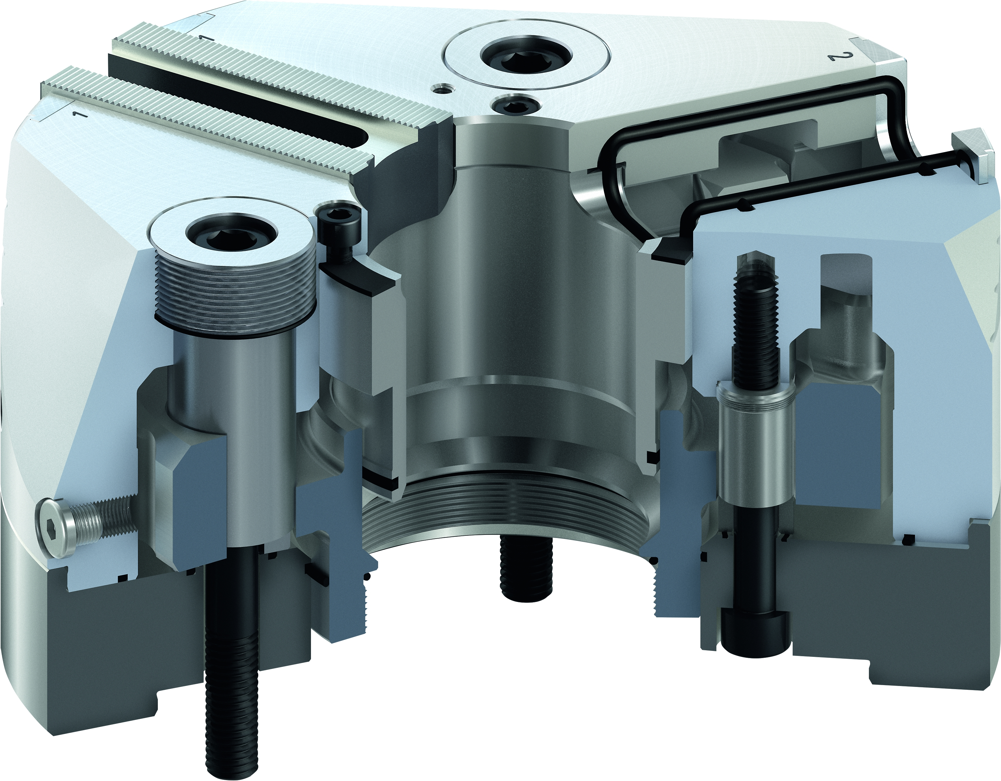
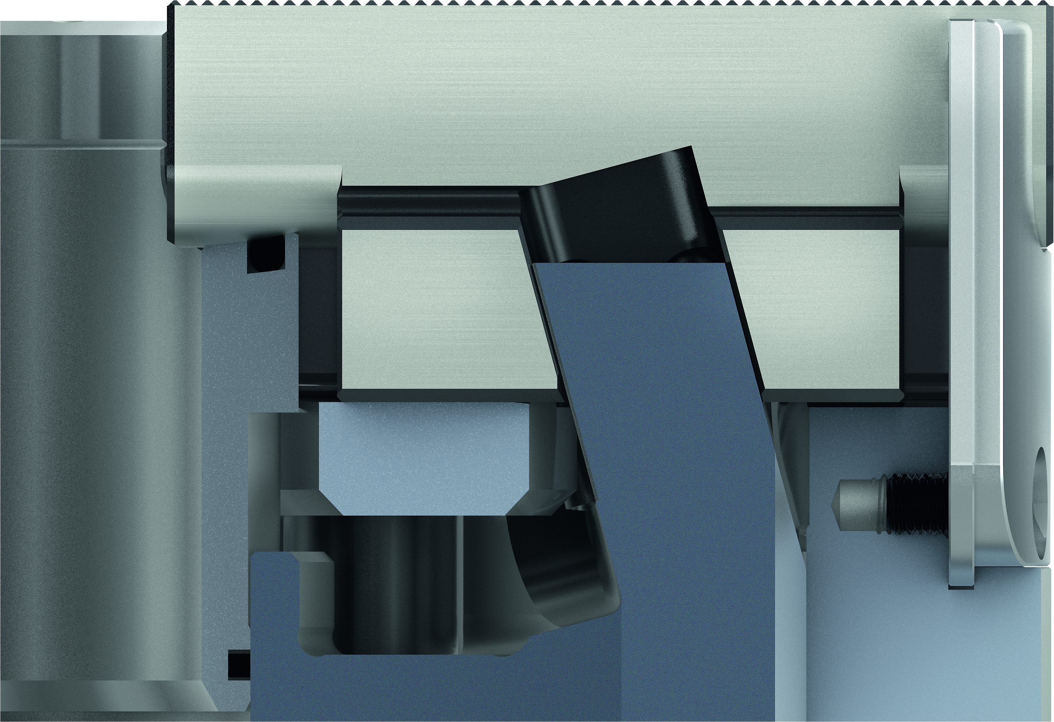
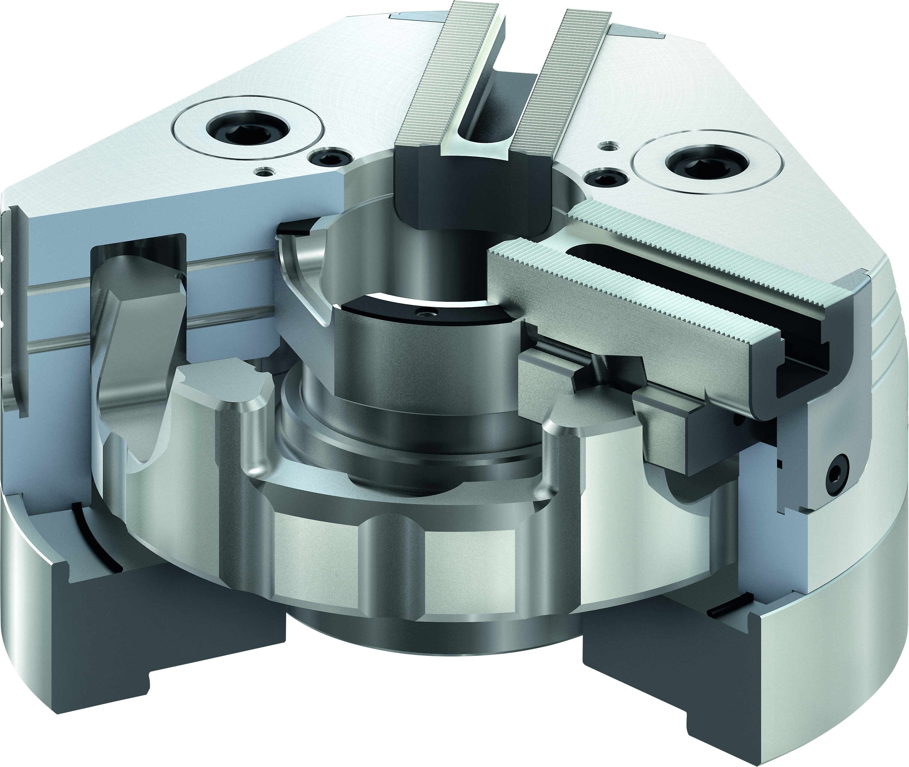
ROTA NCA
Innovative sealing system
Weight-optimized design with
bevelled surfaces
Wedge hook drive in ring piston design
with long and precise piston guidance
Base jaw safety feature

Slide 8
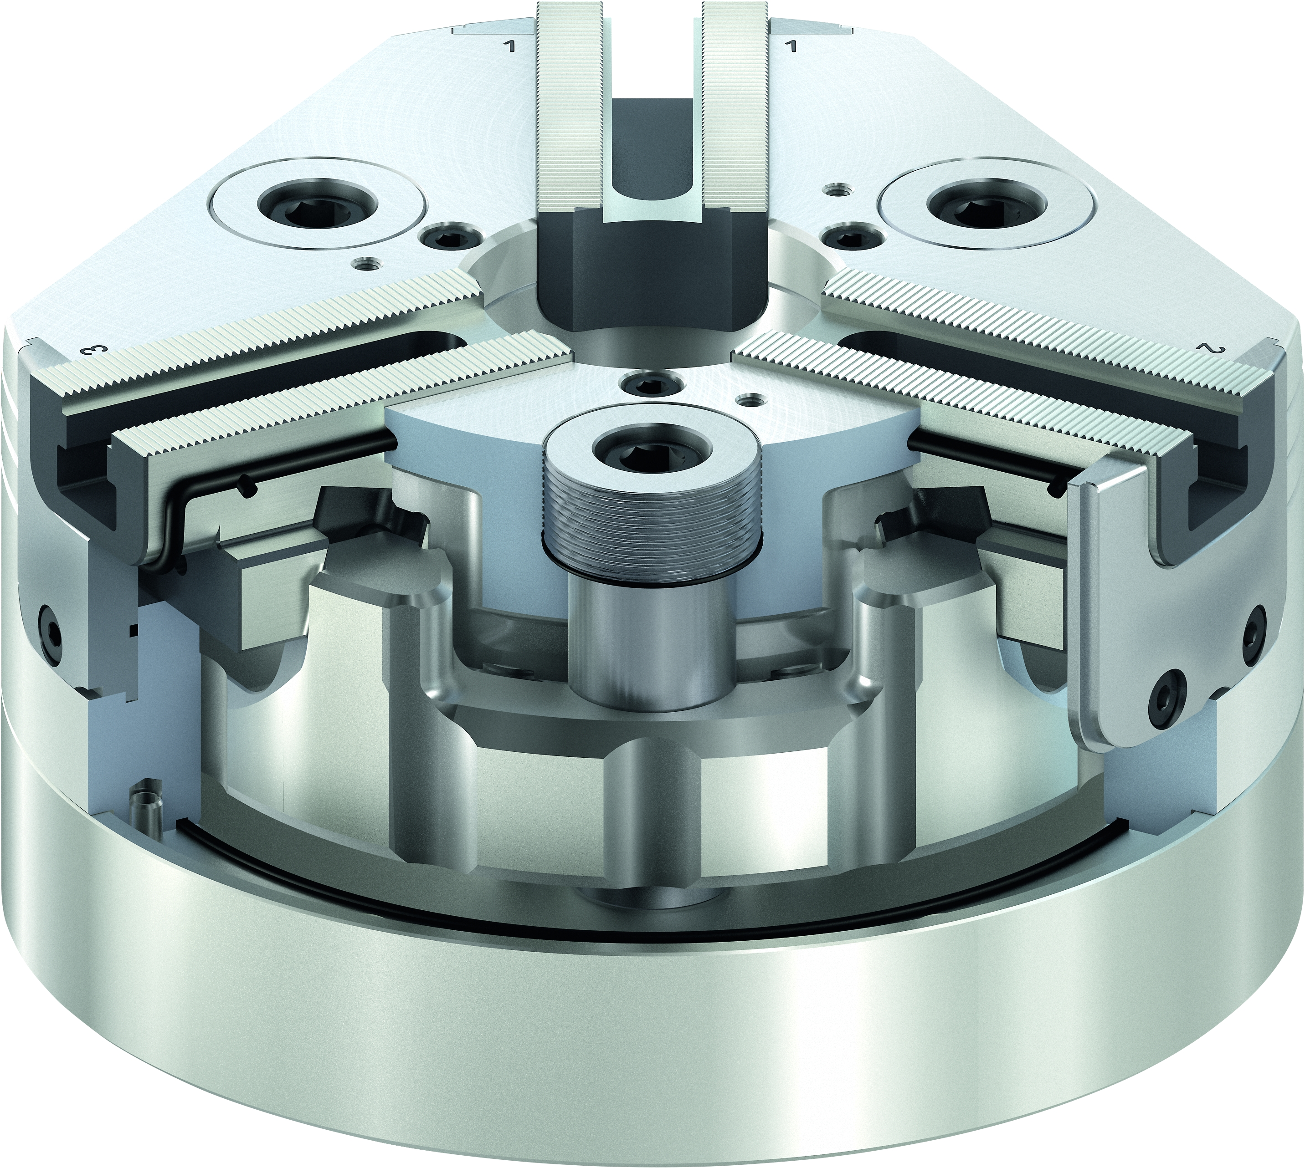
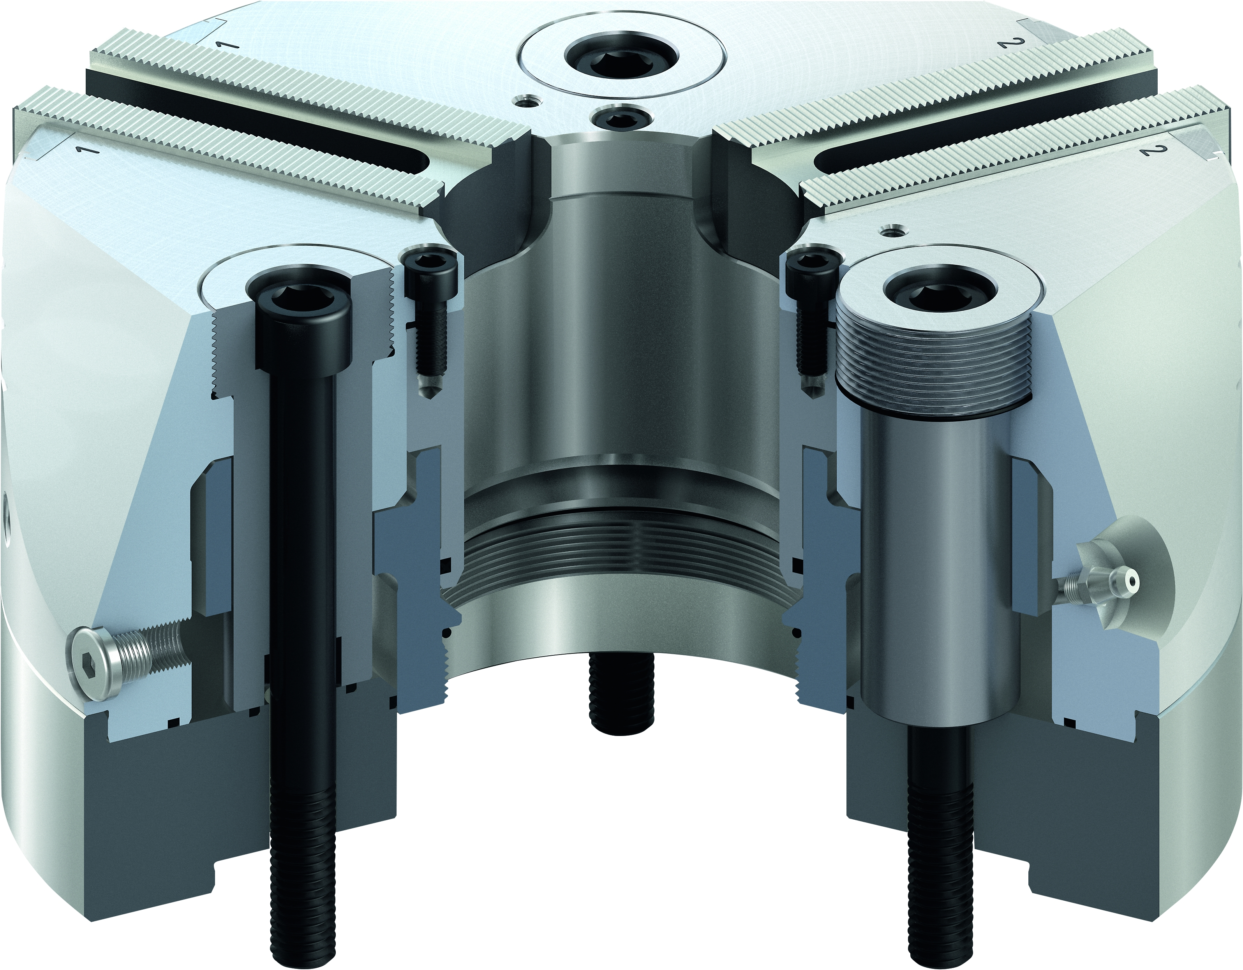
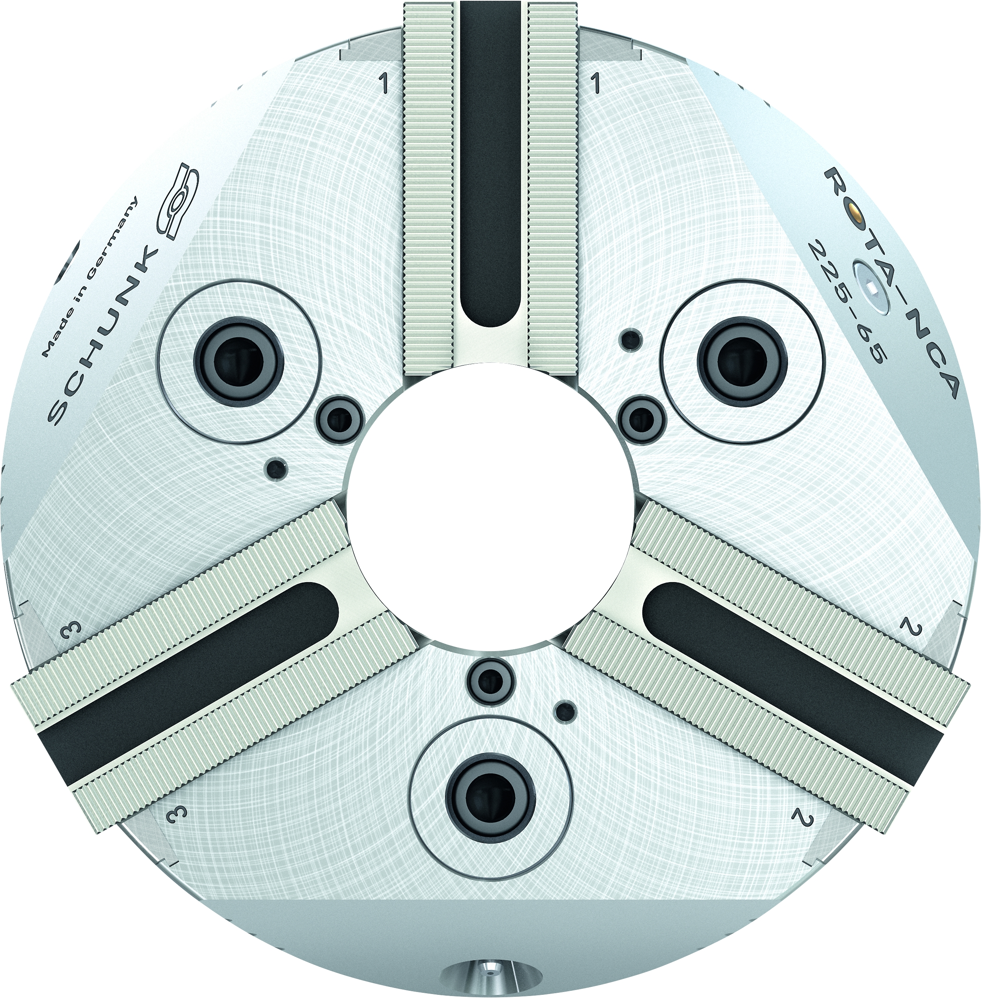
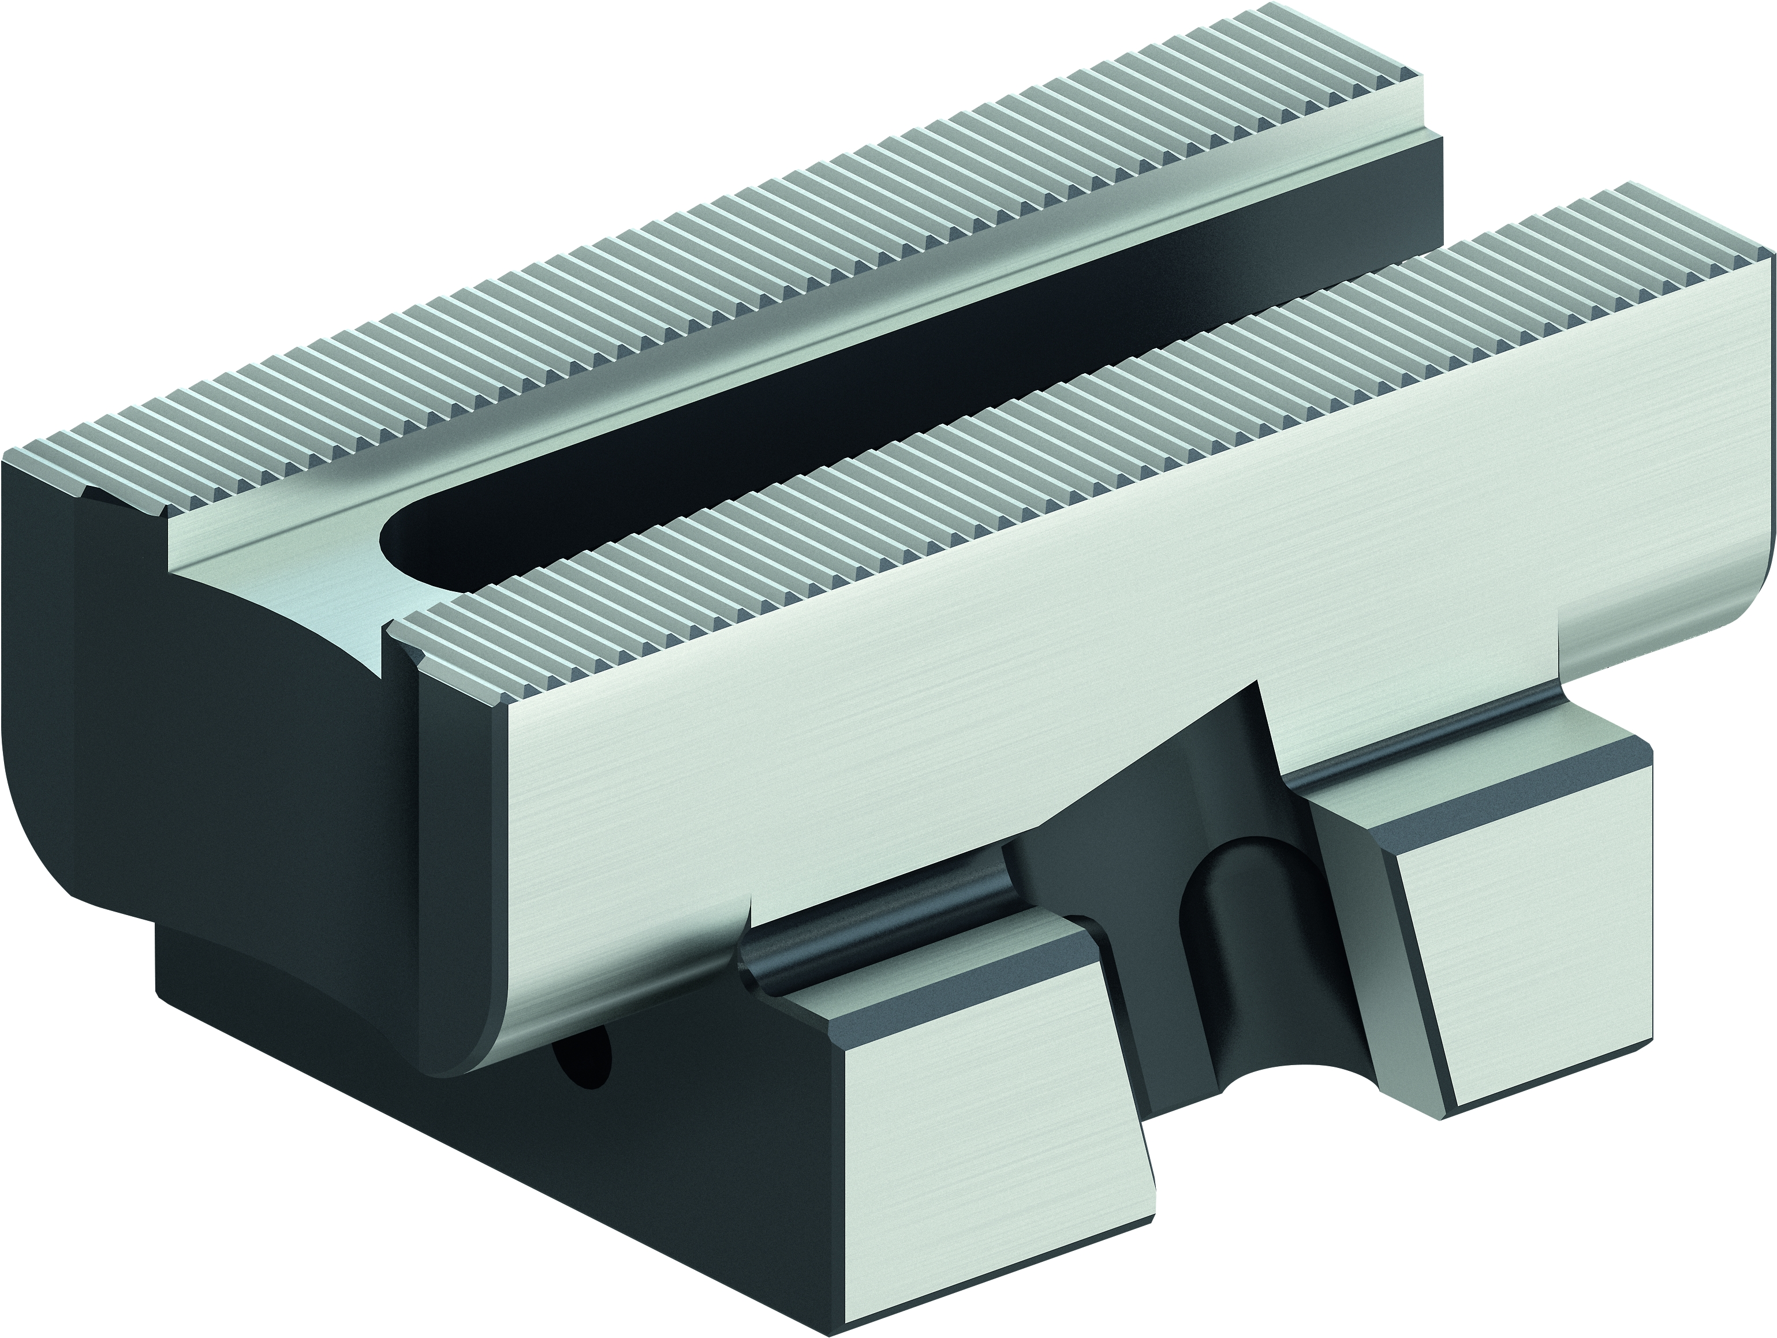
ROTA NCA
Low-maintenance power chuck with permanent grease lubrication
Inlays near the fastening holes
Up to 20 times longer maintenance intervals
Large through-hole
Base jaws with fine serration, high flexibility with 1/16“x90° and 1.5 mmx60°

Slide 9
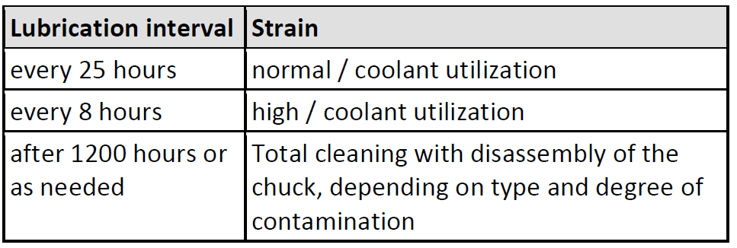
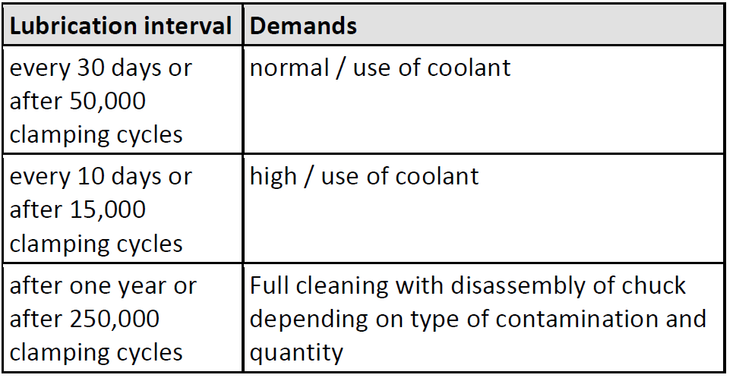
ROTA NCA
Lubrication intervals conventional power lathe chucks
Lubrication intervals ROTA NCA

Slide 10
ROTA NCA
Comparison lubrication intervals:
Conventional power lathe chucks --> ROTA NCA
Notes:
5 min Rüstzeit pro Rüstvorgang mit VERO-S
25 min Rüstzeit pro Rüstvorgang ohne VERO-S
60€/h Maschinenkosten

Slide 11
Variants ROTA NCA
Technical data | Max. RPM [min⁻¹] | Max. clamping force [kN] | Max. actuating force [kN] | Stroke/jaw [mm] | Through-hole [mm] | Piston stroke [mm]
ROTA NCA 160-32 | 5500 | 45 | 20 | 4 | 32 | 15
ROTA NCA 200-52 | 5000 | 72 | 32 | 5,3 | 52 | 20
ROTA NCA 225-66 | 5000 | 100 | 45 | 5,3 | 66 | 20
ROTA NCA 280-86 | 4000 | 140 | 63 | 5,3 | 86 | 20
ROTA NCA 330-104 | 3500 | 160 | 72 | 5,3 | 104 | 20

Slide 12



SCHUNK Services
Engineering
Dimensioning of special plates designed to the manufacturing specifications
Development of special solutions together with the customer
FEM analysis for critical components
Testing
Endurance tests with all new developments
Abrasion checking
Measurement of accuracy
Service
Initial operation of customer´s solution
Inspection and maintenance
Repairs

