Slide 1


ROTA THW vario
Power Lathe Chucks with Jaw Quick-change

Slide 2














Product overview
Gripping Systems
Clamping Technology
Chuck Jaws
Stationary Workholding
Lathe Chucks
Toolholders
Hydraulic Expansion Technology
Manual Lathe Chucks
Power Lathe Chucks with Jaw Quick-change System
Power Lathe Chucks with Through-hole
Power Lathe Chucks without Through-hole
Pneumatic Power Chucks
Steady Rests
Quick-change Systems
Customized Solutions

Slide 3
Challenges
Variants
Global
competition
Time
Time
Demand
Time
Flexibility and und set-up time optimization
heute
zukünftig

Slide 4



Reduction of set-up costs due to
Jaw Quick-change
 | Case 1 | Case 2
Number of Jaw Changes per day | 2 | 5
Time per jaw change without SCHUNK Jaw Quick-change system [min] | 20 | 5
Time per jaw change with SCHUNK Jaw Quick-change system [min] | 5 | 2
Machine costs per hour [€] | 80
Number of workshifts per day | 2
Working days per year | 260
Reduction of set-up costs
Time saving per jaw change [min] | 15 | 3
Annual saving potential [€] | 10.400 | 5.187
ROI
Rechner

Slide 5

ROTA overview
Power Lathe Chucks with Jaw Quick-change System
ROTA THW plus
ROTA THW vario
ROTA NCX

Slide 6
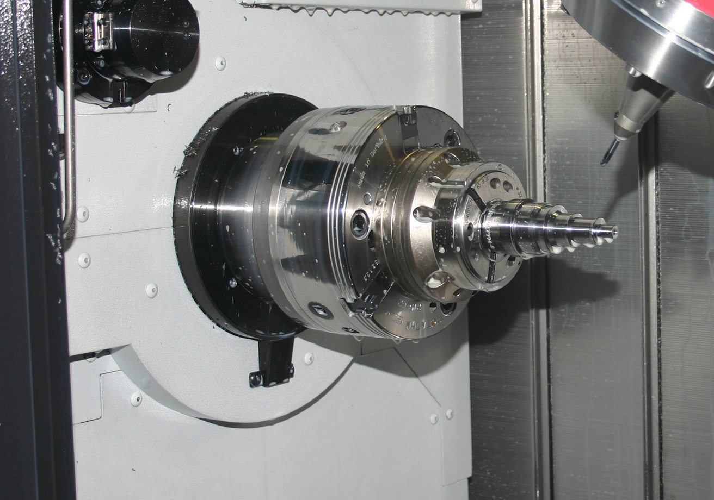
ROTA THW vario
Example of application
Clamping device:
ROTA THW vario with collet chuck vario F.
Features/Application:
Precise O.T. clamping of workpieces via collet chuck without changing the chuck.
Highest flexibility at minimum set-up effort.

Slide 7
ROTA THW vario
Simple re-equipping on a collet or arbor without changing chucks
Convenient jaw quick-change system
High efficiency of the wedge bar system
High jaw quick-change repeatability
Optimized lubrication system
GBK straight-serrated base jaws
All functional parts are ground and hardened

Slide 8
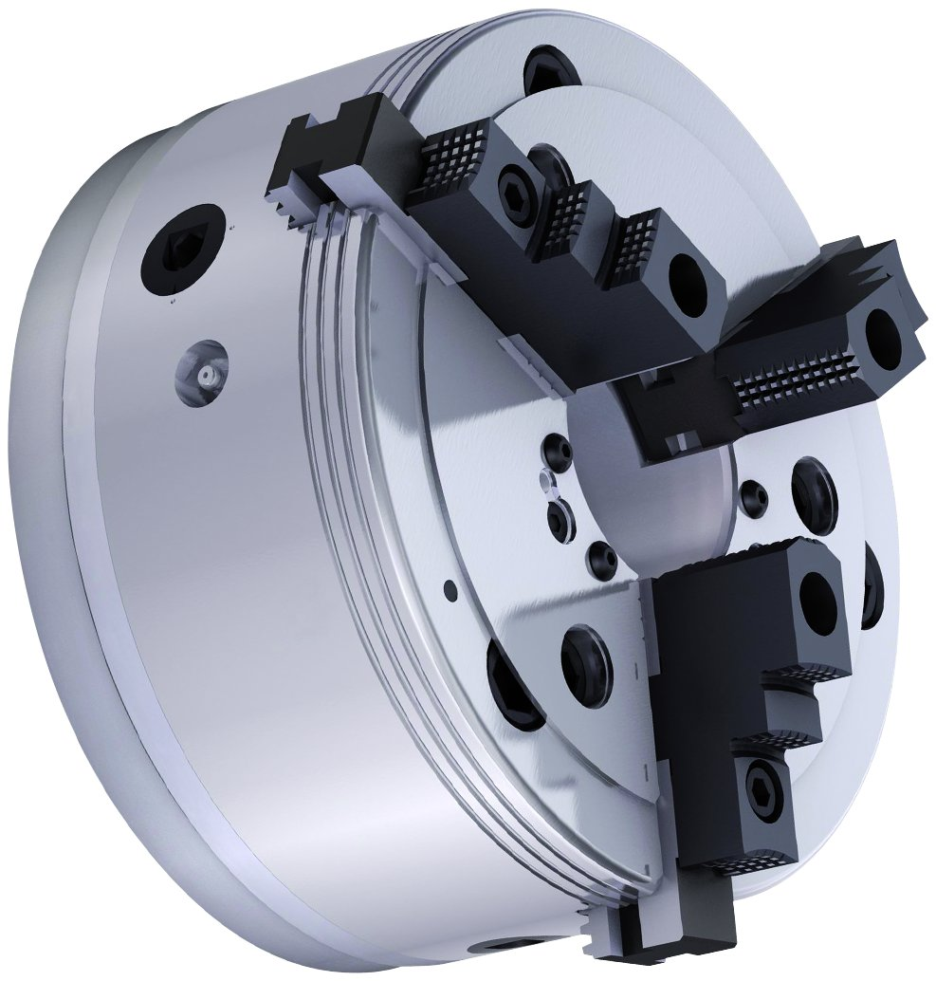
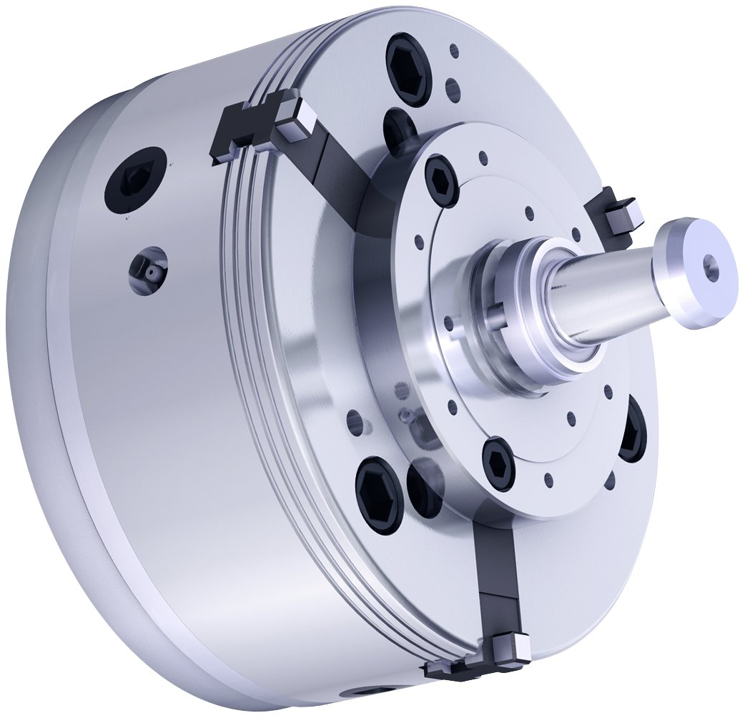
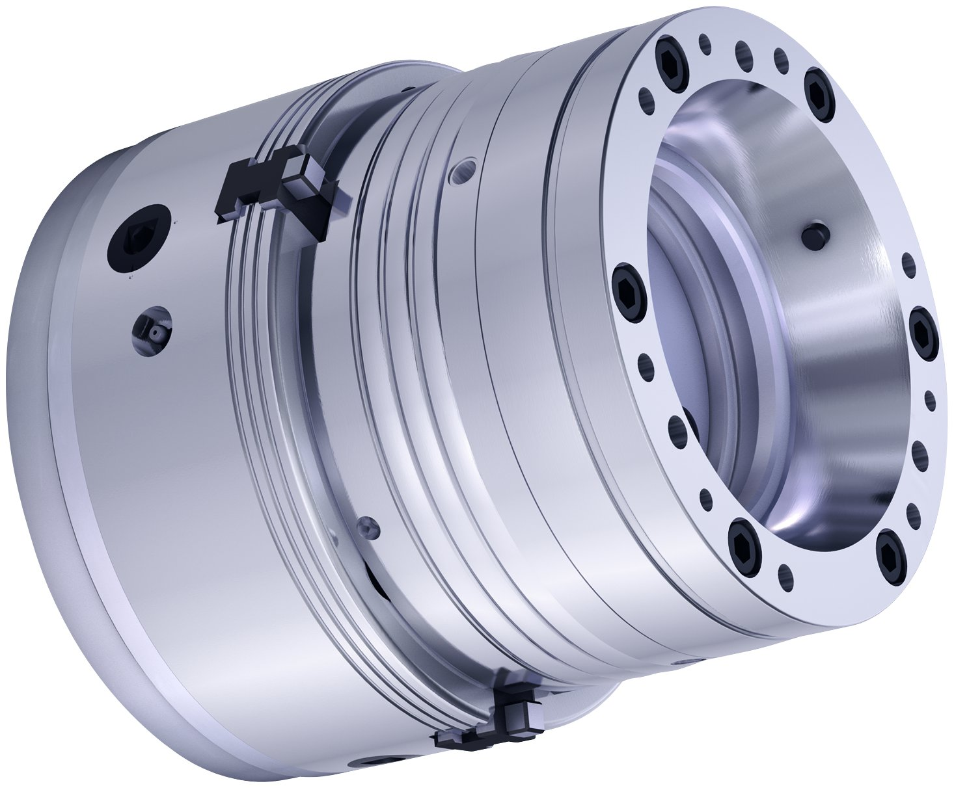
ROTA THW vario
In combination with chuck jaws
In combination with expansion arbor vario D
In combination with collet chuck vario F

Slide 9
Variants ROTA THW vario
Technical data | Max. RPM [min⁻¹] | Max. clamping force [kN] | Max. actuating force [Nm] | Stroke/jaw [mm] | Through-hole [mm] | Piston stroke [mm]
ROTA THW vario 215-62 | 5400 | 82 | 46 | 7.4 | 62 | 25
Technical data | Max. RPM [min⁻¹] | Max. clamping force [kN] | Max. actuating force [kN] | Clamping range [mm] | Covering range [mm] | Max. clamping length [mm]
vario D0 | 6000 | 42 | 10 | 20 – 28 | ± 0.25 | 22
vario D1 | 6000 | 42 | 10 | 26 – 38 | ± 0.25 | 26
vario D2 | 6000 | 85 | 20 | 36 – 54 | ± 0.25 | 43
vario D3 | 6000 | 105 | 25 | 50 – 80 | ± 0.35 | 49
vario F65 | 6000 | 105 | 45 | 4 – 65 | ± 0.5 | 58
vario F65-51 | 6000 | 105 | 45 | 4 – 65 | ± 0.5 | 58
vario F80 | 5500 | 115 | 50 | 5 – 80 | ± 0.5 | 53
vario F100 | 5000 | 150 | 65 | 16 – 100 | ± 0.5 | 53

Slide 10



SCHUNK Services
Engineering
Dimensioning of special plates designed to the manufacturing specifications
Development of special solutions together with the customer
FEM analysis for critical components
Testing
Endurance tests with all new developments
Abrasion checking
Measurement of accuracy
Service
Initial operation of customer´s solution
Inspection and maintenance
Repairs

