Slide 1


ROTA NCX
Power Lathe Chucks with Jaw Quick-change

Slide 2














Product overview
Gripping Systems
Clamping Technology
Chuck Jaws
Stationary Workholding
Lathe Chucks
Toolholders
Hydraulic Expansion Technology
Manual Lathe Chucks
Power Lathe Chucks with Jaw Quick-change System
Power Lathe Chucks with Through-hole
Power Lathe Chucks without Through-hole
Pneumatic Power Chucks
Steady Rests
Quick-change Systems
Customized Solutions

Slide 3
Challenges
Variants
Global
competition
Time
Time
Demand
Time
Flexibility and und set-up time optimization
heute
zukünftig

Slide 4



Reduction of set-up costs due to
Jaw Quick-change
 | Case 1 | Case 2
Number of Jaw Changes per day | 2 | 5
Time per jaw change without SCHUNK Jaw Quick-change system [min] | 20 | 5
Time per jaw change with SCHUNK Jaw Quick-change system [min] | 5 | 2
Machine costs per hour [€] | 80
Number of workshifts per day | 2
Working days per year | 260
Reduction of set-up costs
Time saving per jaw change [min] | 15 | 3
Annual saving potential [€] | 10.400 | 5.187
ROI
Rechner

Slide 5

ROTA overview
Power Lathe Chucks with Jaw Quick-change System
ROTA THW plus
ROTA THW vario
ROTA NCX

Slide 6
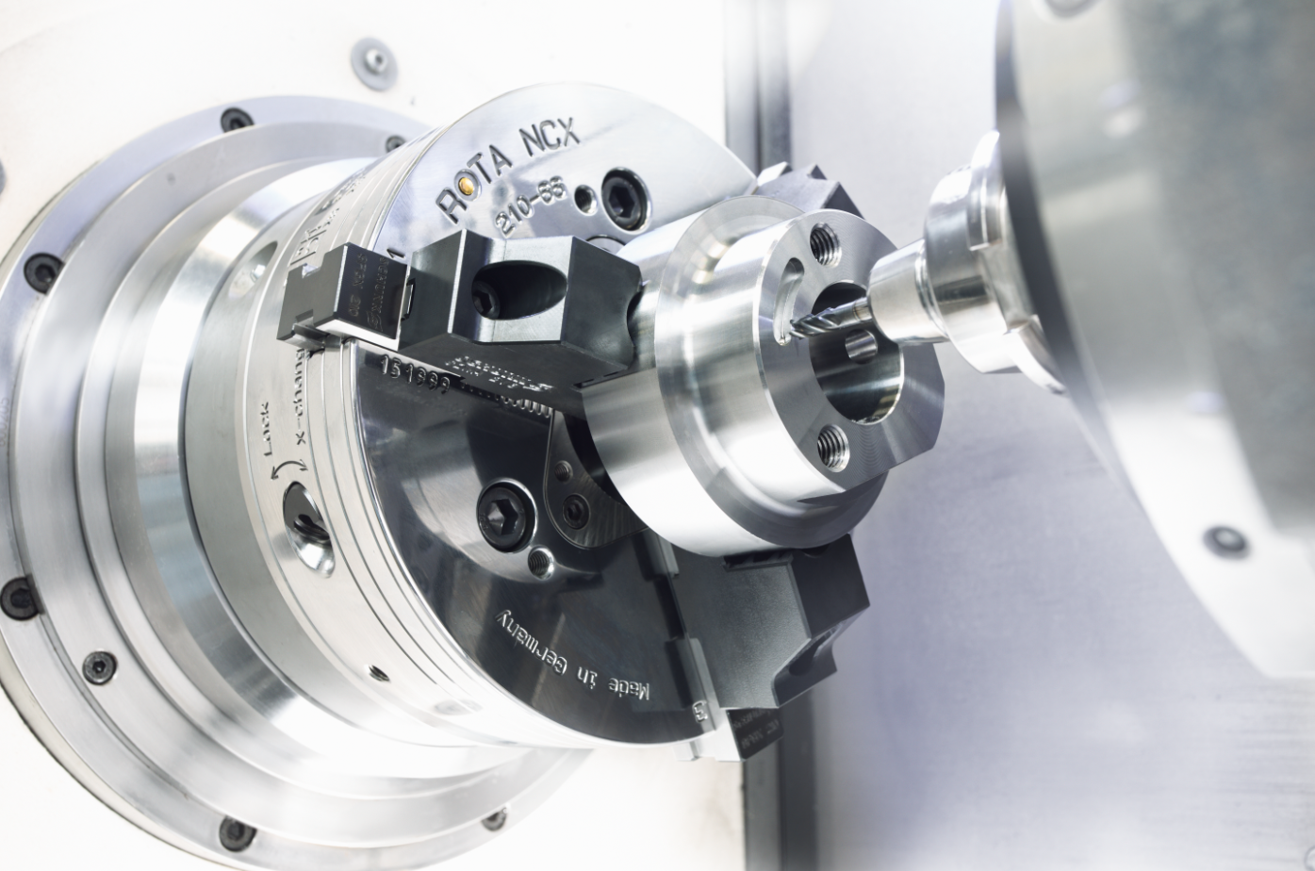
ROTA NCX
Example of application
Clamping device:
ROTA NCX 210 with claw jaws.
Features/Application:
Quick conversion for changing diameters in series or rather individual parts.

Slide 7
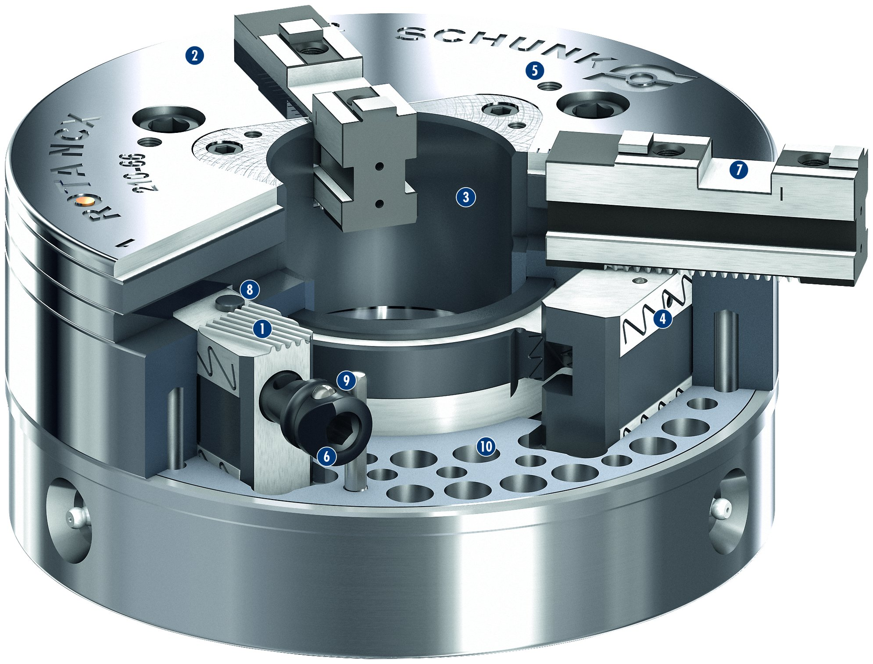
ROTA NCX
2
5
1
Wedge bar actuation system
Hardened and extremely rigid base body
Large through-hole
Optimized lubrication system
Mounting threads
Jaw quick-change system
Standard chuck jaw interface
Locking mechanism with jaw presence monitor
Reliable jaw lock
Weight-optimized design
2
7
3
3
4
8
5
1
4
6
9
7
6
10
8
9
10

Slide 8
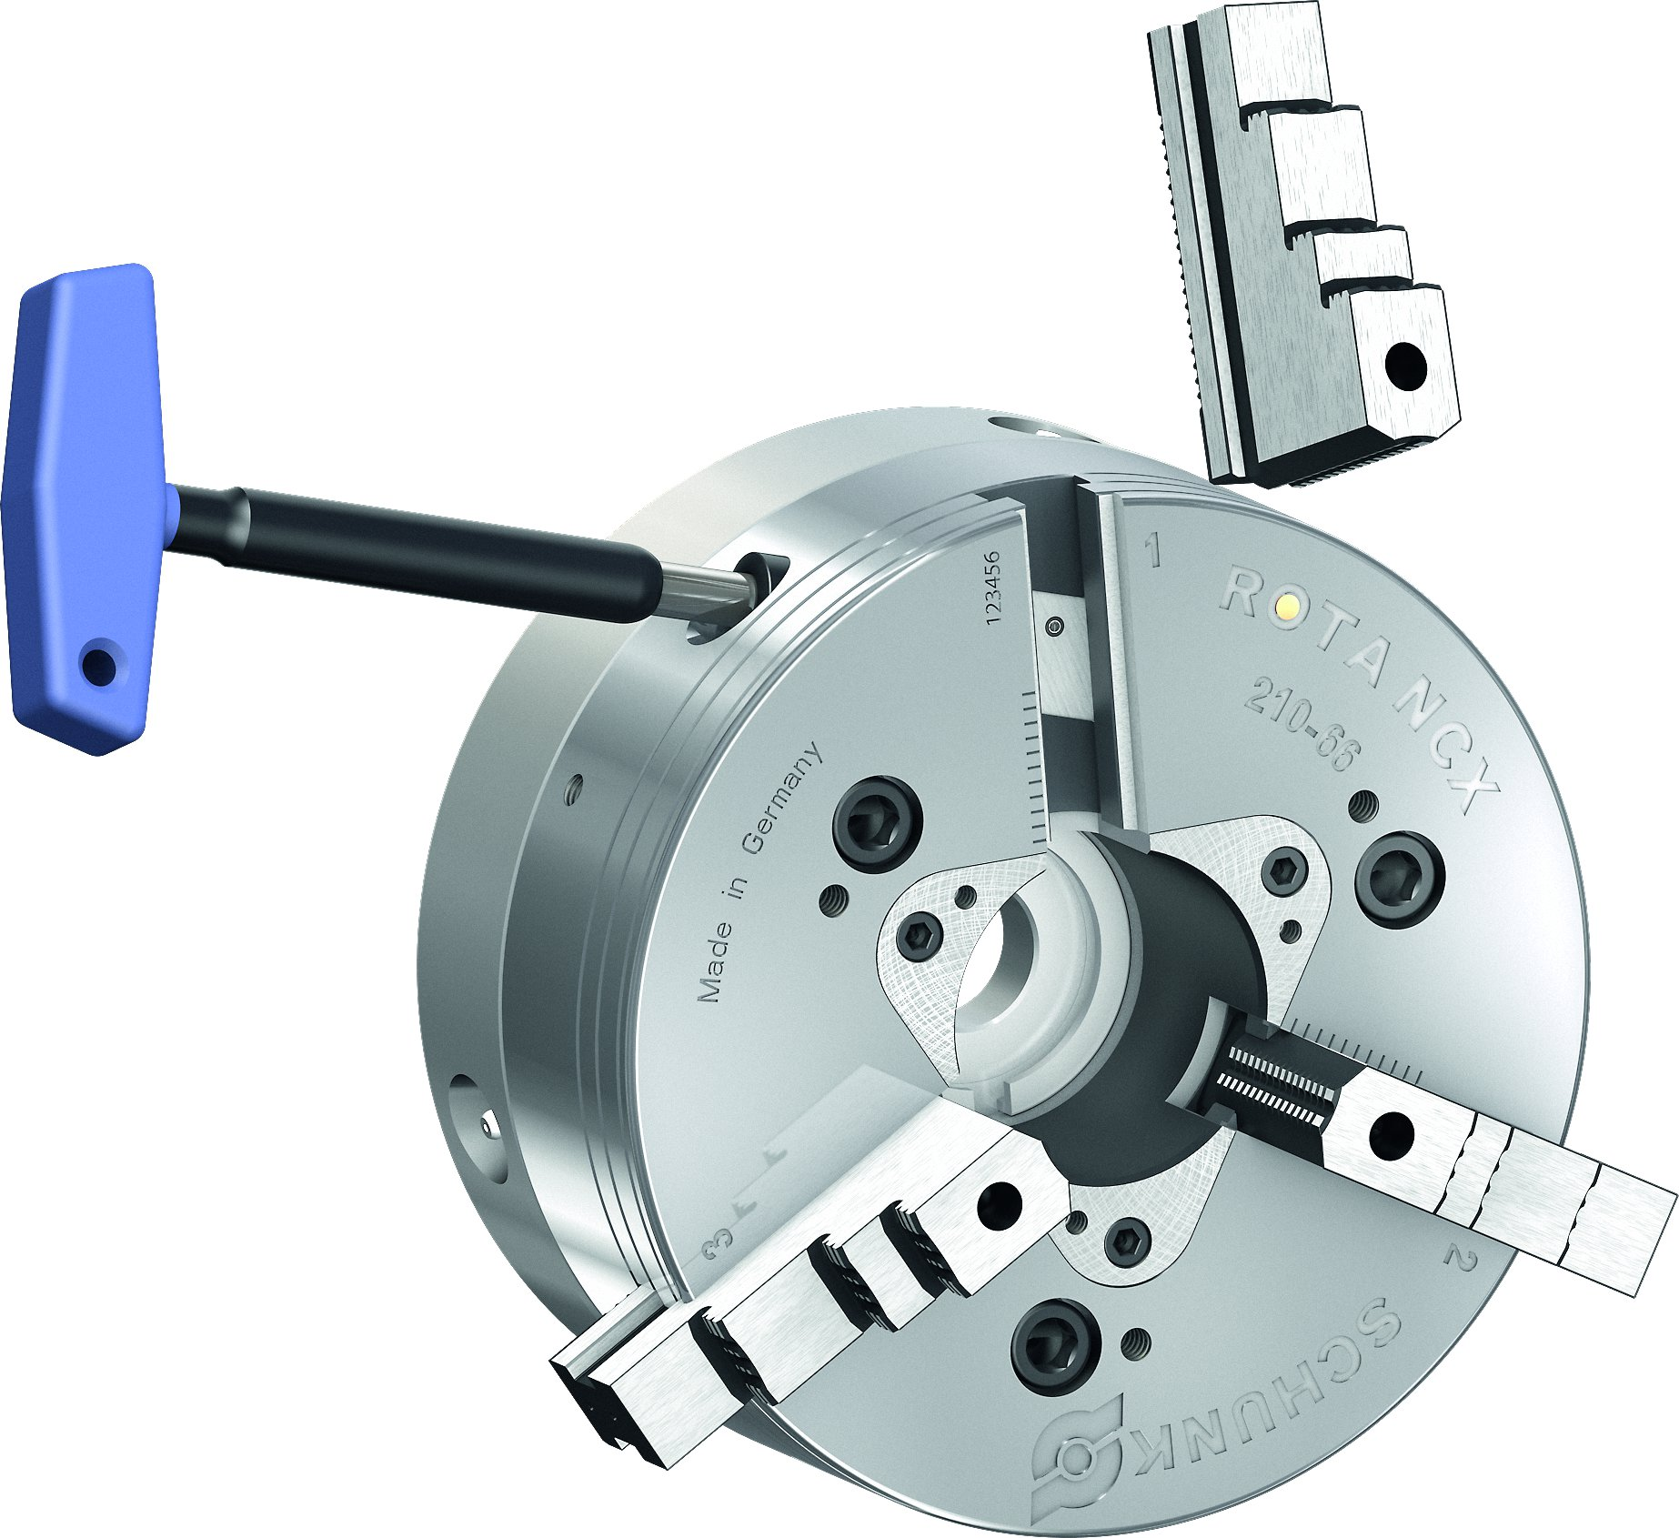
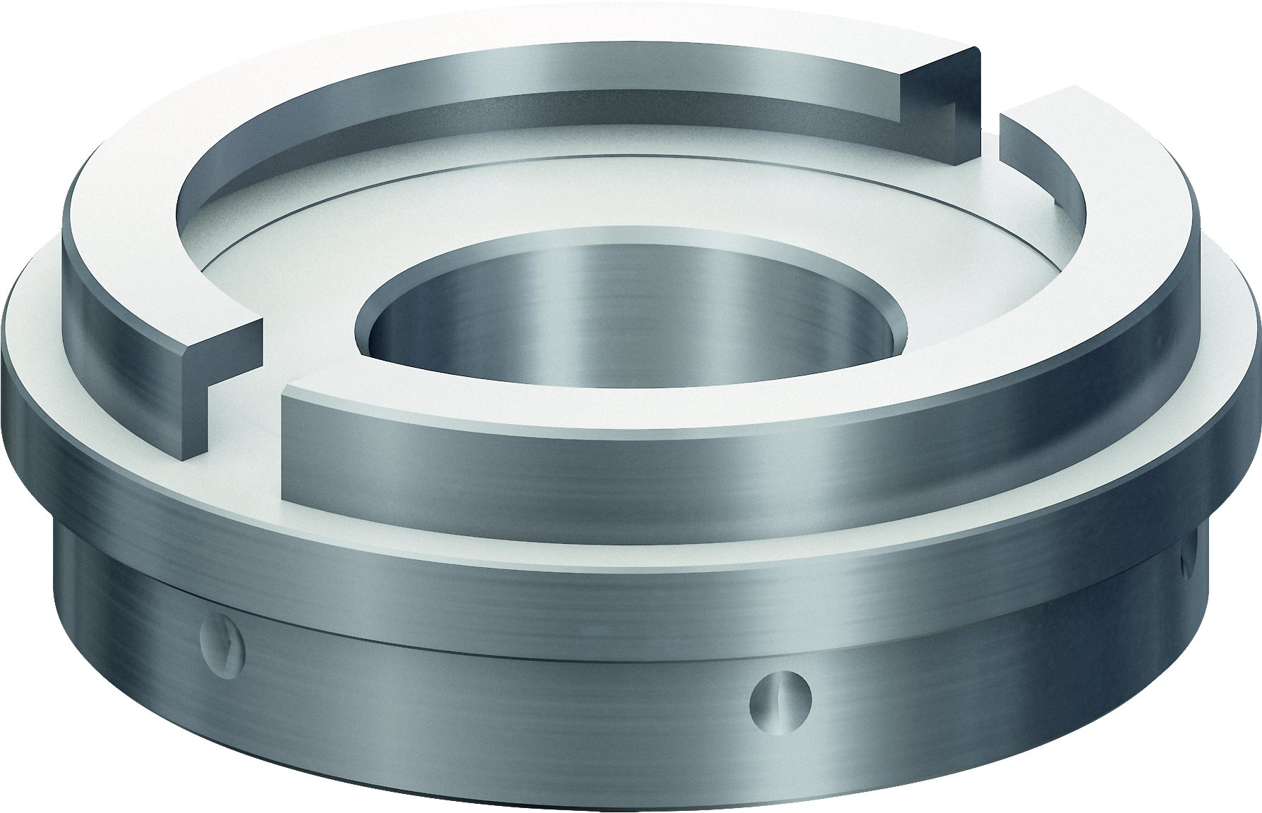
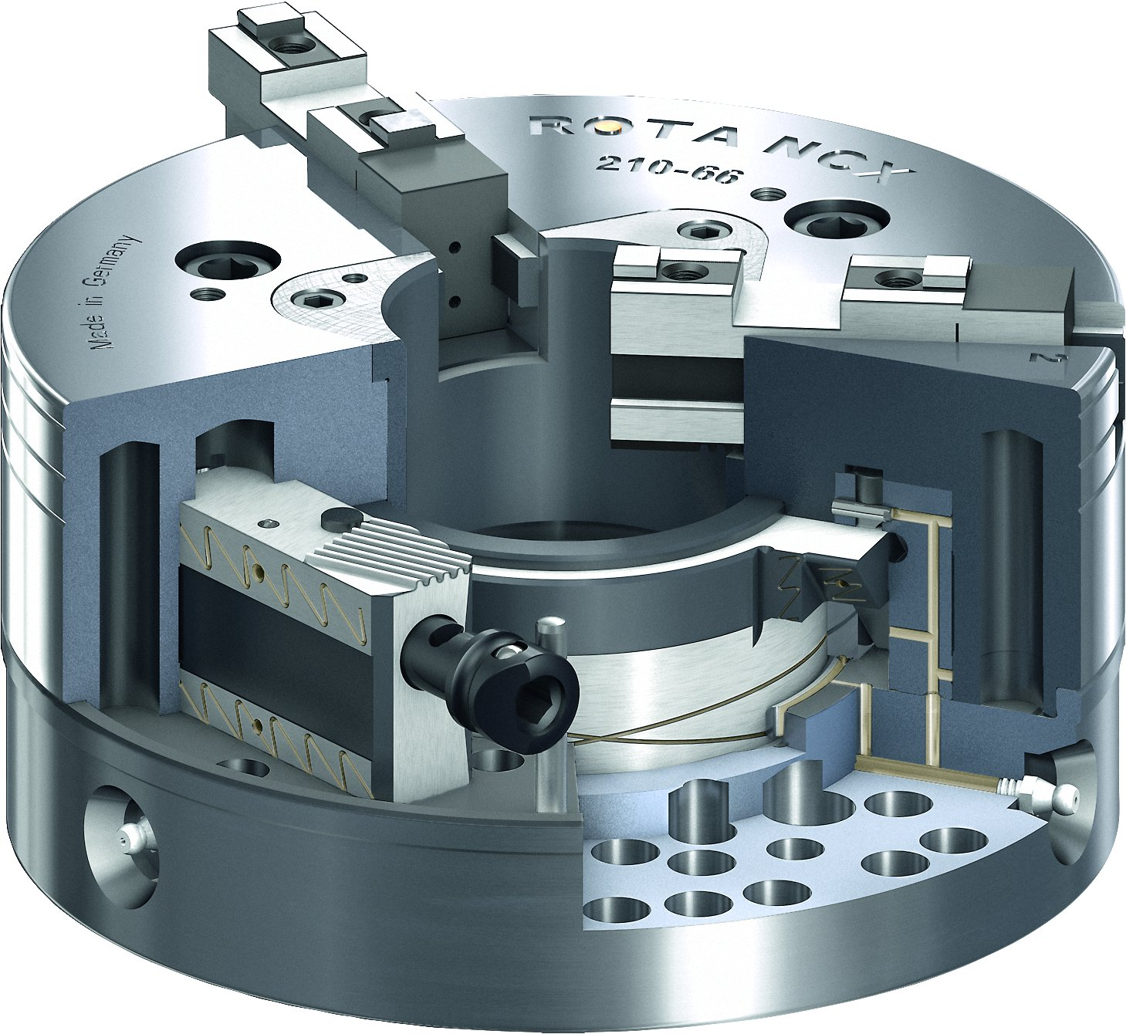
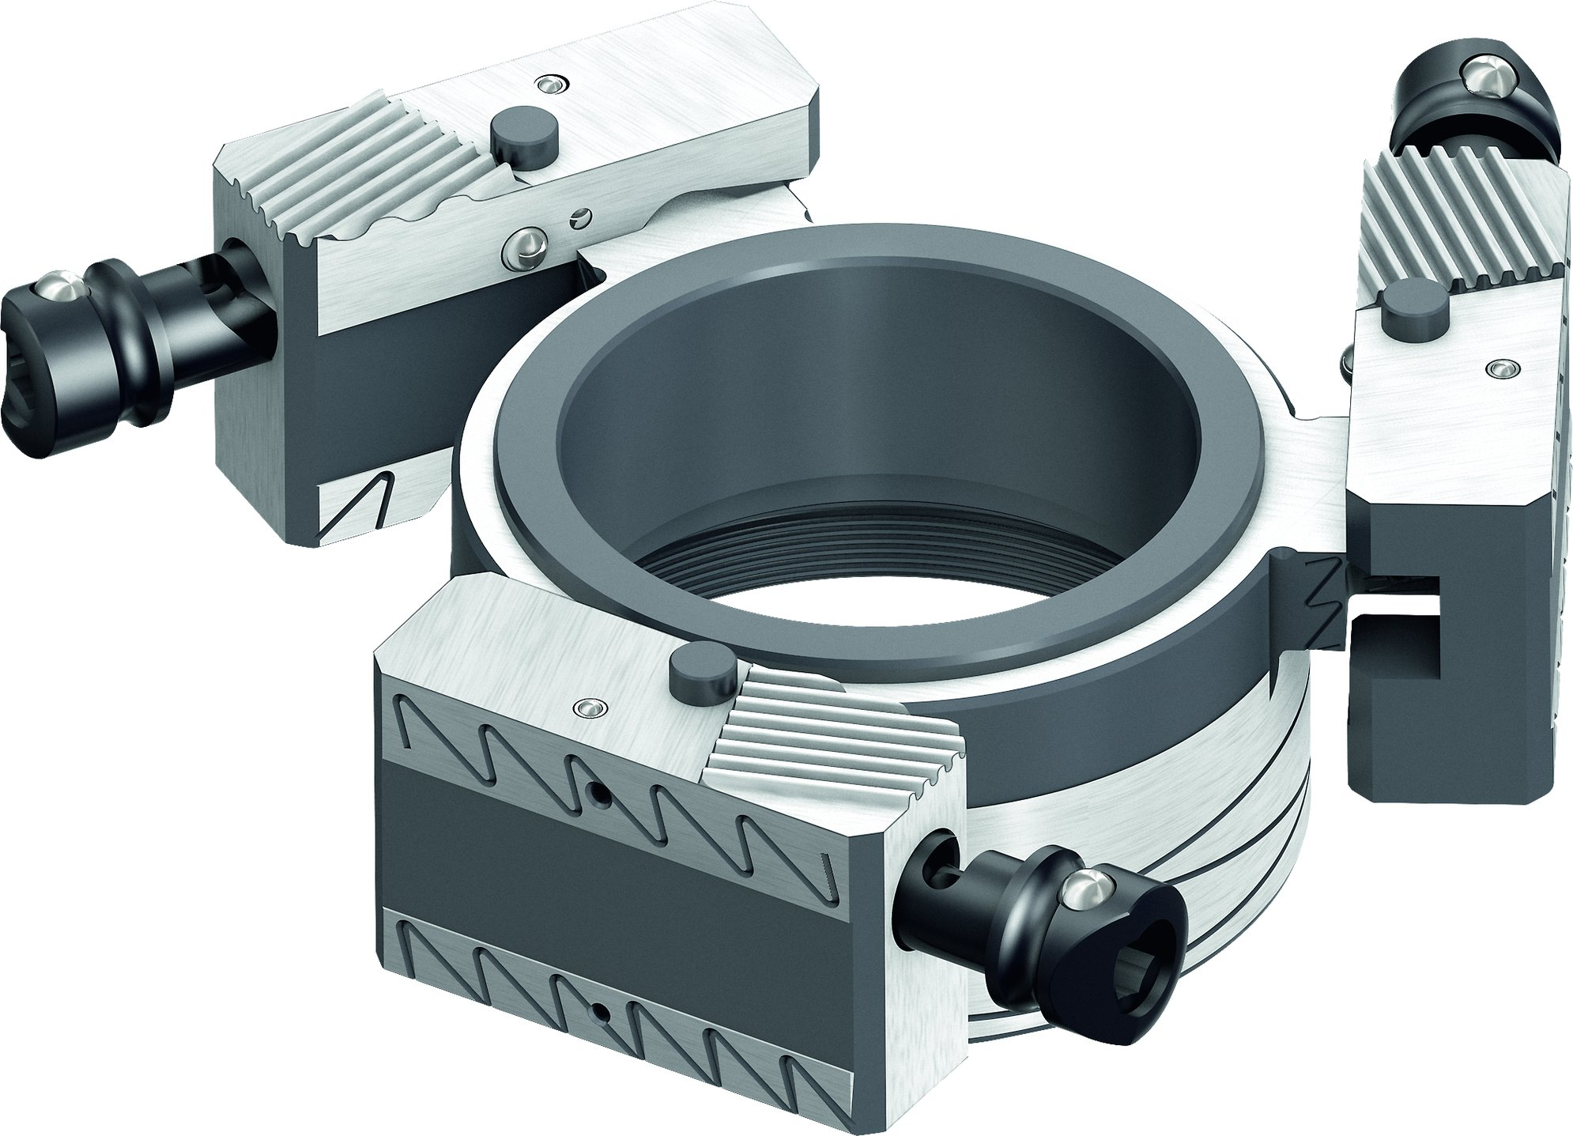
ROTA NCX
Absolute flexibility – blank draw nut
Compatibility Kitagawa BB
Quick jaw change
High repeat accuracy after changing jaws
Optimized lubrication system

Slide 9
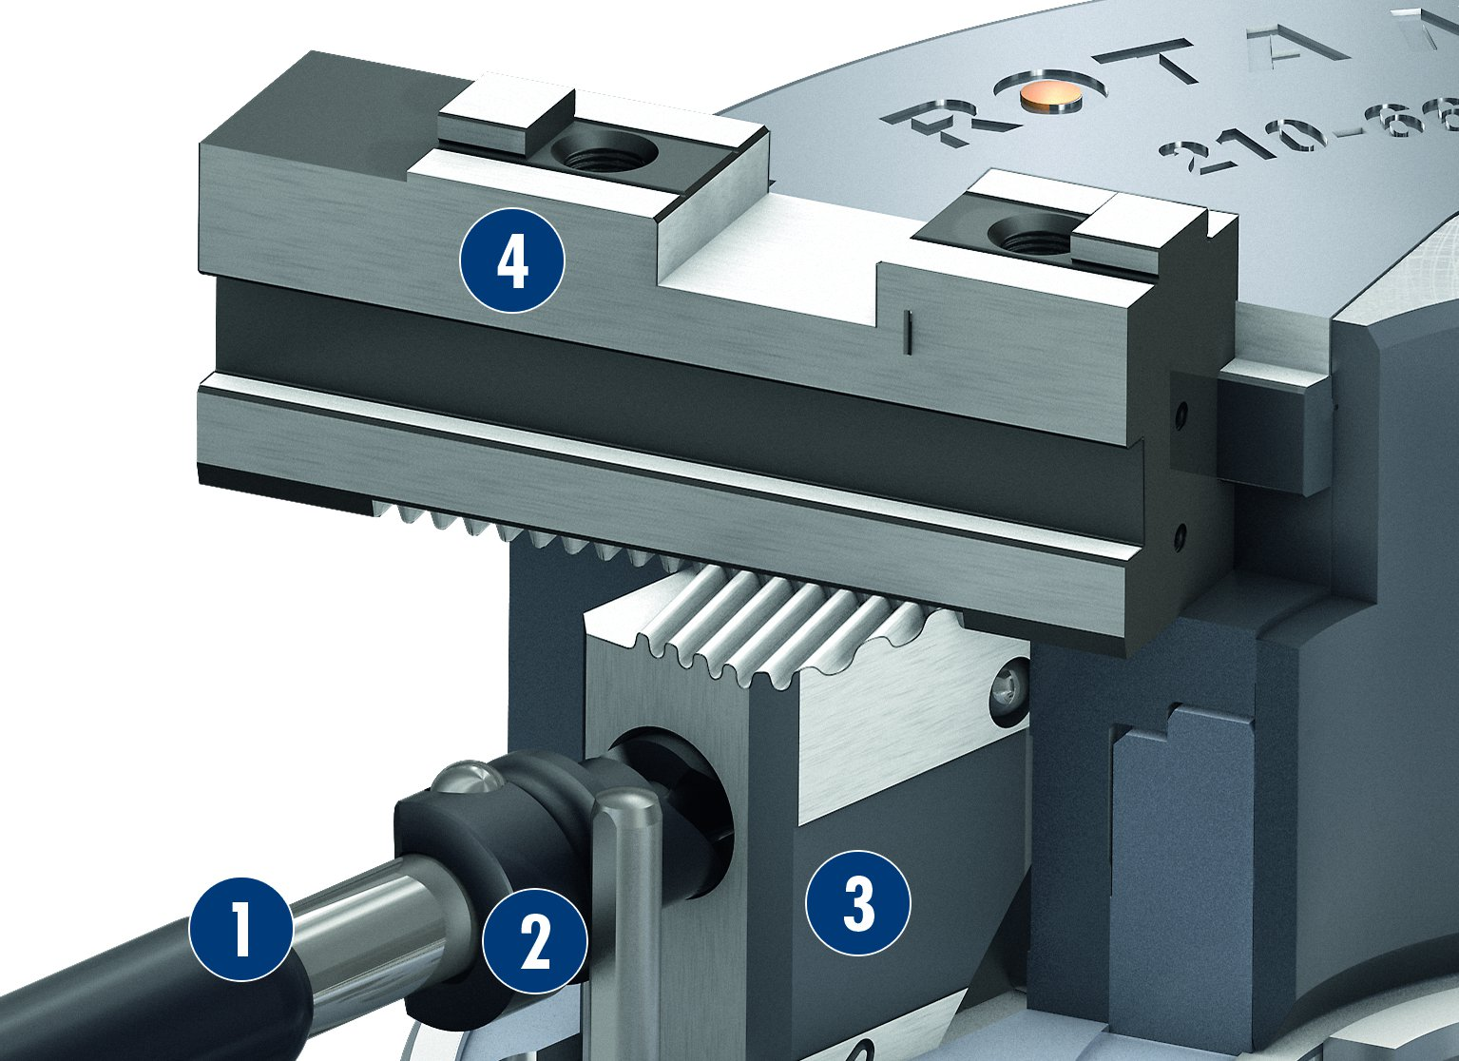
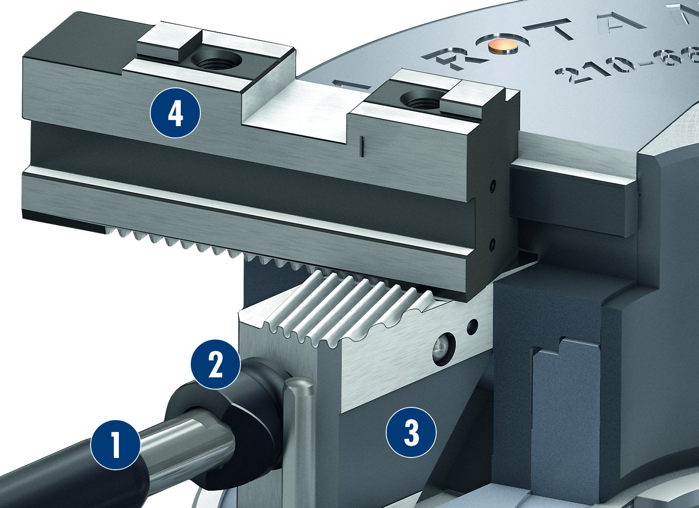
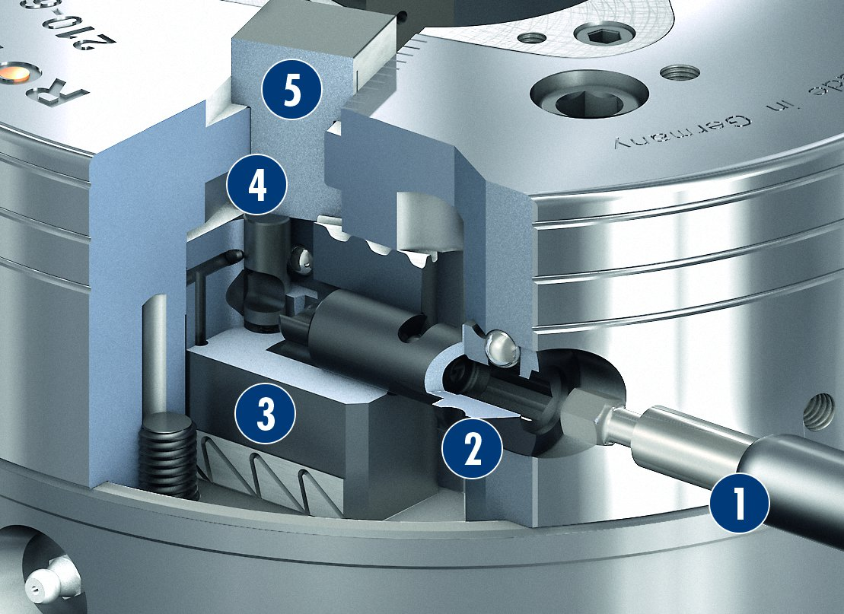
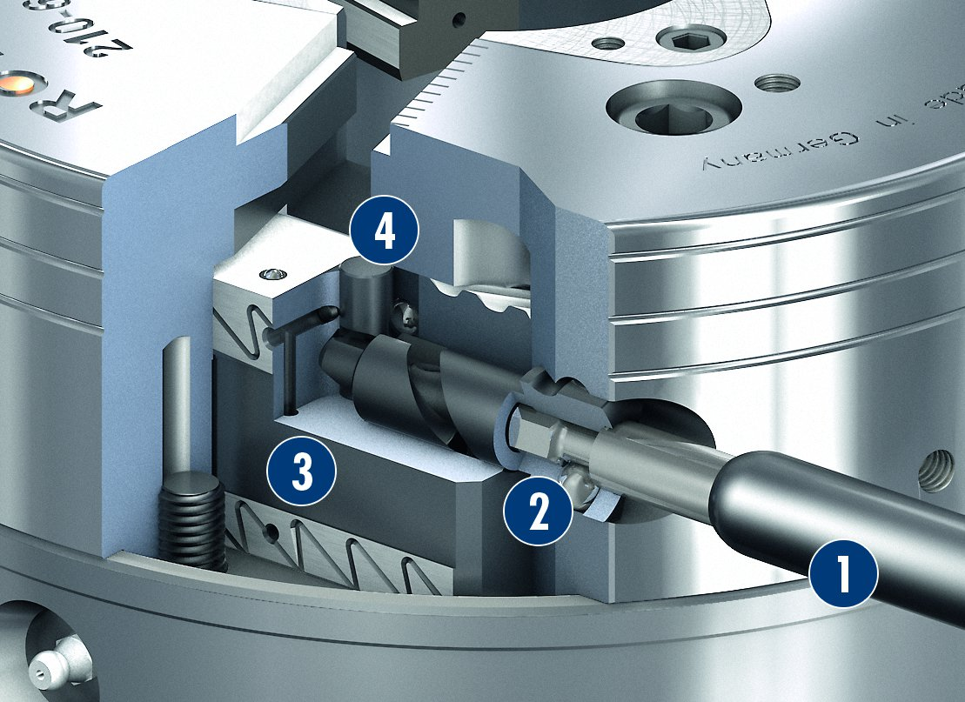
ROTA NCX
Correct jaw position
Incorrect jaw position
1
Jaw quick-change wrench
Release bolt
Wedge bar
Base jaw
1
Jaw quick-change wrench
Release bolt
Wedge bar
Base jaw
2
2
4
3
4
3
4
2
4
1
2
3
1
3
Wedge bar in working position
Wedge bar in change position
1
Jaw quick-change wrench
Release bolt
Wedge bar
Indicator pin
Base jaw
5
1
Jaw quick-change wrench
Release bolt
Wedge bar
Indicator pin
4
2
4
2
3
3
2
3
2
3
1
4
1
4
5

Slide 10
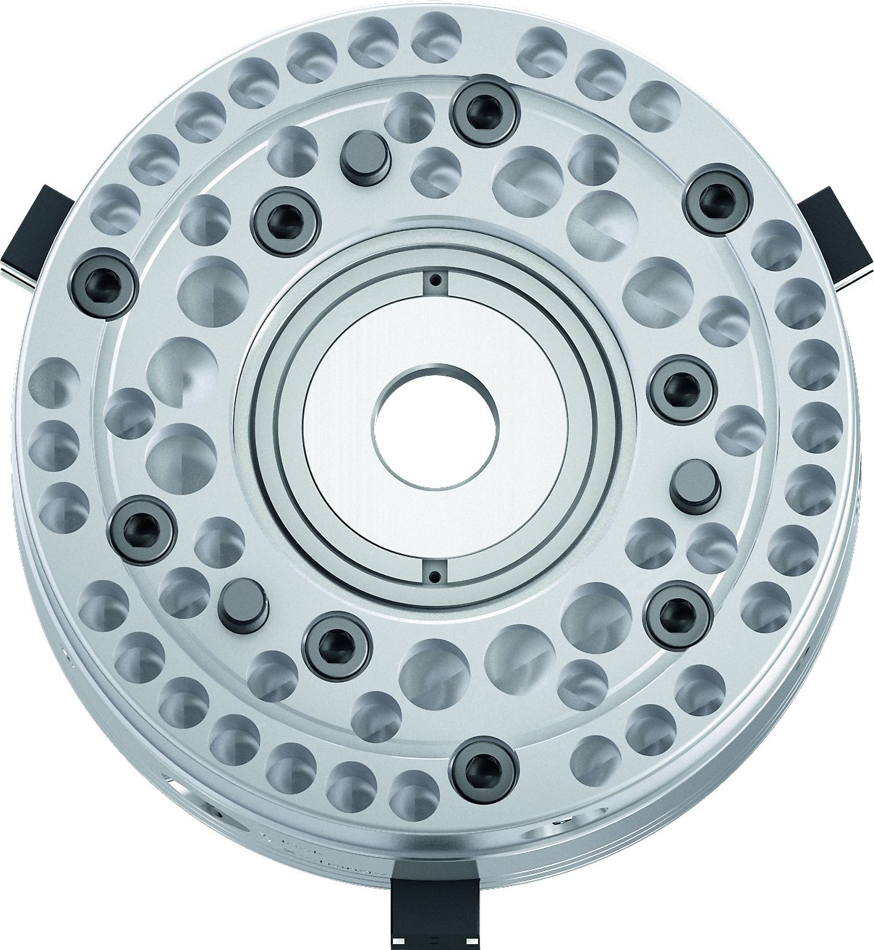
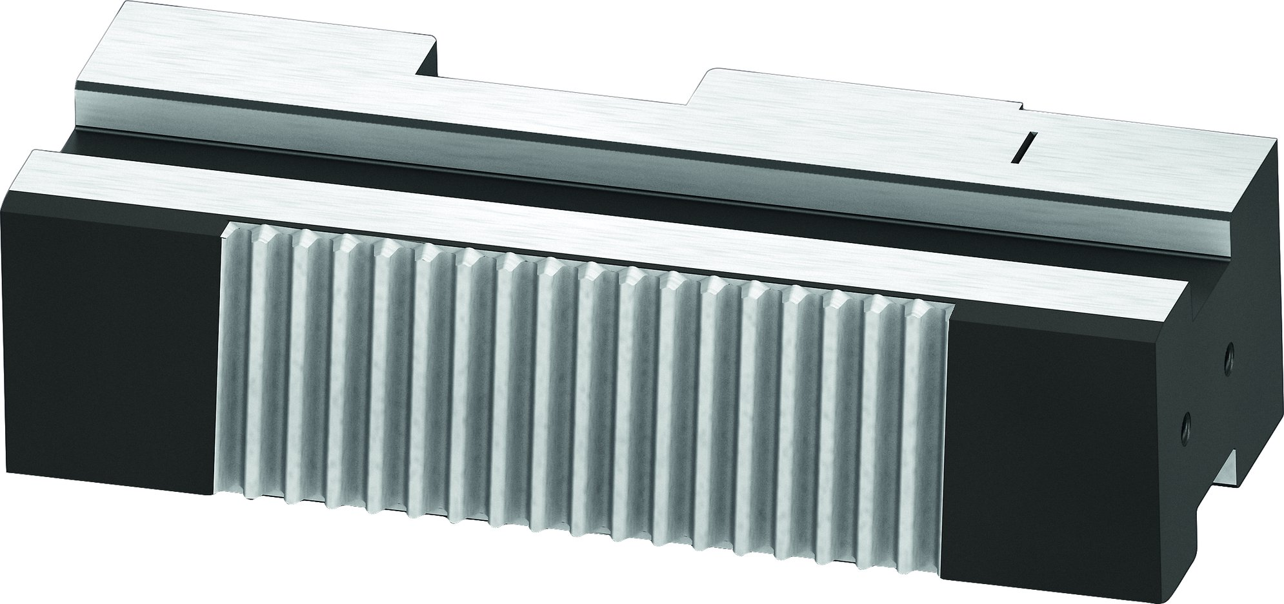
ROTA NCX
Weight optimized chuck
Angled serrated base jaws SFGX

Slide 11
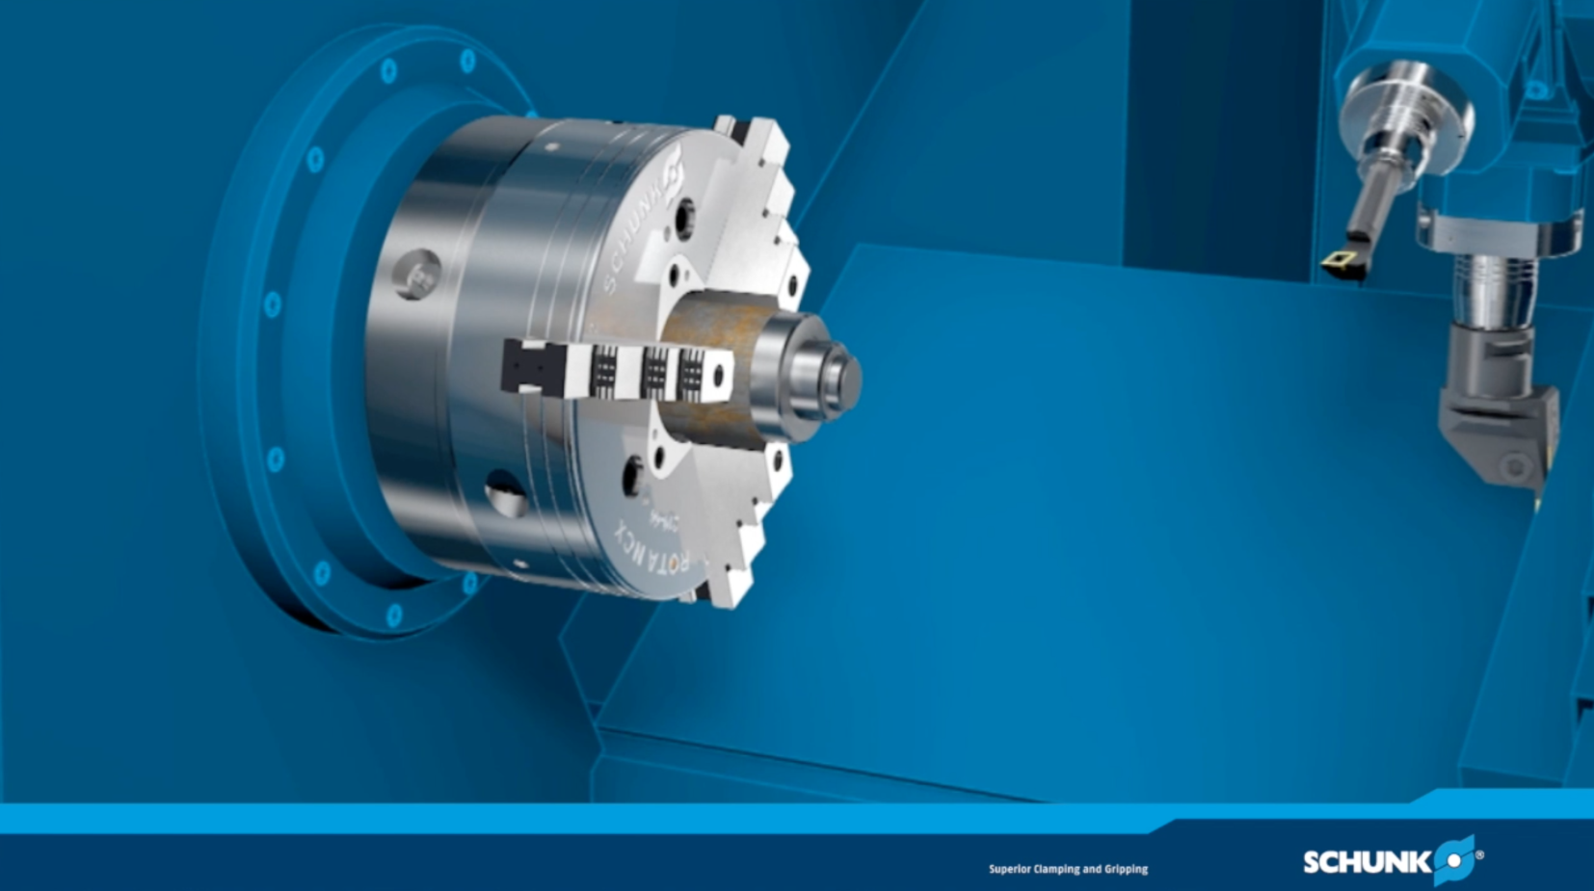
ROTA NCX

Slide 12
Variants ROTA NCX
Technical data | Max. RPM [min⁻¹] | Max. clamping force [kN] | Max. actuating force [kN] | Stroke/jaw [mm] | Through-hole [mm] | Piston stroke [mm]
ROTA NCX 165-53 | 6000 | 50 | 33 | 3 | 53 | 13
ROTA NCX 210-66 | 5000 | 80 | 45 | 4.2 | 66 | 18
ROTA NCX 260-81 | 4500 | 128 | 68 | 5 | 81 | 21
ROTA NCX 315-106 | 3500 | 155 | 88 | 6.3 | 106 | 25

Slide 13



SCHUNK Services
Engineering
Dimensioning of special plates designed to the manufacturing specifications
Development of special solutions together with the customer
FEM analysis for critical components
Testing
Endurance tests with all new developments
Abrasion checking
Measurement of accuracy
Service
Initial operation of customer´s solution
Inspection and maintenance
Repairs

