Slide 1


Jaw Boxes SPK
Manual Lathe Chucks

Slide 2














Product overview
Gripping Systems
Clamping Technology
Chuck Jaws
Stationary Workholding
Lathe Chucks
Toolholders
Hydraulic Expansion Technology
Manual Lathe Chucks
Power Lathe Chucks with Jaw Quick-change System
Power Lathe Chucks with Through-hole
Power Lathe Chucks without Through-hole
Pneumatic Power Chucks
Steady Rests
Quick-change Systems
Customized Solutions

Slide 3
Challenges
Variants
Required accuracy
Time
Time
Demand
Time
Flexibility and und set-up time optimization
heute
zukünftig

Slide 4

ROTA Manual Lathe Chucks
heute
zukünftig

Slide 5

ROTA overview
Manual Lathe Chuck
ROTA-S plus 2.0
ROTA-S flex
SPK
6

Slide 6
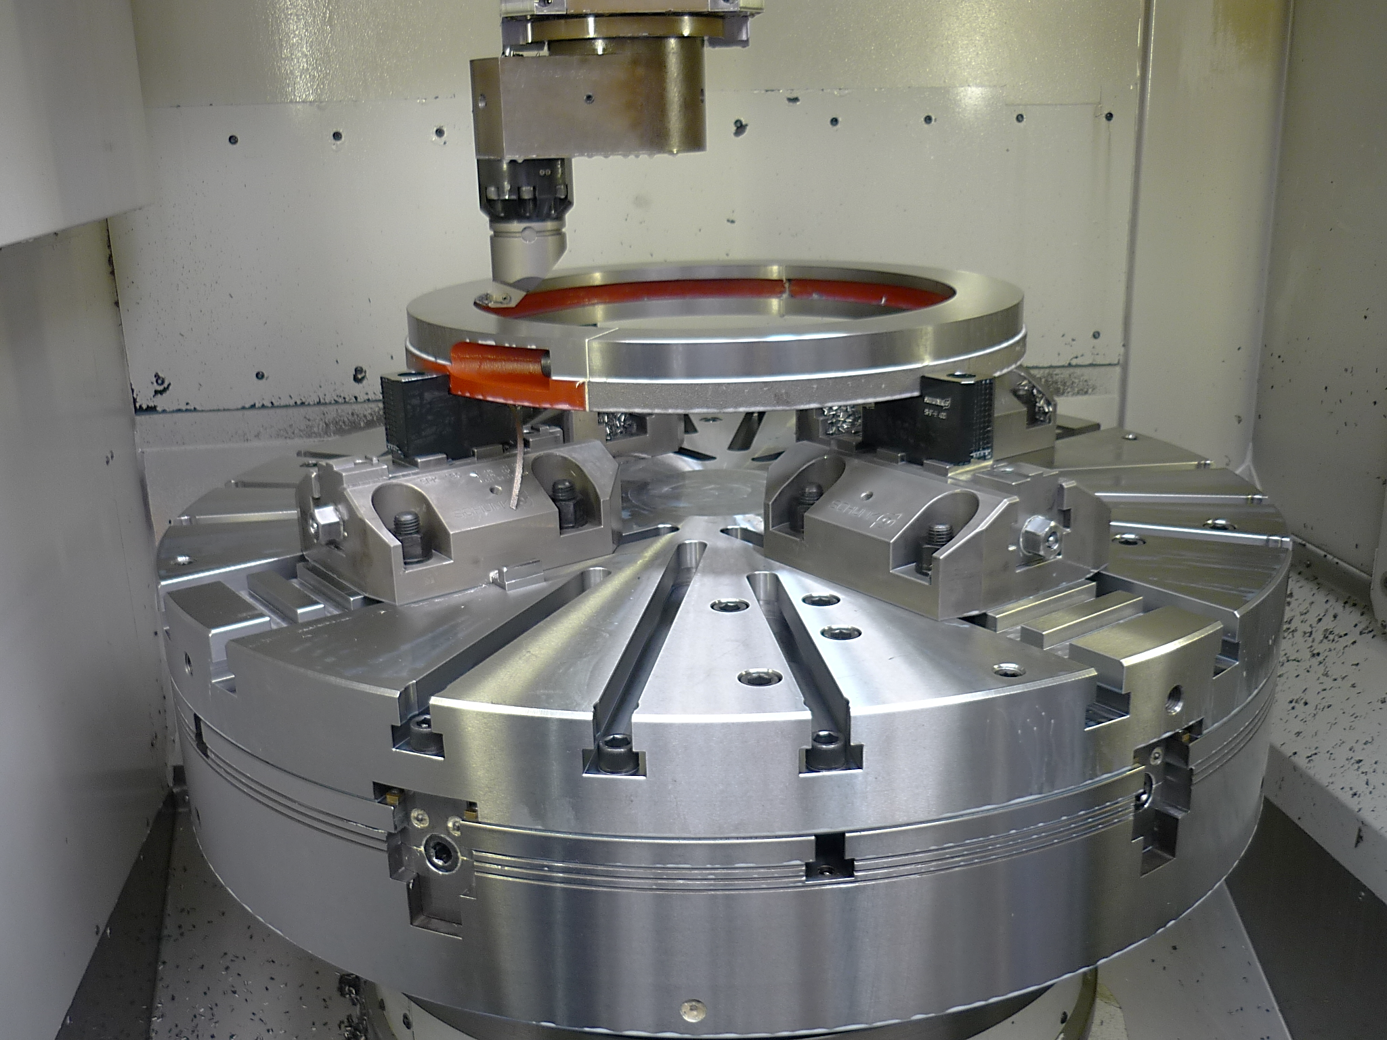
SPK
Example of application
Clamping device:
SPK 180 with hard stepped jaws on a ROTA NCR 1000 with intermediate plate.
Features/Application:
Clamping of cubic workpieces on a lathe. Highest flexibility without time-consuming removal of the lathe chuck from the turning spindle.

Slide 7
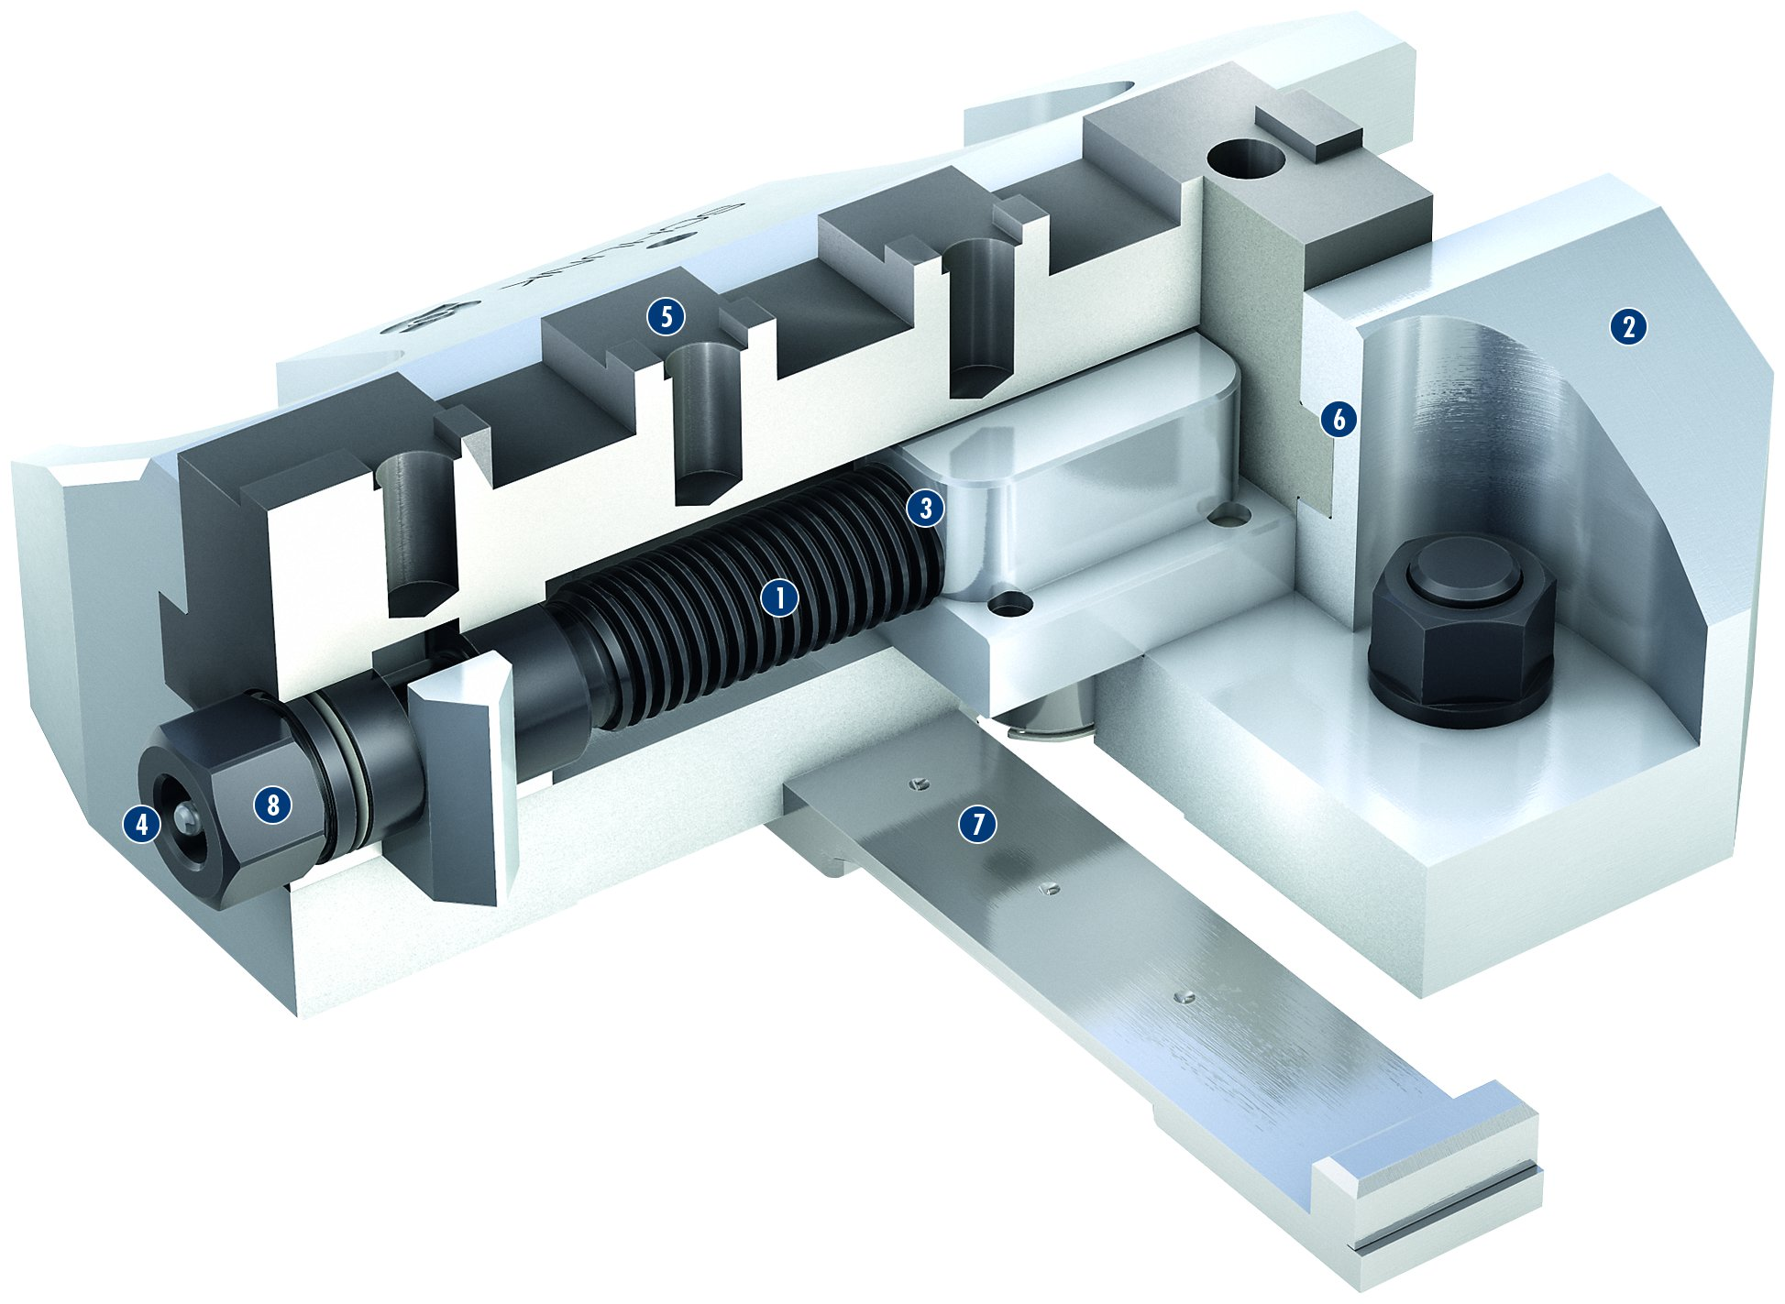
SPK
Spindle drive
Hardened and extremely rigid base body
Completely encapsulated spindle
Optimized lubrication system
Standard chuck jaw interface
Long jaw guidance
Crossbar
Operation via hexagon connection
5
2
1
6
2
3
1
3
4
5
4
8
7
6
7
8

Slide 8
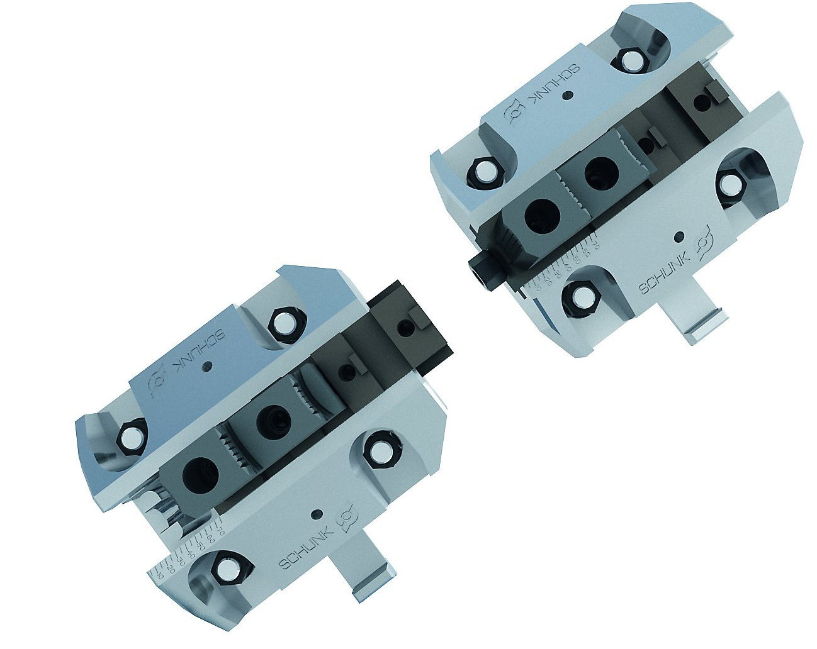
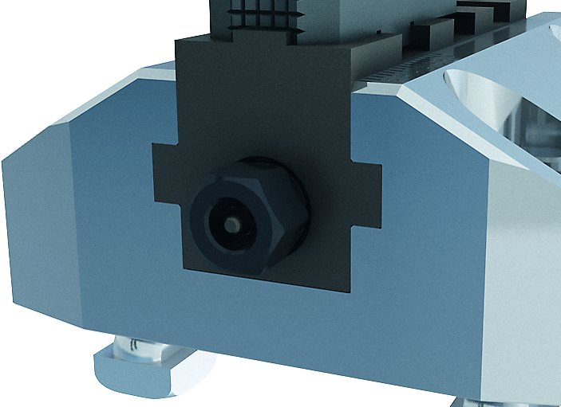
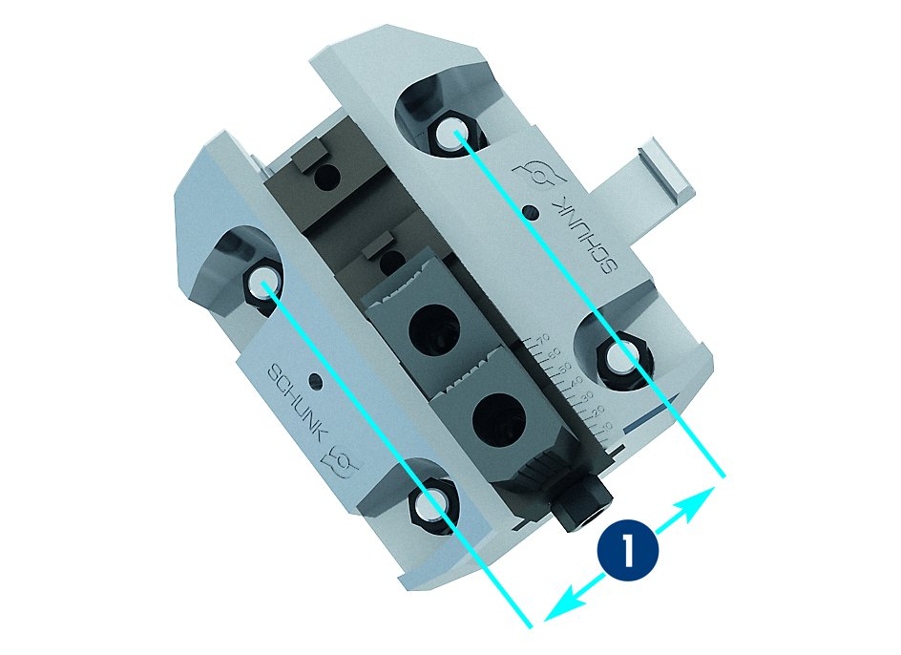
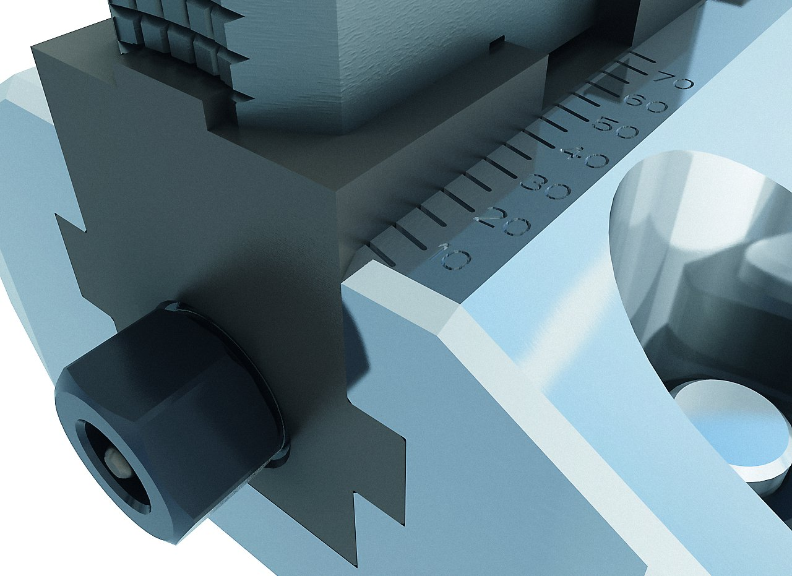
SPK
Spindle drive with integrated lubrication
Spindle completely encapsulated
Jaw stroke display
Adjustable gauge
1
Adjustable gauge
1

Slide 9
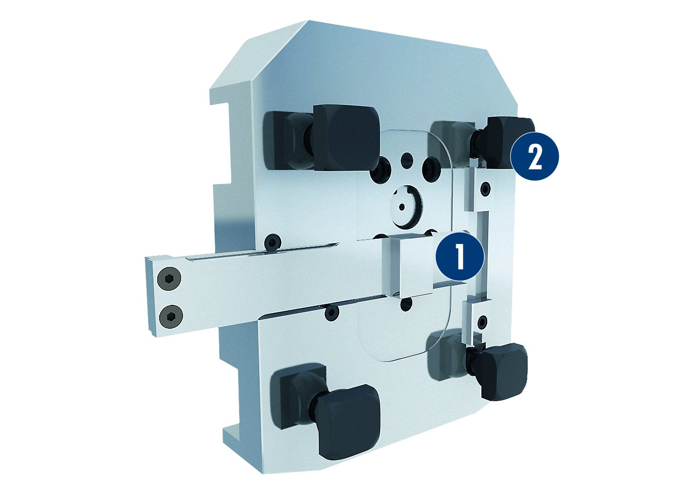
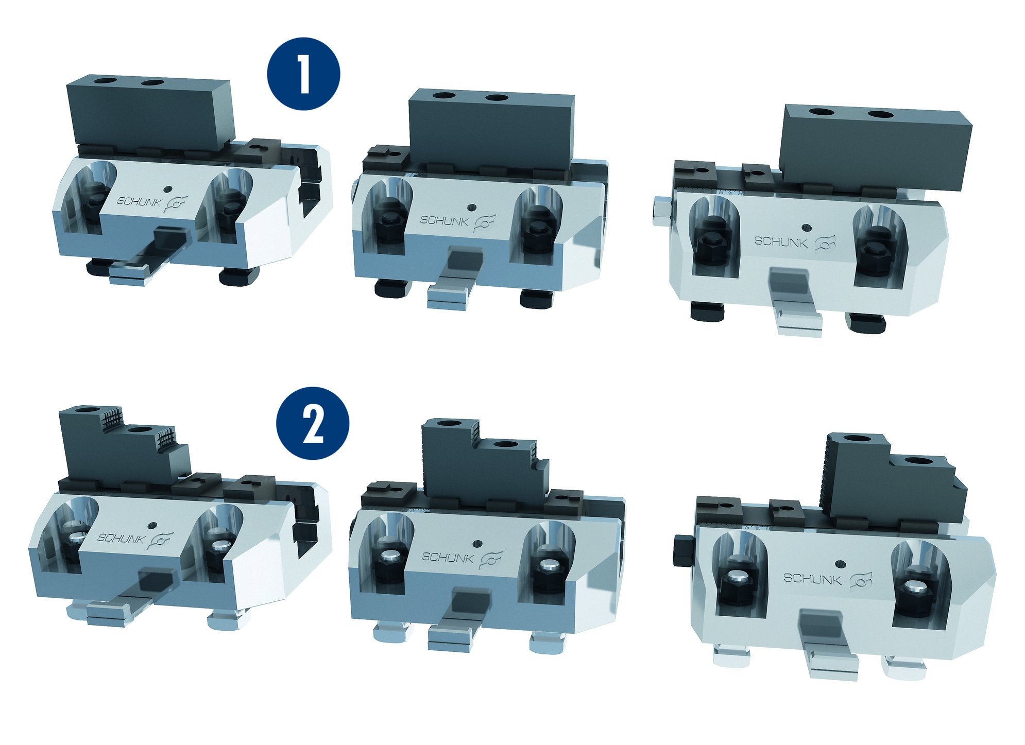
SPK
Bottom
Jaw connection
1
2
1
Crossbar
Positioning stones
1
SPK 180
SPK 220/260
1
2
2
2

Slide 10
Variants SPK
Technical data | Max. RPM [Nm] | Max. clamping force [kN] | Adjustment range of the chuck jaw [mm]
SPK 180 | 230 | 55 | 75
SPK 220 | 330 | 68 | 90
SPK 260 | 360 | 75 | 100

Slide 11



SCHUNK Services
Engineering
Dimensioning of special plates designed to the manufacturing specifications
Development of special solutions together with the customer
FEM analysis for critical components
Testing
Endurance tests with all new developments
Abrasion checking
Measurement of accuracy
Service
Initial operation of customer´s solution
Inspection and maintenance
Repairs

