Slide 1

Product presentation
MFT
Deburring spindle

Slide 2
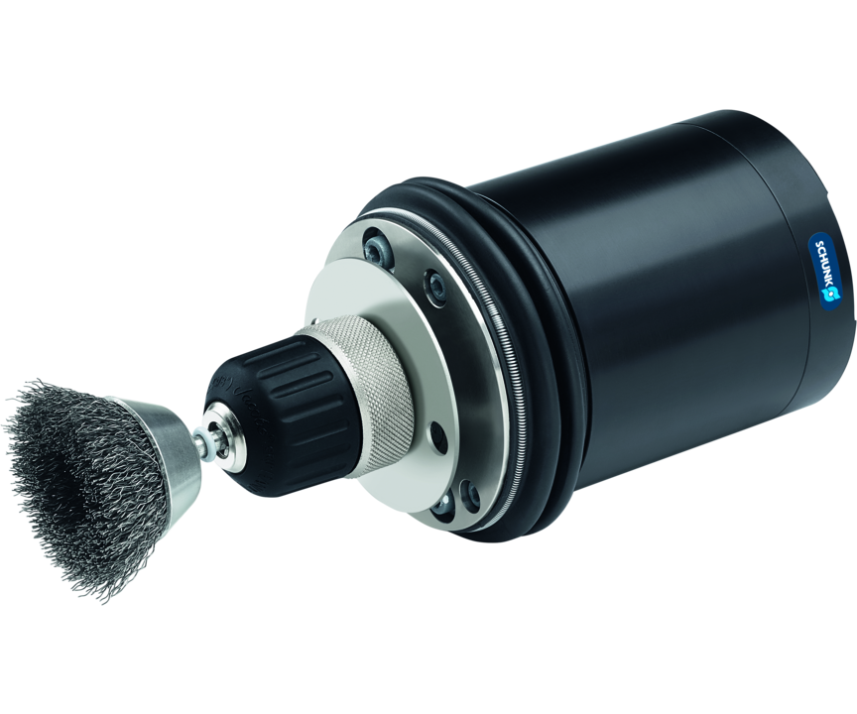
Deburring spindle
Compliant polishing spindle for use on a robot

Slide 3

Productive. Compliant. Robust.

Slide 4
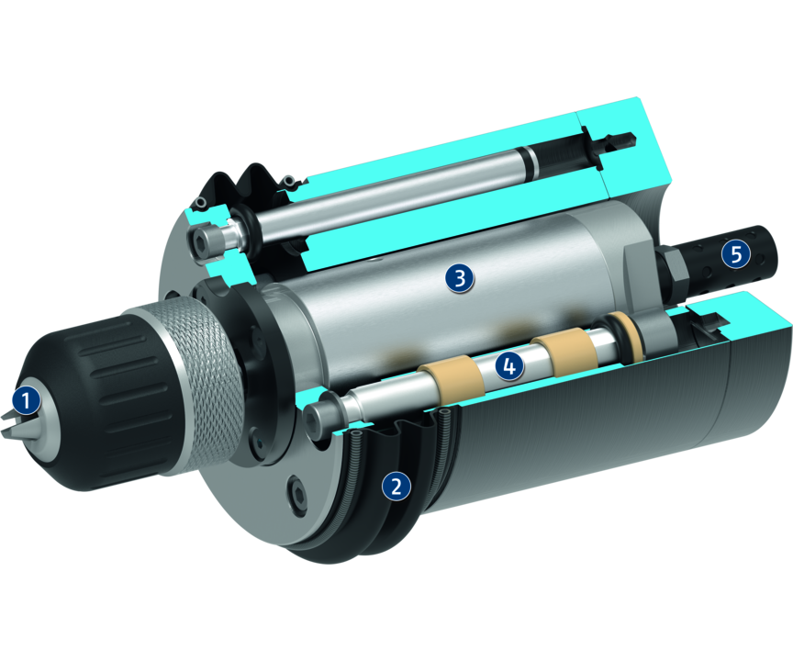
Principle of function
Functional description
The tool holding of the MFT is used for clamping steel brushes, grinding and cup wheels, polishing brushes, deburring cutters and similar tools for surface finishing. The contact pressure against the tool is regulated by the air pressure.
The axis can yield in the axial direction, so a uniform contact pressure is ensured, even on uneven surfaces. This special type of force control ensures high rigidity perpendicular to the surface and the desired flexibility in the machining direction.
1
Tool holder
2
Dust cover
3
Pneumatic spindle
4
Bearing
5
Silencer

Slide 5
Advantages – Your benefits
Flexible high-frequency spindle for maximum flexibility when polishing
Adjustable stiffness of the spindle via air pressure for smooth surfaces in every application
High speeds for high feed rates
Sensor system Optional for retracted/extended stroke and speed monitoring

Slide 6
Technical data
Technical data overview
Size | Recommended compensation path | Weight | Compliance force at 0.35 bar | Compliance force at 4.1 bar | Idle speed
 | [mm] | [kg] | [N] | [N] | [1/min]
390 | 4.5 | 3.3 | 9.7 | 45 | 5600

