Slide 1

Product presentation
FDB-AC
Deburring spindle

Slide 2
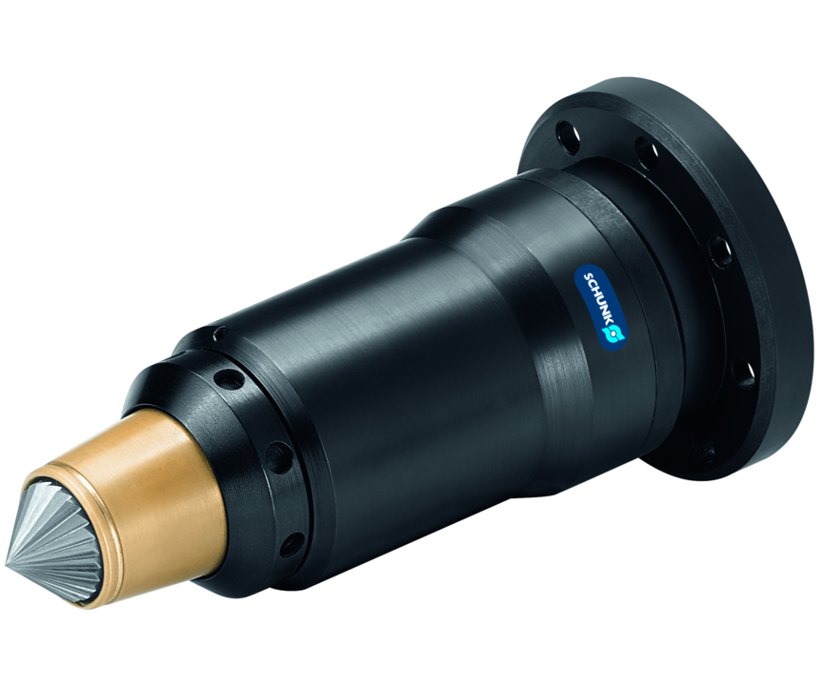
Deburring spindle
Flexible deburring spindle for use in robotic applications

Slide 3

Compliant. Reliable. Flexible.

Slide 4
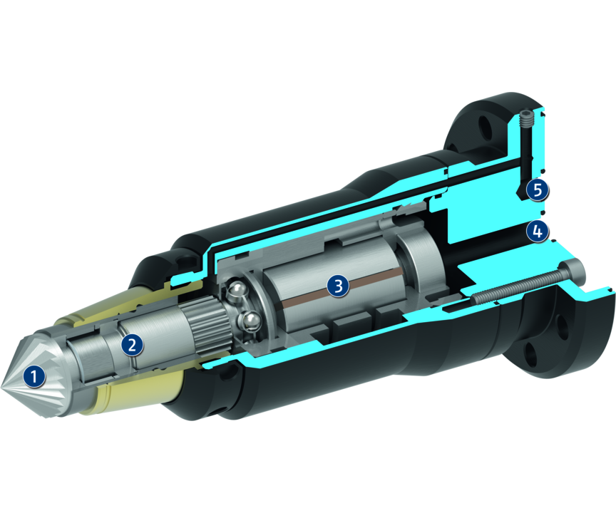
Principle of function
Functional description
The unit is driven by a pneumatic spindle in straight and 90° version. For being able to follow the tolerances of the machining contour, the spindle is axially seated.
The force (rigidity) is needed for moving the spindle (axially). It is controlled by a second air connection. Depending on the pressure, force is applied on the milling cut surface.
1
Milling cutter
2
Compensation piston
3
Pneumatic spindle
4
Pneumatic connection for the spindle
5
Pneumatic connection for the compensation

Slide 5
Advantages – Your benefits
Flexible high-frequency spindle for maximum flexibility when deburring
Pneumatically adjustable rigidity of the cutting spindle via compressed air for clean chamfer edges in every installation position
High speeds for high feed rates
Flexible use on the robot arm or as a stationary unit

Slide 6
Technical data
Technical data overview
Size | Power | Max. compensation path | Recommended compensation path | Min. compensation force | Max. compensation force | Min. compensating pressure | Max. compensation pressure | Idle speed | Weight
 | [W] | [mm] | [mm] | [N] | [N] | [bar] | [bar] | [1/min] | [kg]
180 | 250 | 4.1 | 2 | 1 | 25 | 1 | 3 | 30000 | 0.51

