Slide 1

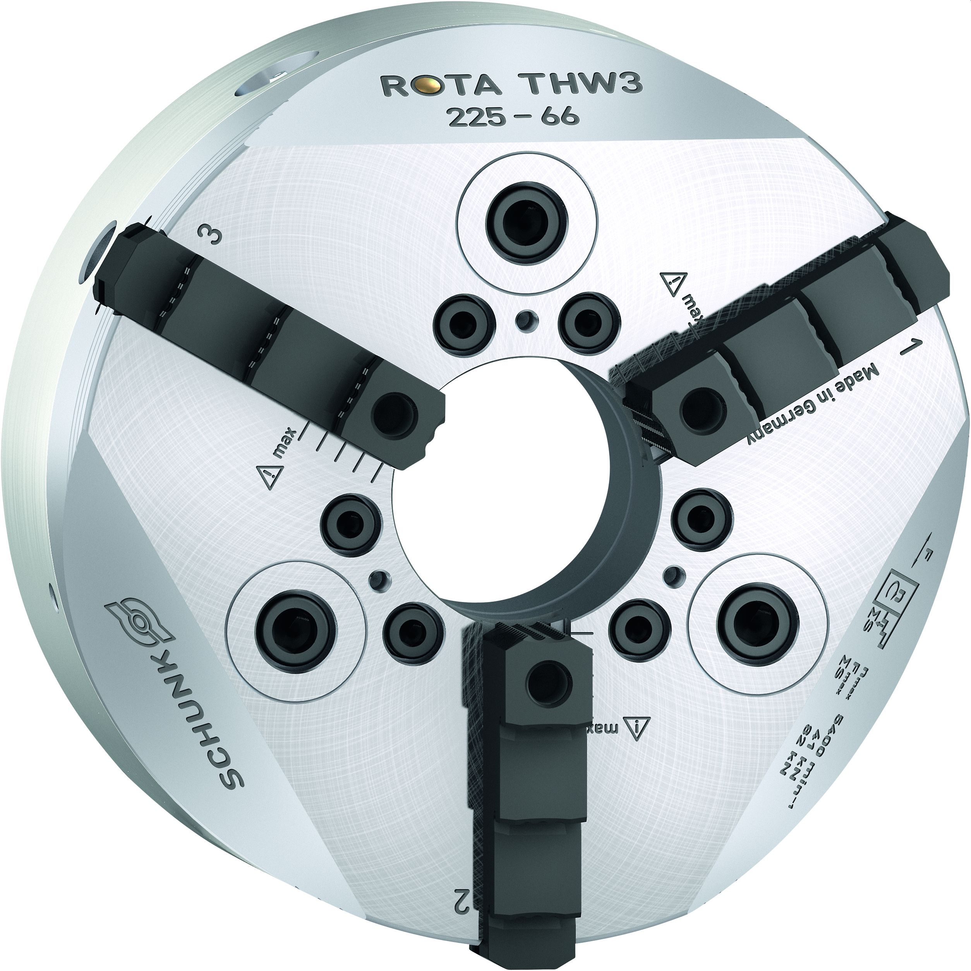
ROTA THW3
Completely sealed Jaw Quick-change Chuck with high Clamping Forces

Slide 2
ROTA THW3
General information
Completely sealed jaw quick-change chuck for a broad number of application possibilities
Permanent grease lubrication for consistently high clamping forces and longer maintenance intervals
Convenient jaw quick-change system for minimizing set-up times
New drive system in ring piston design and pushing jaws
Modular center sleeve system
Base and top jaws one to one compatible to ROTA THW plus and ROTA THW chucks
New generation for all existing chuck sizes

Slide 3
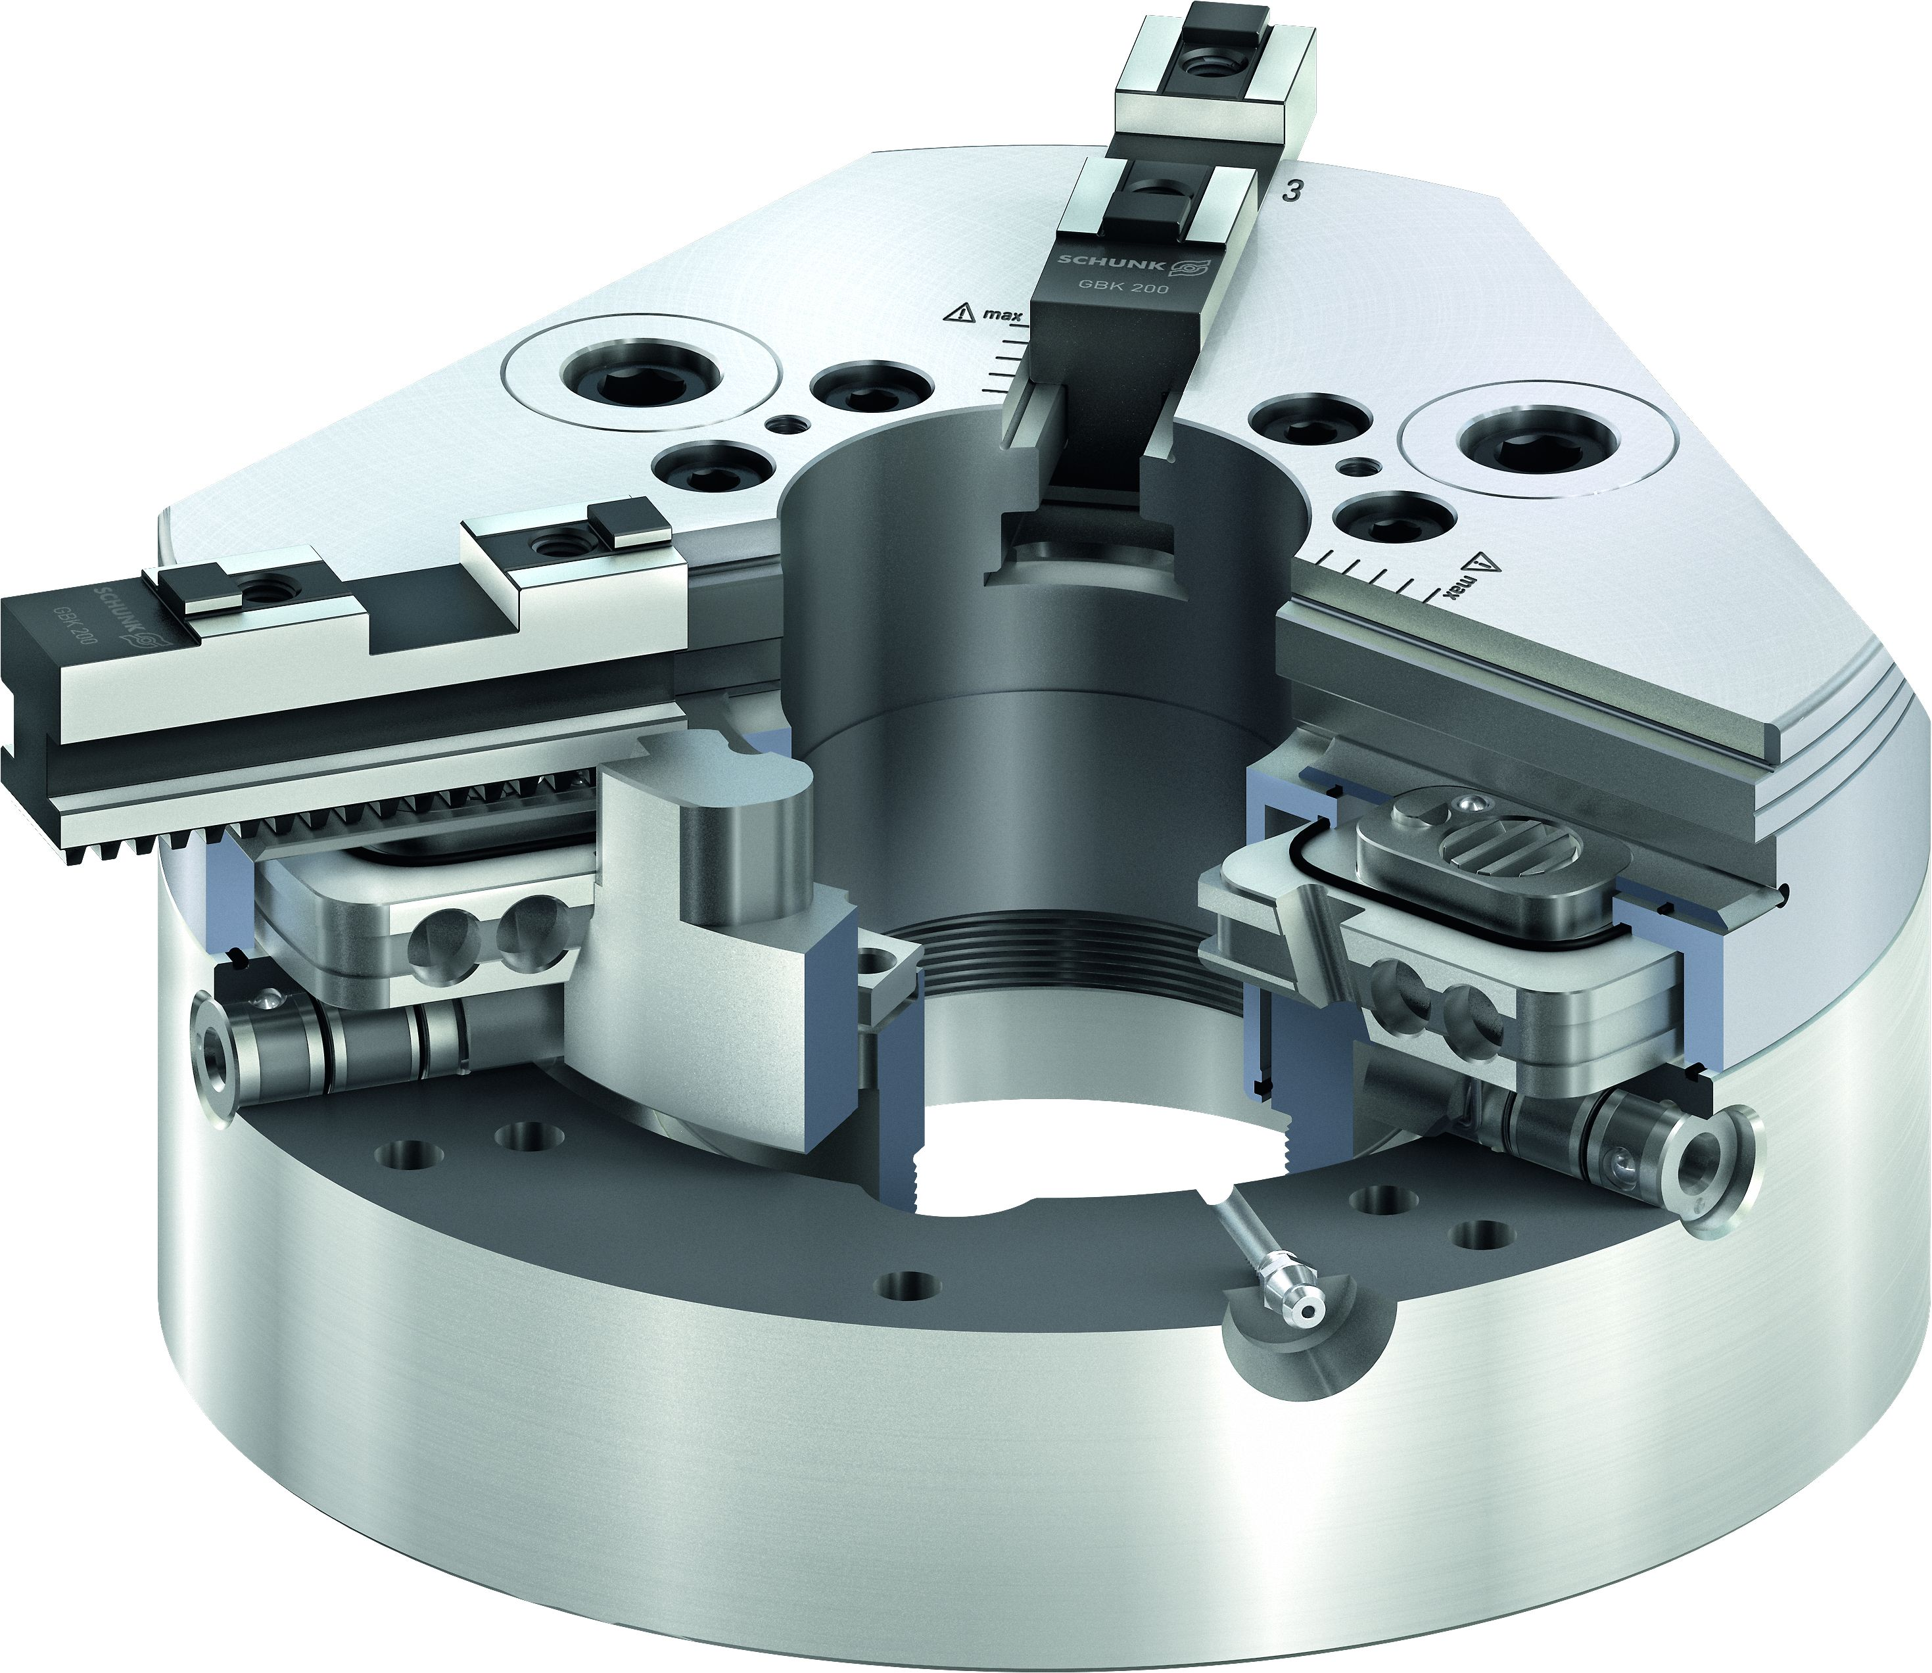
ROTA THW3
Functional diagram
Wedge hook drive in ring piston design
Hardened and extremely rigid base body
Large through-hole
Patented sealing system
Mounting threads for modular center sleeve
Jaw quick-change system
Locking mechanism
Base jaws with straight serration (GBK)
Inlays near the fastening holes to increase the tightness and
rigidity of the chuck
Reliable jaw lock
Display of maximum jaw position
Standard jaw interface
1
2
3
4
5
9
5
12
11
6
8
3
6
4
7
7
1
1
4
8
9
10
10
2
11
12

Slide 4
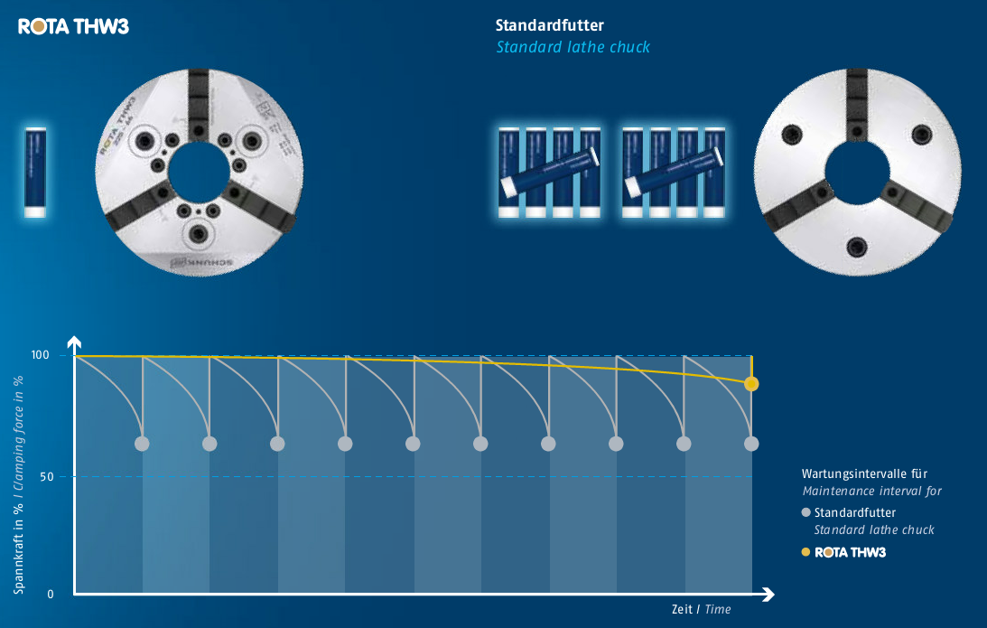
ROTA THW3
20 times longer maintenance interval with constantly high clamping forces
Due to the innovative sealing system, the new ROTA THW3 jaw quick-change chuck belongs to the high-quality SCHUNK PROTACT products. It prevents grease from being rinsed out and a gradual loss of clamping force. Your benefits:
Sealed and therefore low-maintenance
Constantly high clamping forces
20 times lower lubricant consumption
Due to lower contamination, the cooling lubricant does
not have to be changed so frequently
No ingress of chips or dirt into the chuck body
Significantly longer service life
Cost savings and resource conservation

Slide 5
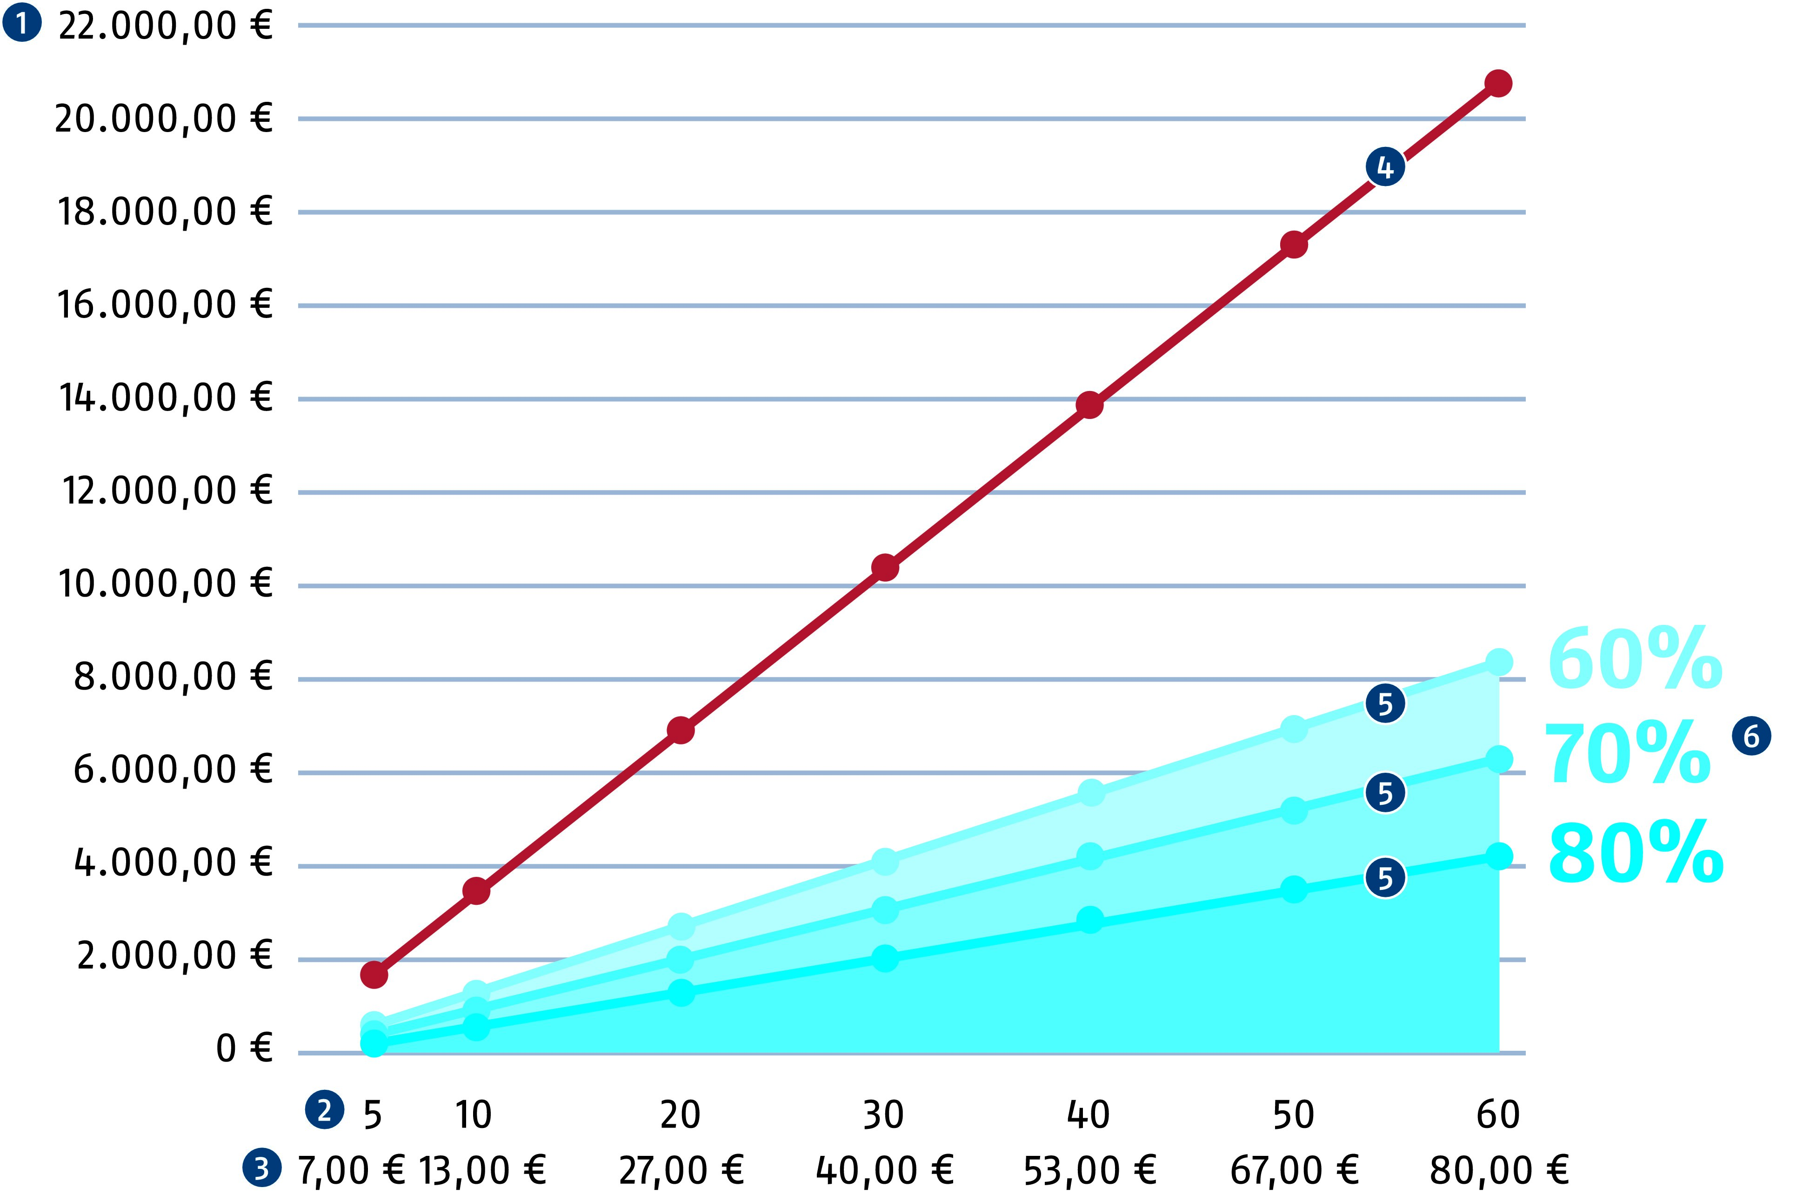
ROTA THW3
Saving set-up costs
The jaw quick-change system is the ideal clamping tool for clamping tasks even up from batch size 1. Ideally the set-up times can be reduced – depending on the numer of jaw changes – by up to 80% in comparison to power lathe chucks with fine serration.
Set-up costs (in Euro per year)
Set-up time (in minutes per day)
Set-up costs (in Euro per day)
Set-up costs (per year without jaw quick-change)
Set-up costs (per year with jaws quick-change)
Savings potential (depending on the set-up rate)
1
4
1
2
3
4
5
5
5
6
6
5
2
3

Slide 6

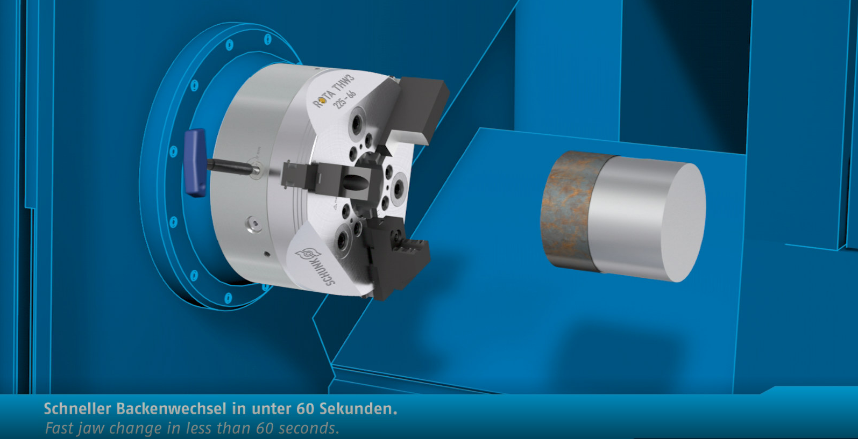
ROTA THW3
Functional movie

Slide 7
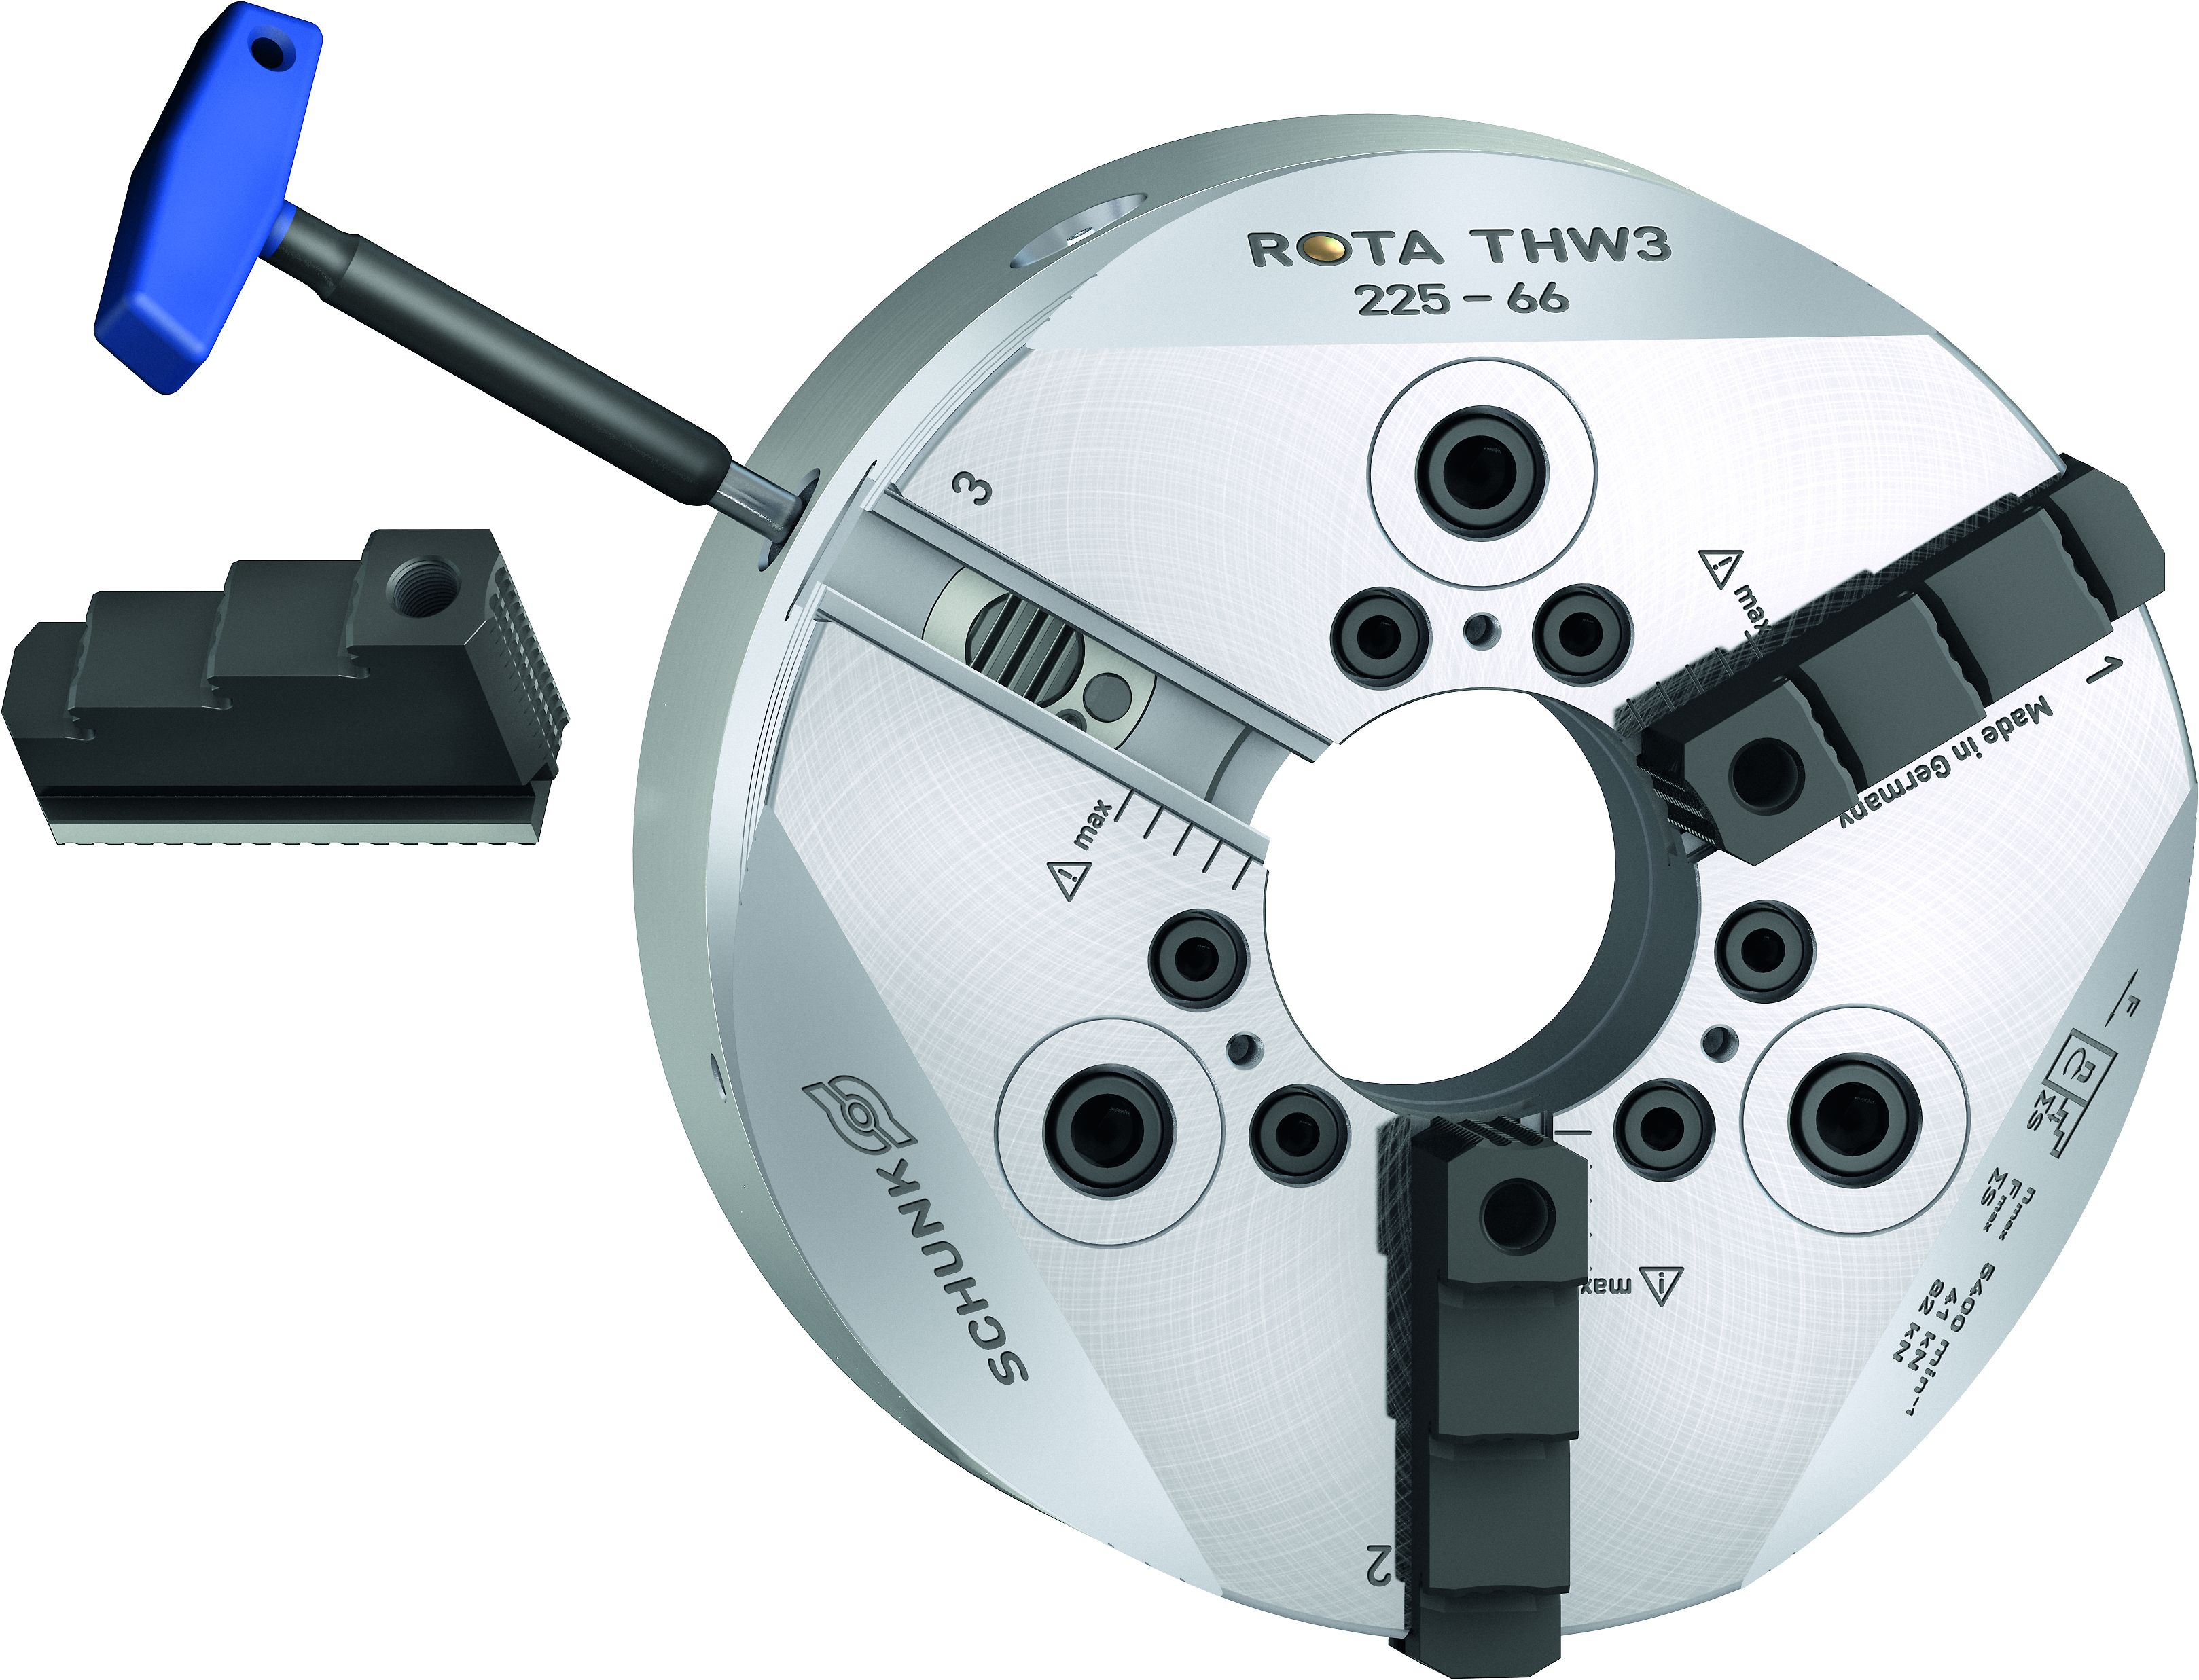
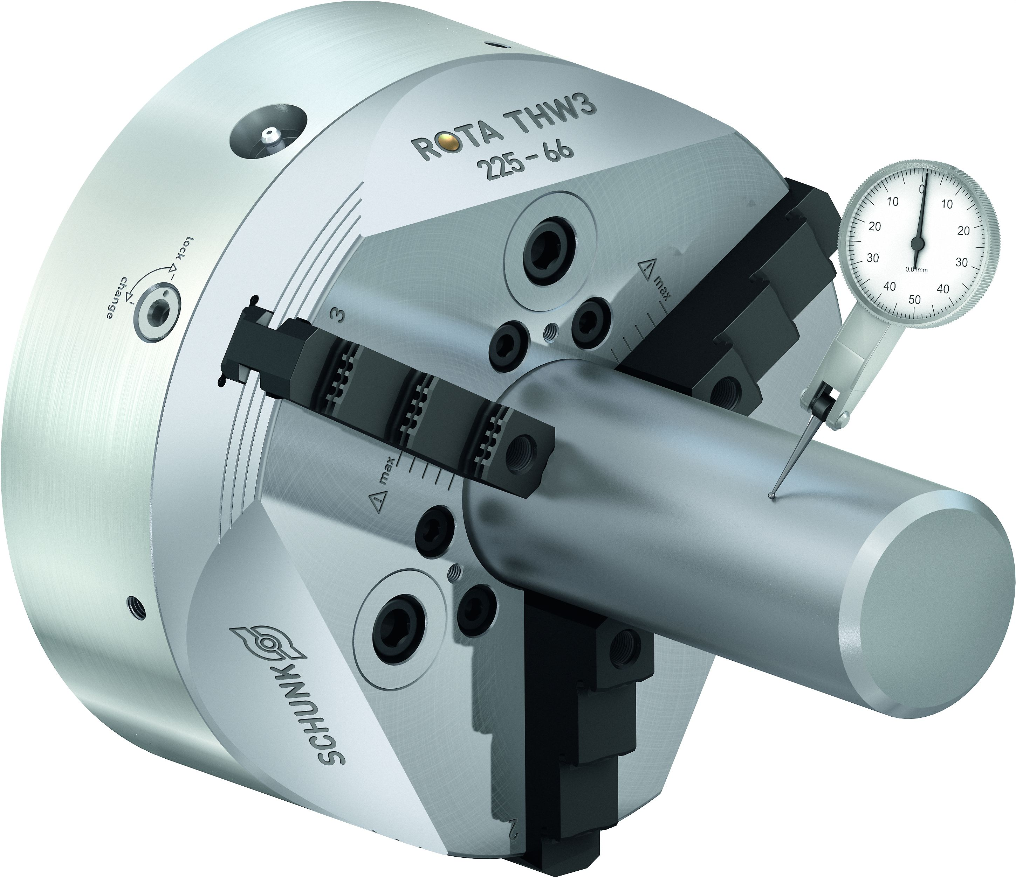
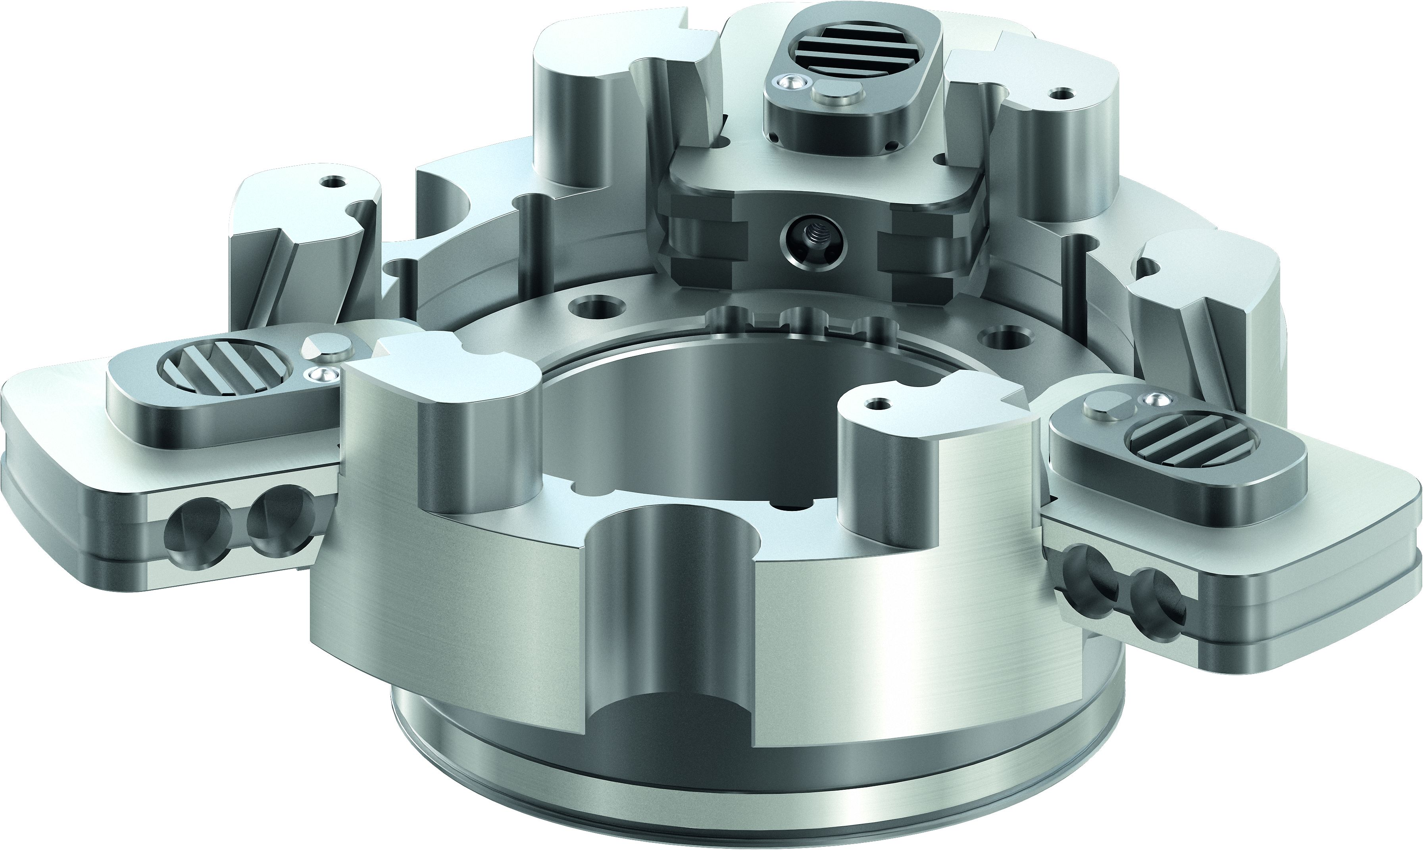
ROTA THW3
Highlights
Quick jaw change
Turning the jaw quick-change wrench by 90° pulls the driver out of the base jaw‘s serration. The complete jaw set can be exchanged in less than a minute.
High repeat accuracy
The dual-guided piston, the direct power transmission and the system consisting of the pusher jaw and integrated driver result in an extremely rigid system. This is evidenced by the extremely high repeat accuracy of the chuck.
High run-out accuracy
Chuck jaws only have to be turned once. The repeat accuracy of
< 0.02 mm ensures permanently high concentricitoes on the workpiece.

Slide 8
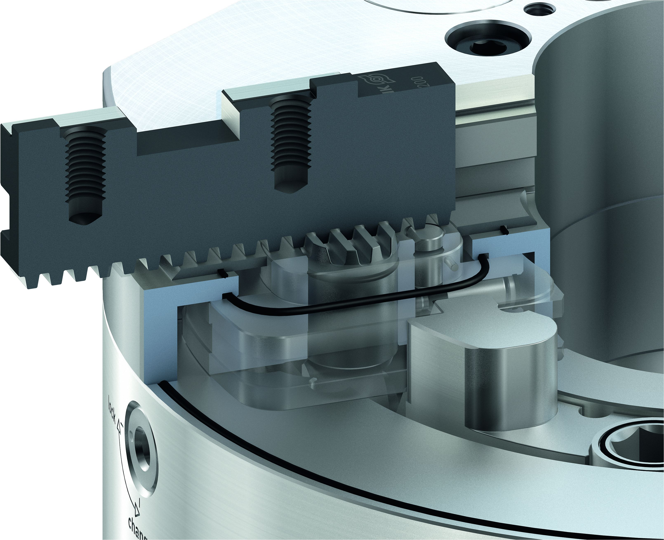
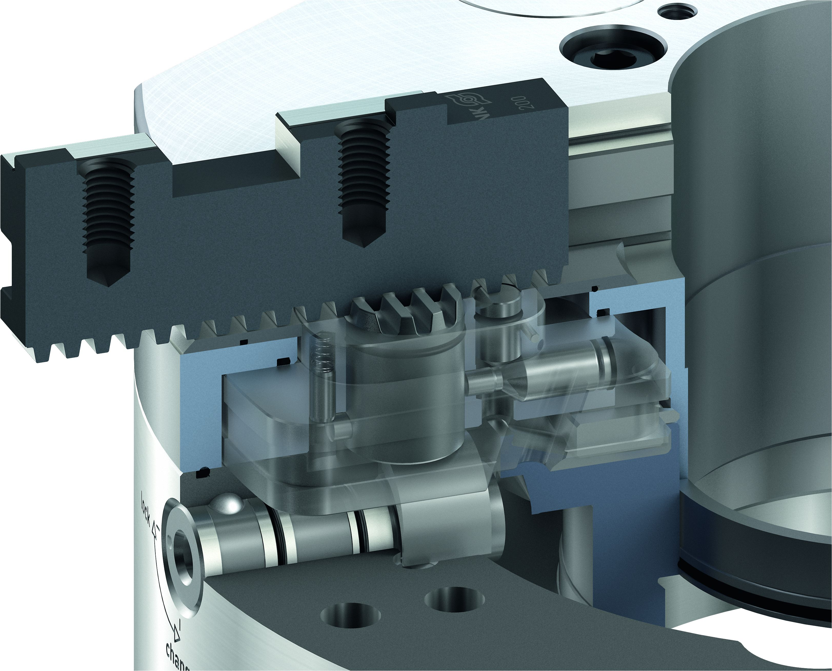
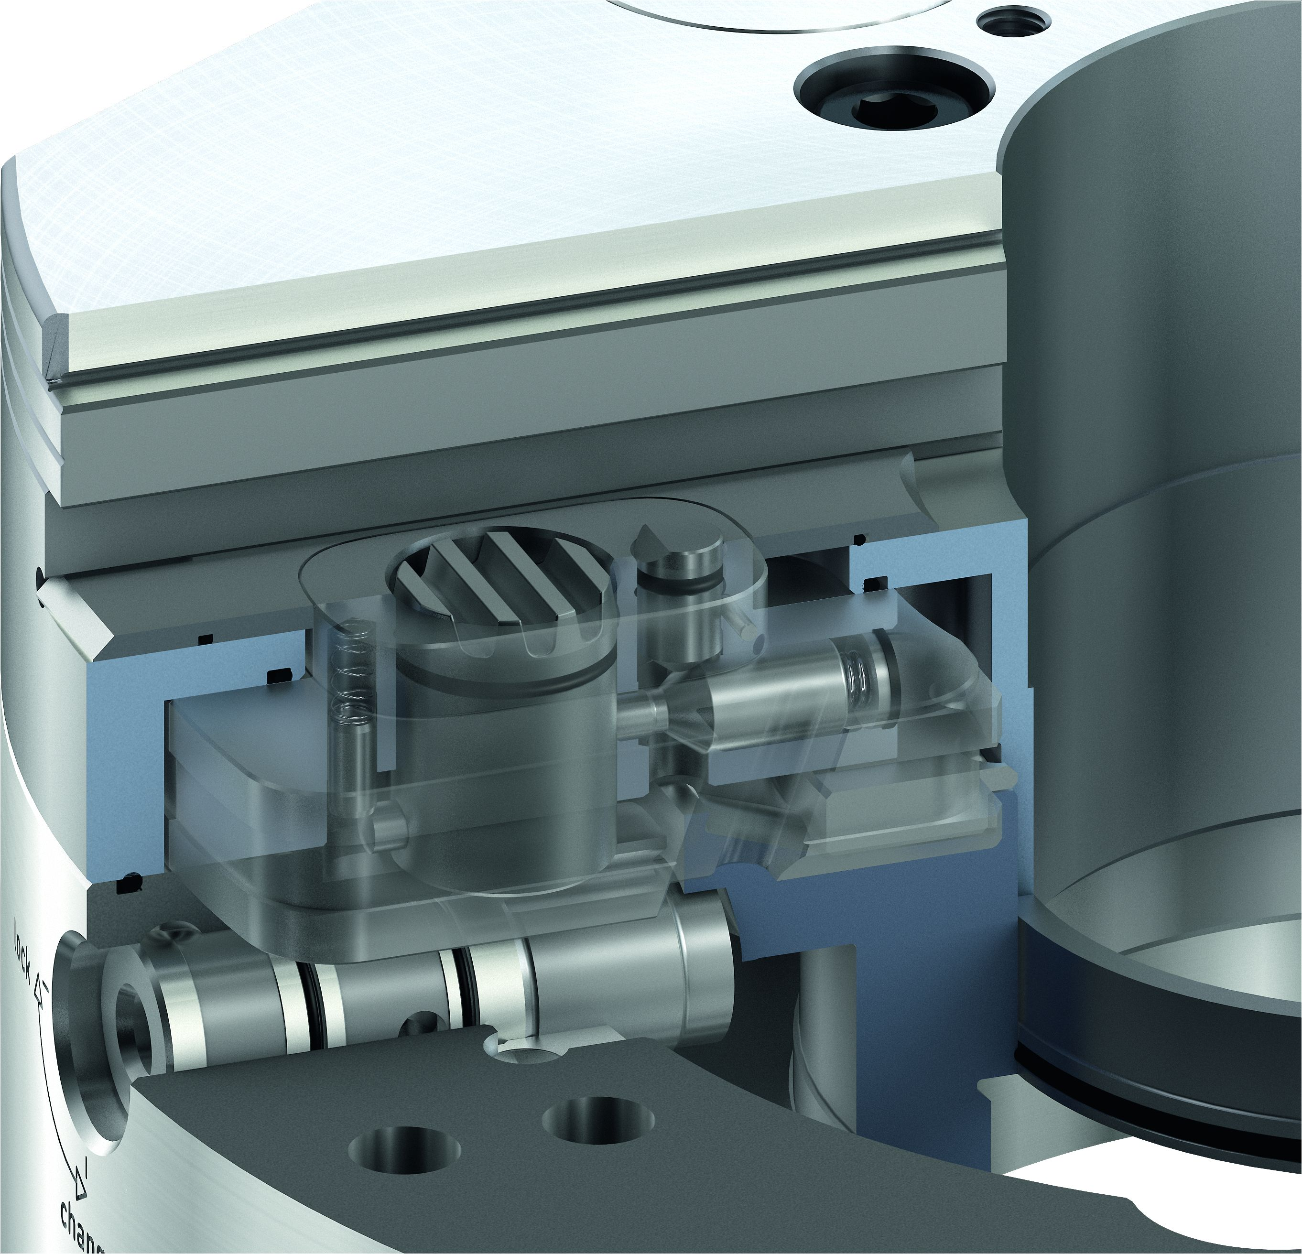
ROTA THW3
Highlights
Patented sealing system
Six seals completely seal the ROTA THW3. This means that even difficult materials can be machined.
Consistent clamping forces
The sealing system also prevents grease escaping from the chuck during machining. This makes it possible to achieve unprecedented consistent clamping forces for quick-change jaw chucks.
Patented jaw locking
The base jaw of the ROTA THW3 is fixed in the chuck by a driver. Pulling the driver back into the pusher jaw releases the base jaw for the jaw change. This system also completely seals the release-mechanism.

Slide 9
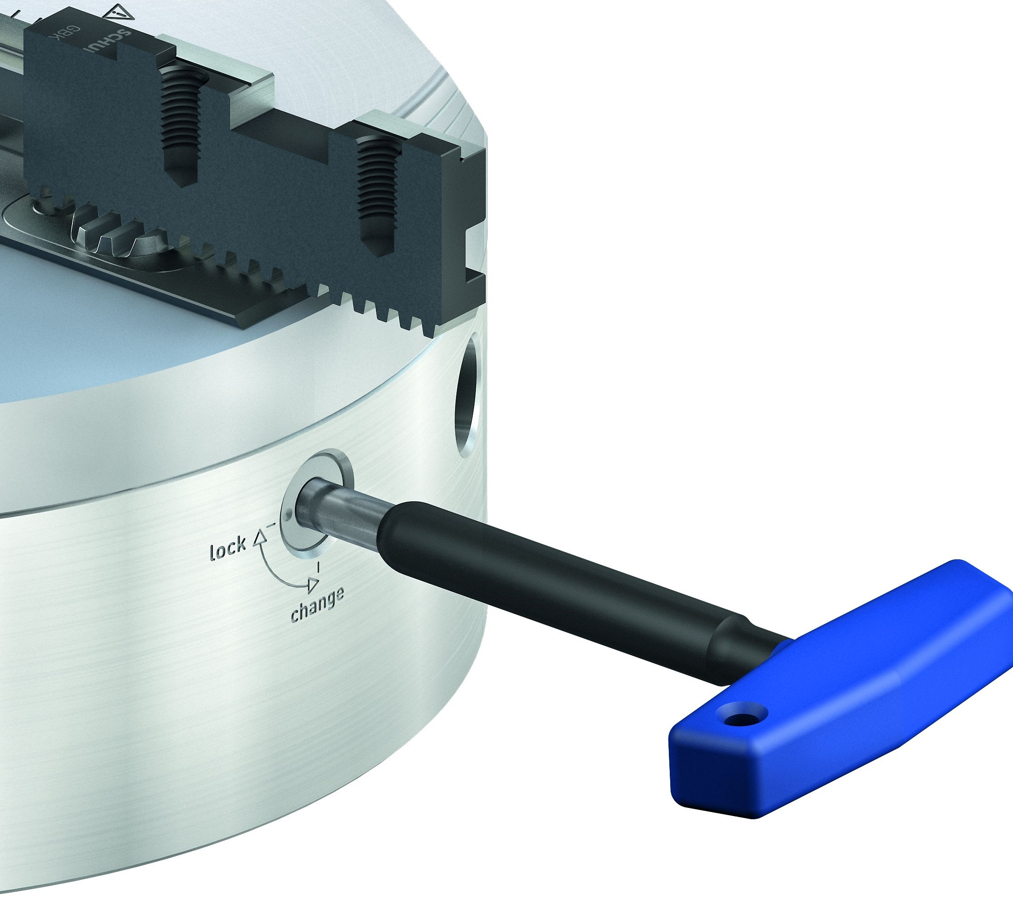
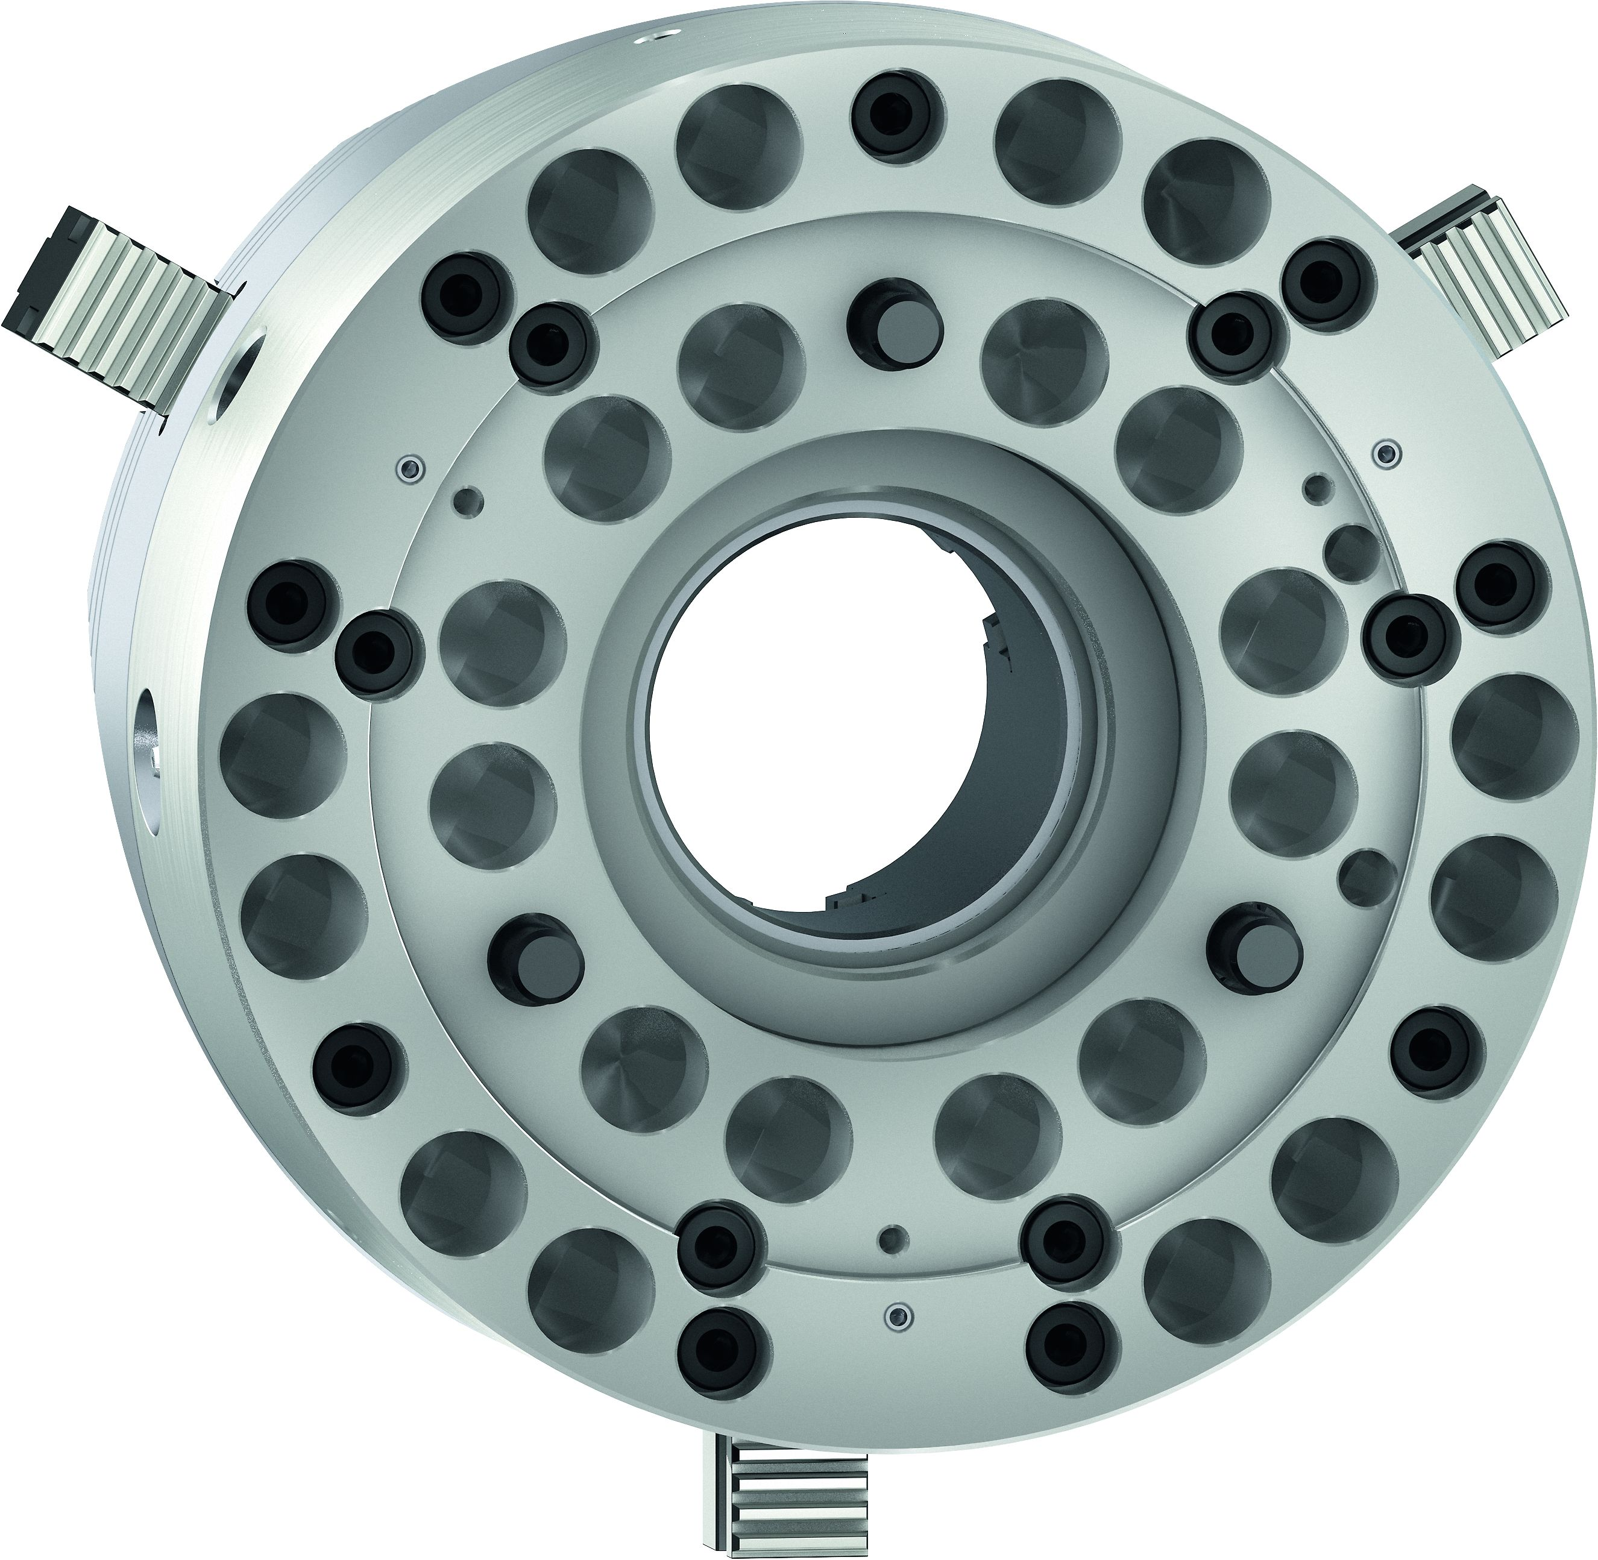
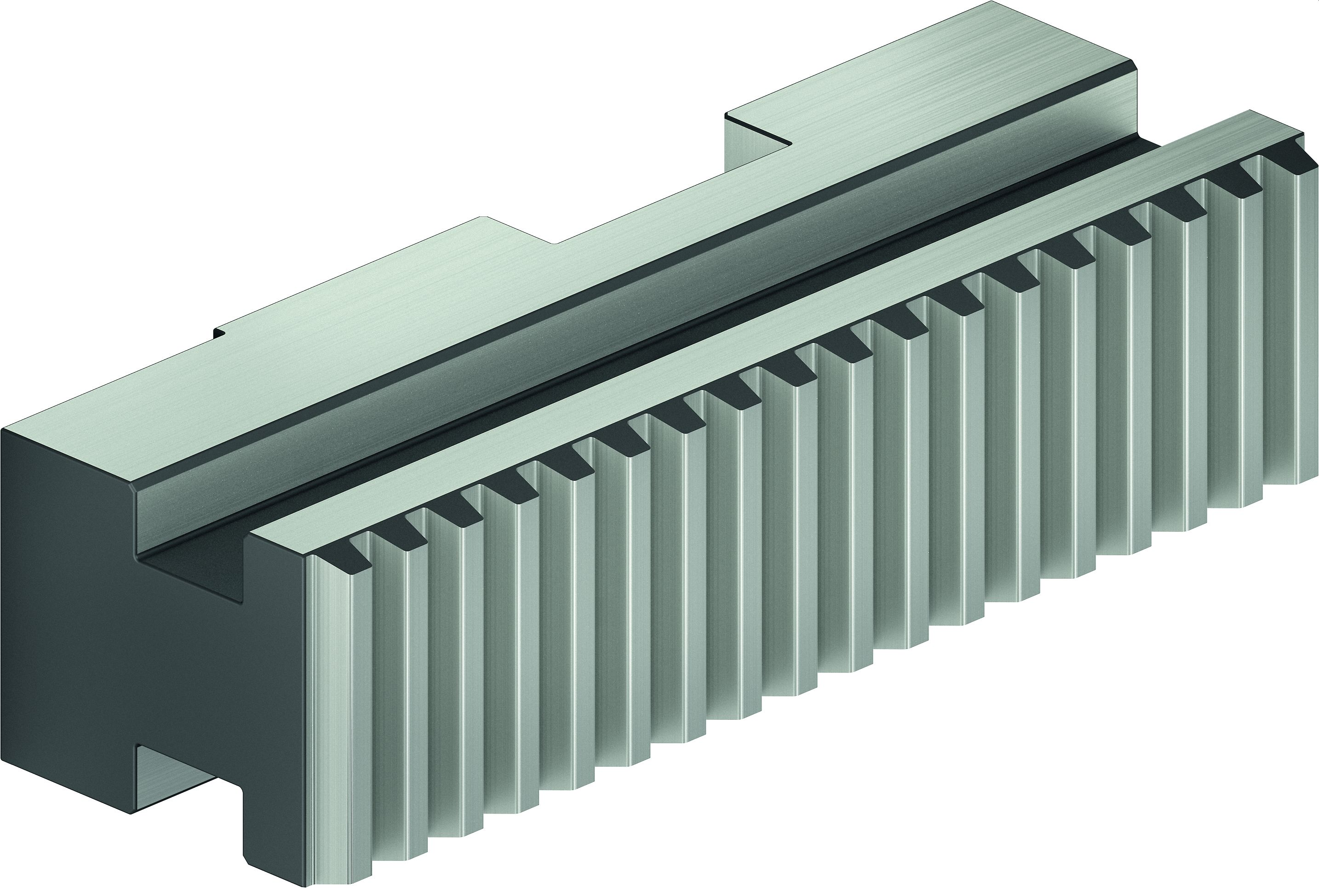
ROTA THW3
Highlights
Jaw change
In opened position the jaws can be adjusted or removed in seconds with the release key.
Jaws 100% compatible
The base and top jaws of the ROTA THW3 are 100% compatible with the predecessors ROTA THW plus and ROTA THW.
Weight-optimized chuck
Weight-reducing bore holes and bevels on the chuck body achieve optimum interia behavior. In addition, the accessibility of the tool to the workpiece is significantly improved.

Slide 10
ROTA THW3
Technical data
 | Max. RPM | Max. Clamping Force | Max. Actuation Force | Stroke/Jaw | Piston Stroke | Tooth Pitch | Weight | Available from
 | [min⁻¹] | [kN] | [kN] | [mm] | [mm] | [mm] | [kg] | [approx.]
ROTA THW3 200-52 | 6.000 | 64 | 35 | 6,7 | 17,5 | 4,712 | 19 | April 2021
ROTA THW3 225-66 | 5.400 | 82 | 41 | 7,4 | 21 | 4,712 | 25 | April 2021
ROTA THW3 260-81 | 4.000 | 115 | 59 | 8,2 | 24 | 5,498 | 43 | April 2021
ROTA THW3 315-104 | 3.600 | 150 | 80 | 8,6 | 25 | 5,498 | 58 | April 2021
ROTA THW3 400-128 | 3.000 | 240 | 128 | 8,6 | 25 | 5,498 | 103 | April 2021
ROTA THW3 500-165 | 2.200 | 240 | 128 | 10,5 | 30 | 7 | 200 | April 2021
ROTA THW3 630-165 | 1.700 | 240 | 128 | 10,5 | 30 | 7 | 300 | April 2021

