Slide 1

Product presentation
BSWS-M-PGZN-plus
Jaw quick-change system

Slide 2
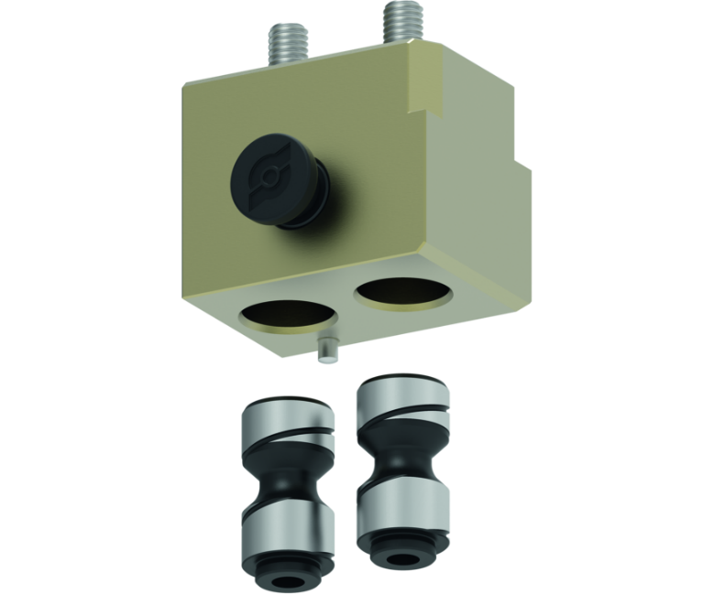
Jaw quick-change system
The tool-free BSWS-M jaw quick-change system allows top jaws to be exchanged on the gripper manually and rapidly. Two adapter pins (= one BSWS-A set) and a base (BSWS-BM) are required for each gripper jaw. In case of reverse assembly and provided that no addional height is created, two adapter pins (= one BSWS-AR set) and an assembly kit (BSWS-URM) per gripper jaw are required. Another effect of the BSWS-URM is that there are no more problematic mounting holes in the finger contours.
The first jaw quick-change system with tool-free actuation on the market
Finger exchange in 10 seconds

Slide 3

Productive. Flexible. Cost-effective.

Slide 4
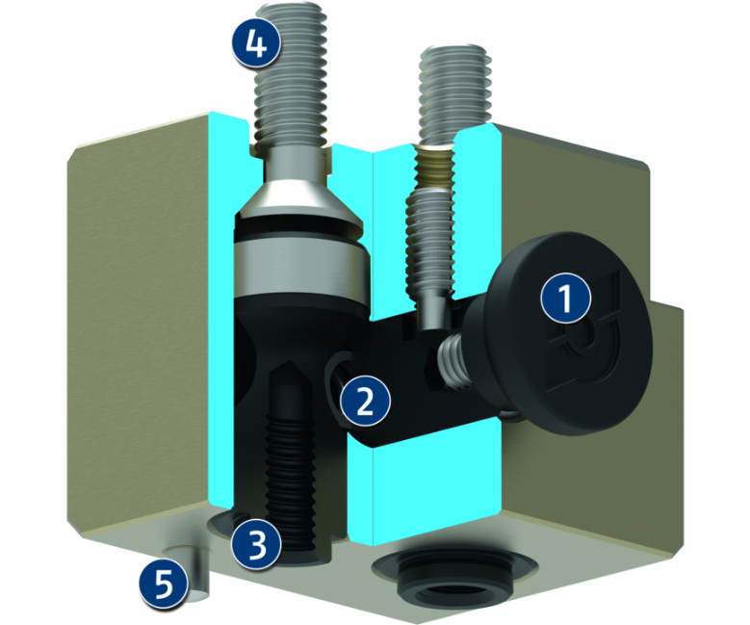
Principle of function
Functional description
The BSWS-M consists of a base, which is firmly screwed to the gripper, and two adapter pins, which are fastened to the gripper fingers to be exchanged. The form-fit locking mechanics ensures fast exchange of the gripper fingers. No tools are required for the exchange. Two adapter pins (= one BSWS-A set) and a base (BSWS-BM) are required for each gripper jaw.
1
Unlocking button
2
Spring preloaded locking pin
3
Adapter pin BSWS-A for fastening the gripper finger to be exchanged
4
Screw connection for mounting on the gripper
5
Optional alignment pin to avoid errors with different gripper fingers (Poka Yoke)

Slide 5
Advantages – Your benefits
Universal application possibilities By using the BSWS-M, just one single gripper is necessary for various applications
Tool-free jaw change via the unlocking button easy and fast for a high gripper flexibility
Saving time when converting applications Different workpieces can be handled by exchanging the gripper fingers

Slide 6
Technical data
Technical data overview
Size | Weight | Number of pins per Id.-No. | Material
 | [kg]
50 | 0.002 .. 0.08 | 1 .. 2 | 42CrMo4+QT
64 | 0.005 .. 0.14 | 1 .. 2 | 42CrMo4+QT
80 | 0.011 .. 0.25 | 1 .. 2 | 42CrMo4+QT
100 | 0.024 .. 0.47 | 1 .. 2 | 42CrMo4+QT
125 | 0.046 .. 0.86 | 1 .. 2 | 42CrMo4+QT
160 | 0.077 .. 1.67 | 1 .. 2 | 42CrMo4+QT
200 | 0.16 .. 0.85 | 1 .. 2 | 42CrMo4+QT

