Slide 1

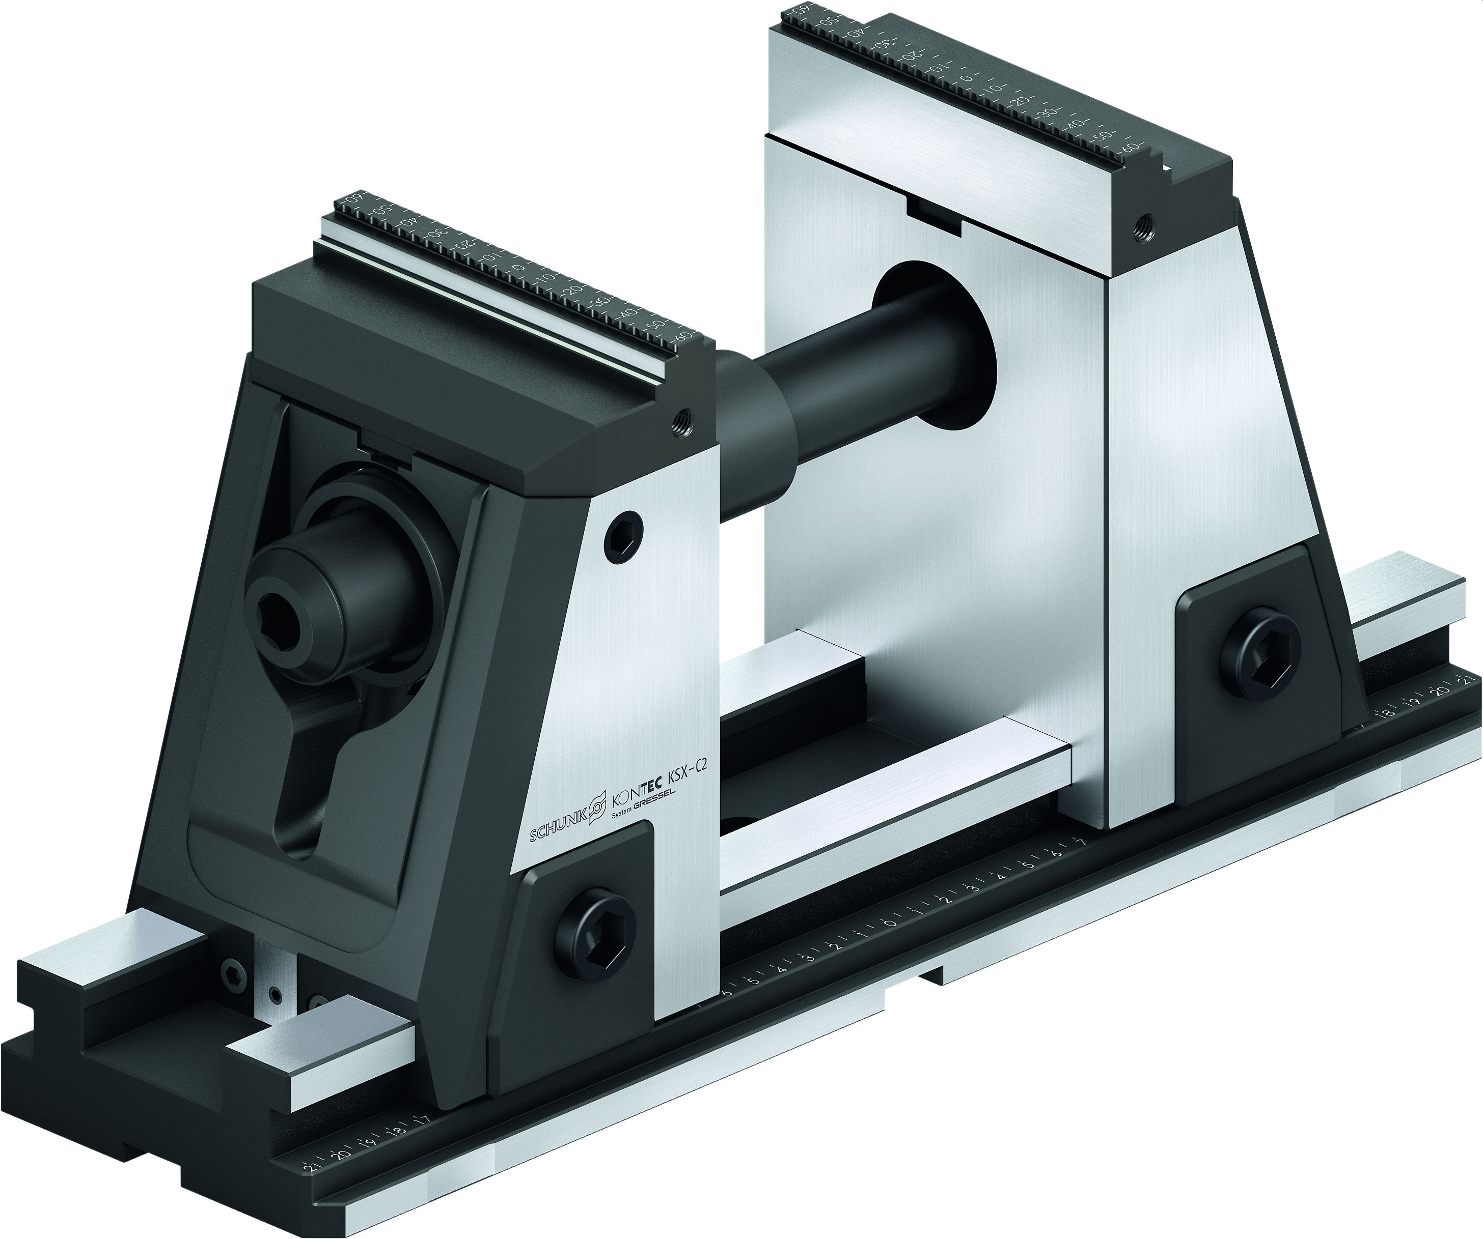
KONTEC KSX-C2
5-Axis Machining in Perfection

Slide 2
KONTEC KSX-C2
Highlights
5-axis vise (without force-amplification) with adjustable clamping center
Active jaw pull-down for a very precise machining of the sixth side
Jaw quick-change system without tools
Largest basic clamping stroke with 130 mm in the marketplace
Available heights: 214 and 175 mm Available lengths: 330, 430, 500, 630 and 800 mm
Easy conversion to extendable clamping range

Slide 3
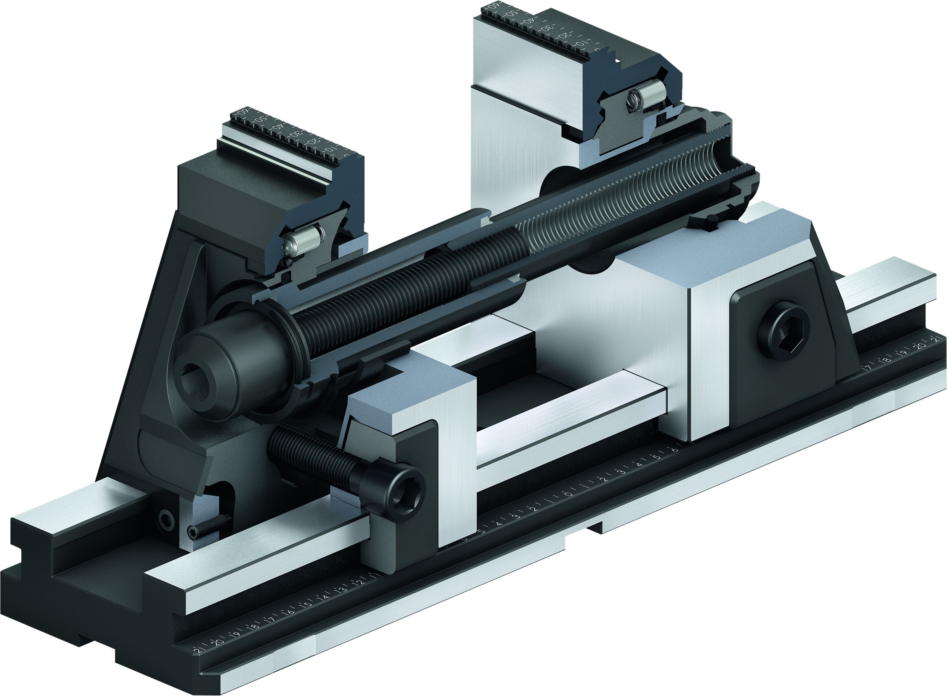
KONTEC KSX-C2
Functional diagram
Jaw quick-change system
Pull-down function
Operation via hexagon connection
Long jaw guidance
Jaw clamping via hexagonal connection for active jaw pull-down
Spring loaded pressure piece secures the jaw against falling off
Large selection of quick-change jaws
Quick-change jaws
Versatile applications for first- and second-side machining
due to active jaw pull-down
1
2
8
7
3
9
1
4
5
2
4
6
6
7
3
5
8
9

Slide 4
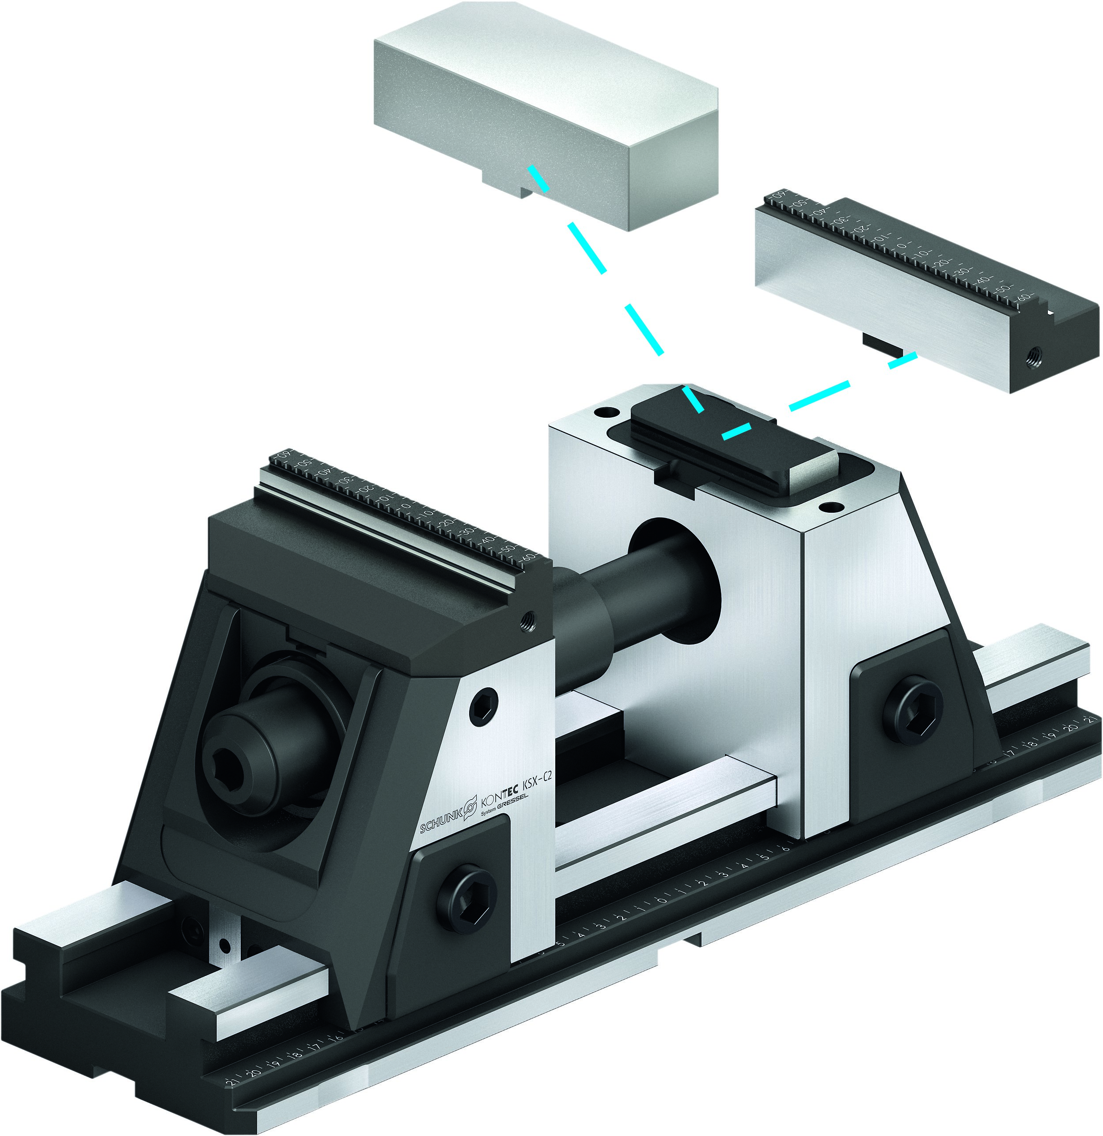
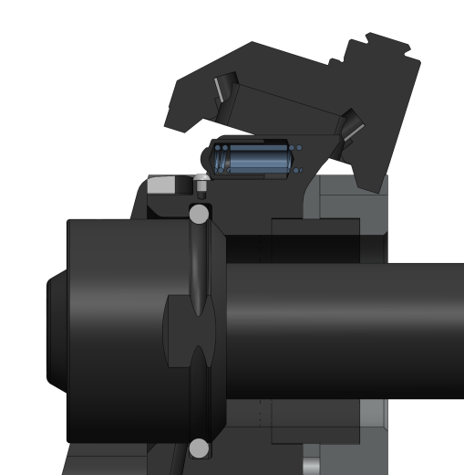
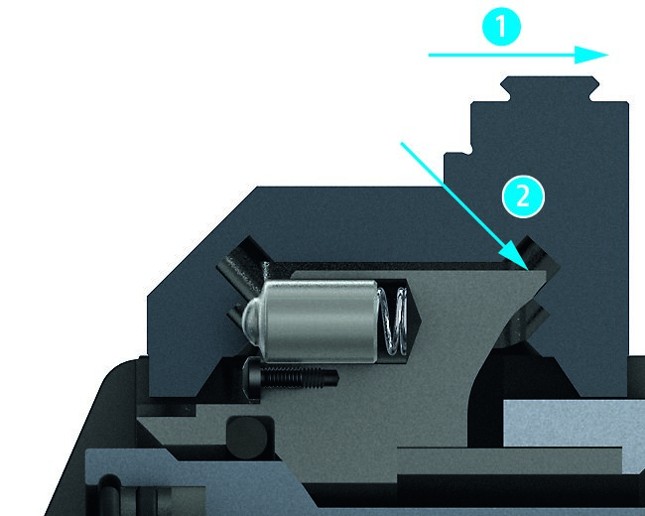
KONTEC KSX-C2
Highlights
1
2
Jaw quick-change system
System jaws can be exchanged in seconds, completely without tools.
Active pull-down function
Fixing of both base jaws, and due to the inlying mechanic, results in a small jaw movement with a parallel pull-down at the workpiece while clamping.

Slide 5
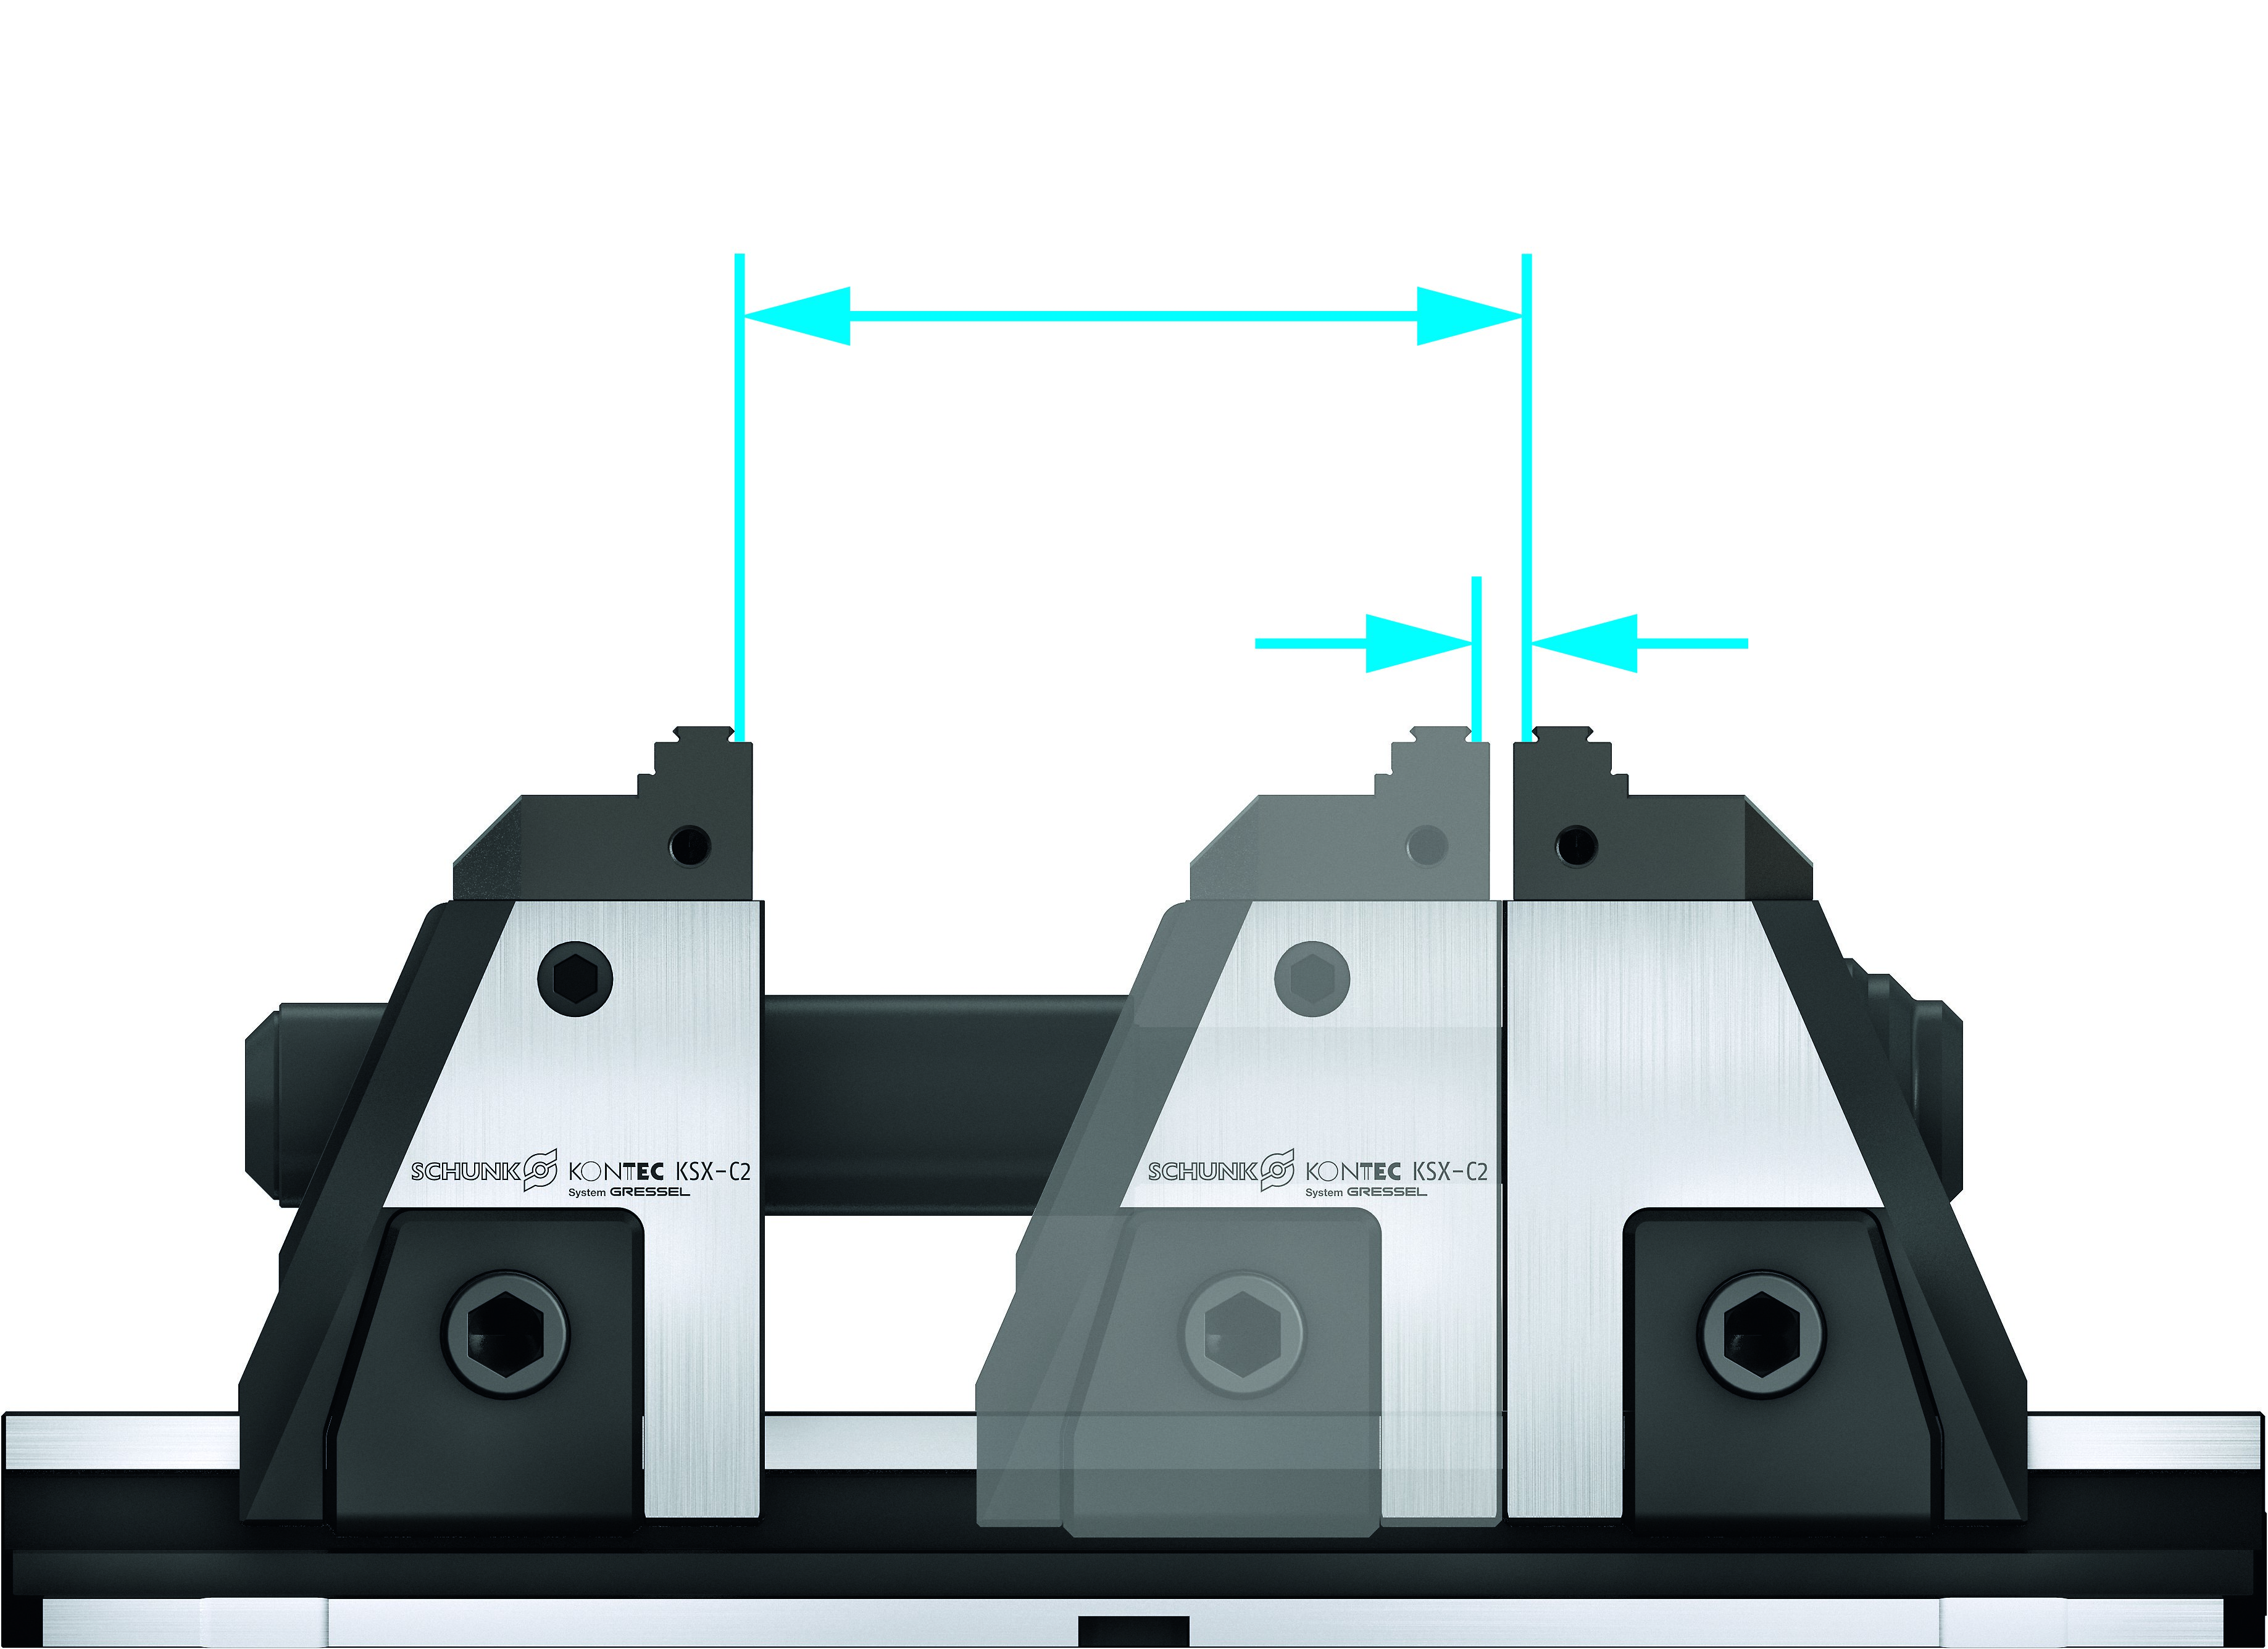
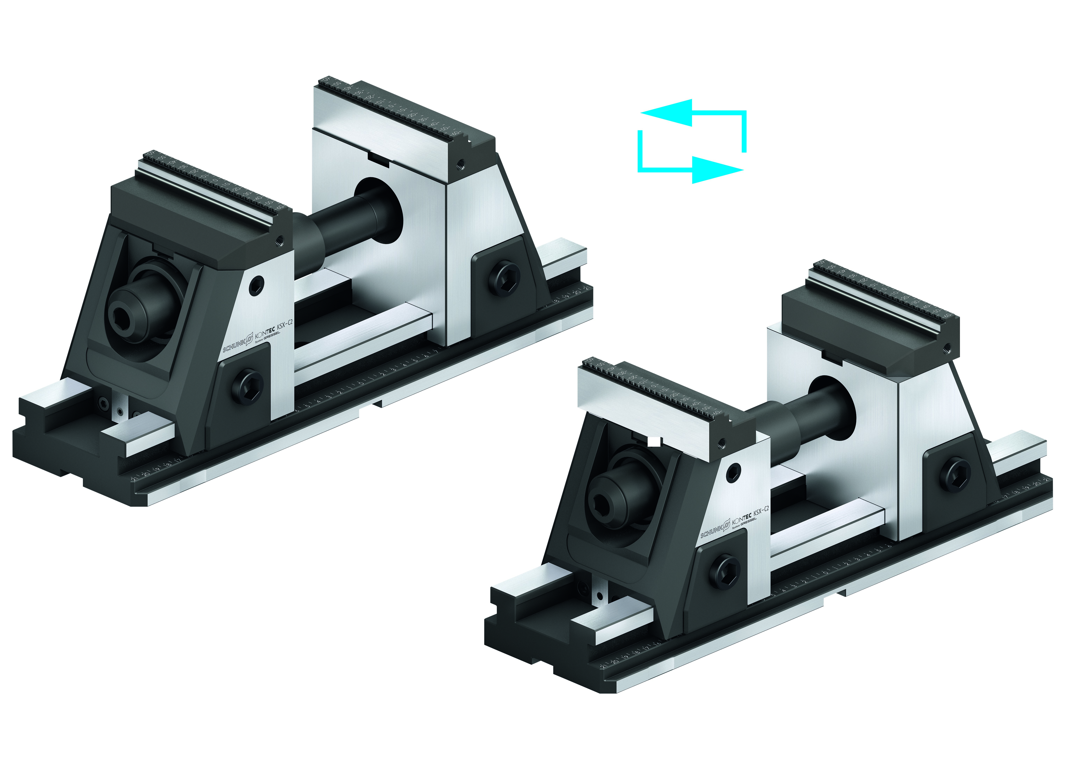
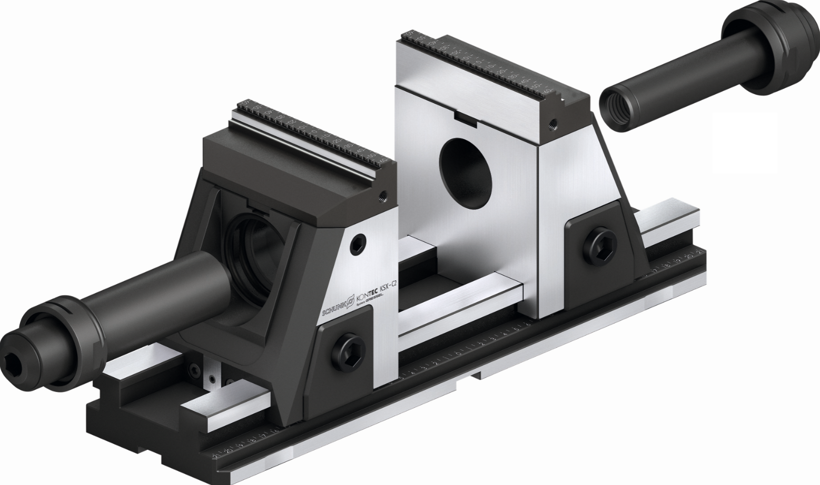
KONTEC KSX-C2
Highlights
Long basic clamping stroke
The KSX-C2 has the basic clamping stroke of 130 mm for each clamp length. Compared with its competitors, it has by far the longest basic stroke in standard.
Freely configurable spindle system
Depending on the vise length, the clamping range can be freely configured via different draw bar extensions.
Quick conversion to a larger clamping range
The KSX-C2 can be converted to an extended clamping range without tools and additional accessories.

Slide 6
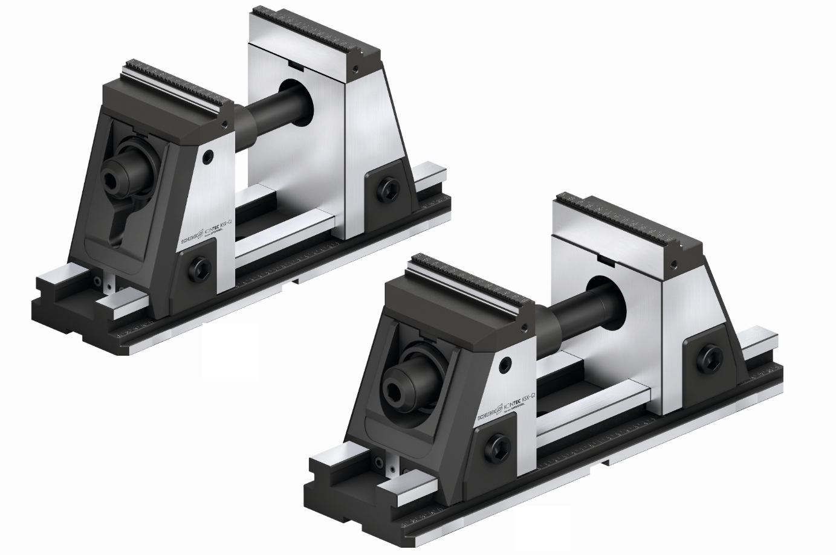
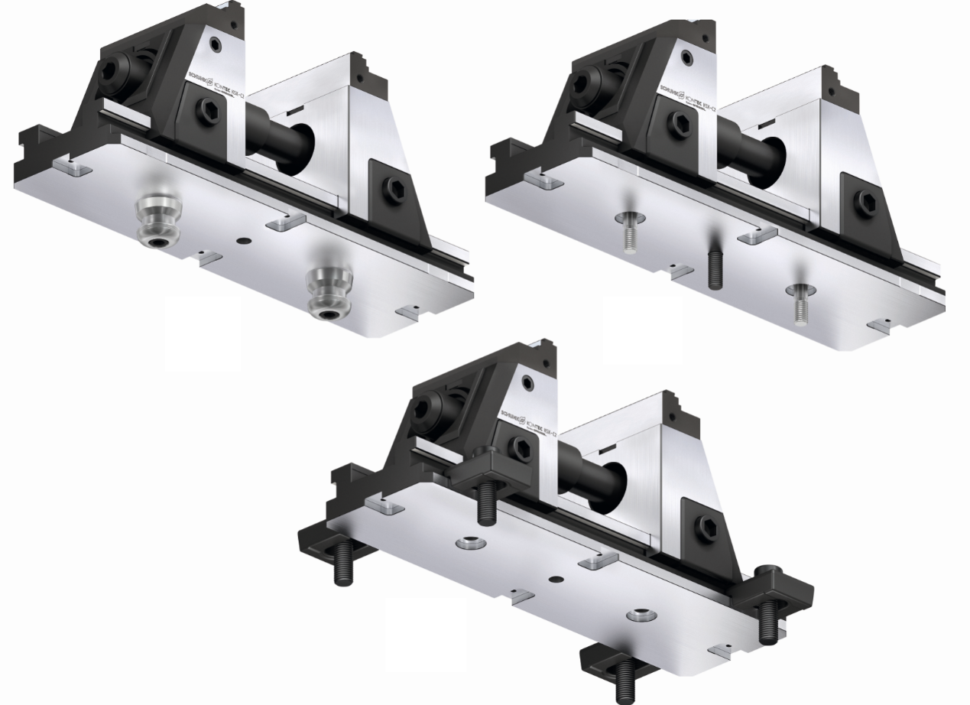
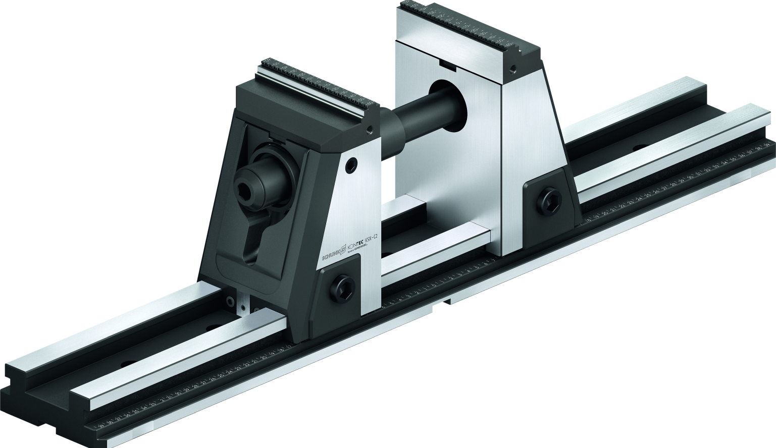
KONTEC KSX-C2
Highlights
Two heights available
The KSX-C2 is available at a height of 214 mm (KSX-C2 125) or 175 mm (KSX-C2 125-L).
Five lengths available
The KSX-C2 is available at a length of 330, 430, 500, 630 and 800 mm.
Mounting options
The KSX-C2 can be set up via quick-change pallet system, fitting screws or precision T-nuts and on the machine table.

Slide 7
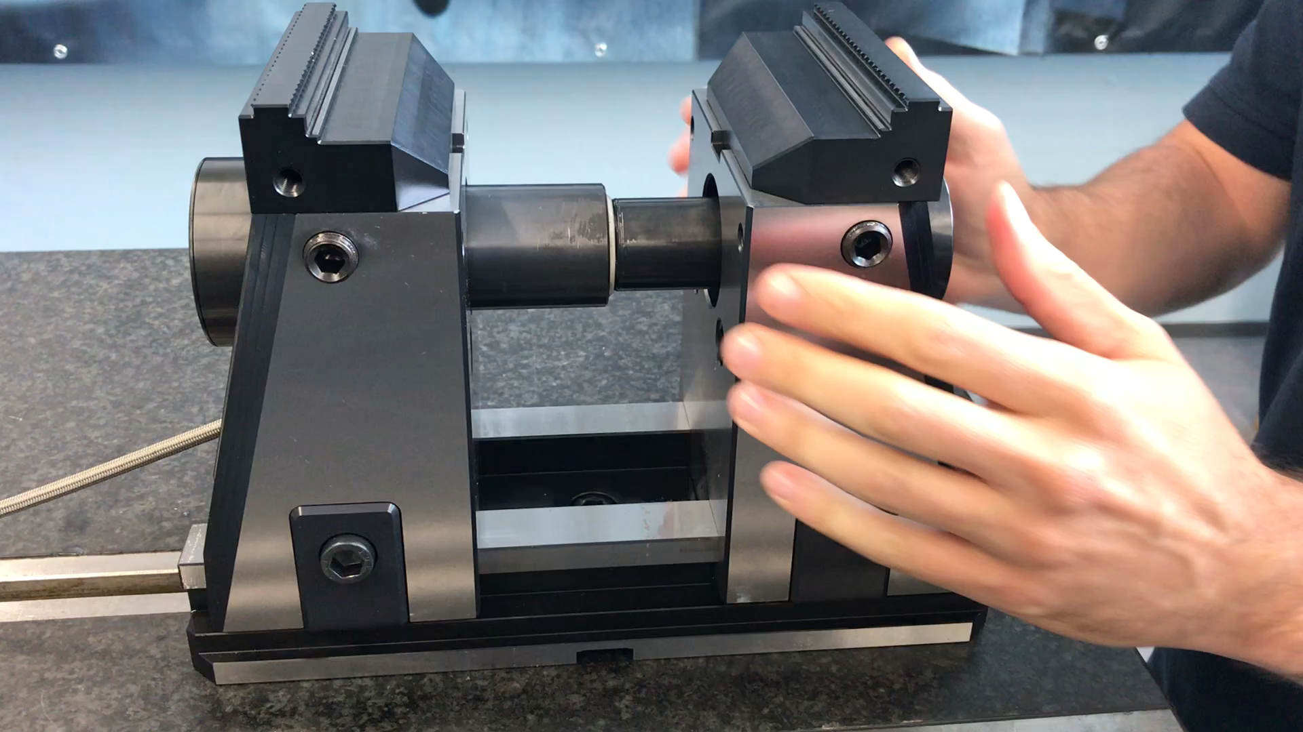
KONTEC KSX-C2
Highlights – Jaw quick-change system

Slide 8
KONTEC KSX-C2
 | ID | Height (with jaws) | Max. Clamping Force | Max. Torque | Basic Clamping Stroke | Weight | Sales Price
 |  | [mm] | [kN] | [Nm] | [mm] | [kg] | [€]
KSX-C2 125-330 | 1452982 | 214 | 40 | 120 | 130 | 33,2 | 3.412,00
KSX-C2 125-330-L | 1452983 | 175 | 40 | 120 | 130 | 27,3 | 3.153,00
KSX-C2 125-430 | 1452984 | 214 | 40 | 120 | 130 | 36,1 | 3.613,00
KSX-C2 125-430-L | 1452985 | 175 | 40 | 120 | 130 | 30,2 | 3.354,00
KSX-C2 125-500 | 1452986 | 214 | 40 | 120 | 130 | 38,1 | 3.744,00
KSX-C2 125-500-L | 1452987 | 175 | 40 | 120 | 130 | 32,2 | 3.485,00
KSX-C2 125-630 | 1452990 | 214 | 40 | 120 | 130 | 41,8 | 3.980,00
KSX-C2 125-630-L | 1452991 | 175 | 40 | 120 | 130 | 35,9 | 3.722,00
KSX-C2 125-800 | 1452992 | 214 | 40 | 120 | 130 | 46,6 | 4.287,00
KSX-C2 125-800-L | 1452993 | 175 | 40 | 120 | 130 | 40,7 | 4.028,00

