Slide 1

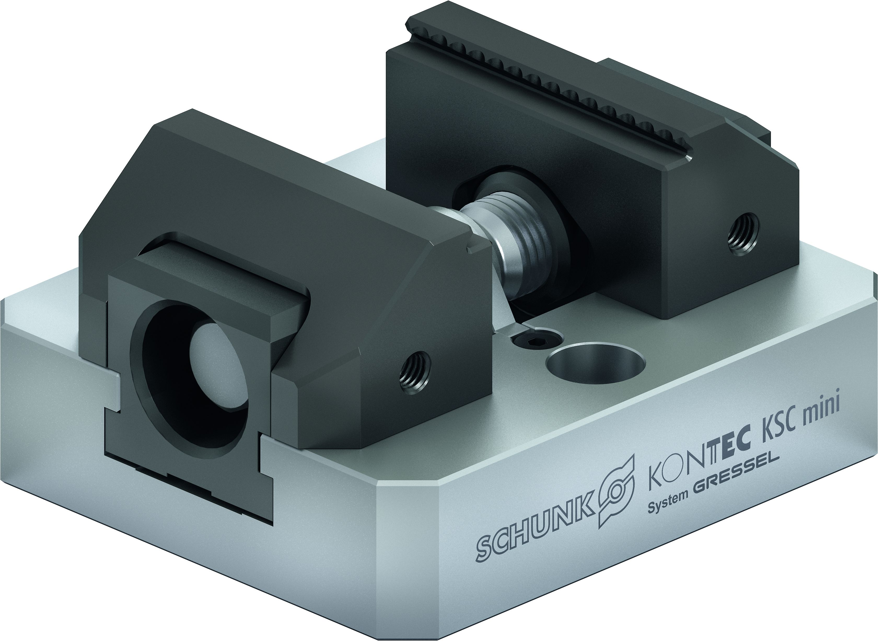
KONTEC KSC mini
Vise for small Workpieces with Jaw Quick-change System

Slide 2
KONTEC KSC mini
Highlights
Centric clamping vise for small workpieces
Jaw quick-change system, completely without tools
Stainless and hardened base body
In jaw widths 45 and 70 mm, which can be used on all sizes (LANG vises does not have this ability!)
Available in the lengths 80 and 100 mm with almost twice as high clamping forces than comparable competitors
Vise with body length 100 mm is prepared for NSE mini interface V1

Slide 3
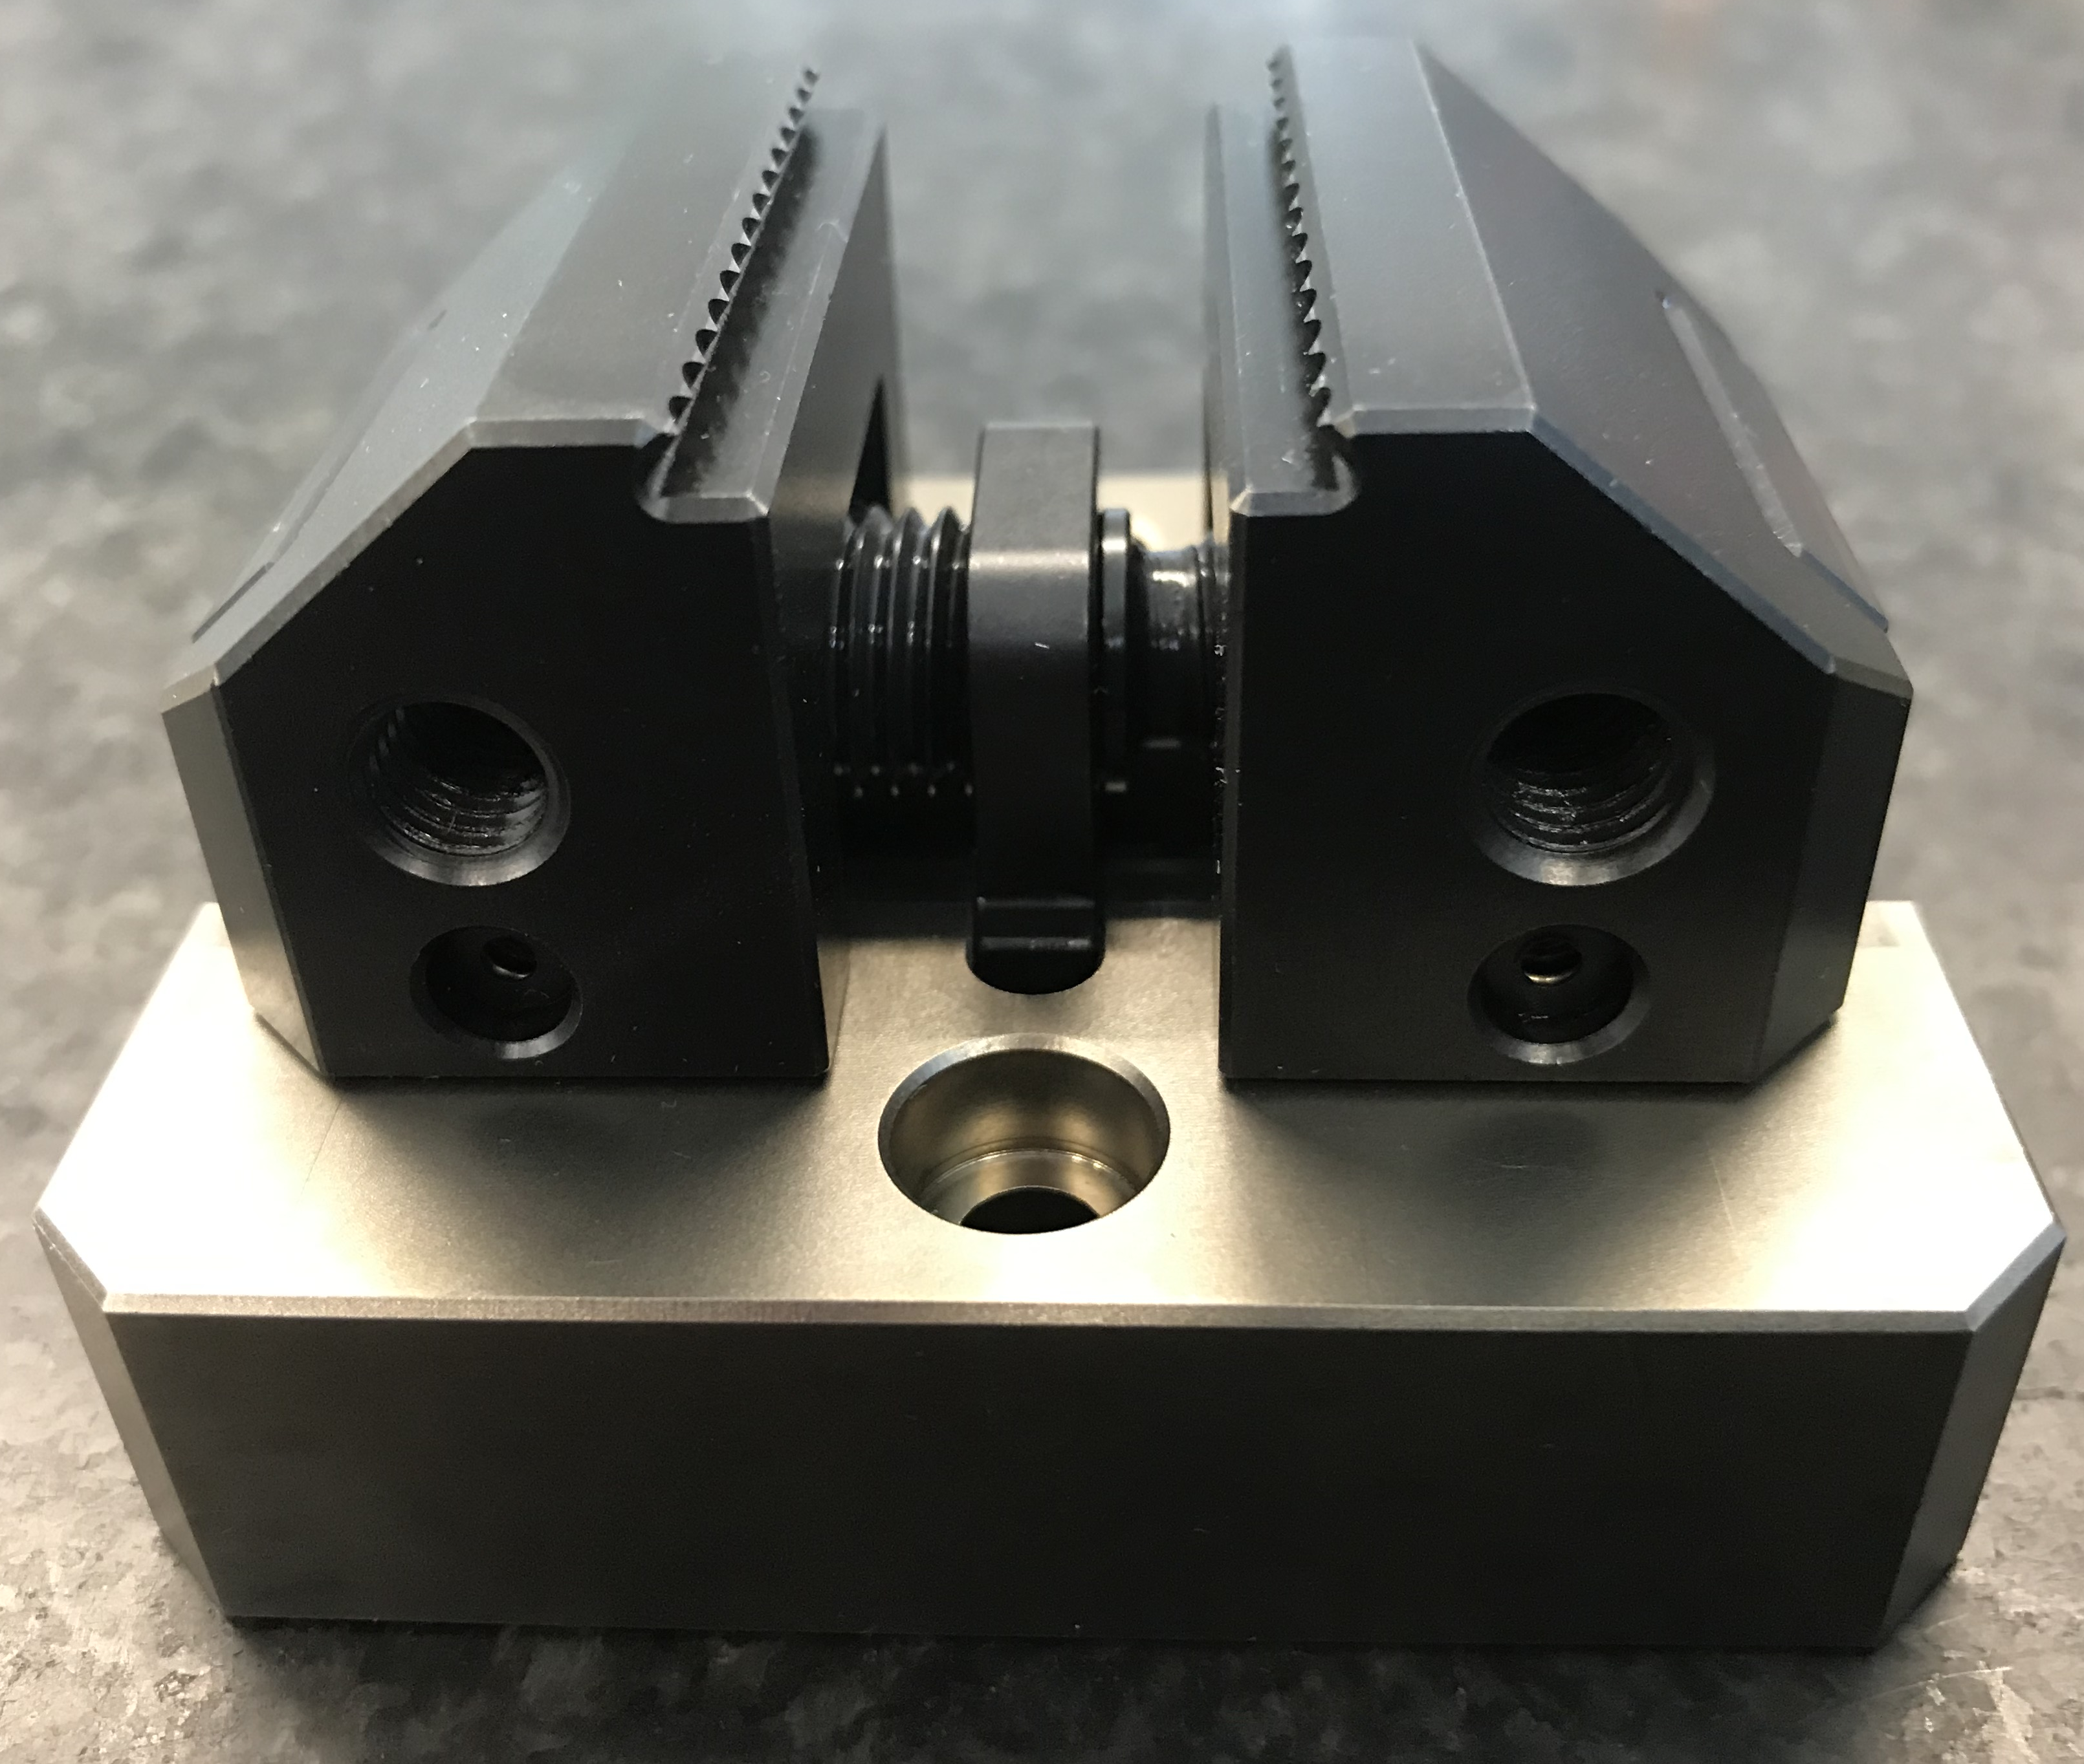
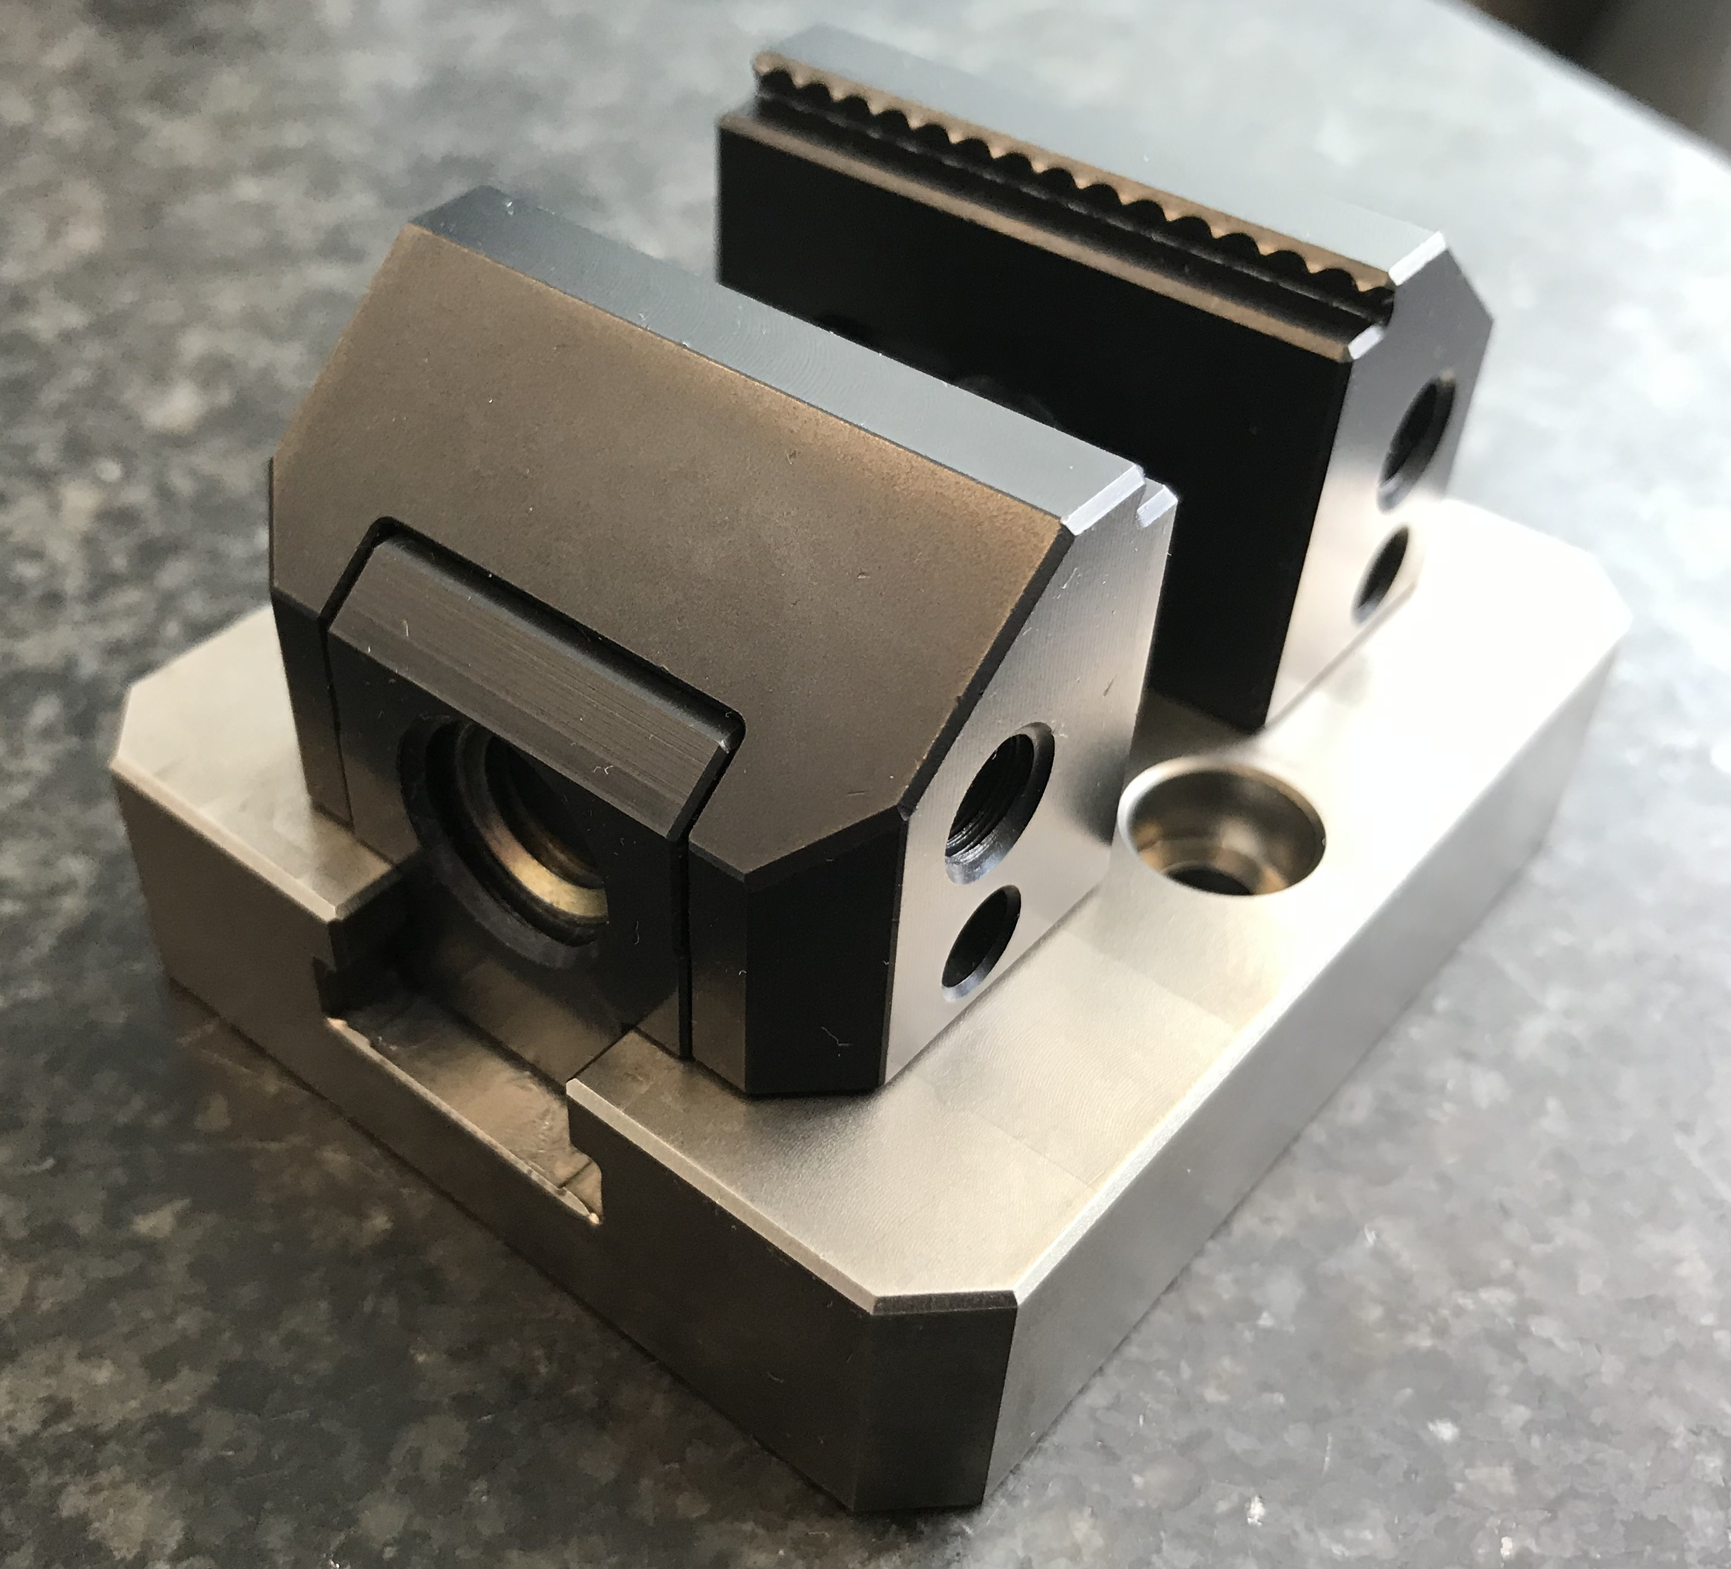
KONTEC KSC mini
Highlights

Slide 4
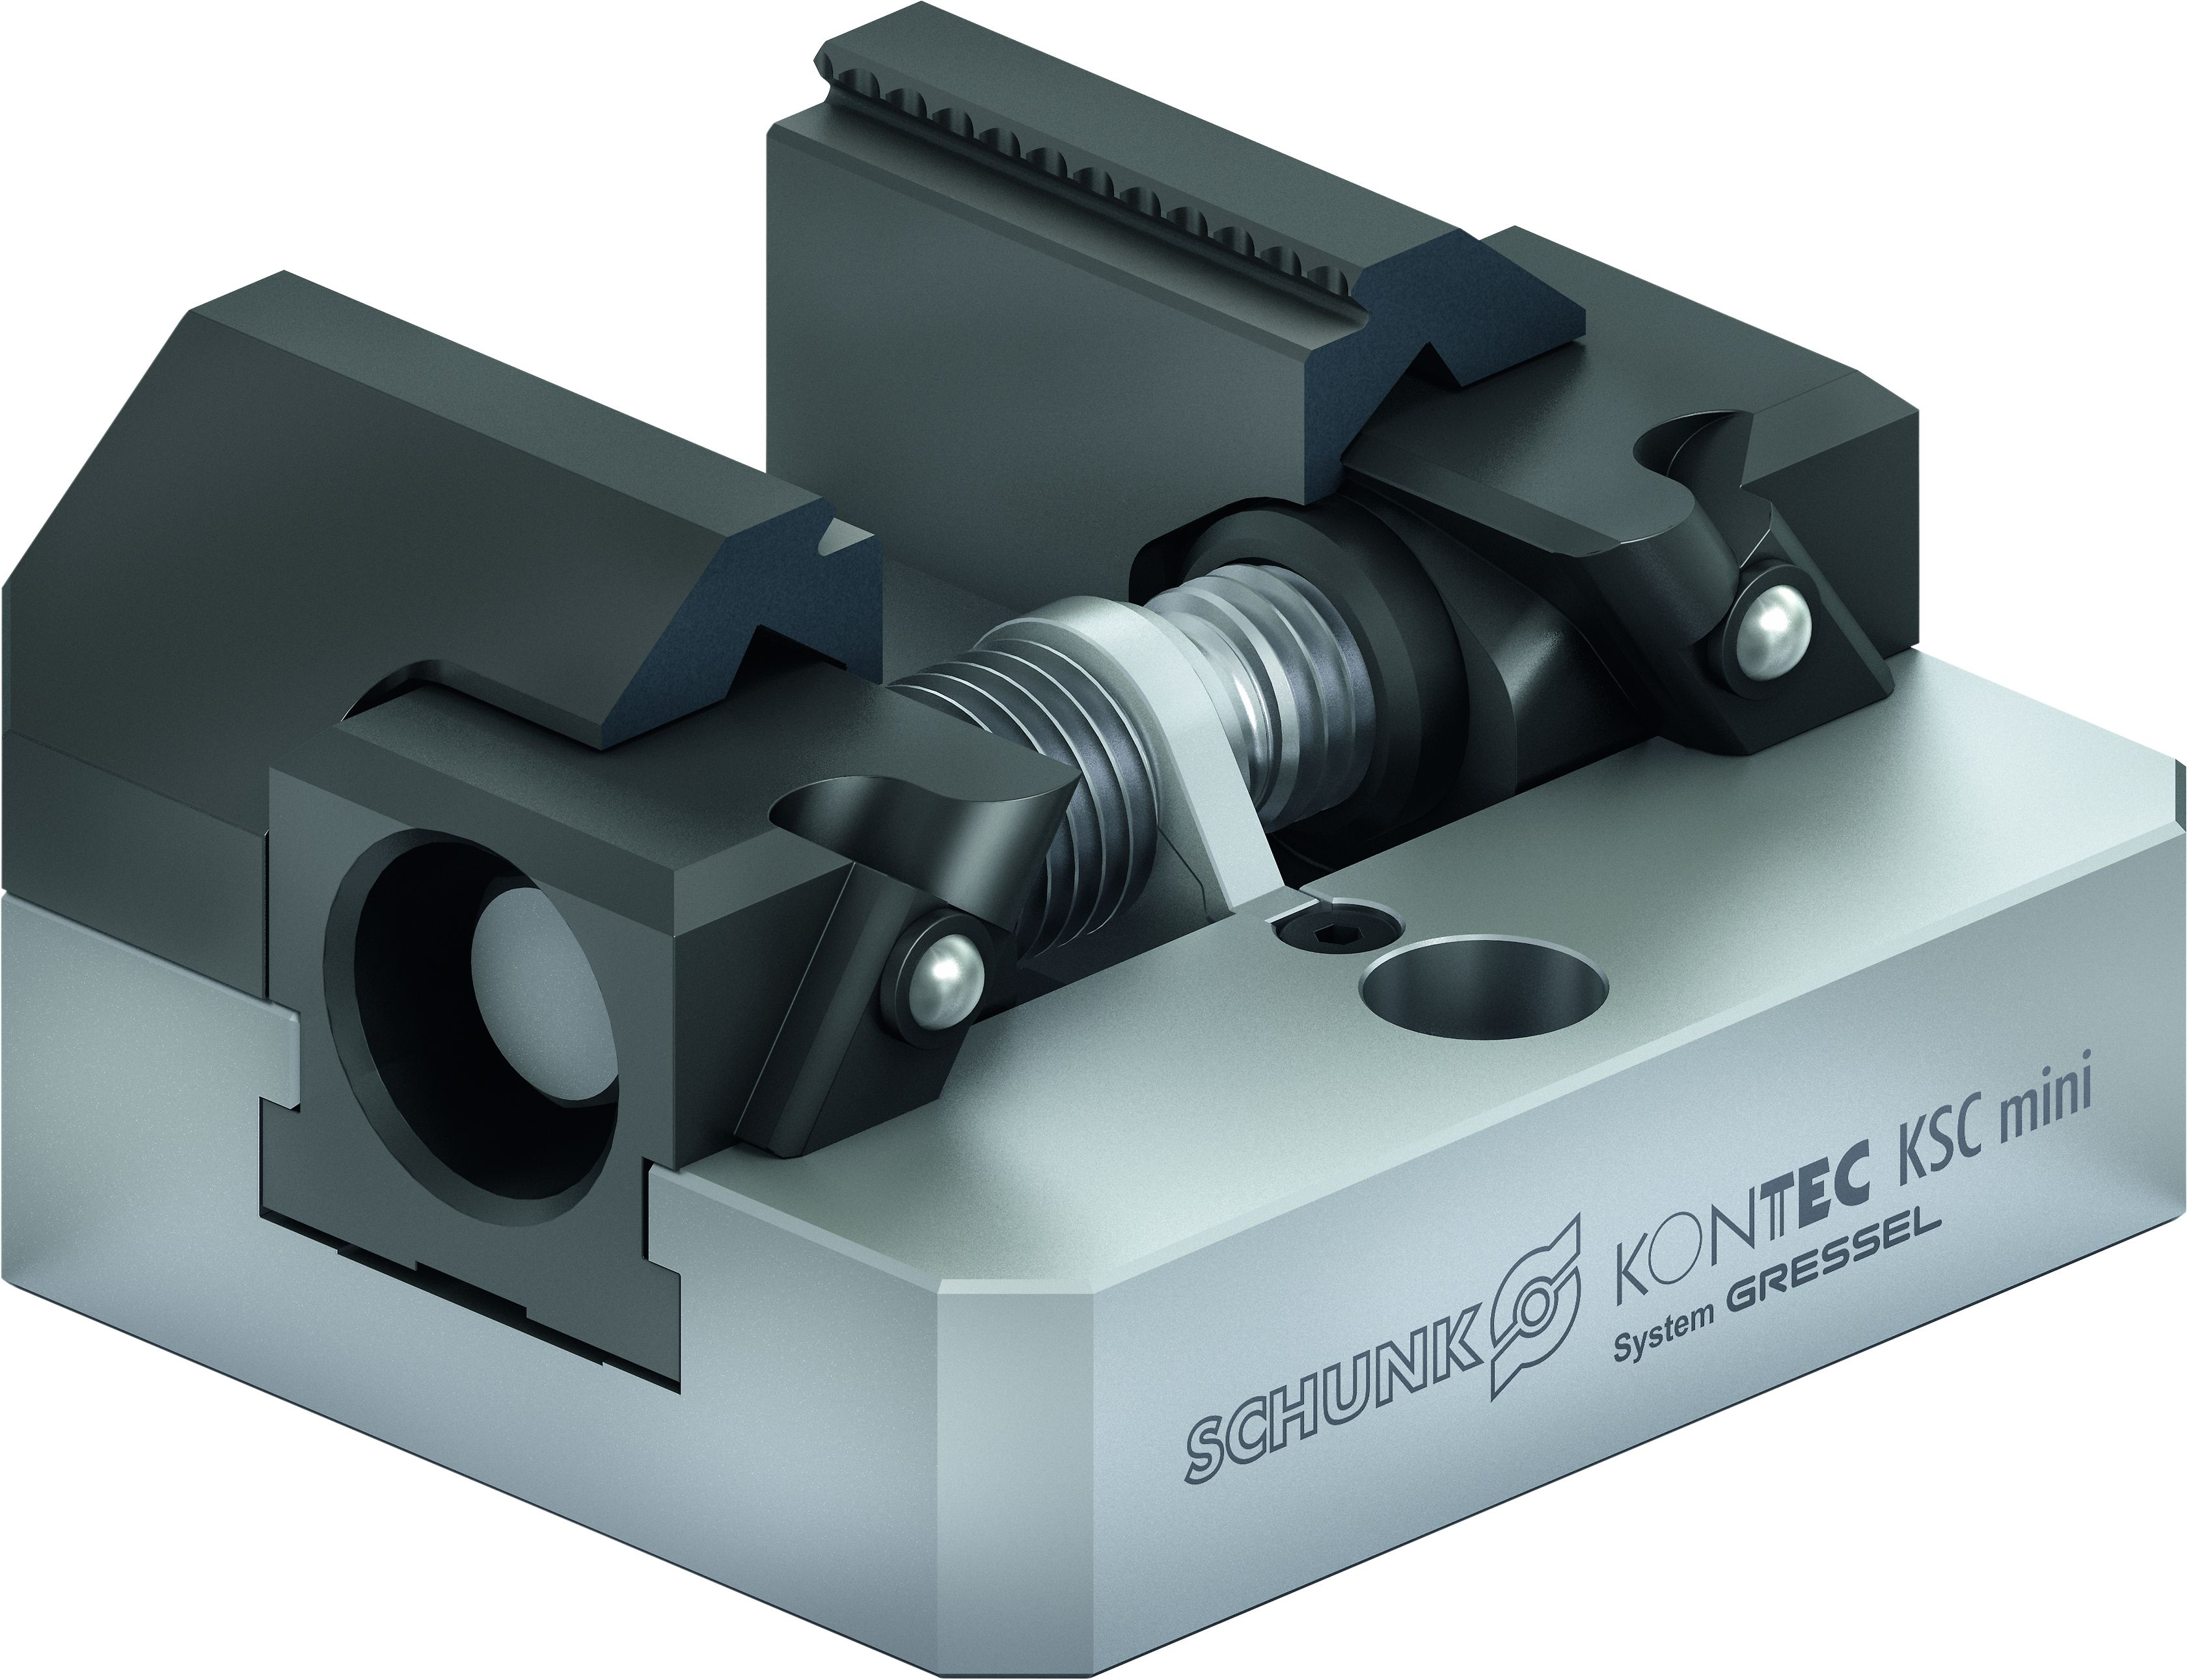
KONTEC KSC mini
Functional diagram
Jaw quick-change system
Stainless and hardened base body
Operation via hexagon connection
Spindle drive
Spring loaded pressure piece
Large range of quick-change jaws
Versatile applications for first- and second-side machining
1
2
3
6
4
1
7
5
6
4
7
2
3
5

Slide 5
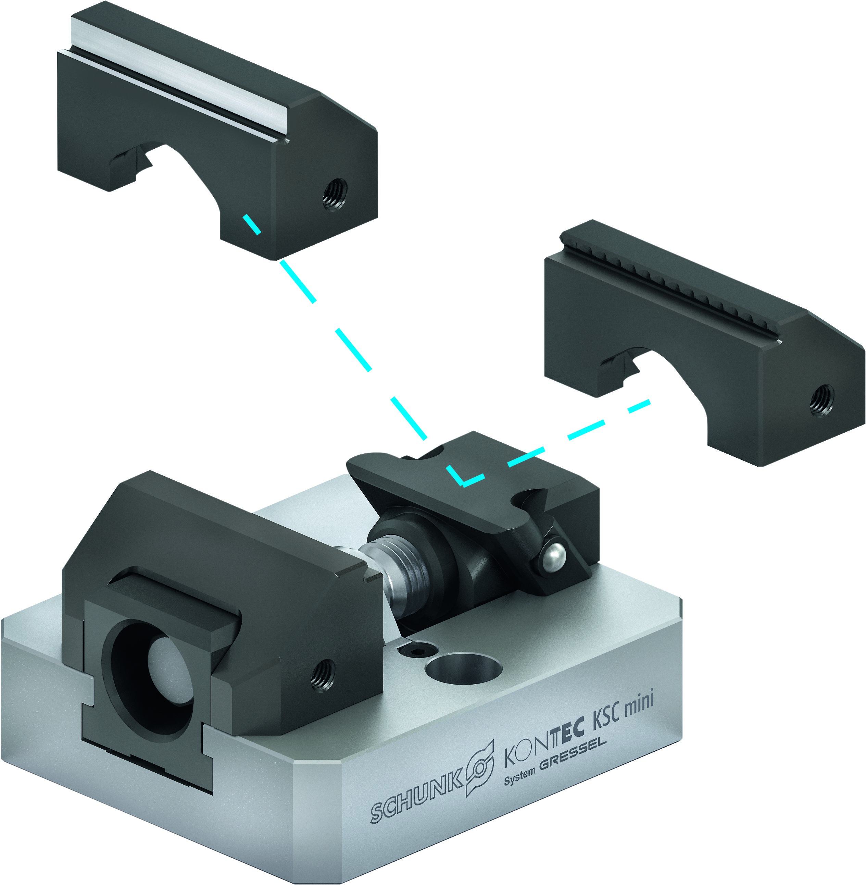

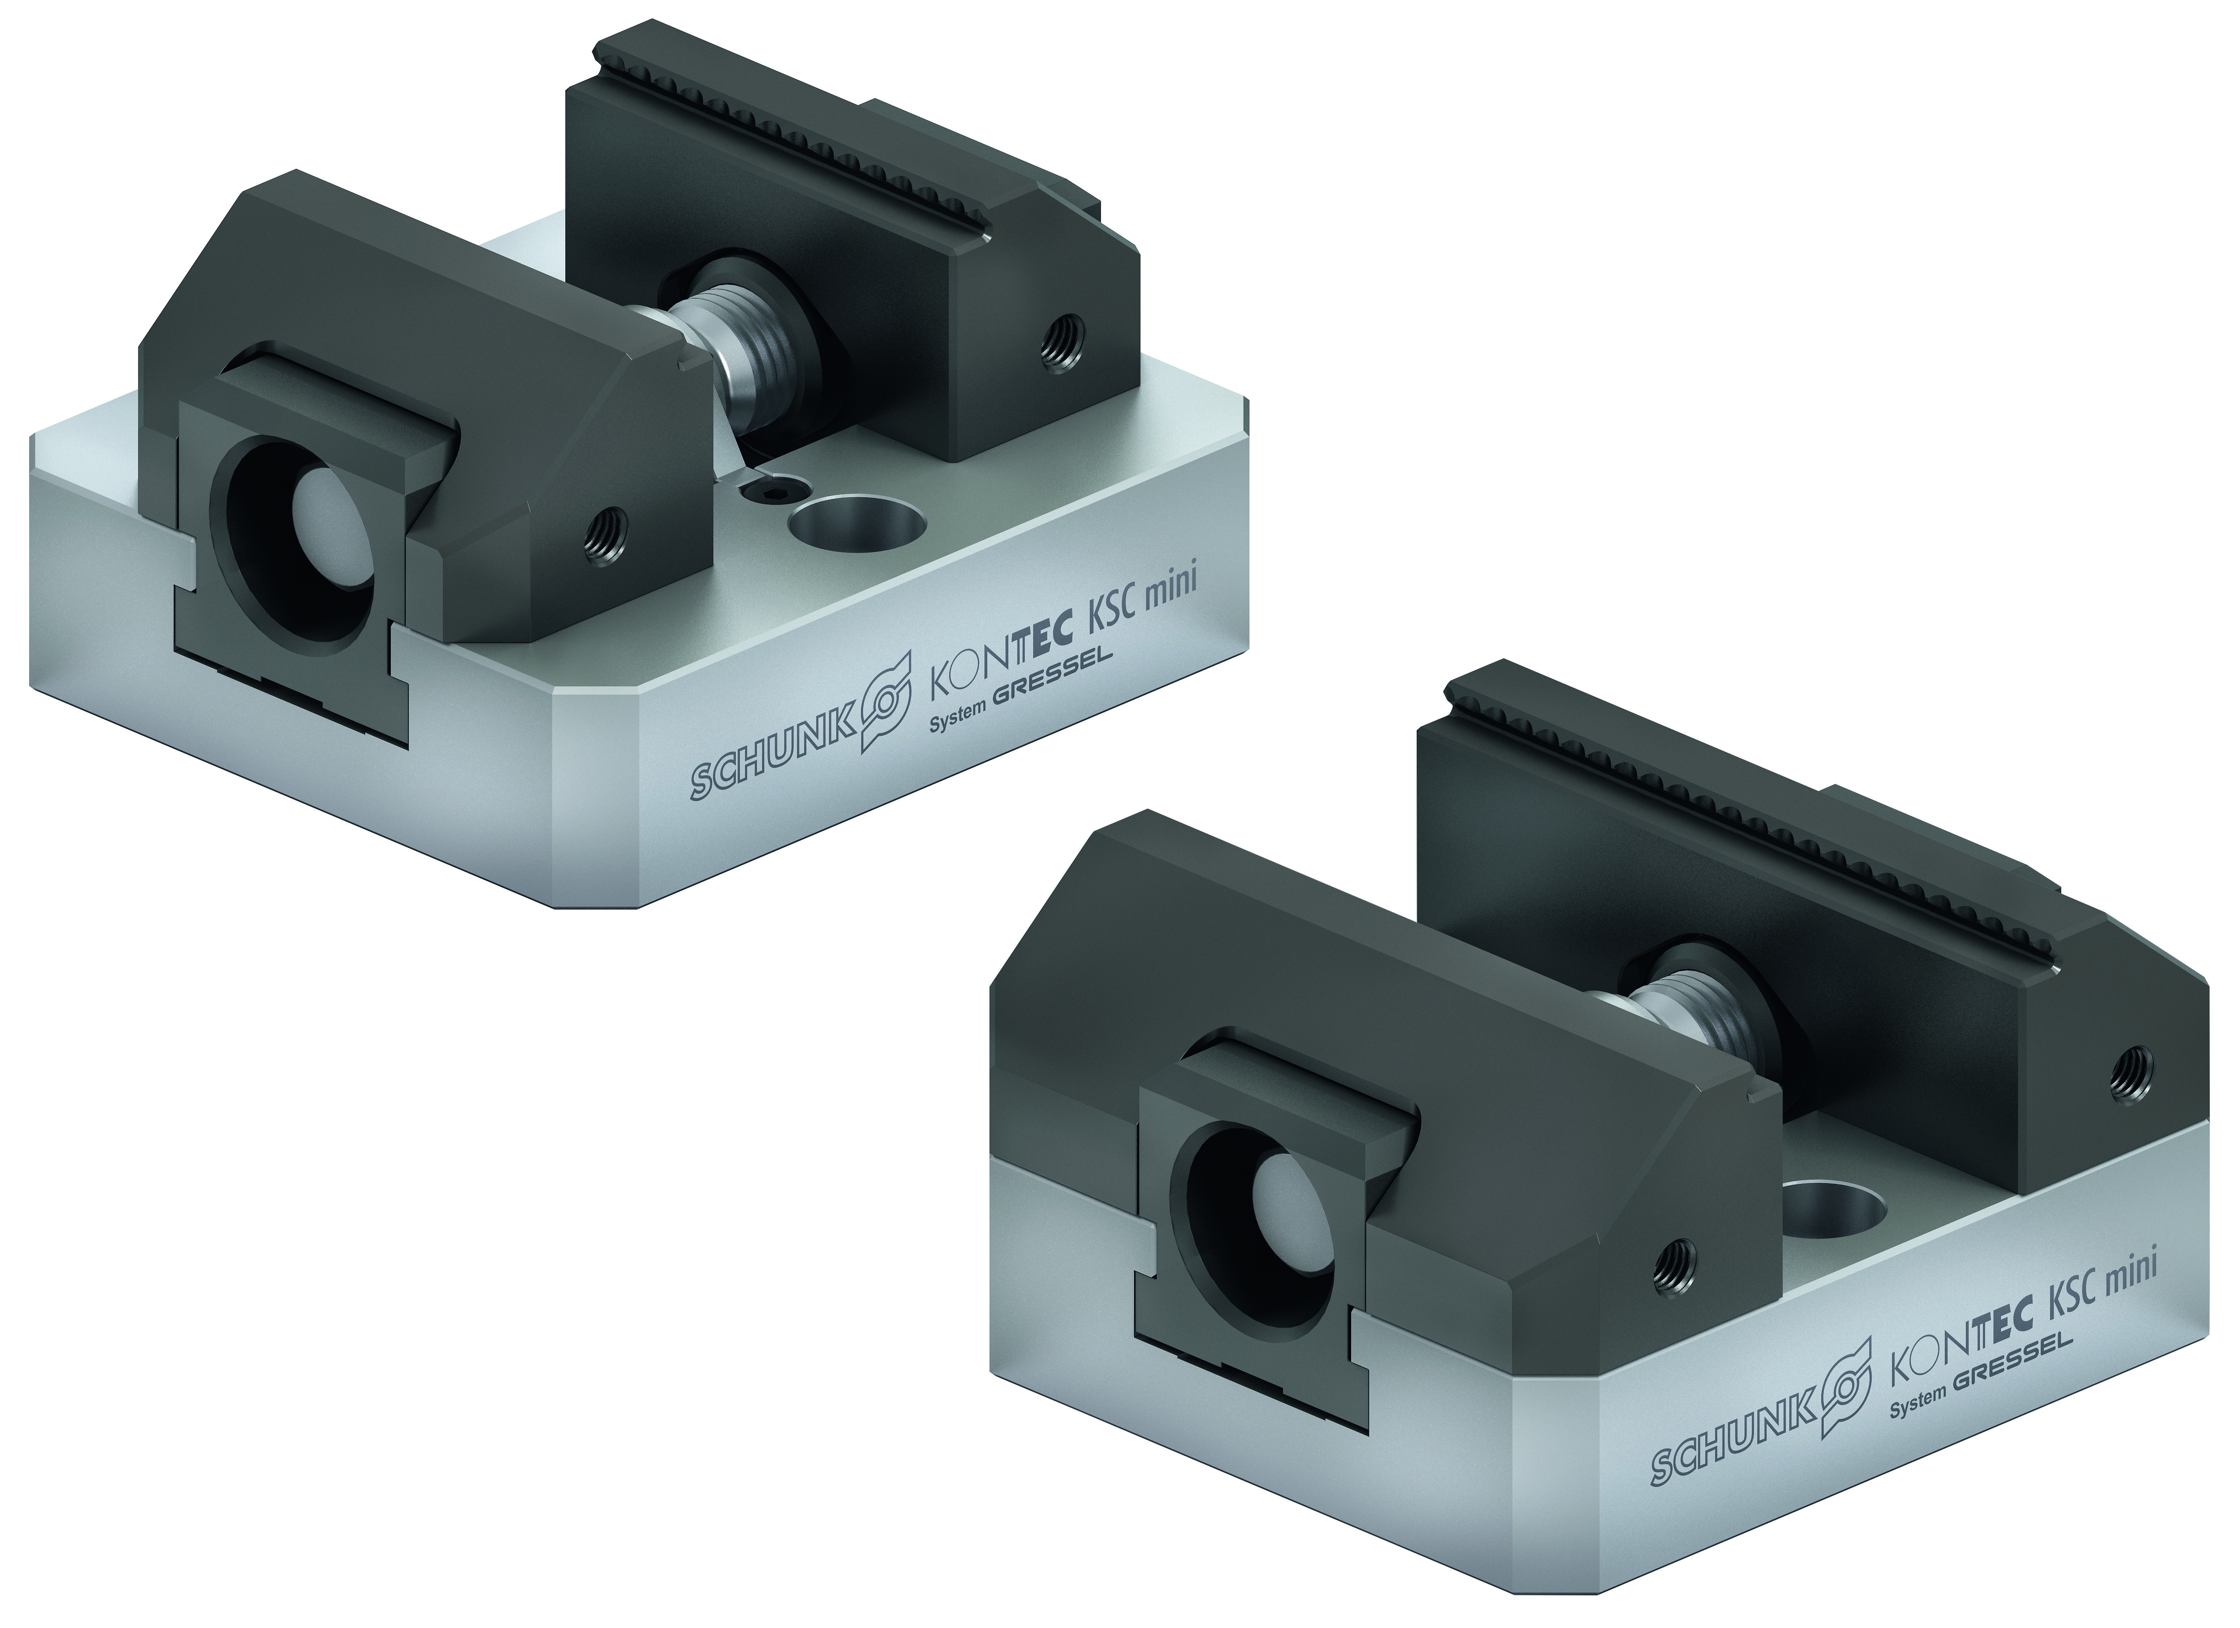
KONTEC KSC mini
Highlights
Jaw quick-change system
Due to the jaw quick-change system, the system jaws of the KSC mini vise can be extremely fast changed over to new system jaws – without any tools at all.
Stainless base body
Stainless and hardened base body.
Several jaw widths can be used
The KSC mini offers the possibility to use different jaw widths of 45 mm and 70 mm depending on the requirements on the vise.

Slide 6
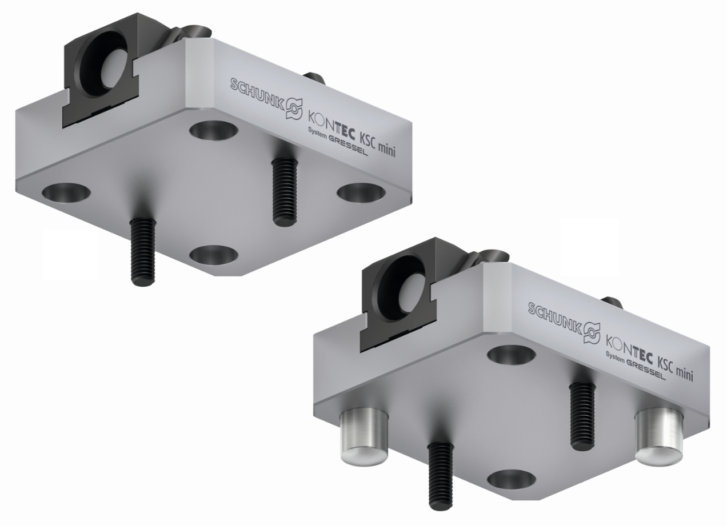
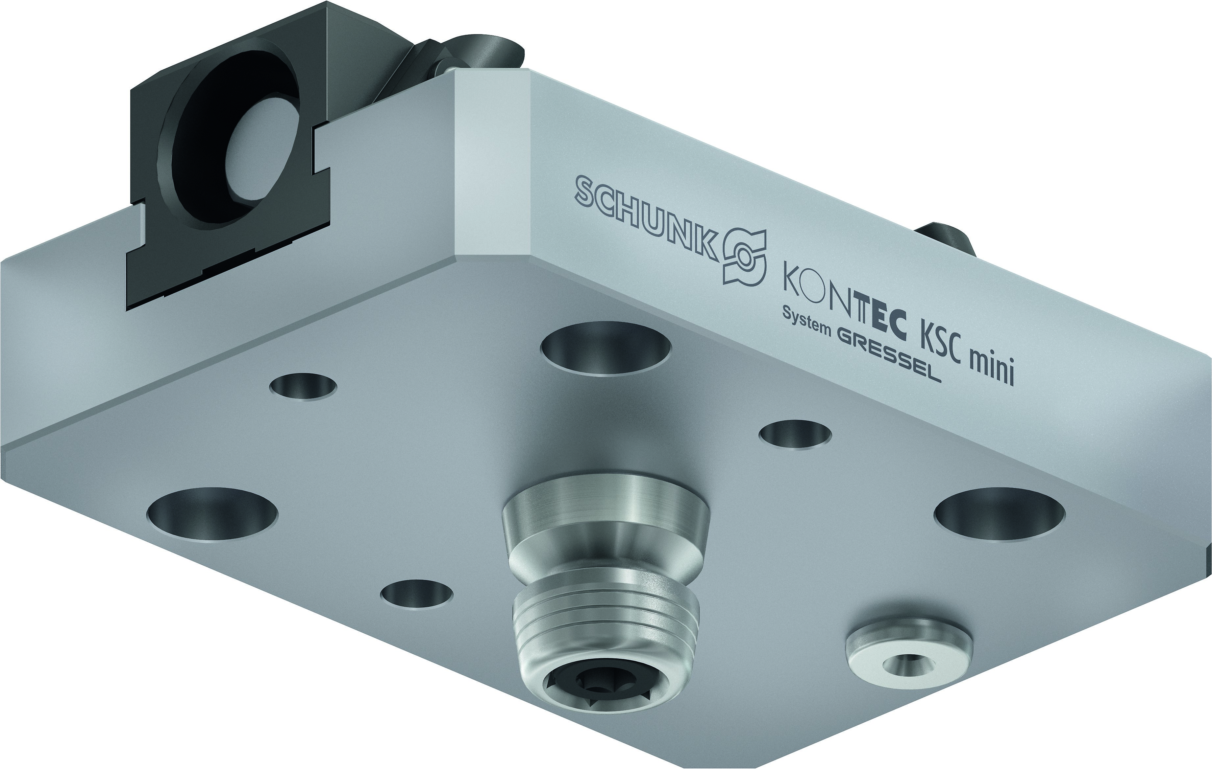
KONTEC KSC mini
Highlights
Mounting options
The KSC mini offers two possibilities to fix both vises on the machine table. Fastening via screws or alignment pins in addition.
VERO-S NSE mini interface
The body length 100 mm the VERO-S NSE mini interface V1 is integrated.

Slide 7
KONTEC KSC mini
Technical data
 | ID | Length | Max. Clamping Force | Max. Torque | Weight | Price
 |  | [mm] | [kN] | [Nm] | [kg] | [€]
KSC mini 70-80 | 1452102 | 80 | 16 | 50 | 0.9 | 375,00
KSC mini 70-100 | 1452103 | 100 | 16 | 50 | 1.1 | 425,00
Quick-change jaws | ID | Jaw Width | Clamping Step | Price
 |  | [mm] | [mm] | [€]
SGWB-G3-B 45-26.5-22 | 1452105 | 45 | 3 | 45,00
SGWB-G3-B 70-26.5-22 | 1452106 | 70 | 3 | 60,00
SGWB-S5-B 45-26.5-22 | 1452107 | 45 | 5 | 55,00
SGWB-S5-B 70-26.5-22 | 1452108 | 70 | 5 | 70,00
VS-Quick-change jaws | ID | Jaw Width | Clamping Step | Price
 |  | [mm] | [kN] | [€]
SGVS-G3-B 45-26.5-22 | 1452074 | 45 | 3 | 45,00
SGVS-G3-B 45-26.5-22 | 1452075 | 70 | 3 | 60,00
SGVS-S5-B 45-26.5-22 | 1452076 | 45 | 5 | 55,00
SGVS-S5-B 45-26.5-22 | 1452077 | 70 | 5 | 70,00

